Slide 1


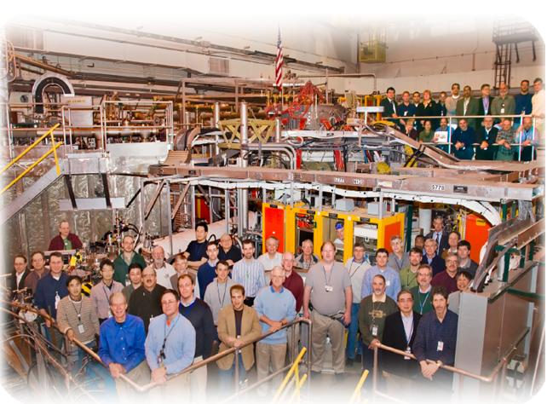
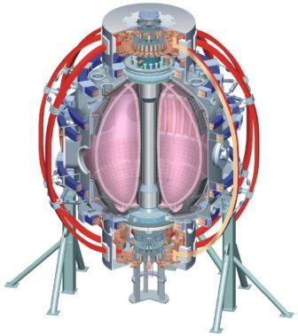
NSTX
Supported by
XMP for β_{N} Controller
College W&M
Colorado Sch Mines
Columbia U
CompX
General Atomics
INL
Johns Hopkins U
LANL
LLNL
Lodestar
MIT
Nova Photonics
New York U
Old Dominion U
ORNL
PPPL
PSI
Princeton U
Purdue U
SNL
Think Tank, Inc.
UC Davis
UC Irvine
UCLA
UCSD
U Colorado
U Illinois
U Maryland
U Rochester
U Washington
U Wisconsin
Stefan Gerhardt
Culham Sci Ctr
U St. Andrews
York U
Chubu U
Fukui U
Hiroshima U
Hyogo U
Kyoto U
Kyushu U
Kyushu Tokai U
NIFS
Niigata U
U Tokyo
JAEA
Hebrew U
Ioffe Inst
RRC Kurchatov Inst
TRINITI
KBSI
KAIST
POSTECH
ASIPP
ENEA, Frascati
CEA, Cadarache
IPP, Jülich
IPP, Garching
ASCR, Czech Rep
U Quebec

Slide 2
Two Changes Are Envisioned for the Controller
Integral Windup Correction
  When the controller is turned on early in shot, larger integral error accumulates.
  Caused problems for Sabbagh, Canik XPs, in that controller didn’t modulate as much as expected.
    Elementary control mistake.
  Modifying code to NOT accumulate integral error when actuators are saturated.
Median Filter
  β_{N} from rtEFIT often has unwelcome transients.
  Present causal LP filter tends to smooth, but not eliminate, these spikes.
  Add a median filter…very good for de-spiking.
  More complicated than box-car filtering, as it requires sorted data.
    Have an implementation that uses the O(n) efficiency of insertion sort algorithm for nearly sorted data…should not drag down the PCS.
Request: Brief 1-2 hour XMP.

