Slide 1

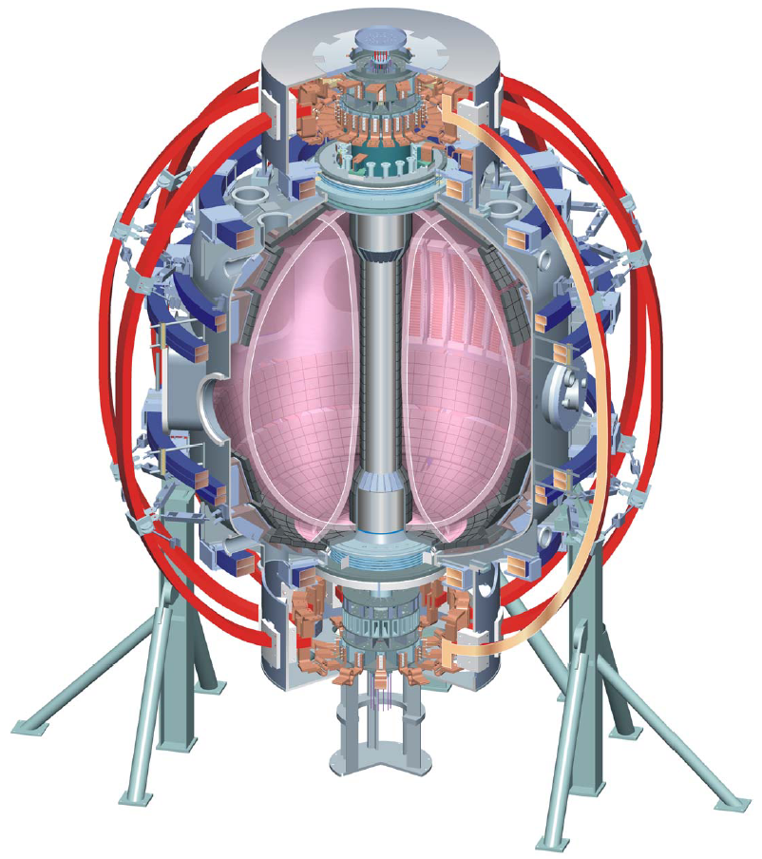
Supported by
Boundary Physics Topical Science Group Plan
College W&M
Colorado Sch Mines
Columbia U
Comp-X
General Atomics
INEL
Johns Hopkins U
LANL
LLNL
Lodestar
MIT
Nova Photonics
New York U
Old Dominion U
ORNL
PPPL
PSI
Princeton U
SNL
Think Tank, Inc.
UC Davis
UC Irvine
UCLA
UCSD
U Colorado
U Maryland
U Rochester
U Washington
U Wisconsin
V. A. Soukhanovskii, TSG Leader
Lawrence Livermore National Laboratory, Livermore, CA
A. Diallo, TSG Deputy
Princeton Plasma Physics Laboratory, Princeton, NJ
D. P. Stotler, Theory & Modeling
Princeton Plasma Physics Laboratory, Princeton, NJ
FY 2011 NSTX Research Forum
18 March 2011
Princeton, NJ
Culham Sci Ctr
U St. Andrews
York U
Chubu U
Fukui U
Hiroshima U
Hyogo U
Kyoto U
Kyushu U
Kyushu Tokai U
NIFS
Niigata U
U Tokyo
JAEA
Hebrew U
Ioffe Inst
RRC Kurchatov Inst
TRINITI
KBSI
KAIST
POSTECH
ASIPP
ENEA, Frascati
CEA, Cadarache
IPP, Jülich
IPP, Garching
ASCR, Czech Rep
U Quebec

Slide 2
Boundary Physics TSG priorities are defined by
DOE and NSTX Milestones
  FY2011 DOE Joint Research Target: Conduct experiments on major fusion facilities to improve the understanding of the physics mechanisms responsible for the structure of the pedestal and compare with the predictive models described in the companion theory milestone.
  R(11-3): Assess very high flux expansion divertor operation
NSTX-U design needs
ITPA participation, ITER design and physics needs
Career development: post-doctoral research

Slide 3
Boundary Physics TSG is actively involved in a number of ITPA PEP and DSOL experiments
DSOL (= Divertor and Scrape-off layer)
  DSOL-21 Introduction of pre-characterized dust for dust transport studies in divertor and SOL
PEP (= Pedestal and Edge)
  PEP-19 Basic mechanisms of edge transport with RMP
  PEP-23 Quantification of the requirements for ELM suppression by magnetic perturbations from off-midplane coils
  PEP-25 Inter-machine comparison of ELM control by magnetic field perturbations from midplane RMP coils
  PEP-26 Critical parameters for achieving L-H transitions
  PEP-27 Pedestal profile evolution following L-H/H-L transition
  PEP-28 Physics of H-mode access with different X-point height
  PEP-29 Vertical jolts/kicks for ELM triggering and control
  PEP-31 Pedestal structure and edge relaxation mechanisms in I-mode
  PEP-33 Effects of current ramps on the L-H transition and on the stability and confinement of H-modes at low power above the threshold
  PEP-34 Non-resonant magnetic field driven QH-mode

Slide 4


Boundary Physics TSG run time guidance << number of received proposals
First Priority
7 days
JRT & R11-3
Second Priority
2.5 days
Second Priority
1 day
First Priority
3 days
FY 11
FY 12
Received 28 Proposals, ~ 30 Run days requested

Slide 5
Submitted proposals grouped by topic
[T. Gray] Achieving I-mode on NSTX
[A. Diallo] Aspect Ratio Effects on the Pedestal Structure in ELMy discharges
[D. Smith] Assess pedestal_SOL fluctuations and poloidal flow fluctuations across LH transitions and ELMs
[R. Maingi] Dependence of density profile modification, and pedestal_core performance on amount of lithium evaporated between discharges
[A. Diallo] Effects of Triangularity and Toroidal field on the Pedestal Structure in ELMy H-mode
[A. Diallo] Elongation Effects on the Pedestal Structure in ELMy H-mode
[D. Battaglia] LH power threshold and H-mode pedestal height versus X-point height
[R. Maingi] Reproduce medium triangularity Enhanced Pedestal H-mode Discharge
[D. Smith] Searching for EHOs in low triangularity plasmas with early RMP
[K. C. Lee] Turbulence and transport measurement on Enhanced Pedestal H-mode triggered by 3-D field
[V. Soukhanoskii] Development and assessment of X-divertor configuration on NSTX
[M. Jaworski] Divertor electron temperature and EEDF modification due to connection length modification
[V. Soukhanoskii] Divertor heat flux mitigation with impurity seeding in high-performance discharges
[V. Soukhanoskii] Snowflake divertor configuration studies in support of R11-3 and NSTX-U divertor options
[R. Maingi] Triggered ELMs in the snowflake configuration – do they burn through
[V. Soukhanovskii] Development of early snowflake-minus configuration for impurity control
[A. Loarte] Compatibility of Radiative Divertor Operation with High Confinement H-mode Plasmas
[D. Battaglia] LH power threshold and H-mode pedestal height versus X-point height {Note Overlap above}
[S. Kaye] L-H Threshold Power Study_ Ramp-Up vs Steady Ip Phase
[A. Loarte] Access and sustainment of H-mode confinement in ramped phases of ITER scenarios
[J. Clementson] Development of Spectroscopic ITER Divertor Diagnostics
[T. Gray] Scrape-off Layer Particle and Energy Transport with varying SOL Collisionality
[T. Munsat] Dynamics of Zonal Flow-Drift Wave System Preceding L-H Transition
[R. Raman] Steady state discharges with LFS fueling
[H. Takahashi] Optimal Positioning of ELM Triggering Electrodes
[H. Takahashi] Validation of SOLC-based ELM-triggering Model
[H. Takahashi] Distinguishing between Two SOLC-Based ELM-Models Inter-Divertor Flux Tube and Homoclinic Tangle
[A. Sontag] Edge oscillations during Type-V and ELM-free H-mode
[A. Sontag] Effect of toroidal flow shear on edge stability
JRT
R11-3,
Divertor Physics
ITPA
ITER & ITPA
ELMs,Zonal Flows,
Stability, transport
NSTX

Slide 6
Boundary Physics proposed research plan for FY 2011

Slide 7
Boundary Physics proposed research plan for FY 2012 and remaining XPs

Slide 8
FY 2011JRT on Pedestal Structure
Conduct experiments on major fusion facilities to improve the understanding of the physics mechanisms responsible for the structure of the pedestal and compare with the predictive models described in the companion theory milestone. Proposed description: The goal of the joint theory-experiment milestones (or replace with research campaigns depending on what OFES prefers) is to understand the physics mechanisms responsible for the structure of the pedestal and develop a predictive capability. The edge of high performance tokamaks is characterized by very steep pressure gradients forming a pedestal in the pressure profile. Core confinement is strongly correlated with the value of the pressure at the top of the pedestal, which is predicted to significantly impact the fusion power in ITER.
Experiment: Improve the understanding of the physics mechanisms responsible for the structure of the pedestal and compare with the predictive models described in the companion theory milestone. Perform experiments to test theoretical physics models in the pedestal region on multiple devices over a broad range of plasma parameters (e.g., collisionality, beta, and aspect ratio). Detailed measurements of the height and width of the pedestal will be performed augmented by measurements of the radial electric field. The evolution of these parameters during the discharge will be studied. Initial measurements of the turbulence in the pedestal region will also be performed to improve understanding of the relationship between edge turbulent transport and pedestal structure.
Theory: A focused analytic theory and computational effort, including large-scale simulations, will be used to identify and quantify relevant physics mechanisms controlling the structure of the pedestal. The performance of future burning plasmas is strongly correlated with the pressure at the top of the edge transport barrier (or pedestal height). Predicting the pedestal height has proved challenging due to a wide and overlapping range of relevant spatiotemporal scales, geometrical complexity, and a variety of potentially important physics mechanisms. Predictive models will be developed and key features of each model will be tested against observations, to clarify the relative importance of various physics mechanisms, and to make progress in developing a validated physics model for the pedestal height.

Slide 9
R(11-3): Assess very high flux expansion divertor operation
The exploration of high flux expansion divertors for mitigation of high power exhaust is important for NSTX-Upgrade, proposed ST and AT-based fusion nuclear science facilities and for Demo. In this milestone, high flux expansion divertor concepts, e.g. the “snowflake”, will be assessed. The magnetic control, divertor heat flux handling and power accountability, pumping with lithium coatings, impurity production, and their trends with engineering parameters will be studied in this configuration. Potential benefits of combining high flux expansion divertors with gas-seeded radiative techniques and ion pumping by lithium will be explored. Two dimensional fluid codes, e.g. UEDGE, will be employed to study divertor heat and particle transport and impurity radiation distribution. Further, H-mode pedestal stability, ELM characterization, as well as edge transport will also be studied in the experiment and modeled with pedestal MHD stability codes, e.g., ELITE, and transport codes, e.g. TRANSP and MIST. This research will provide the foundation for assessing the extrapolability of high flux expansion divertors for heat-flux mitigation in next-step devices.

