Slide 1




NSTX-U
Supported by
Direct measurement of plasma response using Nyquist Contour
Coll of Wm & Mary
Columbia U
CompX
General Atomics
FIU
INL
Johns Hopkins U
LANL
LLNL
Lodestar
MIT
Lehigh U
Nova Photonics
ORNL
PPPL
Princeton U
Purdue U
SNL
Think Tank, Inc.
UC Davis
UC Irvine
UCLA
UCSD
U Colorado
U Illinois
U Maryland
U Rochester
U Tennessee
U Tulsa
U Washington
U Wisconsin
X Science LLC
Z.R. Wang¹, J.-K. Park¹, M. J. Lanctot²,
J. E. Menard¹,Y.Q. Liu³, R. Nazikian¹
¹Princeton Plasma Physics Laboratory
² General Atomics, San Diego, USA
³CCFE, Culham Science Centre
Culham Sci Ctr
York U
Chubu U
Fukui U
Hiroshima U
Hyogo U
Kyoto U
Kyushu U
Kyushu Tokai U
NIFS
Niigata U
U Tokyo
JAEA
Inst for Nucl Res, Kiev
Ioffe Inst
TRINITI
Chonbuk Natl U
NFRI
KAIST
POSTECH
Seoul Natl U
ASIPP
CIEMAT
FOM Inst DIFFER
ENEA, Frascati
CEA, Cadarache
IPP, Jülich
IPP, Garching
ASCR, Czech Rep
NSTX-U Research Forum
February 25, 2015

Slide 2
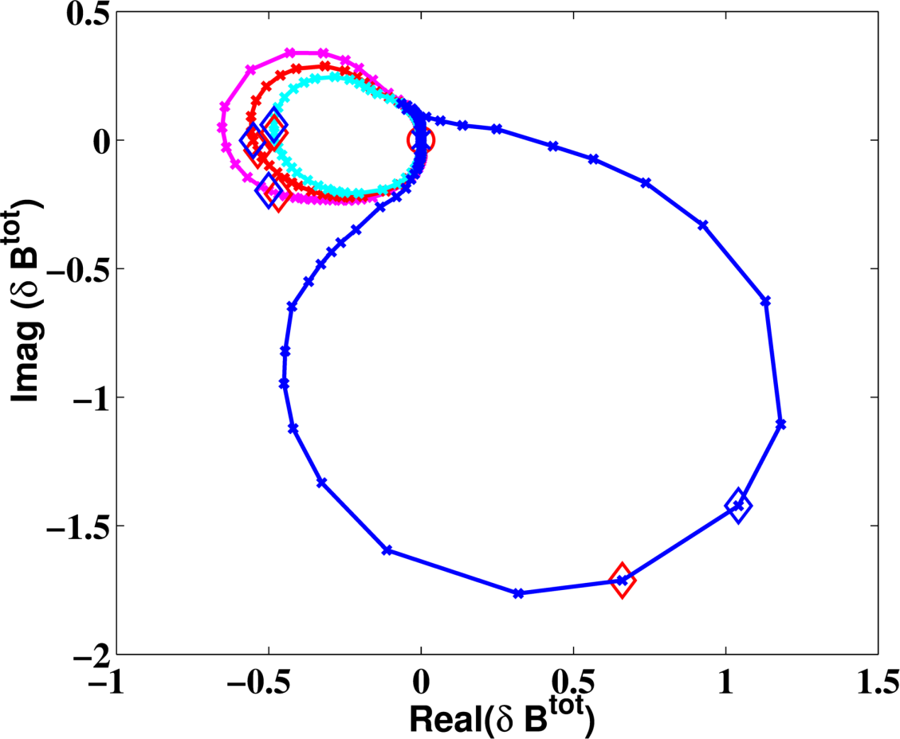
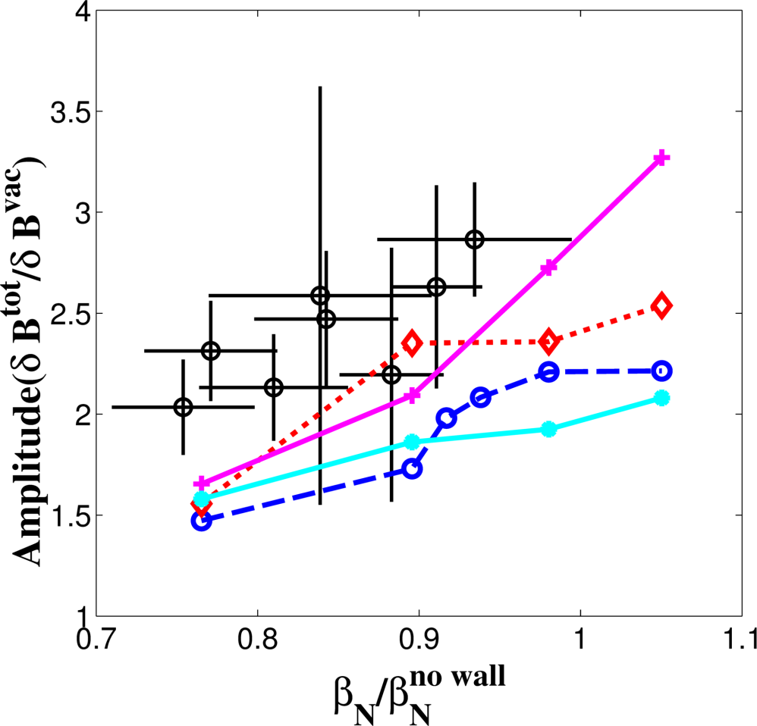

Plasma Response Study with Nyquist Plot in NSTX-U
Nyquist diagram can be generated by scanning coil frequency from -infinity to +infinity.
Fluid vs. Kinetic plasma response shows different Nyquist contours.
Comparing experimental and simulated Nyquist plots can
  Validate kinetic plasma response physics;
  Reveal multi-mode response to n=1 and n=2 perturbation;
  infer growth/damping rate of (multiple) mode(s);
.
$β_{N}^{no wall}$ ~ 4.75
Kinetic + Rotation
Kinetic w/o Rotation
Fluid + Rotation
NSTX
Fluid w/o Rotation
MARS-K can be used to perform modelling, and results to be compared with NSTX-U experiments.

Slide 3
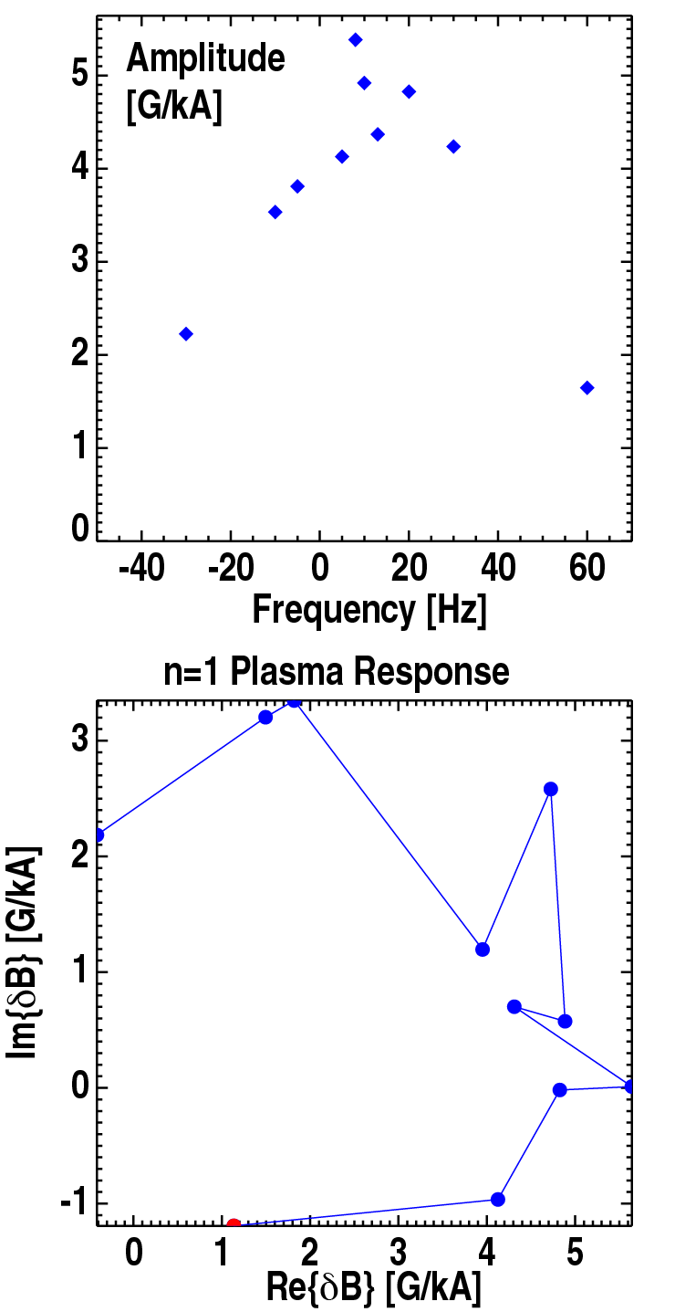
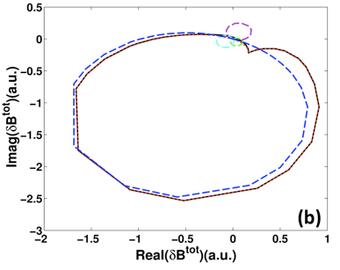
Existing DIII-D Data Shows Initial Evaluation of Nyquist Contour
First I-coil frequency scans in DIII-D resolved peak in n=1 plasma response
  H. Reimerdes, PRL 2004
  LFS magnetics reveal n=1 structure
2003 n=1 ISLD Data – I-240 coil
Nyquist contour similar to MARS-K model for weakly-shaped plasma
Finish more complete frequency scan for n=1 and n=2 response in NSTX-U plasmas
MARS-K n=1 ISL
Courtesy of M.J. Lanctot

Slide 4
Shot Plan (1-2days)
Option 1: beta value can be well controlled in each discharge
  Find 2-3 target plasmas with the different beta value (below, near or above no-wall beta limit)
  Apply magnetic perturbation and vary frequency up to +/- a few hundred Hz in steps
  A number of discharge required to complete Nyquist contour will depend on shot duration
Option 2: beta value cannot be well controlled
  Find one target plasma with increasing beta value across no-wall limit
  Apply magnetic perturbation with a fixed frequency in each shot
  Change frequency from shot to shot to complete Nyquist contour
  Both n=1 and n=2 response experiment can follow above procedure

