Slide 1




NSTX-U
Supported by
Study of tearing mode stability in the presence of external perturbed fields
Experimental validation of MARS-K/Q and RDCON codes
Coll of Wm & Mary
Columbia U
CompX
General Atomics
FIU
INL
Johns Hopkins U
LANL
LLNL
Lodestar
MIT
Lehigh U
Nova Photonics
ORNL
PPPL
Princeton U
Purdue U
SNL
Think Tank, Inc.
UC Davis
UC Irvine
UCLA
UCSD
U Colorado
U Illinois
U Maryland
U Rochester
U Tennessee
U Tulsa
U Washington
U Wisconsin
X Science LLC
Z.R. Wang¹, J.-K. Park¹, J. E. Menard¹,
Y.Q. Liu², R. La Haye³
¹Princeton Plasma Physics Laboratory
²CCFE, Culham Science Centre
³ General Atomics, San Diego, USA
Culham Sci Ctr
York U
Chubu U
Fukui U
Hiroshima U
Hyogo U
Kyoto U
Kyushu U
Kyushu Tokai U
NIFS
Niigata U
U Tokyo
JAEA
Inst for Nucl Res, Kiev
Ioffe Inst
TRINITI
Chonbuk Natl U
NFRI
KAIST
POSTECH
Seoul Natl U
ASIPP
CIEMAT
FOM Inst DIFFER
ENEA, Frascati
CEA, Cadarache
IPP, Jülich
IPP, Garching
ASCR, Czech Rep
NSTX-U Research Forum
February 25, 2015

Slide 2
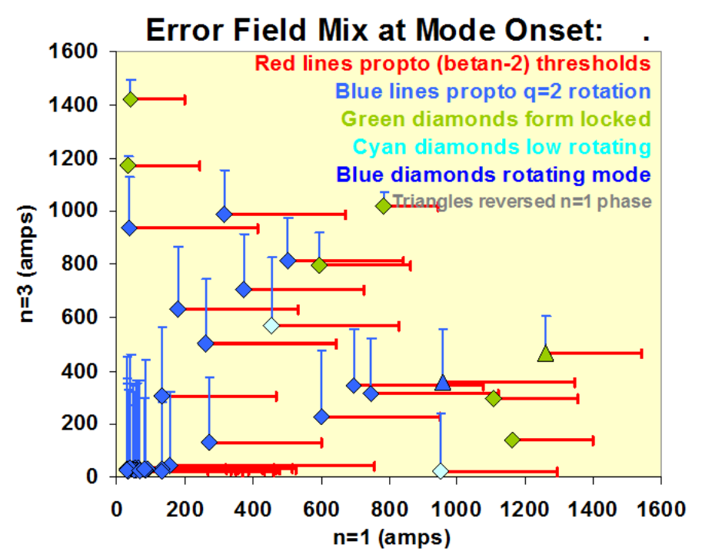
NSTX-U Tearing Mode Experiments by Varying Plasma Rotation Through NTV Torque in Presence of External Fields
Tearing mode limits the plasma beta when ideal kink mode is stable.
Revisit tearing mode stability in NSTX
Study the effect of rotation/shear on tearing mode stability in the presence of external magnetic perturbation.
The idea of experiments to study the (2,1), (3,2) tearing mode stability
  Use NBI provides angular momentum at different location (on/off-axis).
  Apply n=1 and n=2 external perturbations with different strengths to induce NTV torque.
  The correlation among the tearing mode stability, damped rotation profile and the strengths of applied field (resonant field penetration) can be investigated.

Slide 3
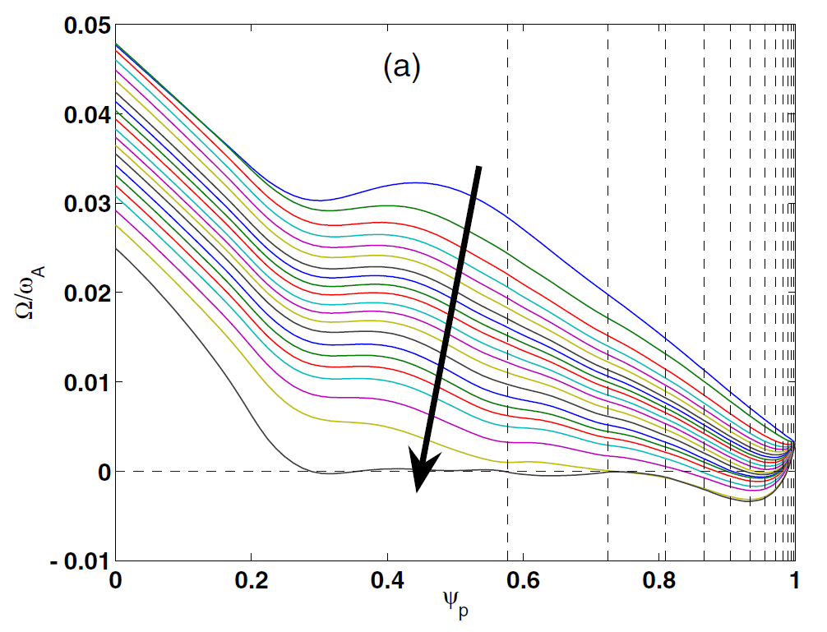
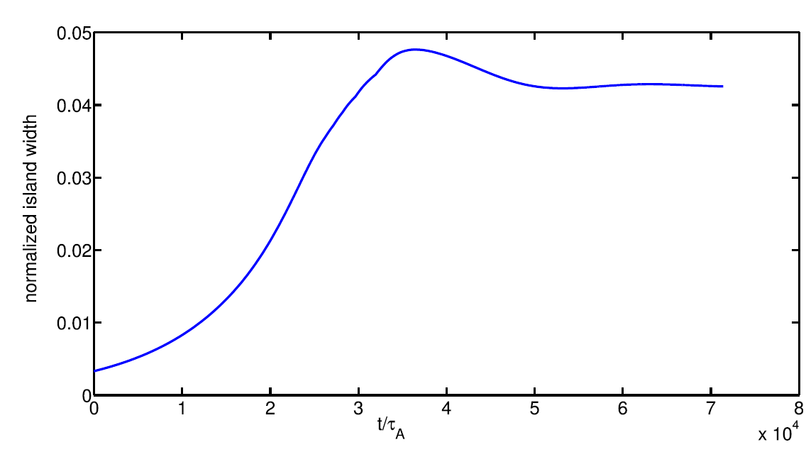
Numerical Capability to Carry Out Simulation of Tearing Instability and NTV Torque in Presence of External Fields
MARS-Q can do the physical analysis in terms of the small island in the quasi-linear approach.
  The code can be used to simulate the dynamics of tearing mode in the experiments.
  The code includes the JxB resonant torque + Neoclassical toroidal viscosity(NTV) torque
MAST plasma with n=3 magnetic perturbation
Time evolution of (2,1) island width
Rotation damping
Y.Q. Liu et al, PPCF 2012
G.Z. Hao et al, PoP 2014
  RDCON can also be used to study the effect of rotation shear at singular surface by matching the inner and outer region solutions.

Slide 4
Shot Plan (1 day)
Revisit NSXT n=1 tearing mode experiments and find a target marginal to tearing mode stability
Adjust NBI (on/off axis) to change plasma rotation/shear
Apply the static n=1 magnetic perturbation with different strengths to damp plasma rotation through NTV torque
Study the threshold of (2,1) tearing mode stability, and time evolution of islands and rotation profiles (CHERS, MPTS, SXR)
Threshold of (3,2) tearing mode stability can be investigated through the same procedure with n=2 magnetic perturbation

