Slide 1
​Ex­situ ion beam analysis of targets with implanted depth markers
Main investigators: Graham Wright, Zach Hartwig
Assisting: Brandon Sorbom, Leigh Ann Kesler, Dennis Whyte

Slide 2
Collaboration Idea: Leveraging MAPP capabilities to expose custom targets for ex-situ IBA at MIT
IBA techniques reveal material distributions below the surface complimenting the surface-focused diagnostics of MAPP.
Two main thrusts would be pursued:
  Traditional ion beam analysis techniques (RBS, NRA, ERD) to measure Li-layer thickness, oxide layer thickness, D retention and Li-C intermixing in targets exposed in NSTX-U.
  The use of low-Z implanted depth markers to track net deposition/erosion of targets as a study for specific scenarios and also as a proof of principle for future campaign considerations.
IBA will be performed with a “traditional” tandem accelerator and also a deuteron tandem accelerator to simulate AIMS capabilities and refine AIMS detection techniques for the NSTX-U environment. Comparison of results will yield insight on the accuracy and resolution of the more complicated deuteron/AIMS IBA techniques.

Slide 3
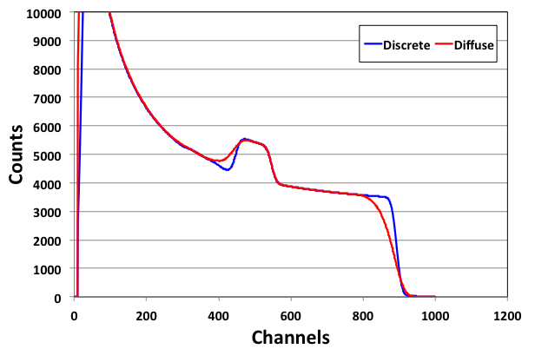
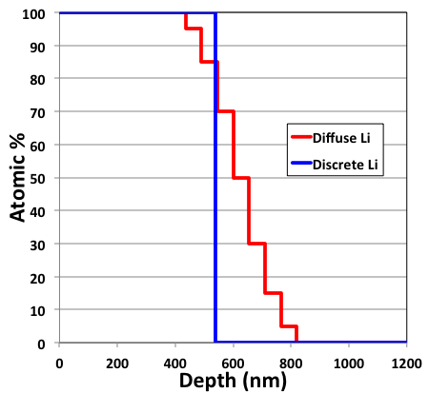
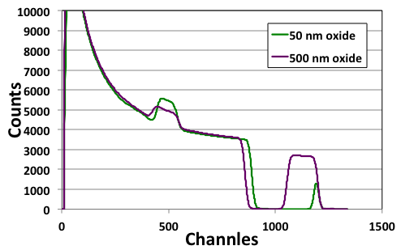
Examples of simulated RBS spectra for C-Li system
RBS spectra is sensitive to Li-C intermixing as well as oxygen content and distribution in Li layer.
Deuterium depth profiles achievable with ³He NRA.
Oxygen peak

Slide 4
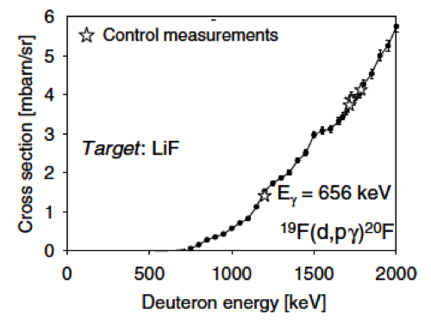
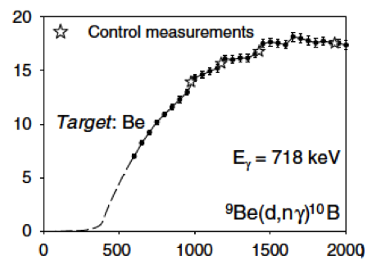
Collaboration Idea: Low-Z implanted depth markers for net erosion/deposition data and AIMS compatibility
AIMS-sensitive depth marker ➔ shot-by-shot depth marker tracking at many different locations ➔ unparalleled insights on net erosion/deposition rates in a tokamak
Be and F are the most promising depth marker candidates
Depth information can be extracted from yields since cross-section is a function of deuteron energy.
Dual depth markers improves dynamic range and allows us to deduce depth information by measuring ratios instead of absolute numbers.
Proposed target
F implantation zone
PFC or
MAPP sample
Plasma
AIMS energy
range
Be implantation zone

Slide 5
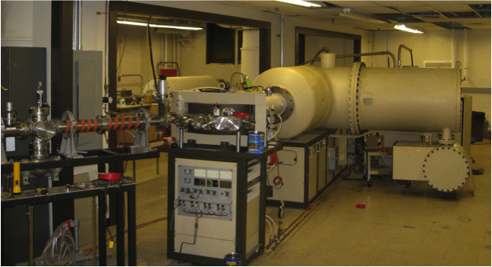
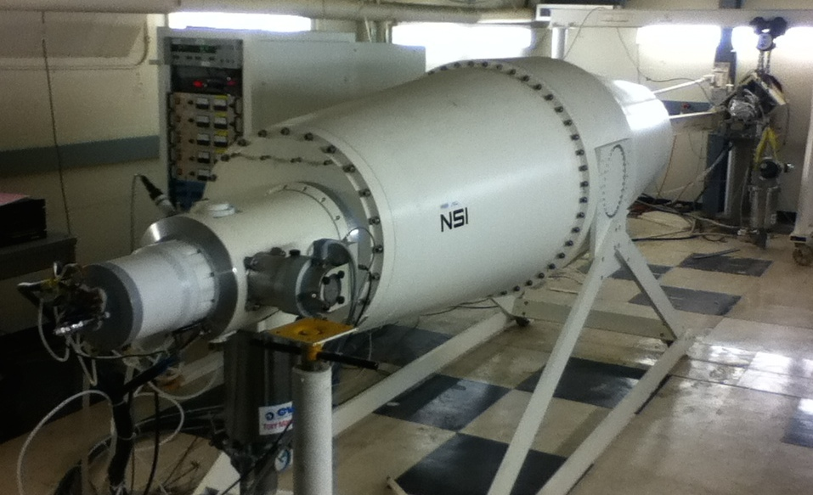
Necessary accelerators are running and preliminary work can begin immediately
Be and F depth markers are detectable with both standard IBA and deuteron IBA, so they are ideal for cross-checks.
Implantation of depth markers and standard IBA is performed by Cockroft-Walton tandem accelerator. Deuteron IBA/AIMS simulation performed by DANTE deuterium tandem accelerator.
We are ready to start immediately even investigating old NSTX tiles to refine and calibrate our measurement techniques.
This aligns well with thrusts MP-1 and MP-2 of the NSTX-U 5-year plan and objectives.
Cockroft-Walton tandem
DANTE tandem

