Slide 1
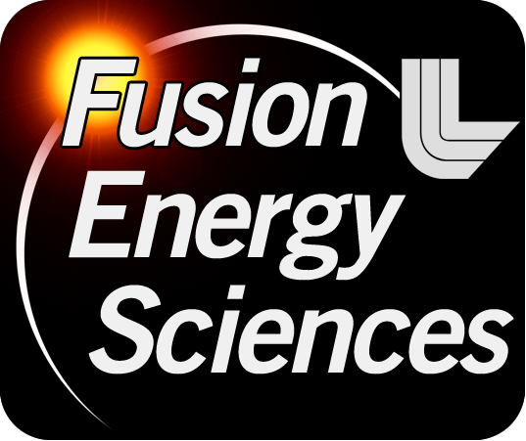
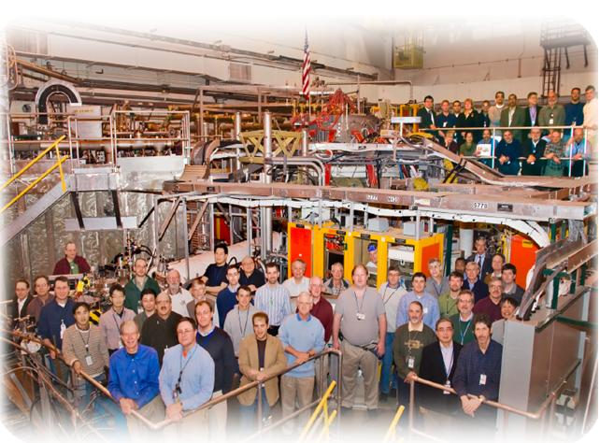
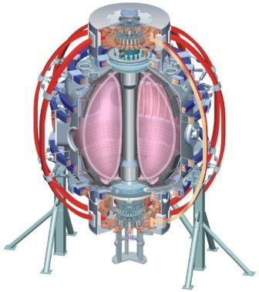
NSTX
Supported by
Radiative divertor with impurity seeding in NSTX
College W&M
Colorado Sch Mines
Columbia U
CompX
General Atomics
INEL
Johns Hopkins U
LANL
LLNL
Lodestar
MIT
Nova Photonics
New York U
Old Dominion U
ORNL
PPPL
PSI
Princeton U
Purdue U
SNL
Think Tank, Inc.
UC Davis
UC Irvine
UCLA
UCSD
U Colorado
U Illinois
U Maryland
U Rochester
U Washington
U Wisconsin
V. A. Soukhanovskii (LLNL)
Acknowledgements:
NSTX Team
Culham Sci Ctr
U St. Andrews
York U
Chubu U
Fukui U
Hiroshima U
Hyogo U
Kyoto U
Kyushu U
Kyushu Tokai U
NIFS
Niigata U
U Tokyo
JAEA
Hebrew U
Ioffe Inst
RRC Kurchatov Inst
TRINITI
KBSI
KAIST
POSTECH
ASIPP
ENEA, Frascati
CEA, Cadarache
IPP, Jülich
IPP, Garching
ASCR, Czech Rep
U Quebec
NSTX Results Review
Princeton, NJ
Wednesday, 1 December 2010

Slide 2
Use of impurity seeding provided an opportunity to study NSTX-U-relevant radiative divertor
Radiative divertor experiments used D₂ injection to demonstrate peak heat flux reduction in NSXT with carbon radiation
A significant divertor peak heat flux reduction will be needed in NSTX-U, probably not possible with low Z impurities
Reduced density LITER operation reduces radiated power due to extrinsic impurity seeding
Control aspects of radiative divertor
  Identify divertor quantities that can be monitored and used as actuators for feeding into PCS to regulate impurity injection

Slide 3
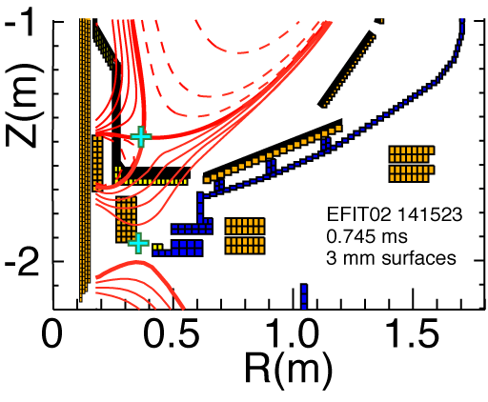
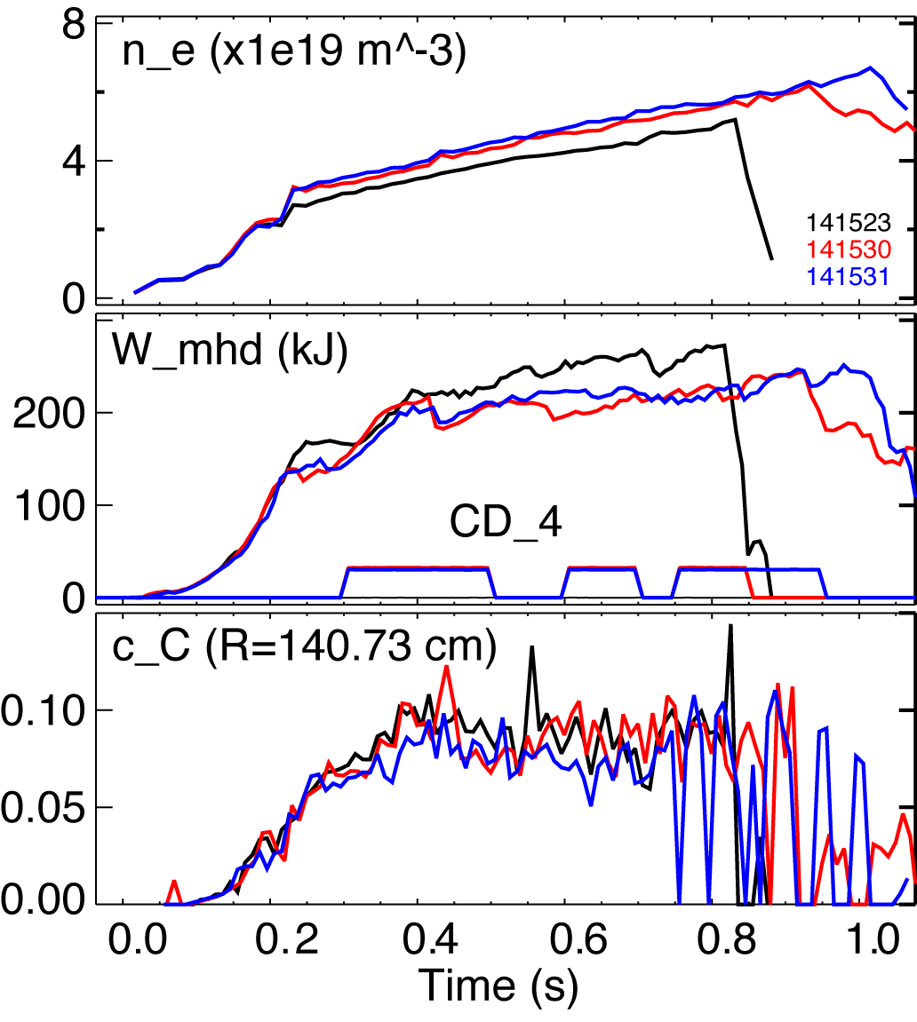
First demonstration of divertor peak heat flux reduction with impurity seeding in NSTX
I_{p}=0.9 MA, P_{NBI} = 4 MW
δ=0.85, κ=2.3, f_{exp}~20
P_{SOL} = 3 MW
Marginal performance degradation

Slide 4
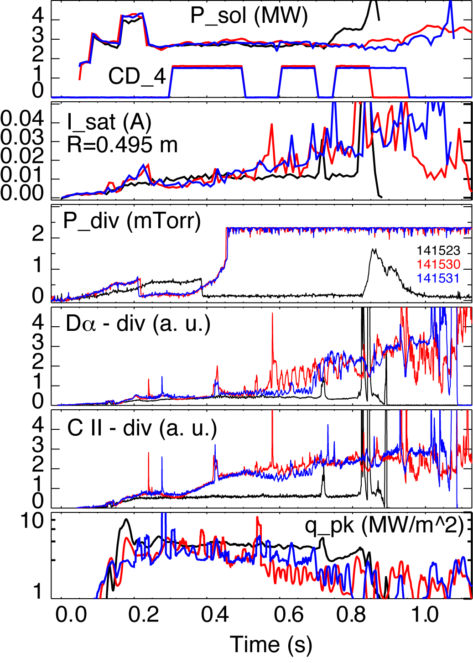
Divertor peak heat flux reduced by up to 80 %, clear signs of partial detachment observed

Slide 5
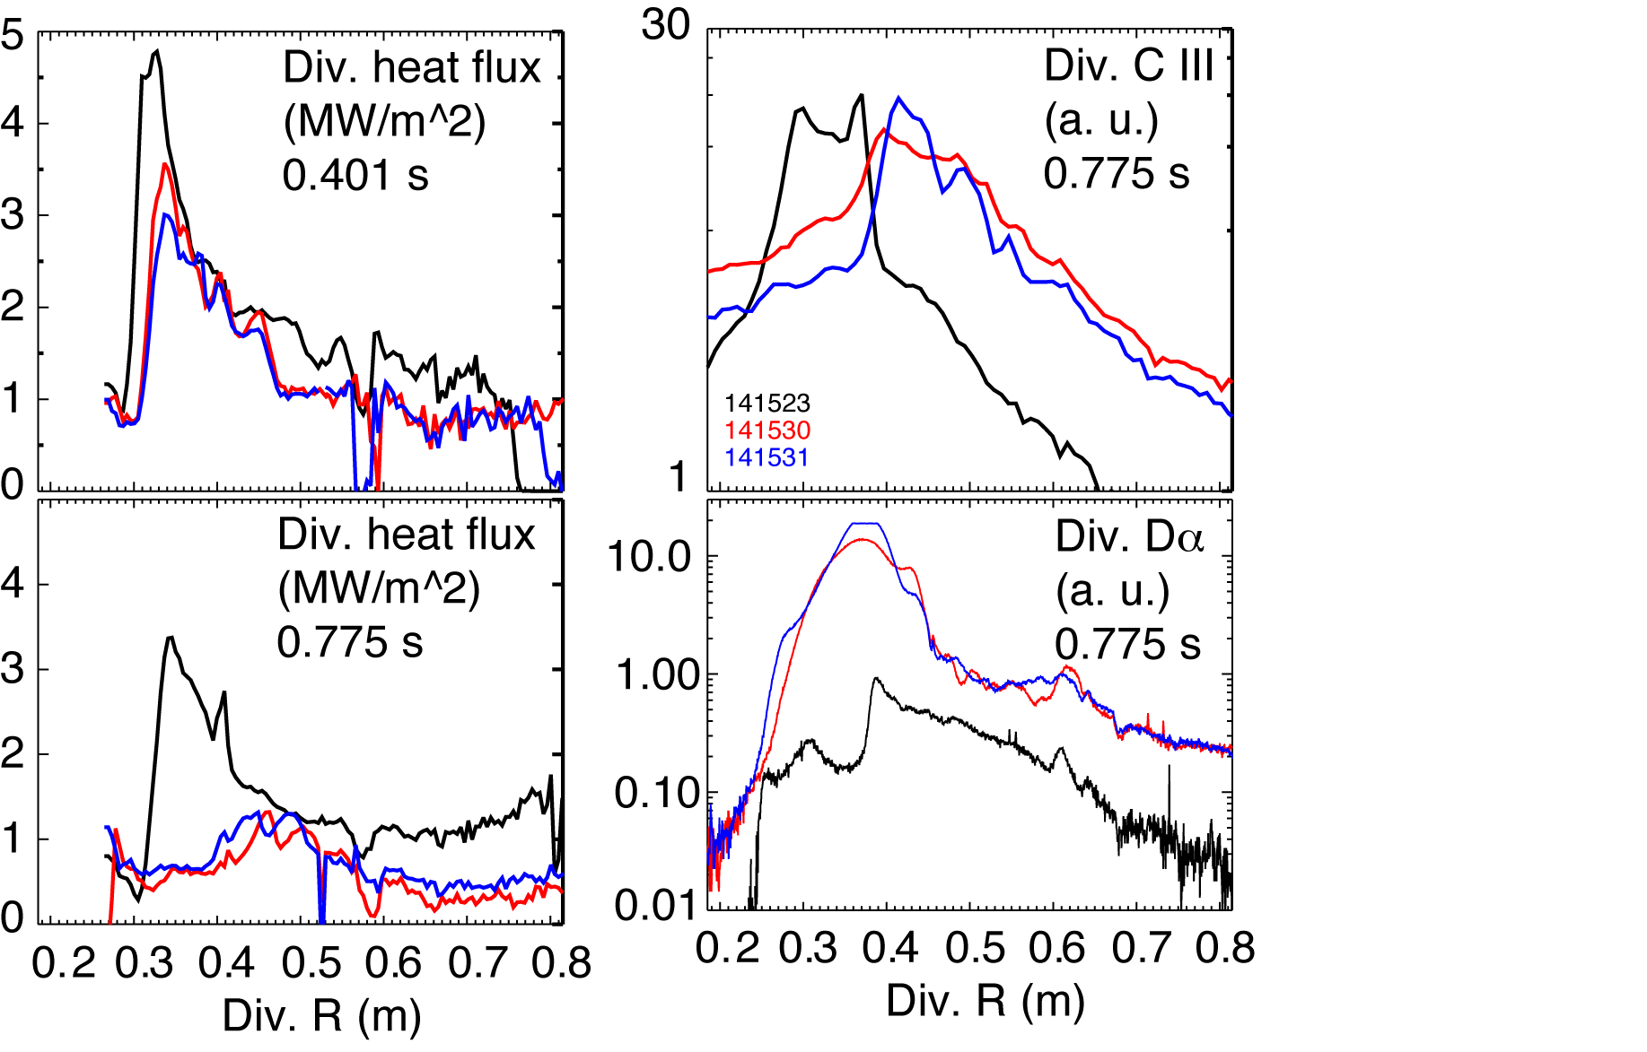
Divertor profiles confirm partial strike point detachment with increased radiation

Slide 6
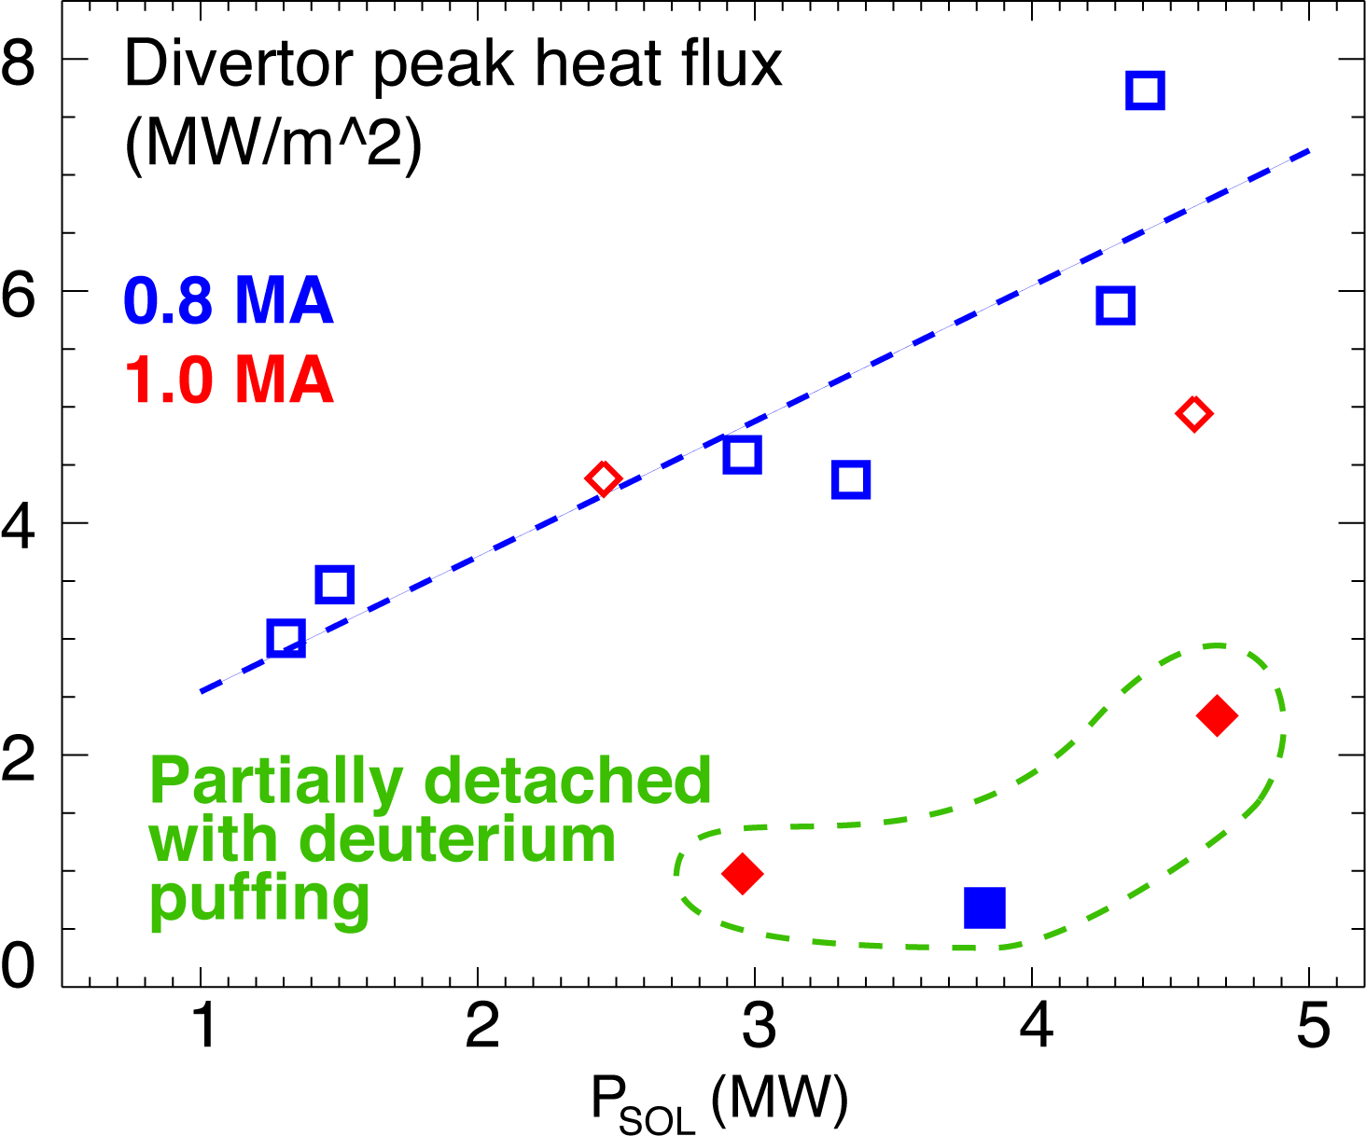
Radiative divertor with CD₄ seeding appears to reduce divertor heat flux as good as PDD with D₂
*
Radiative CD₄ divertor (*): P_{SOL}~3-4 MW, q_{peak}~0.5-1.0 MW/m²
V. A. Soukhanovskii et. al, PoP 16, 022501 (2009)

Slide 7
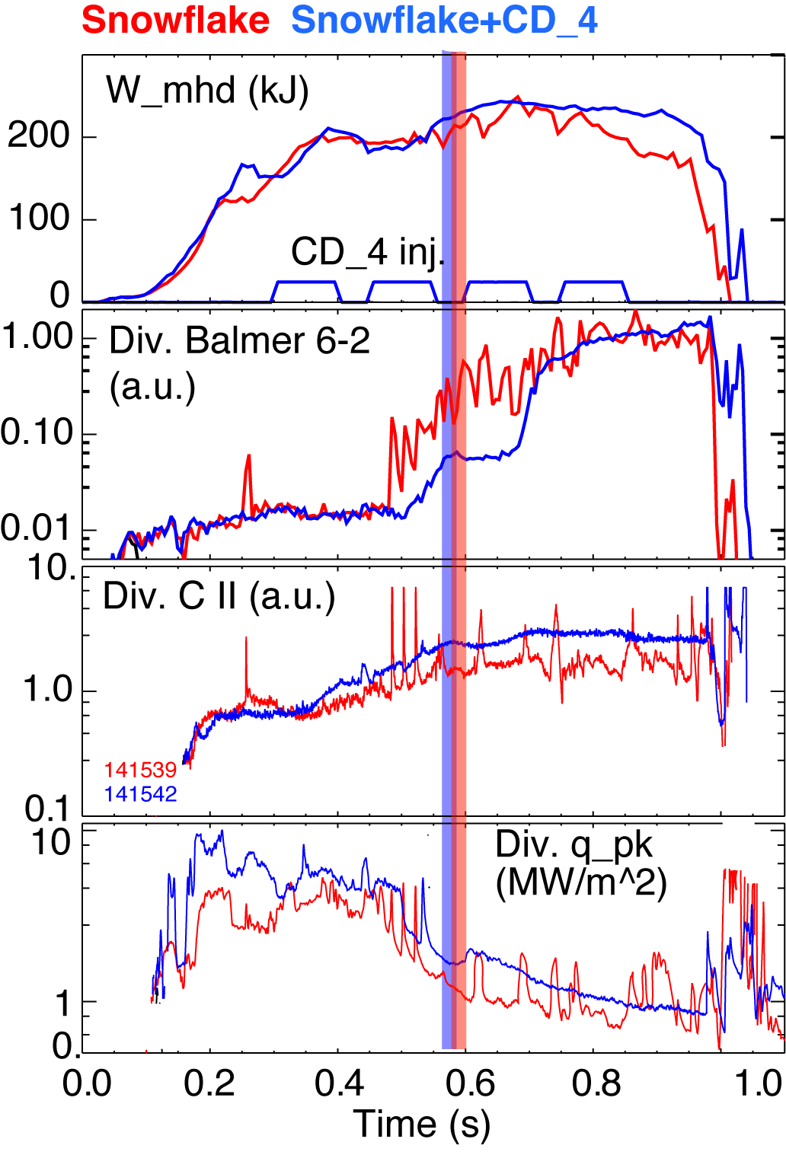
Snowflake divertor with CD₄ seeding leads to increased divertor carbon radiation
I_{p}=0.9 MA, P_{NBI}=4 MW, P_{SOL}=3 MW
Snowflake divertor (from 0.6 ms)
  Peak divertor heat flux reduced from 4-6 MW/m² to 1 MW/m²
Snowflake divertor (from 0.6 ms)
+ CD₄
  Peak divertor heat flux reduced from 4-6 MW/m² to 1-2 MW/m²
  Divertor radiation increased further

Slide 8
Conclusions and Future plans
First demonstration of impurity-seeded radiative divertor provided very encouraging results
  Marginal core plasma performance degradation
  Significant peak heat flux reduction
Continue with these studies in FY2011-2012
  Optimize CD₄ PDD performance for 1.2 MA, 6 MW
  Develop feedback control of radiative divertor
  Combine radiative divertor with snowflake and X-divertor
  Demonstrate and optimize for NSTX-U shape and performance

Slide 9
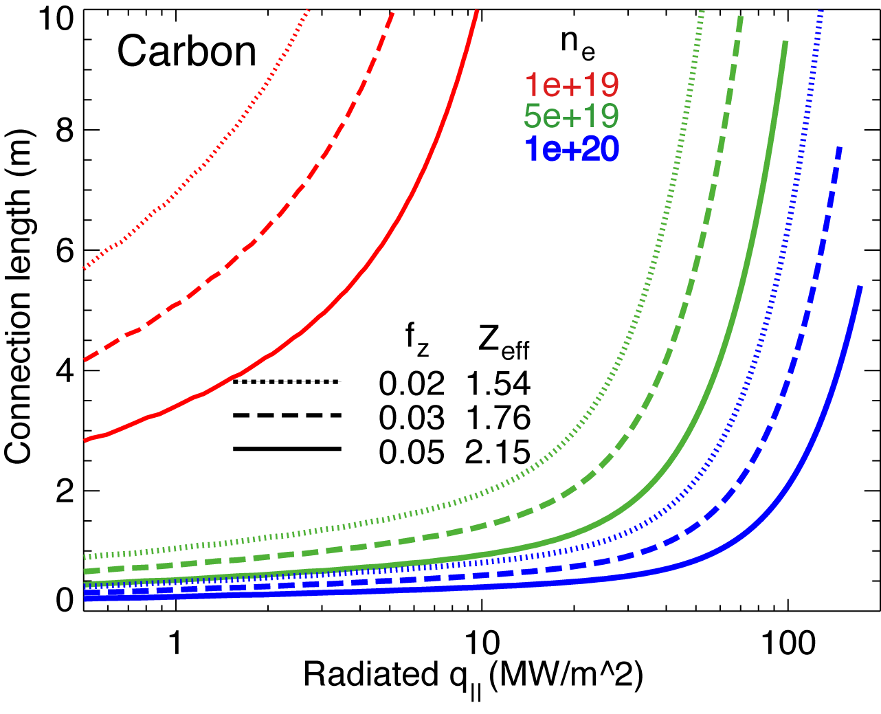
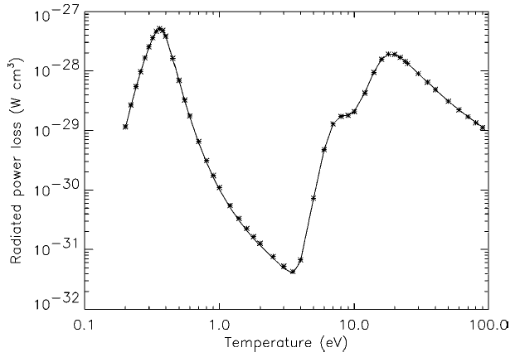
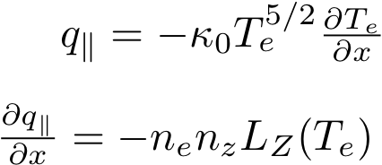
Impurity radiation role is to be clarified in radiative divertor experiments
It is marginally possible to radiate the necessary fraction of q|| with intrinsic carbon in NSTX
Lithium and helium can play an important role in divertor power balance
  Helium - energy expensive (first I.P. 24.6 eV), radiates at 1-10 eV
  Lithium – highly radiative at T_{e} < 1-3 eV
In PDD experiments in FY 2006-2008
  Radiated power was due to D, He, Li, C
  He and C were main contributors

Slide 10
Previous NSTX radiative divertor experiments with neon demonstrated that the divertor was too cold for efficient neon radiation

