Slide 1
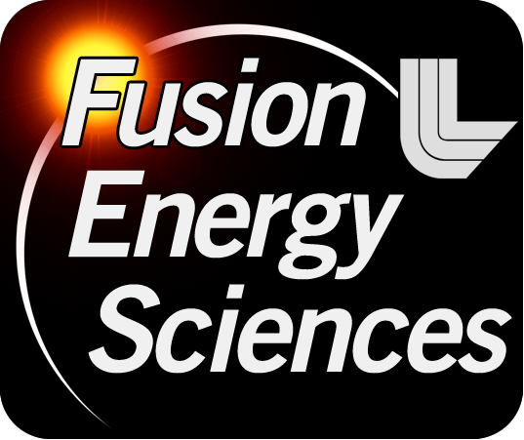
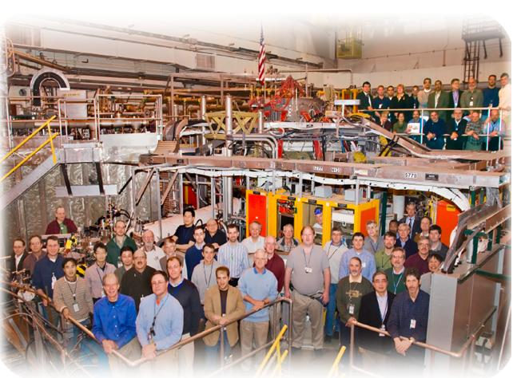
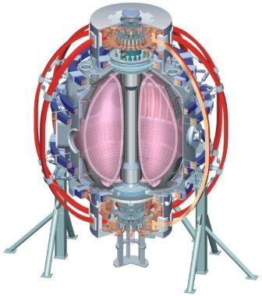
NSTX
Supported by
Snowflake divertor configuration in NSTX
College W&M
Colorado Sch Mines
Columbia U
CompX
General Atomics
INEL
Johns Hopkins U
LANL
LLNL
Lodestar
MIT
Nova Photonics
New York U
Old Dominion U
ORNL
PPPL
PSI
Princeton U
Purdue U
SNL
Think Tank, Inc.
UC Davis
UC Irvine
UCLA
UCSD
U Colorado
U Illinois
U Maryland
U Rochester
U Washington
U Wisconsin
V. A. Soukhanovskii (LLNL)
Acknowledgements:
NSTX Team
Culham Sci Ctr
U St. Andrews
York U
Chubu U
Fukui U
Hiroshima U
Hyogo U
Kyoto U
Kyushu U
Kyushu Tokai U
NIFS
Niigata U
U Tokyo
JAEA
Hebrew U
Ioffe Inst
RRC Kurchatov Inst
TRINITI
KBSI
KAIST
POSTECH
ASIPP
ENEA, Frascati
CEA, Cadarache
IPP, Jülich
IPP, Garching
ASCR, Czech Rep
U Quebec
NSTX Results Review
Princeton, NJ
Wednesday, 1 December 2010

Slide 2
Acknowledgements
D. D. Ryutov, T. D. Rognlien, M. V. Umansky (LLNL),
R. E. Bell, D. A. Gates, A. Diallo, S. P. Gerhardt, R. Kaita,
S. M. Kaye, E. Kolemen, B. P. LeBlanc, R. Maqueda,
J. E. Menard, D. Mueller, S. F. Paul, M. Podesta,
A. L. Roquemore, F. Scotti (PPPL),
J.-W. Ahn, R. Maingi, A. McLean (ORNL),
D. Battaglia, T. K. Gray (ORISE),
R. Raman (U Washington),
S. A. Sabbagh (Columbia U)
Supported by the U.S. DOE under Contracts
DE-AC52-07NA27344, DE AC02-09CH11466,
DE-AC05-00OR22725, DE-FG02-08ER54989.

Slide 3
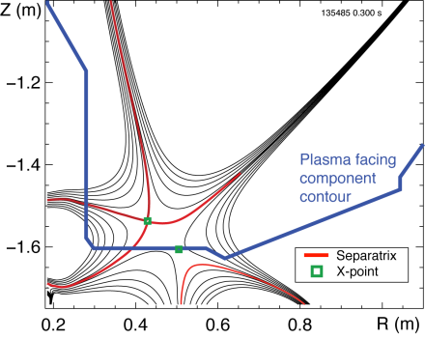
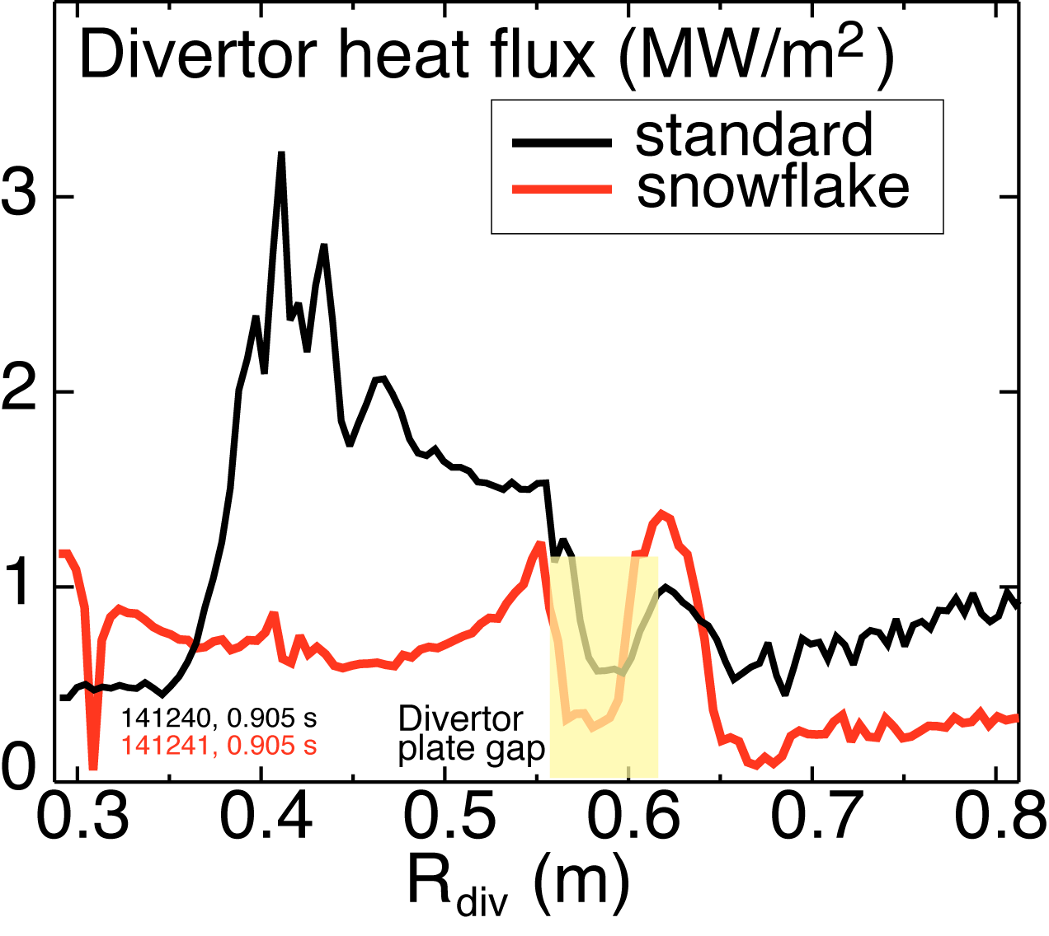
NSTX studies suggest the snowflake divertor configuration may be a viable divertor solution for present and future tokamaks
Steady-state snowflake (up to 600 ms,
many τ_{E}’s)
Good H-mode confinement
Reduced core carbon concentration
Significant reduction in peak divertor heat flux
Potential to combine with radiative divertor for increased divertor radiation
Planned future efforts with the snowflake divertor:
  Improved magnetic control
  Pedestal peeling-balooning stability
  ELM heat and particle deposition profiles
  Divertor impurity source distribution
  Divertor and upstream turbulence (blobs)

Slide 4
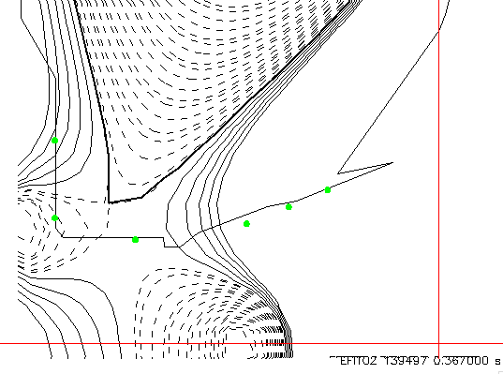
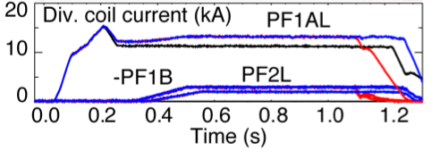
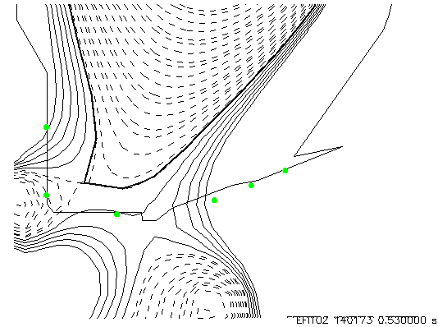
Standard divertor (medium and high-δ) is transformed into snowflake divertor using three divertor coils
Snowflake divertor with three coils (w/ reversed PF1B) from a medium-δ discharge
      ELMy H-mode with steady-state snowflake
    Snowflake with three coils (w/ reversed PF1B) from a high-δ discharge
  Best steady-state SFD, no OSP sweeping through CHI gap
  Fiducial like-performance, basis for integration with advanced scenarios

Slide 5
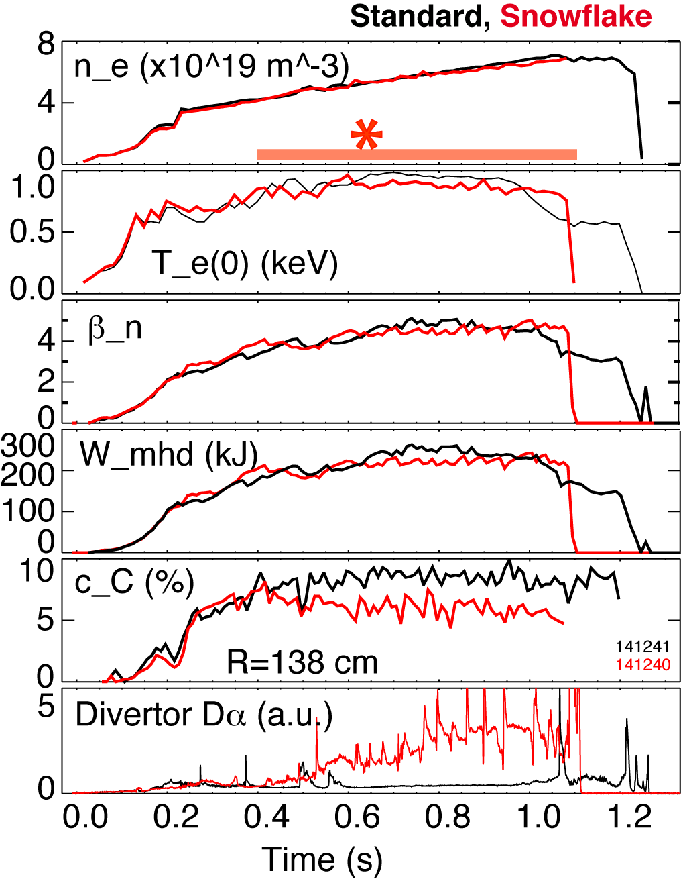
  Significant core impurity reduction and good H-mode confinement properties with snowflake divertor
0.8 MA, 4 MW H-mode
κ=2.1, δ=0.8
Core T_{e} ~ 0.8-1 keV, T_{i} ~ 1 keV
β_{N} ~ 4-5
Plasma stored energy ~ 250 kJ
H98(y,2) ~ 1 (from TRANSP)
Core carbon reduction due to
  Medium-size Type I ELMs
  Edge source reduction
In ELM-free discharges with snowflake divertor, carbon concentration reduction also observed and attributed to edge source reduction

Slide 6
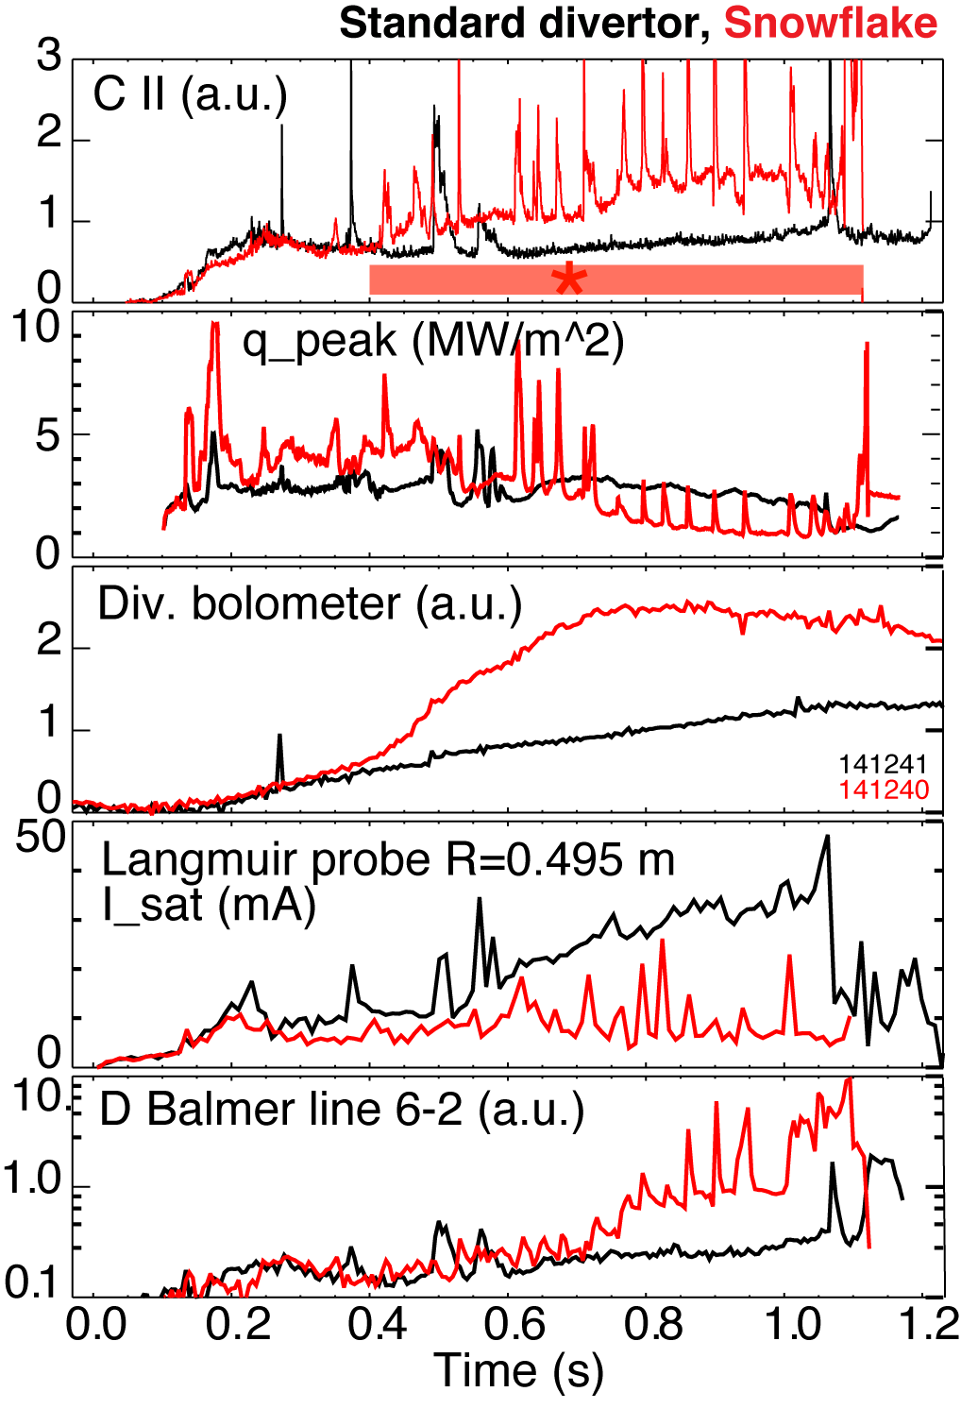
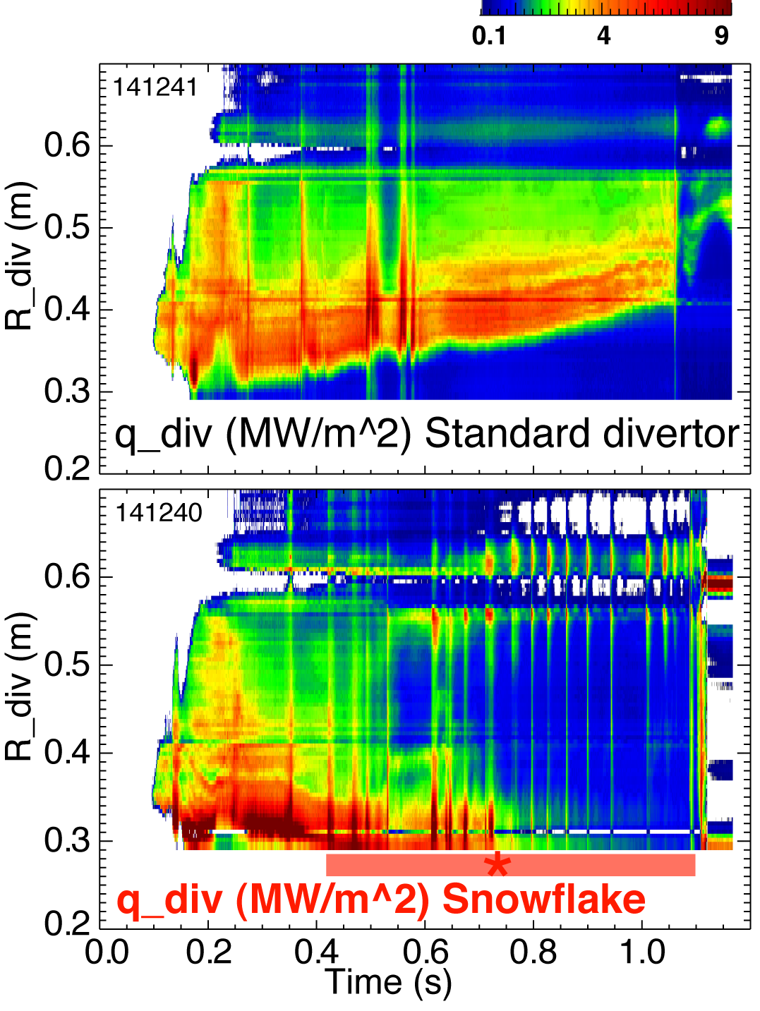
Strong signs of partial strike point detachment are observed in snowflake divertor
Heat and ion fluxes in the outer SP region decreased
Divertor recombination rate and radiated power are increased

Slide 7
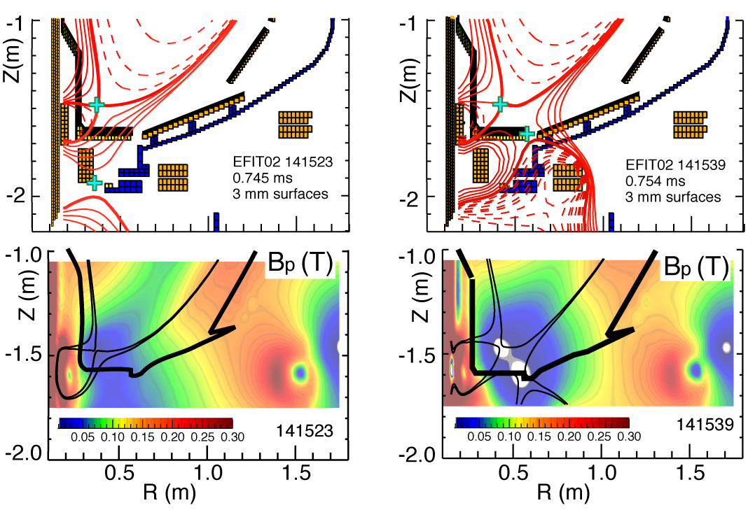
Snowflake divertor configurations obtained in NSTX confirm analytic theory and modeling
Standard
Snowflake
f_{exp}
B_{p}

Slide 8
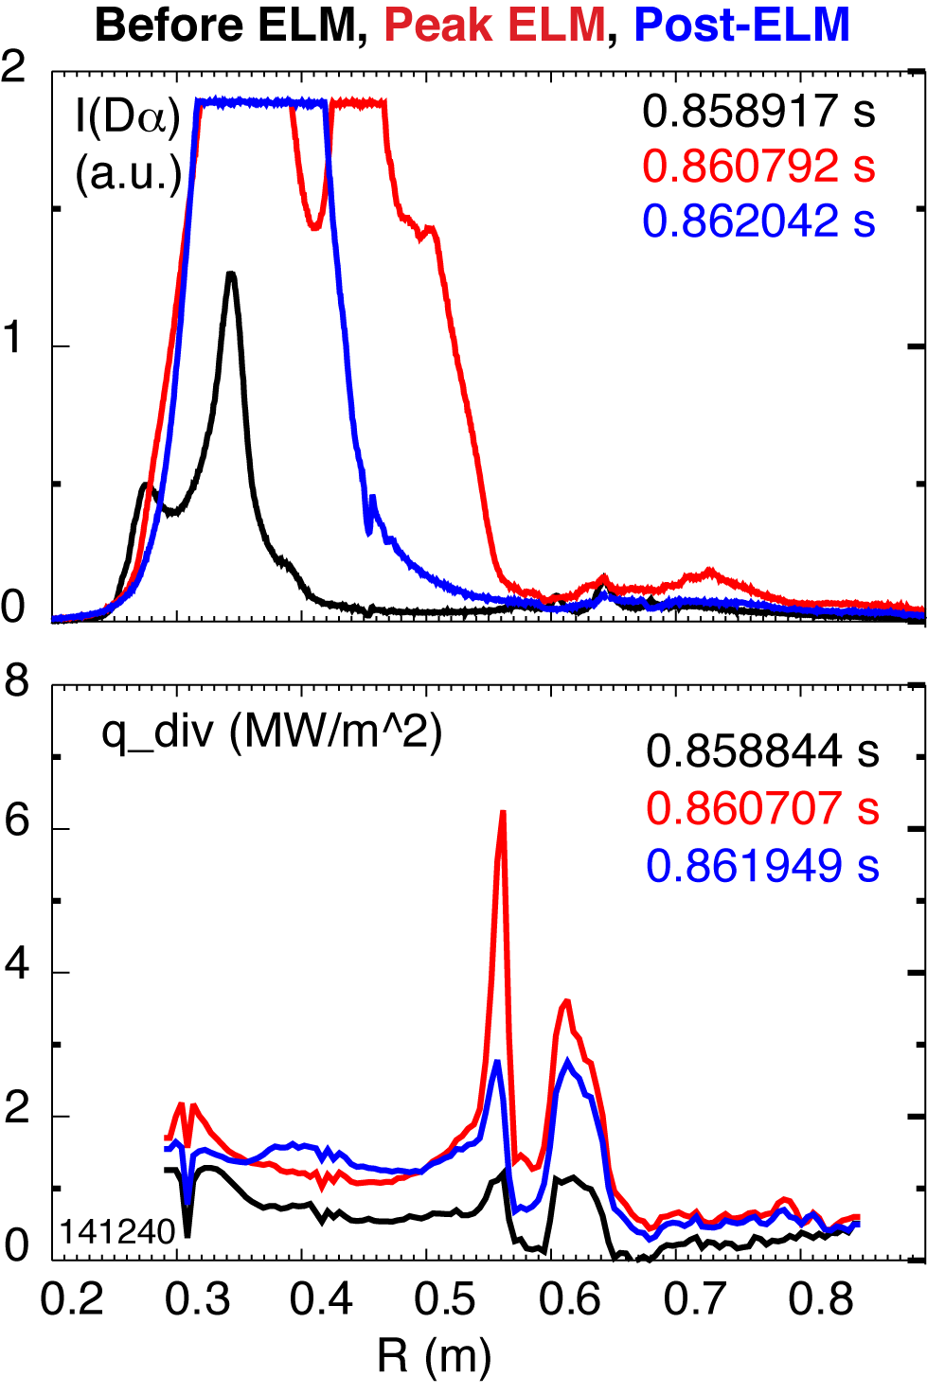
Snowflake divertor appears to alter pedestal stability and impulsive divertor heat loads due to ELMs
Increased magnetic shear predicted in snowflake divertor
In NSTX
  Snowflake sometimes does not survive ELMs
  Convective ELM heat flux follows magnetic surfaces, peak still reduced
  Snowflake divertor triggered ELMs from a suppressed ELM state (lithium)
Snowflake divertor effect on ELMs in TCV (F. Piras et al., PRL 2010)
  Type I ELMs in snowflake divertor
    increased size
    decreased frequency

Slide 9
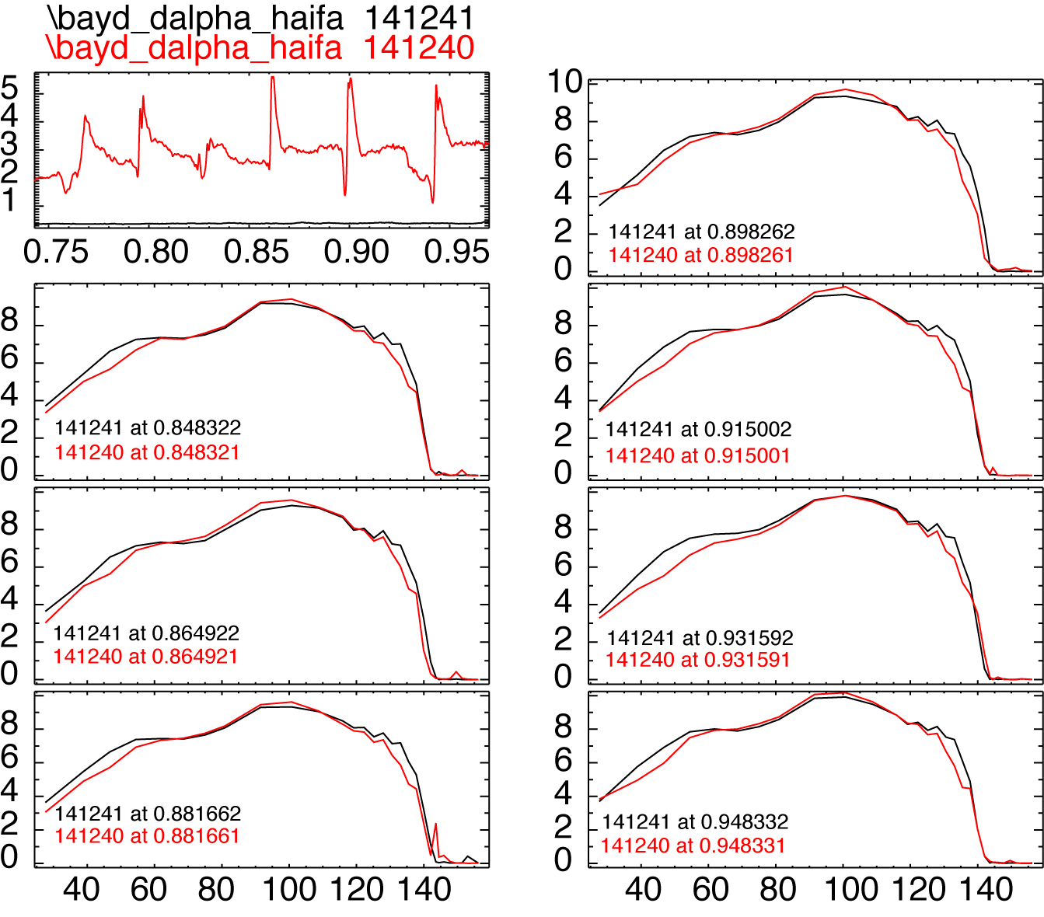
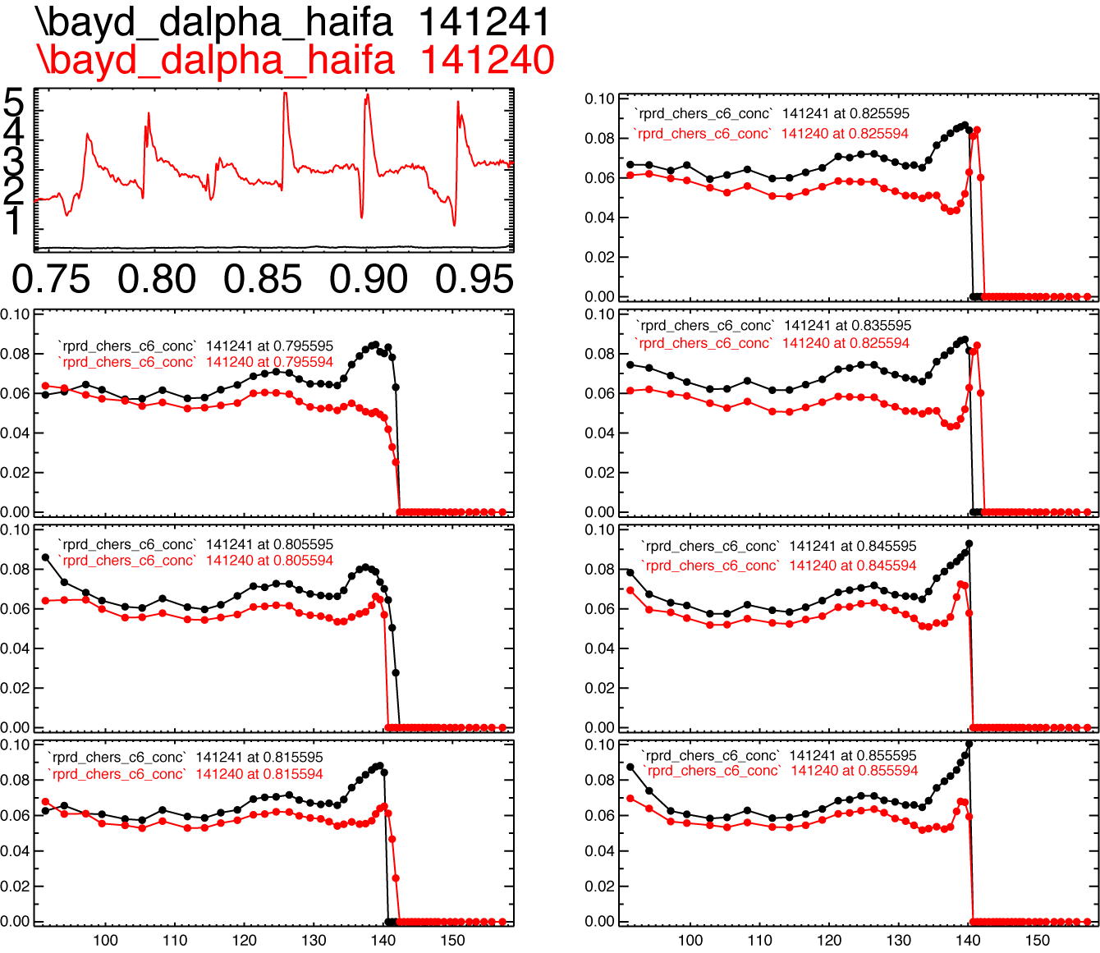
Different edge profiles are measured during the ELMy snowflake phase
Carbon concentration reducedby 10-20 % in the pedestal region
n_{e} reduced in top pedestal region (due to carbon reduction?)

Slide 10
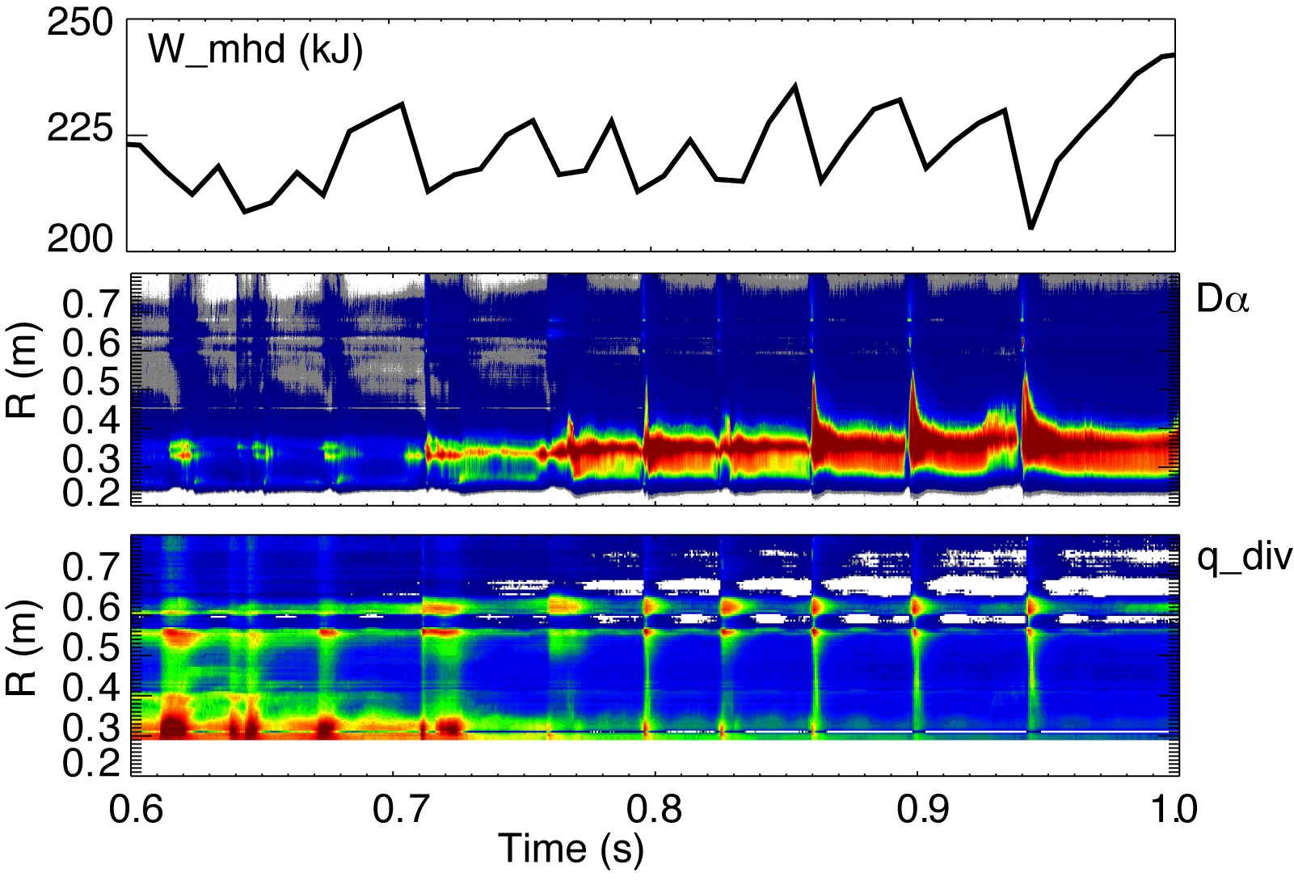
Snowflake divertor alters divertor heat load deposition profile due to ELMs

Slide 11
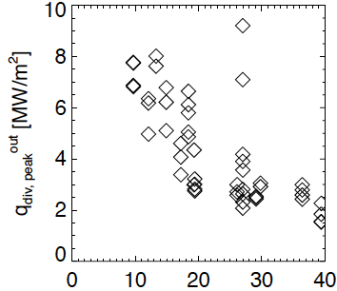
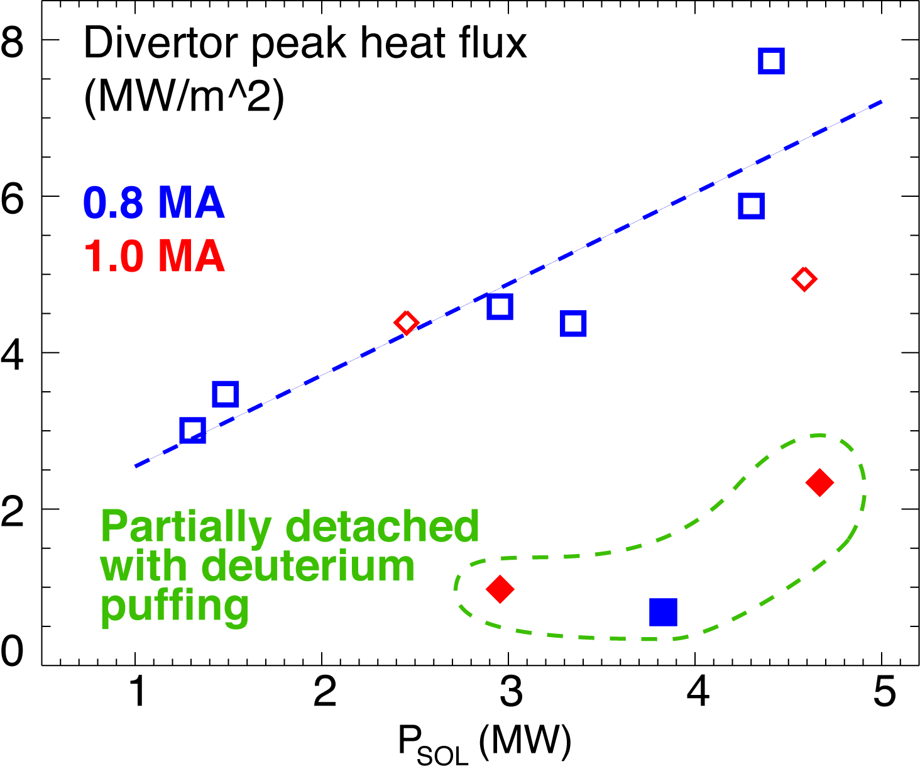
Snowflake divertor heat flux consistent with NSTX divertor heat flux scalings
0.8 MA
*
*
*
flux expansion
Snowflake divertor (*): P_{SOL}~3-4 MW, f_{exp}~40-80, q_{peak}~0.5-1.5 MW/m²
T. K. Gray et. al, EX/D P3-13, IAEA FEC 2010
V. A. Soukhanovskii et. al, PoP 16, 022501 (2009)

Slide 12
Backup

Slide 13
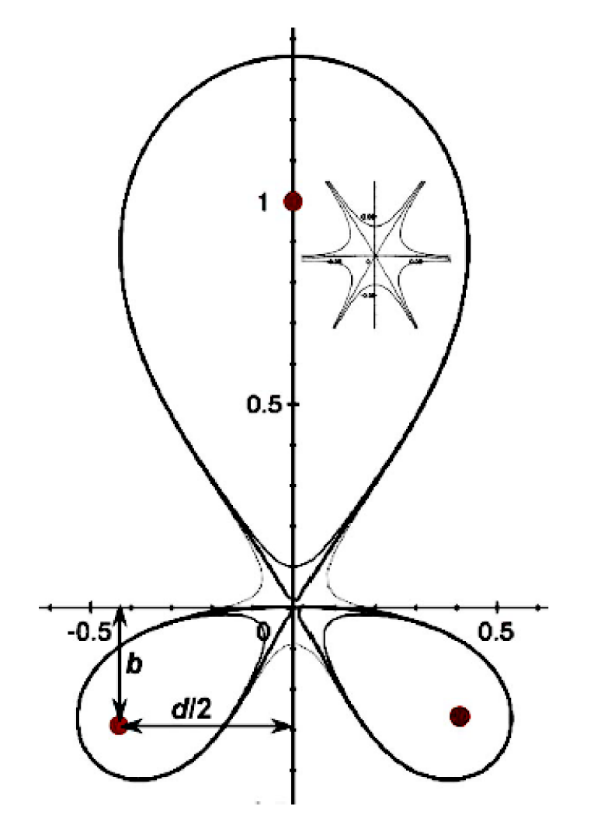
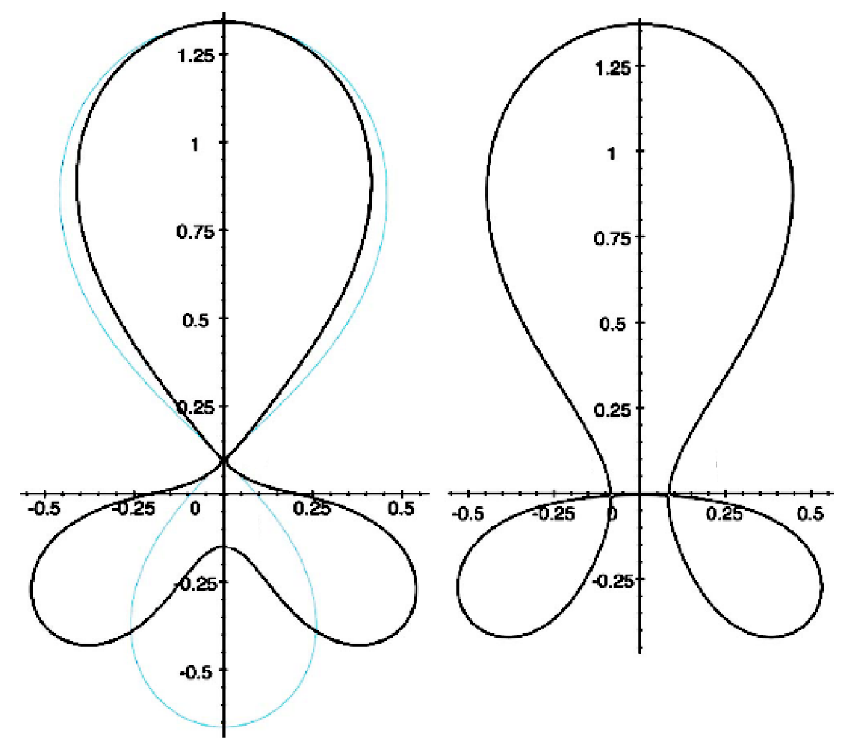
Attractive divertor geometry properties predicted by theory in snowflake divertor configuration
Snowflake divertor
  Second-order null
      B_{p} ~ 0 and grad B_{p} ~ 0; B_{p} ~ r²
      (Cf. first-order null: B_{p} ~ 0; B_{p} ~ r)
  Obtained with existing divertor coils (min. 2)
  Exact snowflake topologically unstable
Predicted properties (cf. standard divertor)
  Larger low B_{p} region around X-point
  Larger plasma wetted-area A_{wet} (flux expansion f_{exp})
  Larger X-point connection length L_{x}
  Larger effective divertor volume V_{div}
  Increased edge magnetic shear
Experiments
  TCV (F. Piras et. al, PRL 105, 155003 (2010))
Exact
snowflake
divertor
snowflake-minus
snowflake-plus
D. D. Ryutov, PoP 14, 064502 2007

Slide 14
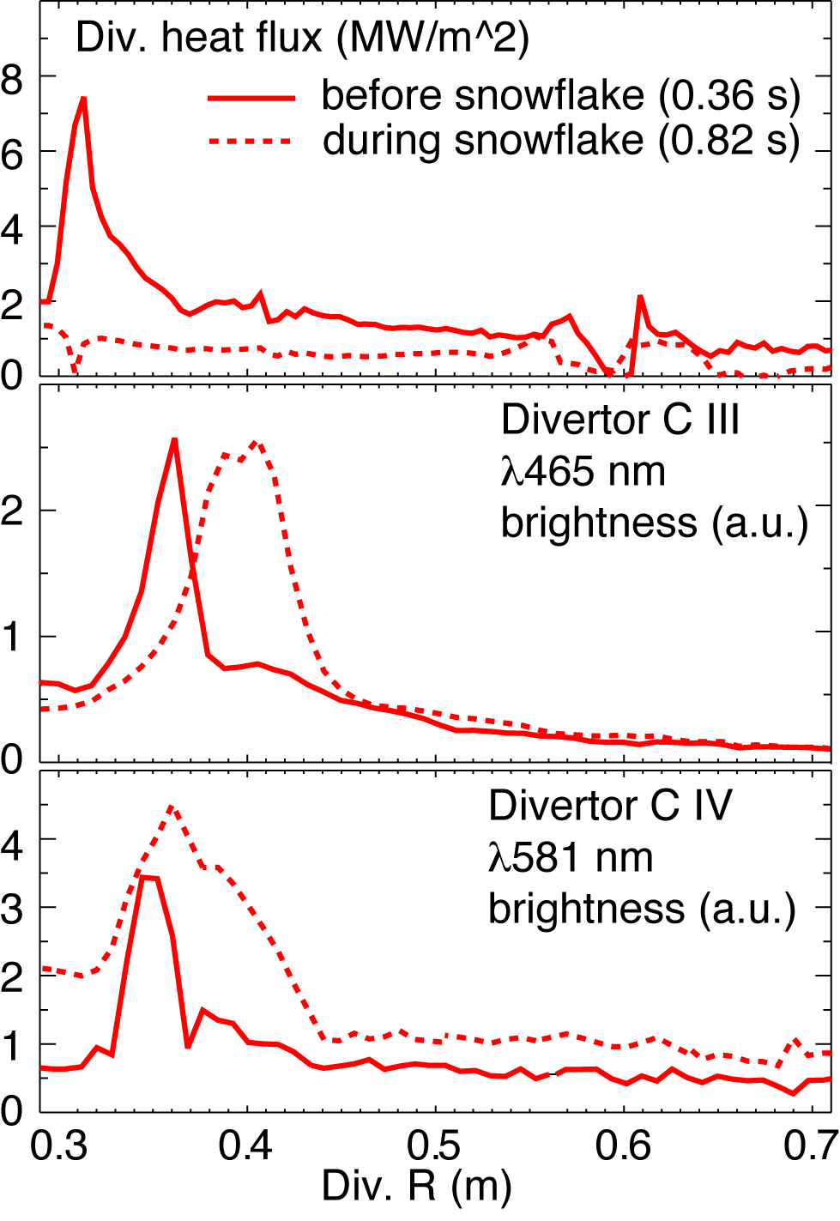
Divertor profiles show low heat flux, broadened C III and
C IV radiation zones in the snowflake divertor phase
Heat flux profiles reduced to nearly flat low levels, characteristic of radiative heating
C III and C IV emission profiles broaden
High-n Balmer line spectroscopy and CRETIN code modeling confirm outer SP detachment with T_{e} ≤ 1.5 eV, n_{e} ≤ 5 x 10²⁰ m⁻³
  Also suggests large reduction of carbon physical and chemical sputtering rates

Slide 15
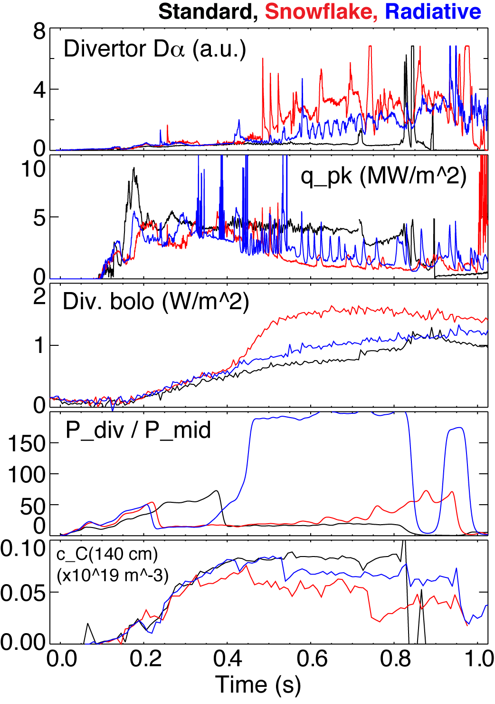
Snowflake divertor reduces heat flux and screens impurities as good as radiative divertor
I_{p}=0.9 MA, P_{NBI} = 4 MW, P_{SOL} = 3 MW
Comparison of standard divertor, snowflake divertor, and radiative divertor with CD₄ puffing (onset at 0.5 s)
Peak heat flux reduced by 60-75 % by radiative divertor and snowflake divertor
Divertor P_{rad} increased by up to 50 % in snowflake divertor, less in radiative divertor
Neutral compression (P_{div} / P_{mid}) higher in snowflake and radiative divertors
Pedestal impurity concentration reduced in snowflake and radiative divertors

Slide 16
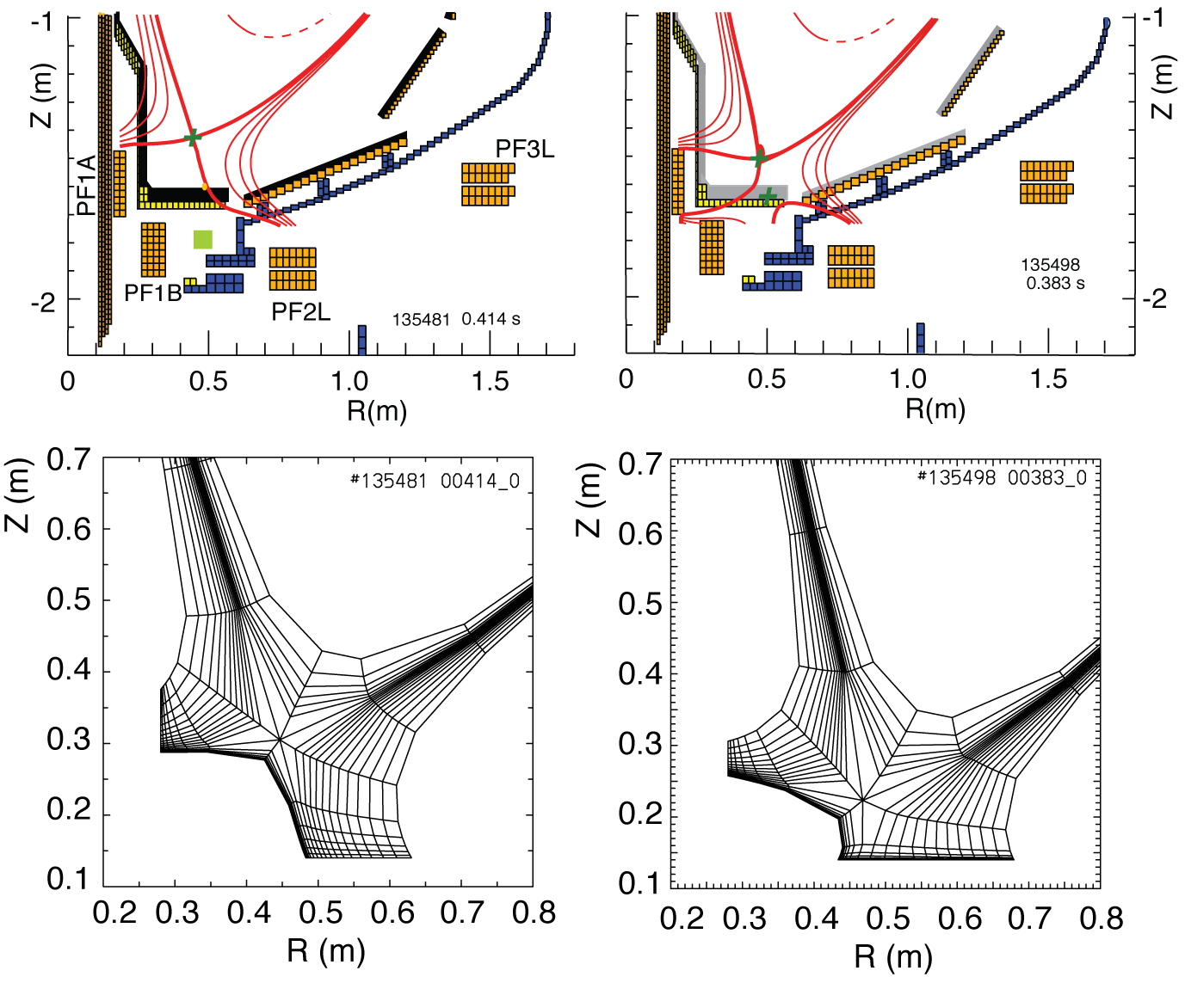
2D multi-fluid edge transport code UEDGE is used to study snowflake divertor properties
Fluid (Braginskii) model for ions and electrons
Fluid for neutrals
Classical parallel transport, anomalous radial transport
Core interface:
  T_{e} = 120 eV
  T_{i} = 120 eV
  n_{e} = 4.5 x 10¹⁹
D = 0.25 m²/s
χ_{e,i} = 0.5 m²/s
R_{recy} = 0.95
Carbon 3 %
Standard Snowflake

Slide 17
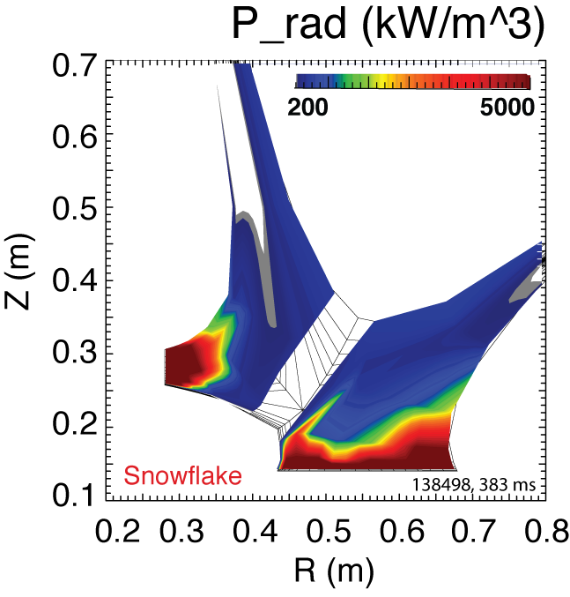
Radiated power is broadly distributed in the outer leg of snowflake divertor
UEDGE model

Slide 18
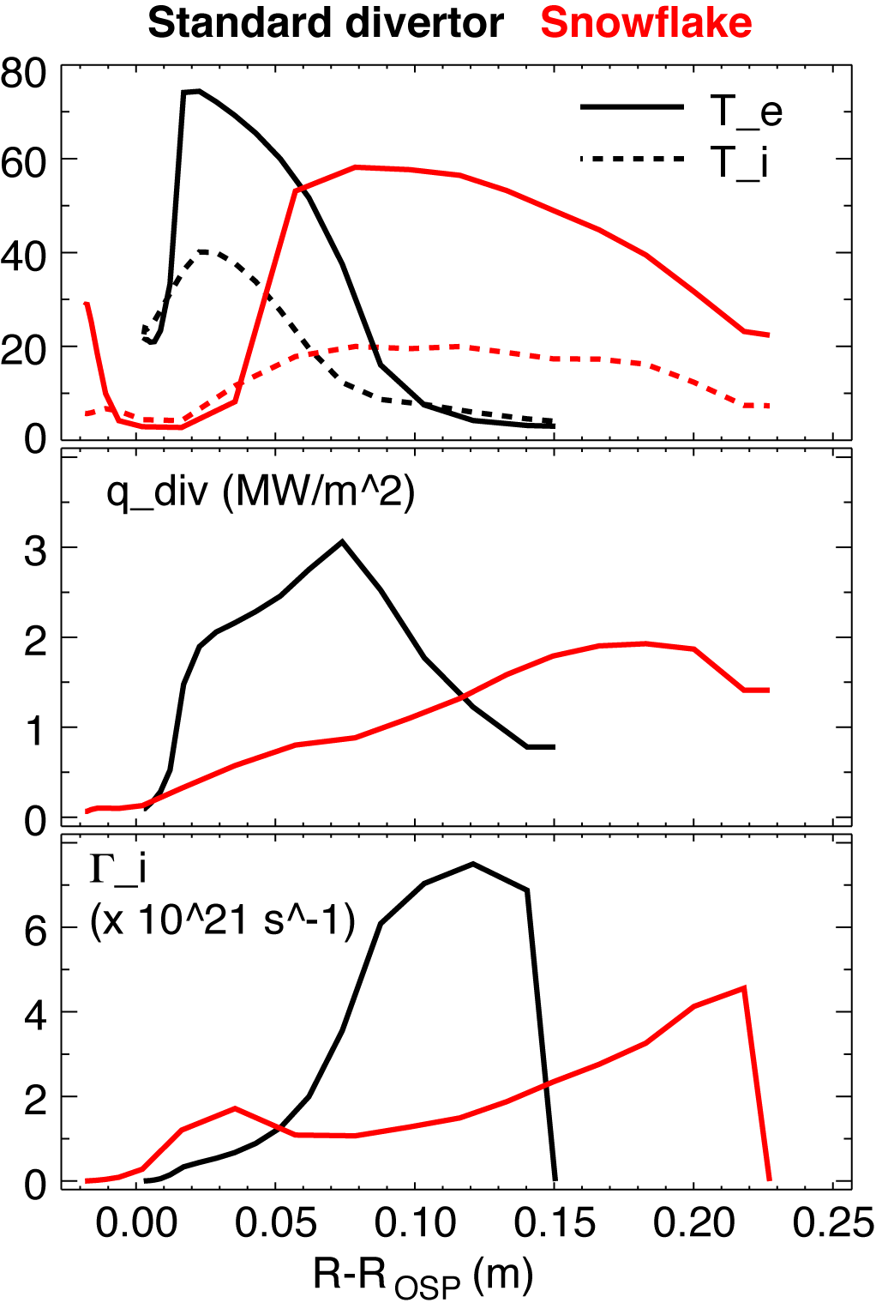
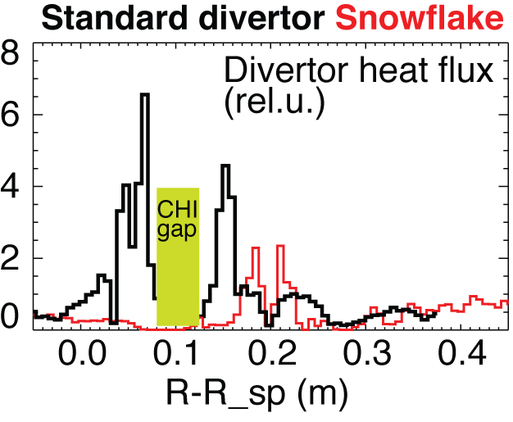
UEDGE model shows a trend toward detachment in snowflake divertor outer leg (cf. standard divertor)
In the snowflake divertor outer strike point region:
T_{e} and T_{i} reduced
Divertor peak heat flux reduced
Particle flux low
UEDGE model
Experiment

