Slide 1

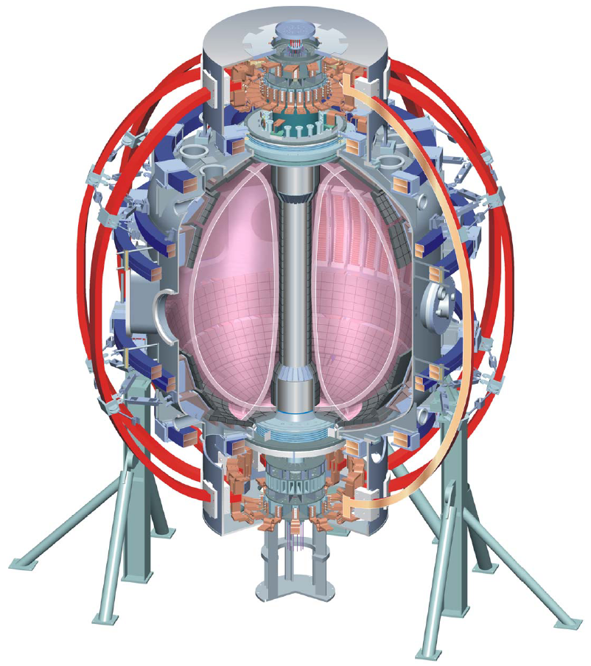
Supported by
Boundary Physics Topical Science Group
summary
College W&M
Colorado Sch Mines
Columbia U
Comp-X
General Atomics
INEL
Johns Hopkins U
LANL
LLNL
Lodestar
MIT
Nova Photonics
New York U
Old Dominion U
ORNL
PPPL
PSI
Princeton U
SNL
Think Tank, Inc.
UC Davis
UC Irvine
UCLA
UCSD
U Colorado
U Maryland
U Rochester
U Washington
U Wisconsin
V. A. Soukhanovskii, TSG Leader
Lawrence Livermore National Laboratory, Livermore, CA
R. Maingi, TSG Deputy
Oak Ridge National Laboratory, Oak Ridge, TN
D. P. Stotler, Theory & Modeling
Princeton Plasma Physics Laboratory, Princeton, NJ
NSTX FY 2010 Results Review
30 September 2010
Princeton, NJ
Culham Sci Ctr
U St. Andrews
York U
Chubu U
Fukui U
Hiroshima U
Hyogo U
Kyoto U
Kyushu U
Kyushu Tokai U
NIFS
Niigata U
U Tokyo
JAEA
Hebrew U
Ioffe Inst
RRC Kurchatov Inst
TRINITI
KBSI
KAIST
POSTECH
ASIPP
ENEA, Frascati
CEA, Cadarache
IPP, Jülich
IPP, Garching
ASCR, Czech Rep
U Quebec

Slide 2
Boundary Physics TSG priorities are defined by
DOE and NSTX Milestones
  FY2010 DOE Joint Research Target: Conduct experiments on major fusion facilities to improve understanding of the heat transport in the tokamak scrape-off layer (SOL) plasma, strengthening the basis for projecting divertor conditions in ITER.
  FY2010 Research Milestone R(10-3): Assess H-mode pedestal characteristics and ELM stability as a function of collisionality and lithium conditioning
  FY2011 DOE Joint Research Target: Conduct experiments on major fusion facilities to improve the understanding of the physics mechanisms responsible for the structure of the pedestal and compare with the predictive models described in the companion theory milestone.
NSTX-U planning needs and ST development path needs
ITPA participation, ITER needs

Slide 3
Three Boundary Physics TSG priorities have been defined for FY 2010 run
Compare divertor heat flux widths to midplane density and temperature widths and edge turbulence characteristics, and determine the scaling of SOL and divertor heat transport (FY2010 Joint Research Milestone)
Determine the relationship of ELM properties to discharge boundary shape, lithium conditioning, and 3D resonant magnetic perturbations (RMPs), and compare stability of pedestal / ELMs with model calculations (Milestone R10-3)
Understand and develop a predictive capability for the physics mechanisms responsible for the structure of the H-mode pedestal (FY2011 Joint Research Milestone)

Slide 4
FY 2010 BP TSG Experiments are supporting 3 APS DPP Invited talks and 4 IAEA FEC presentations
APS Invited Talks:
  J.-W. Ahn, Modification of divertor heat and particle flux profiles with 3-D fields in NSTX
  J. Canik, Edge transport and turbulence reduction, and formation of ultra-wide pedestals with lithium coated PFCs in NSTX
  V. A. Soukhanovskii, Taming the Plasma Material Interface with the ``Snowflake'' Divertor in NSTX
IAEA FEC presentations:
  J. Canik, Oral, Optimization of Density and Radiated Power Evolution Control using Magnetic ELM Pace-making in NSTX
  R. Maingi, Oral, Modification of Edge Profiles, Edge Transport, and ELM Stability with Lithium in NSTX
  V. A. Soukhanovskii, Poster, Synergy between the “Snowflake” Divertor Configuration and Lithium Plasma-Facing Component Coatings in NSTX
  J.-W. Ahn, Poster, Divertor heat and particle flux profile modification during 3-D field application in NSTX

Slide 5
Completed and remaining experiments address high-priority issues for STs, NSTX-U and ITER
Completed experiments
  XP 1026, A. Loarte, Effects of ELM control with resonant magnetic perturbation on edge power fluxes between and at ELMs
  XP 1043, R. Maingi, Scaling of heat flux profiles and edge turbulence in NSTX discharges with lithium-coated PFCs for the FY2010 JRT
  XP 1044, A. Diallo, Increasing the Range of Achievable Pedestal Height
  XP 1045, V. A. Soukhanovskii, "Snowflake" divertor configuration
  XP 1046, J.-W. Ahn, Effect of externally applied 3D fields on divertor profiles
  XP 1048, J.-K. Park, RMP threshold of ELM modification at different q₉₅
  XP 1051, S. Zweben, Test of LLD Electrodes for SOL Control
  XP 1069, J. Canik, Watching ELMs disappear with optimum diagnosis of turbulence
Remaining (scheduled) experiments
  XP 1030, D. Battaglia, ELM suppression using 3D fields from a single row off-midplane coils on NSTX
  XP 1050, V. A. Soukhanovskii, Radiative divertor with impurity seeding and lithium pumping
  XP 1068, R. Goldston, Edge harmonic oscillations
  XP J. Boedo, SOL transport and turbulence with lithium conditioning

Slide 6
XP 1026 (A. Loarte): Effects of ELM control with RMP on edge power fluxes between and at ELMs

Slide 7
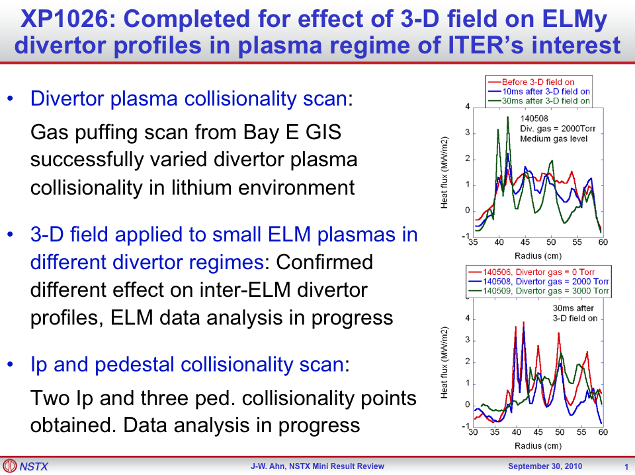
XP 1026 (A. Loarte): Effects of ELM control with RMP on edge power fluxes between and at ELMs

Slide 8
XP 1043 (R. Maingi): Scaling of heat flux profiles and edge turbulence in NSTX discharges with lithium-coated PFCs for the FY 2010 JRT

Slide 9
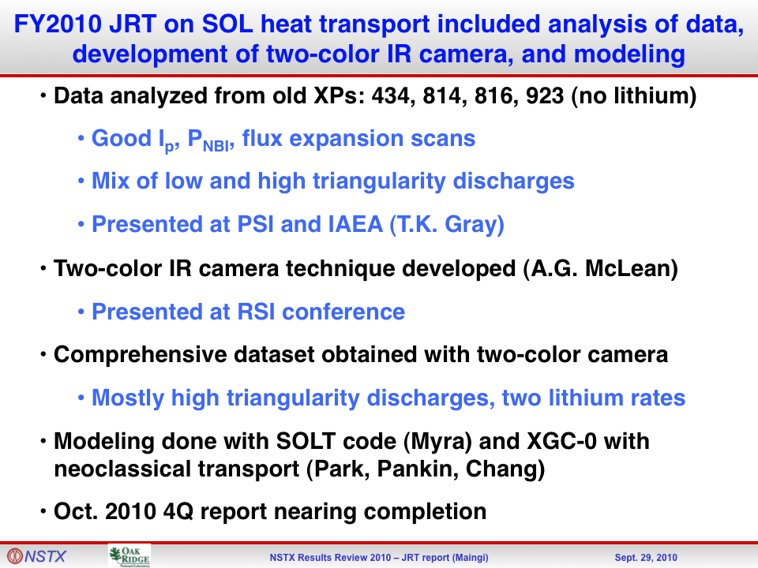
XP 1043 (R. Maingi): Scaling of heat flux profiles and edge turbulence in NSTX discharges with lithium-coated PFCs for the FY2010 JRT

Slide 10
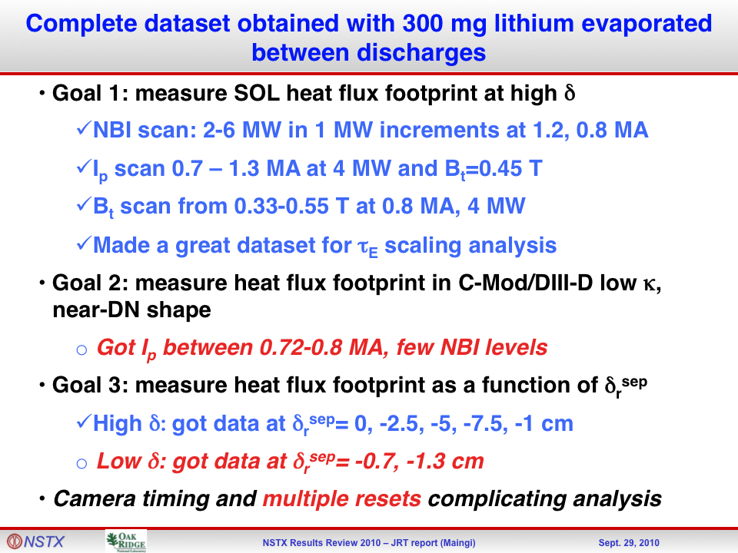
XP 1043 (R. Maingi): Scaling of heat flux profiles and edge turbulence in NSTX discharges with lithium-coated PFCs for the FY2010 JRT

Slide 11
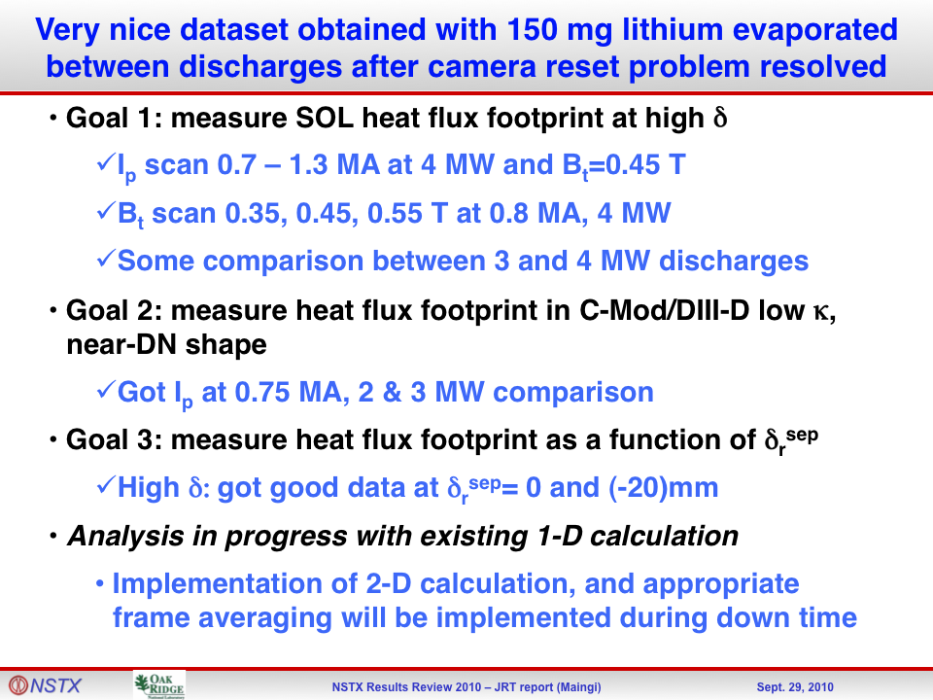
XP 1043 (R. Maingi): Scaling of heat flux profiles and edge turbulence in NSTX discharges with lithium-coated PFCs for the FY2010 JRT

Slide 12
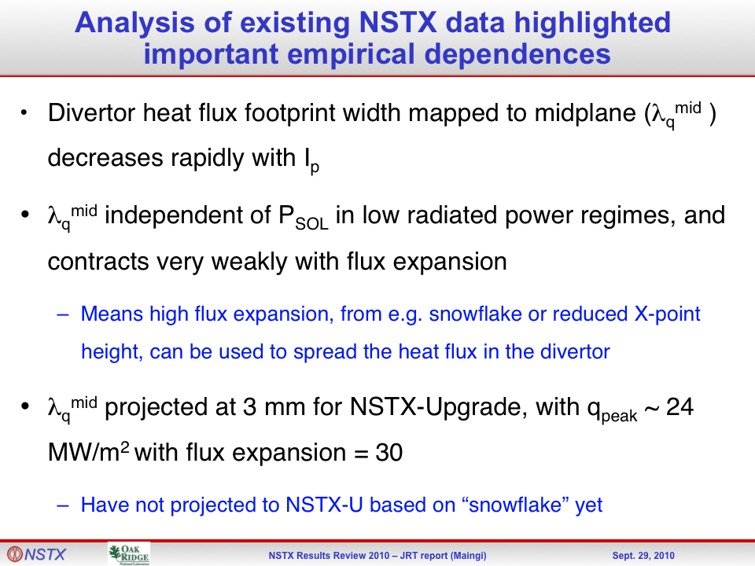
XP 1043 (R. Maingi): Scaling of heat flux profiles and edge turbulence in NSTX discharges with lithium-coated PFCs for the FY2010 JRT

Slide 13
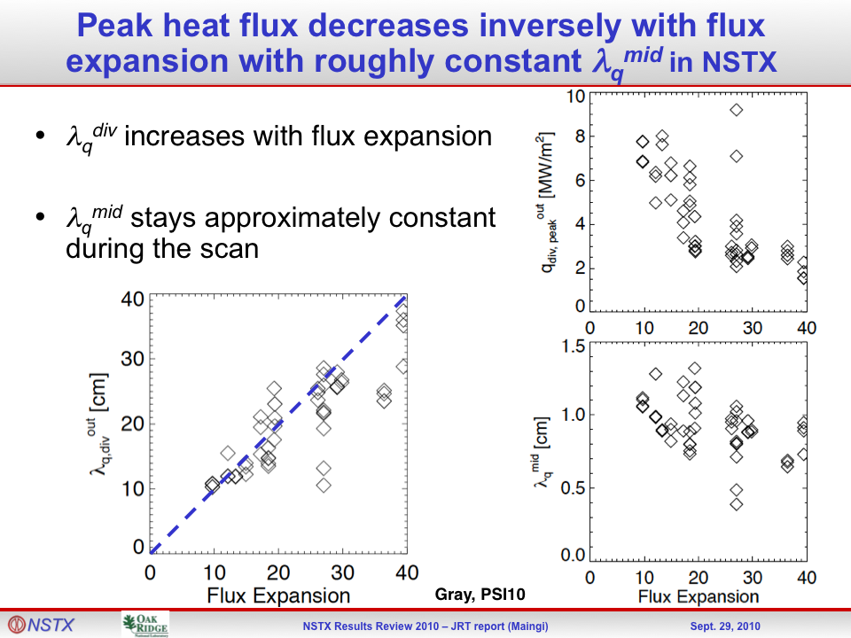
XP 1043 (R. Maingi): Scaling of heat flux profiles and edge turbulence in NSTX discharges with lithium-coated PFCs for the FY2010 JRT

Slide 14
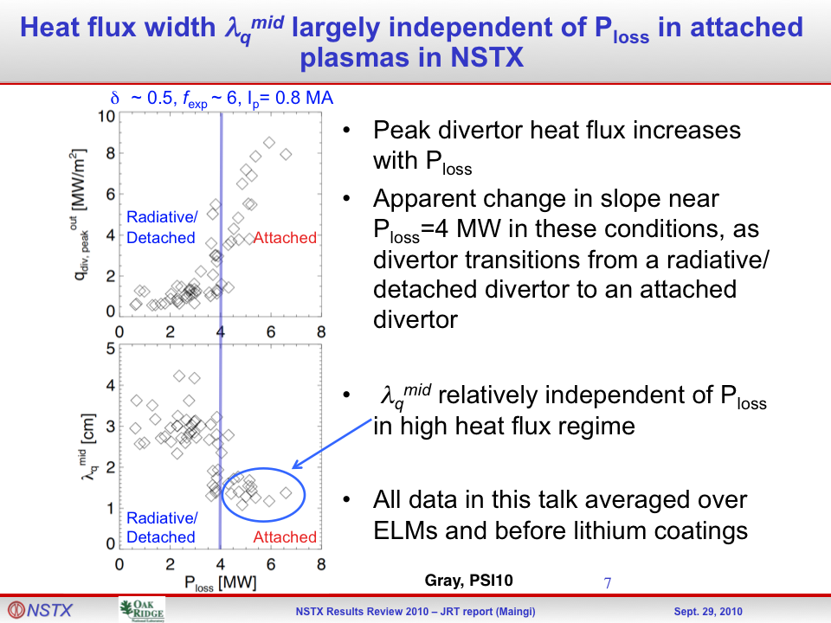
XP 1043 (R. Maingi): Scaling of heat flux profiles and edge turbulence in NSTX discharges with lithium-coated PFCs for the FY2010 JRT

Slide 15
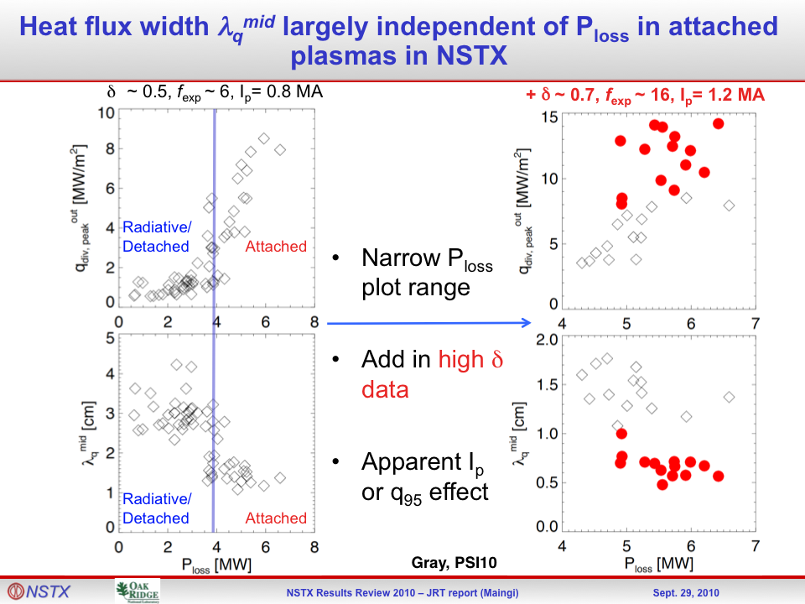
XP 1043 (R. Maingi): Scaling of heat flux profiles and edge turbulence in NSTX discharges with lithium-coated PFCs for the FY2010 JRT

Slide 16
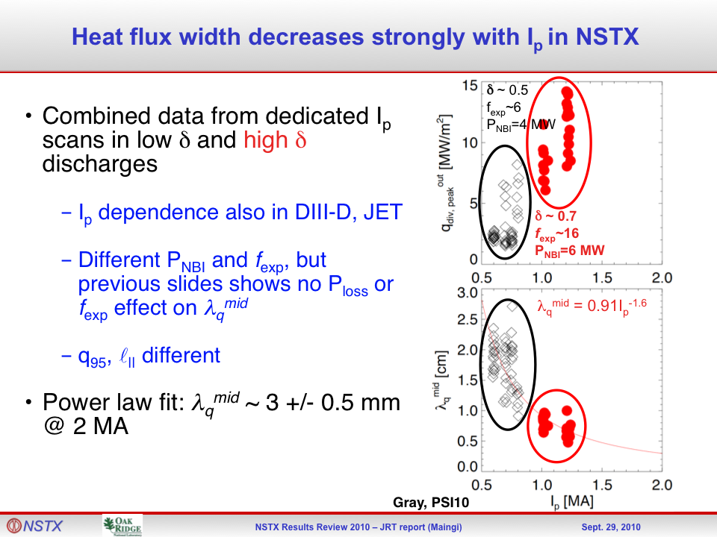
XP 1043 (R. Maingi): Scaling of heat flux profiles and edge turbulence in NSTX discharges with lithium-coated PFCs for the FY2010 JRT

Slide 17
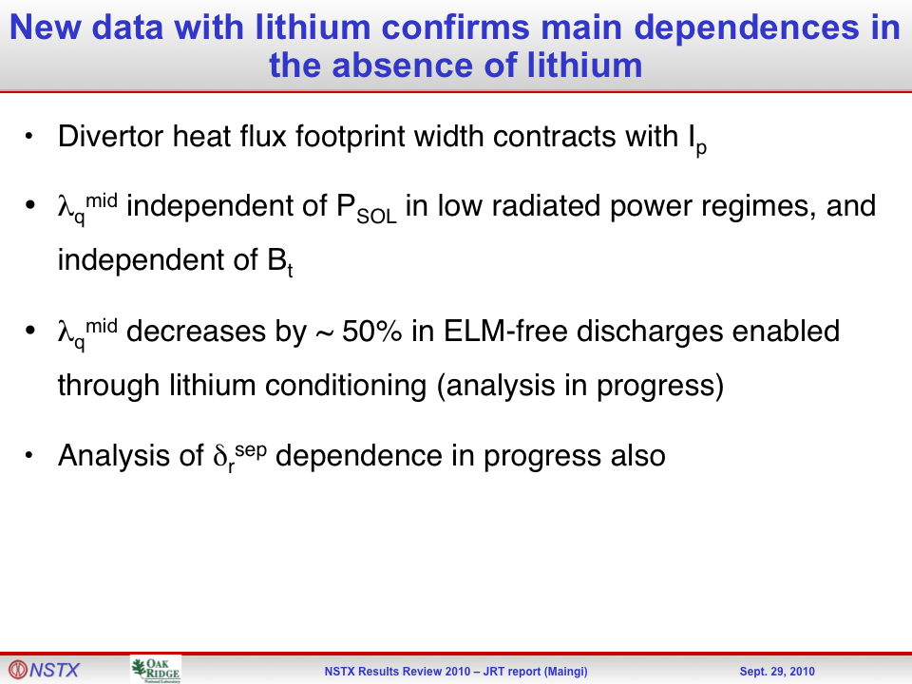
XP 1043 (R. Maingi): Scaling of heat flux profiles and edge turbulence in NSTX discharges with lithium-coated PFCs for the FY2010 JRT

Slide 18
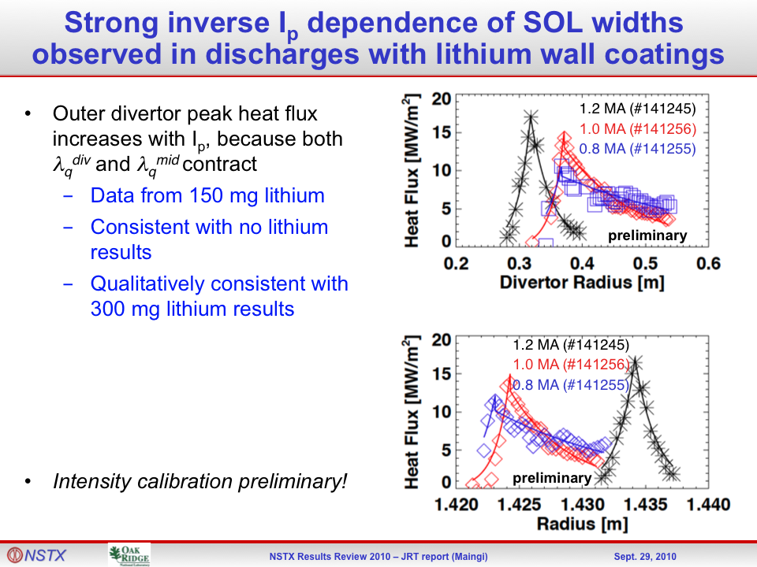
XP 1043 (R. Maingi): Scaling of heat flux profiles and edge turbulence in NSTX discharges with lithium-coated PFCs for the FY2010 JRT

Slide 19
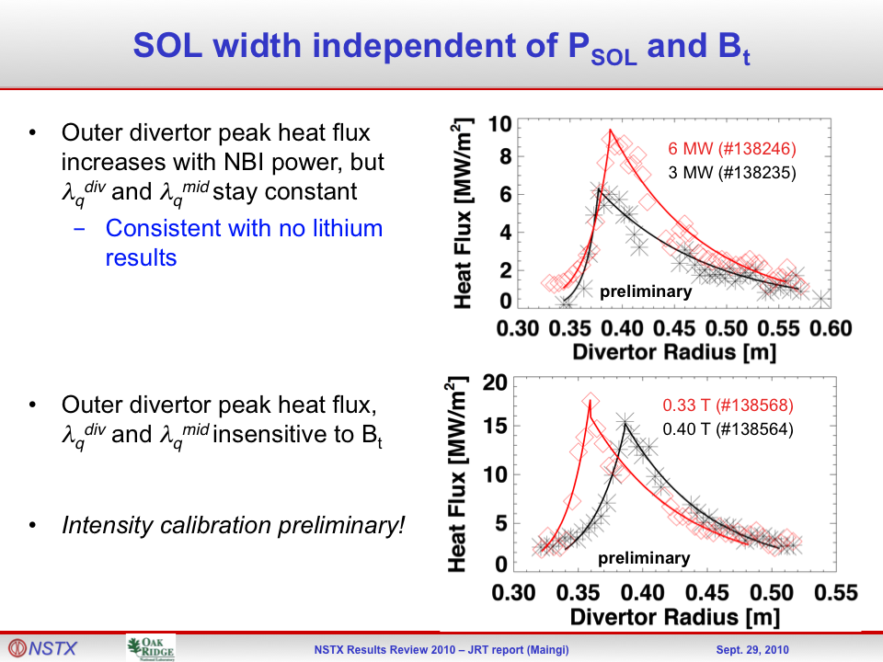
XP 1043 (R. Maingi): Scaling of heat flux profiles and edge turbulence in NSTX discharges with lithium-coated PFCs for the FY2010 JRT

Slide 20
XP 1044 (A. Diallo): Increasing the Range of Achievable Pedestal Height

Slide 21
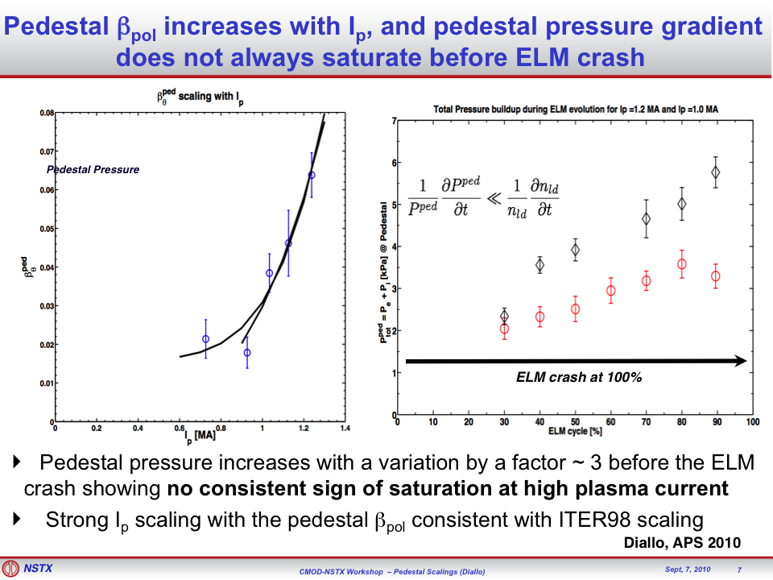
XP 1044 (A. Diallo): Increasing the Range of Achievable Pedestal Height

Slide 22
XP 1045 (V. A. Soukhanovskii): “Snowflake” divertor configuration in NSTX

Slide 23
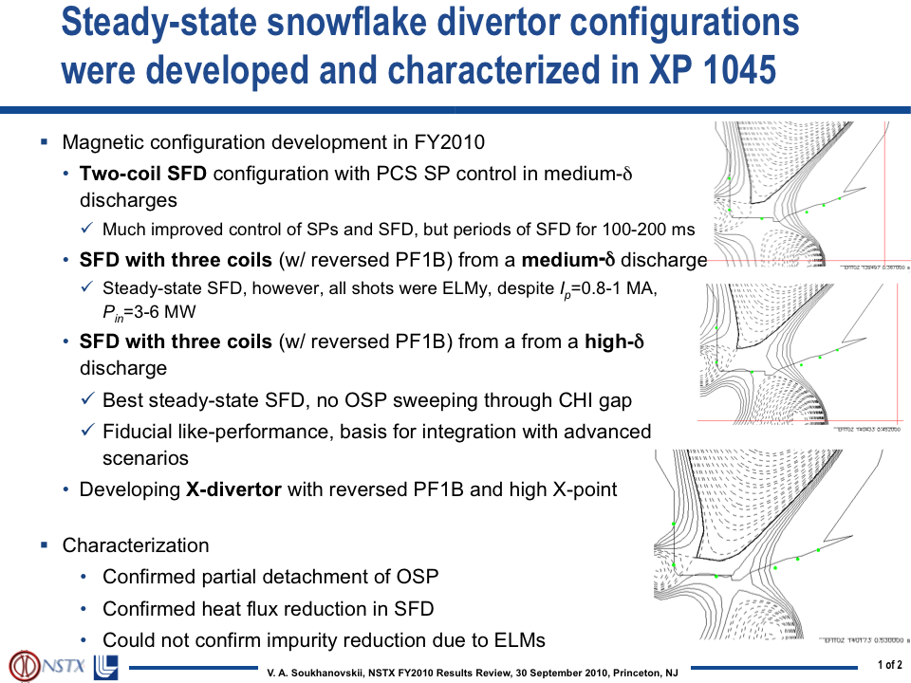
XP 1045 (V. A. Soukhanovskii): “Snowflake” divertor configuration in NSTX

Slide 24
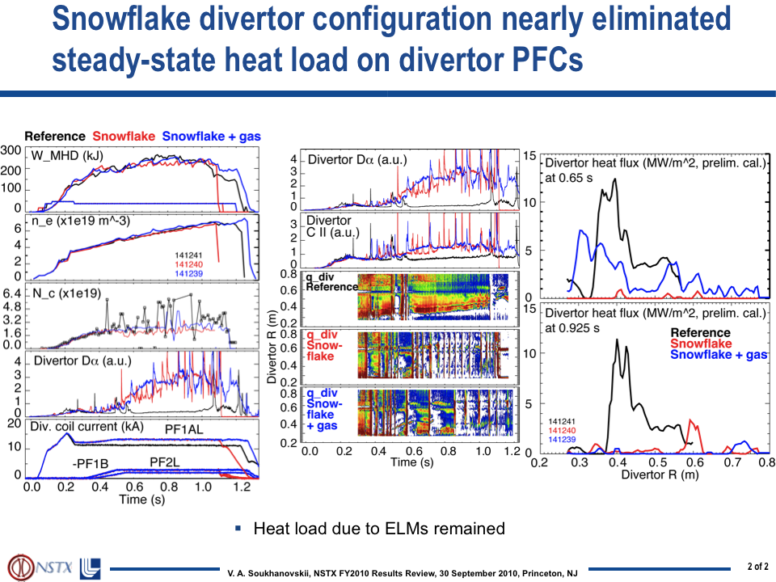
XP 1045 (V. A. Soukhanovskii): “Snowflake” divertor configuration in NSTX

Slide 25
XP 1046 (J.-W. Ahn): Effect of externally applied 3D fields on divertor profiles

Slide 26
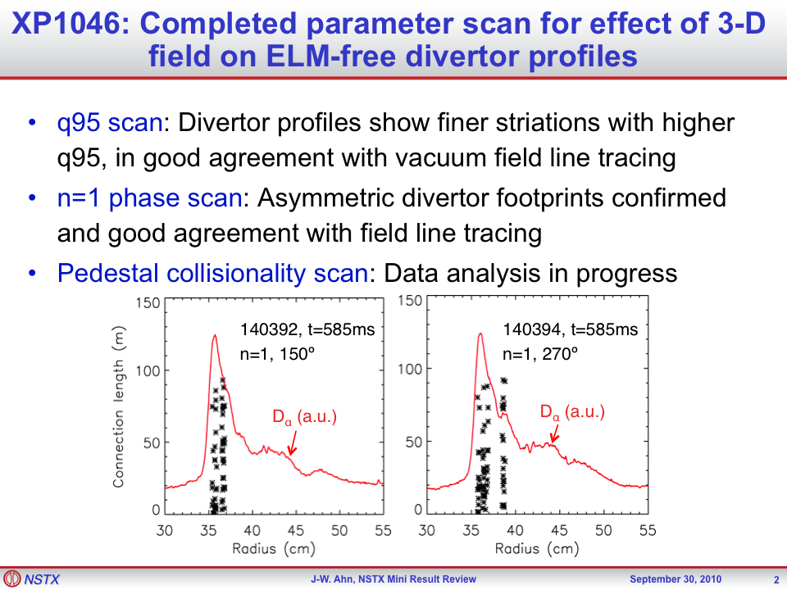
XP 1046 (J.-W. Ahn): Effect of externally applied 3D fields on divertor profiles

Slide 27
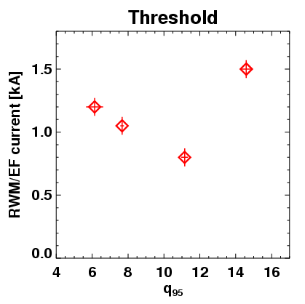
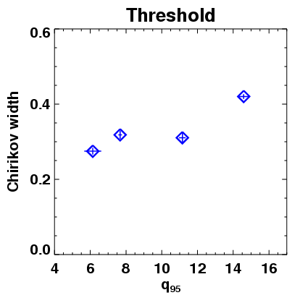
XP 1048 (J.-K. Park): RMP threshold of ELM modification at different q₉₅
Target plasmas : I_{P}=0.7~1.3MA, 3MW beam, 300mg LITER, high κ~2.5, high σ~0.8, q₉₅=6~15
For q₉₅=6~11 : Lower threshold for higher q₉₅,
stochastic layer (vacuum Chirikov > 1) width ~ 0.3
For q₉₅>12 : Higher threshold for higher q₉₅
Optimal q-window ~ 11 for ELM triggering?

Slide 28
XP (J. Boedo): SOL profiles almost identical, Pedestal shows differences as lithium rate changed
Data shows NO/LITTLE difference (aside small ELMs) in the SOL
Only difference seems to be where the pedestal rises near R-Rsep=0
In 140152 (233 mg li) the pedestal is~0.5-1 cm further in
In 140150 and 140151 (0 ms lithium) the rise is closer to the nominal R-Rsep=0
We conclude that the transport changes occur inside, or at, the LCFS.

Slide 29
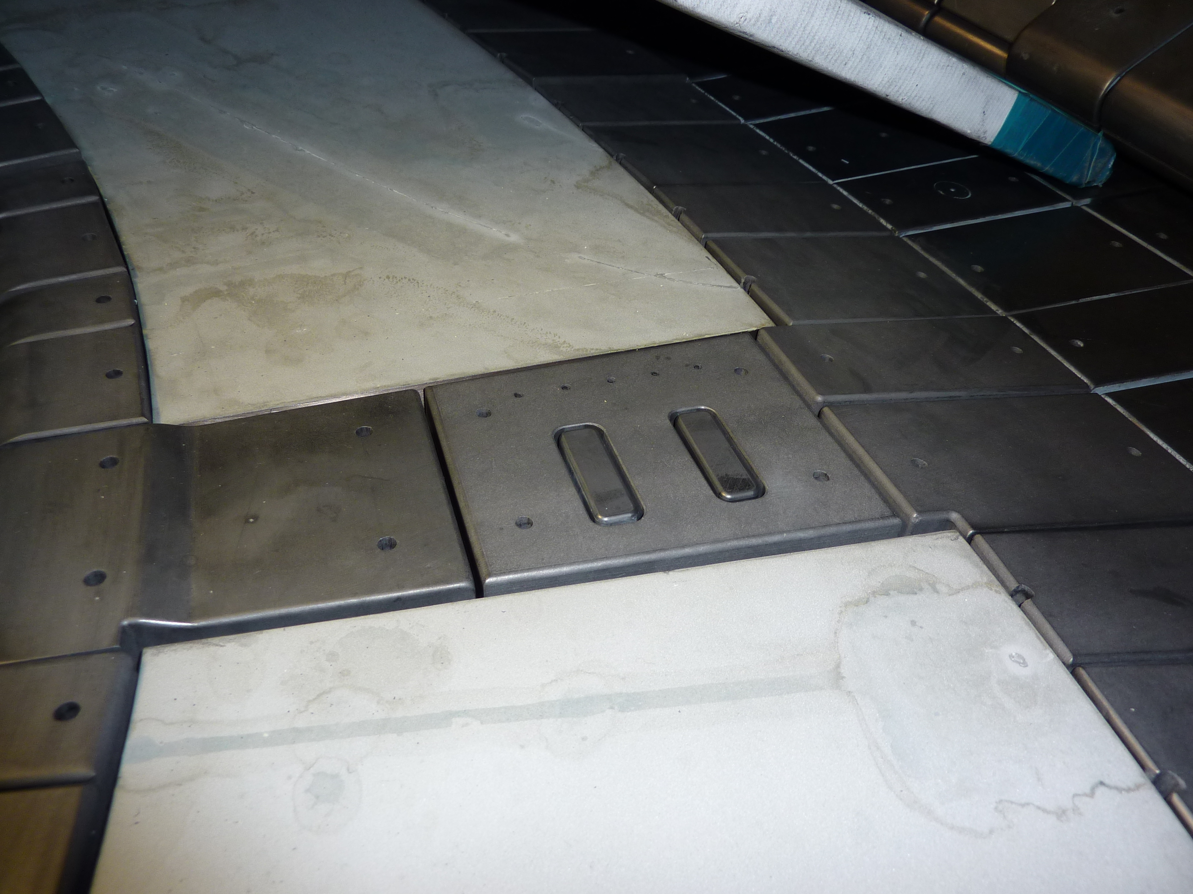
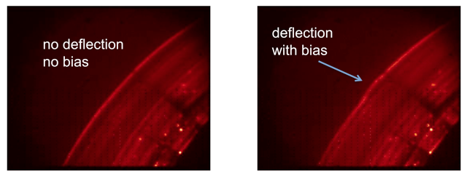
XP 1051 (Zweben): Effect of divertor electrode biasing on local SOL transport
Motivation: learn whether the divertor plate particle flux can be controlled by local electrode biasing
Goal of XP: bias electrodes in Bays E and K and measure effects on local probes and visible emission
Electrodes deflect plasma at divertor surface by ~ 1 cm
Bay E electrodes
without ±90 V bias
with ±90 V bias
Li I
Li I

Slide 30
  XP 1069, J. Canik, Watching ELMs disappear with optimum diagnosis of turbulence

Slide 31
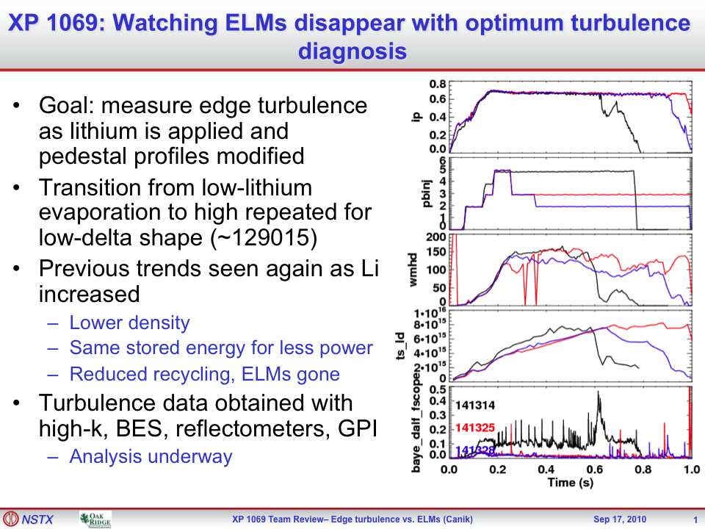
  XP 1069, J. Canik, Watching ELMs disappear with optimum diagnosis of turbulence

Slide 32
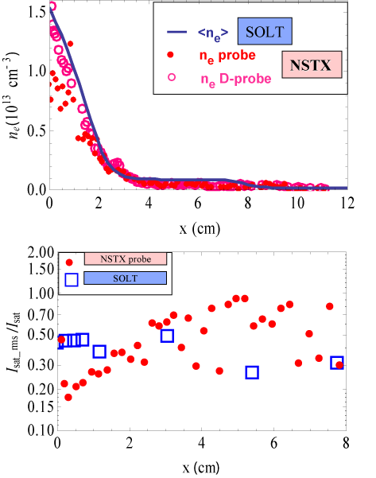
Modeling highlight: Lodestar SOLT Modeling for FY 2010 JRT Examines Role of Turbulence in SOL Width
SOLT: 2-D fluid turbulence at midplane.
Simulate several H-mode shots to investigate P_{in} & I_{p} scaling,
Compare with GPI, probe, IRTV.
See weak λ_{q} scaling with P_{in}; I_{p} scaling is weaker than observed.
New convective cell mechanism determines width in H-mode simulations.
[Myra et al, FY 2010 4Q Report]

