Slide 1
Steady-state snowflake divertor configurations were developed and characterized in XP 1045
Magnetic configuration development in FY2010
Two-coil SFD configuration with PCS SP control in medium-δ discharges
Much improved control of SPs and SFD, but periods of SFD for 100-200 ms
SFD with three coils (w/ reversed PF1B) from a medium-δ discharge
Steady-state SFD, however, all shots were ELMy, despite I_{p}=0.8-1 MA, P_{in}=3-6 MW
SFD with three coils (w/ reversed PF1B) from a from a high-δ discharge
Best steady-state SFD, no OSP sweeping through CHI gap
Fiducial like-performance, basis for integration with advanced scenarios
Developing X-divertor with reversed PF1B and high X-point
Characterization
Confirmed partial detachment of OSP
Confirmed heat flux reduction in SFD
Could not confirm impurity reduction due to ELMs

Slide 2
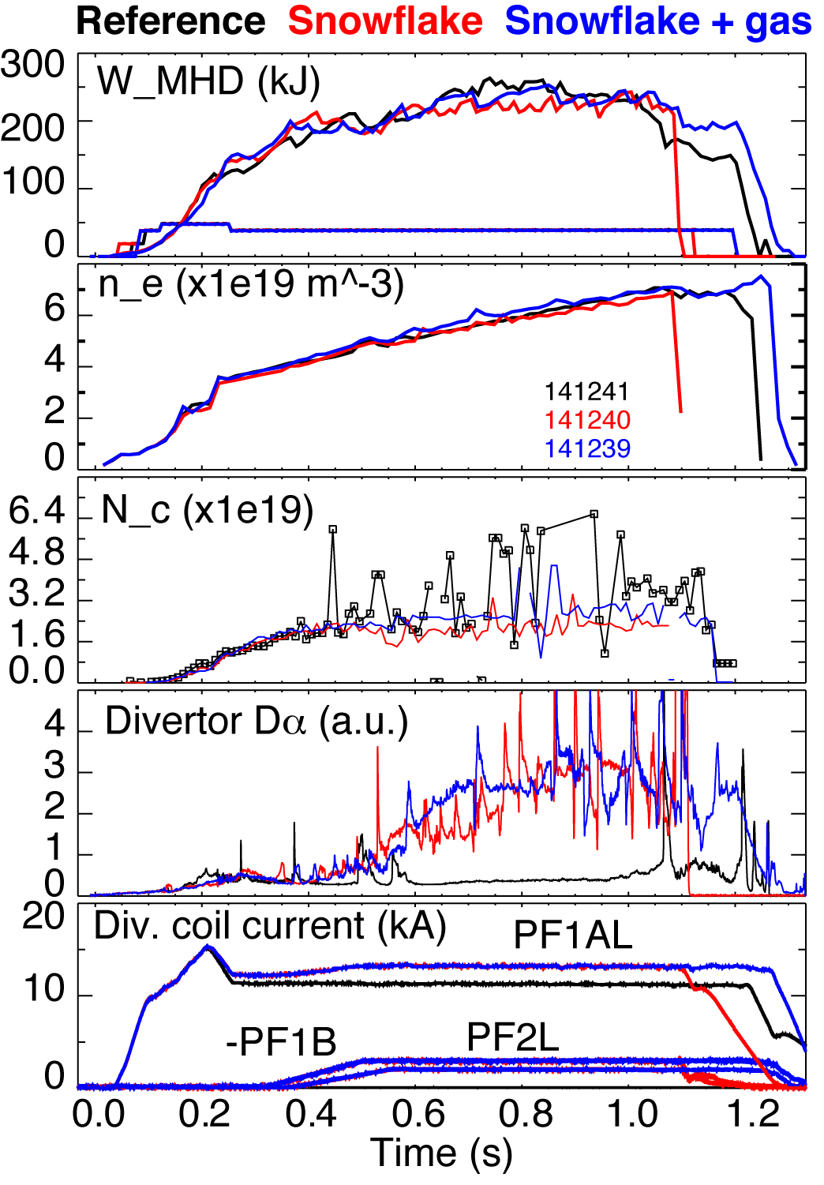
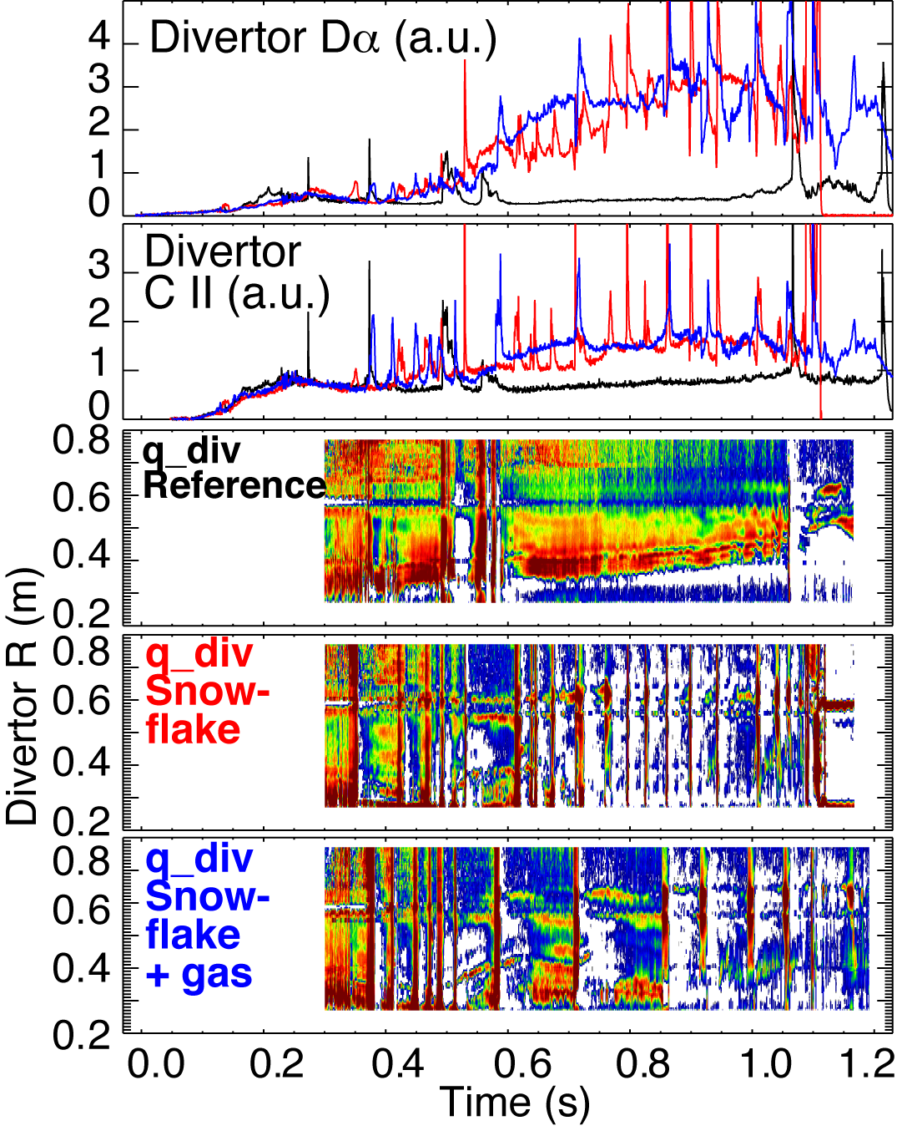
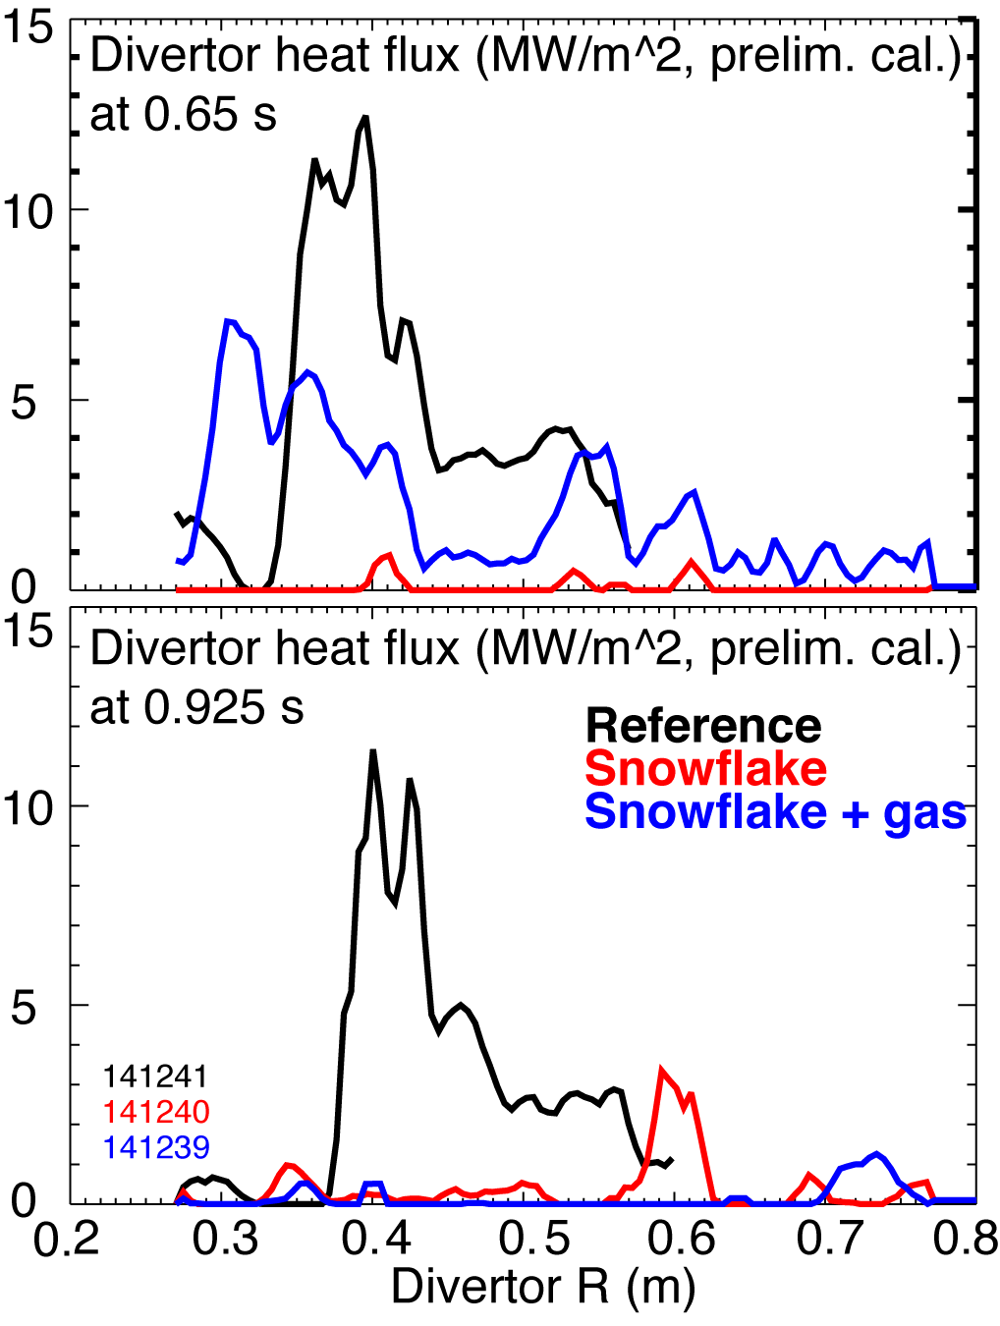
Snowflake divertor configuration nearly eliminated steady-state heat load on divertor PFCs
Heat load due to ELMs remained

