Slide 1
Vertical stability calculations
J. Menard, E. Kolemen, S. Gerhardt
NSTX-U Results Review
PPPL B318
September 21, 2016

Slide 2
Background
Recently published ST-FNSF / Pilot Plant paper required vertical stability projections
Used rigid plasma model, LRDFIT / ISOLVER structure model and code infrastructure
Benchmarked against NSTX natural VDE data with coil voltages frozen → plasma drift
Assessed FNSF drift recovery vs. vertical offset
Determined marginal ΔZ/a vs l_{i} and wall position

Slide 3
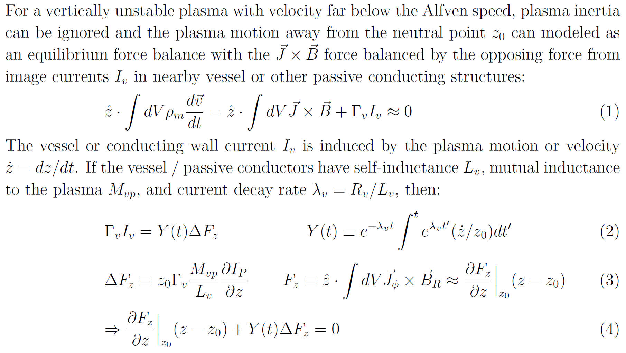
Rigid plasma vertical growth rate model

Slide 4
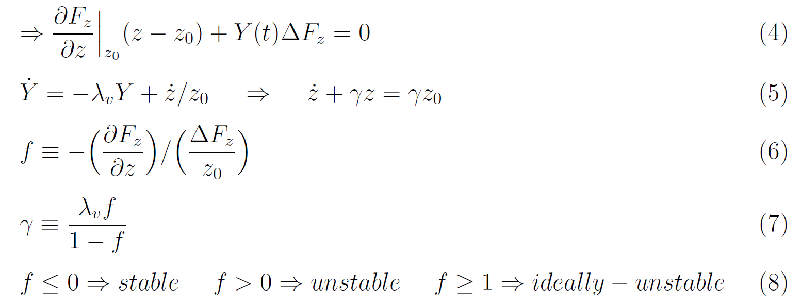
Growth rate dependence on stability index f

Slide 5
Two eigenmode growth rate model

Slide 6
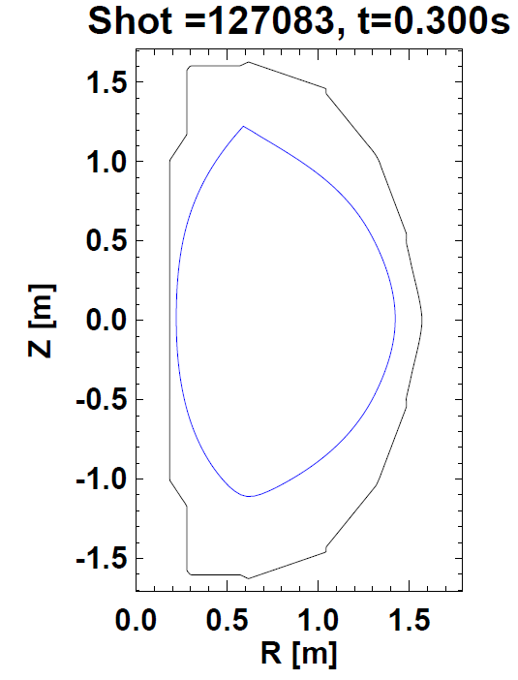
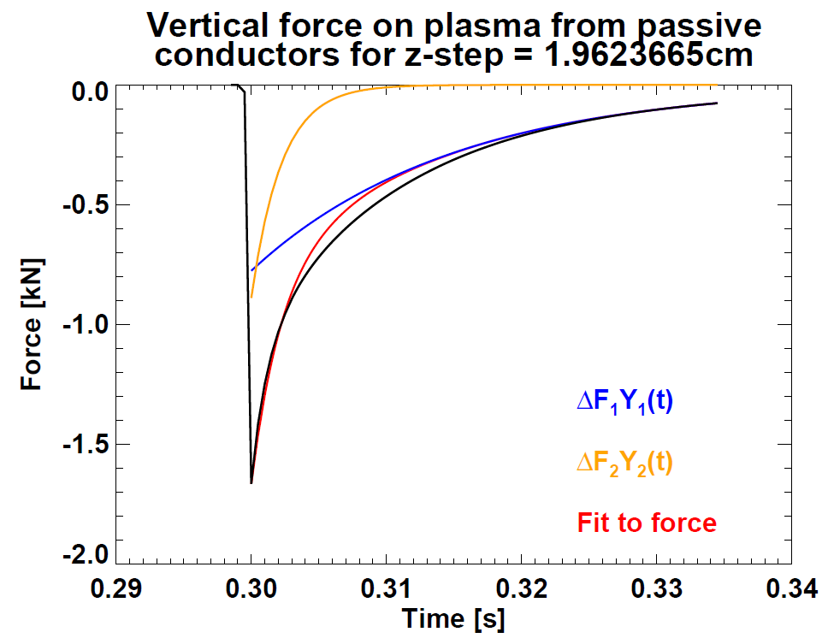
Passive current force in reduced model
λ₁ = 67s ⁻¹
λ₂ = 446s ⁻¹

Slide 7
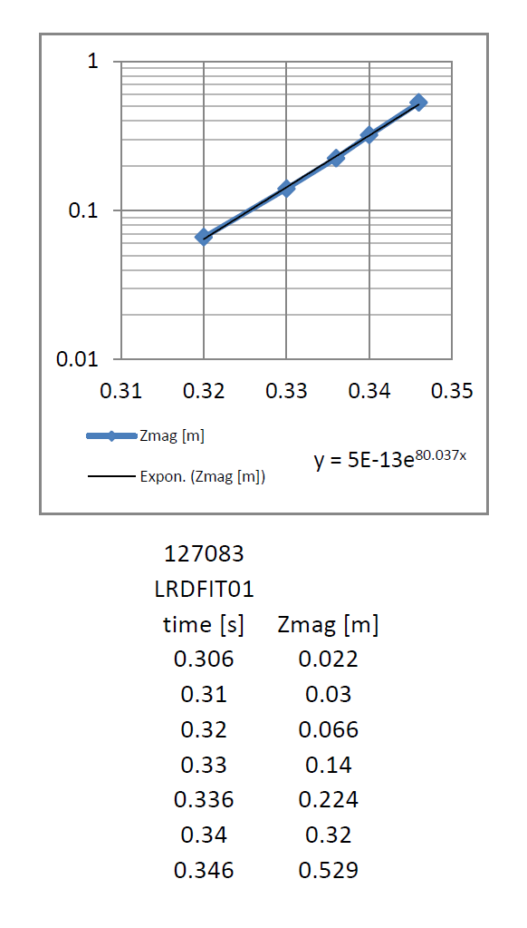
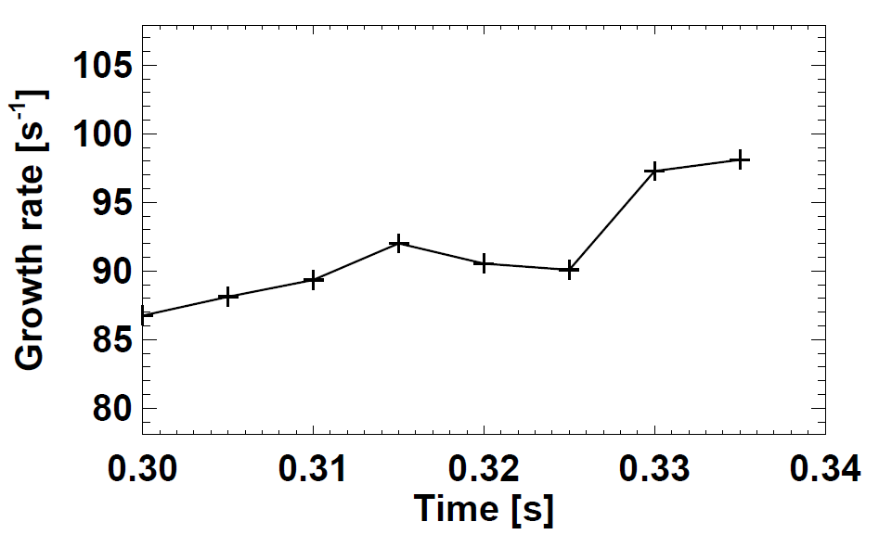
Simulated γ 10-15% higher than expt
Simulated growth rate
Measured
Future: Need to assess variation in predicted growth rate vs. # of conducting wall eigenvalues retained

Slide 8
Model for vertical position dynamics
Depends linearly on Δ z_{j+1}
➔ Solve for Δ z_{j+1}(Δ z_{j}, …)
Force from control coils
Assess ability to recover plasma from vertical offset:
Let plasma drift exponentially to vertical offset ΔZ
Apply step voltage to control coils
Determine if coil force can return plasma to mid-plane
Assess power vs. max offset ΔZ_{max} as metric for controllability

Slide 9
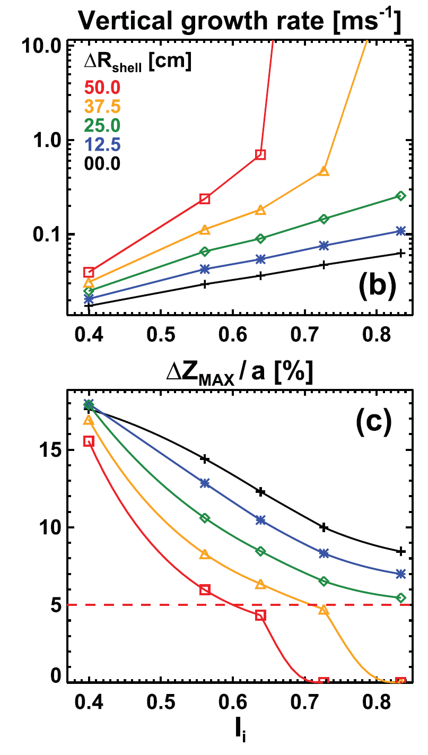
Example controllability calculation for FNSF
Acceptable control

Slide 10
Possible future work / ideas
Benchmark against NSTX-U (when we get some uncontrolled drift rate data)
Correlate NSTX / NSTX-U controllability vs. open loop growth rate and/or stability index
Complete / extend dynamical model for modular closed-loop control simulations
Optimize sensor positions, assess EFC/RWM coils for n=0
Implement n=0 stability calculator in PCS and/or TRANSP
Adjust elongation based on calculated marginal point?

