Slide 1
Status of 3-D Modeling of Advanced Divertor Configurations in NSTX-U
I. Waters¹, H. Frerichs¹, O. Schmitz¹, J-W Ahn², S. Kaye², G. Canal³, T.E. Evans³, R. Maingi², V. Soukhanovkii⁴-September 22, 2016
1- University of Wisconsin-Madison, Madison, WI
2- Princeton Plasma Physics Laboratory, Princeton, NJ
3- General Atomics, San Diego, CA
4- Lawrence Livermore National Laboratory, Livermore, CA

Slide 2
Introduction
Motivation
Numerical and Analytic Tools
  EMC3-EIRENE
  FLARE
  Multi-Reservoir Particle Balance
Heat Flux Survey
Particle Balance Analysis
Neutral Fueling
Summary
Next Steps

Slide 3
Motivation
Damaging ELMs present a major problem in future tokamaks
  Resonant Magnetic Perturbations (RMPs) one possible mitigation strategy
Steady State heat loads also threaten divertor lifetimes
  Snowflake and X-Divertors both seek to address this issue
How do they work together and how does that impact fueling and exhaust?

Slide 4
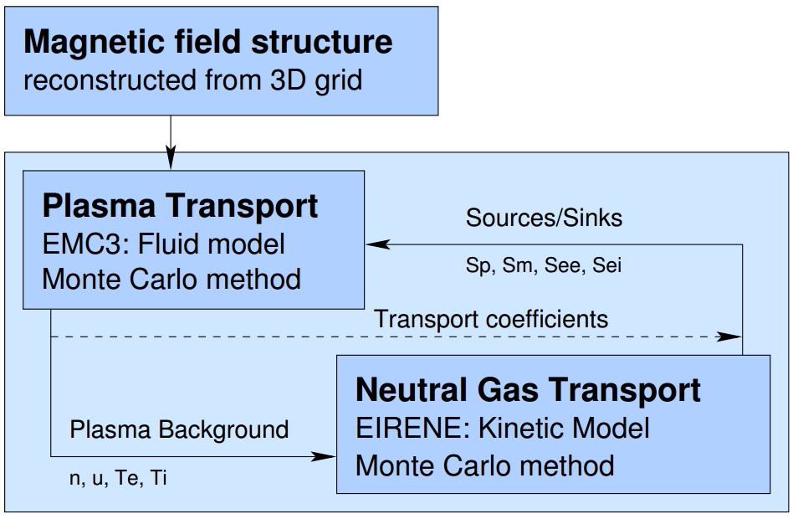
Numerical and Analytic Tools
EMC3-EIRENE
  Coupled 3D plasma fluid and kinetic neutral transport code
  Enhanced set of post processing tools developed-- specifically a Zone Resolved Particle Balance
FLARE
  Field Line Analysis and Reconstruction Environment
  Grid generator for EMC3-EIRENE
  Magnetic analysis toolbox

Slide 5
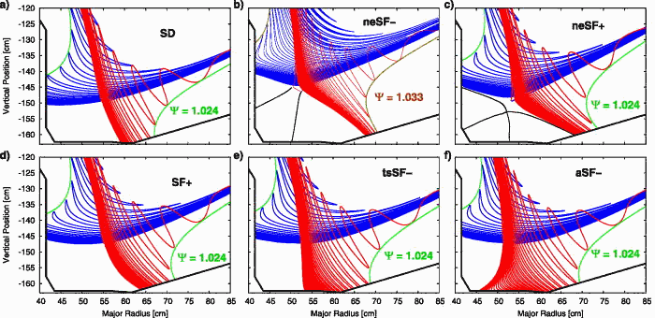
First Systematic Assessment of Major Advanced Divertor Configurations at NSTX-U with EMC3-EIRENE
H. Frerichs et al Phys. Plasmas 23, 062517 (2016); http://dx.doi.org/10.1063/1.4954816

Slide 6
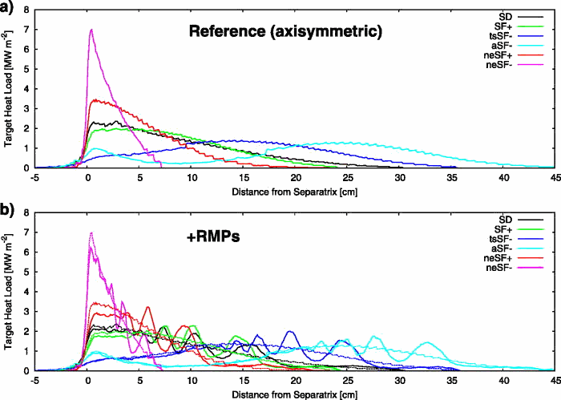
Peaked heat loads in Near Exact Snowflake, lowest heat loads in X-Divertor like configurations.
RMP fields don’t impact toroidal average.
General Snowflake
Near Exact Snowflake
X-Divertor Like
H. Frerichs et al Phys. Plasmas 23, 062517 (2016); http://dx.doi.org/10.1063/1.4954816

Slide 7
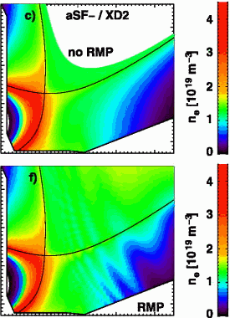

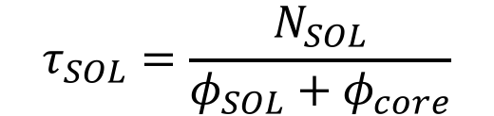
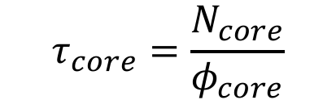


Numerical and Analytic Tools
Global particle balance analysis
Multi-Reservoir particle balance analysis
$$\frac{dN}{dt}=−\frac{N}{τ}+ φ_{REC}+φ_{Ext Fuel}−φ_{Ext Pump}$$
CORE:
$$\frac{dN_{core}}{dt}=−\frac{N_{core}}{τ_{core}}+φ_{core}$$
$$τ_{core}=\frac{N_{core}}{φ_{core}}$$
SOL:
$$\frac{dN_{SOL}}{dt}=−\frac{N_{SOL}}{τ_{SOL}}+φ_{SOL}+\frac{N_{core}}{τ_{core}}$$
$$τ_{SOL}=\frac{N_{SOL}}{φ_{SOL}+φ_{core}}$$
FUELING:
$$φ_{REC}=φ_{SOL}+φ_{core}$$

Slide 8
Reduced Global Particle Confinement in Modeling Domain with Increasing RMP Strength in Tilted Symmetric Snowflake Minus

Slide 9
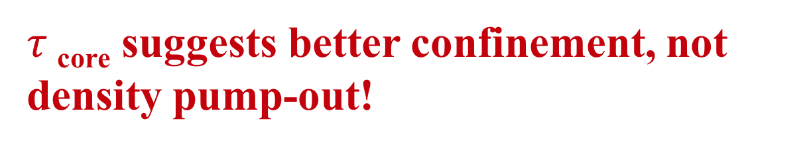
$τ$_{core} suggests better confinement, not density pump-out!

Slide 10
Lower Fueling Fraction for 3kA Case Explains Density Pump-Out Without Lower Core Confinement

Slide 11
Summary
First systematic study of advanced divertor configurations in EMC3-EIRENE
  Phys. Plasmas 23, 062517 (2016); http://dx.doi.org/10.1063/1.4954816
  Provides database for exhaust studies
Evidence of global pump-out with increasing RMP coil current
  Modeled RMP currents in excess of what was used on NSTX by factor of three
Global pump-out does not lead to decreased core-confinement => neutral fueling effect does

Slide 12
Next Steps
Better experimentally constrain EMC3-EIRENE modeling
  Lithium wall recycling
  Core fueling
Investigate role of plasma response and RMP strength
  Informed by M3D-C1 calculations of plasma response [by Dr. Canal]
  Comparative study with MAST
    MAST shows pump-out, but only at much higher RMP currents and with favorable plasma response

