Slide 1
NSTX-U Results Review, September 21-22, 2016
Nonlinear simulations of CAEs
Elena Belova
Completed nonlinear simulations of CAEs, including scaling of CAE-to-KAW energy channeling with the beam power, and saturation mechanism.
A scan of the beam ion distribution parameter have been performed, which resulted in several new findings (J. Lestz):
dependence of number of unstable CAE/GAEs on v₀/v_{A}
comparison with experimental GAE/CAE database
dependence on most unstable ω on beam parameters
unstable co-GAEs
Calculated NSTX-U equilibrium using HYM GS solver coupled with FREE_FIX code (Luca G.) for a fixed plasma shape.
Performed initial simulations of GAEs in NSTX-U: n=7-12 (E. Fredrickson GAEs stabilization experiments).

Slide 2
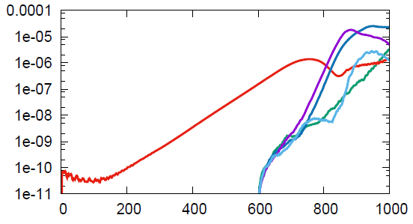
2
Nonlinear CAE simulations
n=4 CAE ⎯⎯
n=5 GAE ⎯⎯
n=6 GAE ⎯⎯
n=7 GAE ⎯⎯
n=8 CAE ⎯⎯
Fully nonlinear simulations including 32 toroidal harmonics show saturation of the n=4 CAE mode.
Initial conditions for nonlinear run were obtained by running the n=4 linearized simulations (from t=0-550) to obtain a converged linear mode structure of CAE.
Nonlinear run starts at t=550, and also shows growth of n=5,6,7 GAEs and n=8 CAE modes.
|dB_{n} |²
(au)
tω_{ci}
Time evolution of amplitudes of different toroidal harmonics from fully nonlinear simulations for NSTX shot 141398.

Slide 3
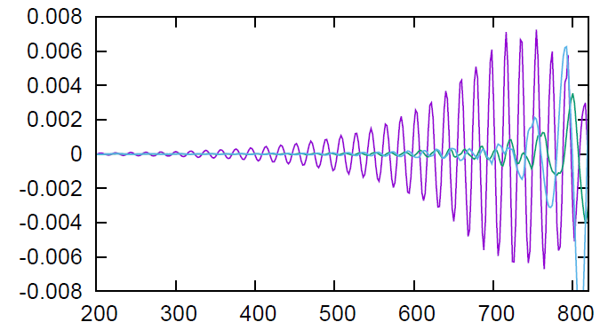
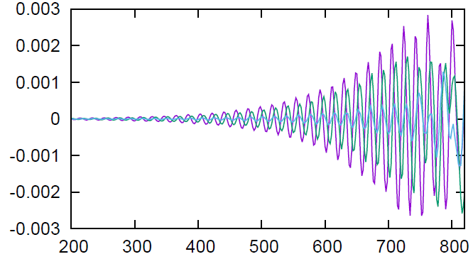
3
Nonlinear simulations show CAE saturation amplitudes higher but comparable to experimentally observed
δB||
δB_{R}
δB┴
In the core, the compressional perturbation is 3-4 times larger than the shear perturbation.
Mixed compressional/shear polarization near the plasma edge on LFS .
δB/B₀
core
δB||
δB_{R}
δB┴
δB/B₀
edge
tω_{ci}
Time evolution of dB|| and two components of δB⊥ in the core, and close to the plasma edge on LFS.
Saturation amplitude of the n=4 CAE: δB||/B₀= 6.6×10⁻³.
Measured plasma displacement |ξ|= 0.1-0.4 mm [Crocker,2013] corresponds to δB/B₀= (0.9-3.4)×10⁻³ (based on HYM-calculated mode structure for n=4 CAE).
Rate of change of the beam ion energy, calculated as ∫ (J_{beam}E) d³x, is ~1.5MW for calculated the n=4 CAE saturation amplitude δB||/B₀= 6.6×10⁻³.

Slide 4
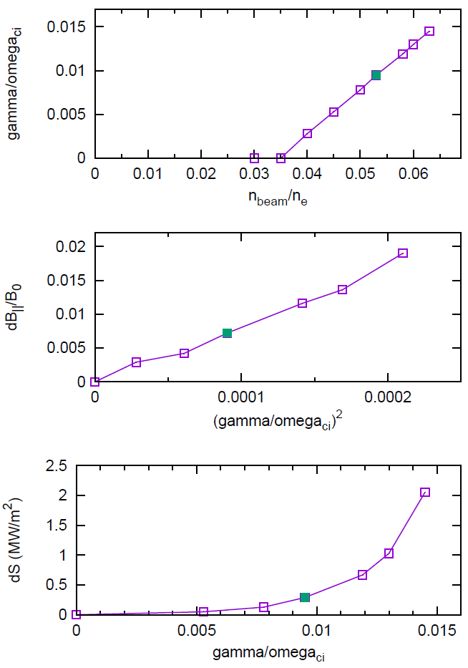
CAE-to-KAW energy channeling shows strong scaling with the beam power
(a) Growth rate of the n=4 CAE vs beam ion density (b) Saturation amplitude vs γ²
(c) Calculated change of the energy flux at the resonance location vs γ
γ/ω_{ci}
From density threshold – damping rate due to CAE/KAW coupling is large γ_{damp}= 0.66 γ_{dr.}
Threshold value of the beam power needed for the excitation of the n=4 CAE can be estimated as P~4MW.
Absorption rate shows a very strong scaling with growth rate: ΔS ~ (γ/ω_{ci})⁵, implying that the energy loss at the resonance scales as a fifth power of the beam ion density (beam power).
δB||/B₀
(γ/ω_{ci})²
ΔS
(MW/m²)
γ/ω_{ci}

Slide 5
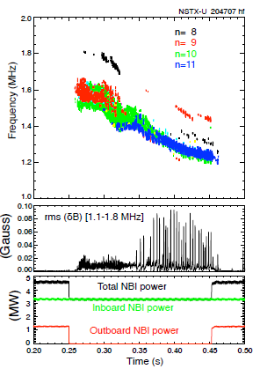
NSTX-U simulations: GAE stabilization
Off-axis neutral beam injection reliably and strongly suppresses GAEs
HYM #204707 t=0.44
HYM #204707 t=0.47
γ/ω_{ci}
t=0.44s
|dB_{n} |²
t=0.47s
tω_{ci}
ω/ω_{ci}
Time evolution of magnetic energy of n=10 GAE from HYM simulations for t=0.44s (red), and t=0.47s (blue).
HYM shows suppression of n=10 counter-GAE by additional beam injection.
n
(a) Spectrogram on magnetic fluctuations
(b) rms magnetic fluctuations;
(c) injected beam power.
(a) Growth rates and (b) frequencies of unstable counter-GAEs from HYM simulations for t=0.44s. Blue line is Doppler-shift corrected frequencies, points – experimental values.

Slide 6
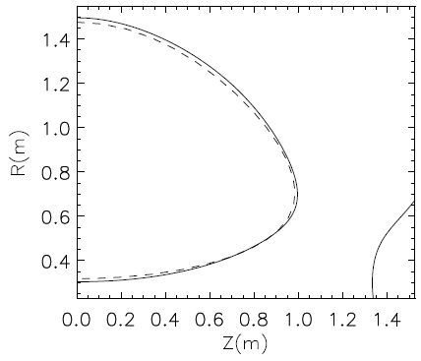
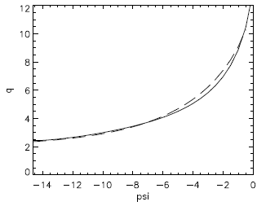
HYM plans
Code development
Improve the fast ion distribution function model.
Improvement of numerical model (equilibrium solver, parallel scaling).
Include thermal ions kinetic effects (Hall, FLR).
Include the effects of bulk plasma rotation.
⎯⎯ HYM
- - - - TRANSP
Physics
Understanding conditions for preferential excitation of GAEs and CAEs.
Continue NSTX-U simulations – GAEs stabilization.
Comparison of the relative importance of the energy channeling vs anomalous electron transport mechanisms.
Comparison with experimental results including mode structure, saturation amplitudes and etc for several shots.
q(ψ)
ψ
Plasma shape and q-profile for NSTX-U shot 203262A03 t=0.220 from TRANSP and HYM GS solver + FREE_FIX.

