Slide 1


Simulated heat transport in NSTX via CAE- & GAE-induced electron orbit modification
N. A. Crocker (UCLA), K. Tritz (JHU), R. B. White, E. D. Fredrickson, N. N. Gorelenkov (PPPL)
NSTX-U Results Review 2016
Princeton Plasma Physics Laboratory
Sep. 21-22, 2016

Slide 2
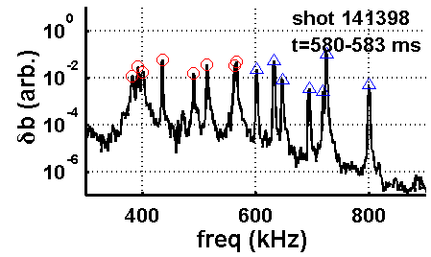
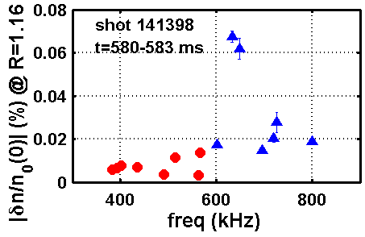
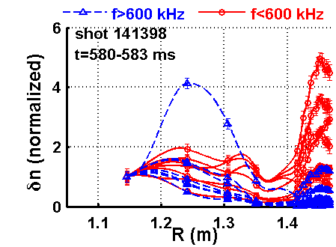
Structure and amplitude of CAE & GAE δn measured in high performance plasma
Observed modes identified as:
  GAEs: f < ~ 600 kHz,
  n = -6 – -8
  CAEs: f > ~ 600 kHz,
  n = -3 – -5
CAEs have larger δn in core
GAEs have larger δn in edge
CAEs
GAEs

Slide 3
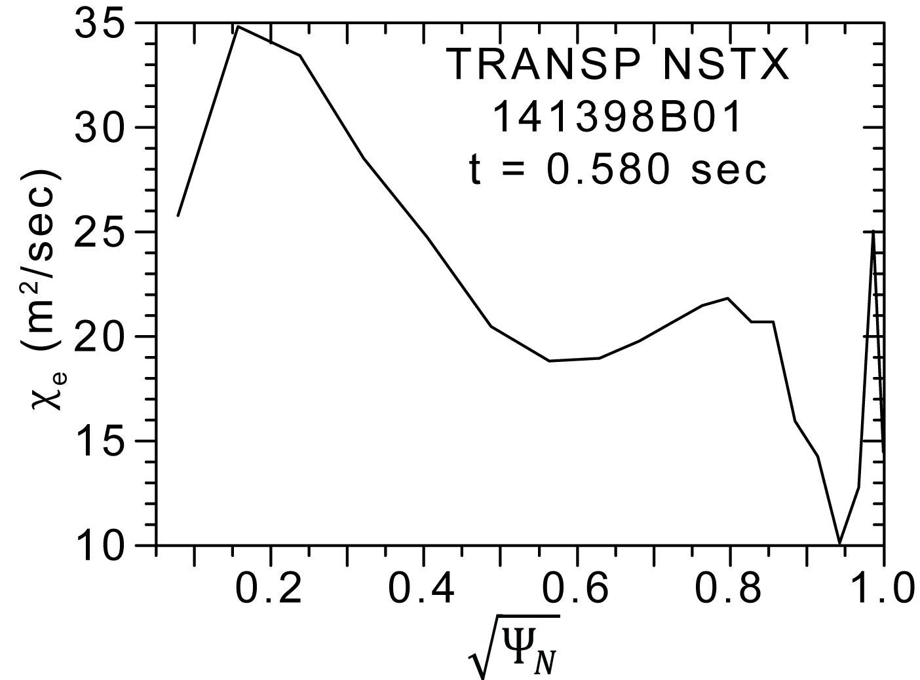
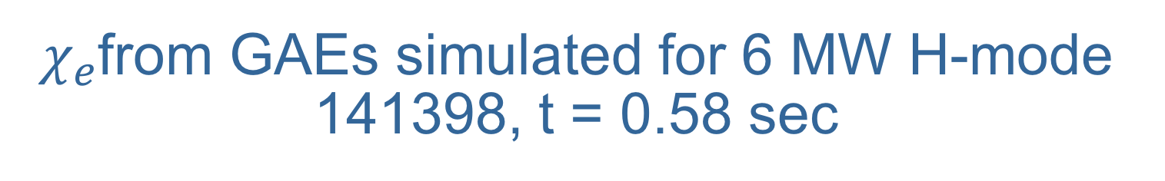
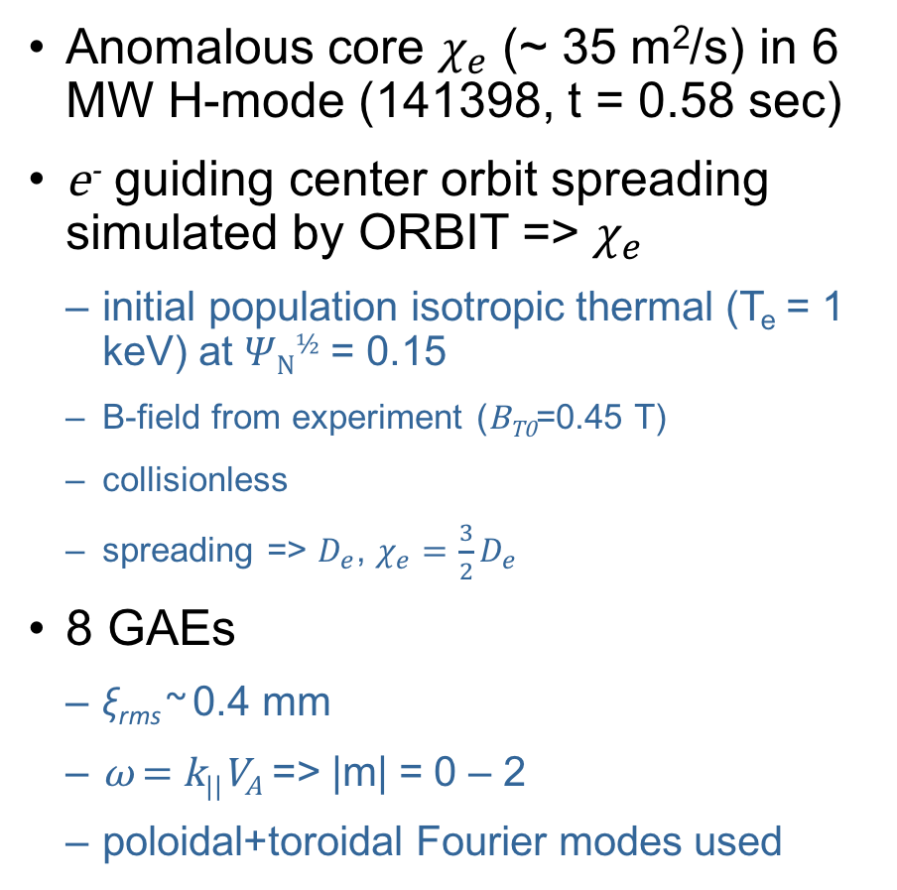
$χ_{e}$from GAEs simulated for 6 MW H-mode 141398, t = 0.58 sec
Anomalous core $χ_{e}$ (~ 35 m²/s) in 6 MW H-mode (141398, t = 0.58 sec)
e⁻ guiding center orbit spreading simulated by ORBIT => $χ_{e}$
  initial population isotropic thermal (T_{e} = 1 keV) at 𝛹_{N}^{½} = 0.15
  B-field from experiment (B_{T0}=0.45 T)
  collisionless
  spreading => $D_{e}$, $χ_{e}=\frac{3}{2}D_{e}$
8 GAEs
  ξ_{rms} ~ 0.4 mm
  ω = k||V_{A} => |m| = 0 – 2
  poloidal+toroidal Fourier modes used
simulation
location
f (kHz) | n | m | ξ (mm)
383 | -8 | -2 | 0.1
393 | -7 | -1 | 0.11
401 | -8 | -2 | 0.13
436 | -7 | 0 | 0.12
491 | -8 | 0 | 0.06
515 | -7 | 1 | 0.21
563 | -6 | 2 | 0.05
567 | -8 | 1 | 0.25

Slide 4
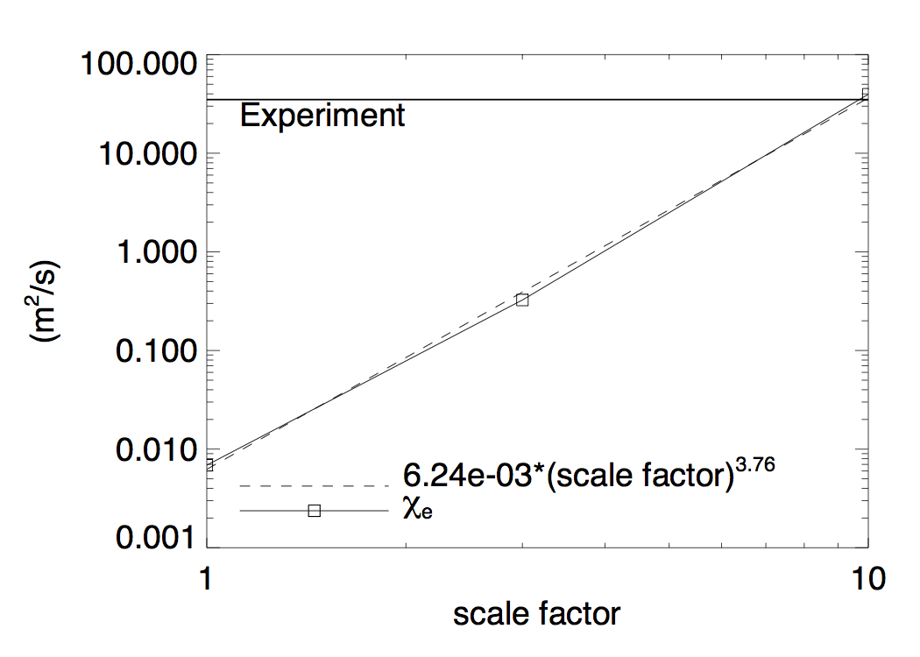
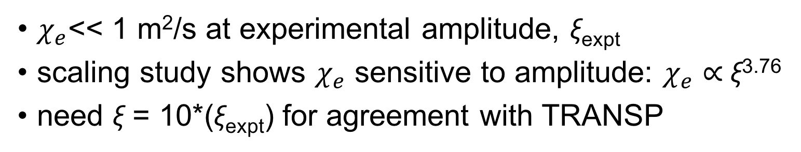
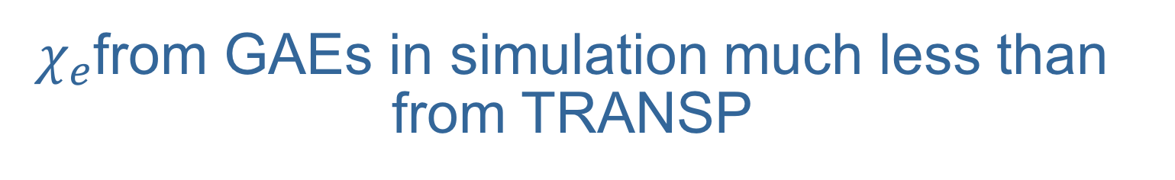
$χ_{e}$from GAEs in simulation much less than from TRANSP
$χ_{e}$<< 1 m²/s at experimental amplitude, ξ_{expt}
scaling study shows $χ_{e}$ sensitive to amplitude: $χ_{e}$ ∝ ξ^{3.76}
need ξ = 10*(ξ_{expt}) for agreement with TRANSP

Slide 5
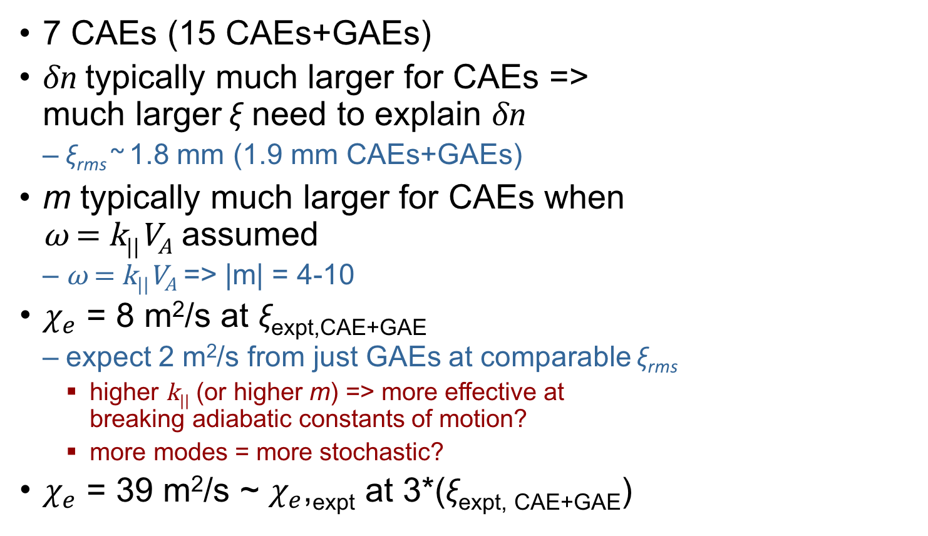

Inclusion of CAEs as shear modes increases simulated $χ_{e}$, but still not enough
7 CAEs (15 CAEs+GAEs)
δn typically much larger for CAEs =>
much larger ξ need to explain δn
  ξ_{rms} ~ 1.8 mm (1.9 mm CAEs+GAEs)
m typically much larger for CAEs when
ω = k||V_{A} assumed
  ω = k||V_{A} => |m| = 4-10
$χ_{e}$ = 8 m²/s at ξ_{expt,CAE+GAE}
  expect 2 m²/s from just GAEs at comparable ξ_{rms}
    higher k|| (or higher m) => more effective at
    breaking adiabatic constants of motion?
    more modes = more stochastic?
$χ_{e}$ = 39 m²/s ~ $χ_{e}$,_{expt} at 3*(ξ_{expt, CAE+GAE})
f (kHz) | n | m | ξ (mm)
602 | -5 | 4 | 0.31
633 | -4 | 5 | 1.23
648 | -1 | 8 | 1.05
695 | -5 | 5 | 0.26
720 | 0 | 10 | 0.36
726 | -3 | 7 | 0.57
800 | -4 | 7 | 0.32

Slide 6
Future Work
Implement more physically realistic poloidal strucuture
CAEs need to be included as compressional modes
  compressional modes not fully implemented
  ORBIT is currently being modified
Simulation with eigenmodes from codes
  HYM, CAE3B, CAE

Slide 7
UCLA reflectometers operational on NSTX-U
(a)
Example: phase fluctuations
(∝ δn), 42.5 GHz reflectometer, 204636
  (a) 0 – 3 MHz
    GAEs at ~ 1.8 MHz
  (b) 0 – 200 kHz.
    TAEs and other MHD
(b)

