Slide 1


Comparison of compressional Alfvén eigenmodes in NSTX with simulation using the CAE3B eigenmode solver
Nicholas Geiser, Fordham University
N. A. Crocker (UCLA), H. Smith (MP-IPP, Greifswald),
E. D. Fredrickson (PPPL)
NSTX-U Results Review 2016
Princeton Plasma Physics Laboratory
Sep. 21-22, 2016

Slide 2
Understanding energy transport requires predictive capability for CAEs
Compressional Alfvén eigenmodes (CAEs) may contribute to energy transport
  Stochastization of resonant electron orbits?
  Electromagnetic channeling of beam energy to plasma edge?
Frequency and toroidal mode number of experimentally observed CAEs can be measured
CAE3B eigenmode solver numerically simulates CAEs in experimental plasmas
CAE3B simulations can be compared with observed modes in an NSTX discharge to verify the physics of CAE3B and further our understanding of CAEs

Slide 3
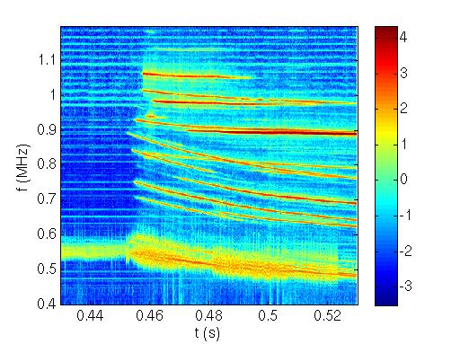
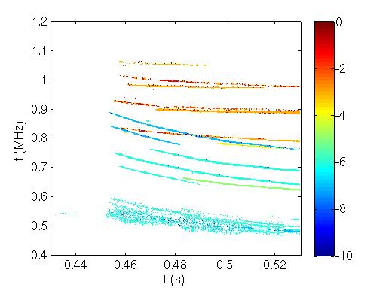


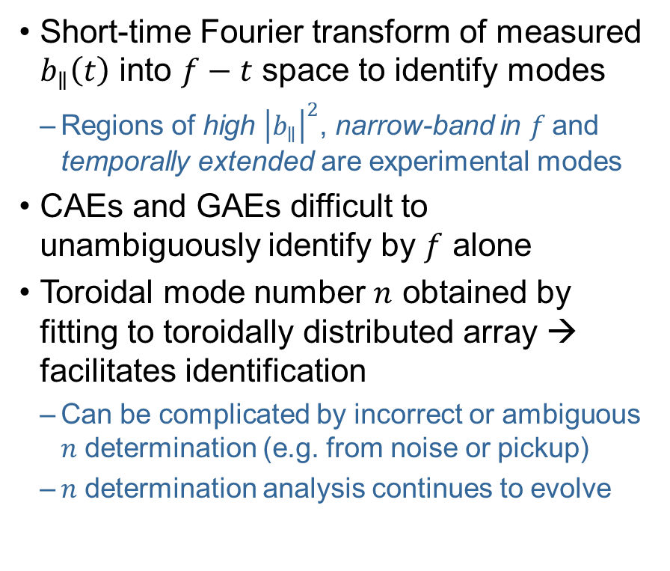
Can identify CAEs and GAEs in the NSTX with an array of edge magnetic sensing coils
Observed modes in
NSTX shot 130335
Short-time Fourier transform of measured $b_{∥}\left(t\right)$ into $f−t$ space to identify modes
  Regions of high ${\left|b_{∥}\right|}^{2}$, narrow-band in $f$and temporally extended are experimental modes
CAEs and GAEs difficult to unambiguously identify by $f$ alone
Toroidal mode number $n$ obtained by fitting to toroidally distributed array → facilitates identification
  Can be complicated by incorrect or ambiguous $n$ determination (e.g. from noise or pickup)
  $n$ determination analysis continues to evolve
$$\log_{10}{{\left|b_{∥}\right|}^{2}}$$
$$n$$

Slide 4
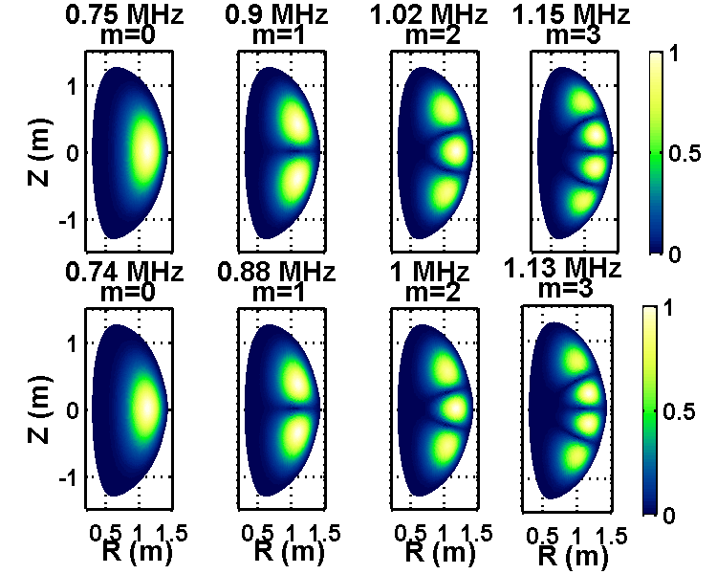

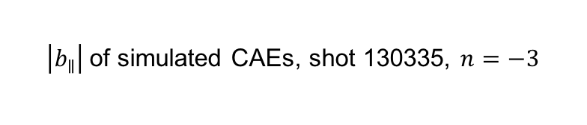
Eigenmode solver CAE3B can be used to simulate CAEs in an NSTX plasma
Simulated CAEs can be compared to observed modes in the NSTX to validate the physics of CAE3B
CAE3B assumes Hall MHD with
simplified physics
  Hall MHD keeps ion inertia effect in
  Ohm’s law: $\frac{ω}{ω_{ci}}≲1$
  Simplified boundary at edge of
  plasma: $b_{∥}=0$
  Removes coupling to shear Alfvén
  waves: $\frac{v_{A^{2}}}{ω^{2}B^{2}}{\left(\text{B}∙∇\right)}^{2}≪\text{1}$
Only compare subsets of observed
and simulated modes
  Observed modes include CAEs and GAEs
  CAE3B produces only CAEs and spurious solutions
  CAE3B doesn’t predict which CAEs are unstable
$\left|b_{∥}\right|$of simulated CAEs, shot 130335, $n=−3$
Notes:
Hall MHD keeps ion inertia effect in Ohm’s law; ion inertia important for wave near ion cyclotron frequency, $\frac{ω}{ω_{ci}}≲1$
Ideal MHD: E + V x B = 0, where V is velocity of fluid (V≈V_{i}, where V_{e} = ion velocity)
Hall MHD: E + V x B = J x B/(en) => E + V_{e} x B = 0, where J = current density, n = plasma density, e = electron charge and V_{e} = electron velocity. Inclusion of “Hall term” [J x B/(en)] important when $\frac{ω}{ω_{ci}}≲1$ because ion fluid no longer obeys E + V_{i} x B = 0, but electrons fluid still obeys E + V_{e} x B = 0. At low pressure ($β=\frac{p}{B^{2}/{μ_{0}}_{ }}≪1$, which is reasonable in NSTX-U), if $\frac{ω}{ω_{ci}}≪1$, then V x B >> J x B/(en), so Hall term is negligible.

Slide 5
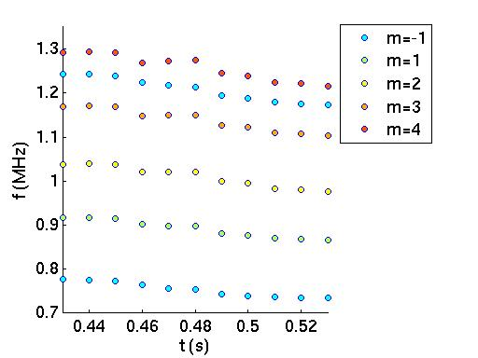
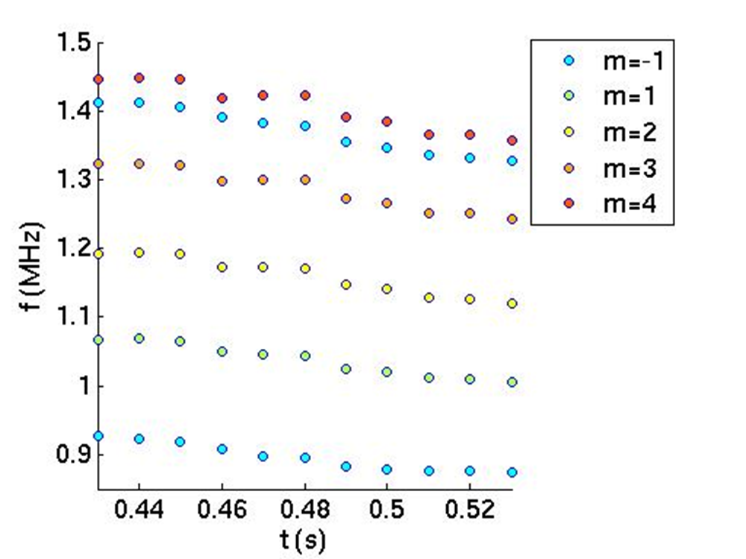
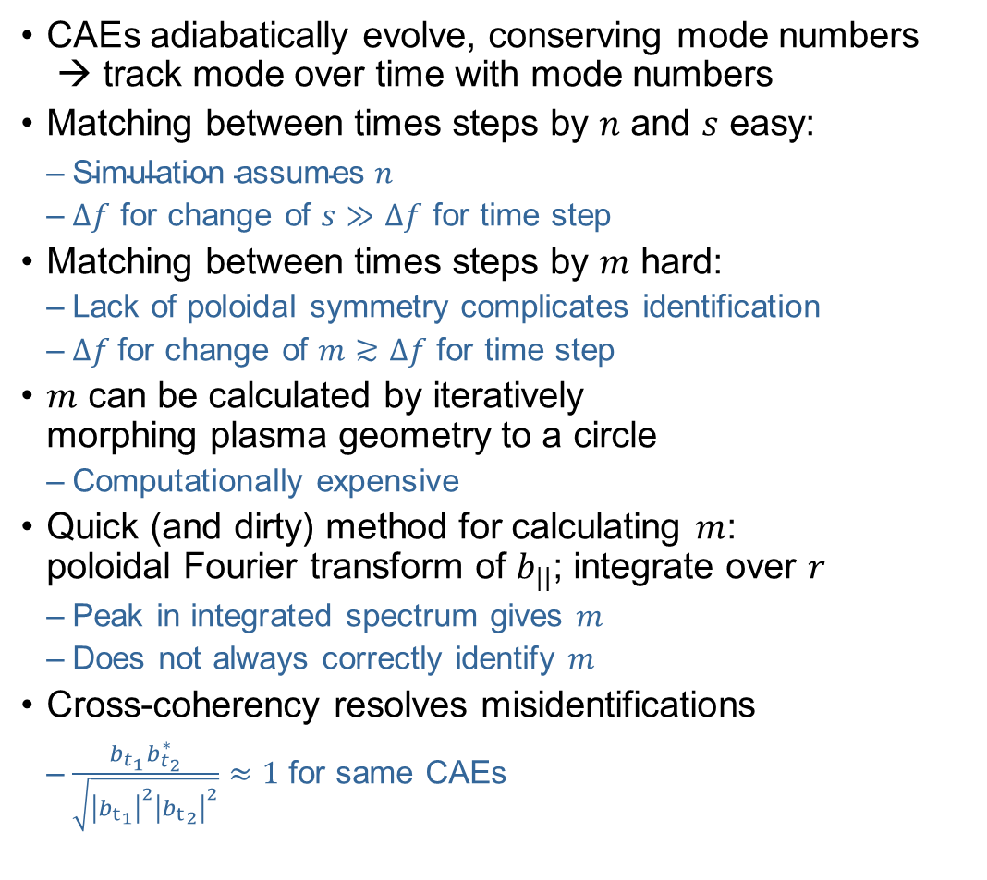
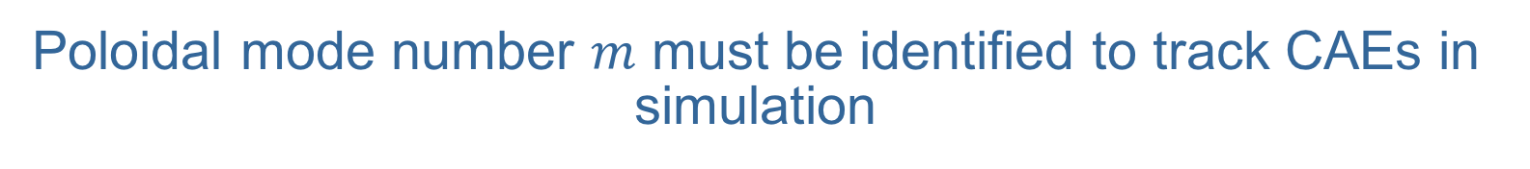


Poloidal mode number $m$ must be identified to track CAEs in simulation
CAEs adiabatically evolve, conserving mode numbers
→ track mode over time with mode numbers
Matching between times steps by $n$ and $s$ easy:
  $\text{S}\text{imulation} \text{assumes} n$
  $Δf$ for change of $s$ $≫$ $Δf$ for time step
Matching between times steps by $m$ hard:
  Lack of poloidal symmetry complicates identification
  $Δf$for change of $m$ $≳Δf$ for time step
$m$ can be calculated by iteratively
morphing plasma geometry to a circle
  Computationally expensive
Quick (and dirty) method for calculating $m$:
poloidal Fourier transform of $b_{||}$; integrate over $r$
  Peak in integrated spectrum gives $m$
  Does not always correctly identify $m$
Cross-coherency resolves misidentifications
  $\frac{b_{t_{1}}b_{t_{2}}^{∗}}{\sqrt{{\left|{b_{t}}_{1}\right|}^{2}{\left|{b_{t}}_{2}\right|}^{2}}}≈1$ for same CAEs
$$n=−3$$
$$n=−6$$

Slide 6
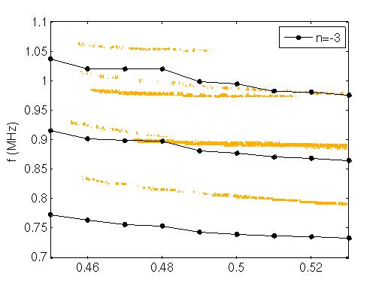
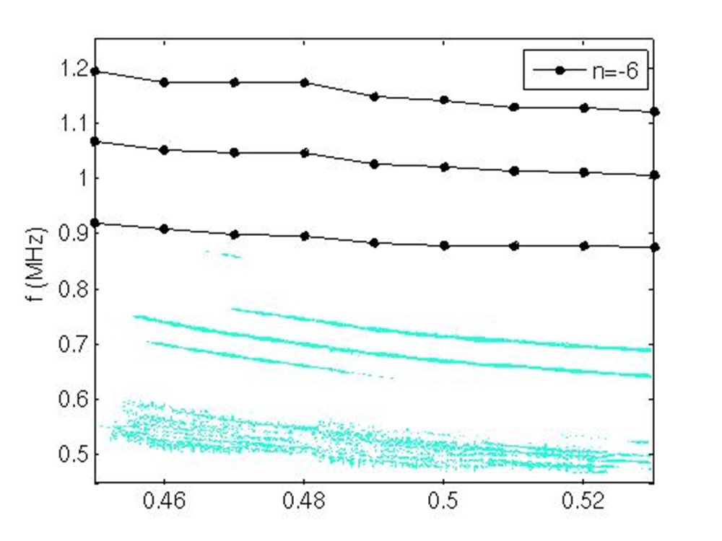
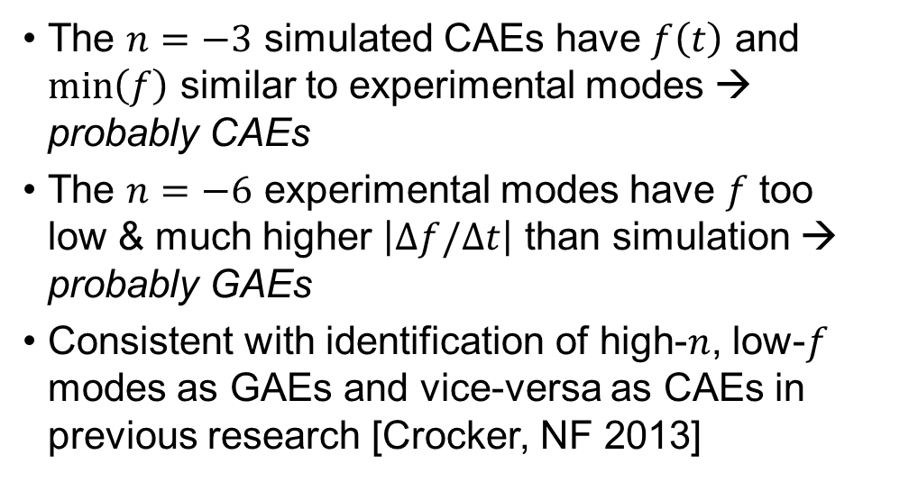
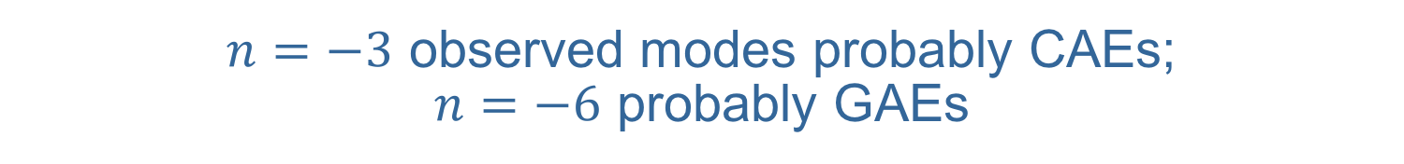
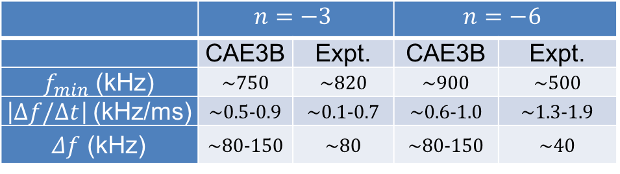
$n=−3$ observed modes probably CAEs;
$n=−6$ probably GAEs
The $n=−3$ simulated CAEs have $f\left(t\right)$ and $\min\left(f\right)$ similar to experimental modes → probably CAEs
The $n=−6$ experimental modes have $f$ too
low & much higher $\left|Δf/Δt\right|$ than simulation → probably GAEs
Consistent with identification of high-$n$, low-$f$ modes as GAEs and vice-versa as CAEs in previous research [Crocker, NF 2013]
 | $$n=−3$$ |  | $$n=−6$$
 | CAE3B | Expt. | CAE3B | Expt.
$f_{min}$ (kHz) | ~750 | ~820 | ~900 | ~500
$\left|Δf/Δt\right|$ (kHz/ms) | ~0.5-0.9 | ~0.1-0.7 | ~0.6-1.0 | ~1.3-1.9
$Δf$ (kHz) | ~80-150 | ~80 | ~80-150 | ~40

Slide 7
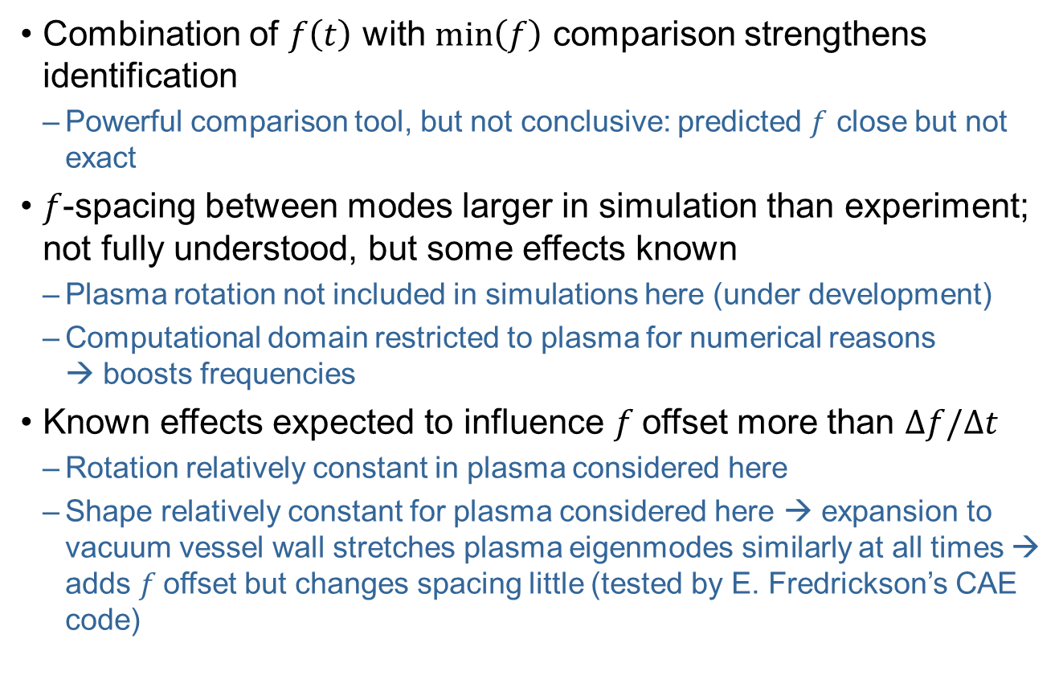
CAE3B enhances toolkit for distinguishing CAEs and GAEs in NSTX and NSTX-U plasmas
Combination of $f\left(t\right)$ with $\min\left(f\right)$ comparison strengthens identification
  Powerful comparison tool, but not conclusive: predicted $f$ close but not exact
$f$-spacing between modes larger in simulation than experiment; not fully understood, but some effects known
  Plasma rotation not included in simulations here (under development)
  Computational domain restricted to plasma for numerical reasons
  → boosts frequencies
Known effects expected to influence $f$offset more than $Δf/Δt$
  Rotation relatively constant in plasma considered here
  Shape relatively constant for plasma considered here → expansion to vacuum vessel wall stretches plasma eigenmodes similarly at all times → adds $f$offset but changes spacing little (tested by E. Fredrickson’s CAE code)

Slide 8
Acknowledgements
Supported by US DOE Contracts DE­SC0011810 and DE­AC02­09CH11466.
Supported by NSF Research Experience Undergraduates program at UCLA (Grant No. REU PHY-1460055).

