Slide 1
M3D-C¹-K
Joshua Breslau
NSTX-U Results Review
September 22, 2016

Slide 2
Background & Motivation
M3D-C¹ is a mature nonlinear extended MHD code that has superseded the old M3D code for most tokamak applications because of its
Efficient, high-accuracy 5th-order-polynomial finite-element field representation with C¹ continuity
Fully implicit time advance scheme
More accurate model of gyroviscous stress and Hall terms, etc.
Fast 2D-complex mode of operation for linear problems
Finite-thickness resistive wall capability and in-mesh coils
Clean, modern Fortran programming paradigm
A key remaining step to achieving feature parity with M3D-K is the development of a hybrid kinetic capability for energetic ions.

Slide 3
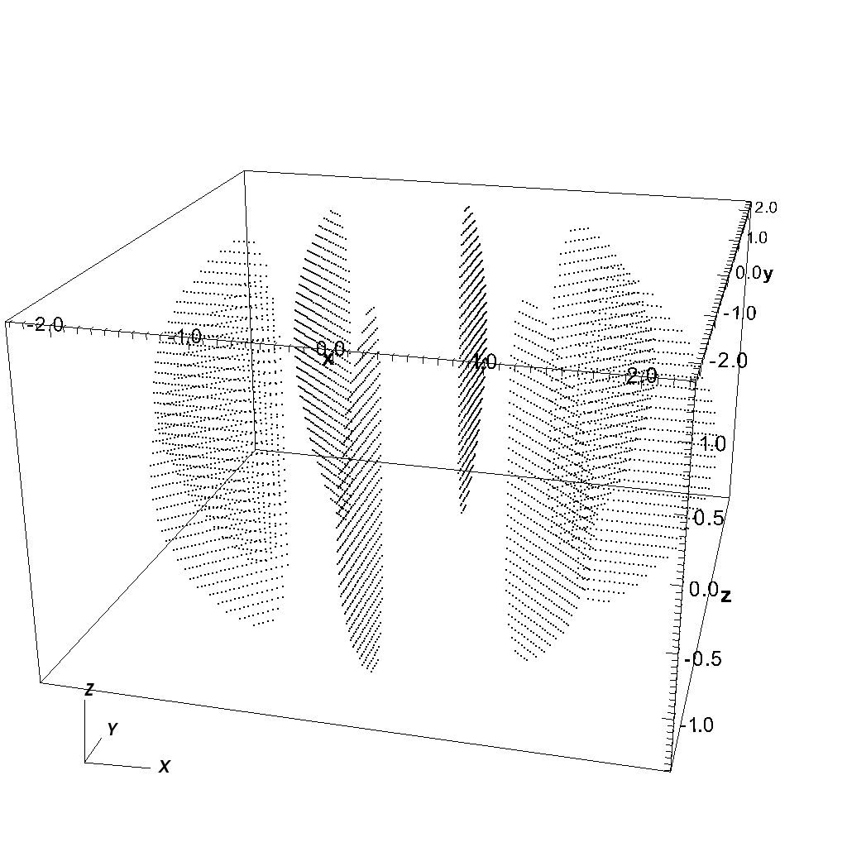
Particle loading
Physical space initialization: uniform over (R,ϕ,z) cube with Jacobian to ensure uniformity over d³x. Particles outside mesh rejected.
Velocity space initialization: use Jacobian to initialize distribution uniformly on d³v, with 0<|v|<sqrt(2E_{max}/m).
Uniform particle weights.
Sample spatial distribution over four-partition KSTAR mesh:
5840 / 8192 = 32 x 8 x 32 particles deposited.

Slide 4
Particle push
Particles advance by a specified time increment between fluid steps, using given 2D (real or complex) or 3D fields, subcycling as necessary.
Hierarchical organization of particles by element, element ensemble, OMP thread, and MPI/mesh partition allows good optimization.
4th- and 5th-order Runge-Kutta ODE integration have been implemented; both show good energy, P_{ϕ} conservation over many time steps.

Slide 5
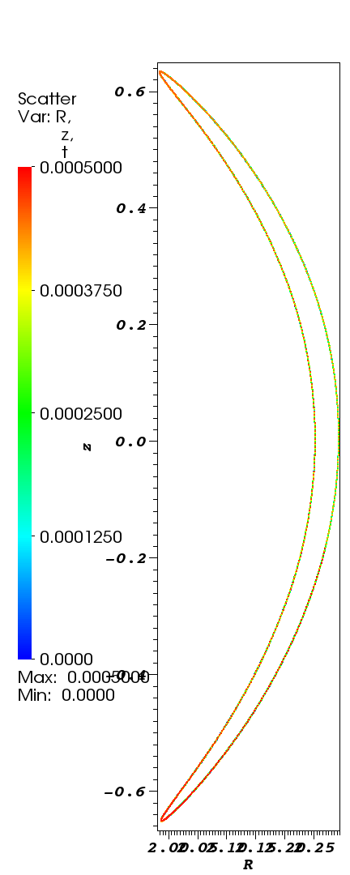
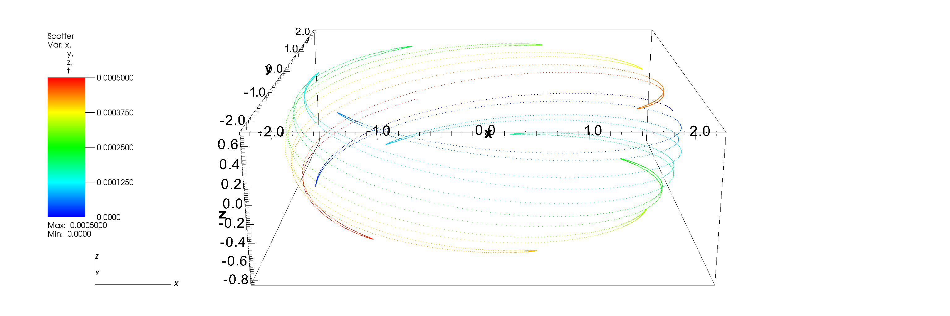
Sample trapped orbit (λ₀ = 3π/5)
5000 steps, dt (drift-kinetic)=10⁻⁷ s ≈ 5 gyroperiods.
Initial KE=9.9995e+03 eV; final=9.9990e+03.
Initial P_{ϕ}=-0.476633; final=-0.476630.
R-z plane projection
Colors indicate advancing time.

Slide 6
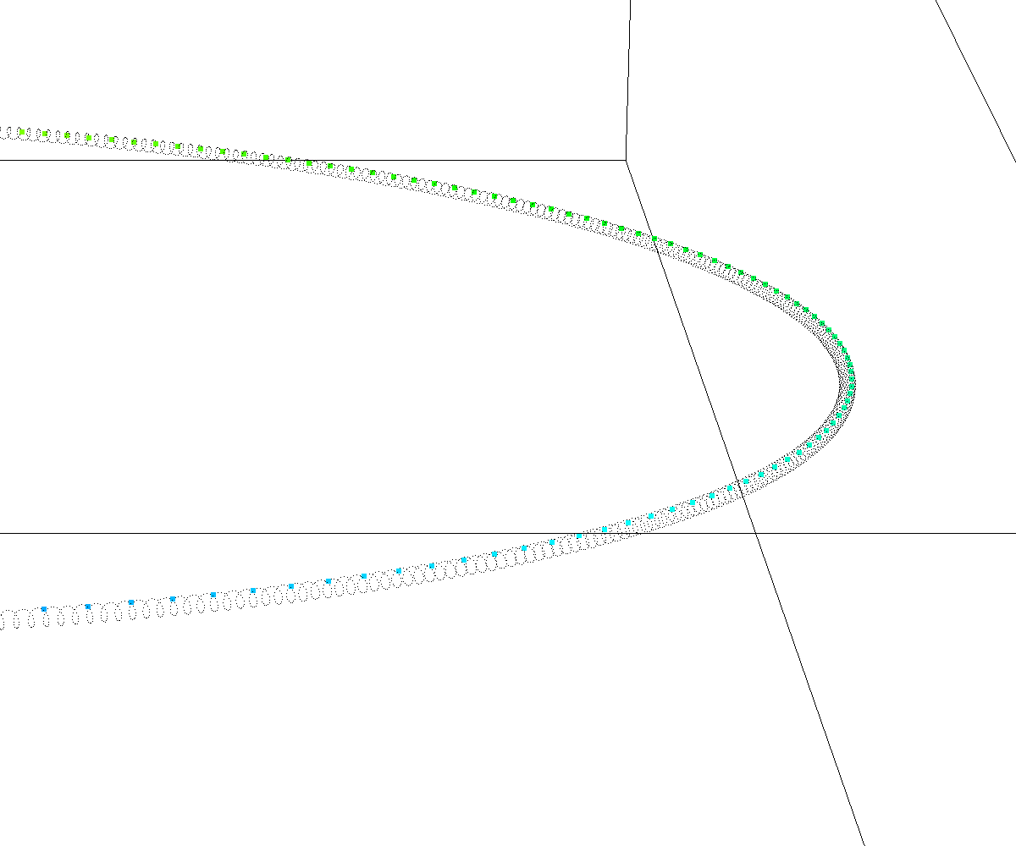
Drift-kinetic/full-orbit comparison
Full-orbit: 20,480 steps, dt=10⁻¹⁰ s ≈ 0.005 gyroperiods.
KE conservation for full-orbit is good, but angular momentum conservation is relatively poor.
A drift-kinetic step is about twice as fast as a full-orbit step, and can be around 1600x larger for comparable accuracy.
Detail

Slide 7
Pressure deposition
RHS vectors for p||, p⊥ computed by integrating over particle delta functions within each element.
LHS vectors computed by mass matrix inversion for each component.
Very fast (time is independent of particle count).

Slide 8
Fluid coupling
In progress!
Plan: pressure coupling, i.e.,
(1)
where
(2)
so that if δp ≡ p||-p⊥, then
(3)

Slide 9
Fluid coupling, continued
All terms in (3) are projected to the M3D-C¹ velocity representation with appropriate operators integrated by parts:
e.g.

Slide 10
I/O & Diagnostics
The particle_test() subroutine writes out the entire trajectory of a predetermined subset of particles, tracking KE and P_{ϕ} .
Subroutine hdf5_write_particles() uses parallel HDF5 to dump the entire particle distribution at a given time, including positions, velocities, and weights.
Utilities exist to extract position data from these to a text file, enabling comparisons and plotting with VisIt.
Utilities to visualize velocity distributions, pressure tensor components are now being developed.
Checkpointing of particle distribution will be based on HDF5.

Slide 11
Summary
Particle initialization, full-f push, pressure deposition, and I/O now working, tested and optimized for 2D complex version.
Weight evolution, fluid coupling in progress.
First linear validation tests on fishbone mode to be conducted in October.

