Slide 1




Equilibrium, NTV, and Disruption Event Characterization and Forecasting Results Update for NSTX/NSTX-U
S.A. Sabbagh¹, J.W. Berkery¹, R.E. Bell², J.M Bialek¹, M.D. Boyer², D.A. Gates², S.P. Gerhardt², I Goumiri³, C. Myers², Y.S. Park¹, J.D. Riquezes⁴, C. Rowley³
¹Department of Applied Physics, Columbia University, New York, NY
²Princeton Plasma Physics Laboratory, Princeton, NJ
³Princeton University, Princeton, NJ
⁴University of Michigan, Ann Arbor, MI
NSTX-U Results Review
September 22nd, 2016
PPPL
*This work supported by the US DOE contracts DE-AC02-09CH11466 and DE-FG02-99ER54524
V1.2

Slide 2
OUTLINE – Updates on three subjects
Impact of PF1aU on equilibrium reconstruction
Disruption Event Characterization and Forecasting development
Neoclassical Toroidal Viscosity on NSTX-U
  One shot identified in Walter’s L-mode experiments has sufficient data for NTV profile analysis
  More to do, not enough time to show – will send by email

Slide 3
Equilibrium reconstruction recent conclusion: PF1aU issue has negligible effect on reconstructions since it appeared
Near maximum difference
Near peak stored energy
Stored energy
Stored energy
DRSEP
Reconstructions use PF coil currents, have small error (~ 0.5%), so PF1aU issue might affect result
However, the balance of the magnetics minimize reconstruction changes
  The fitted PF1aU does deviate from the measured value – becomes worse in time

Slide 4
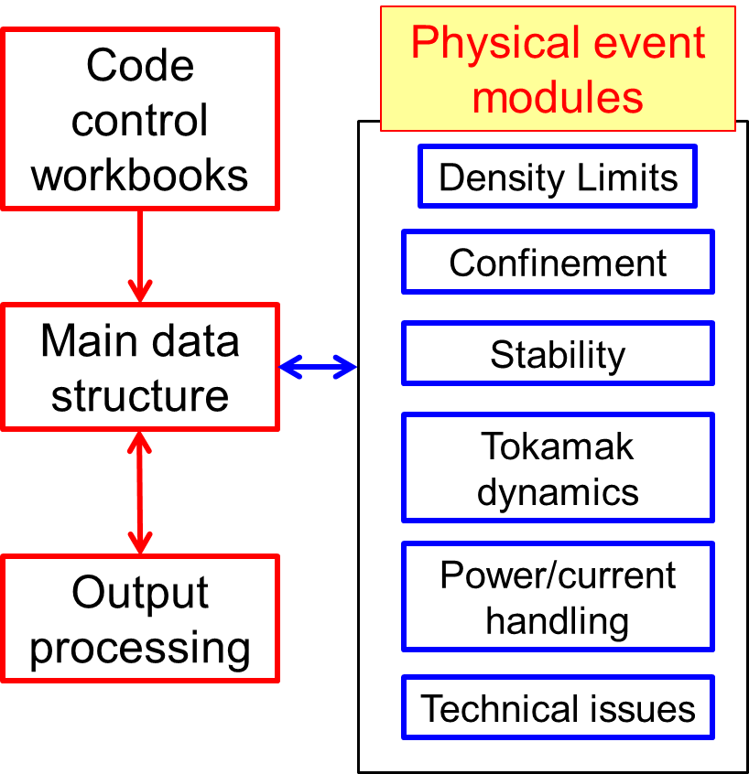
DECAF is structured to ease parallel development of disruption characterization, event criteria, and forecasting
Initial DECAF analysis goals
  Define physics criteria that define an initial set of disruption “events”
  Characterize time sequences of events in disruptive shots
  Produce initial physics models to define marginal points of key events
  Enable initial disruption forecasting capability for most well-defined events / sequences
DECAF disruption events and chains
➔ e.g. Loss of shape control
SCL
➔
RWM
VDE
SCL
IPR
DIS
DECAF code schematic

Slide 5
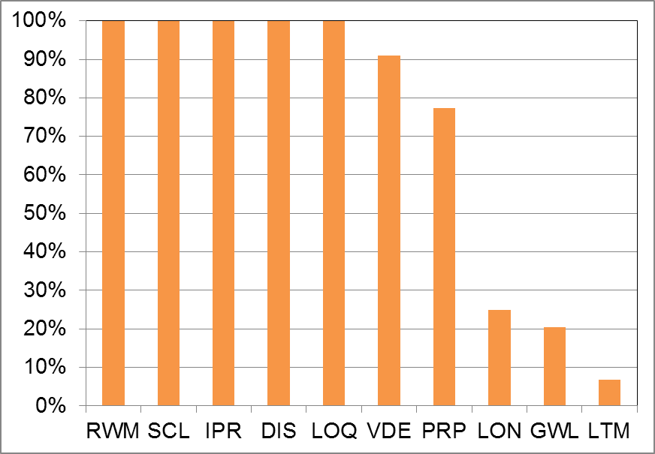
Recap: DECAF results detect disruption chain events when applied to dedicated 44 shot NSTX RWM disruption database
Several events detected for all shots
  RWM: RWM event warning
  SCL: Loss of shape control
  IPR: Plasma current request not met
  DIS: Disruption occurred
  LOQ: Low edge q warning
  VDE: VDE warning (40 shots)
Others:
  PRP: Pressure peaking warning
  GWL: Greenwald limit
  LON: Low density warning
  LTM: Locked tearing mode
Occur with or after RWM

Slide 6
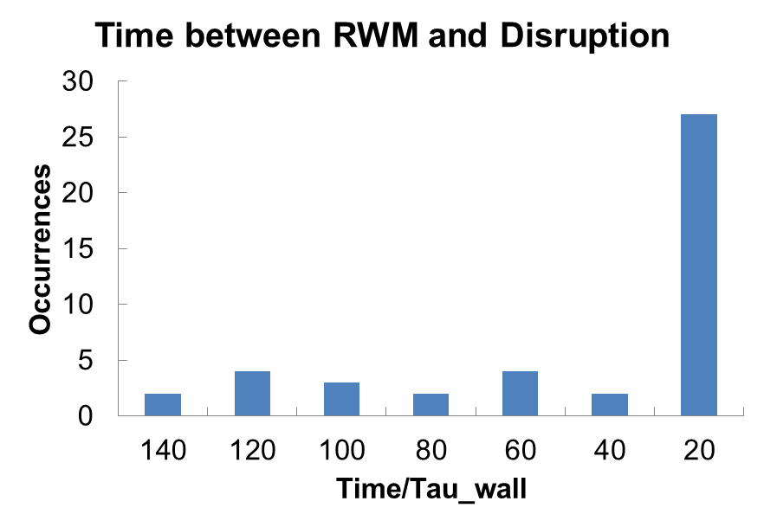
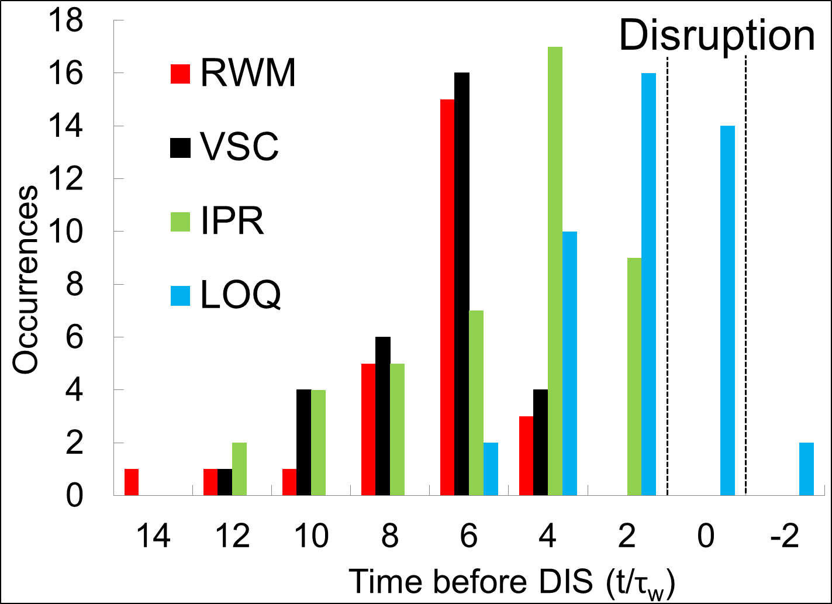
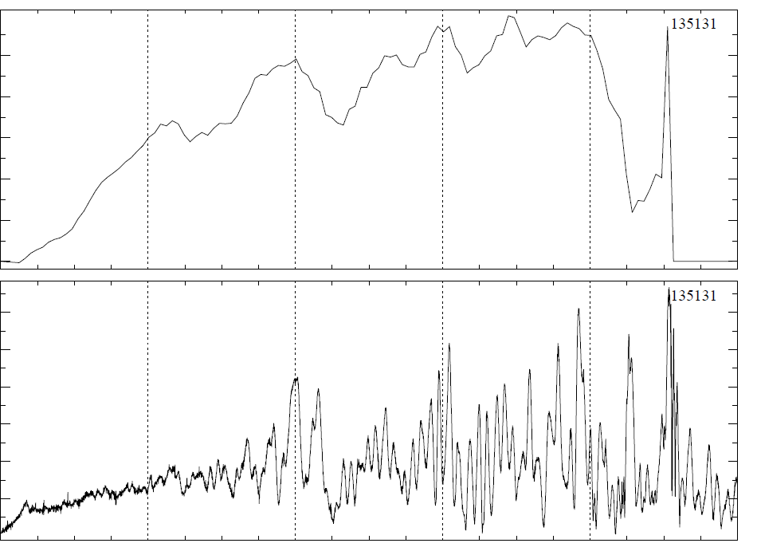
DECAF results detect disruption chain events when applied to dedicated 44 shot NSTX RWM disruption database
VDE
6
Most RWM near major disruption
  61% of RWM occur within 20 τ_{w} of disruption time (τ_{w} = 5 ms)
  Earlier RWM events NOT false positives – cause large decreases in β_{N} with recovery (minor disruptions)
β_{N}
4
2
0
60
40
B_{PL}^{n=1} (G)
20
0
t(s)
0.0
0.2
0.4
0.6
0.8
1.0

Slide 7
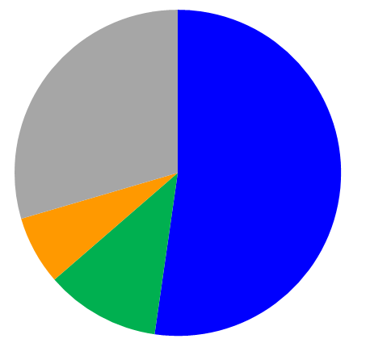
Initial DECAF analysis finds common disruption event chains (44 shot NSTX disruption database)
Common disruption event chains (52.3%)
  Related chains
    RWM ➔ SCL ➔ VDE ➔ IPR ➔ DIS
    VDE ➔ RWM ➔ SCL ➔ IPR ➔ DIS
    VDE ➔ RWM ➔ IPR ➔ DIS ➔ SCL
    RWM ➔ SCL ➔ VDE ➔ GWL ➔ IPR ➔ DIS
Disruption event chains w/o VDE (11.4%)
New insights being gained
  Chains starting with GWL are found that show rotation and β_{N} rollover before RWM (6.8%)
  Related chains
    GWL ➔ VDE ➔ RWM ➔ SCL ➔ IPR ➔ DIS
    GWL ➔ SCL ➔ RWM ➔ IPR ➔ DIS
RWM
VDE
SCL
IPR
DIS
Disruption event chains with RWM
Other
(29.5%)
Event chains with RWM and VDE
(52.3%)
GWL start
(6.8%)
No
VDE
(11.4%)

Slide 8
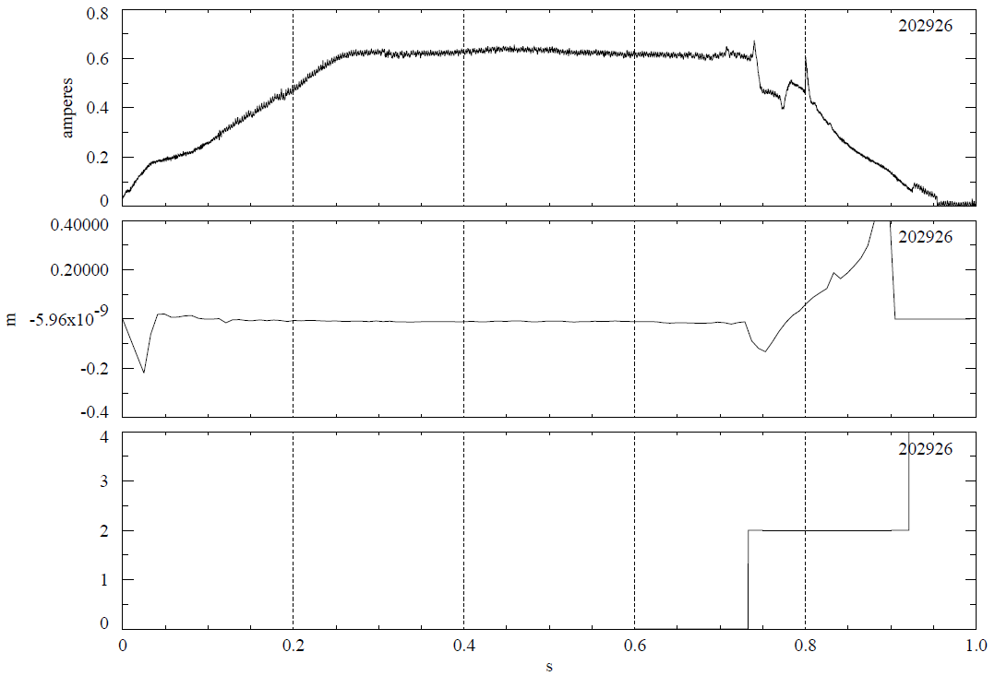
First DECAF results for NSTX-U replicate the triggers found in new real-time state machine shutdown* capability
0.8
DECAF
Important capability of DECAF to compare analysis using offline vs. real-time data
  Simple, initial test
PCS Shut-down conditions are analogous to DECAF events
  PCS loss of vertical control ➔ DECAF
DECAF comparison:VDE event
  Matches PCS when r/t signal used (1 criterion)
  VDE event 13 ms earlier using offline EFIT signals (3 criteria)
I_{p} (MA)
0.4
VDE
Using r/t data (t = 0.733s) Using EFIT (t = 0.720s)
0
0.4
EFIT offline reconstruction
of Z position
Z_{axis} (m)
0
VDE
-0.4
4
PCS trigger
For VDE
(t = 0.733s)
2
PCS trigger
0
0.0
0.2
0.4
0.6
0.8
1.0
t(s)
*See S.P. Gerhardt, et al., NSTX-U shutdown handler talk

Slide 9
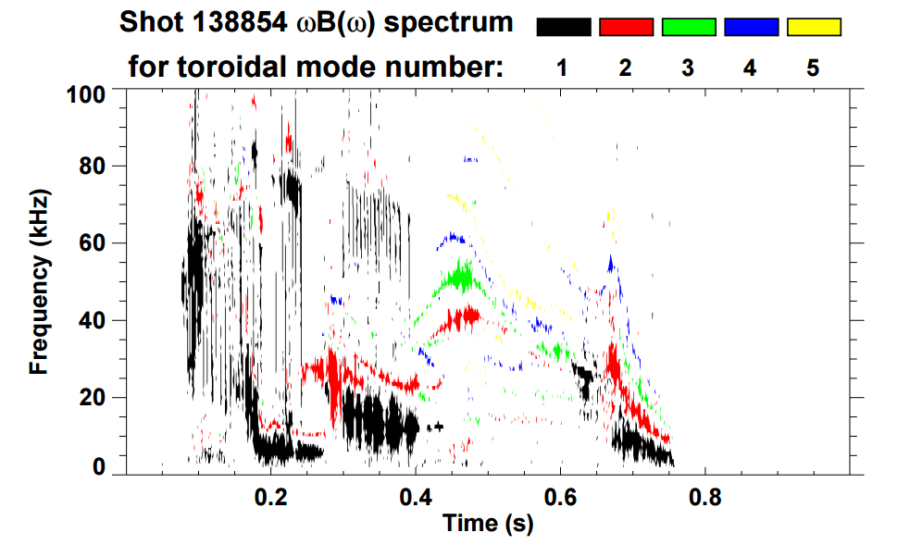
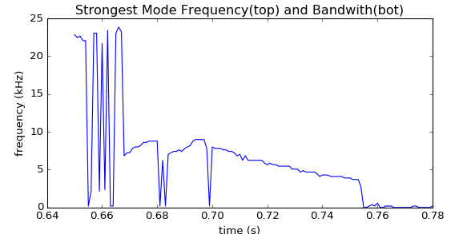
      Next essential step for DECAF analysis: Identification of rotating MHD (e.g. NTMs)
Initial goals
  Create portable code to identify existence of rotating MHD modes
  Track characteristics that lead to disruption
    e.g. rotation bifurcation, mode lock
Approach
  Apply FFT analysis to determine mode frequency, bandwidth evolution
  Determine bifurcation and mode locking
n = 1 mode frequency vs. time
(new code)
ω₀ ~ 9 kHz
bifurcation ~ 4 kHz
w/ J. Riquezes (U. Michigan – SULI student)

Slide 10
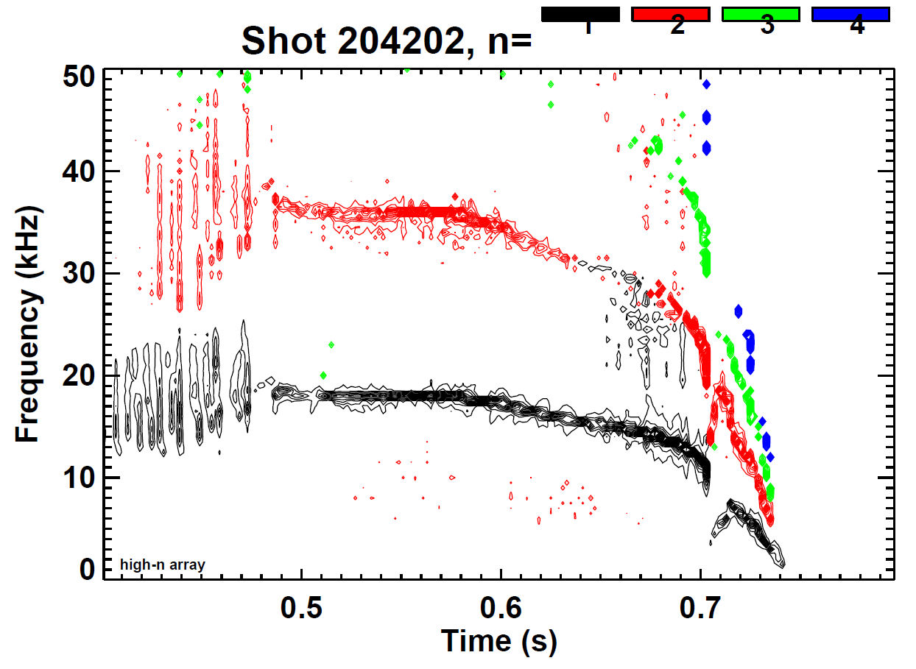
      Many shots with rotating MHD (e.g. NTMs) examined for NSTX and NSTX-U – two illustrated here
Magnetic spectrogram of rotating MHD mode locking termination
NSTX 138854
NSTX-U 204202

Slide 11
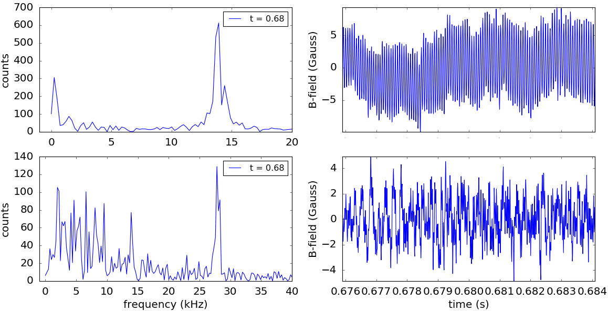
Fast Fourier transforms used to find mode peak frequency within a time interval
FFTs
Odd-n
Signals
Even-n
Reveals potential issues handling multiple frequency peaks
Next step to include toroidal array / n number discrimination
J. Riquezes (U. Michigan – SULI student)

Slide 12
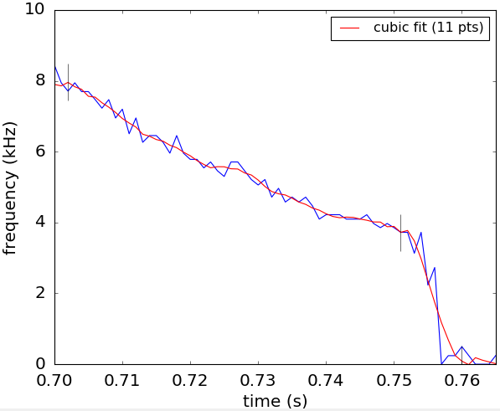
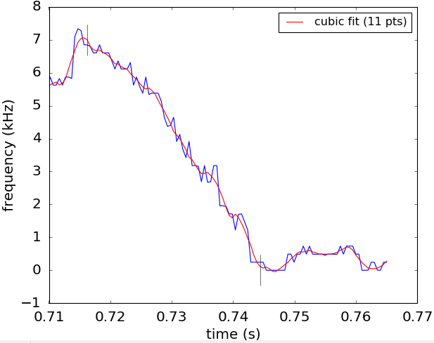
The characterization algorithm shows that the expected bifurcation event can be found
Algorithm written looks for a “quasi-steady state” period, a potential bifurcation, the possible mode locking
odd-n peak frequencies
odd-n peak frequencies
quasi-SS
shot 138854
shot 204202
bifurcates
lock
lock

Slide 13
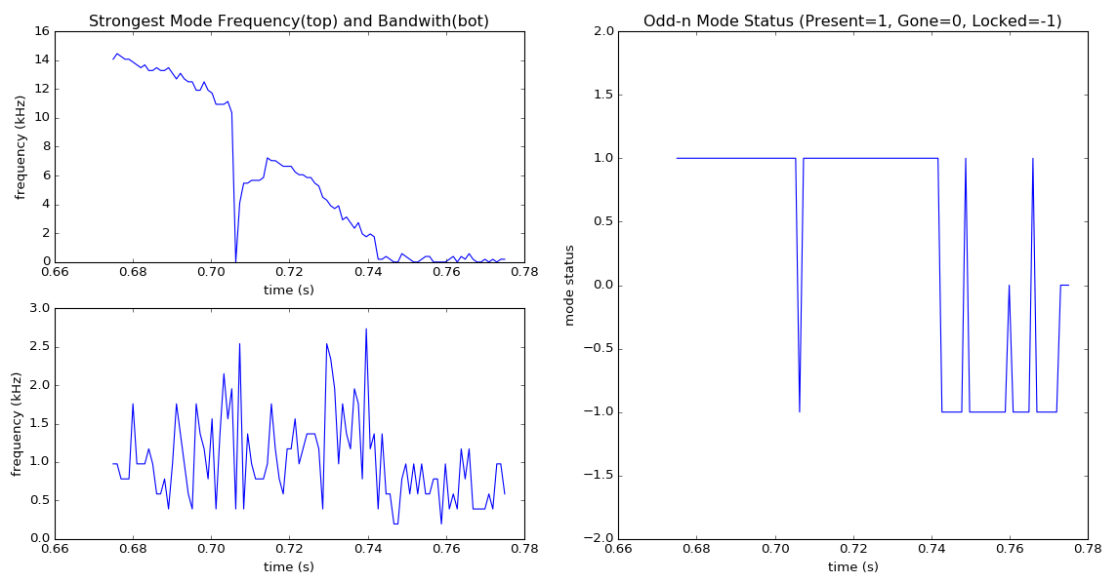
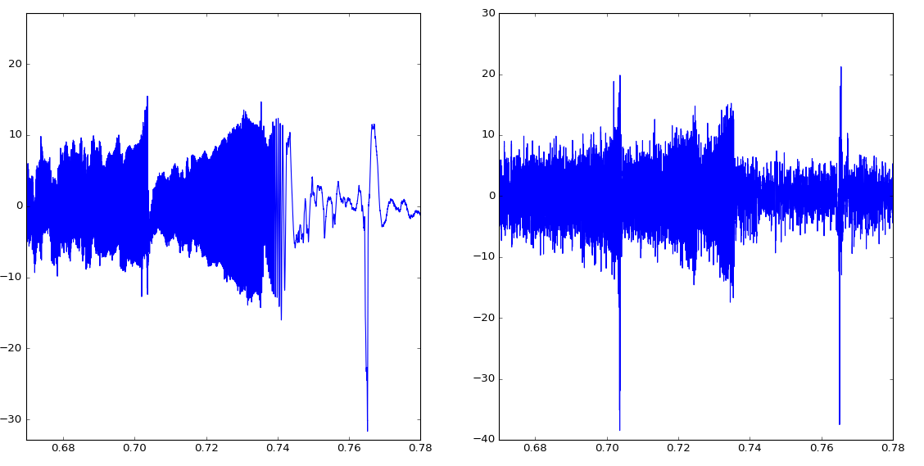
      Continuing analysis of rotating MHD for DECAF includes accurate analysis of mode “status” (I)
Odd-n magnetic signal / analysis (mode locking / unlocking)
Frequency vs. time
DECAF mode status
1 = Mode present
0 = No mode
Signal
B (G)
-1 = Mode locked
204202
mode lock
t (s)

Slide 14
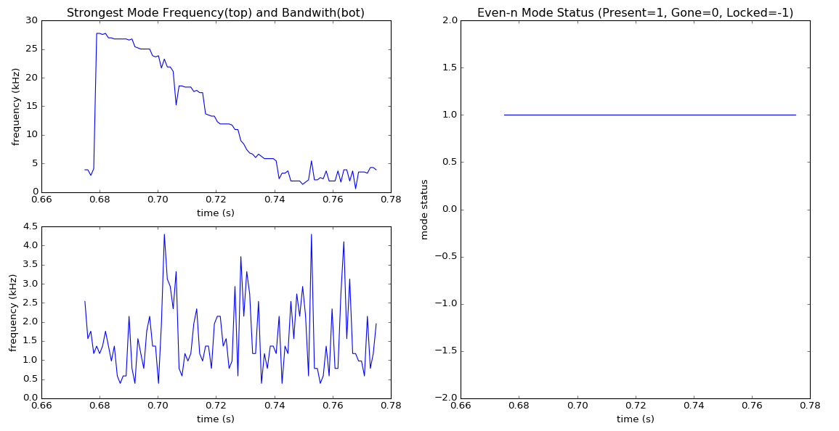
      Continuing analysis of rotating MHD for DECAF includes accurate analysis of mode “status” (II)
Even-n magnetic signal / analysis (mode present, not locked)
Frequency vs. time
DECAF mode status
1 = Mode present
0 = No mode
Signal
-1 = Mode locked
B (G)
204202
t (s)

Slide 15
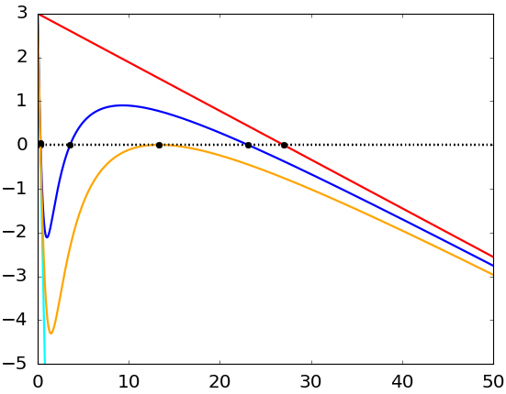
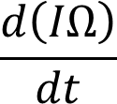

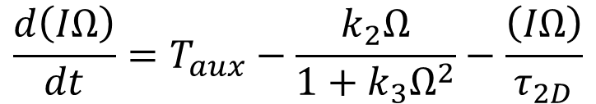
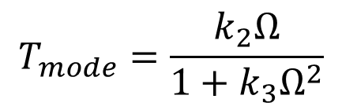

Model for mode rotation evolution / mode lock forecasting derived, will be tested in DECAF in next step
Model derived to allow island drag for both “slip” and a “no slip” condition
Simple “Ω₀” defines steady state
  Best way to define this?
Simple “Ω₀/2” defines bifurcation point
  ➔ Next step is to analyze this model using DECAF
$$\frac{d\left(IΩ\right)}{dt}=T_{aux}−\frac{k_{2}Ω}{1+k_{3}Ω^{2}}−\frac{\left(IΩ\right)}{τ_{2D}}$$
$$T_{mode}=\frac{k_{2}Ω}{1+k_{3}Ω^{2}}$$
$$k_{2}=0$$
Model based on
R. Fitzpatrick et al., Nucl. Fusion 33 (1993) 1049
~ Ω₀/2
“steady-state”
Ω₀
Bifurcation frequency

Slide 16
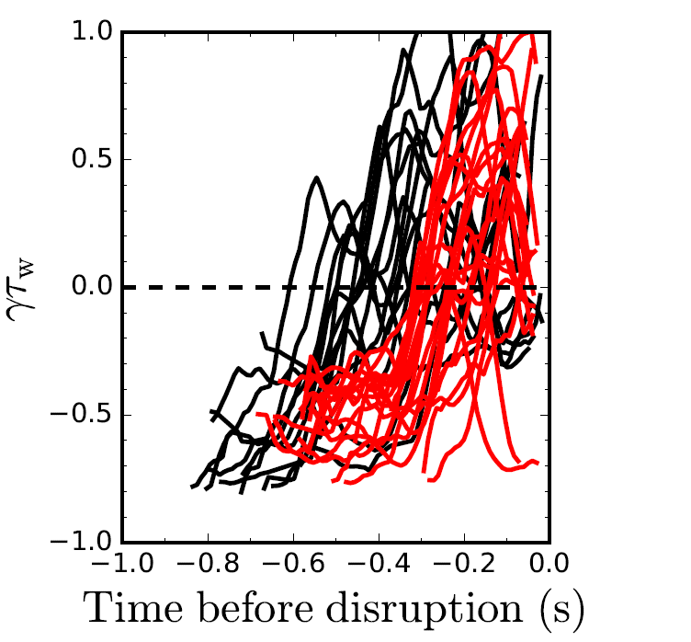
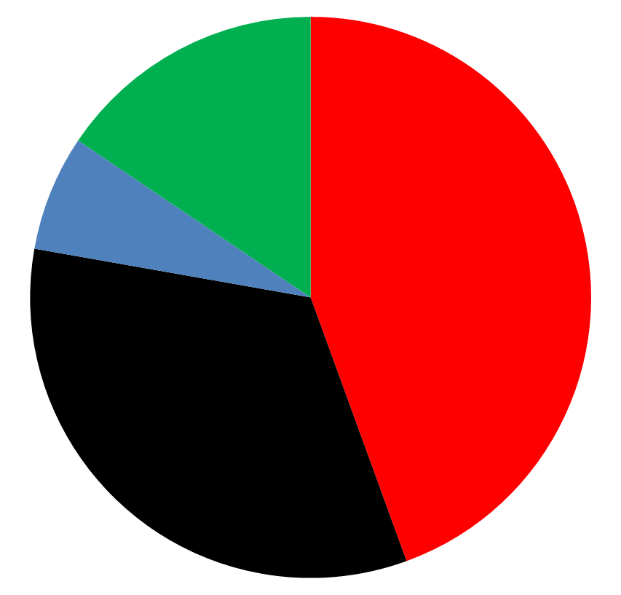
      DECAF reduced kinetic MHD model implemented: initially tested on database of NSTX discharges with unstable RWMs
Normalized growth rate vs. time
Predicted instability statistics (45 shots)
Stable
(16%)
Instability < 320 ms
before disruption
(44%)
(7%) False
positives
unstable
Instability within 100 ms of minor
disruption
(33%)
stable
84% of shots are predicted unstable
44% predicted unstable < 320 ms (approx. 60τ_{w}) before current quench
33% predicted unstable within 100 ms of a minor disruption
See Jack Berkery’s talk (next) for full detail

Slide 17
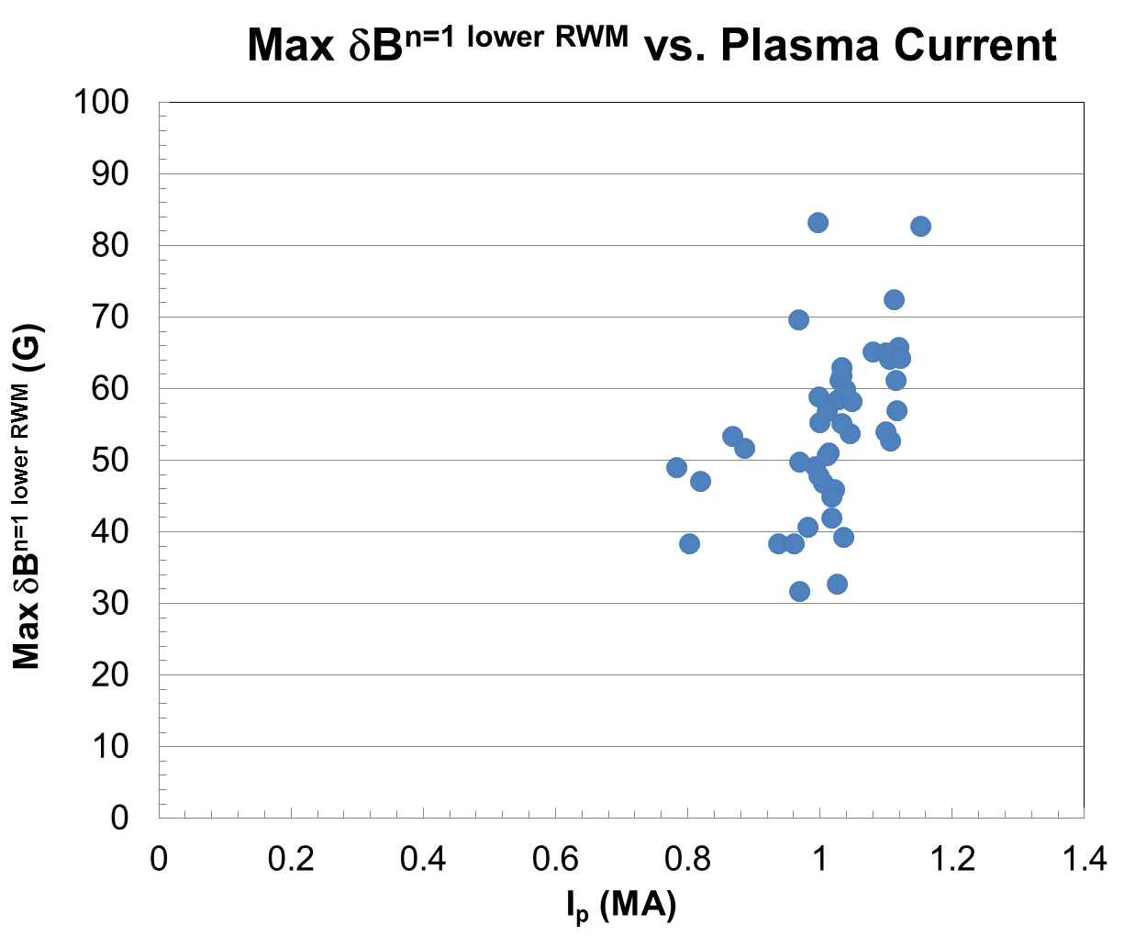
      Another criterion: what levels of plasma disturbances (δB_{p}; δB_{p}/B_{p}(a)) are permissible to avoid disruption MHD modes?
ITER high priority need
  Analysis requested by ITER
  Vetted through ITPA
Compare maximum δB_{p} (n = 1 amplitude) causing disruption vs I_{p}
  Maximum δB_{p} increases with I_{p}
Further analysis may provide guidance for a disruption predictor in DECAF
NSTX
RWM-induced
Disruptions
(n = 1 global
MHD mode)

Slide 18
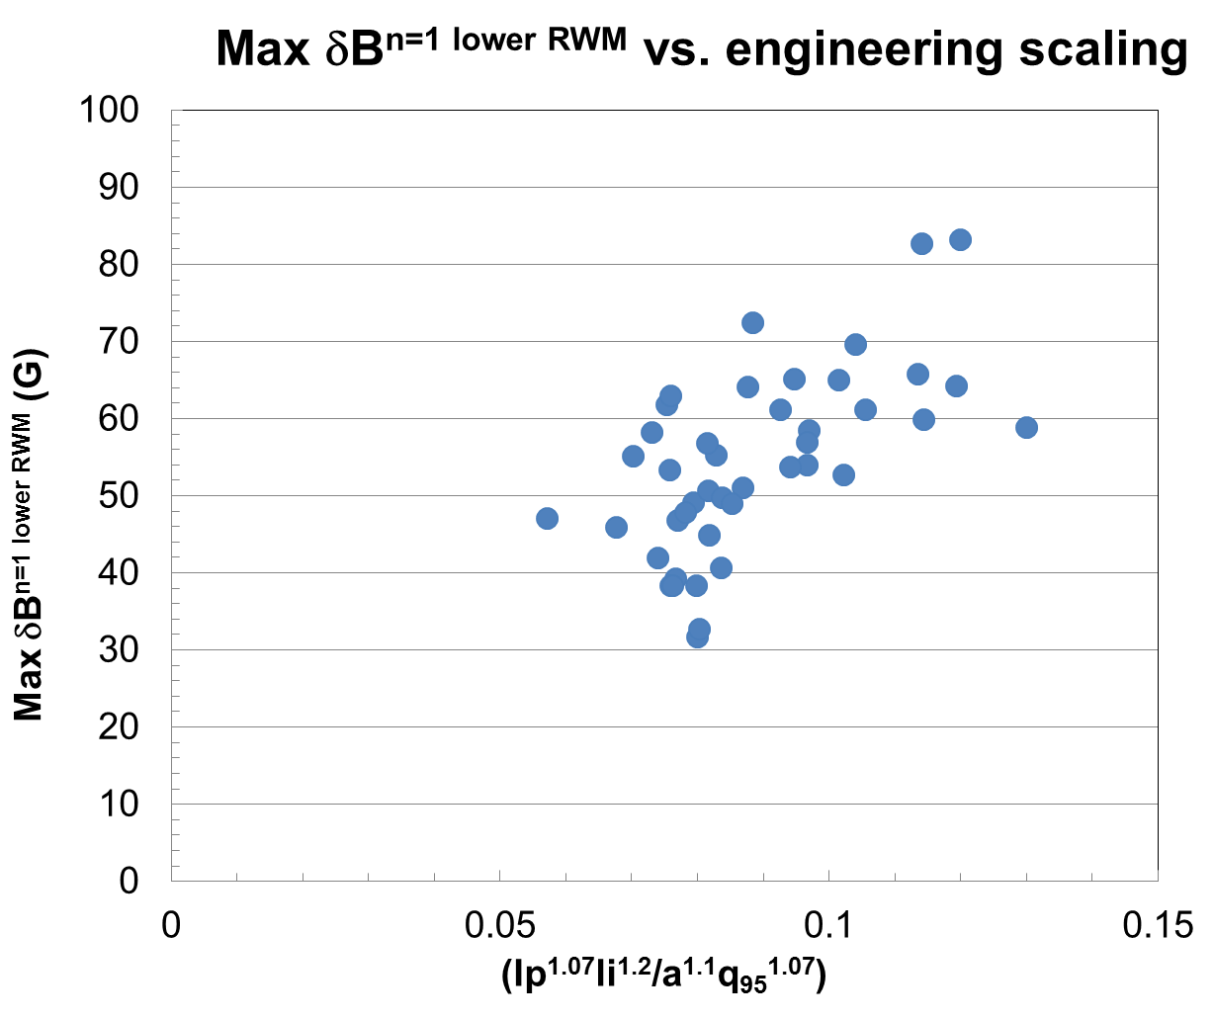
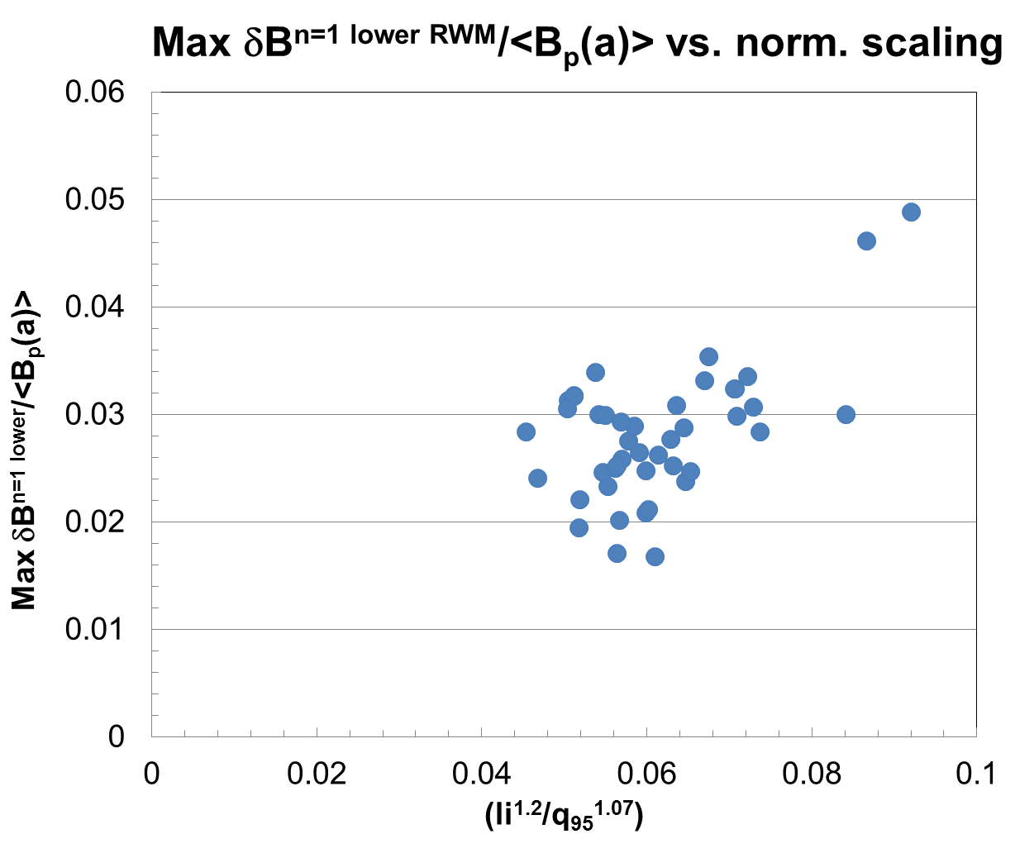
      Maximum δB_{p} might follow de Vries-style* empirical scalings
NSTX RWM-induced disruptions (n = 1 global MHD mode)
Will be tested in DECAF as a “tolerable limit” to global mode amplitude
*P.C. de Vries, G. Pautasso, E. Nardon, et al., Nucl. Fusion 56 (2016) 026007

Slide 19
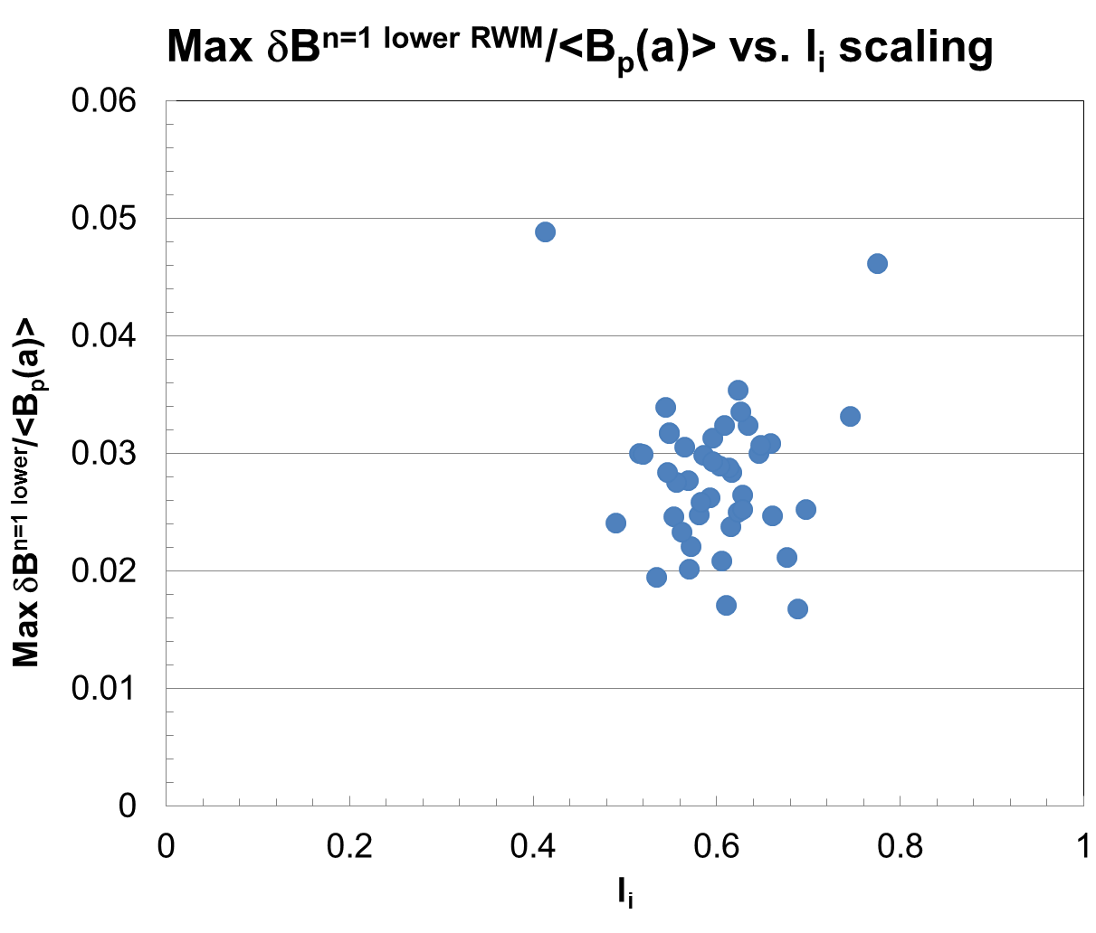
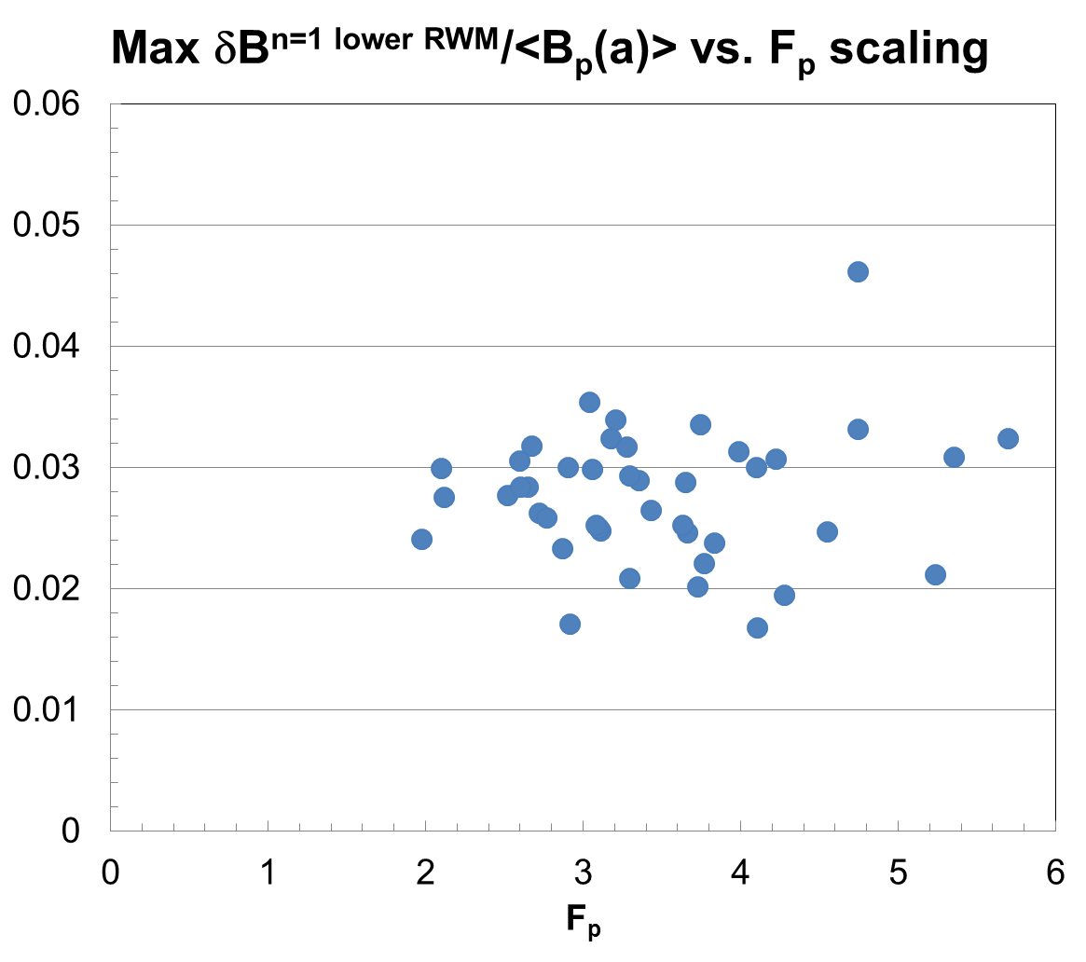
      In contrast, maximum δB_{p}/<B_{p}(a)> seems independent of scaling on (l_{i}) or (F_{p}) (or (F_{p}/l_{i}))
NSTX
RWM-induced
Disruptions
(n = 1 global
MHD mode)
internal inductance
total pressure peaking factor
F_{p} = p_{tot}(0)/<p_{tot}>_{vol} (from kinetic equilibrium reconstructions)
Dependence on l_{i}, F_{p} expected for RWM marginal stability points

Slide 20
Reminder: NSTX-U rotation controller including NTV and NBI torque profiles can compensate for T_{i} variations in NTV
Rotation evolution and NBI and NTV torque profiles
3D coil current and NBI power (actuators)
10
2.0
7
2.5
10⁴
desired ω_{φ}
t₁ = 0.59s
t₂ = 0.69s
t₃ = 0.79s
1.8
6
8
2.0
5
t₃
1.6
6
1.5
4
t₂
NTV
torque
1.4
NBI power (MW)
3D Coil Current (kA)
NBI, NTV torque density (N/m²)
3
Plasma rotation (rad/s)
t₁
t₂
4
t₃
1.0
1.2
t₂
2
2
t₁
t₁
0.5
1.0
1
NBI
torque
t₃
0.8
0
0
0.0
0.5
0.7
0.9
0.5
0.7
0.9
0.0
0.2
0.4
0.6
0.8
1.0
t (s)
t (s)
ψ_{N}
1.8
1.2
T_{i} (keV)
K1 = 0, K2 = 2.5
0.6
NTV torque profile model for feedback dependent on ion temperature
t₁
t₂
t₃
t (s)
0.0
0.4
0.5
0.6
0.7
0.8
0.9

Slide 21
Supporting Slides Follow

Slide 22
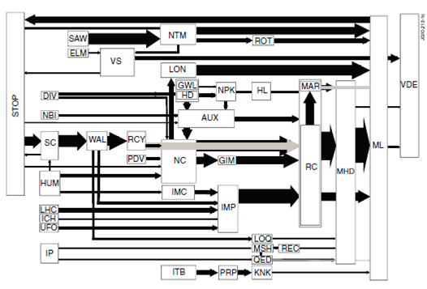
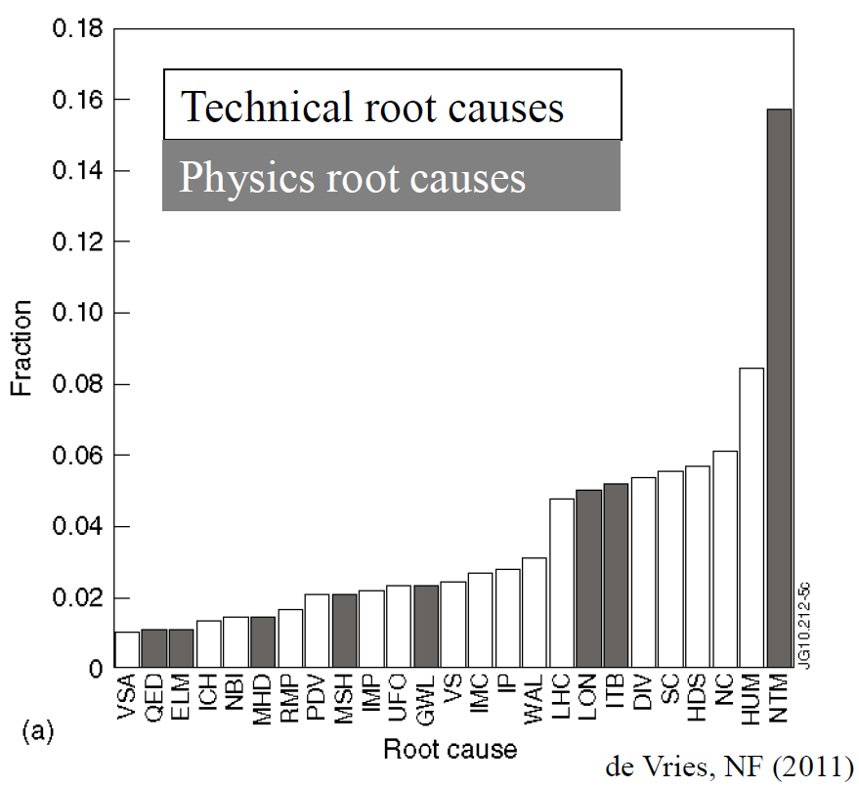
JET disruption event characterization provides framework for understanding / quantifying disruption prediction
JET disruption event chains
Related disruption event statistics
P.C. de Vries et al., Nucl. Fusion 51 (2011) 053018
JET disruption event chain analysis performed by hand, desire to automate

Slide 23
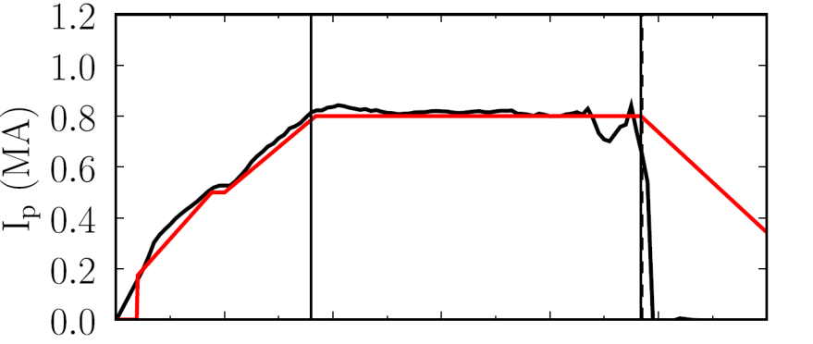
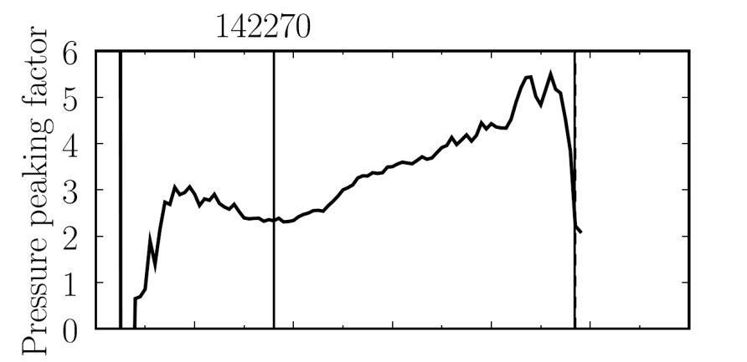

Disruption Event Characterization And Forecasting Code (DECAF) yielding initial results (pressure peaking example)
10 physical events presently defined in code with quantitative warning points
  Builds on manual analysis of de Vries
  Builds on warning algorithm of Gerhardt
  New code written (in Python), easily expandable, portable to other tokamaks (can now read DIII-D data)
Example: Pressure peaking (PRP) disruption event chain identified by code before disruption
  (PRP) Pressure peaking warnings identified first
  (VDE) VDE condition subsequently found 19 ms after last PRP warning
  (IPR) Plasma current request not met
  (SCL) Shape control warning issued
NSTX
142270
P.C. de Vries et al., Nucl. Fusion 51 (2011) 053018
Disruption
S.P. Gerhardt et al., Nucl. Fusion 53 (2013) 063021
PRP warnings
Event chain
PRP
VDE
IPR
SCL
Detected at: 0.4194s
0.4380s
0.4522s
0.4732s
J.W. Berkery, S.A. Sabbagh, Y.S. Park (Columbia U.)
and the NSTX-U Disruption PAM Working Group

Slide 24
DECAF is structured to ease parallel development of disruption characterization, event criteria, and forecasting
Physical event modules encapsulate disruption chain events
  Development focused on improving these modules
  Structure eases development
    E.g. separate code by C. Myers that improved disruption timing definition was quickly imported
Physical events are objects in physics modules
  e.g. VDE, LOQ, RWM are objects in “Stability”
  Carry metadata, event forecasting criteria, event linkages, etc.
Physical event modules
Code control workbooks
Density Limits
Confinement
Main data structure
Stability
Tokamak dynamics
Output processing
Power/current handling
Technical issues

Slide 25
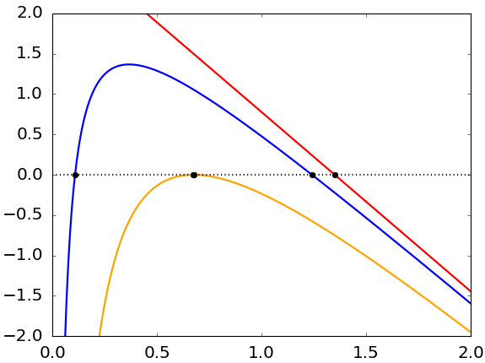


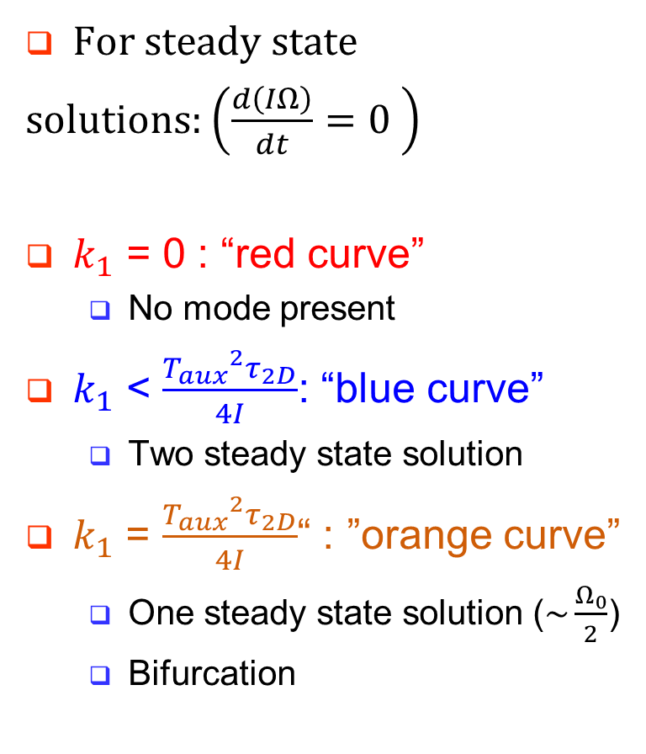

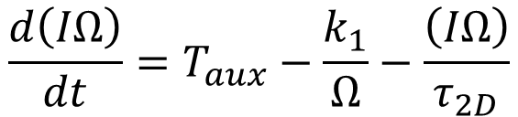
The model using a “no slip” condition has no steady state solutions at a large enough island width ($k_{1}$)
For steady state
solutions: $\left(\frac{d\left(IΩ\right)}{dt}=0 \right)$
$k_{1}$ = 0 : “red curve”
  No mode present
$k_{1}$ < $\frac{{T_{aux}}^{2}τ_{2D}}{4I}$: “blue curve”
  Two steady state solution
$k_{1}$ = $\frac{{T_{aux}}^{2}τ_{2D}}{4I}$ : “”orange curve”
  One steady state solution ($\sim \frac{Ω_{0}}{2}$)
  Bifurcation
$$\frac{d\left(IΩ\right)}{dt}=T_{aux}−\frac{k_{1}}{Ω}−\frac{\left(IΩ\right)}{τ_{2D}}$$
$$Ω_{0}$$
  Bifurcation
    At close to half the steady state natural rotation frequency ($Ω_{0}$)

