Slide 1



Studies of lithiumization and boronization of ATJ graphite PFCs in NSTX-u
Predrag Krstic & Javier Dominguez
Institute for Advanced Computational Science
SUNY at Stony Brook,
Thank you for support
Thank you for support

Slide 2
What are we doing?
We calculate chemistry, retention of D, chemical sputtering of a B-C-O-D, Li-C-O-D and B-Li-C-O-D surface.
Why? To understand the fundamental processes in the windows of time&space when these actually happen.
Here we are: atomistic approaches
Most processes end in less than 100 ps . Cumulative processes of D
require longer time.
Flux: 10²⁵m⁻²s⁻¹ means I D atom at 10 nm² each 10 ns. However each
impact atom changes the target surface – the dynamical surface
How do we do it?
Classical molecular dynamics with REAXFF
Verified by quantum-classical molecular dynamics (need exoscale computing resources
Validated by NSTX-U and lab experiments whenever available

Slide 3
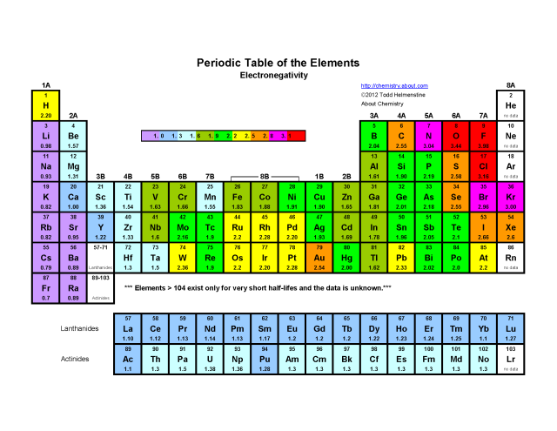
Why is classical mechanics not good for the problems with B-Li-C-O-D.?
It is good for W-D or C-D problems.
The answer lays in different electronegativity of the atoms in B-Li-C-O-D mixture
This means polarization and charges of the atoms in mixture dynamically
change with change of the coordinates of atoms, in particular during
the D impact cascade. Changes in electronic cloud can be handled
only by quantum mechanics.
We use SCC-DFTB approximation to DFT which is nominally about 1000
Times faster than DFT, still 1000 times slower than classical mechanics, and
REAXFF: Intermediate solution: combination of classical mechanics and
semi-empirical QM calibrated method (Electronegativity Equalization, EEM)
which recalculate charges each time step of classical mechanics. This is
about 100 times slower than classical mechanics.
How uncertainty propagates through scales?
As these computational codes have limits, so do the experimental and metrology tools. Key is to fill the gap one with the other and identify regions of validation in combination with the data uncertainty and more importantly identify appropriate and strategic problems to solve

Slide 4
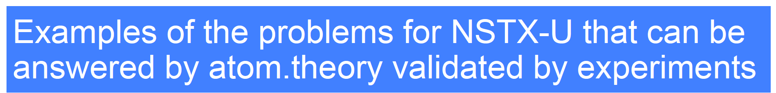
Effects of B and Li deposited onto the carbon tiles. In particular:
Effects of deuterium accumulation
Effects of varying concentration of B and Li DONE!
Onto deuterium retention and chemical sputtering of the surface.
Compare with experimental data form MAPP and lab.
Effects of impurities, in particular of O and its derivate (O₂, H₂O) at D recycling and erosion
In liquid Li on carbon and high-Z substrates. Compare with experimental data. IN WORK!
Determine intermolecular interactions of liquid metals (Li, Sn, Ga) with high-Z substrate
and model the wetting.
Effects of temperature and impurities on the wetting of the liquid metals, as well as on the
trapping and release. LATER!
To feed the mesoscopic dynamics (KMC) with the obtained atomistic data and to
continuum dynamics through XGC-DEGASII.

Slide 5
Some achieved results
Bonding and retention chemistry in boronized and oxidized surfaces
Percentage of D bonds with constituents of the deuter-ated BCO surface as function of D accumulated con-centration (left axis). Total retention per impact of D (%) on BCOD and LiCOD (right axis).
(a) O1s, (b) C1s, and (c) B1s XPS spectra
using MAPP with boronized ATJ graphite for various days of deuterium plasma exposure.
Bonds of (a) O, (b) C, and (c) B to other
constituents in the BCOD as a function of
D concentration.

Slide 6
C) Sputtering of BCO as function of D impact energy
Without O
With O
Sputtered molecules, upon D saturation
Sputtering in various configurations

Slide 7
B) Comparison of retention chemistry and sputtering in lithiated and boronized surfaces
Total and C ejection yield per D for various surfaces configurations
Bonding of D to various constituents of the surface.
Noncumulative case at 5 eV D.

Slide 8
CONCLUSIONS: Outlook forward
PMI chemistry in NSTX-U requires QM in form of QCMD or advanced CMD+QM combinations to describe correctly both
hydrogen retention and erosion in PMI.
Approximate QM is adequate, however this has to be evaluated to tens of thousands of trajectories for reducing
statistical error and even for correct phenomenology.
Going with QM over DFT for PMI systems might be not feasible in next 10 years systems.
Improved classical potentials, based on multiple neighbor QM calculations are the key for next phase of the NSTX-U
atomistic modeling research, especially for metals. Checking DFT-fitted potentials by the methods of quantum
computational chemistry beyond DFT is doable with current computational power, leading to acceptable results, which need
Experimental verification= Quality control.
Processing speed for extension of atomistic MD to longer times, meeting mesoscale. Algorithmic development.
Bringing together the various scales of PMI and plasma is the fundamental multisdisciplinary question,
covering plasma science, surface science, atomic physics, computer science and applied mathematics.
The main weight in the science of integration of fusion plasma and its interfacial surface boundaries is carried
by PMI because 1) the basic PMI phenomenology evolves much faster than the plasma time scale, and
2) it evolves through wider range of the scales, which partially overlap with the scale of plasmas.
The PMI has to be understood and parameterized at nanoscale before integrating it with plasma at the
“same footing” at micro-­‐scale.
Thank you!

Slide 9
SUPPLEMENTAL

Slide 10
D) Retention chemistry and sputtering for Li-B-C-O-D
Li-B-C-D
Li-B-C-O-D
This is material mix of 5 constituents
5 eV impact of D
Oxygen gets dominant in retention chemistry
(over B) once there is D accumulated

