Slide 1
GTS simulations of NSTX L- and H-Mode Plasmas
Y. Ren¹
W. Wang¹, W. Guttenfelder¹, S.M. Kaye¹, J. Ruiz-Ruiz², S. Ethier¹, R.E. Bell¹, B.P. LeBlanc¹, E. Mazzucato¹,
D.R. Smith³, C.W. Domier⁴, H. Yuh⁵ and the NSTX-U Team
1. PPPL 2. MIT 3. UW-Madison 4. UC-Davis 5. Nova Photonics
NSTX-U Results Review
September 21st – 22nd, 2016

Slide 2
Why are Global Effects Important?
Global effects are considered to be important for STs
Local assumption of flux tube simulations based on ρ*~0
Large ρ* of STs due to weaker toroidal field compared to conventional tokamaks (ρ* ~ 0.01 for NSTX)
Global effects, i.e. turbulence spreading, requiring global GK codes
Study of global effects are important for achieving predictive capability for future STs
Need to validate first principle model for developing reduced transport model with global effects
Serious validation efforts applying global GK codes to ST plasmas are still lacking

Slide 3
NSTX L-mode plasmas

Slide 4
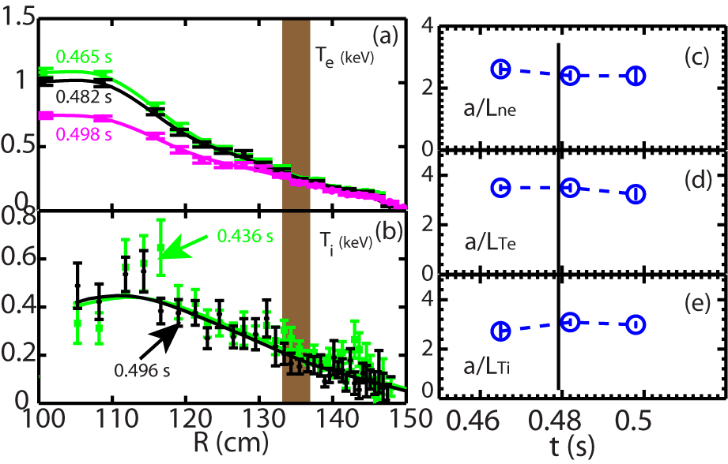
GTS Simulations were Carried Out to Assess Thermal Transport before and after RF Cessation
<15% variation in equilibrium quantities in the high-k measurement region before and right after the RF cessation (over 17 ms)
Equilibrium quantities not expected to change significantly on the time scale on which the turbulence changes (0.5-1 ms)
Energy confinement time~ 10 ms
High-k measurement region
Shot=140301
RF-heated L-mode plasma with
B_{T} =5.5 kG and I_{p}=300 kA
Time of the RF cessation
Ren et al., PoP 2015

Slide 5
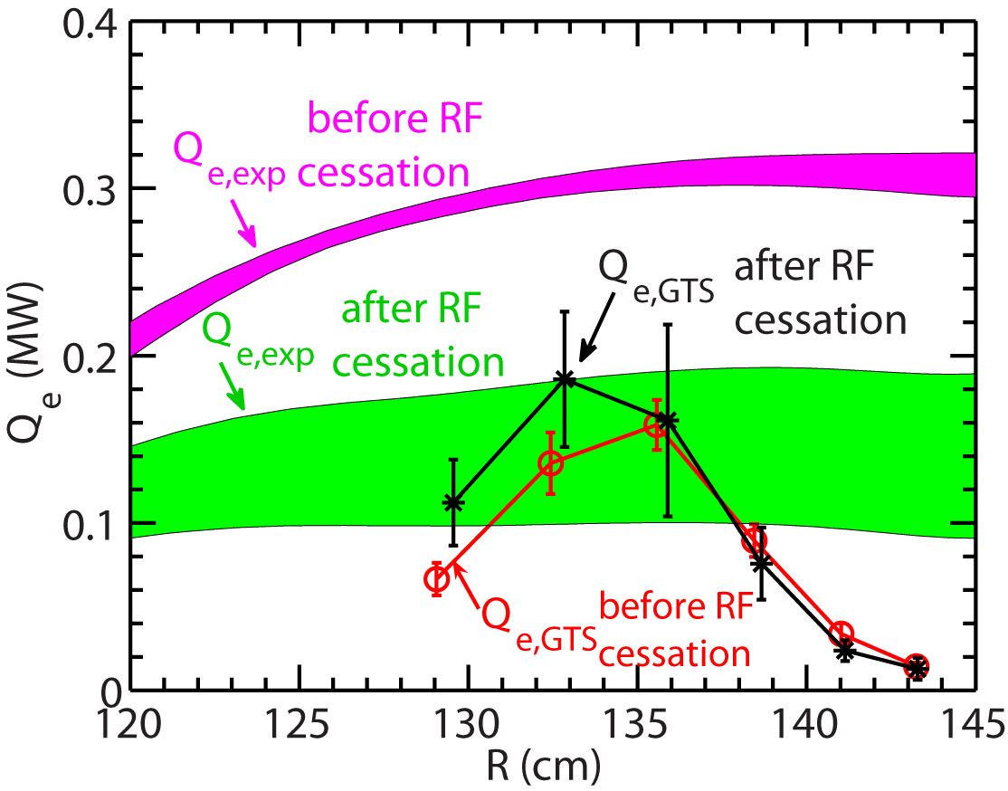
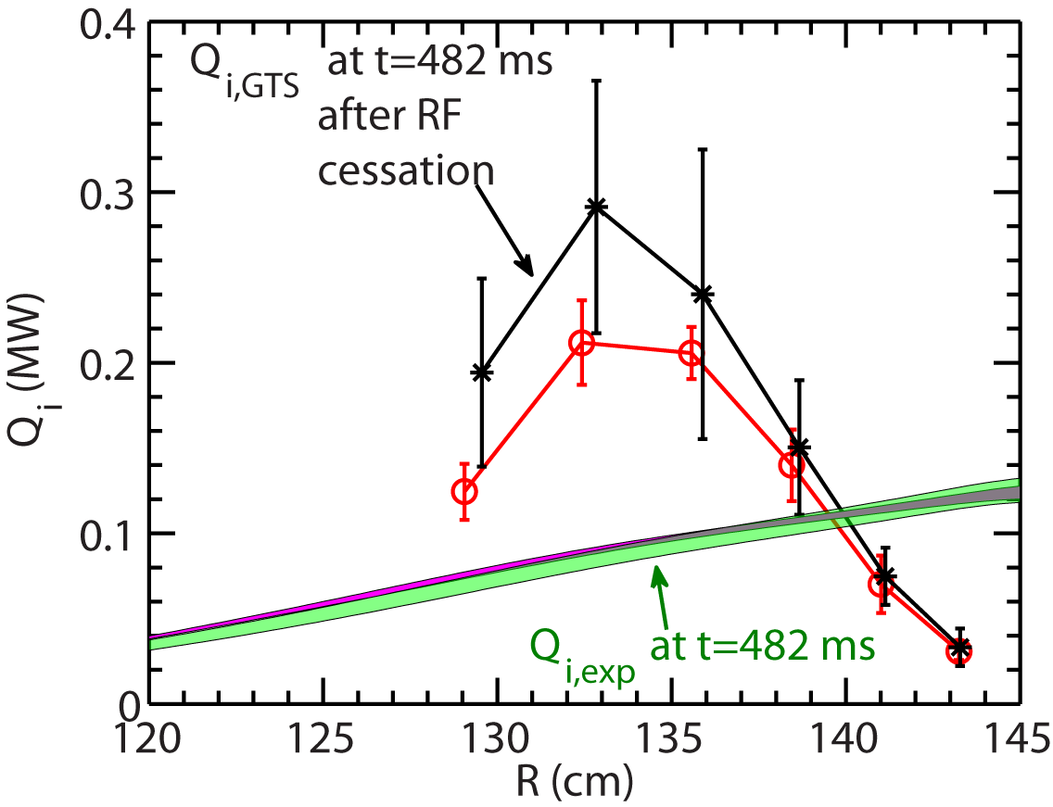
Similar Energy Fluxes from GTS are Seen before and after the RF cessation
Electron energy flux matches experimental value after the RF cessation but not before
Experimental values from TRANSP+TORIC analysis
Ion energy flux is over-predicted
Electron thermal transport
Ion thermal transport

Slide 6
NSTX H-mode plasmas

Slide 7
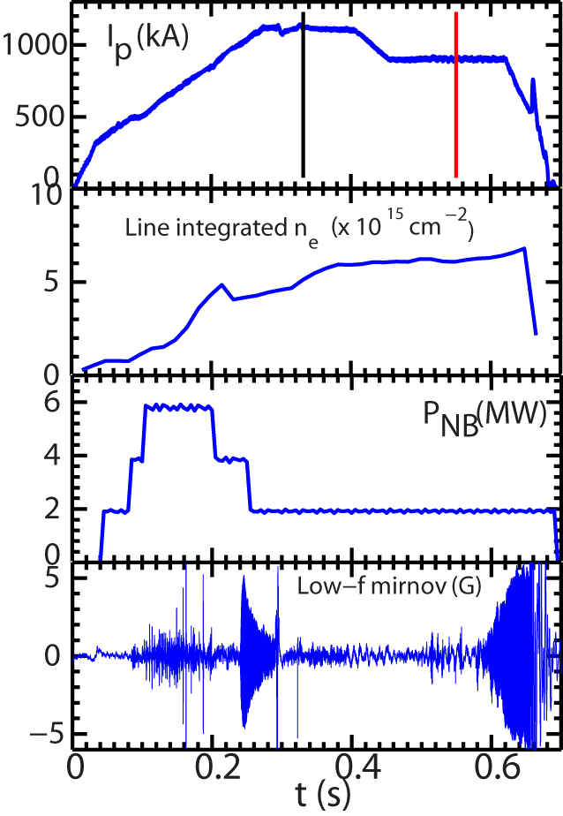
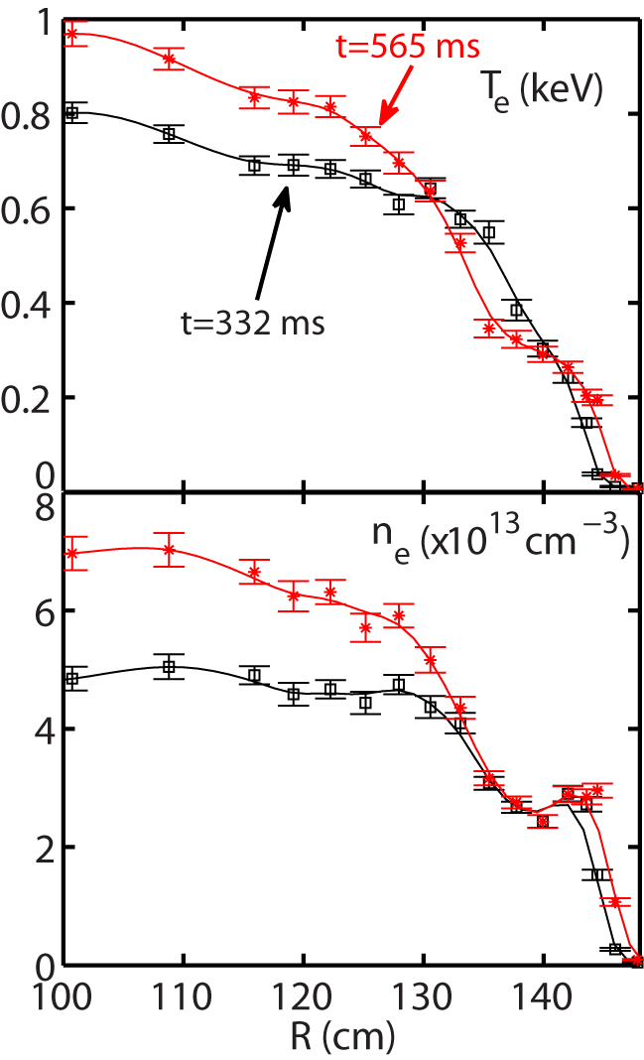
Current Ramp-down in NSTX H-mode Plasma Leads to Core Density Gradient Increase
Shot=141767
NBI-heated L-mode plasma with
B_{T} =5.5 kG
Ruiz-Ruiz et al., PoP 2015

Slide 8
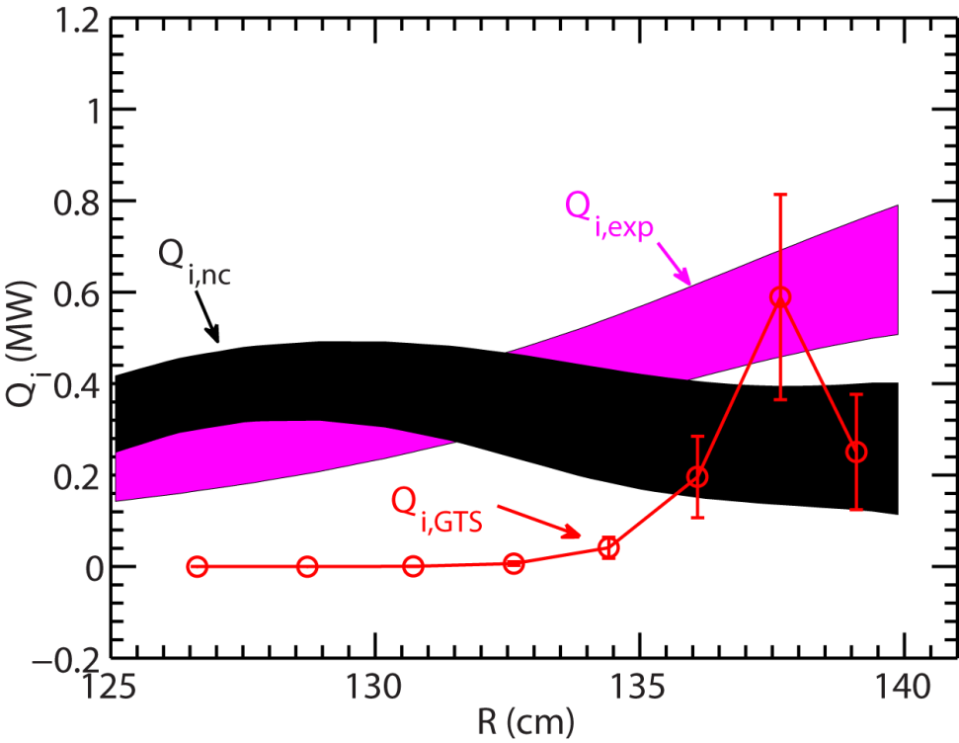
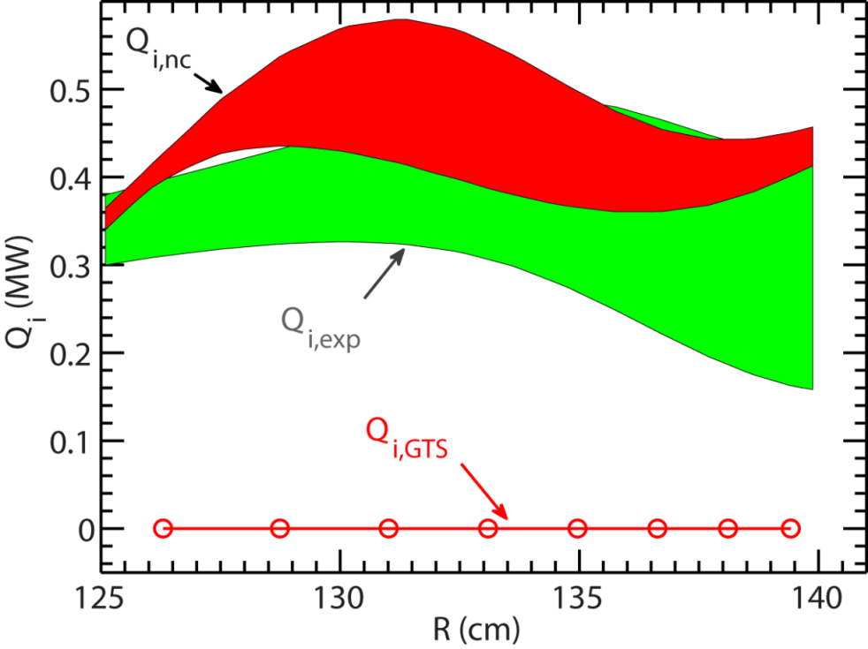
Ion Energy Flux from GTS Is in Agreement with Experiment
t=332 ms
t=565 ms
Neoclassical ion thermal transport can account for experimental ion thermal transport
Ion-scale turbulence suppression due to ExB shear
Ion energy flux from ion-scale turbulence contributes significantly at R>135 cm

Slide 9
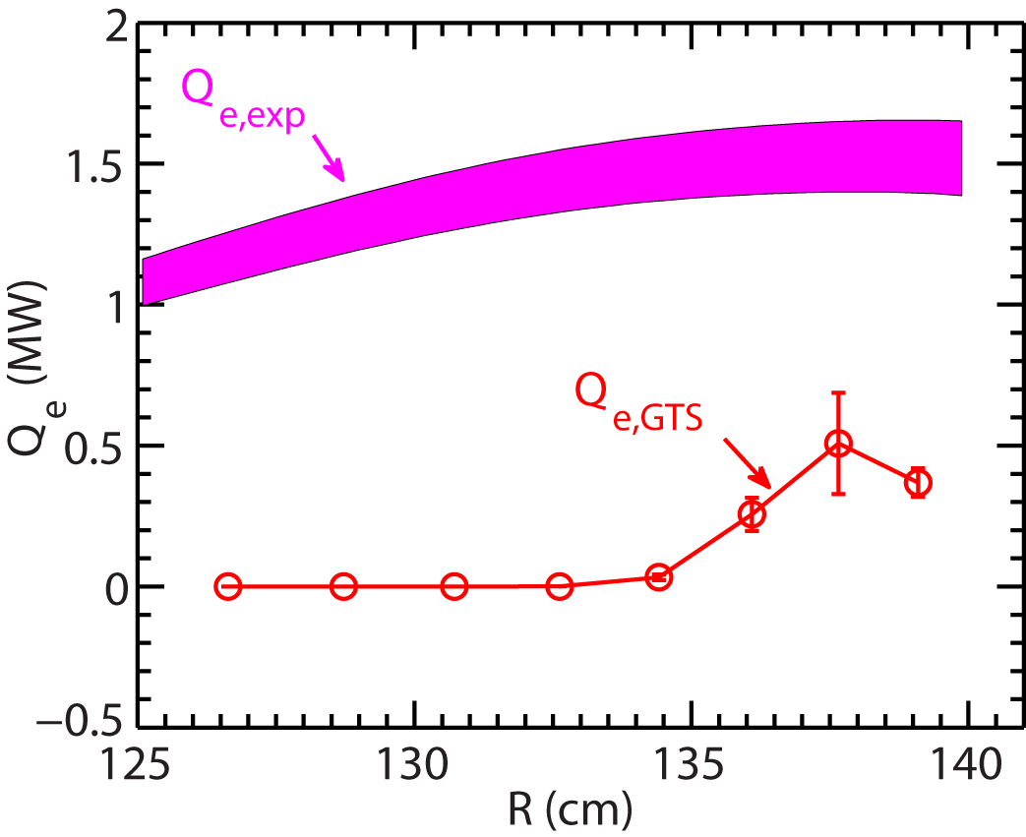
Electron Thermal Transport is Significantly Under-predicted by GTS
t=332 ms
Electron energy flux from GTS is only significant at R>135 cm
Much smaller than experimental electron thermal transport
Contribution from ETG and electromagnetic effects may be important

Slide 10
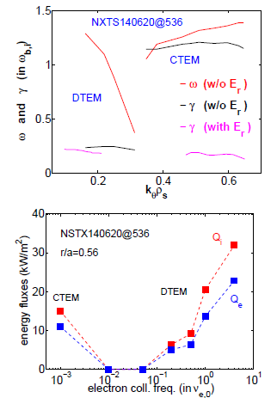
Dissipative-TEM May be Important for NSTX H-mode Plasmas
Dissipative-TEM found due to strong ∇n in an NSTX H-mode right after ELM
Capable to survive Strong E × B shear
Drives experimentally relevant transport
DTEM-transport increases with $ν_{e}$
CTEM strongly suppressed by collisions in STs
C/DTEM-free regime in low collisionality
(possibly relevant to NSTX-U & ST-FNSF)
Roles of DTEM further investigated over broad NSTX discharges

