Slide 1
TRANSP Analysis of NSTX-U
L- and H-modes
S. M. Kaye, PPPL
NSTX-U Results Review
Sept. 22, 2016

Slide 2
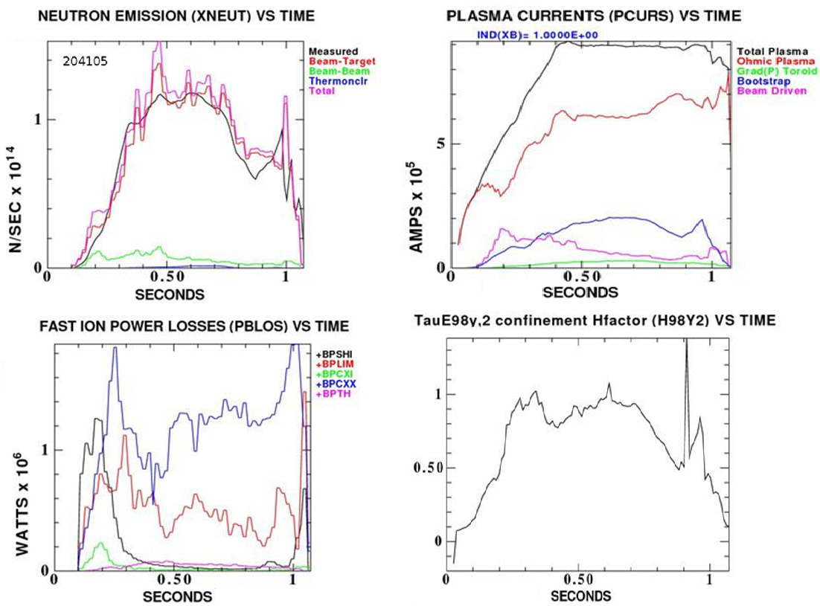
New NSTX-U tool: Between and Among
Shot TRANSP (BEAST) will aid experiment execution
NSTX-U BEAST TRANSP run
Typical BEAST run completed in 8 mins
  NSTX-U has 15-20 mins between shots
In preparation for next shot, session leader can gauge:
  Non-inductive fraction
  Beam loss
  Confinement quality
  Any TRANSP quantity…

Slide 3
TRANSP Runs Performed for Many L- and H-mode Discharges
Perform global/thermal confinement analysis
Study local transport (interpretive and predictive)
Hampered by either no CHERS (when second beam on) or poor signal
(at low input power)
  Often use Chang-Hinton neoclassical prediction for T_{i}
  Flat Z_{eff}=2 profile
  Feedback on AFID for neutron match
L-mode data taken from Beam #1 L-mode scan (W. Guttenfelder)
  I_{p} = 0.6 to 1.0 MA
  P_{inj} = 1 to 5 MW
  n_{e,bar} = 2.8 – 6 x 10¹⁹ m⁻³
Compare to 204118 (H-mode)

Slide 4
Thermal Confinement Trends Difficult to Extract Due to Poor Coverage Across Parameter Space
L-Mode

Slide 5
H-mode Confinement Enhancement Well Above that of L-mode (and >=1)

Slide 6
Reduction in χ_{e} Going From L- to H-; RLW predicts T_{e}
Caveat: Linear GYRO indicates
microtearing is NOT dominant
μinstability

