Slide 1
Parametric investigation of CAE & GAE instability and effect on thermal confinement in NSTX
S. Tang, UCLA
N.A. Crocker, T.A. Carter, E.D. Fredrickson, N.N. Gorelenkov, W. Guttenfelder
NSTX-U Results Review 2016
Princeton Plasma Physics Laboratory
Sep 21-22, 2016

Slide 2
Database extended with spectral characteristics of CAEs and GAEs
Existing database with plasma parameters from TRANSP extended to include characteristics of CAEs and GAEs
Database spans 195 total shots and 1051 total times
Frequency, mode power, and toroidal mode number calculated for each 50ms interval
Divide into 1ms records and FFT
Keep points (t,f) that are a good fit to single toroidal mode number
Power weight (dB^2) average f, n
Investigate whether these modes play a role in anomalous electron transport, as well as understanding physics controlling the instability
[Fredrickson 2014]
[Stutman 2009]
Notes:
This database comprises TRANSP runs on shots from the 2010 experimental campaign on NSTX
50ms window for each time
Various plasma parameters from TRANSP and EFIT reconstructions and direct plasma measurements are included
TRANSP runs assume no fast ion anomalous transport
Average only includes good fits to a single toroidal mode number
----- Meeting Notes (9/19/16 14:34) -----
Divide into 1ms recors and FFT

Slide 3
Beam power correlates with mode power
Correlation found between total mode power (|db|^2) and TRANSP calculated absorbed beam power
Power law found |db| ~ P_{abs}^{2.5}
Roughly consistent with nonlinear simulations and analytic theory which have shown: db ~ P_{b}²
[Lestz & Belova, 2016]
Notes:
Talk about consistency with HYM
----- Meeting Notes (9/14/16 14:59) -----
Rho=.67 and r^2=0.44
This plot is done using beam transition filter, Te>500, -10<n<-4,pabs>1,freq>200kHz
Restore,’april21.sav’
Mpnew=restore_to_struct(‘jul12_beam.sav’)
.run plot_pabs_mp_fit.pro
----- Meeting Notes (9/19/16 14:34) -----
Roughly consistent*
This is filtered specifically

Slide 4
Toroidal mode number and frequency highly correlated
(n/R)/(ω_{ci}/v_{b||})
dB² weighting
ω/ω_{ci}
Normalize ω and n as:
ω → ω/ω_{ci}
k_{tor} → k_{tor}/(ω_{ci}/max(v_{b||,inj})), k_{tor}= n/R
Motivated by parallel resonance condition
Perform mode power (dB^2) weighted fit
Notes:
Consistent with simulations of counter propagating GAEs (Check Jeff’s abstract APS)
Talk about averaging
Restore,’AUG24.SAV’
.run norm_f_n.pro
Coeff_fit_09162016,fn,nn,weight=mp.totpwrnz
----- Meeting Notes (9/19/16 10:54) -----
Isolates modes with significant mode power

Slide 5
Correlation improves with normalization motivated by parallel resonance condition
Instability thought to be governed by Doppler shifted cyclotron parallel resonance condition
ω_{ci} = ω – kv_{b||}
k and destablizing v_{b||} not known → k_{tor} and max(v_{b||,inj}) used
Correlation coefficient improves from ρ = 0.52 +/- 0.05 to ρ = 0.85 +/- 0.05
ρ calculated using dB² weighted
Suggests that resonance condition plays some role in governing instability
Notes:
Suggests that the resonance condition plays some role in governing instability
----- Meeting Notes (9/14/16 14:59) -----
doppler shifted cyclotron parallel resonance condition
3 beams, diff tan radii, max vb||
Take max vb|| on axis chosen for most energetic beam bc fast ion energy density peaks on axis and the most energetic beam is expected to be most destabilizing to modes
mention mode power weighting of fit
----- Meeting Notes (9/19/16 14:34) -----
actual vb|| that excites the wave
max (vb||) chosen for most energetic beam

Slide 6
T_{e0} correlates with both <f_{norm}>, <n_{norm}>
T_{e0} (eV)
dB² weighting
<n_{norm}>
T_{e0} correlates with both <f_{norm}> and <n_{norm}> with statistical significance, with ρ = 0.32±0.05 and ρ = 0.45±0.05 respectively
<f_{norm}>,<n_{norm}> control T_{e0}?
Notes:
Leading hypothesis for anomalous electron thermal transport is stochastization of electron orbits by resonant interaction with modes
May expect that frequency and mode number play a role in this mechanism
-fix plot
-R2 suggesting temperature controlled by other factors
Restore,’AUG24.SAV’
.run norm_f_n.pro
coeff_fit_09162016_2,nn,trnsp.te,weight=mp.totpwrnz
----- Meeting Notes (9/19/16 11:21) -----
Сonnection between Te0 and transport complicated
Look for more direct measure of core transport
----- Meeting Notes (9/19/16 14:34) -----
<fnorm>
central te not a direct measure of confinement
we look to find other quantities that directly characterizes confinement

Slide 7
min(τ_{e}) in core correlates with <f_{norm}>,<n_{norm}>
𝜒_{e} ideal indicator of anomalous transport but very noisy
Connects to Stutman PRL 2009
τ_{e}(ρ) integrated, low noise
Median smoothing to eliminate outliers
take minimum value between ρ = 0.1 and ρ = 0.5
Correlation of <f_{norm}>, <n_{norm}> with τ_{e} gives ρ = 0.296 ± 0.05, 0.302 ± 0.05 respectively
Modeling assume classical fast ion diffusivity → τ_{e} controlled by anomalous fast ion transport?
Some f, n more effective at orbit stochastization?
τ_{e}
dB² weighting
<n_{norm}>
Notes:
In principal chi-e is indicator of anomalous transport but is noisy (bc grad te goes to very small values in the area we look at)
Transp models taue as a function of radius and taue( r) is integrated measure of confinement and less noisy; min(taue) expected to decrease with degrading confinement
Temperature is measured(no modeling involved) so its correlation with f and n is not enforced
Temperature correlation is not enforced by the normalizations
-fix range
-tau e function of radius, use min value in core
-what it might mean (stochastization of electron orbit theory may be supported by this)
-Te changes, diff orbit frequency
-different freq and mode number might be more effective and orbit stochastization
-higher n,lower w more effective ?
----- Meeting Notes (9/14/16 14:59) -----
injection energy, how long energy is confined
stored energy/injected power
for each volume you have diff confinement time
clarify taue
location of min(taue)
Can also discuss how the weighted fit of frequency and tau_e improves drastically over unweighted
coeff_fit_09162016_3,nn,trnsp.teemed,weight=mp.totpwrnz
----- Meeting Notes (9/19/16 14:34) -----
ideal indicator
make сonnection to paper which first highlighted this topic
TRANSP modeling noisy
Not clear what role f, n play in efficiency of CAE->KAW energy transport mechanism

Slide 8
Backup Slides

Slide 9
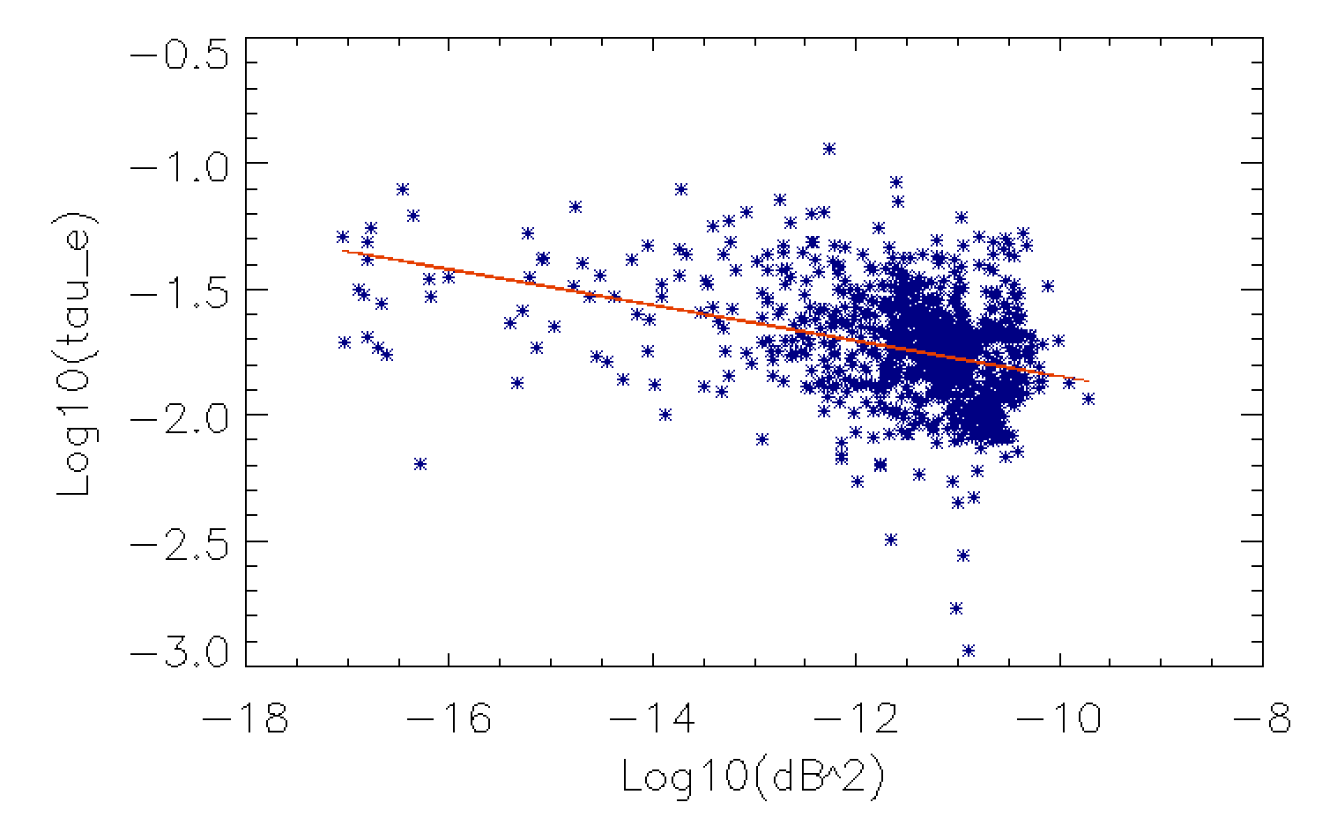
Mode power vs τ_{e}
Rho = - 0.356 +/- 0.03
R² = 0.13
Notes:
Rho = 0.356
R^2=0.13

Slide 10
<f> vs τ_{e}
τ_{e}
<f>_{norm}
Rho = 0.296 +/- 0.05
R² = 0.09
Notes:
Rho=0.296+/- 0.05
r^2 = 0.09

