Slide 1
Gas Puff Imaging (GPI) in NSTX-U
S.J. Zweben, F. Scotti (LLNL), D.P. Stotler, A. Diallo,
B. Davis, N. Mandell, J.L. Terry (MIT), W. Han (MIT)
• Previous GPI in NSTX (up to 2010)
• New GPI hardware for NSTX-U
• GPI results from 2016 run
• Planned XPs and analysis
NSTX-U Results Review Sept. 2016

Slide 2
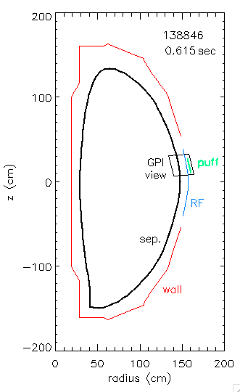
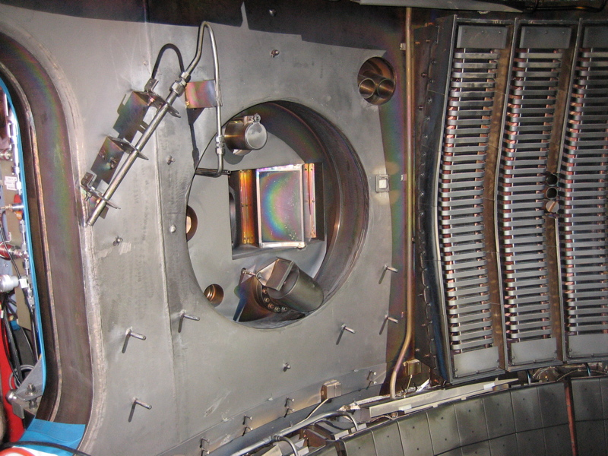
Gas Puff Imaging (GPI) Diagnostic on NSTX
• D₂ gas puffed from GPI manifold on outer wall above midplane
• Dα light emission from gas puff viewed from along local B field
• Fluctuations in Dα light emission interpreted as ñ turbulence
GPI gas
puffer
Dα emission
from puff
RF limiter
GPI
view
B field
GPI optical
viewport
2

Slide 3
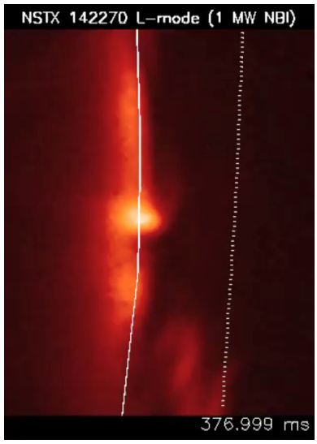
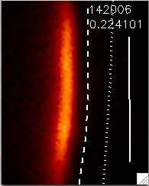
Example of NSTX GPI Data
• Exposure time/frame = 2.1 µsec/frame @ 400,000 frames/sec
radial
24 cm
1 msec movie
H-mode
separatrix
RF ant.
poloidal
30 cm
time (msec)
movies at http://w3.pppl.gov/~szweben/NSTX2013/NSTX2013.html

Slide 4
Analysis of Previous GPI Results
• We have outstanding database of GPI data from 2010 run,
including ~320 good shots (thanks to R. Maqueda)
• Many papers have been written to describe this data and to
compare the results with theory (thanks to J. Myra et al)
• The results are similar to many other devices, e.g. MAST
Yet the GPI data on edge turbulence is still not well understood,
so further measurements and comparisons with theory
and simulation (e.g. XGC-1) are appropriate

Slide 5
New GPI Hardware for NSTX-U
• New coherent imaging bundle (x3 larger signal)
• New Dα optical filter (x2-3 larger signal)
• New zoom lens (from ~5 mm to ~1 mm optical resolution)
look for possible small-scale structure in edge turbulence
reduce GPI gas puff rate for lower edge perturbation
increase GPI gas puff length when needed to ≥ 1 sec

Slide 6
GPI Results from 2016 Run
• No GPI gas puff (piezo not connected),
but rest of GPI system worked well
• Can see good signal in Dα background
light at 100 kHz (vs. 400 kHz in NSTX)
• Edge turbulence looks as expected, but
difficult to analyze due to 3-D effects
• Signal useful for comparison with ENDD
neutral measurement (Stotler, Scotti)
4 msec movie

Slide 7
Planned GPI Hardware for NSTX-U
• 9x10 APD array for higher S/N in GPI (brought from C-Mod)
• Fast camera view of GPI puff from across machine (Scotti)
• Helium line ratio measurement of edge T_{e} and n_{e} profiles
using GPI view, initially at f ≤1 kHz (Wisconsin/Padova)
Future:
• Additional GPI view(s) for measuring 3-D filament structure
• Better collimated gas manifold for higher spatial resolution
• Remote control of GPI pan/zoom for small-scale structure

Slide 8
Planned XPs for NSTX-U
• Search for small-scale edge turbulence structure at k_{pol}ρ_{i} ~ 1
(Mandell, Ren, Guttenfelder)
• Correlation of edge turbulence with heat flux SOL width and
XGC-1 results (Gray, Chang)
• Continue study of L-H transition (Diallo, Stoltfus-Dueck)
• Measure edge q(r) from turbulence filament tilt angle using
GPI + side view fast camera, like SAMI (Scotti)
Analyze 2010 GPI database for effects on edge turbulence of: divertor geometry, divertor detachment, RF fields, and RMP perturbations, to motivate other possible XPs for next run

