Slide 1
NSTX-U Run Assessment Overview of Run
S.P. Gerhardt
NSTX-U Run Assessment
PPPL B-318
9/28/2016, 10:00 AM

Slide 2
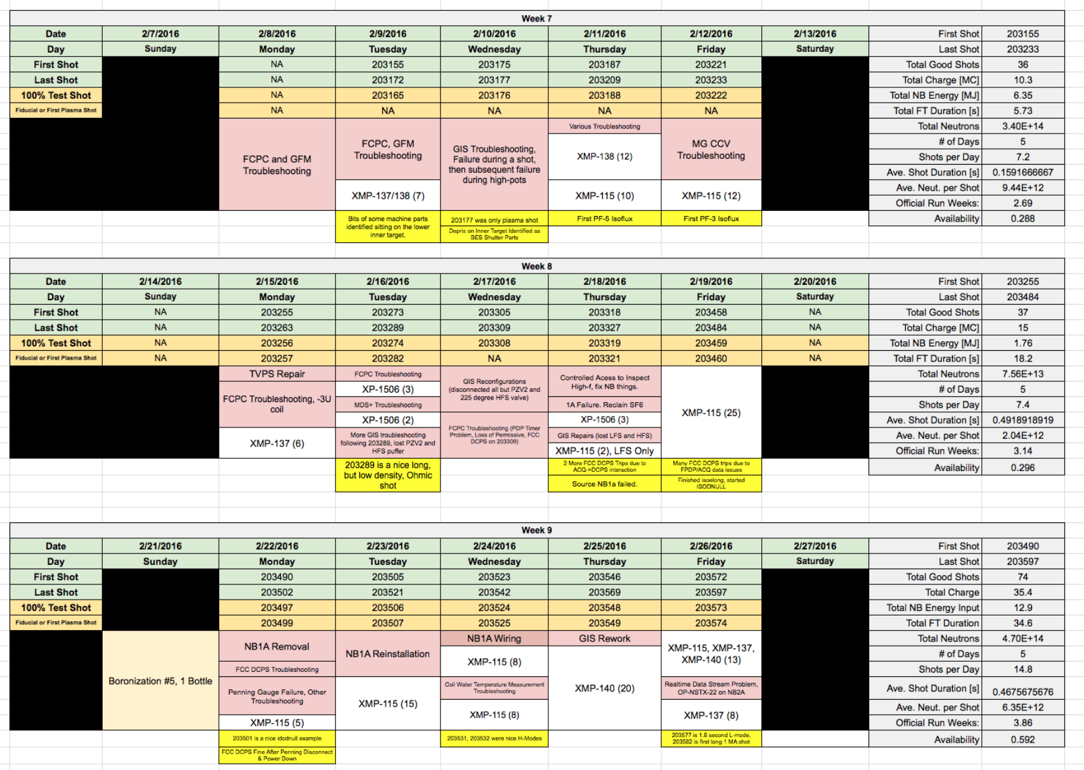
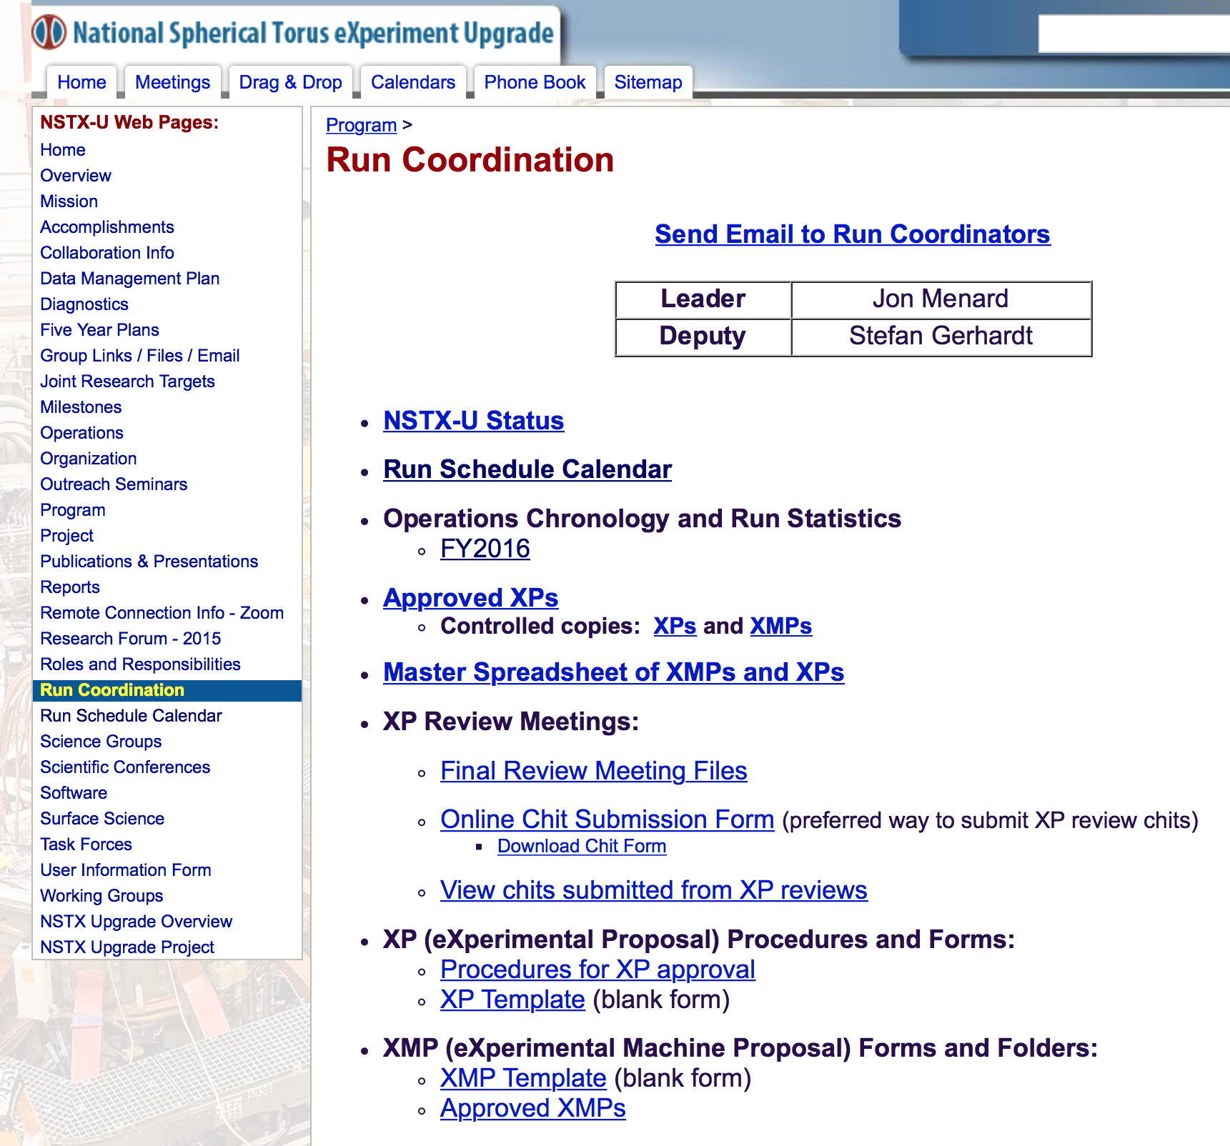
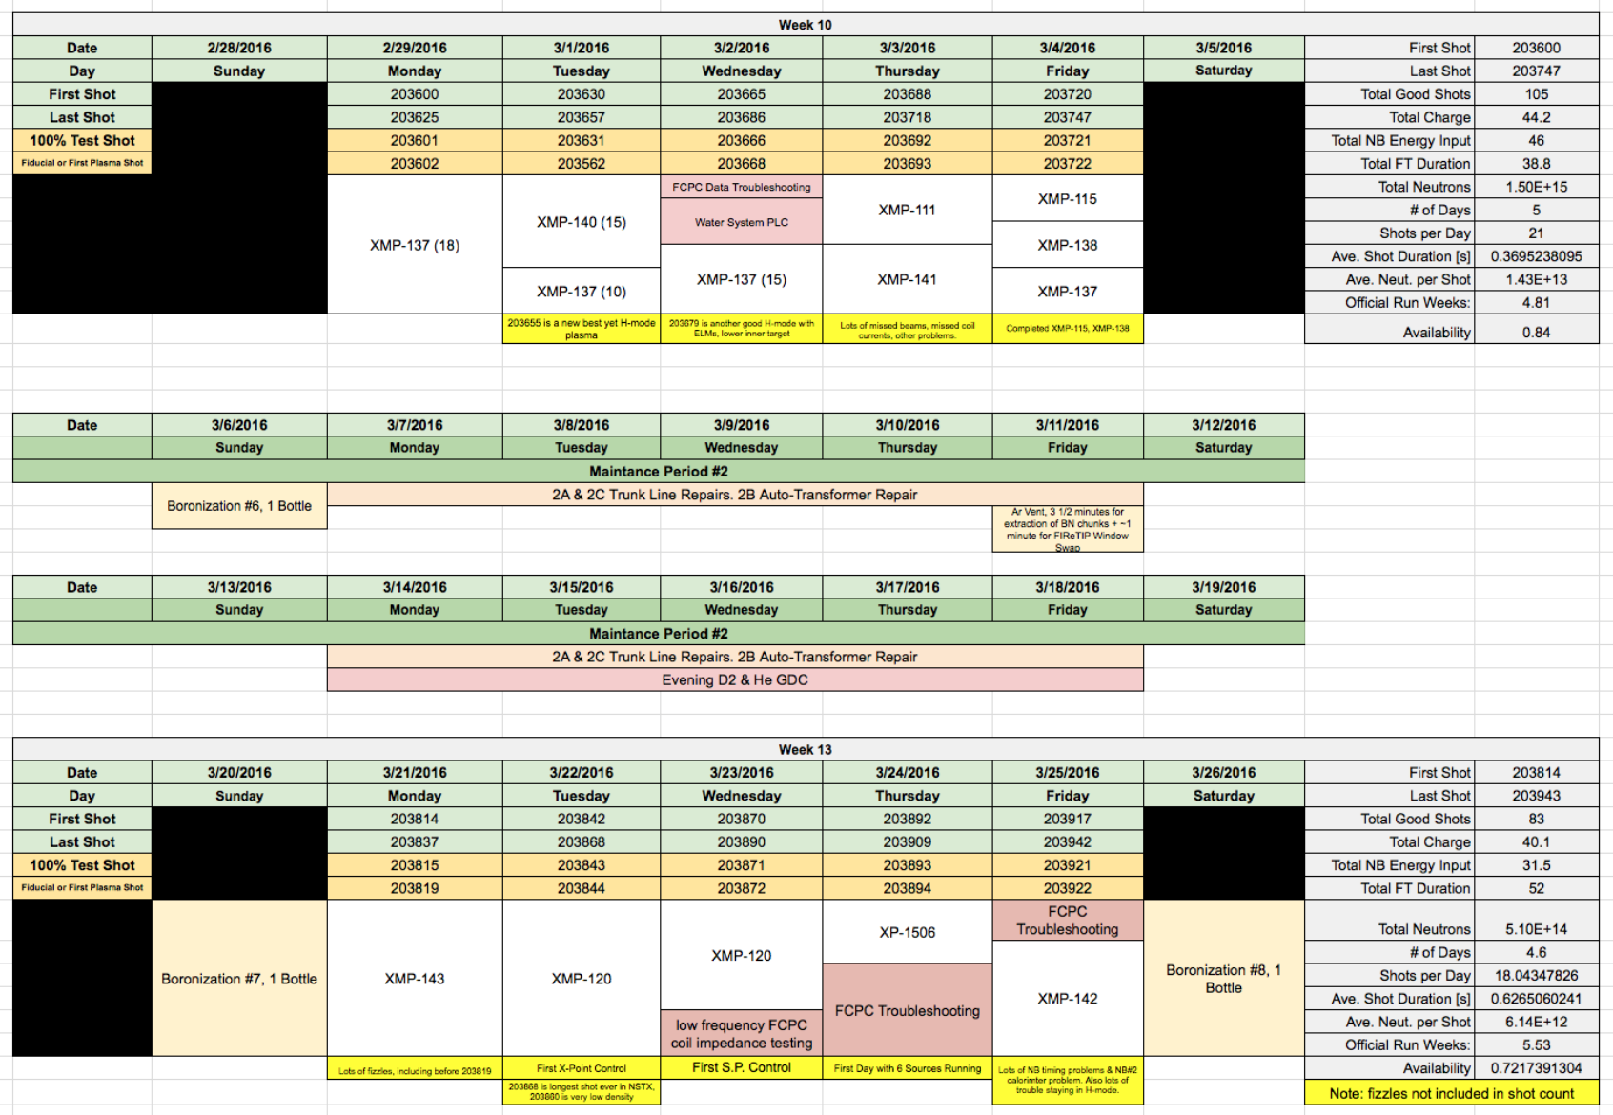
Comprehensive Run Summary is Posted

Slide 3
Highest Level Overview
Refrigerator Cooled: 12/2/2014
ISTP: Started on ~11/11/2015
First Plasma: 12/21/2015
Last Plasma: 6/28/2016
End of Operations Phase: 8/10/2016
11 declared maintenance weeks in the 27 weeks
And ~16 weeks where we tried to run.
10 full bottle boronizations and 12 mini-boronizations
1 ¾ Years
27 Weeks
39 Weeks

Slide 4
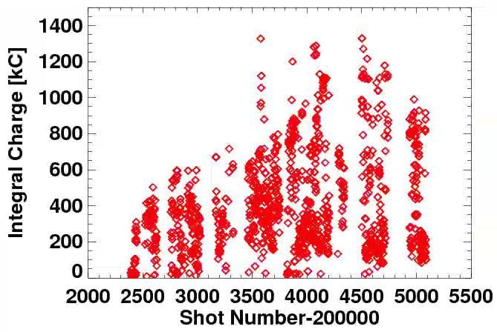
Much Progress Made During the Run Charge

Slide 5
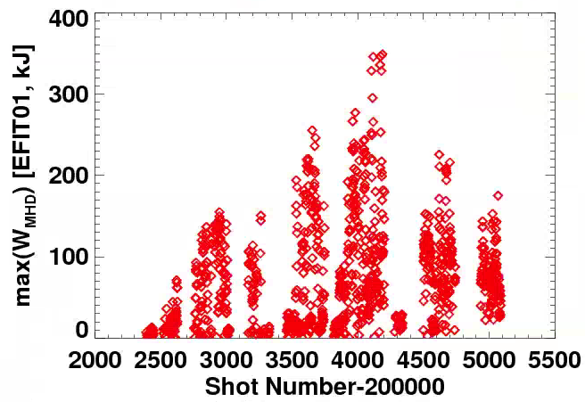
Much Progress Made During the Run Stored Energy

Slide 6
Much Progress Made During the Run Stored Energy
~15 Calendar Weeks
~12 Operations Weeks
~9 Calendar Weeks
~4 Operations Weeks

Slide 7
Much Progress Made During the Run Stored Energy
~15 Calendar Weeks
~12 Operations Weeks
~9 Calendar Weeks
~4 Operations Weeks
Last Full Boronization
Mini Boronizations
See F. Scotti Talk at from Results Review for More Boronization Data

Slide 8
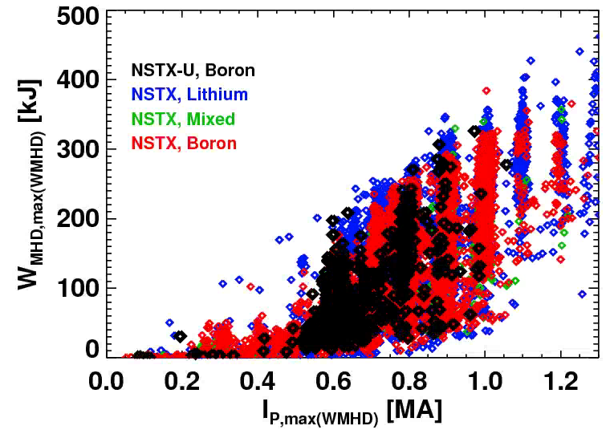
Stored Energy of the Best H-Modes in NSTX-U Matched those in NSTX w/ Lithium

Slide 9
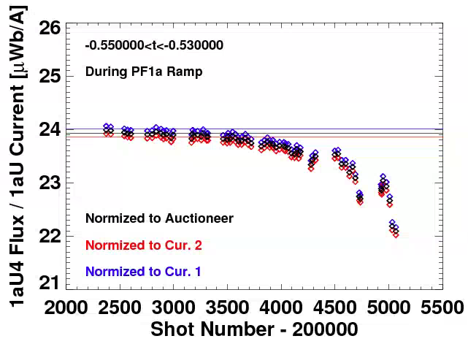
The -1aU Coil Was Slowly Failing Through the Run
~15 Calendar Weeks
~12 Operations Weeks
~9 Calendar Weeks
~4 Operations Weeks
Test Shot Analysis
See team meeting slides from 7/29/16 for more details

Slide 10
Key Message: We Really Did Make a Lot of Progress
15 Calendar Weeks
12 Calendar Weeks
From Dec. 21 through first week of April, made great strides despite a host of problems to solve.
May through June were very challenging:
Three discreet events during those months:
Inner-Outer vessel connection developed
PF-1aU hard bus flag bent
PF-1aU flow path became blocked
Apparent slow failure of the -1aU coil during operations

Slide 11
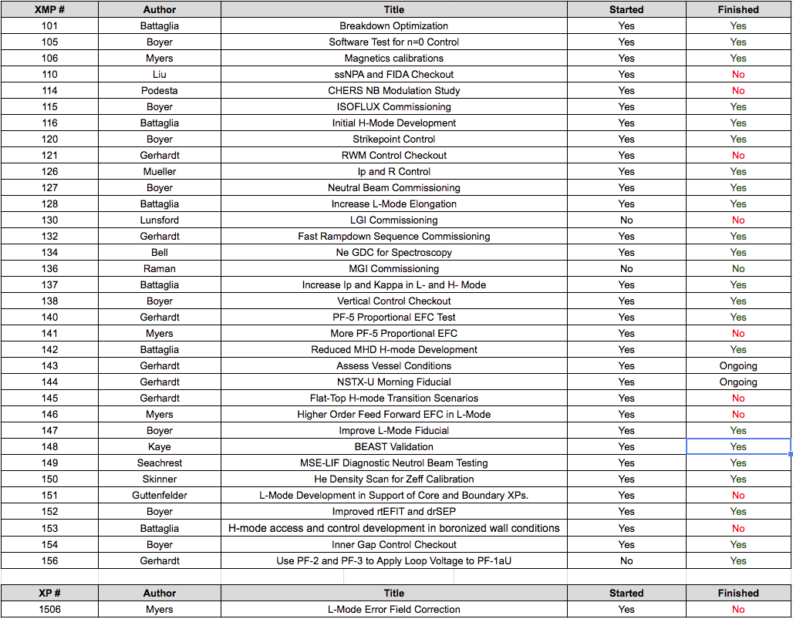
Ran All or Part of 35 Commissioning XPs and XMPs

Slide 12
Key Accomplishments During the Run: Engineering Operations
DCPS, PCS, EPICS, MDS+ provided excellent service.
Excellent MG and FCPC availability.
Up to 12 MW of beams simultaneously firing at the end of run.
FISO sensors deployed on the TF
Control of all GIS valves from PCS
CHI Handiscope installed and used
Things that were ready to go when we stopped:
LITERs and APS
HHFW (after breaker failure recovery)
IGI
MGI

Slide 13
Key Accomplishments During the Run: Diagnostics
Core Profile Diagnostics
BES
AXUV Core Bolometer
Poloidal CHERS
Toroidal CHERS
ERD
MPTS
MSE-CIF
MSE-LIF
USXR Poloidal Arrays (2)
rtVPhi
ME-SXR
Fast Ion Diagnostics
T-FIDA
V-FIDA
SNPAs (3)
Neutron Detectors
S-FLIP
I-FLIP
Fixed-f Reflectometer
Magnetics
Operations Magnetics
Diamagnetic Loop
RWM sensors
High-f and high-n arrays
Divertor
Divertor AXUV Bolometer (LADA)
Divertor Fast Cameras
Divertor Intensified Cameras
Infrared Video Bolometer
Divertor Langmuir Probes
U. Of Tennessee Spectrocospy
1D CCDs
MAPP
Divertor Tangential Imaging
Wide Angle Infrared Camera
Fast Infrared Cameras
Divertor SPRED
Spectroscopy
ENDD
XEUS
LOWEUS
MonaLISA
VIPS
DIMS
VB
EIES (Filterscopes)
DIBS
Other
Plasma TV (2)
Shunt Tiles
GPI
Penning Gauges
Operational
In Progress

Slide 14
Key Accomplishments During the Run: Research Operations
Breakdown and current ramp scenarios in the challenging high pre-charge scenario.
H-Modes on 8th (!) operations day.
And recovered (briefly) NSTX like H-mode performance at 900 kA.
And did it in about ~10 calendar weeks!
Developed L-mode scenarios for physics studies.
Enormous amount of control development, including many capabilities not available on NSTX.
Error field assessment and initial corrections.
Physics results coming out…see Results Review
2nd Neutral Beam Physics: Blip experiments, GAE modes
L-mode core turbulence and divertor filaments
Error fields

Slide 15
It was a Pleasure Working With The Team During This Operations Phase The End

Slide 16
Major Challenges For Run Coordination (I)
Evolving Facility
Beams were on an strong upward trajectory through the full run, but there were daily changes of status.
Unknown to us, the PF-1aU coil inductance and Cu cooling tube state.
Boronization Schedule
Each full boronization is a full day activity!
We moved to mini-boronization scheme on 4/4/16 after 10 full boronizations
This appeared to be supported by the diverter OII light.
This may or may not have been the right choice.
P_{LH} regression indicates threshold doesn’t scale simply with this quantity.
We were going to go back to a full boronization when the -1aU broke.

Slide 17
Major Challenges For Run Coordination (II)
H-mode Development vs. L-mode XPs
We had a bias towards H-mode development…milestones…
We could have done more L-mode XPs.
Though the lack of MSE made some of these XPs less attractive.
Communications
Was very difficult to plan more than a few days in advance.
Tried to keep the google run schedule calendar up to date.
Was on occasion hesitant to send status emails to anonymous groups.
But needed to get information to the control-room physicists.
Defaulted to my own email list

