Slide 1
NSTX Upgrade Test Cell Initial Schedule
Vent vacuum vessel by 9/19
No vessel entry at this time
Period of removals prior to start of outage: 9/19 – 10/14
Must complete by October 14th
Machine Technicians will provide assistance
Install new 118’ platform on west side by 10/14
Needed for racks being moved out of the way of NB2
Establish construction power by 10/14
Portable carts in 3 places in NTC
Disconnect all power in NSTX Test Cell except construction power
Will occur on 10/17
Assures all power has been removed from racks and equipment
Marks the end of free access to the Test Cell

Slide 2
NSTX Upgrade Test Cell Initial Schedule
Remove cable tray at top of machine start 10/18
To provide access for structural modifications
Remove RF piping within 10’ of machine starts 10/18
To provide access to the east side of the machine
Rack and equipment removals to make room for NB2 starts 10/18
Removals by machine technicians working to written procedures
Reviewed and coordinated by the Work Control Center
Removals of diagnostics from on/near vacuum vessel starts 10/18
Start with Bays J, K, and L
Coil up and protect cables, tubing and fibers
Structural modifications to umbrella and coil supports starts 1/2
Grinding and welding involved in all bays – top, mid-plane and bottom

Slide 3
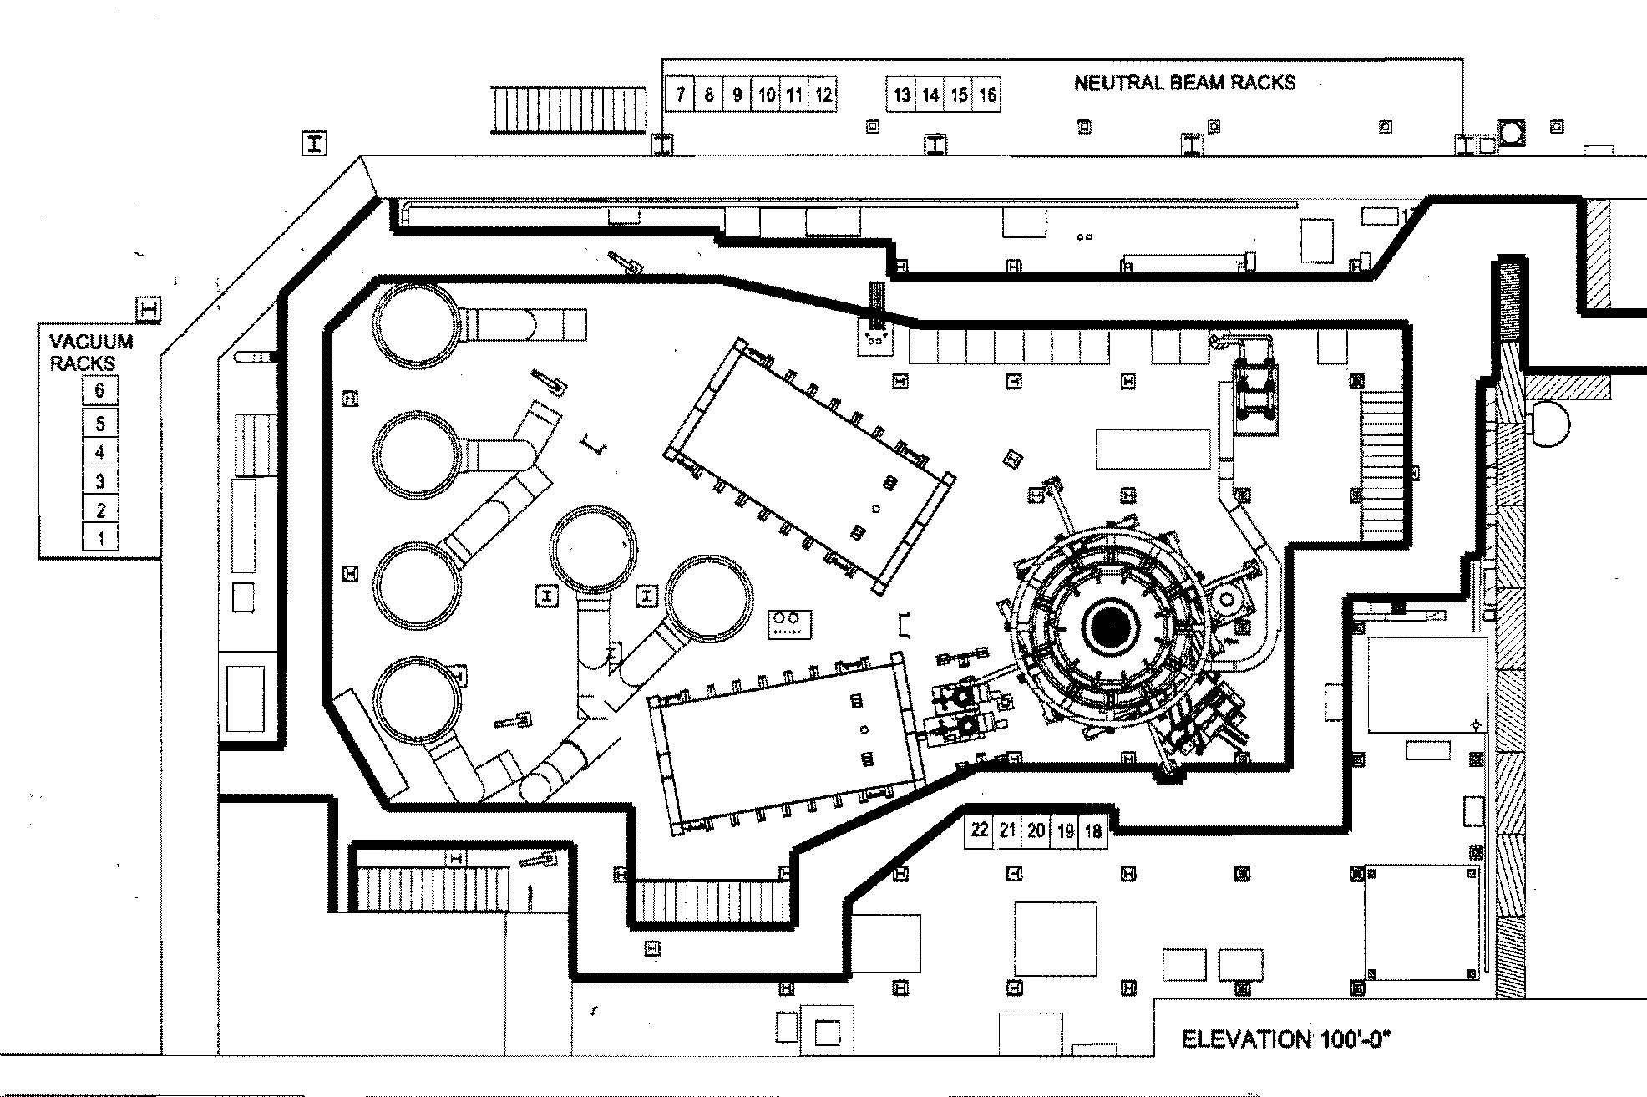
NTC Layout at End of Upgrade

Slide 4
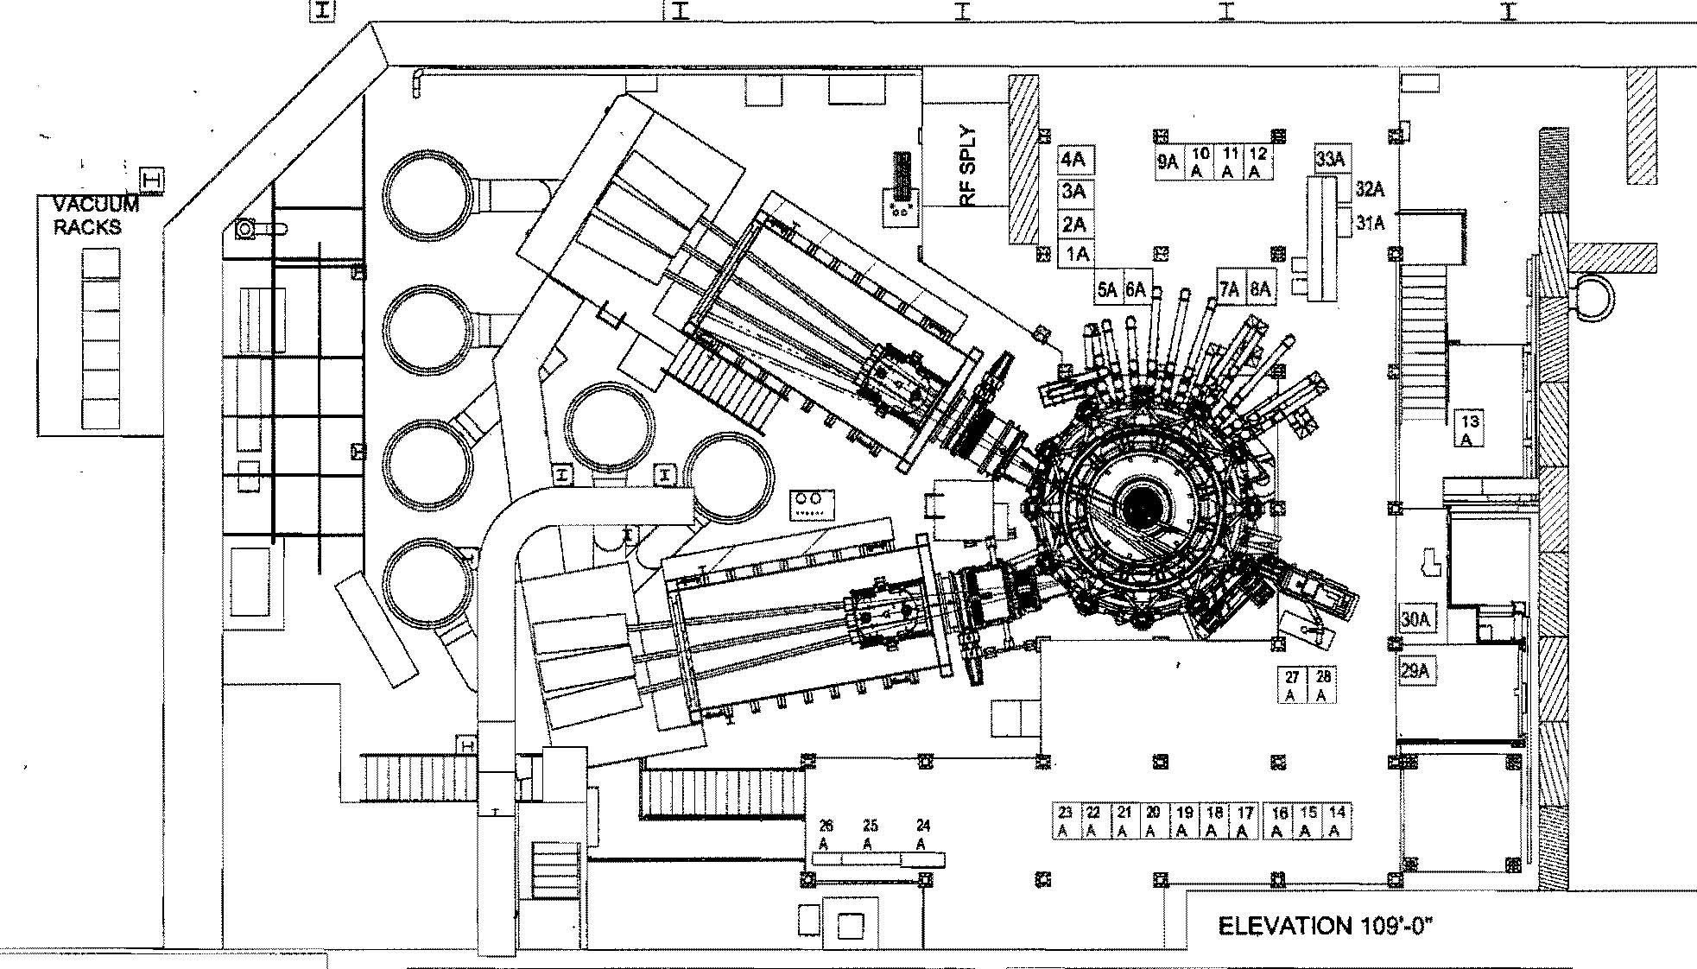
NTC Layout at End of Upgrade

Slide 5
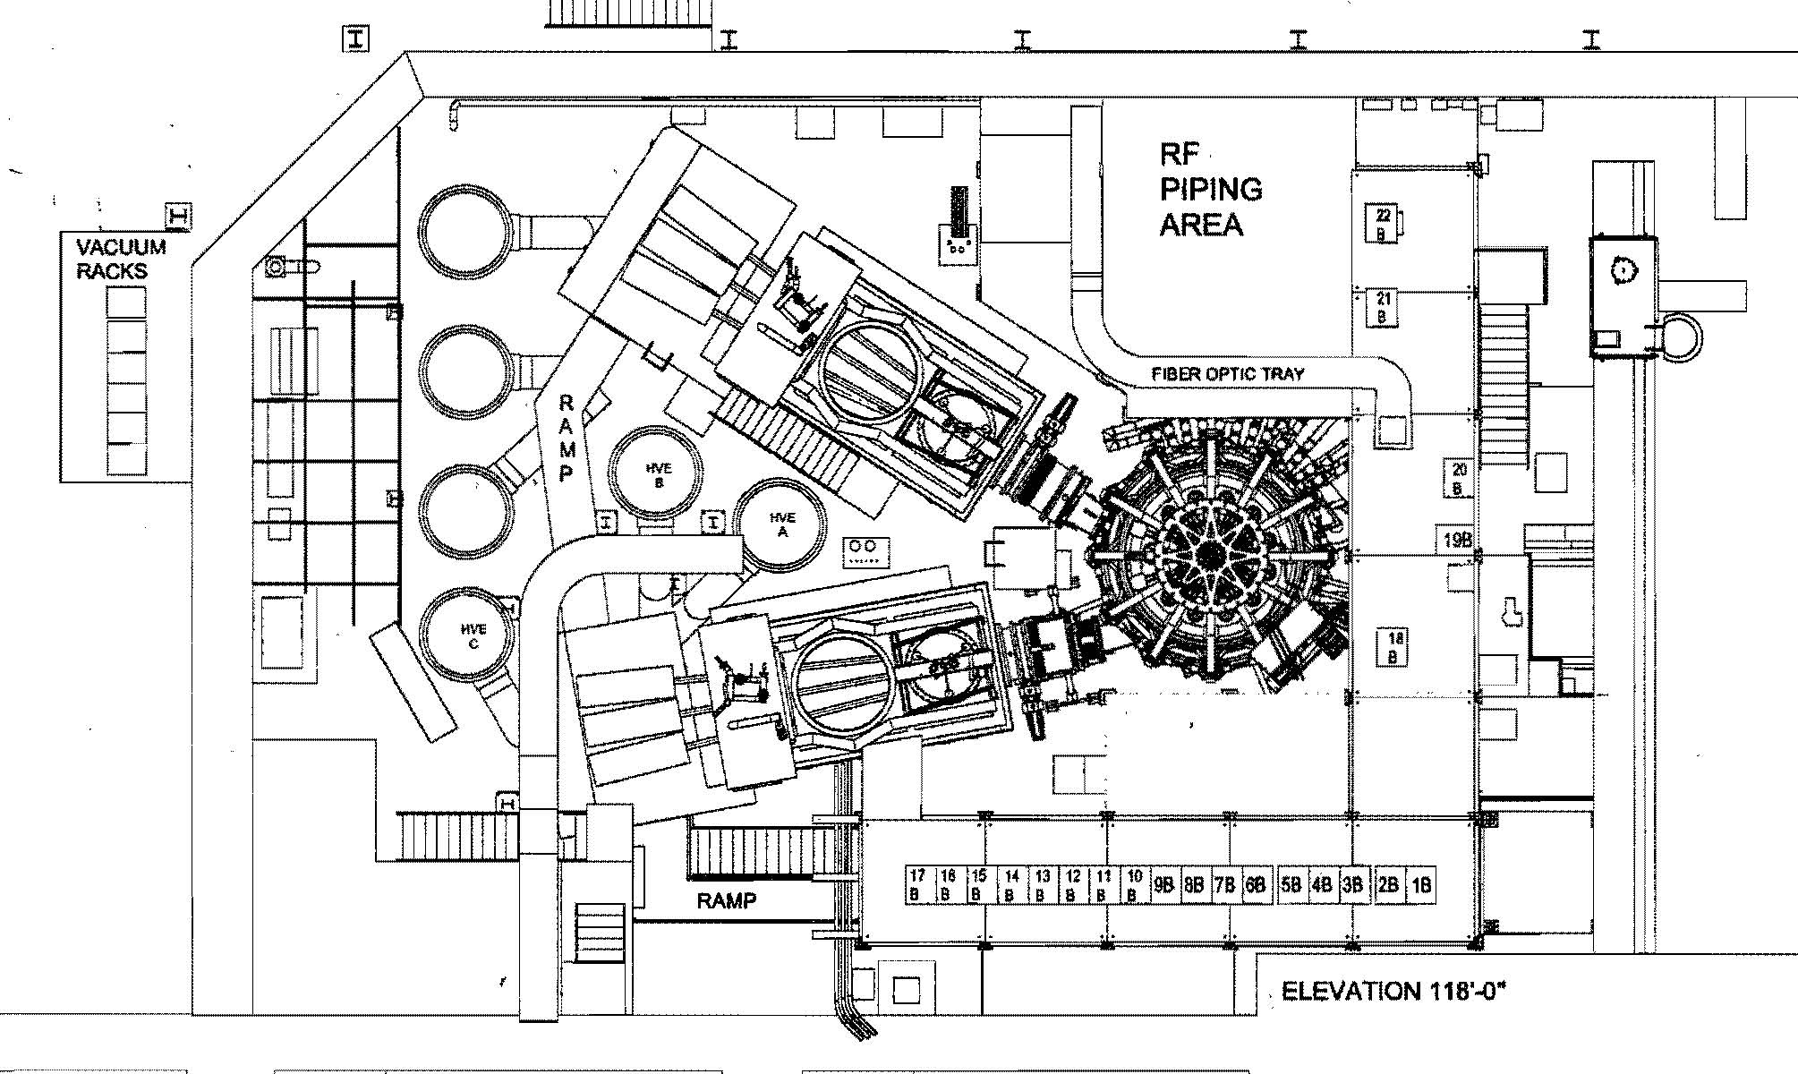
NTC Layout at End of Upgrade

