Slide 1




NSTX-U
Supported by
NSTX-U Program Update
Coll of Wm & Mary
Columbia U
CompX
General Atomics
FIU
INL
Johns Hopkins U
LANL
LLNL
Lodestar
MIT
Lehigh U
Nova Photonics
Old Dominion
ORNL
PPPL
Princeton U
Purdue U
SNL
Think Tank, Inc.
UC Davis
UC Irvine
UCLA
UCSD
U Colorado
U Illinois
U Maryland
U Rochester
U Tennessee
U Tulsa
U Washington
U Wisconsin
X Science LLC
J. Menard
Culham Sci Ctr
York U
Chubu U
Fukui U
Hiroshima U
Hyogo U
Kyoto U
Kyushu U
Kyushu Tokai U
NIFS
Niigata U
U Tokyo
JAEA
Inst for Nucl Res, Kiev
Ioffe Inst
TRINITI
Chonbuk Natl U
NFRI
KAIST
POSTECH
Seoul Natl U
ASIPP
CIEMAT
FOM Inst DIFFER
ENEA, Frascati
CEA, Cadarache
IPP, Jülich
IPP, Garching
ASCR, Czech Rep
NSTX-U Team Meeting
B318
May 7, 2013

Slide 2
Outline
FESAC facility review
NSTX-U 5 Year Plan preparation
Request of research team members

Slide 3
FESAC facility prioritization for 2014-2024 ranked NSTX-U
“(a) absolutely central” for enabling world-leading science
Contributions critical to ITER
  Energetic particle physics, where the new heating systems in NSTX-U will provide expanded ability to vary the velocity and spatial distribution of energetic ions in the plasma
  Radiative divertor solutions to the ITER-relevant heat fluxes, impurity transport using multiple conditioning and PFC scenarios to enable control techniques to be developed in impurity-seeded ITER plasmas
Developing new solutions for the plasma-material interface:
  The ability to explore very high exhaust power density, high magnetic expansion, and liquid metals in the same device is unique in the world fusion program
Establishing the physics basis for FNSF
  With access to the highest magnetic field and heating and current drive power of any low aspect ratio tokamak, NSTX-U will be the leading device in the world program to assess the viability of this regime for FNSF applications

Slide 4
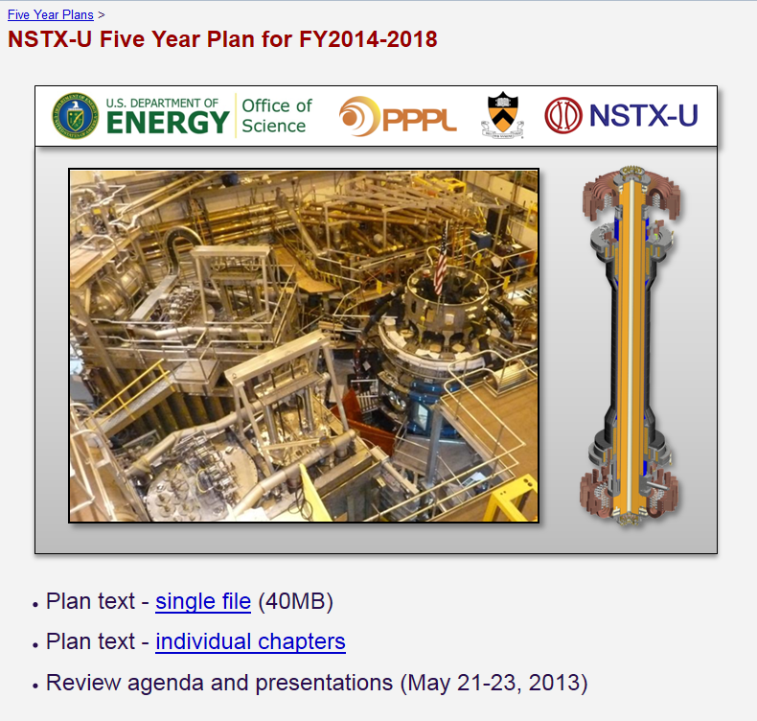
NSTX-U research team recently completed 5 year plan text
Plan text made available to review panel in April
760 pages total – panel given 1 month to read
Plan structure
  Executive Summary
  Ch 1: Overview
  Ch 2-9: TSG research plans
  Ch 10: Facility and diagnostics
  Ch 11: Collaborator plans
Thanks to chapter authors for all your hard work!
Thanks also to the internal reviewers for their comments
  welcome back to PPPL Rich!
Your comments on the plan are no longer welcome! ☺
4

Slide 5
NSTX-U 5 year plan review will be held May 21-23 at PPPL
Charge questions (many sub-questions not shown)
Assess the scientific and technical merit of the ongoing and planned research
Comment on the appropriateness of the proposed research plan.
Evaluate the competency of the proposed senior research personnel, adequacy of the proposed research environment & resources
Assess the reasonableness of the proposed costs for fusion research and facility operations
Assess the performance of the NSTX research team during the previous five-year period. Also, assess the plans for NSTX Upgrade facility operations (at a top level)

Slide 6
Request to research team members
2 key measures of the productivity and quality of our scientific research: publications and invited talks
Please work with Stan to identify APS-DPP invited talk ideas - nominations due May 15, 2013
We urge you to try to publish your results in a prominent/widely read journal (PRL, Science, Nature)
  Utilize time between 5YP review and prep for NSTX-U 1st plasma
  2012 PRL count was 1 vs. recent years: 3-6 – need to increase this

