Slide 1
Research Operations Update
S.P. Gerhardt
Thanks to Bob Ellis, Bob Kaita, Brent Stratton, Vlad Soukhanovskii, Dennis Mueller, Joel Hosea
NSTX-U Team Meeting
B-318, PPPL
2/5/2016

Slide 2
Outline
Diagnostics
RF Operations
Boundary Operations
Physics Operations

Slide 3
Diagnostics Update
Magnetics & MTPS routinely taking data
Debugging realtime processing of RWM sensors
CHERS has written data to the tree as well.
Real Time Velocity diagnostic has obtained initial plasma data
MSE-CIF ready and waiting for NB to come up in energy
Installations in progress:
LLNL EUV spectrometers (Xeus, Loweus, and Mona Lisa)
IR cameras at Bay H Top and Bay G Bottom
Gas Puff Imaging (but related GIS things remain outstanding)
AXUV diode and ME-SXR noise problems being resolved
Hoping to finish remaining diagnostic installations for the current run in March
Design work on Divertor SPRED, FIReTIP, Laser Blowoff system, Fusion Products diagnostic, IR Video Bolometer, Pulse Burst Laser System, and Resistive Bolometers is ongoing.
Thermionics probe drive for Fusion Products diagnostic is ready to ship.
Computer connection between SAMI diagnostic and England has been tested successfully. Updating SAMI firmware. SAMI shutter is connected and has been cycled.
LLNL spectroscopy making good progress
EIES, VIPS2, filtered divertor cameras, LADA all operational (LADA also suffering SPA noise problems)
Getting close on Xeus, Loweus, Mona Lisa, 1D CCD arrays, DIMS
If there are required shutters not yet in the control cycle please let me know.

Slide 4
RF Operations Status
ECH-Pre Ionization system commissioned and is supporting NSTX-U operations
6 HHFW sources commissioned in December 2015
Source #5 breaker failure was encountered in Jan 2016
Repair under recovery action plan is underway
Expect to begin vacuum cond. with 2-4 sources at end of February, sources 5 & 6 may take a bit longer
Will begin conditioning with 2 sources at a time
Decoupling between 2 sources for vacuum operation adjusted to better than -30 dB down (next slide)
Lots of progress on related diagnostics
ORNL reflectometer installed and being instrumented for measuring density fluctuations and PDI effects through the HHFW antenna
ORNL Langmuir probe being modified to fit through a gate valve to make measurements in front of the antenna
6 coaxial Langmuir probe arrays at J Top and J Bottom being instrumented for measuring RF deposition properties associated with the RF power lost to the SOL
RF probes are being prepared for Bay J installation
Several IR cameras are installed (or being installed) and will provide wide angle RF coverage for viewing the RF deposition in the divertor regions bottom and top
Mounting equipment and DAQ are being built for the antenna-dedicated fast visible camera and IR camera

Slide 5
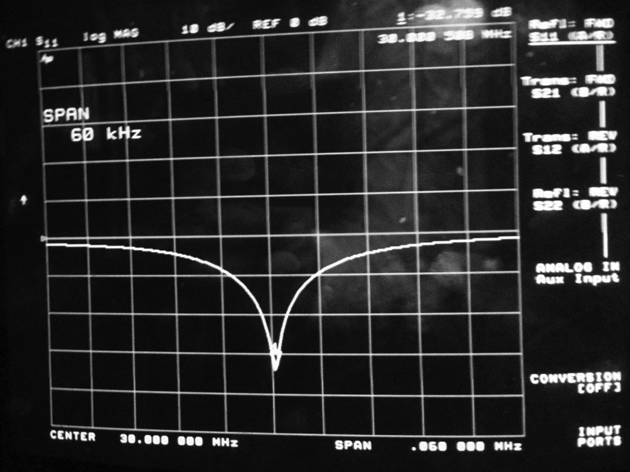
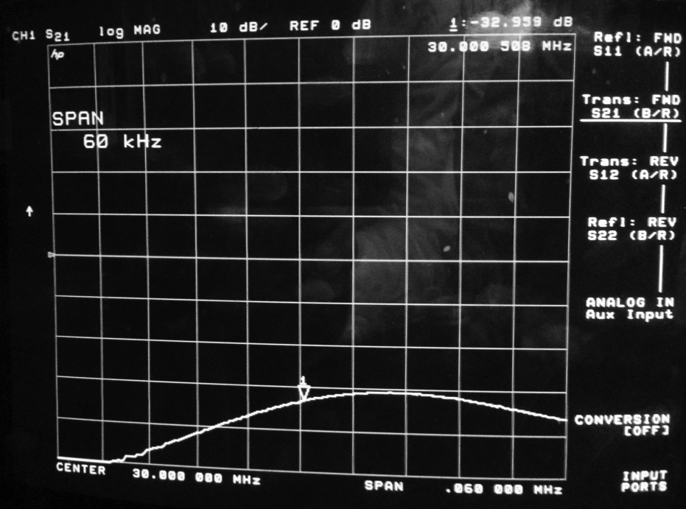
Feed configuration for two adjacent source vacuum conditioning
Strap 1 2 7 8
Decoupler between adjacent source cubes gives excitation phase flexibility
Decoupling between sources is better than – 30 dB for vacuum
+
-
-
+
-
Source 1
-
+
-
+
-
Source 2
Decoupler
S11
S12
- 30 dB
- 30 dB

Slide 6
Boundary Physics Operations
Electrical installations for LITERs complete with attachment of cables between electronics rack and probe drives in NTC
Procedures complete for filling and installing LITERs on NSTX-U
Radiation levels in South High Bay prevent access for LITER loading during plasma operations
May limit lithium deposition rates due to less frequent LITER loading
Impact being compared with additional complexity of using TFTR Test Cell
Initial data obtained with Materials Analysis Particle Probe – MAPP
Surface analysis of ATJ graphite and Titanium-Zirconium-Molybdenum (TZM) samples performed before and after exposure to boronization of NSTX-U PFCs with X-ray photoelectron spectroscopy - XPS
Preliminary results indicate change in surface oxygen after boronization
New electrostatic analyzer for XPS being installed for better energy resolution
Support stand built and remote control system development for granule injector complete
Installation planned for next maintenance period with completion of electrical installation package
Successful Preliminary Design Review held for initial high-Z tile set
Test machining indicated no issues with fabricating pockets for diagnostics
Bulk of TZM plate for manufacturing new tiles received
Aspiring for FDR in later February
Installation in outboard divertor planned for upcoming outage

Slide 7
Physics Operations
Now (semi)routinely operations produce ~20-25 plasma shots per day.
Shot cycle 15-20 min cycle is set by the time to cool the OH coil, not GDC+pumpout
Coming improvements in next 4 weeks:
New gas valve controller
Correct mapping of all 4 centerstack puff valves
2 - 1/8” and 2 - ¼” diameter, one each at midplane and shoulder
Multiple sensors for vertical control, improved filtering on sensors
rtEFIT & isoflux: first control of outer gaps, DRSEP
X-point control will come latter
Automatic limit on OH heating to keep rep. rate uniform
Ability to program n=1,2,3 fields directly proportional to PF/OH/TF coil currents
Machine start-up XMPs underway
Two immediate priorities
Still tuning shape/position control…this is the focus of first week back.
Continued development of the H-mode scenario at lower l_{i}, higher κ, reduced PF-1a currents
A few diagnostic XMPs will then follow as a priority
Ready for some XPs
Latency of PCS reduced by 200 μs to ~ 515 μs
New operators being phased in

Slide 8
Schedule Note
Maintenance periods presently scheduled for weeks of
March 7th
April 11th
See: http://www-local.pppl.gov/dss/CurrentRollover.pdf
Remember:
Permanent change to the NSTX-U device requires a work package.
Typically includes drawings, design reviews (peer reviews)
Can take a few weeks (or more) to assemble, so plan early.
Minor tasks not falling under this description can be done under work permits.
If in doubt, ask me, Tim, Al, Brent, Bob Kaita, Bob Ellis.

