Slide 1

PF-1aU Summary
Stefan Gerhardt
Devon Battaglia, Dan Boyer, Jon Menard, Clayton Myers
NSTX-U Team Meeting
PPPL, MBG Auditorium
7/29/2016

Slide 2
Overview
Observations from Our Testing Last Week
Model of Circulating Currents in the PF-1a Coils
Analysis of Some Historical Data

Slide 3
Overview
Observations from Our Testing Last Week
Model of Circulating Currents in the PF-1a Coils
Analysis of Some Historical Data

Slide 4
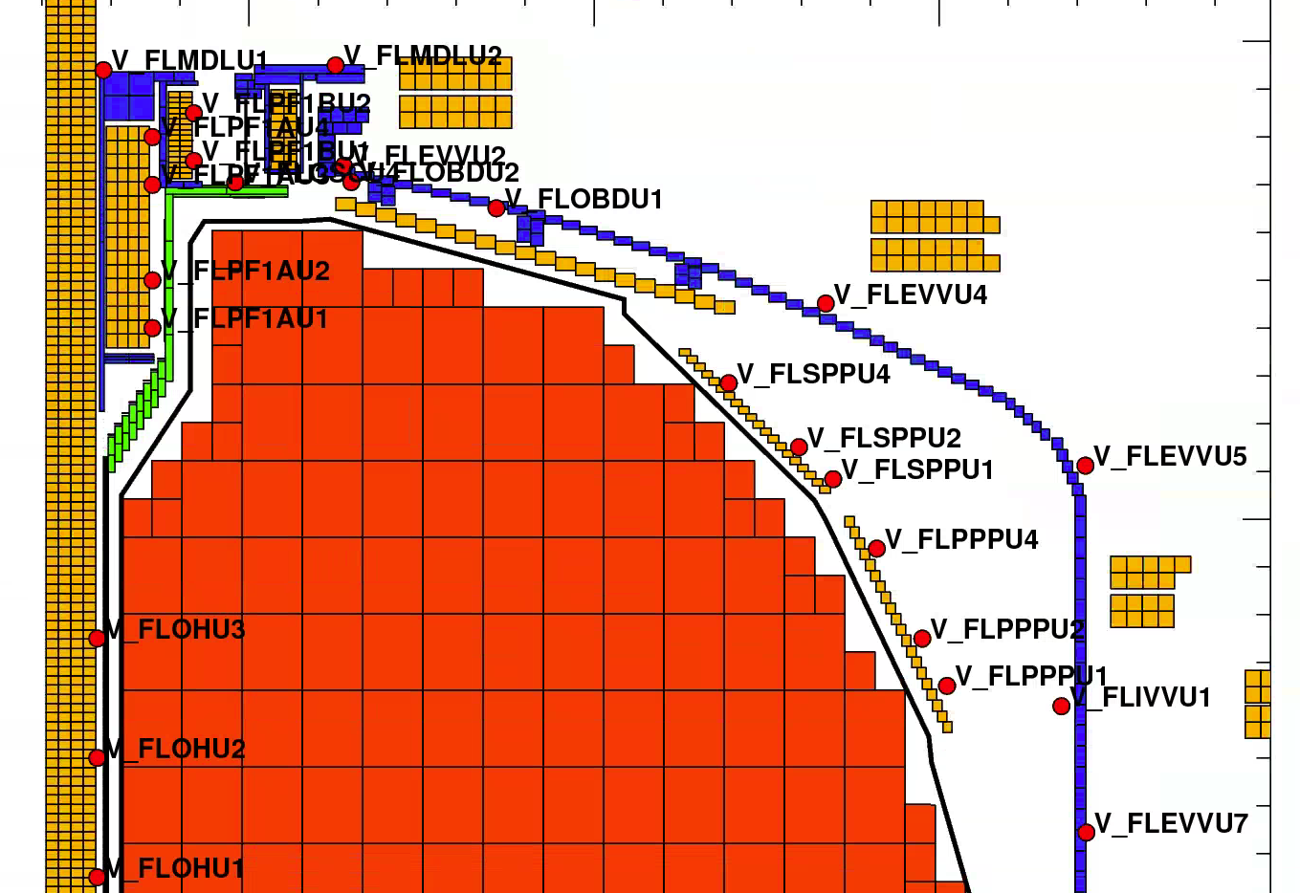
Reminder of Geometry
PF-2U
PF-1aU
PF-3U
OH
Each red dot is a voltage loop.
In cases where we integrate the signal, it is also a poloidal flux loop

Slide 5
Reminder: Status @ Last Team Meeting
Friday, 7/15/2016
PF-1aU flow blockage on Tuesday 6/28/2016
Copper slug, presumably from the coil, found in the water on Tuesday 7/5/2016.
Water leak develop on PF-1aU on Tuesday 7/5/2016
  PF-1aU coil was taken out of service.
Wednesday 7/6 – Friday 7/15 spend drying the CS
Were still waiting for the TF insulation resistance to recover before restarting operations.
-------------------- Team Meeting ----------------
Met Tuesday 7/19/16 to make a plan for restoration of operations.
  Start with PF-2U shots to “tickle” the PF-1aU, then move to OH, then OH+TF
Insulation resistance recovered sufficiently by Wednesday 7/20/16.
  Thanks to clever drying techniques by the machine techs.

Slide 6
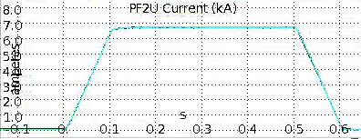
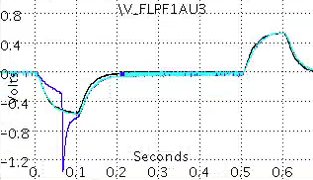
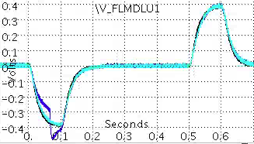
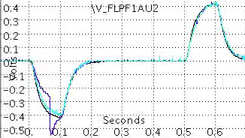
First Shot of 7/20/2016 Was a PF-2U Shot; Showed a Large Voltage “Glitch”
PF-2U Current
V_FLPF1aU3
202124 – reference from December
205321 – 1st 50% PF2U
205323 – next 50% PF2U
Glitch on 203521
V_FLPF1aU1
V_FLPF1aU2
7/20/16

Slide 7

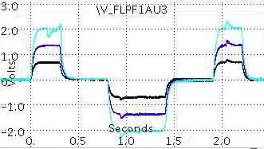
Similar Glitch Observed on an OH Shot
[25%, 50%, 75%] test shots taken (fractions with respect to 21 kA allowable).
205326: 25% OH
205327: 50% OH
205328: 75% OH
Voltage on a loop wrapped around the 1aU coil
Glitch on 203528
We stopped on 7/20/16 at this point and formulated a new test plan on 7/21/16
7/20/16

Slide 8
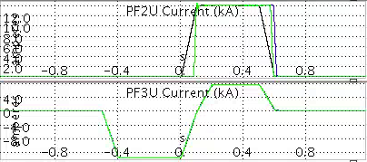
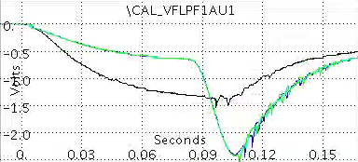
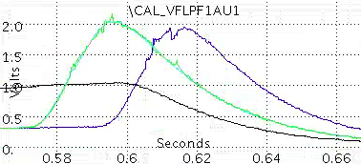
Operations on Subsequent Days Found Smaller Voltage Transients
XMP-156: Use PF-2U and PF-3U only
205350
205355
205357
205359
These were the last shots before stopping operations.
Voltage Loop on -1aU Coil…Small Transients Observed
7/22/16

Slide 9
Overview
Observations from Our Testing Last Week
Model of Circulating Currents in the PF-1a Coils
Analysis of Some Historical Data

Slide 10
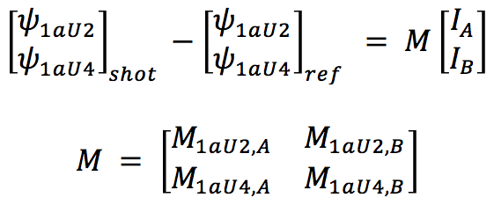
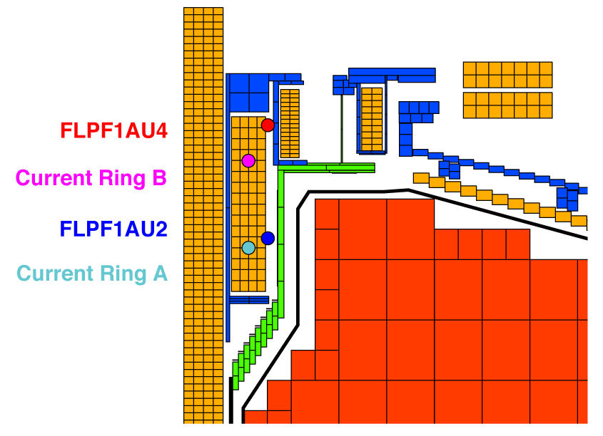
Use Two Model ‘Current Rings’ in PF1aU to Estimate Current Transients
The fluxes are measured at FLPF1AU4 and FLPF1AU2
The difference between the fluxes measured during recommissioning in July and during reference shots in December can be used to infer circulating currents in the compromised PF1aU coil
Model the circulating currents in PF1aU with two current rings (A & B)
Compute the mutual inductance matrix and invert to find the currents that produce the measured flux differences
Identical analysis on the bottom coil and loops
PF2U

Slide 11
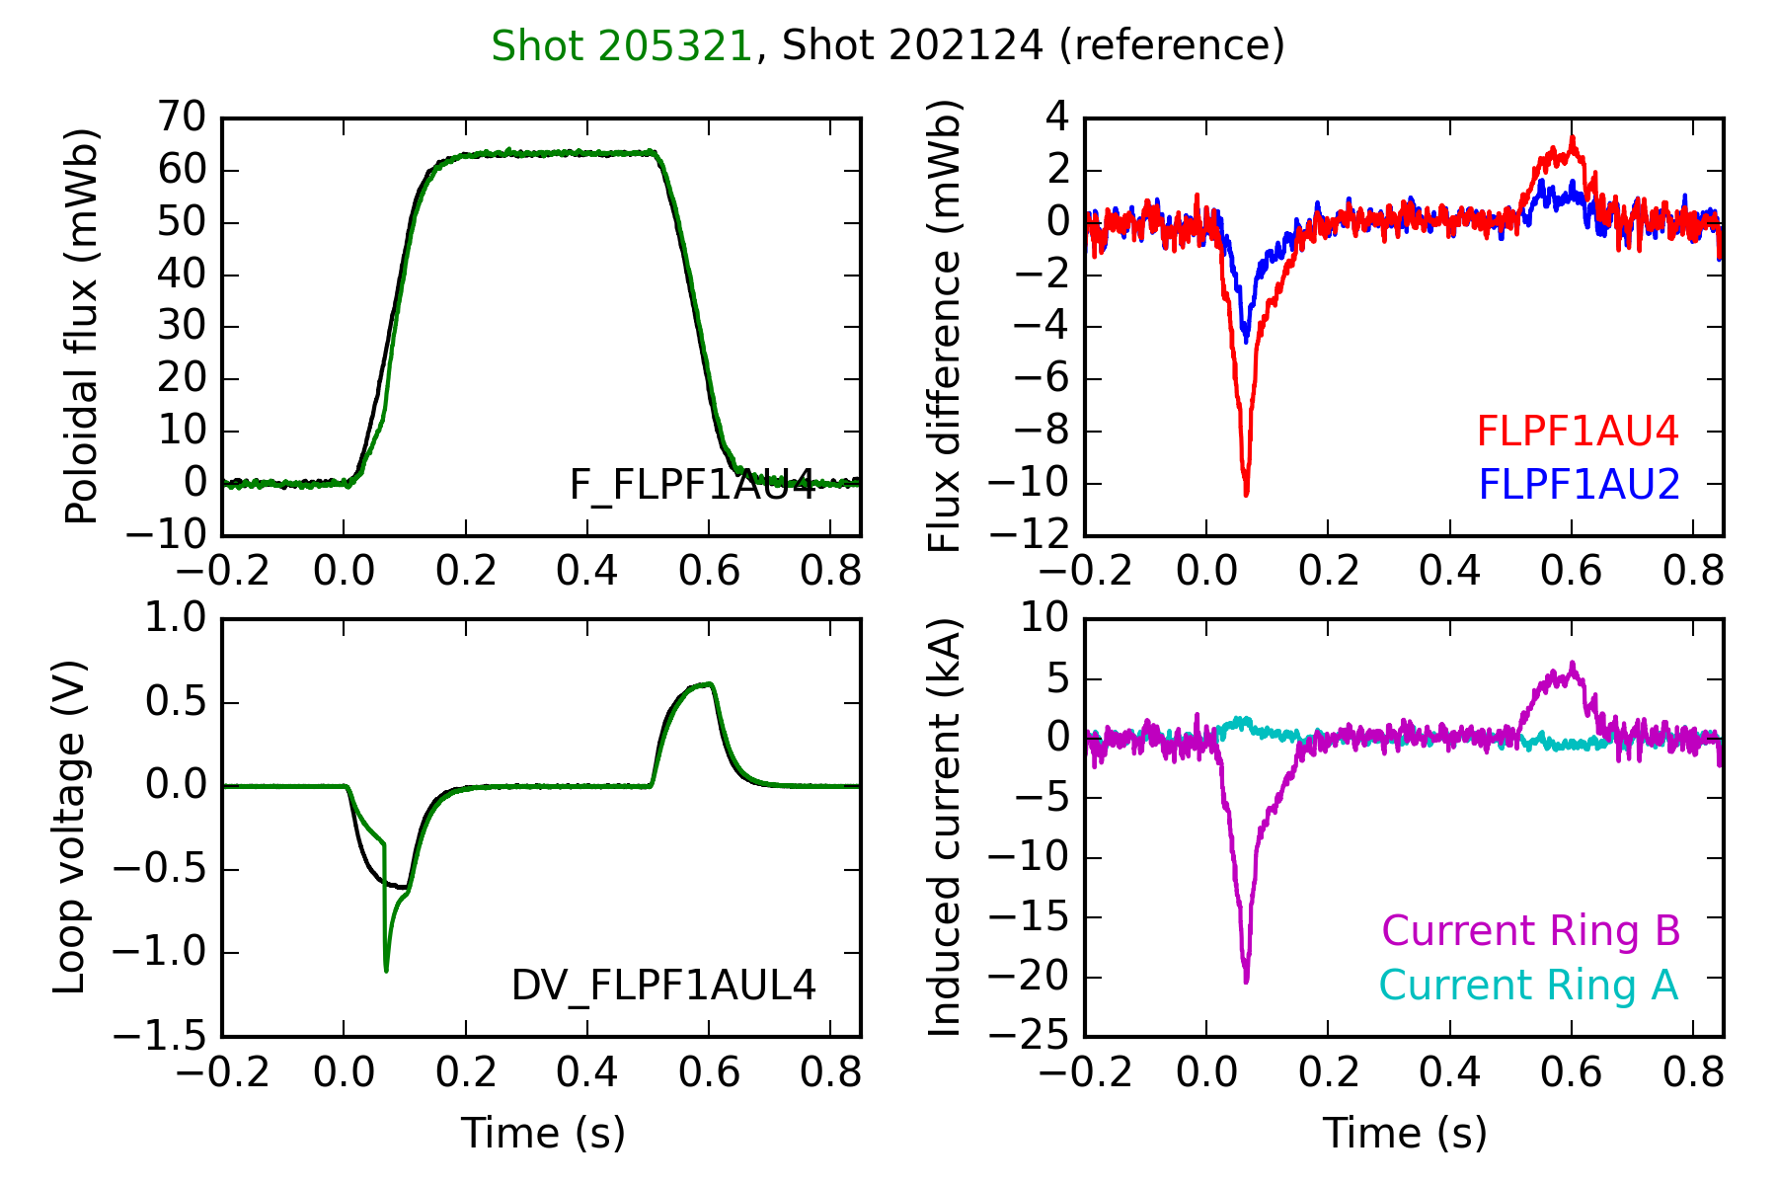
Estimate ~20 kA-Turns Induced During the First PF2U Recommissioning Shot
Large voltage transient suggests initially shorted turn(s) open up
Total induced current in transient is ~20 kA-turns (at the top of the coil)
In second hump of induced voltage, a steady difference is still visible
The second hump has ~5 kA-turns of induced current
7/20/16

Slide 12
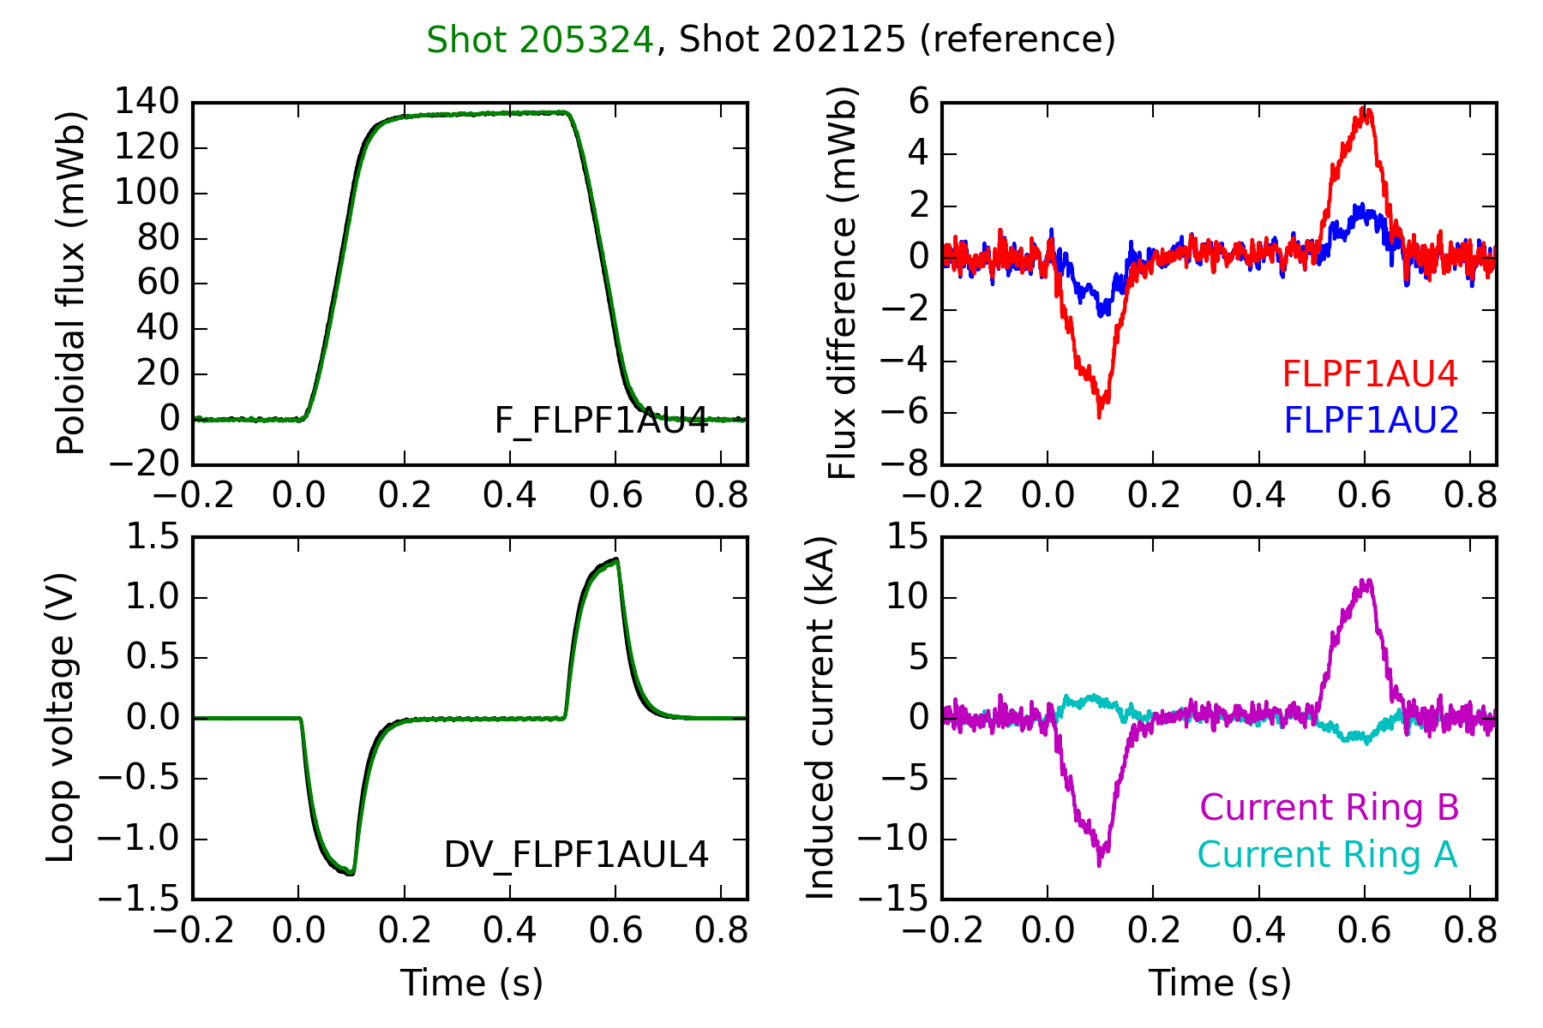
Subsequent Shots Showed Circulating Induced Currents in PF-1aU
Shot 205324 is a 100% PF2U shot
The previous 5 kA-turn behavior is a consistent 10 kA-turn signature…at 1 volt loop voltage
The melting potential implied by these currents during plasma scenarios drove us to halt operations on 7/25/16 in consultation with FES.
7/20/16

Slide 13
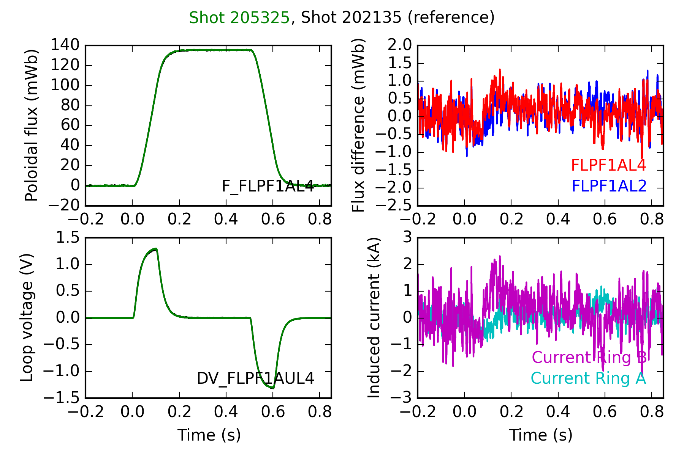
Similar Analysis on the PF-1aL Shows No Errant Circulating Currents
Shot 205325 is a 100% PF2L shot
Negligible circulating current is measured
The error bars are +/-2 kA at this larger PF2L current
7/20/16

Slide 14
Overview
Observations from Our Testing Last Week
Model of Circulating Currents in the PF-1a Coils
Analysis of Some Historical Data

Slide 15
Initial Analysis of Historical Data Yielded
No Trends
Firing angle request on the -1aU rectifier during test shots not visibly different on 6/28/2016 compared to previous days.
PSRTC “dI/dt algorithm” didn’t register anything.
EFIT chi-squares may have been creeping up, but not dramatically.
The process of analyzing the issues on 6/20/16-6/22/16 taught us more sensitive means of looking at magnetics data.

Slide 16
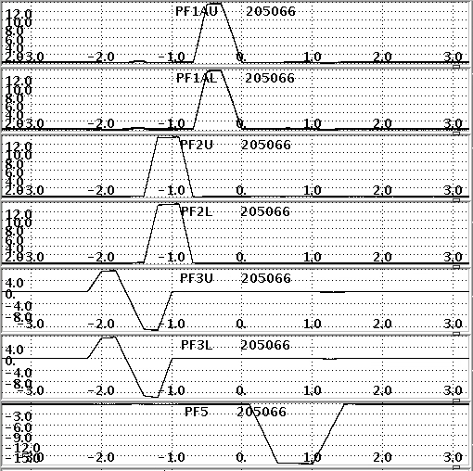
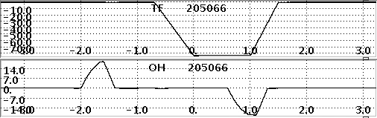
Test Shots Have Coils Coming and Going at Various Times
Test shot defined by requirement to run all coils in a single shot w/o violating any DCPS or FCPC allowables.

Slide 17
Test Shots Have Coils Coming and Going at Various Times
Test shot defined by requirement to run all coils in a single shot w/o violating any DCPS or FCPC allowables.
OH & PF-3 Ramps
OH Flat Top and PF-3 Ramp
PF1a Ramp
PF-1a Flat Top
OH Flat Top and PF-5 Ramp
OH & PF-5 Ramps

Slide 18
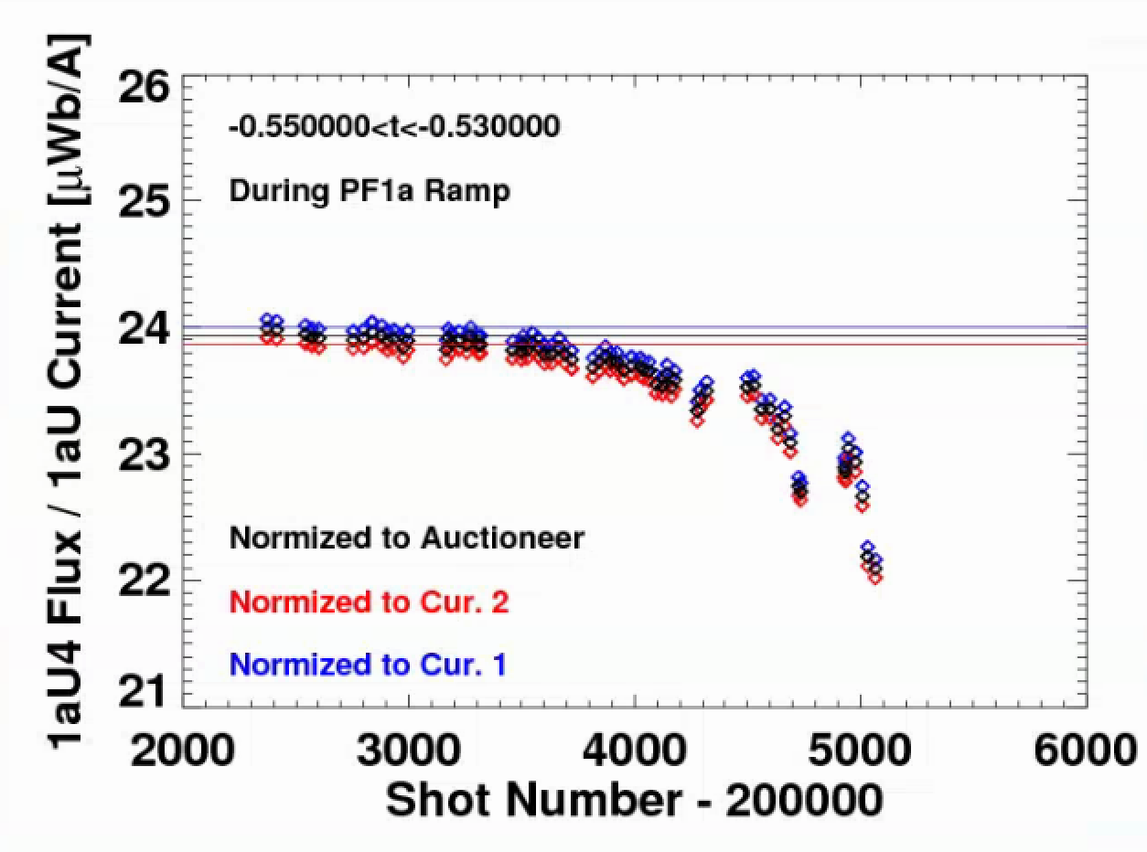
Analysis of 100% Test Shots Found a Slow Degradation of the -1aU Coil
Method: Normalize the flux on the -1aU coil to the -1aU power supply current
Flux Measurement: Flux loops on the coil OD
Current Measurement: Cur1, Cur2, and (Cur1+Cur2)/2
Less poloidal flux for the same power supply current
-> Inductance of the coil slowly changing in time
Rapid degradation leading into the final set of shots
Upper Coil

Slide 19
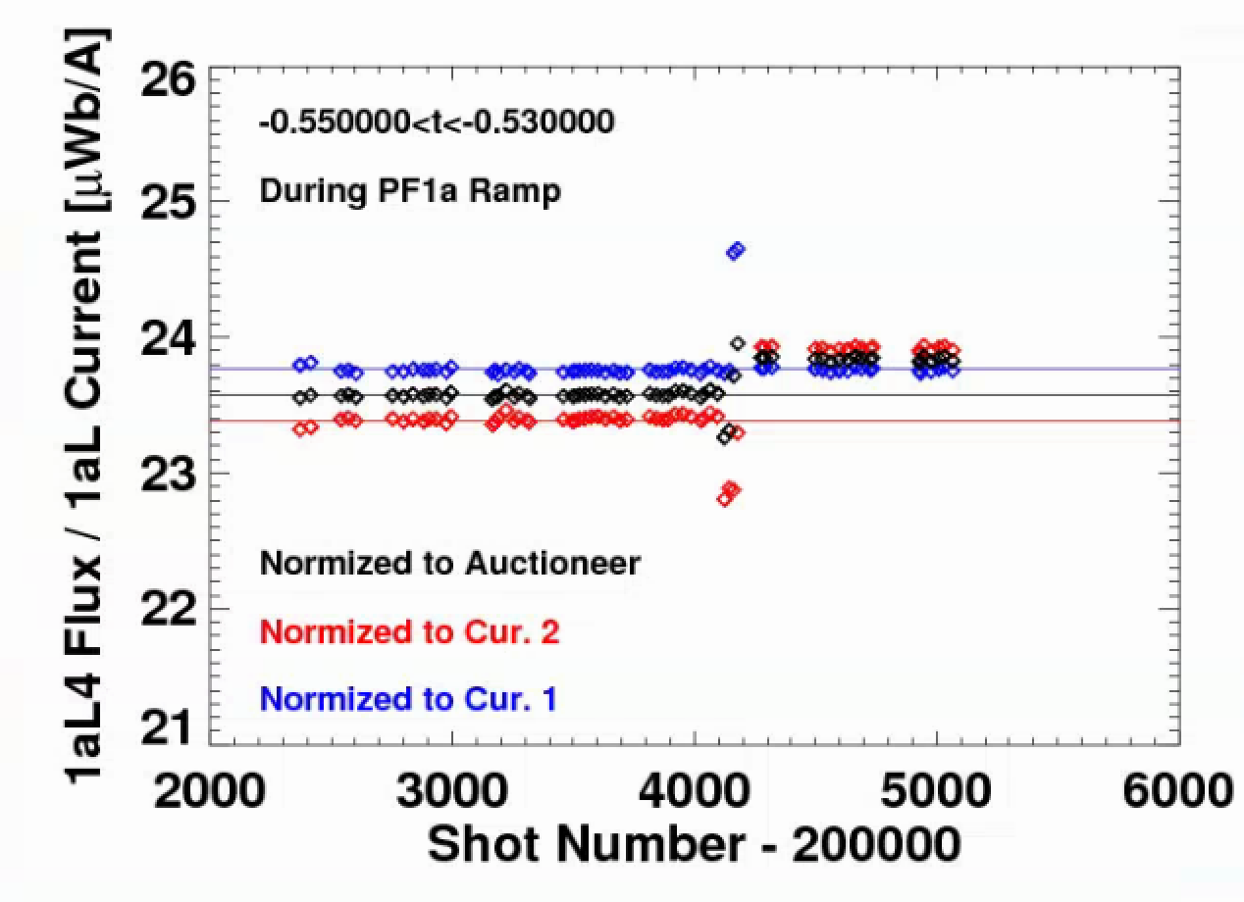
After Some Confusion, Lower 1a Coil Was Found to NOT have the Same Bad Inductance Trend
Method: Normalize the flux on the -1aL coil to the -1aL power supply current
Flux Measurement: Flux loops on the coil OD
Current Measurement: Cur1, Cur2, and (Cur1+Cur2)/2
Change in the Cur2 calibration on April 5th
Coil current is controlled against the average of Cur1 and Cur2.
The actual current in the coil during the test shot changed by a few %
Flux normalized to Cur1 has a flat trend
Lower Coil

Slide 20
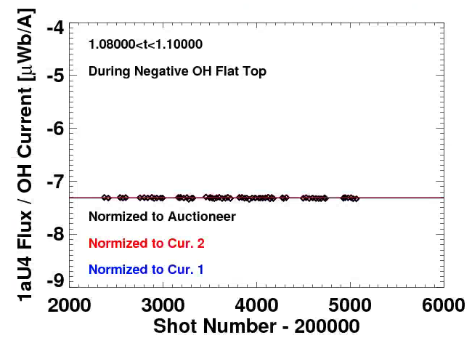
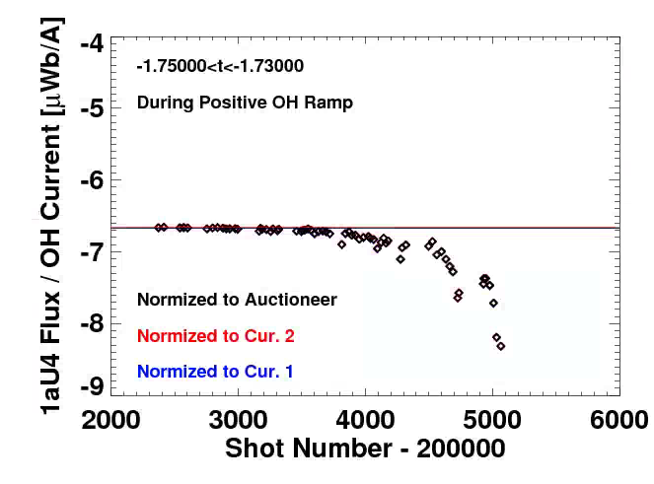
Similar Trends Observed on PF-1aU from OH-Dominant Part of Test Shots
Method: Normalize the flux on the -1aU coil to the OH supply current
Flux Measurement: Flux loops on the coil OD…difference fluxes!!
Current Measurement: Cur1, Cur2, and (Cur1+Cur2)/2
Large trend when the OH is swinging
Flux relative to the midplane is reduced later in the run
Consistent with induced currents trying to buck the OH flux change
No trend when the OH is flat-topped
Upper Coil
Upper Coil

Slide 21
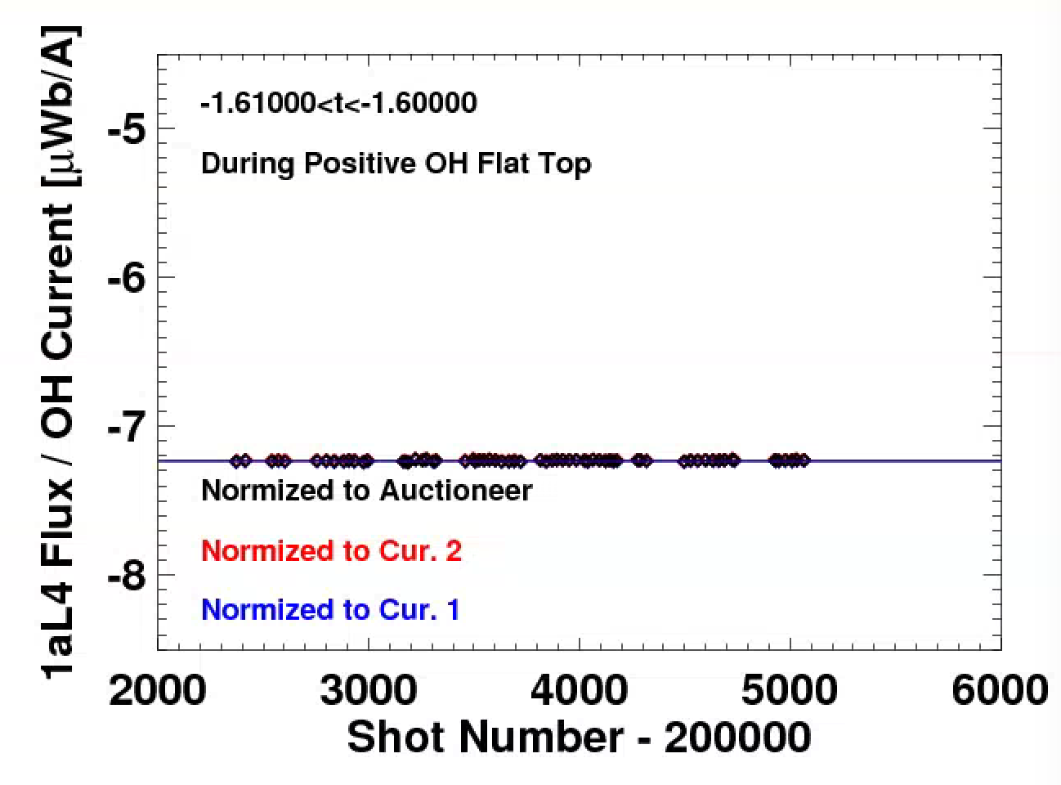
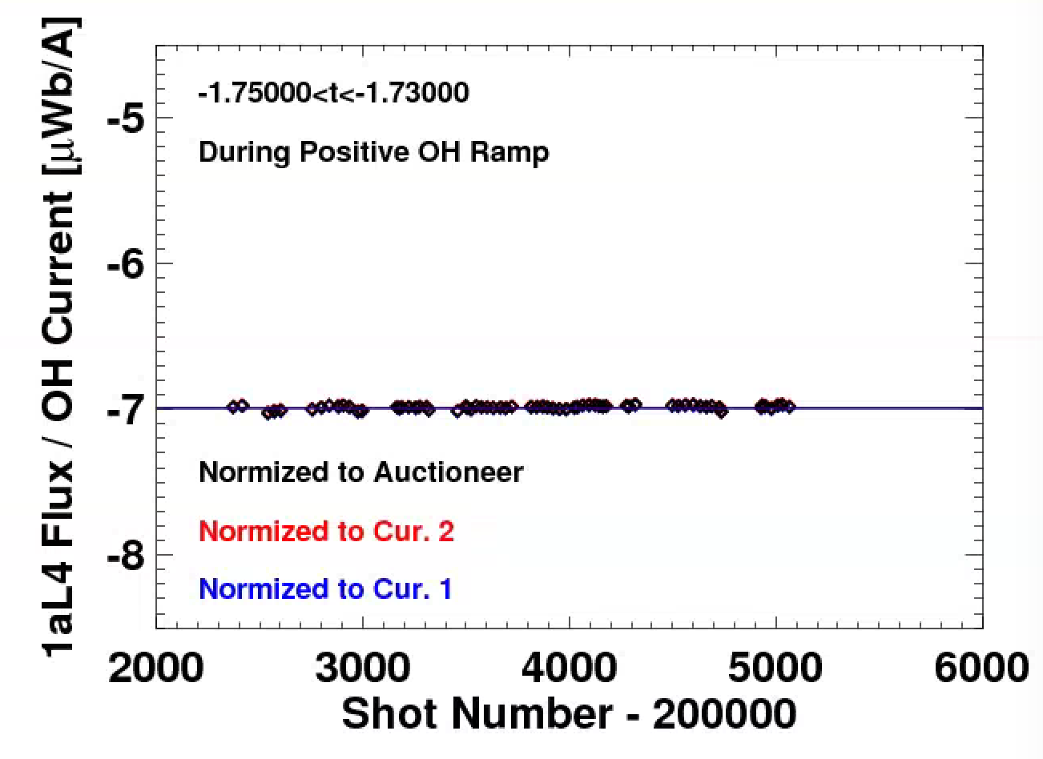
PF-1aL Shows No Concerning Trends When Considering OH Coupling
Method: Normalize the flux on the -1aL coil to the OH supply current
Flux Measurement: Flux loops on the coil OD…difference fluxes!!
Current Measurement: Cur1, Cur2, and (Cur1+Cur2)/2
No trend when the OH is flat-topped
No trend when the OH is ramping
Lower Coil
Lower Coil

Slide 22
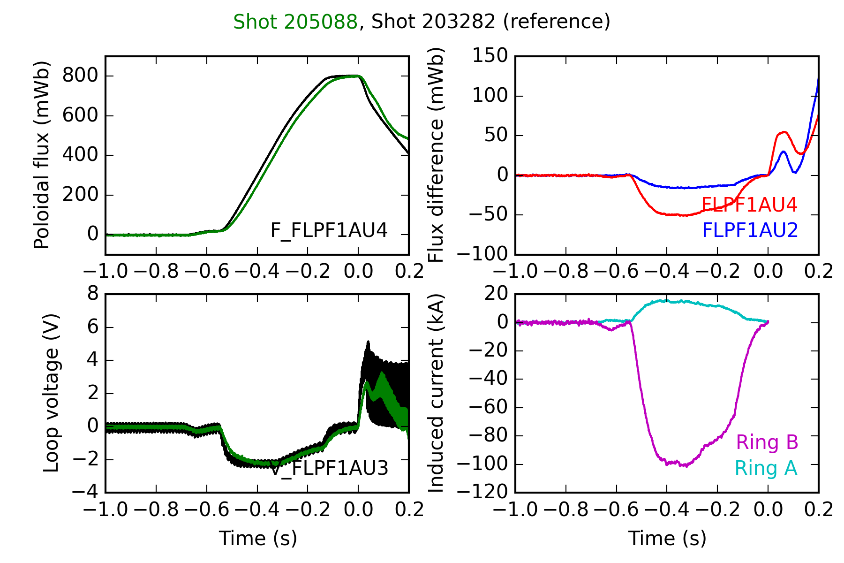
OH Pre-Charge Used on Every Shot Provides Another Opportunity for Trending
Shot 205088 is the last plasma shot of the run
Approximately 100 kA-turns of current induced in PF1aU
Minimal induced current in PF1aL

Slide 23
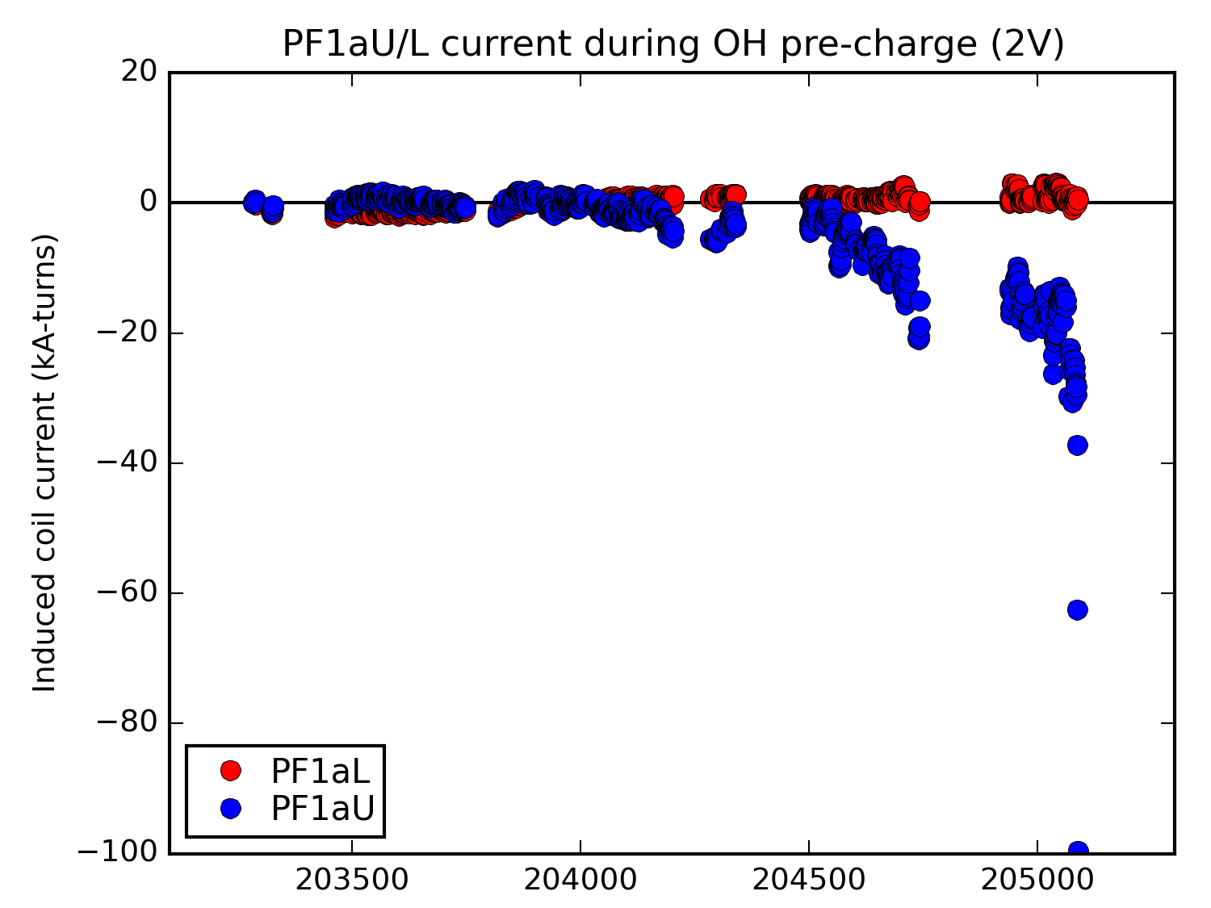
Database Analysis During OH Ramp Confirms Degradation of -1aU, Consistency of -1aL
PF1aL trend is flat zero through to the end of the run
PF1aU first starts to conduct current at the end of the March/April run period
Consistent degradation during the May run period
Coil does not continue to degrade during May/June maintenance period
Very fast degradation on the final run day in June
May
June

Slide 24
Summary w/ Regard to PF-1a Coils
PF-1aU coil suffered a failure on 6/28/2016
  Initially manifest as a flow blockage, but now understood to have involved some conductor melting.
  Process of attempting to unblock the flow resulted in a water leak that required cleanup and recovery
After attempting to resume operations 7/20-7/22, it was determined in consultation with FES that plasma operations was unwise.
  Voltage transients and circulating currents indicate potential for further damage to the coil and nearby elements, including possible/likely Cu melting under plasma scenarios.
Analysis of historical data shows that the PF-1aU has been deteriorating for some period
  The PF-1aL does not show similar trends.
A forensics team has been identified to define and execute a plan to determine the failure mode of the coil.

Slide 25
Remaining Tasks
Completed some RWM coil shots on Tuesday 6/26/2016
Ran XMP-157 on 6/27/16 (Wednesday)
  Study the beam species mix using the FIDA system, NB into D₂ gas operations.
MAPP samples installed 6/28/16 (yesterday)
Boronization on 6/29/16 for surface science studies
XMP-158 (MSE-LIF Beam into Gas w/ Fields) and XMP-106 (Magnetics Calibration Shots) will be performed next week
  Loop voltage levels & duration will be beneath any threshold for melting or arcing.
  No TF or OH operations.
Will likely repeat some coil hydrostatic tests and low-frequency inductance tests.
Rayleigh-Raman scattering during the week of 8/15

Slide 26
Overview
Observations from Our Testing Last Week
Model of Circulating Currents in the PF-1a Coils
Analysis of Some Historical Data

Slide 27
Want to Thank the Team for All the Work During the Run
Physics Operations Group
COEs, Shift Supervisors, Construction Managers
Diagnostic Operations…techs, engineers, physicists
NB Engineering & Operations
RF Engineering & Operations
FCPC and MG Engineering and Operations
Electronics Design and Fabrication
ME Design, Analysis, and Fabrication
IT, CODAC
Machine Techs, Vacuum Techs, Water System Techs.
AC Power
Tech Shop
Facilities
QA and Best Practices
Business Operations
Industrial hygiene, health physics, and other ES&H functions.
Special teams…BN removal, PF-1a flex bus repairs

Slide 28
Overview
Observations from Our Testing Last Week
Model of Circulating Currents in the PF-1a Coils
Analysis of Some Historical Data

Slide 29
We Accomplished an Enormous Amount in the Last Year
Made enormous improvements to PCS with minimal downtime, while operating the new DCPS and MDS+ systems
Commissioned many many many diagnostics
Commissioned MGI and APS, got LITER probes to the very edge of deployment
Got 12 MW of NB power running
Recommissioned the HHFW system
Recovered full FCPC/MG operations
Got routine breakdown, current ramp, long-pulse L-mode scenarios
Studied plasma control, error fields, fast ion physics, diagnostic techniques, surface science & H-mode scenario development

