Slide 1
Forklift Battery Accident
On 2/16/17, a worker was checking the battery fluid levels in an electric, stand-up forklift.
The worker attempted to pull the large battery bank out a short distance for access to the fill hose and indicator light.
Once the battery pack began moving on the built-in roller bed, the momentum caused the pack to continue moving until it dropped nearly all the way out of the forklift, catching the worker’s left leg between the battery and a fire extinguisher.
This contact resulted in a fracture to the worker’s left tibia.

Slide 2
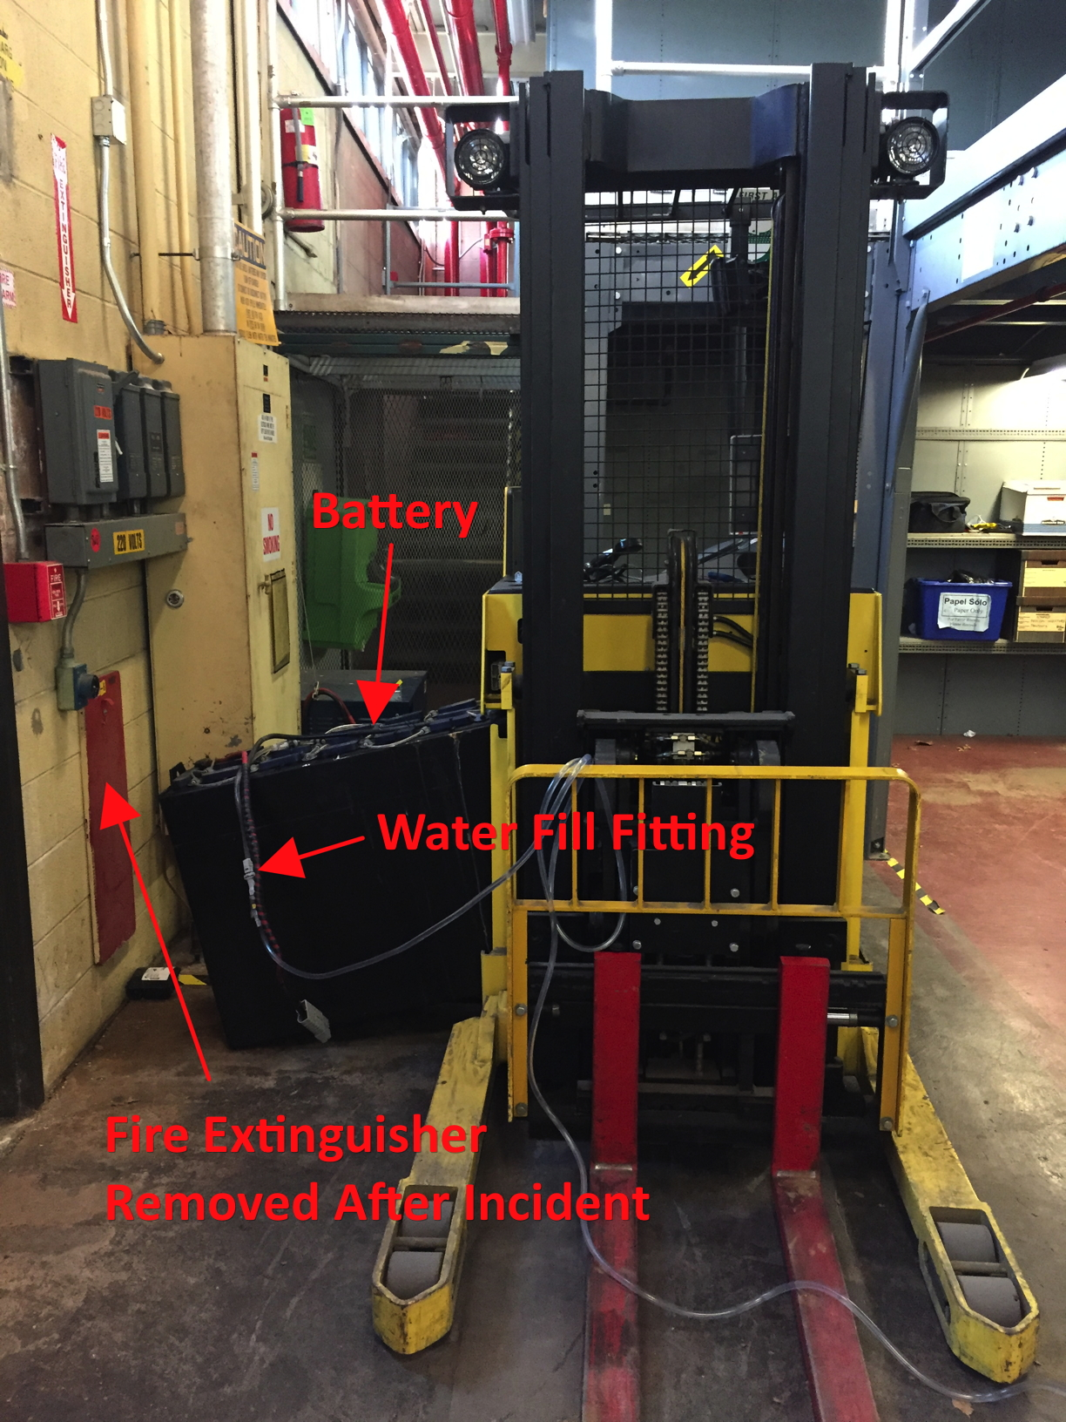

Slide 3
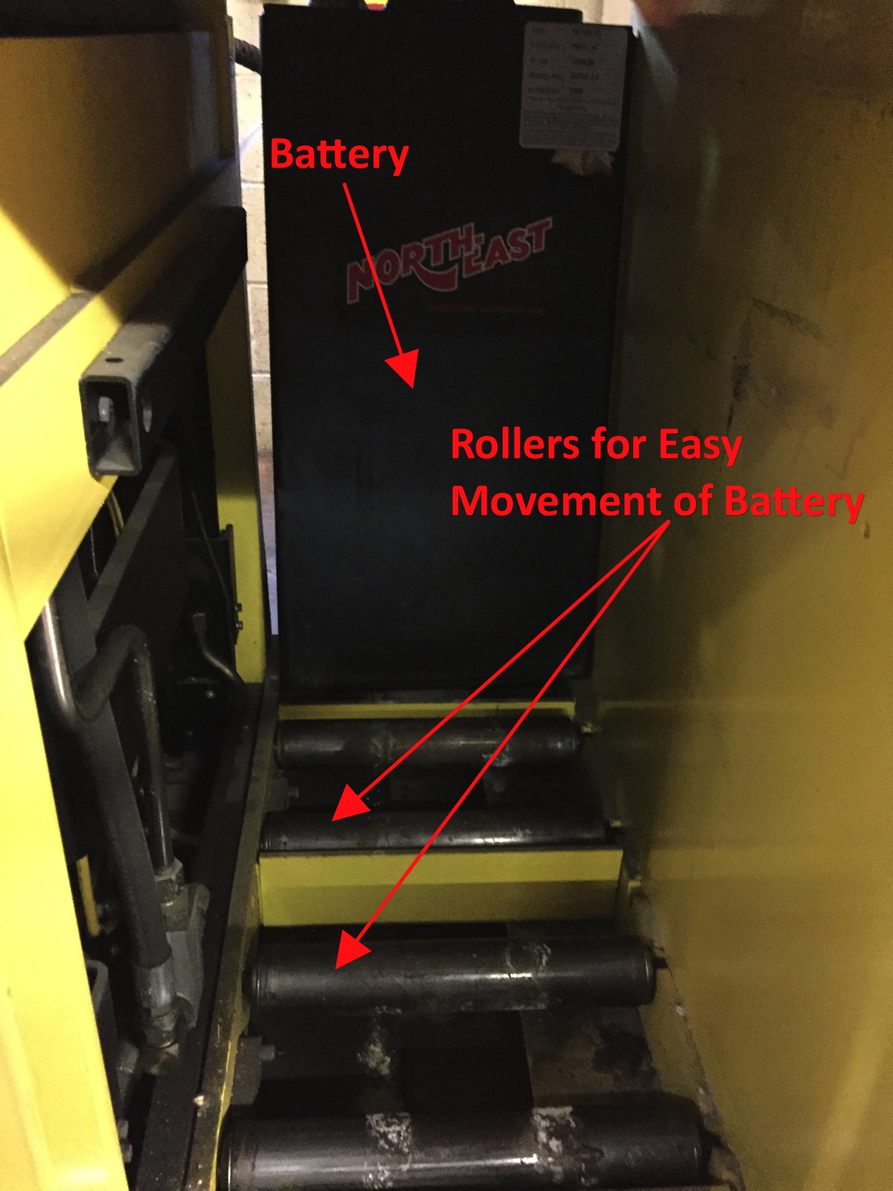

Slide 4
Forklift Battery Accident
Work was considered routine. It did not always require pulling out the batteries but it had been done numerous times before.
No built-in stop to prevent the batteries from rolling entirely out of the forklift.
Operating manual does not indicate that the batteries should not be pulled out for testing or filling.
ISM not properly implemented; potential hazard of the uncontrolled motion of the battery was not identified, and therefore hazard controls were not developed and implemented to prevent the injury.

Slide 5
Forklift Battery Accident
After incident, owner/operators of similar forklifts (2 others) were notified of the potential hazard of the uncontrolled battery movement.
Procedures developed to prevent this from recurring (e.g., use of battery stand).
Review all “routine” tasks to ensure that all hazards have been adequately addressed. A common source of failure in the ISM program is a belief that since it’s been done that way before, it is the correct way to continue to perform that task.

