Slide 1


Transition to Recovery Construction Phase
NSTX-U Team Meeting – March 4, 2020
Les Hill

Slide 2
Graduation time of sorts for Recovery design
After 137 (+/-) CDRs, PDRs, FDRs, and PRs, and
Other special reviews, and
A project CDR and PDR…
NSTX-U Recovery is on the cusp of achieving 100% Final Design!

Slide 3
Import design activities that remain
One PR and FDR – this week
Project FDR
Close out the documentation
  Calculations signed and archived
  Chit reports completed, approved and filed
  Drawings signed and issued
  DAFs signed
  Other…

Slide 4
Transition to construction has started
Plant
Shielding mods nearing completion
Site Prep Working Group
Space
Laydown
Assembly/pre-assembly
Logistics
Process
People
Example: procurement
Scale-up of other existing processes
Staffing profile refinement
Recovery-HR-Procurement machine

Slide 5
Each reassembly/construction shift will be staffed with the quorum needed to support safe, efficient field work
Refining previous staffing analyses to determine specifics…
  Technicians and supervisors
  Construction safety SMEs
  Engineering support
  QA/QC support and inspection services
  Work Planners
  Other…
Additional resources already here and more in the pipeline, examples:
  Work Planners
  Safety Reps
  WPC Coordinator
  Outage Manager

Slide 6
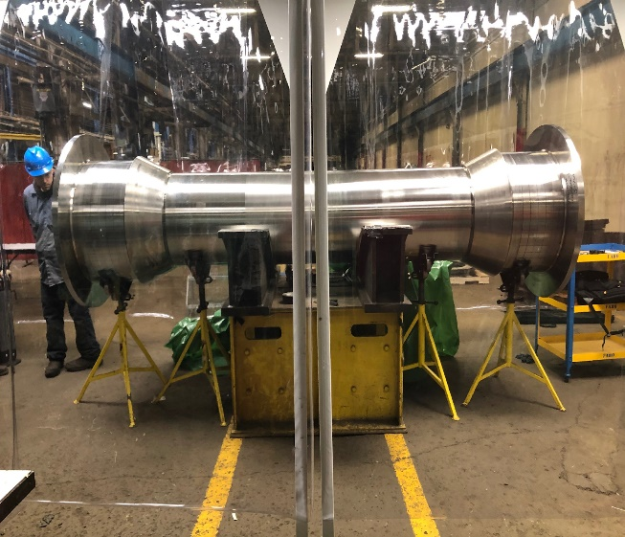
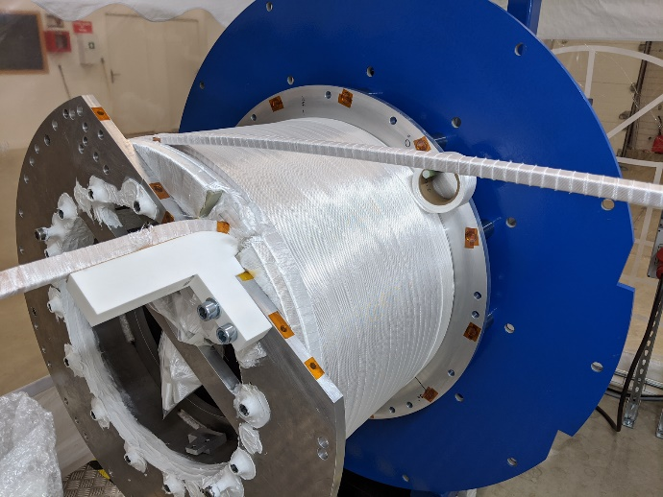
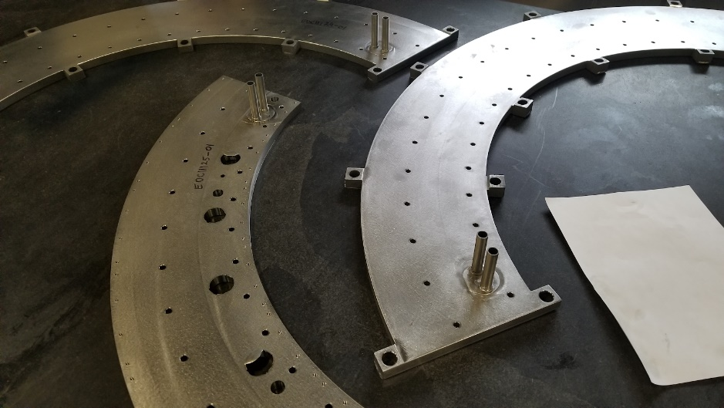
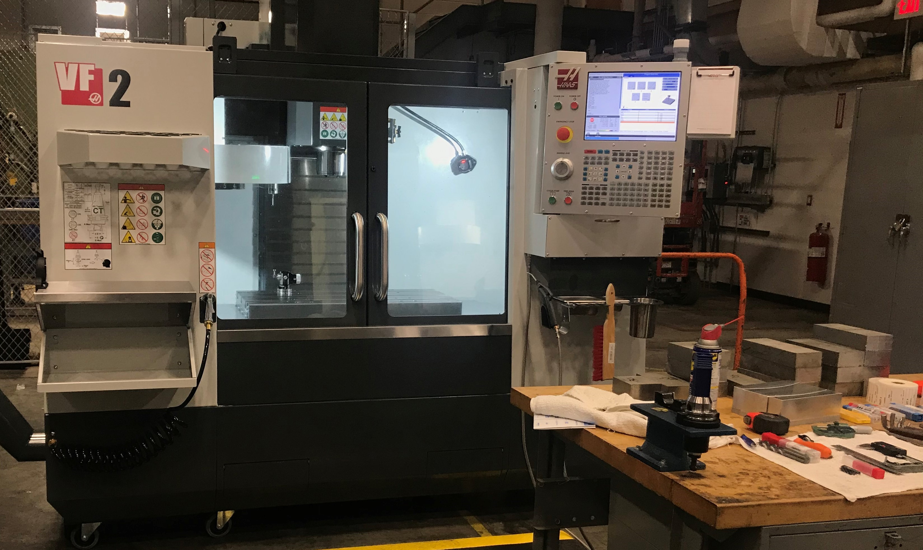
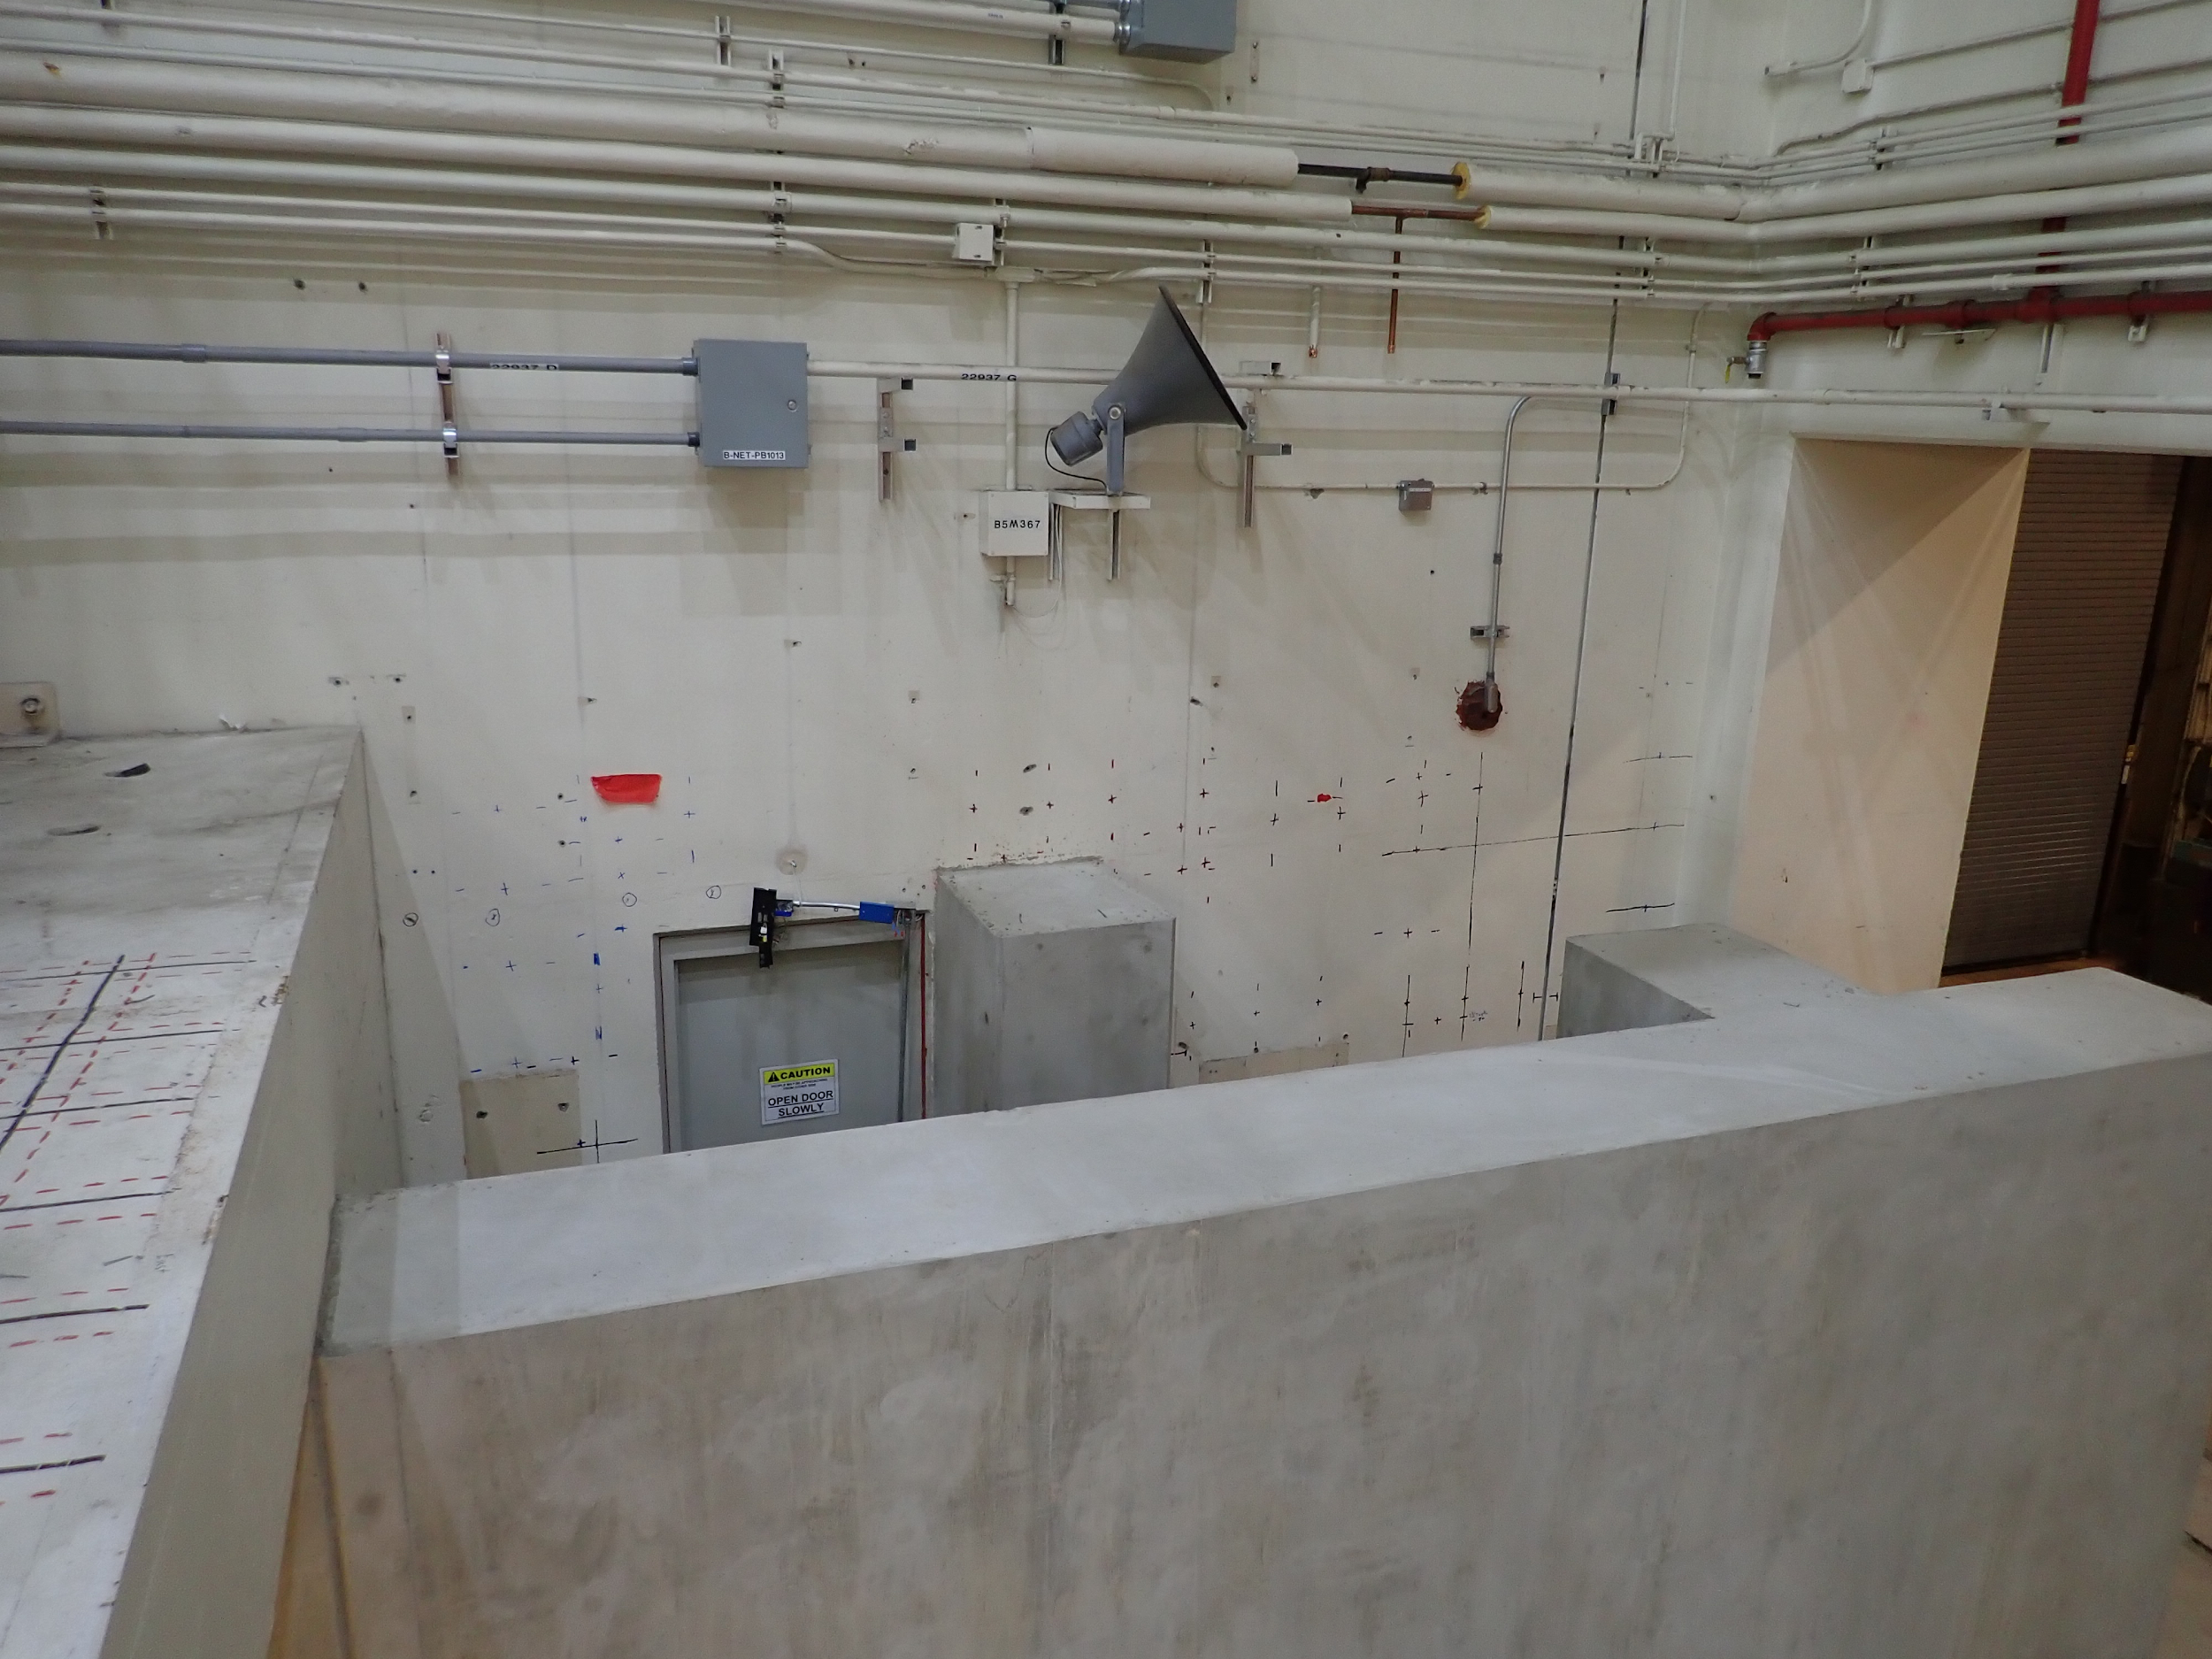
Leveraging in-house capability and external BOA suppliers - fabrication of most long-lead parts underway
PF Coils
Center stack casing
Heat Transfer Plate
Machine Core Structures
PFC Tiles
Passive Plates Brackets
…remainder on the way

Slide 7

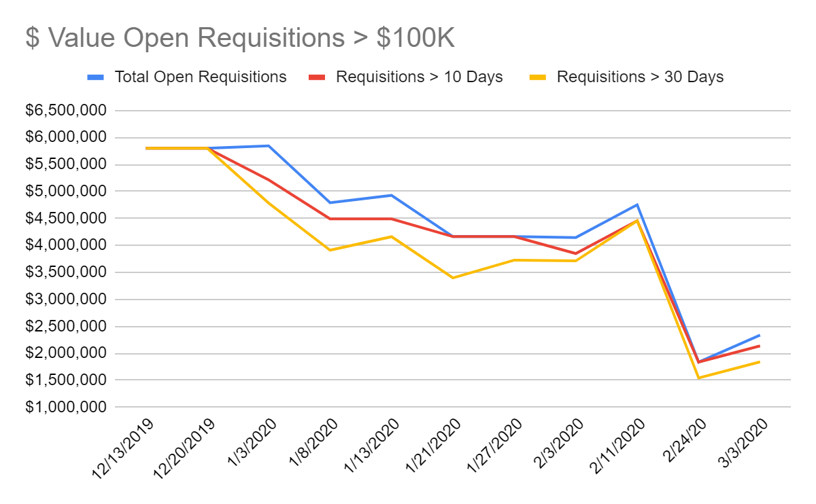
Improvements among integrated procurement team are yielding dividends
Timely and efficient acquisition of parts, materials and services needed for U Recovery is an us thing...need everyone on the boat
Improvements made by Procurement-QA/QC-Recovery partners having a profound impact

Slide 8
Construction schedule update in progress to provide solid platform for resource and work planning
Fast forward from WAF days to post-FDR era
Bake in parts delivery dates
Integrated systems approach
Engagement of reassembly experts
Ability to decompose to shift level

Slide 9
Safety is Job #1 - starts with planning, planning, and more planning
Solid plan and schedule – both project and D-Site
Early Field Work Package preparation
Meaningful and thorough stakeholder engagement (e.g. Safety Rep)
Craft/technician engagement
Resources are being provided to do the job right the first time

