Slide 1
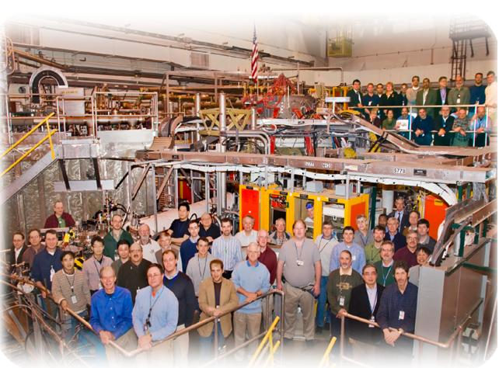
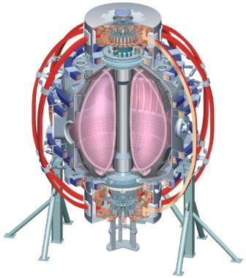
NSTX
Supported by
Effect of 3-D fields on edge power/particle fluxes between and during ELMs (XP1026)
College W&M
Colorado Sch Mines
Columbia U
CompX
General Atomics
INEL
Johns Hopkins U
LANL
LLNL
Lodestar
MIT
Nova Photonics
New York U
Old Dominion U
ORNL
PPPL
PSI
Princeton U
Purdue U
SNL
Think Tank, Inc.
UC Davis
UC Irvine
UCLA
UCSD
U Colorado
U Illinois
U Maryland
U Rochester
U Washington
U Wisconsin
A. Loarte, J-W. Ahn, J. M. Canik, R. Maingi, and J.-K. Park
and the NSTX Research Team
Culham Sci Ctr
U St. Andrews
York U
Chubu U
Fukui U
Hiroshima U
Hyogo U
Kyoto U
Kyushu U
Kyushu Tokai U
NIFS
Niigata U
U Tokyo
JAEA
Hebrew U
Ioffe Inst
RRC Kurchatov Inst
TRINITI
KBSI
KAIST
POSTECH
ASIPP
ENEA, Frascati
CEA, Cadarache
IPP, Jülich
IPP, Garching
ASCR, Czech Rep
U Quebec
NSTX Team Review
B252, PPPL
July 23, 2010

Slide 2
Motivation
XP 1046 (Ahn): Effect of 3-D fields below ELM triggering threshold
XP 1048 (Park): Effect of 3-D fields on ELM characteristics with q₉₅ scan
  ELM control in ITER is required for a large range of plasma conditions, not only for flat top of 15 MA Q_{DT} =10 scenario
  → Dependences of the applied 3-D field effects on divertor power/particle fluxes on plasma parameters need to be determined to understand consequences for ITER stationary conditions and controlled ELM power fluxes
  → Compatibility with scenario requirements to be checked: acceptable stationary power flux (high n_{e} divertor), erosion,
Characterization of 3-D field effect above the ELM triggering threshold with parameter scan (I_{3-D}, ν*_{e}, q₉₅, etc)

Slide 3
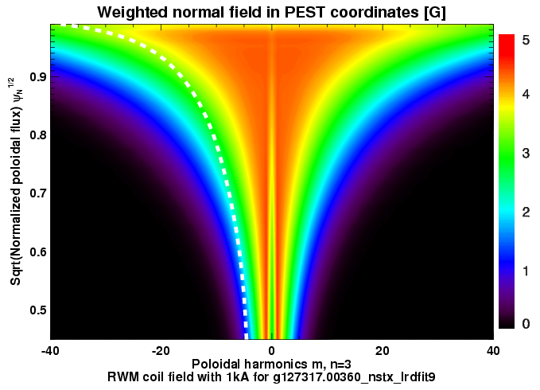
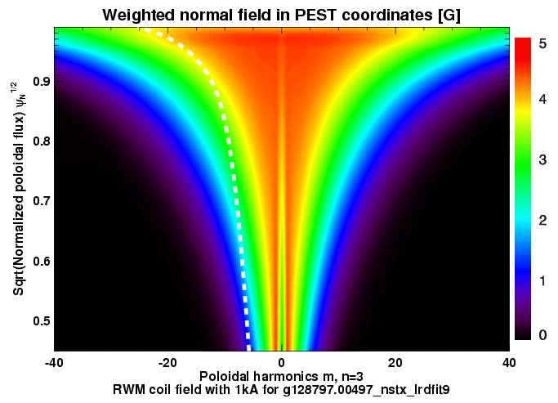
Best aligned 3-D magnetic perturbation from XP1048
VAC3D modeling for NSTX expects different ratio of non-resonant to resonant components for different q₉₅
→ Smaller ratio for lower q₉₅ is expected. Use the result of XP1048 to figure out best aligned 3-D field perturbation
→ Parameter scan at this alignment
J.-K. Park
NSTX
q₉₅~10
NSTX
q₉₅~6

Slide 4
Parameter scan at best alignment
I_{p} scan at constant q₉₅
→ Higher I_{p} tends to make the ELM size bigger and likely increase radial transport during ELMs
→ Will need to vary B_{t} to keep q₉₅ constant
Pedestal collisionality scan
→ Apply 3-D field at different density levels → Effects on power deposition between ELMs and at ELMs
→ Change of P_{NBI} can further change the pedestal collisionality
SOL plasma collisionality scan/divertor density scan
→ Apply divertor D₂ gas puffing to change SOL/divertor plasma conditions
3-D field coil current scan above the ELM threshold
→ Higher coil current tends to produce more frequent ELMs. Need to investigate impact on divertor profiles of smaller ELMs at similar P_{ped} and divertor conditions

Slide 5
Shot plan
Establish lowest q₉₅ (~6) discharge (140000) to obtain best aligned 3-D field spectrum with ELM triggering. Scan 3 coil current levels (eg, 1, 1.5, and 2kA) → Total of 3 shots
Perform I_{p} scan at constant q₉₅ (~6). Try three I_{p} values, 700, 900, 1100kA → Total of 3 shots
SOL plasma collisionality scan. Try two divertor D₂ gas levels (3000 and 1500Torr of Bay E GIS), 2 shots for each plasma condition
→ Total of 4 shots
Pedestal collisionality scan. Apply 3-D field blips at three time slices during the density ramp-up in the H-mode. Try 2 NBI power levels (P_{NBI}=2, 5-6MW), Ip → Total of 2 shots
Misalign 3-D field coil spectrum by changing q₉₅, i.e. Δq₉₅ = 2, by the means of Bt change (0.45T and 0.55T) at fixed Ip (700kA)
→ Total of 3 shots

