Slide 1
Second Peer Review for New MGI Valves for NSTX-U
(Update on Valve Testing)
R. Raman, et al.
October 29, 2013

Slide 2
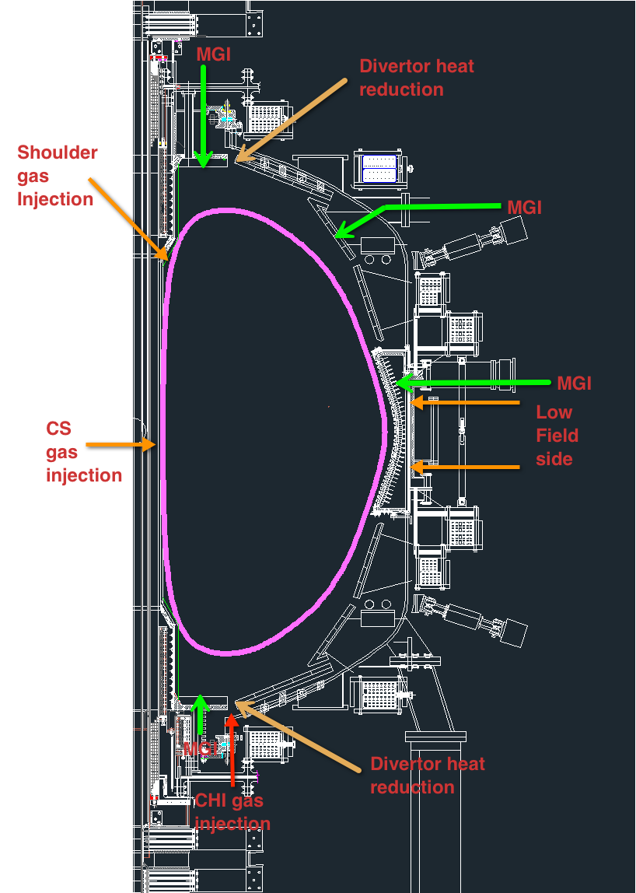
Valve & System Requirements
Empty most of the plenum in <2ms after valve is triggered
  Requires large orifice (limited by physical size limitations)
  Rapid opening of the vacuum seal (coil voltage/current limits, PS size)
Compatible with external magnetic fields
  Conventional solenoid valves not suitable
Compact in size so it can be installed on NSTX-U organ pipe flanges
High reliability
  Few and simpler systems for operation
4 – 5 identical systems needed for NSTX-U
  Top & bottom organ pipe, 2 in mid-plane location (toroidally displaced) and one above mid-plane
  Mid-plane valves need same diameter and length piping as organ pipe locations (one with length of tube ending at vessel & second in which the same length tube gets as close as reasonably possible to the plasma)

Slide 3
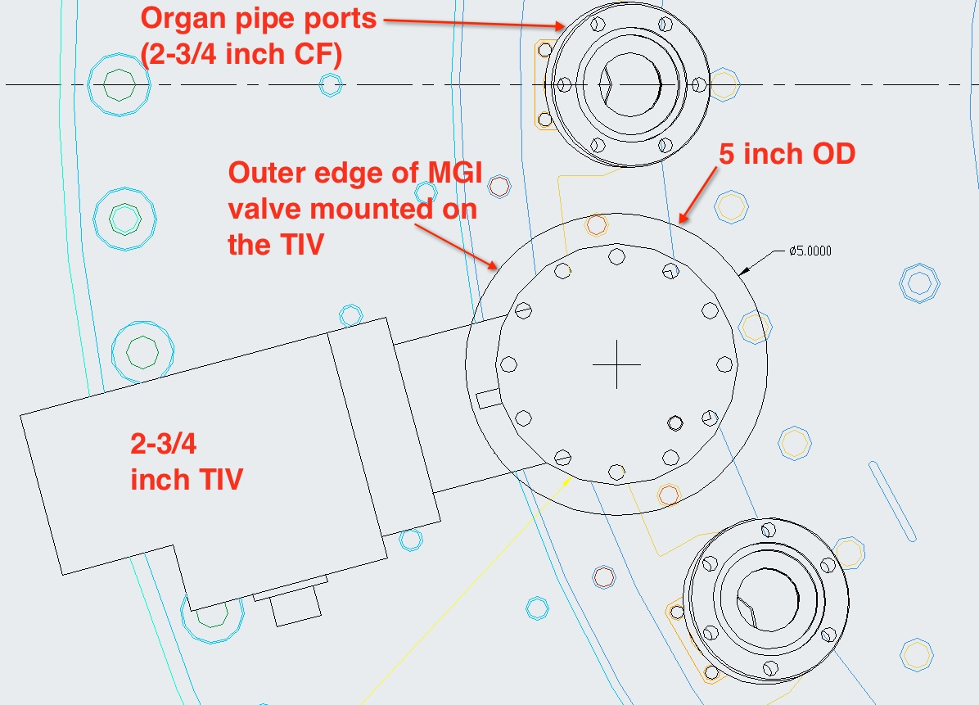
Up/Down view of MGI valve on Organ Pipe

Slide 4
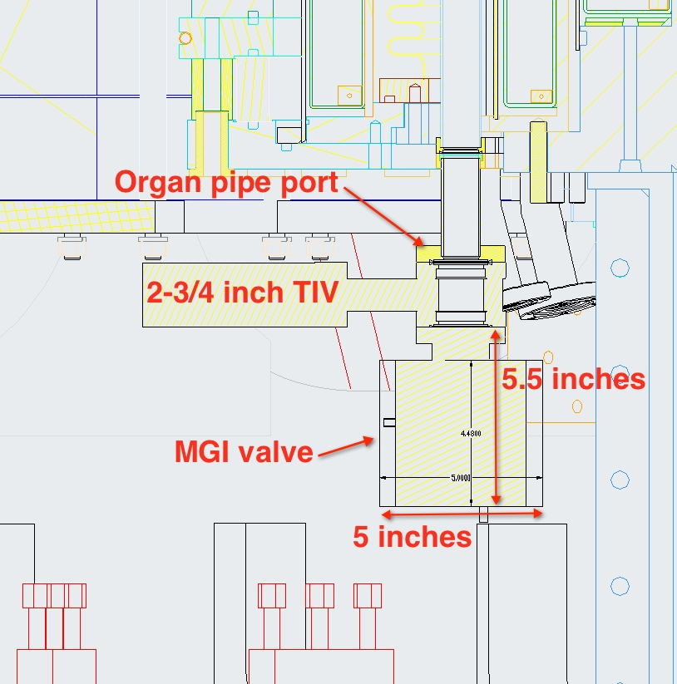
Horizontal view of valve on Organ Pipe
(Original Installation Concept)

Slide 5
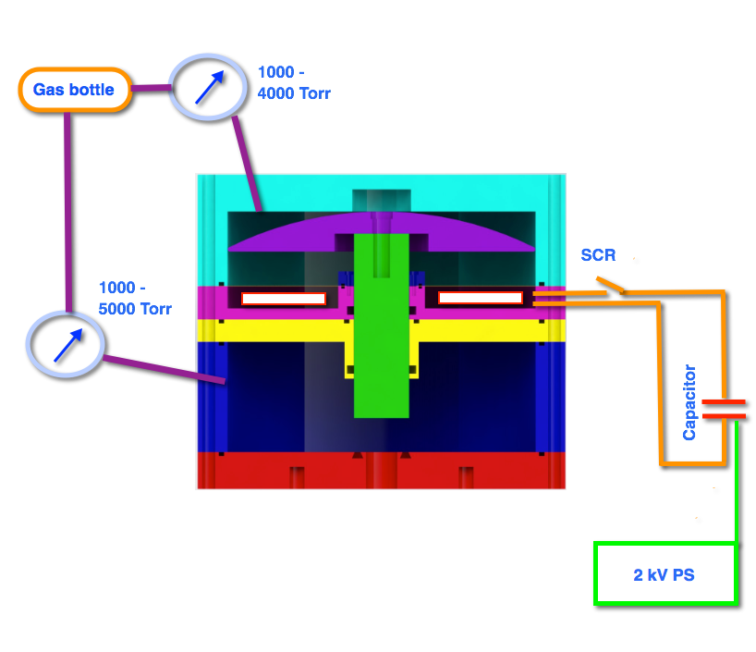
Electromagnetic Valve
(similar in design to the ITER MGI valve)
Differential pressure across both plenums reduces load on pulsed power system
By properly balancing pressures, the power supply requirements are nearly independent of the pressure in the primary chamber
FY15: Max 5000 Torr (6.6 bar)
  Consider >5000 Torr for FY16 and later
  Requires upgrades to NSTX-U GIS

Slide 6
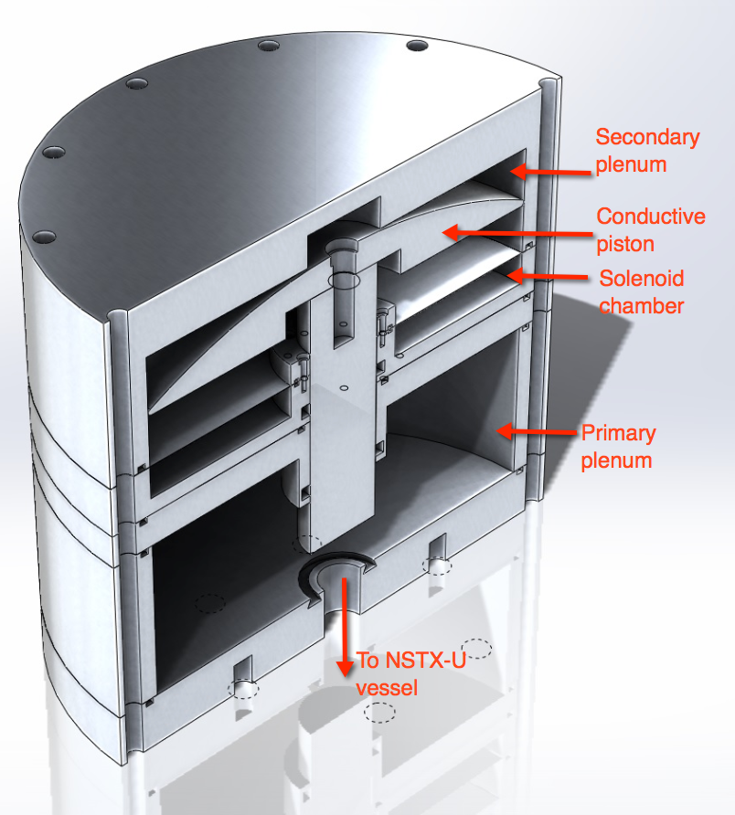
Valve Fabrication and Testing Update
Primary plenum operated to 3500 Torr
Secondary plenum at 2000 Torr
850 V, 500µF, coil current 2.3kA, 400µs pulse (200µs, FWHM)
100 Torr.L N₂ injected
FY15 NSTX-U Experiments will use 50-100 Torr.L neon for poloidal comparison experiments (based on recent DIII-D experiments that used 60-90 Torr.L neon)

Slide 7
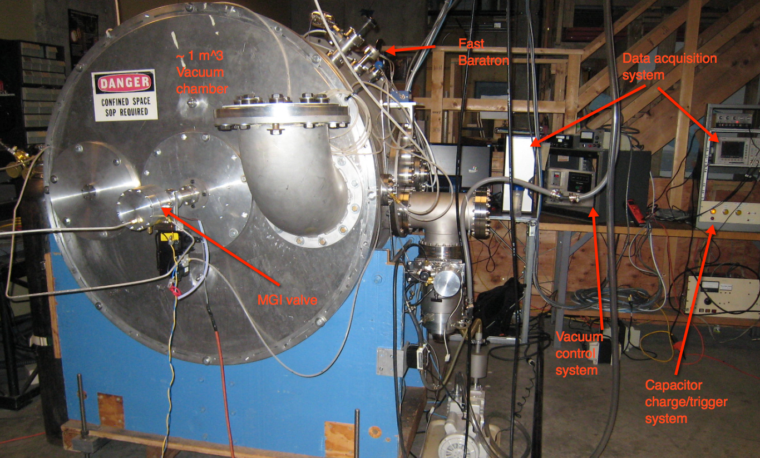
Present Test Set-up

Slide 8
Next Steps (1)
Move test set-up to a different room
  Operate power system from an adjacent room, after adding door interlocks
  Increase pressure to 5000 Torr in primary chamber
  Increase charging voltage to the 1.5 to 2kV range
  Collect fast baratron data of pressure pulse inside vessel
Finish Characterizing valve operating parameters for this first valve design (upto 1000 Torr.L)

Slide 9
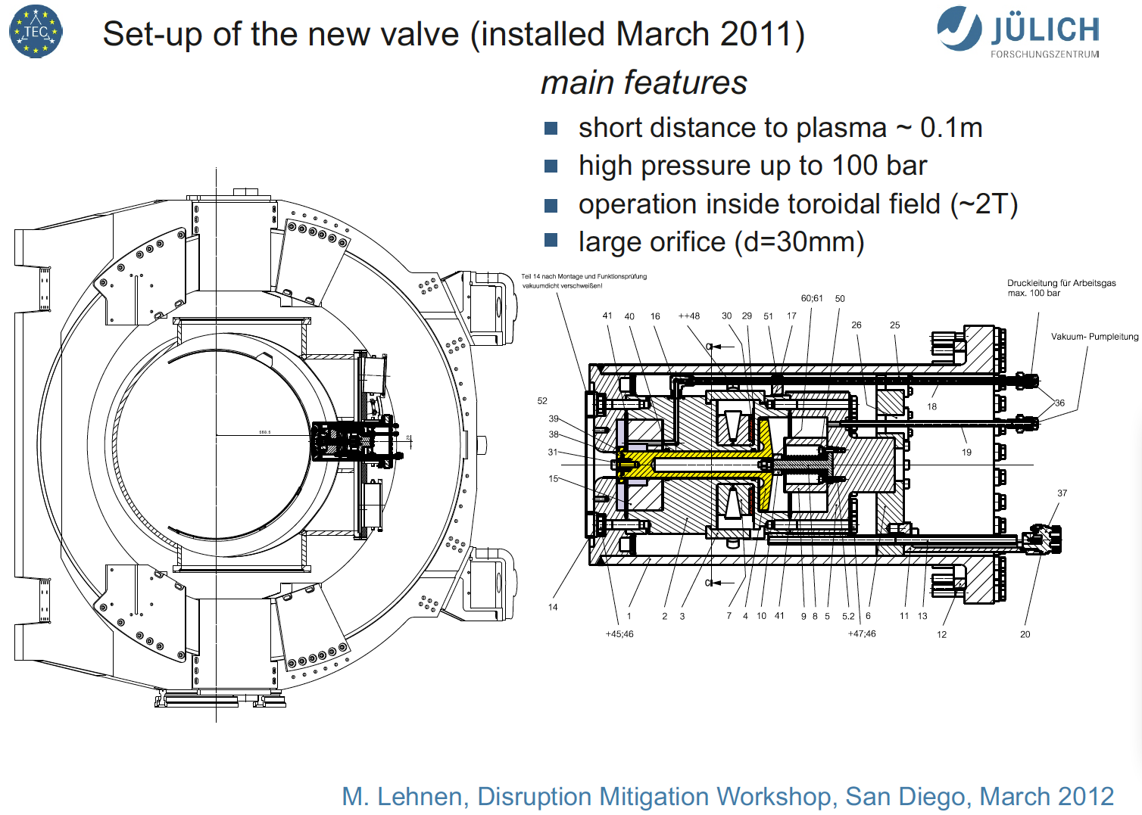
TEXTOR Valve Operated at 2T Radial Fields
(15 X NSTX-U valve)

Slide 10
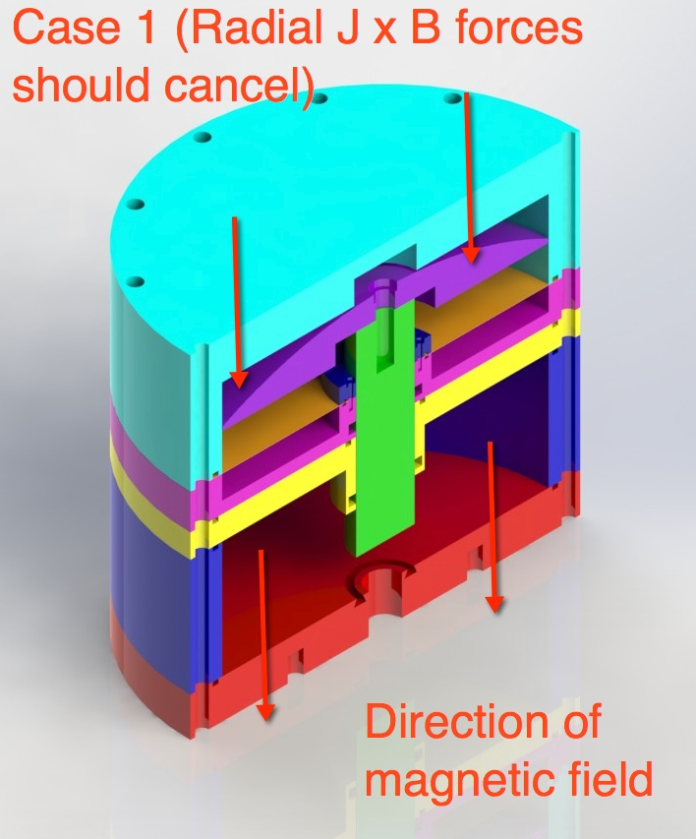
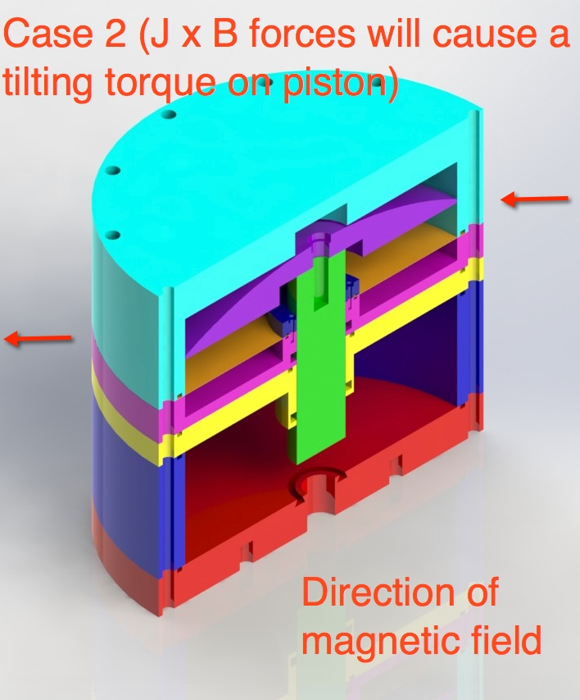
Next Steps (2)
Test with magnets installed near the valve body
  6 inch x 3 inch x 1 inch magnets with surface field of ~1-1.3T (neodymium magnets to be used)
  Higher forces can be simulated by increasing coil current above normal operating levels

Slide 11
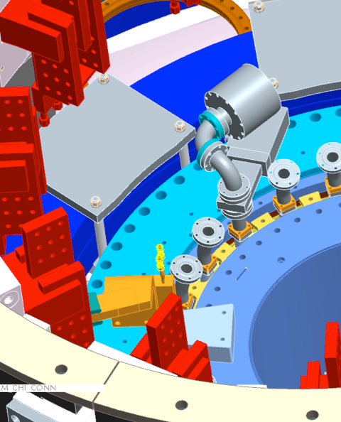
Next Steps (3) & Modified Installation on NSTX-U (CASE 1)
Strengthen internal valve components
  Possibly use 15-20 mm orifice size, dependent on Valve 1 results
Characterize this valve upto 1000 Torr.L
Describe results in Peer Review (Jan, 2014) – Then fabricate NSTX-U valves
Revised installation arrangement also avoids issue of lithium getting trapped near O-ring seals
  Need to consider how to support current leads from the valve (2-5kA current, coax or twisted pair)
  Additional support for external valve body
  Valve will be electrically isolated from vessel by a suitable insulating (non-ceramic) spacer (0.5 inch thick), and insulated bolt sleeves

