Slide 1
NSTX-U Gas Systems
18 June 2012
R. Raman, D. Mueller, W. Blanchard,
L. Roquemore, P. Sichta

Slide 2
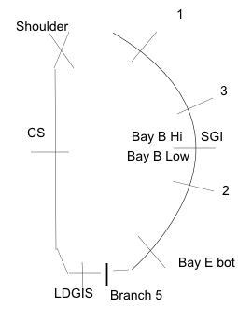
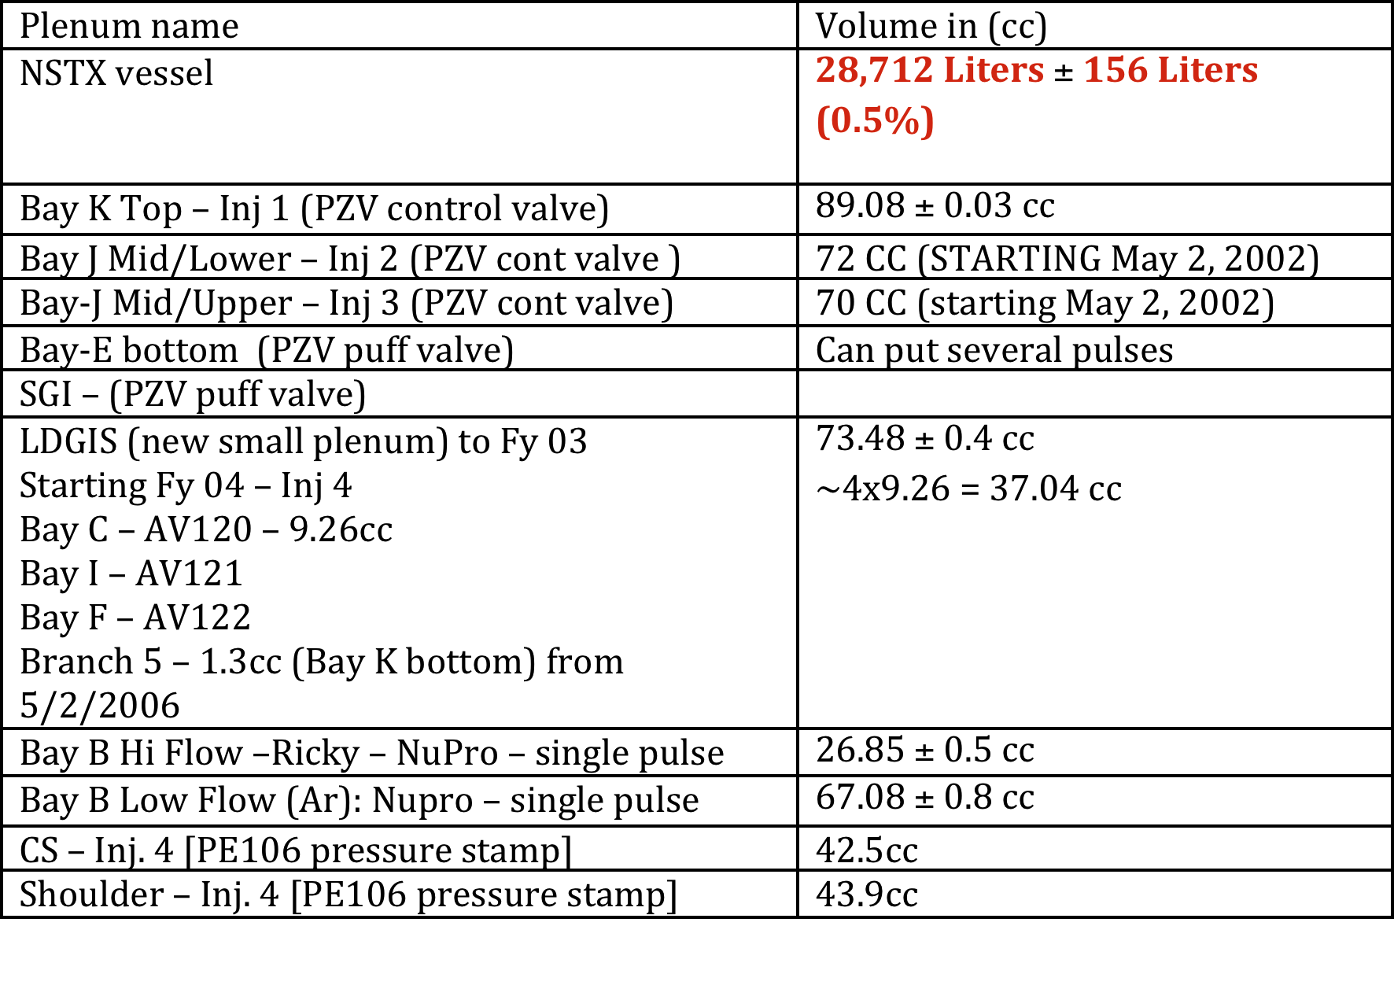
NSTX Gas Systems

Slide 3
NSTX / NSTX-U Gas Systems
Name | NSTX | NSTX-U
Inj 1 - PZV | Bay K Top (89 cc) | Same
Inj 2 - PZV | Bay J Mid-Lo (72cc) | Bay K Mid-Lo (Install port)
Inj 3- PZV | Bay J Mid-Up (70cc) | Bay G Mid-Lo (Install port)
Div-1 - PZV | Bay-E botton | Same
GPI – NuPro – Single pulse | Bay-B Hi Flow (26.85cc) | Same
Argon – NuPro – Single pulse | Bay-B Lo Flow | Same
Inj 4 Inj 4 Inj 5 Inj 5 | CS – Mid (42.5cc) Shoulder (43.9cc) | Same Same CS-2 New Shoulder-2 New
Branch 5 – Single Pulse | Bay K bot (1.3cc) | Same (1 to 3cc) Bay G or L-Bot
LDGIS-1 LDGIS-2 LDGIS-3 LDGIS-3 - removed | Bay C – AV120 Bay I – AV121 Bay F – AV122 (all 9.25cc each) | MGI-1 Bay A 15 deg bot. MGI-2 Bay G 180 deg bot. MGI-3 Bay L 345 deg top (all 100-200cc – TBD)

Slide 4
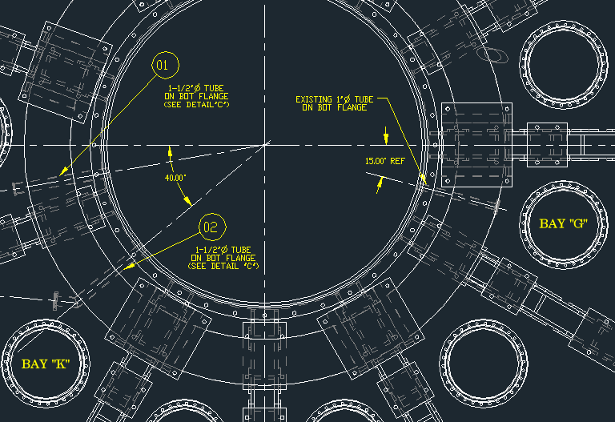
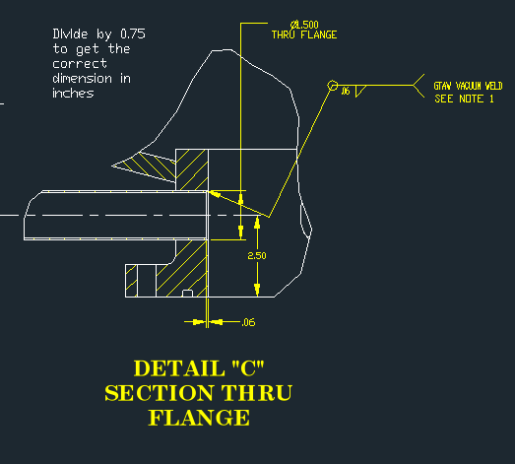
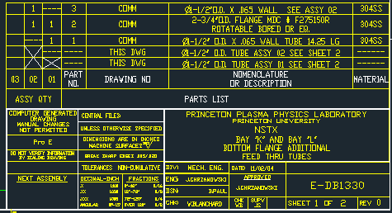
Branch 5 Injectors

Slide 5
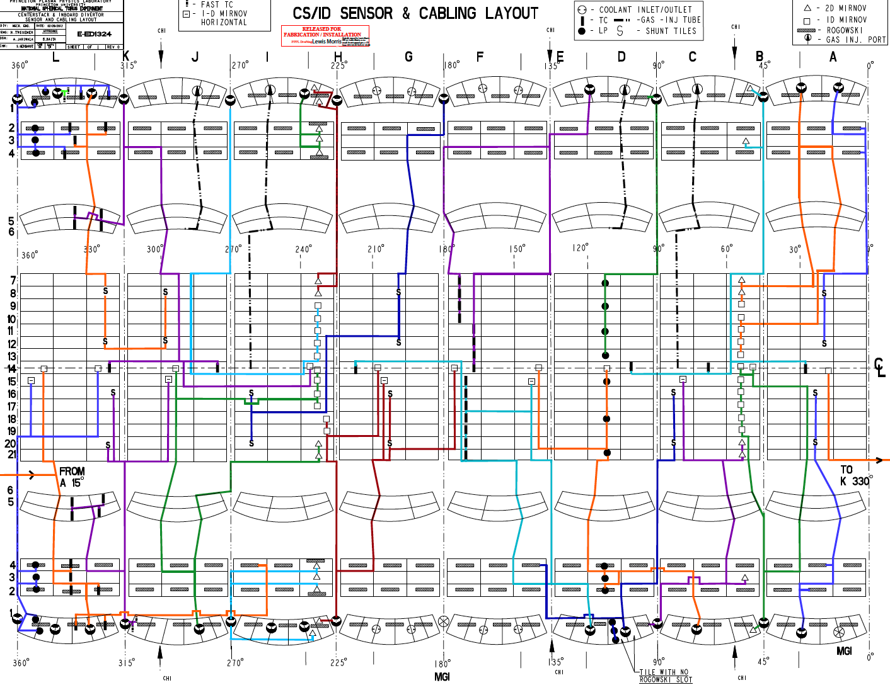

Slide 6
Signal Names
Gauge Name | Location | IC_Tag | EC_Tag | IC_digitizer | EC_digitizer
MIG_1 | Bay H midplane | \OPERATIONS::MIG1_IONCURR | \OPERATIONS::MIG1_EMISSIONCURR | MI_H908_01 | MI_H908_01
MIG_2 | Bay E midplane | \OPERATIONS::MIG2_IONCURR | \OPERATIONS::MIG2_EMISSIONCURR | MI_H908_01 | MI_H908_01
Mig_3 | Bay L midplane | \ENGINEERING::MIG3_IONCURR | \ENGINEERING::MIG3_EMISSIONCURR | GS_908C28N14 | GS_908C28N14
MIG_4 | Bay C Top | \ENGINEERING::MIG4_IONCURR | \ENGINEERING::MIG4_EMISSIONCURR | GS_908C28N14 | GS_908C28N14
MIG_5 | Bay C midplane | \ENGINEERING::MIG5_IONCURR | \ENGINEERING::MIG5_EMISSIONCURR | GS_908C28N14 | GS_908C28N14
PEN_1 | Bay G_LD | \ENGINEERING:: | None | GS_908C28N14 | None
PEN-2 | Bay K_UD | \ENGINEERING:: | None | GS_908C28N14 | None
INP_1 | Bay C_Top | \OPERATIONS::INP1_IONCURR | \OPERATIONS::INP1_EMISSIONCURR | MI_H908_01 | MI_H908_01
INP-2 | Bay C_Bottom | \OPERATIONS::INP2_IONCURR | \OPERATIONS::INP2_EMISSIONCURR | MI_H908_01 | MI_H908_01
IG-110 | Bay-L_End | \engineering::top.epics.gas.digitizers:gs_ig110_tr | \engineering::gs_ig110_torr
PE-111 | Bay-L_End | \engineering::gs_pe111
PE-114 | Below Lower Divertor | \engineering::gs_pe114_TD*2.37e-4

Slide 7
NSTX-U (CHI/MGI)
CHI-1L – Lower dome (Bay J, 300 degrees)
CHI-2L – Lower dome (Bay E, 135 degrees)
CHI-3L/MIG-2L – Lower dome (Bay B, 15 degrees)
MGI-1L – Lower dome (Bay F, 180 degrees)
CHI-1U – Upper dome (Bay J, 285 degrees)
CHI-2U/MGI-1U – Upper dome (Bay E, 135 degrees)
CHI-3U/MIG-2U – Upper dome (Bay B, 60 degrees)
Organ Pipes: 1.125 inch ID and 1.25 inch OD

Slide 8
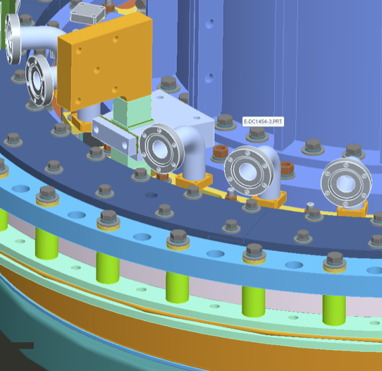
Drawing of Organ pipes
Other than the elbow, nothing else exist at this time.

Slide 9
NSTX-U (High Field Side)
Inj-CS-1 (Plenum size?)
Inj-CS-2 (Plenum size?)
  Two CS gas injectors
  Pipe size
  Location of port on top of machine
Inj-SH-1 (Plenum size ?)
Inj-SH-2 (Plenum size ?)
  Two shoulder gas injectors
  Pipe size
  Location of port on top of machine

Slide 10
NSTX-U (Low Field Side)
Inj-1 (Bay K Top) / plenum size ?
Inj-2 (Bay J-Mid/Low)
Inj-3 (Bay J-Mid/Up)
Inj-4 (Bay ?-Mid/HeGDC)
Inj-5 (Bay E –Bottom, divertor gas puff)
Inj-6 (Bay ? – Divertor gas puff)
SGI (Bay ?)

Slide 11
CHI Current Sensors at Vessel
Pearson – 1 (CHI feed inlet on bus bar)
Pearson – 2 (CHI feed outlet on bus bar)
DCCT-1 (CHI feed inlet on bus bar)
DCCT-2 (CHI feed outlet on bus bar)

Slide 12
CHI Voltage Sensors on Vessel
Lower vessel Monitors
  Resistive divider 10kHz (Outer vessel to ground) – bottom or top [-1sec to +10sec] (VCHI1O) – Available all the time [-1 to +6sec]
  Resistive divider 10kHz (Inner vessel to ground) – bottom or top [-1sec to + 10 sec] (VCHI1I) – Available all the time [-1 to +6 sec]
  Ross Voltage monitor (Outer-Inner) / Fiber optic – bottom or top (VCHI2) – Available all the time [0 to 20 ms]
  Resistive divider Inner vessel to ground / Handy scope (VCHI3I)[0 to 20 ms]
  Resistive divider Outer vessel to ground / Handy scope (VCHI3O)[0 to 20ms]
Upper Vessel Monitors
  Resistive divider Inner vessel to ground / Handy scope (VCHI4I) [0 to 20ms]
  Resistive divider Outer vessel to ground / Handy scope (VCHI4O) [0 to 20ms]

Slide 13
MIG & Ion Gauge Digitizers
MIG-1 (Bay E) [-5sec to +25sec] (MG1-IC & MG1EC)
MIG-2 (Bay C) [-5sec to +25sec] (MG2-IC & MG2-EC)
MIG-3 (Bay H) [-2sec to +8sec] (MG3-IC & MG3-EC)
MIG-4 (Pumping duct) [-5sec to +25sec] (MG4-IC & MG4-EC)
MIG-5 (end of pumping duct) [-5sec to +25sec] (MG5P)
IG-1 (Pumping duct) [-2 to +8sec] (IG1P)
IG-2 (Pumping duct) [-2 to +8sec) (IG2P)
IG-3 (end of pumping duct) [-2 to 8sec) (IG3P)

Slide 14
Penning Gauges
PEN-1 Bay G_LD (PG1P) [-2 to +8 sec]
PEN-2 Bay K_UP (PG2P) [-2 to +8 sec]

Slide 15
CHI/ MGI Plenum Sensors (Sensotek)
Pressure Sensor | Availability | Max Press (Torr)
CHI1L-P | Day-0 | 2400
CHI2L-P | Day-0 | 2400
MG11L-P | Day-0 | >5000
MGI2L-P | YR-2/3 | >5000
MGI1U-P | YR-2/3 | >5000
MGI2U-P | YR-2/3 | >5000
MGIM1-P | Day-0 | >5000
MGIMU1-P | YR2/3 | >5000

Slide 16
High and Low Field Senotek Sensors
Pressure sensor | Availability | Max press (Torr)
Inj-CS1 | Day-0 | 2400
Inj-CS2 | Yr 2 | 2400
Inj-SH1 | Day-0 | 2400
Inj-SH-2 | Yr 2 | 2400
Inj-1 | Day-0 | 2400
Inj-2 | Day-0 | 2400
Inj-3 | Day-0 | 2400
Inj-4 | Day-0 | 2400
Inj-5 | Day-0 | 2400
Inj-6 | Day-0 | 2400
SGI | Day-0 | >5000

