Slide 1
NSTX-U Gas Systems
10 August 2012
R. Raman, L. Roquemore, W. Blanchard, D. Mueller,
L. Roquemore, P. Sichta

Slide 2
NSTX / NSTX-U Gas Systems
Name | NSTX | NSTX-U
Inj 1 - PZV | Bay K Top (89 cc) | Same
Inj 2 - PZV | Bay J Mid-Lo (72cc) | Bay K Mid-Lo (Install port)
Inj 3- PZV | Bay J Mid-Up (70cc) | Bay G Mid-Lo (Install port)
Div-1 - PZV | Bay-E botton | Same
GPI – NuPro – Single pulse | Bay-B Hi Flow (26.85cc) | Same
Argon – NuPro – Single pulse | Bay-B Lo Flow | Same
Inj 4 Inj 4 Inj 5 Inj 5 | CS – Mid (42.5cc) Shoulder (43.9cc) | Same Same CS-2 New Shoulder-2 New
Branch 5 – Single Pulse | Bay K bot (1.3cc) | Same (1 to 3cc) Bay G or L-Bot
LDGIS-1 LDGIS-2 LDGIS-3 LDGIS-3 - removed | Bay C – AV120 Bay I – AV121 Bay F – AV122 (all 9.25cc each) | MGI-1 Bay A 15 deg bot. MGI-2 Bay G 180 deg bot. MGI-3 Bay L 345 deg top MGI-4 Mid-Plane MGI-5 Above Mid-plane (all 100-200cc – TBD)
SGI | Bay ? | Bay ?

Slide 3
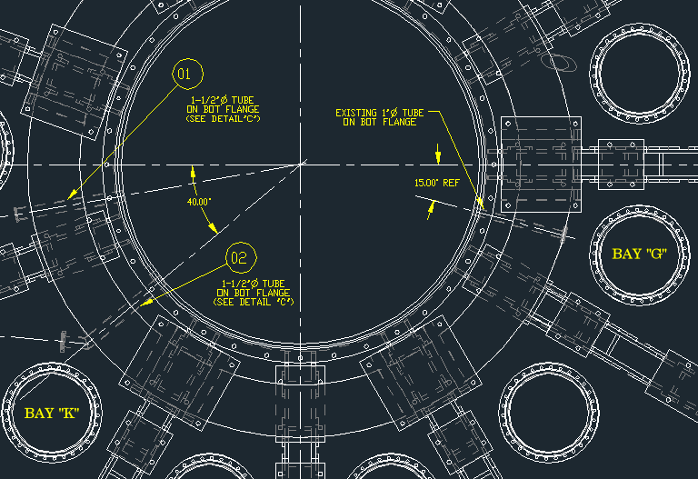
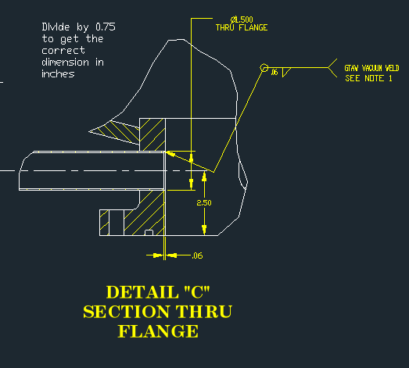
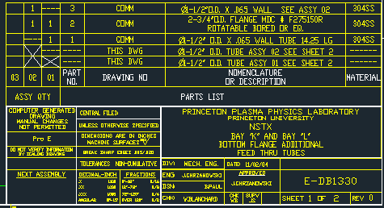
Branch 5 Injectors

Slide 4
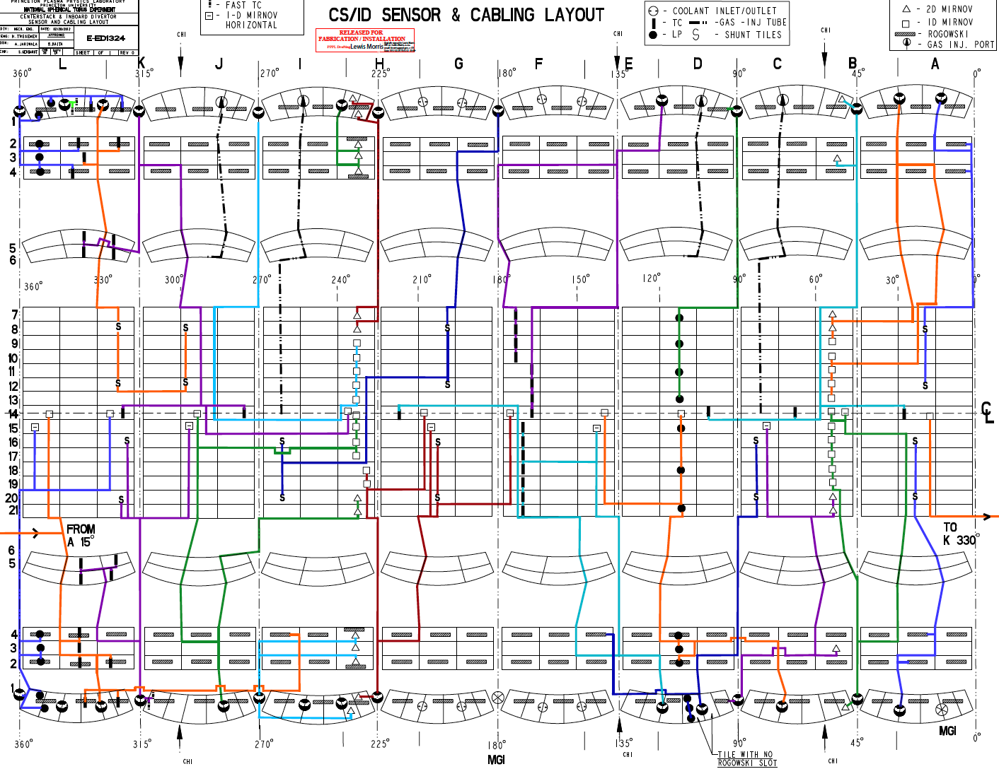

Slide 5
Photo of Bay K Mid-Lo (Install port)

Slide 6
Photo of Bay G Mid-Lo (Install port)

Slide 7
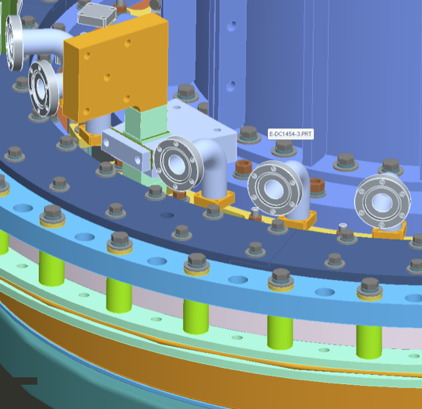
Drawing of Organ pipes
Other than the elbow, nothing else exist at this time.

Slide 8
NSTX-U (High Field Side)
Inj-CS-1 (Plenum size?)
Inj-CS-2 (Plenum size?)
  Two CS gas injectors
  Pipe size
  Location of port on top of machine
Inj-SH-1 (Plenum size ?)
Inj-SH-2 (Plenum size ?)
  Two shoulder gas injectors
  Pipe size
  Location of port on top of machine

Slide 9
MIG & Ion Gauge Locations
MIG-1 (Bay E?) [-5sec to +25sec] (MG1-IC & MG1EC)
MIG-2 (Bay C?) [-5sec to +25sec] (MG2-IC & MG2-EC)
MIG-3 (Bay H?) [-2sec to +8sec] (MG3-IC & MG3-EC)
MIG-4 (Pumping duct) [-5sec to +25sec] (MG4-IC & MG4-EC)
MIG-5 (end of pumping duct) [-5sec to +25sec] (MG5P)
IG-1 (Pumping duct) [-2 to +8sec] (IG1P)
IG-2 (Pumping duct) [-2 to +8sec) (IG2P)
IG-3 (end of pumping duct) [-2 to 8sec) (IG3P)

Slide 10
Penning Gauges
PEN-1 Bay G_LD (PG1P) [-2 to +8 sec]
PEN-2 Bay K_UP (PG2P) [-2 to +8 sec]

Slide 11
CHI/ MGI Plenum Sensors (Sensotek)
Pressure Sensor | Availability | Max Press (Torr)
CHI1-Bay K bot | Day-0 | 2400
CHI2-Bay G/L | Day-0 | 2400
MGI1 (Lo) MGI2 | Day-0 | 5000
MGI3 (Up) | Day-0 | 5000
MGI4 (Mid) MGI5 (Mid-up) | Day-0 | 5000
DIV-1 | Day-0 | 2400
GPI | Day-0 | 2400
Argon | Day-0 | 2400

Slide 12
High and Low Field Senotek Sensors
Pressure sensor | Availability | Max press (Torr)
Inj-CS1 | Day-0 | 2400
Inj-CS2 | Day-0 | 2400
Inj-SH1 | Day-0 | 2400
Inj-SH-2 | Day-0 | 2400
Inj-1 | Day-0 | 2400
Inj-2 | Day-0 | 2400
Inj-3 | Day-0 | 2400
Inj-4 | Day-0 | 2400
Inj-5 | Day-0 | 2400
SGI | Day-0 | >5000

