Slide 1
Gas Systems Requirements for NSTX-U Research Operations 28 August 2012 Peer Review
R. Raman, L. Roquemore,
W. Blanchard, D. Mueller,
V. Soukhanovskii, S.P. Gerhardt

Slide 2
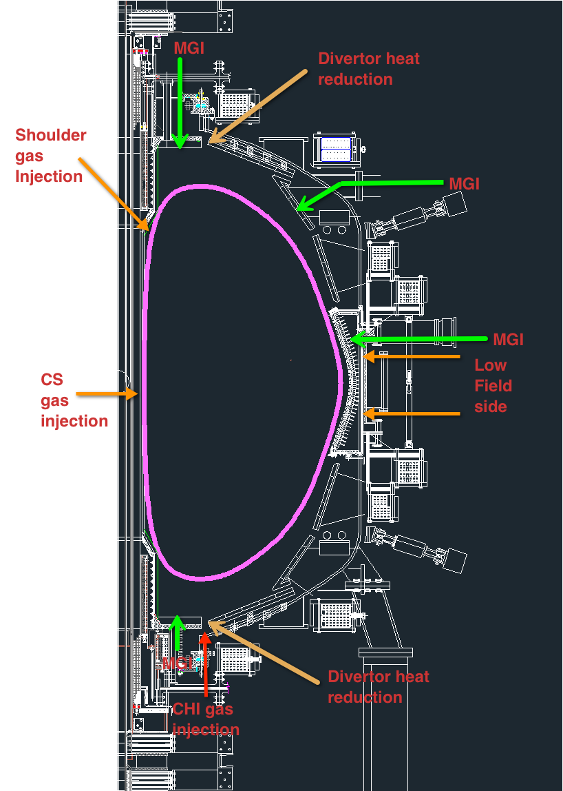
NSTX-U Plasma Operations Requires Capability for Gas Injection form Multiple Locations
1) Plasma Fueling
Inductive Plasma start-up: Low field side gas injection (D2)
Inductive H-mode initiations and early current ramp-up: Center stack gas injection
Density control during Li operation: Additional gas injection from low field side & center stack or shoulder gas injection
2) CHI Start-up
Branch 5 gas injection from divertor gap
3) HeGDC
Low field side (LFS)
4) Boronization
Up/down organ pipe locations & LFS
5) Div. heat flux mitigation studies
Localized divertor impurity gas injection at multiple locations
6) Disruption Mitigation studies
Massive gas injection from multiple locations

Slide 3
Summary of NSTX / NSTX-U Gas Systems (YR 1)
RED: new port location, Green: port to be identified, Black: work in progress
Name | NSTX | NSTX-U
Plasma Fueling Inj 1-PZV Inj 2-PZV Inj-3PZV | Bay K Top (89 cc) Bay J Mid-Lo (72cc) Bay J Mid-Up (70cc) | Same (Bay K Top) Bay I/J Mid-Lo (Install port) Bay F/G Mid-Lo-Left (Install port)
SGI | Bay I Midplane | Bay I Midplane
Inj 4a Inj 4b Inj 5a Inj 5b | CS – Mid (42.5cc) Shoulder (43.9cc) | Same Same CS-2 Shoulder-2
Branch 5 – Single Pulse | Bay K bot (1.3cc) | CHI-1 Bay K bot CH-2 Bay G bot (add Tee to CHI Penning gauge port)
Diagnostics Argon –PZV – single pulse GPI – PZV – single pulse | Bay-B Lo Flow Bay-B Hi Flow | Bay-B Hi Flow Bay-B Hi Flow
Diruption Mitigation LDGIS-1 LDGIS-2 LDGIS-3 LDGIS-4/MGI-1 | Bay C – AV120 (organ pipe - OP) Bay I – AV121 (OP) Bay F – AV122 (OP) Bay K – AV123 (OP) | MGI-1 Bay A 15 deg bot. MGI-2 Bay G 180 deg bot. MGI-3 Bay L 345 deg top MGI-Midplane-4 Bay I/J Mid-Up (Install port)
Divertor Studies DivL-1- PZV (YR 1) DivL-2-PZV (~180 degree apart) DivU-1- PZV DivU-2-PZV | Bay E bottom | Bay-E bottom Bay-J bottom TBD Upper dome port to be identified By Lane Roquemore

Slide 4
Divertor & MGI Gas Systems Upgrade (YR 2 or later)
Name | NSTX | NSTX-U
Divertor Studies YR-2 or later (based on YR-1 results) Lower Divertor (YR 2) DivL-3-PZV DivL-4-PZV Upper Divertor (YR 2) DivU-3-PZV DivU-4-PZV Massive Gas Injection Studies YR-2 or later (based on YR-1 results) MGI-2 | Bay K-Mid (Outer Vessel - OV) | Ports to ne identified Ports to be identified MGI-5 Bay F Up Horiz. dome (drill hole in div. plate)

Slide 5
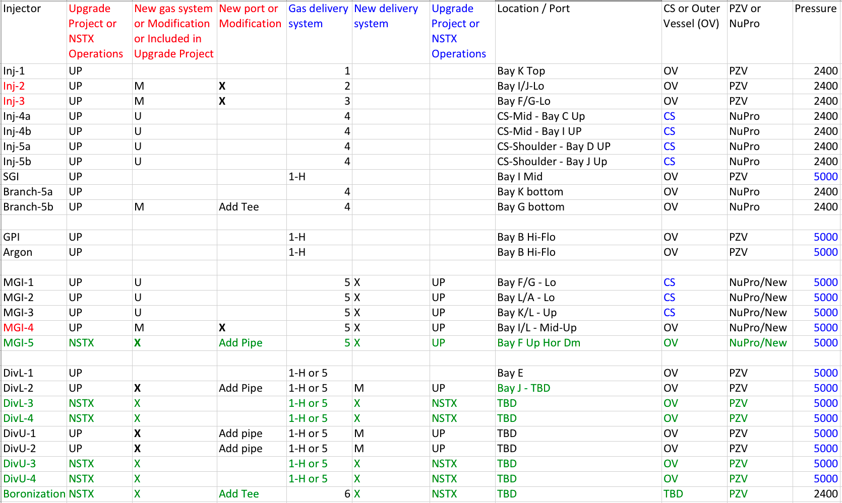
NSTX-U Gas Injection / Delivery System
Injectors in Black and Red are for YR-1 availability. Injectors in Green are for YR-2 or YR-3 availability

Slide 6
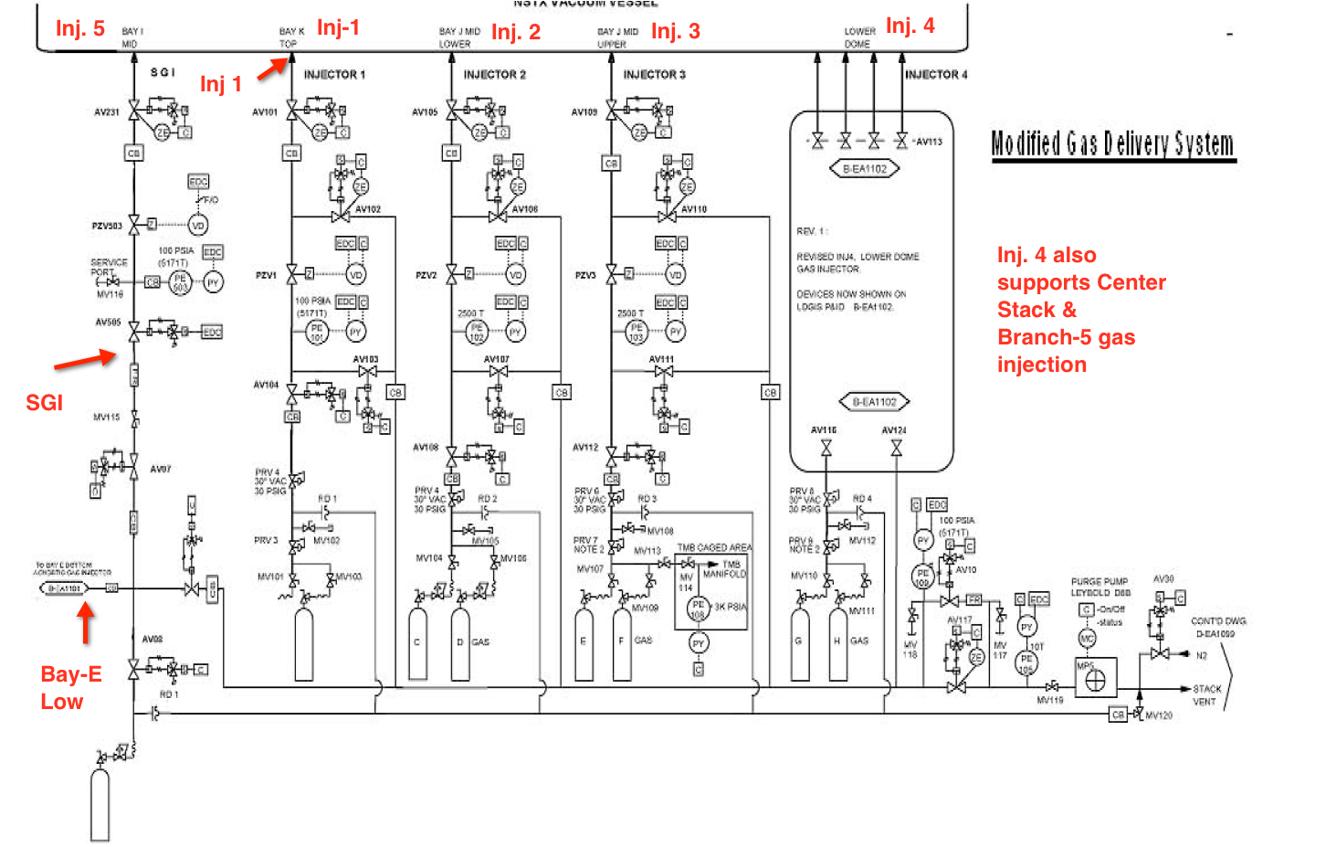
NSTX Gas Delivery System
SGI & Bay-E (& Argon and GPI) systems use existing gas delivery system controls – So these are a Hybrid of the present 1-4 gas delivery system

Slide 7
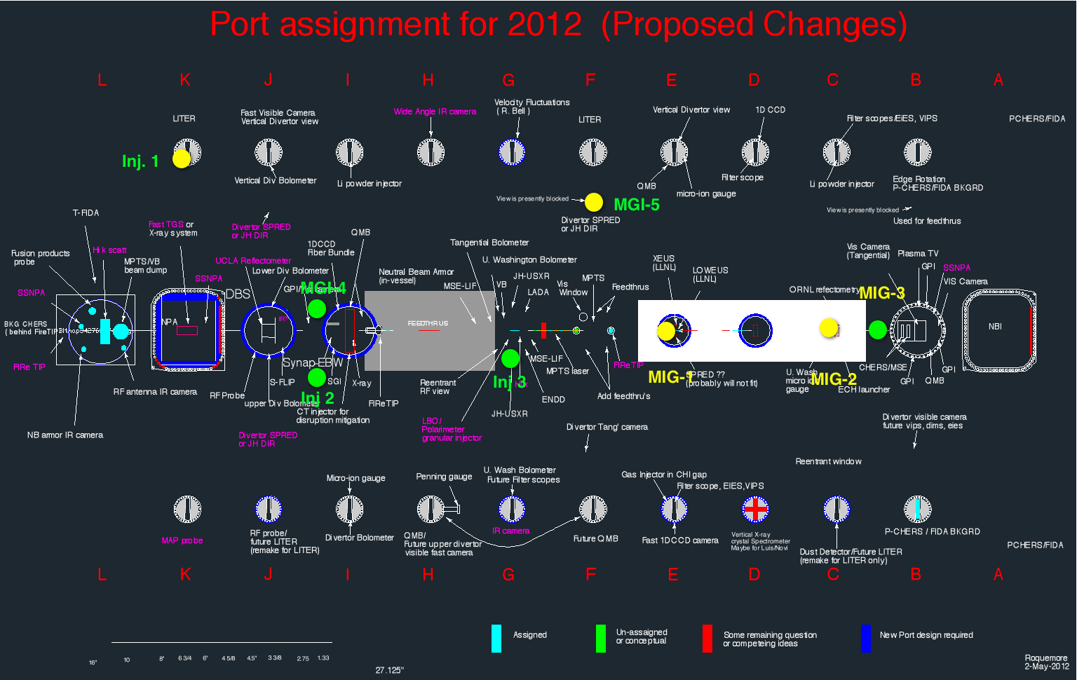
Examined installation of a single large 6-inch port to support three gas injectors and found the only location identified (Bay F/G Lo) to be unsuitable due to severe interference with the Thomson Scattering system

Slide 8
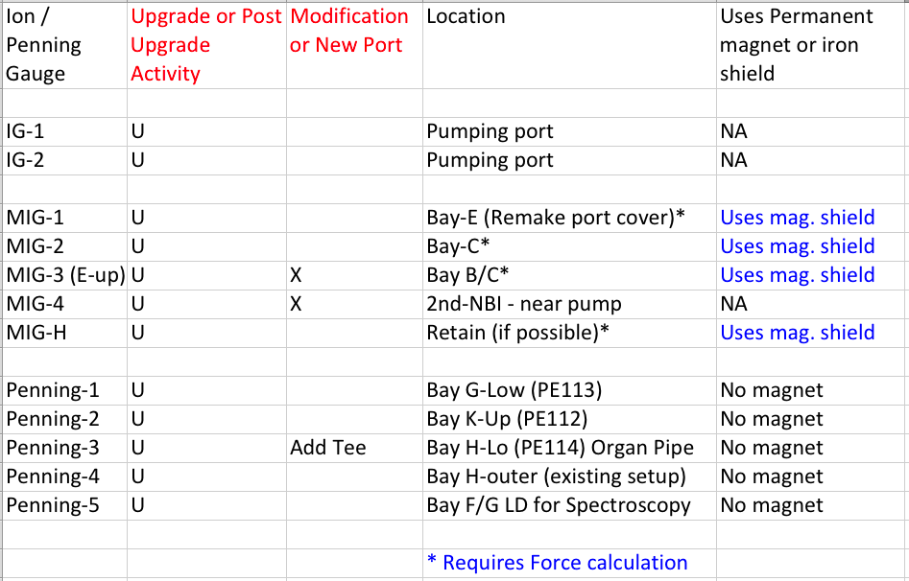
Ion / Penning Gauge Locations
Existing digitizers and cabling can be used, but need to ensure digitizers support 10 sec operations

Slide 9
Reference Plan: Install Four 2-3/4 inch ports (1.5 inch dia. pipe) on the vessel wall
Port-1 & 2: Bay I / J Mid-Lo (2 ports at this location for Inj. 2 and MGI-4)
Port 3: Bay F / G-Left Mid-Lo (1 ports at this location for Inj. 3)
Port 4: Bay B/C - MIG-3 (1 port)
MGI-5 mid upper [Bay F upper Horizontal Dome]
Port near Turbo pump for MIG-4 (1 port, but not on vacuum vessel)
OPTIONAL spares- Install one additional port in Bay F/G-Right-Right & Bay G/F-Up (GPI Upgrade)

Slide 10
Number of Gas Delivery Systems Needs to be increased from 4 to 6
System 1 (D2) [Mid-plane GIS]
System 2 (He for GDC)
System 3 (D2) [Mid-plane GIS]
System 4 (D2) as on NSTX [CS & Branch-5 GIS]
System 1-H (D2 and impurity gas) SGI & Bay-E Lower
System 1-H (3 impurity gases) as on NSTX Argon and GPI
System 5 (5000 Torr) for MGI – NEW for YR1
Will support Divertor Gas Injection system
Improves flexibility by freeing up SGI delivery system
System 6 (for new Boronization system)
Bill Blanchard to investigate if System 5 and 6 could be combined into a single system

Slide 11
New Boronization (TMB) Gas Delivery System would have additional safety measures
Doubly-contained piping
Diaphragm or bellows sealed pumps
Soft seal valves
Flow monitoring or limiting devices
Gas cabinets with appropriate purging
Automatic monitoring of the secondary eneclosure
Installed in test cell

Slide 12
Some Scope is with NSTX Operations, and some with the Upgrade Project
Upgrade Project Scope: Restore previous operations capabilities
Outer vessel penetrations for replacement valves and gauges
Plumbing to all LFS and CS injectors
Restoration of at least partial divertor gas injection (single divertor gas injection at bay E as before)
NSTX Operations Scope: Prepare for physics program (in rough priority order)
Additional gas delivery system for boronization
Full divertor gas injection (2 injectors top, two bottom)
Additional gas delivery system for the high pressure impurities (System #5, for MGI and Divertor injection)
Second MGI location in upper horizontal dome port (requires plate modification)
Should begin basic engineering assessments of these tasks in order to refine prioritization

Slide 13
Appendix

Slide 14
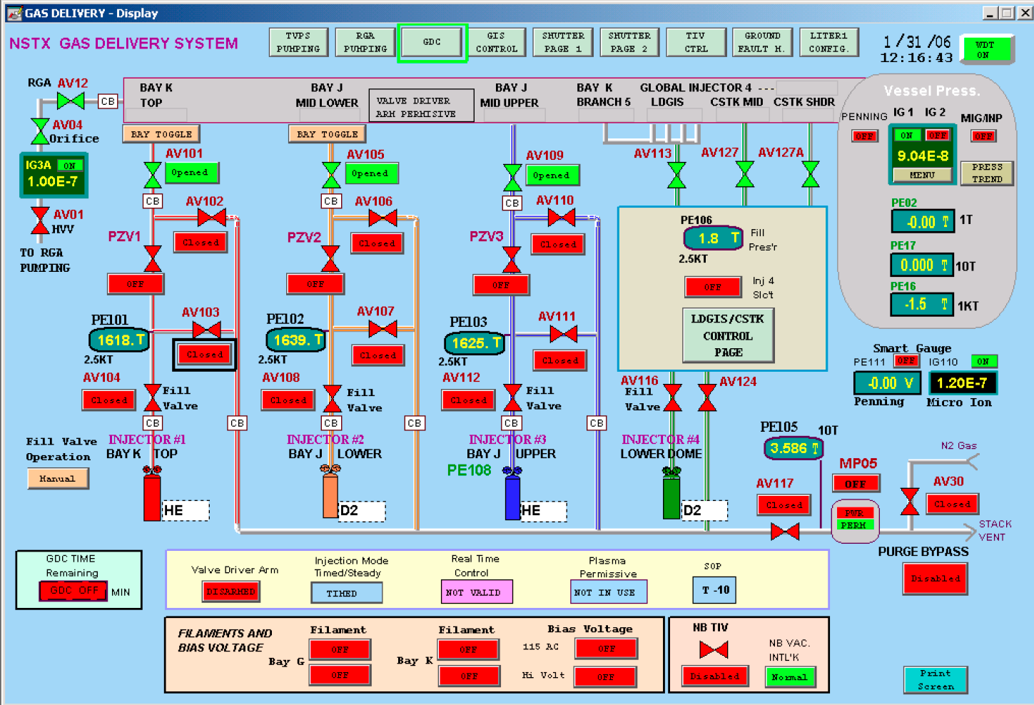
EPICS Gas Systems Control Page

Slide 15
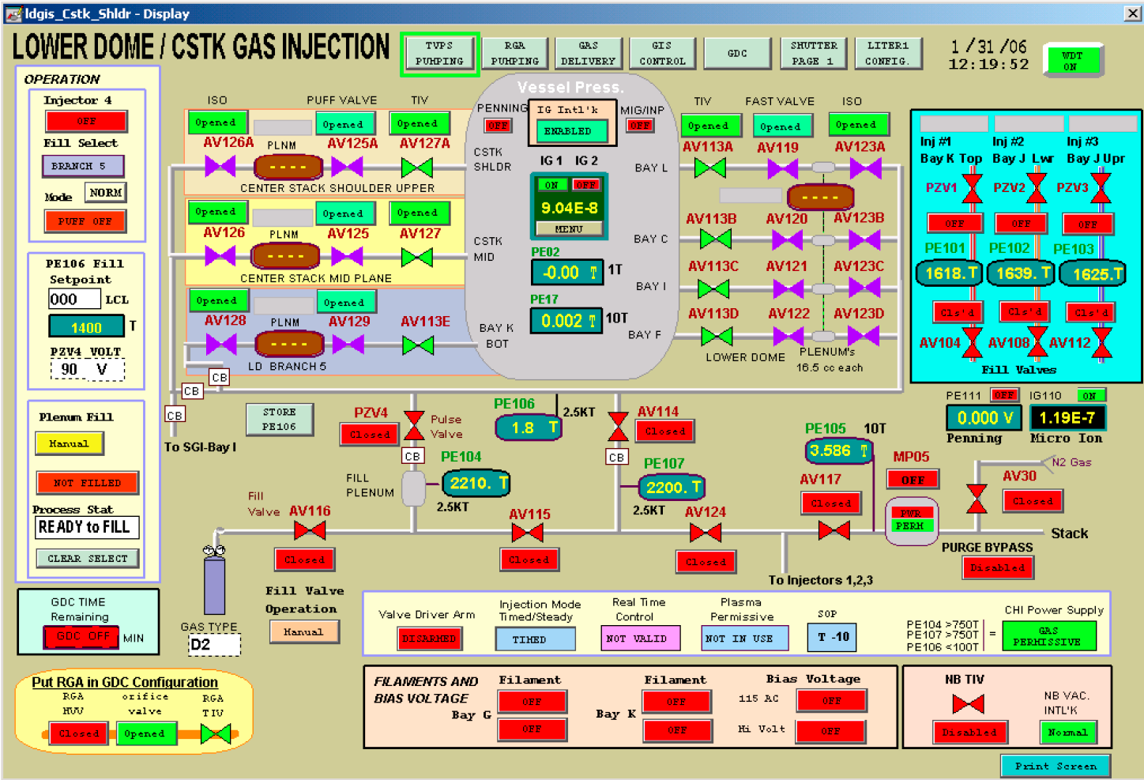
LDGIS / CS / Branch-5 Gas Systems Control Page

Slide 16
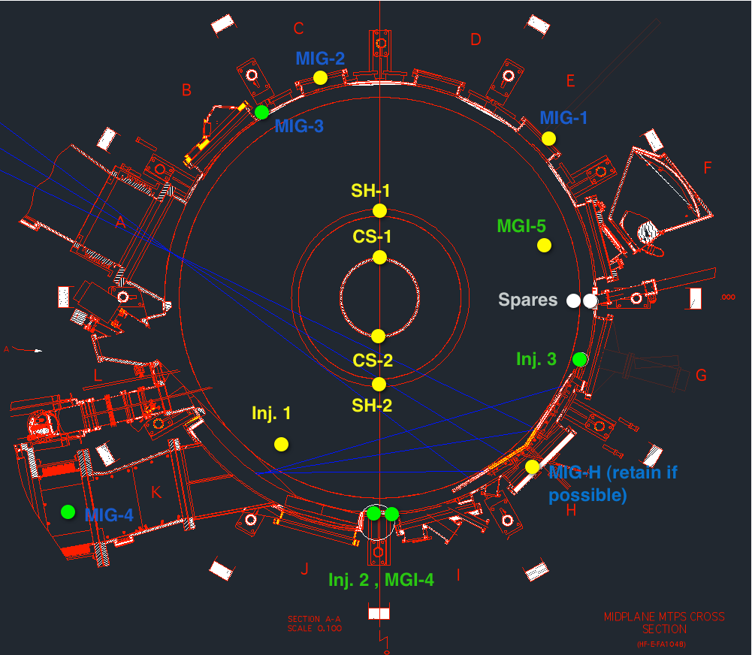
Top-Down View of GIS & MIGs

Slide 17
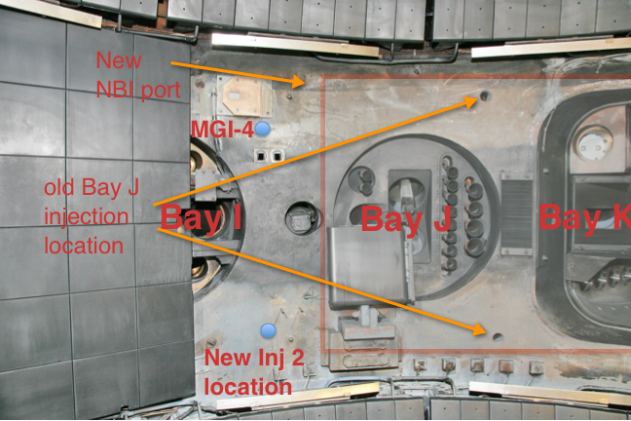
Photo of Bay I / J Mid-Lo (Ports 1 & 2)
Two gas injection ports removed to provide space for tangential NBI port

Slide 18
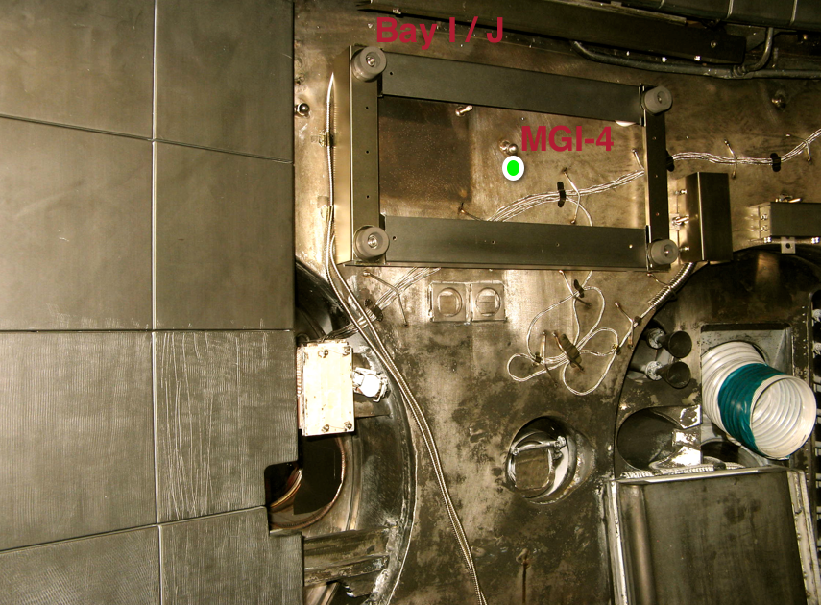
Bay I / J Port (Port 2- Partial view as previous photo)

Slide 19
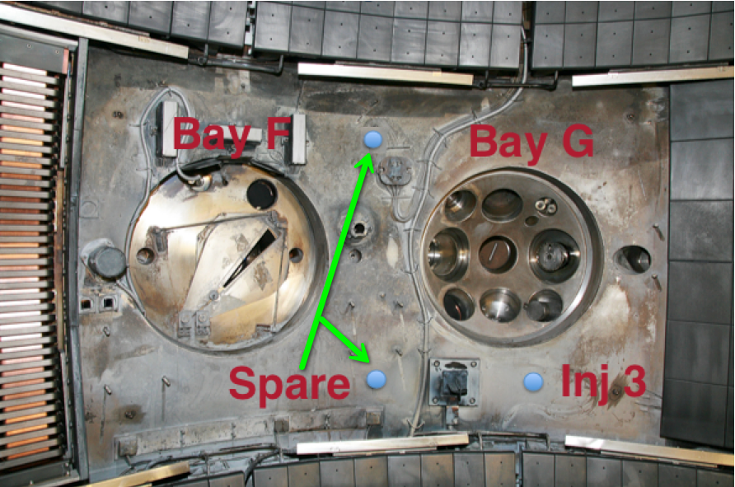
Photo of Bay G Mid-Lo (Port 3)

Slide 20
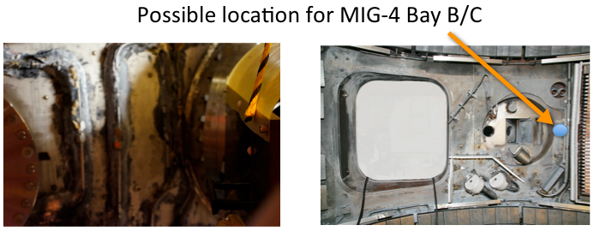
MIG-4 Port (Port 4)
Outside and inside views

Slide 21
MGI-5 Requires Modification to Bay-F Horizontal Dome Port

Slide 22
CHI Brach-5 Injectors

Slide 23
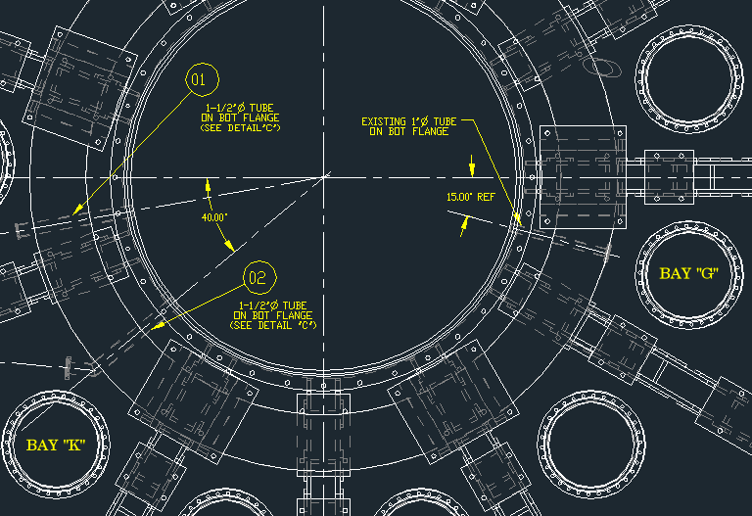
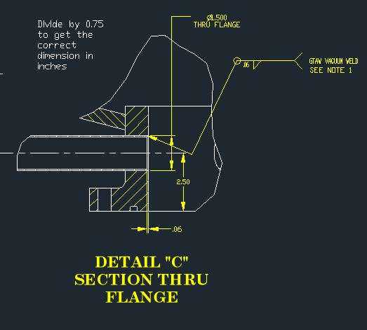
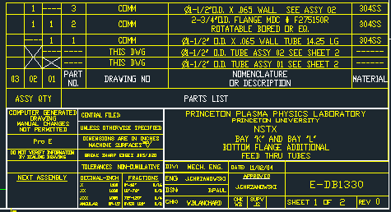
Branch 5 Injectors
CHI-2 & Penning gauge
CHI-1

Slide 24
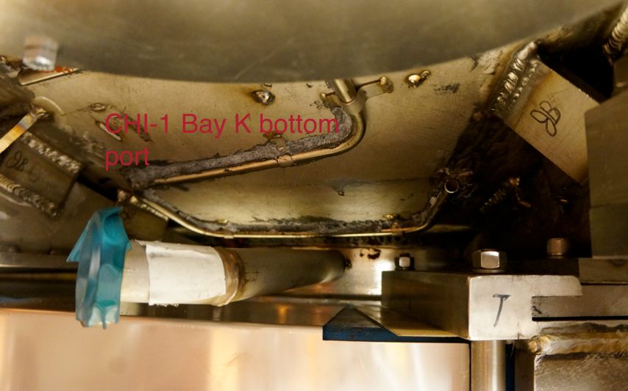
CHI-1 Bay K bottom port

Slide 25
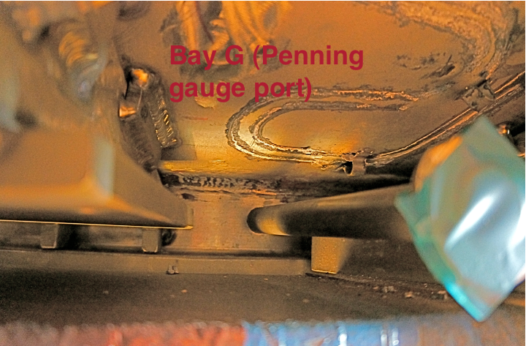
CHI-2 & Penning gauge Bay G Bottom
Install Tee and install both the Penning gauge and a second line for CHI gas injection

Slide 26
Configuration for Divertor Gas Injection

Slide 27
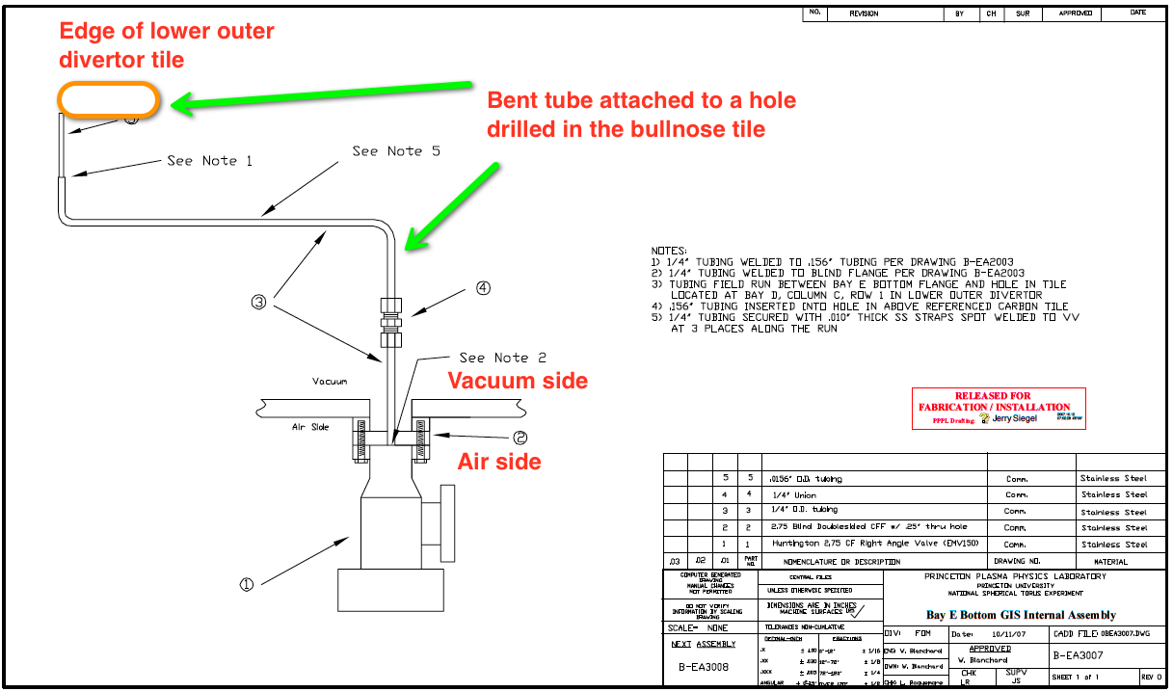
Bay-E Lo Vacuum & Air side connection

Slide 28
Bay-E DIV-1 gas injection pipe photo

Slide 29
Organ Pipe Usage

Slide 30
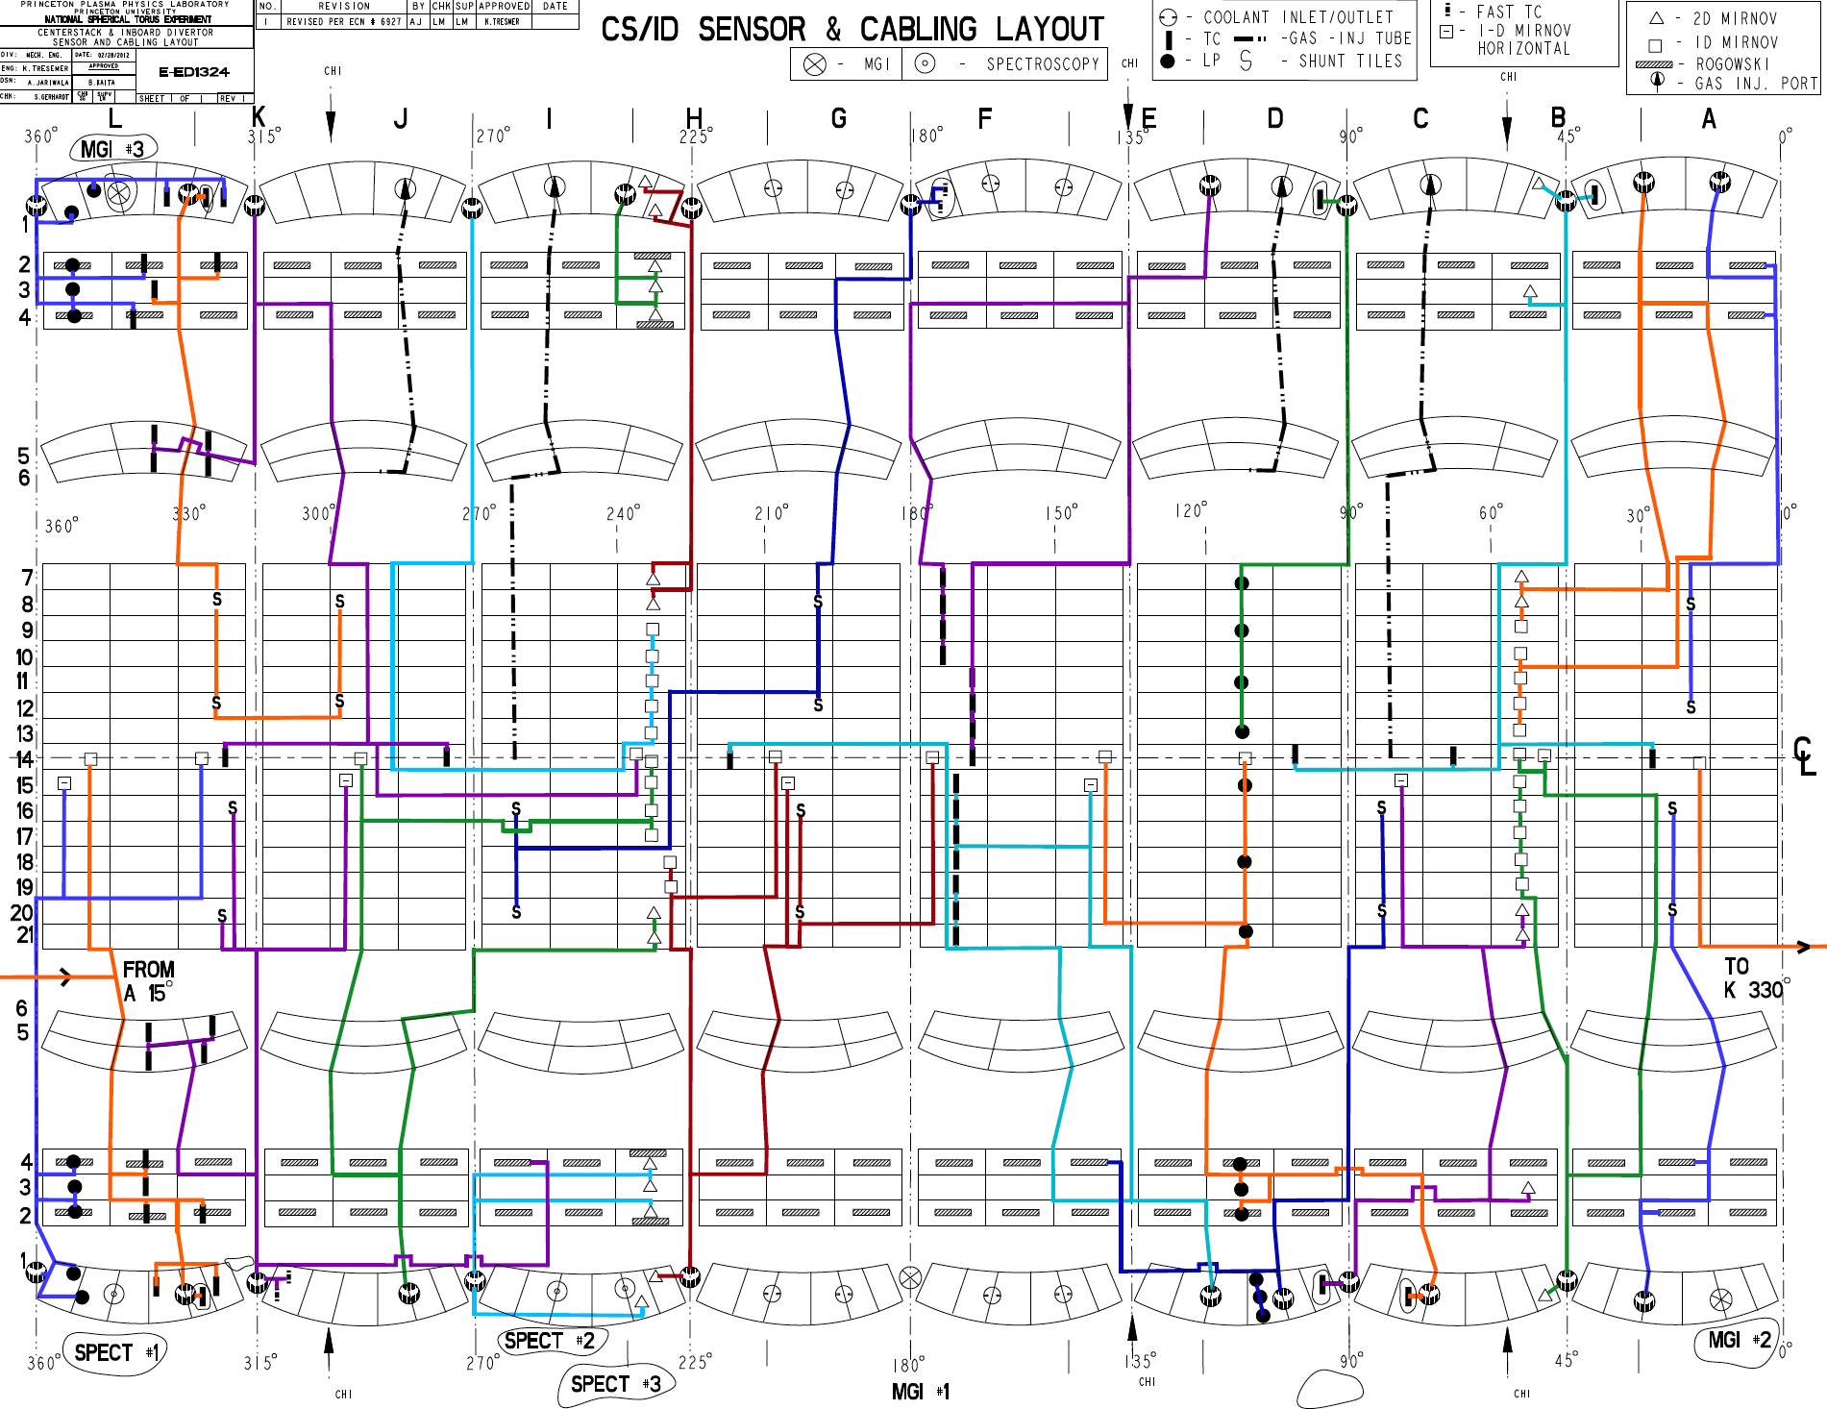

Slide 31
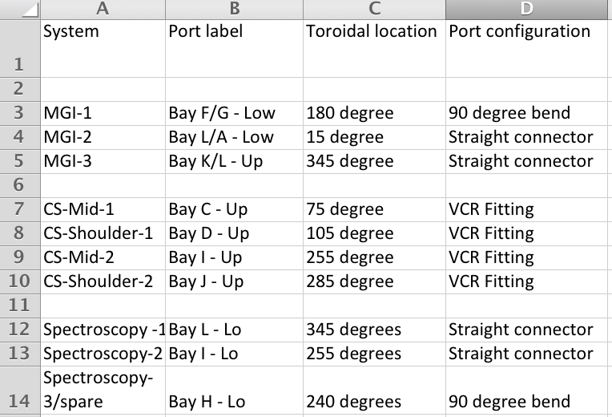
Upper / Lower Gas Injection and Spectroscopy Organ Pipes

Slide 32
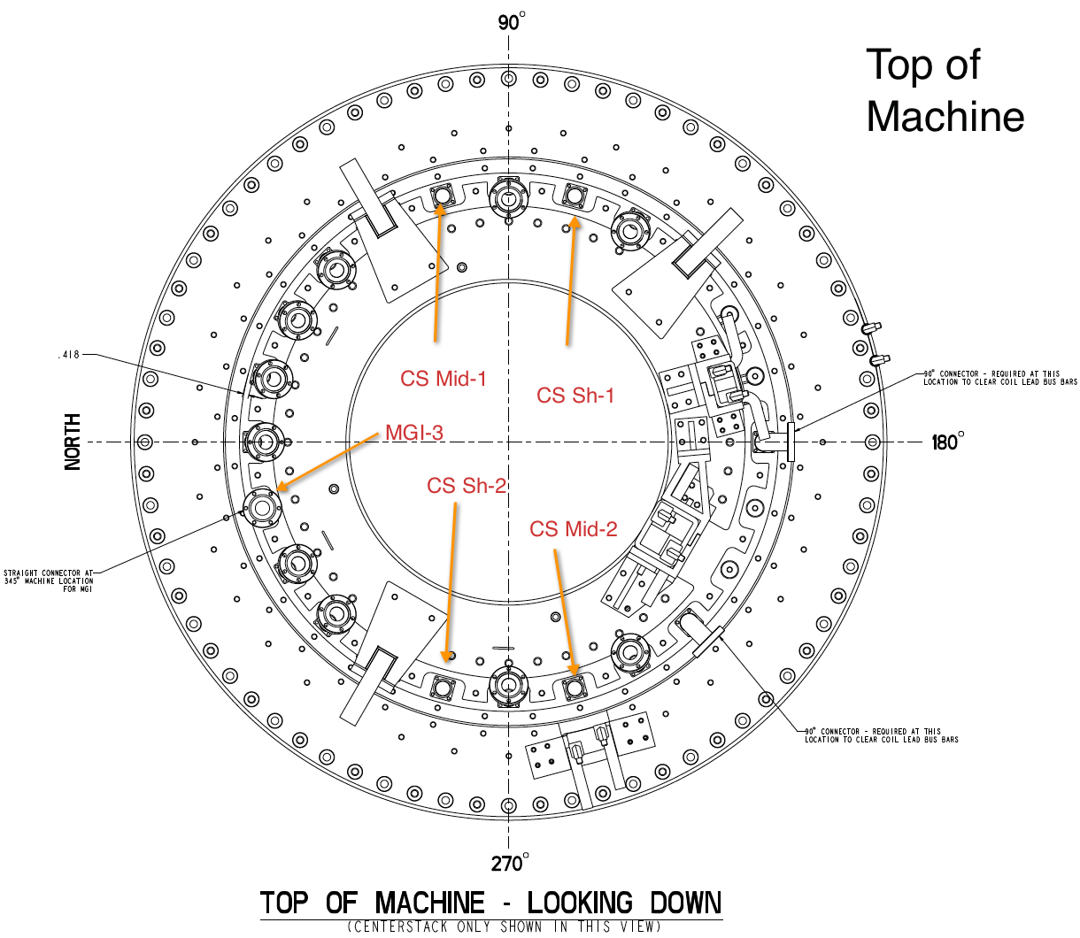
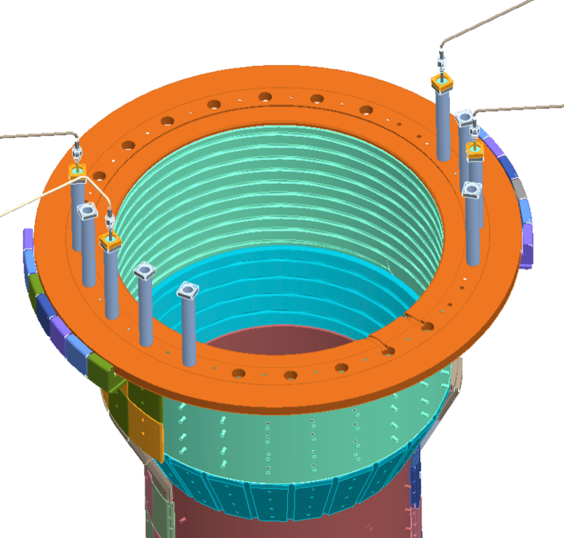
Center Stack & MGI-3

Slide 33
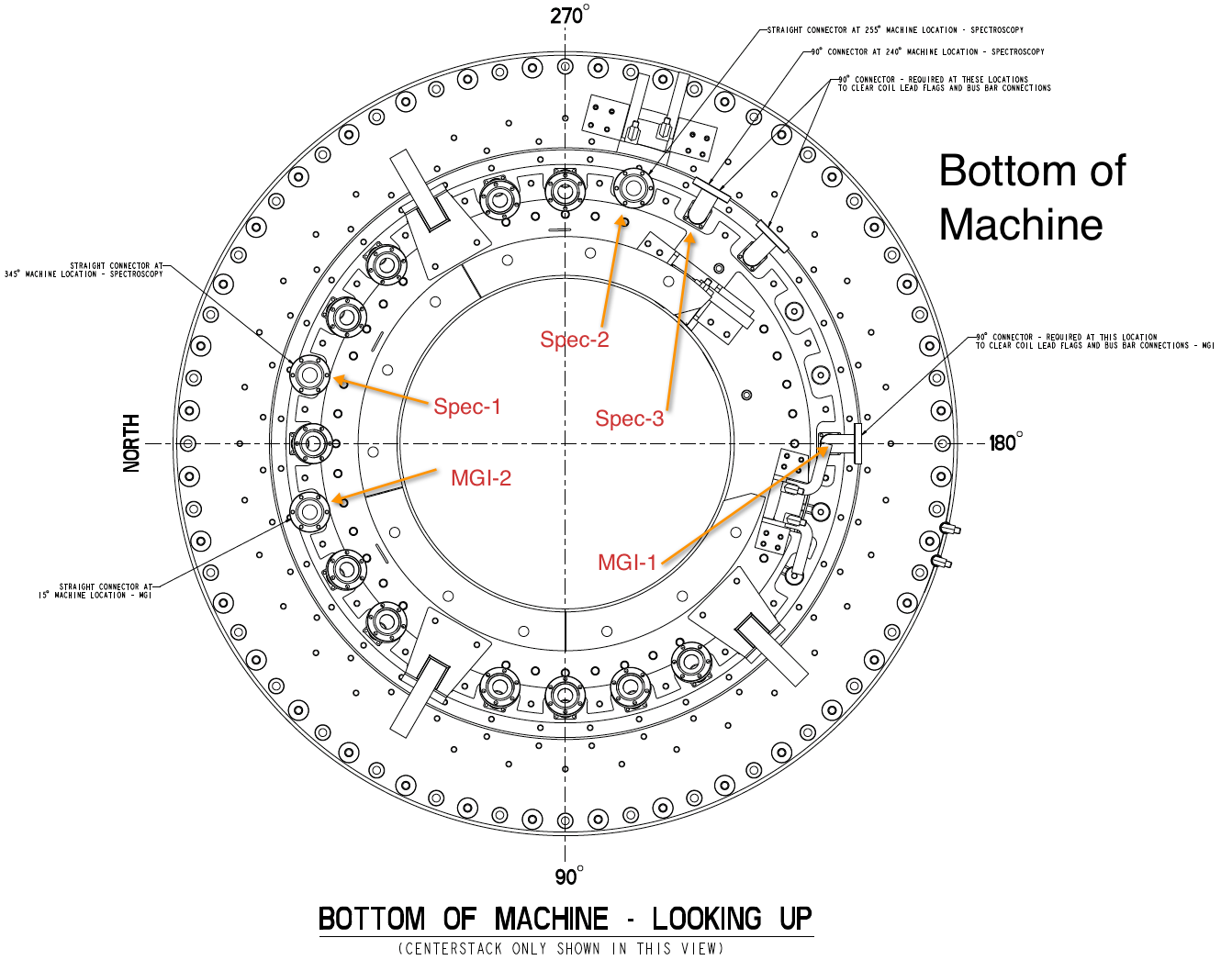
MGI 1, 2 & Spectroscopy Ports

Slide 34
Neutral Pressure Gauge Locations

Slide 35
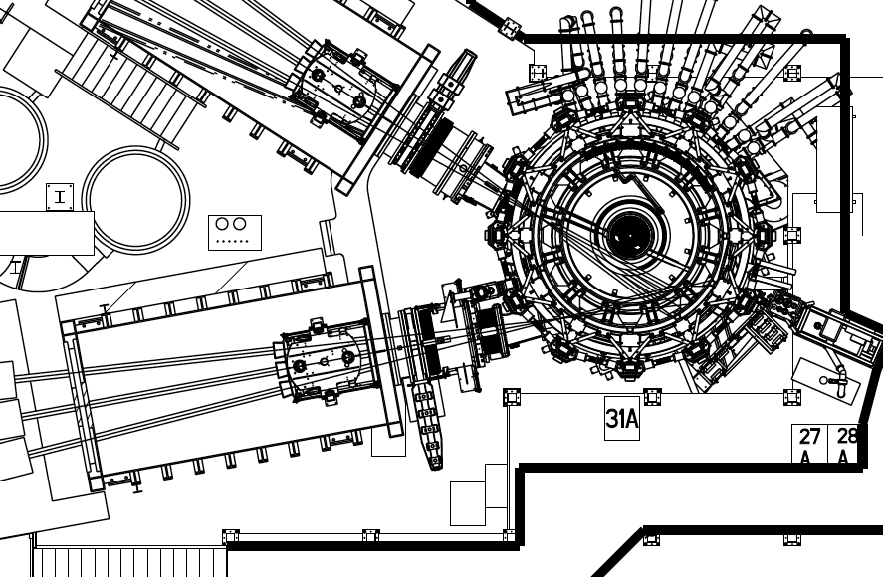
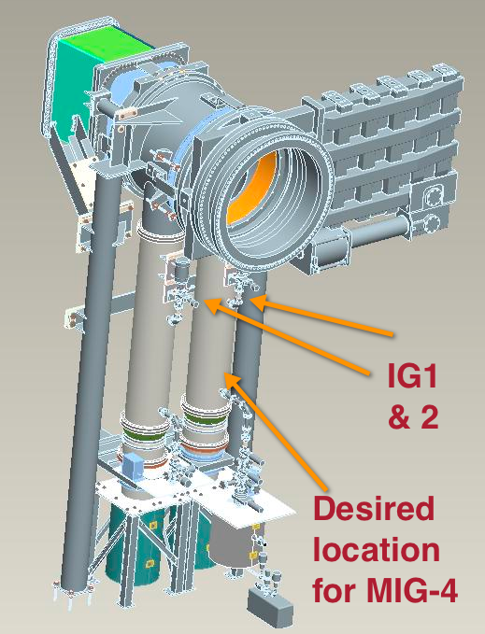
IG 1, 2 and MGI-4 Locations

Slide 36
Penning Gauges
PEN-1 Bay G_LD (PG1P)
PEN-2 Bay K_UP (PG2P)

Slide 37
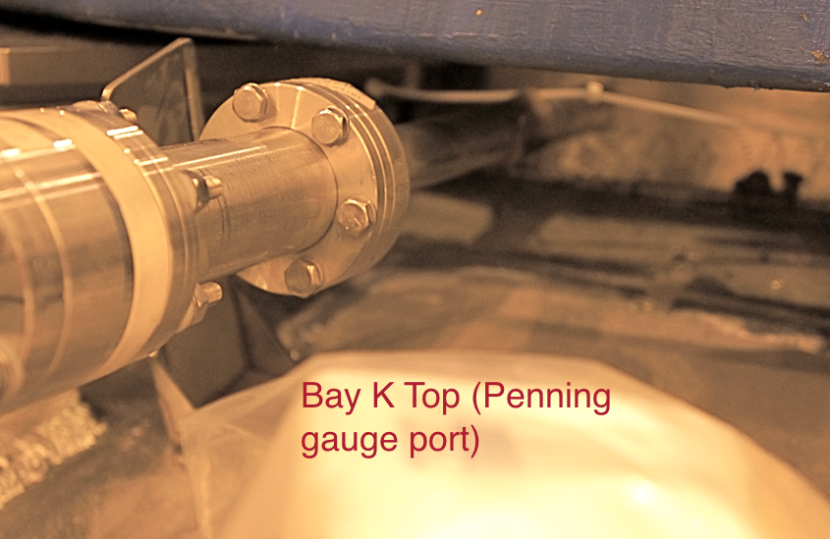
Bay K Top (Penning gauge port)

Slide 38
CHI-2 & Penning gauge Bay G Bottom
Install Tee and install both the Penning gauge and a second line for CHI gas injection

Slide 39
Plenum Sensotec Requirements

Slide 40
CHI/ MGI / Divertor Plenum Sensors (Sensotek)
Pressure Sensor | Availability | Max Press (Torr)
CHI1-Bay K bot CHI2-Bay G/L | YR-1 YR-1 | 2400 Gas Delivery System 4)
MGI-1 MGI-2 MGI-3 MGI-4 MGI-5 | YR-1 YR-1 YR-1 YR-1 YR-1 | 5000 (Gas Delivery System 6)
DIV1L DIV2L DIV3L DIV4L DIV1U DIV2U DIV3U DIB4U | YR-1 YR-1 YR-2 YR-2 YR-1 YR-1 YR-2 YR-2 | 5000 (Gas Delivery System 5,6 – YR1 And add 7,8 during YR2)

Slide 41
High and Low Field Sensotek Sensors
Pressure sensor | Availability | Max press (Torr) / system #
Inj-1a-CS1 | YR-1 | 2400 / 4
Inj-1b-CS2 | YR-1 | 2400 / 4
Inj-2a-SH1 | YR-1 | 2400 / 4
Inj-2b-SH-2 | YR-1 | 2400 / 4
Inj-1 | YR-1 | 2400 / 1
Inj-2 | YR-1 | 2400 / 2
Inj-3 | YR-1 | 2400 / 3
GPI | YR-1 | 5000 / 5
Argon | YR-1 | 5000 / 5
SGI | YR-1 | 5000 / 4

