Slide 1
MGI ACC Review
May 5th 2016

Slide 2
Functional Overview
MGI uses current pulse from discharging a capacitor to quickly open a valve
Three separate systems
Each system consists of three main sections
Systems mounted in two equipment racks

Slide 3
MGI (Power) System Overview

Slide 4
Components
Charger Enclosure
  Capacitor Charger
  AC Power isolation
Capacitor Enclosure
  Capacitor: 550uF, 1000V -> 275J
  NC Discharge Relay
  NO Charge Relay
  Voltage & current sensors

Slide 5
Components (cont.)
Control
  NI Compact-RIO system (real-time controller)
  Compact-RIO operated from remote GUI
  Charges & discharges capacitor during NSTX-U shot following configurable time sequence
  Monitors status of charger and capacitor
  Records measurements
  Observes all Hardware Interlock signals & reacts accordingly

Slide 6
Safety Signals
Hardware Interlock Signals
  NO ESTOP, LOOP SET
  TVPS n
Equipment Rack Door Switches
Controller Related
  EPICS signals: system powered down and cap. Discharged between shots
  Controller Watchdog: forcing system into safe state if controller becomes unresponsive

Slide 7
Hardware Interlock Signal ‘NO ESTOP’
Monitored in all MGI components
Inactive NO ESTOP:
  Removes AC power from charger
  Forces closure of discharge relay and capacitor discharge
  Removes power from trigger circuit

Slide 8
Hardware Interlock Signal ‘LOOP SET’
Monitored in all MGI components
Inactive LOOP SET:
  Removes AC power from charger
  Forces closure of discharge relay and capacitor discharge
  Removes power from trigger circuit

Slide 9
Hardware Interlock Signal ‘TVPS n’
One signal for each MGI system
Inactive TVPS:
  Removes AC power from charger
  Forces closure of discharge relay and capacitor discharge
  Prevents triggering of SCR

Slide 10
Equipment Rack Door Switches
Two door switches in each rack
Ensure that rack doors are closed during operation
Inactive Door Switches:
  Prevent charging of capacitor
  Remove power from trigger circuit

Slide 11
Control Software Safety
MGI only functions if under operator control
Controller monitors all HW interlock signals and reacts accordingly
Controller has built-in HW watchdog to force system into safe state if controller software becomes unresponsive

Slide 12
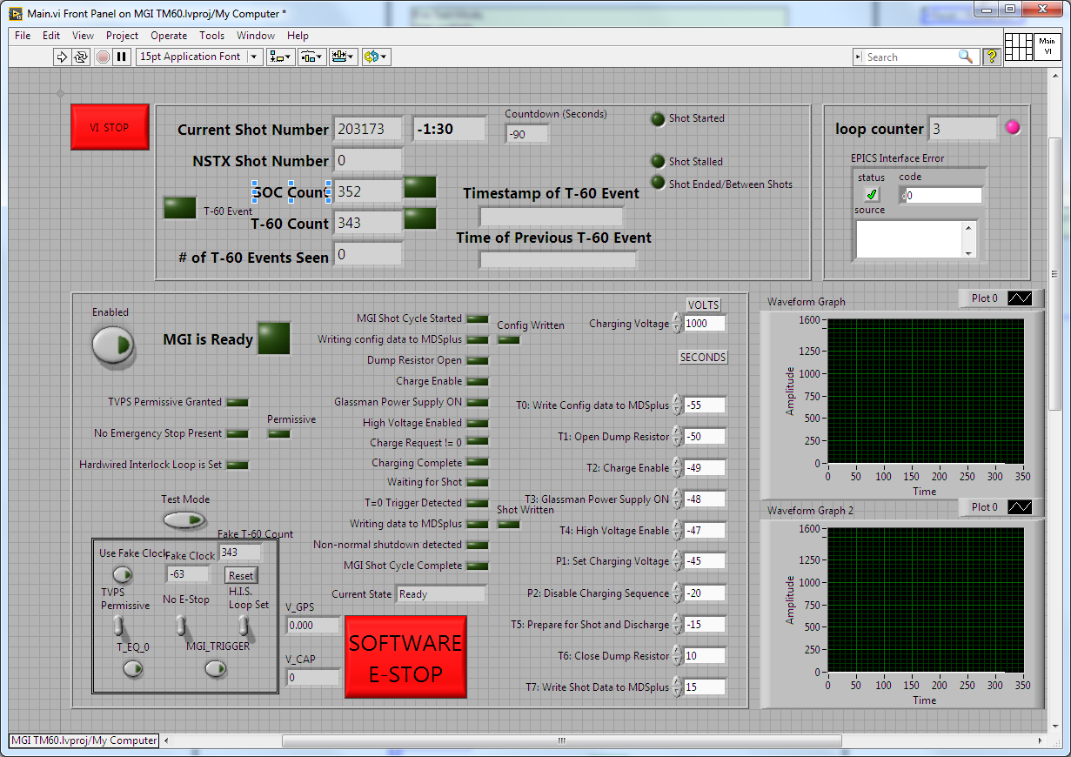
Remote Control GUI

Slide 13
Procedures
Capacitor Safing Procedure
  Process to ensure capacitor is discharged & grounded before any maintenance
MGI PTP
  Defines functional tests for a MGI system before installation
MGI ISTP
  Defines functional tests after installation, before operation
MGI Operation Procedure

Slide 14
Additional Slides …

Slide 15
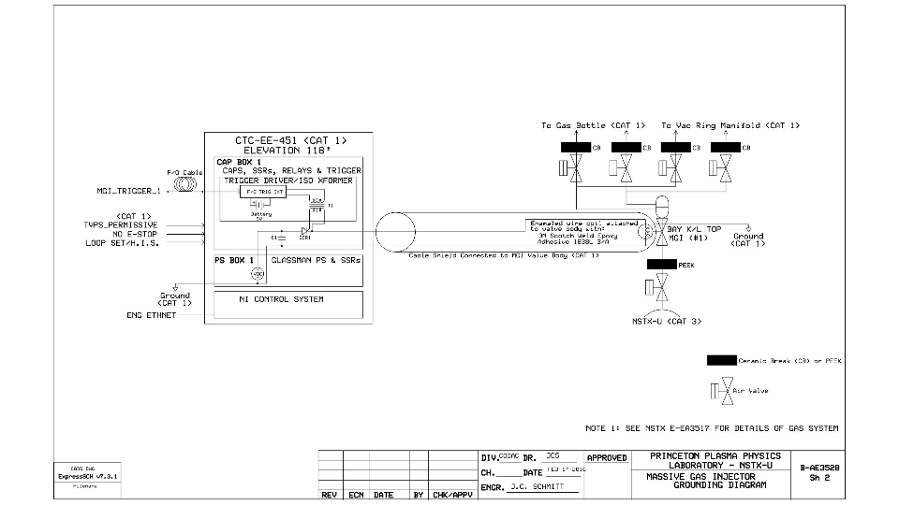
Grounding Diagram

Slide 16
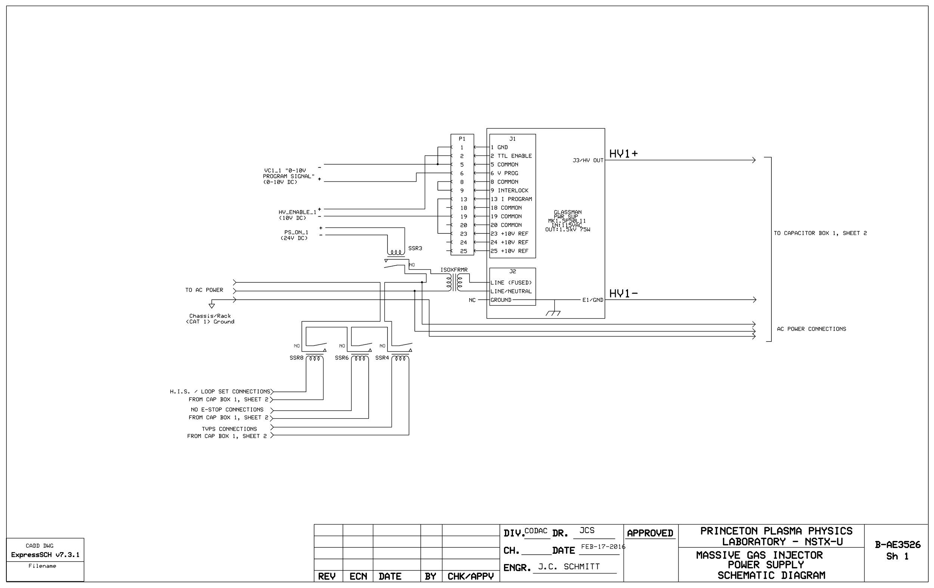

Slide 17
