Slide 1
Massive Gas Injector Power supply and control system CDR
10/16/2015

Slide 2
Outline
Massive Gas Injector (MGI) Overview
Supply schematic
Relays and interlocks
Control signals
High voltage considerations
Control system – NI cRIO chassis and modules
Power
Modules: DO, DI, AO, AI
Sequence and state diagrams
System tests
Other necessities
NEPA, Vacuum PLC, PCS, etc.
Timeline

Slide 3
MGI Overview
Unmitigated disruptions in a tokamak discharge
Cause excessive diverter heat loads
Large halo currents
Injecting massive amounts of gas prior to the disruption can thermally quench the plasma and reduce the impact of disruptions
NSTX-U is studying the effects of MGI at various poloidal locations around the plasma
The injectors are installed; Power supplies and control systems are presented here

Slide 4
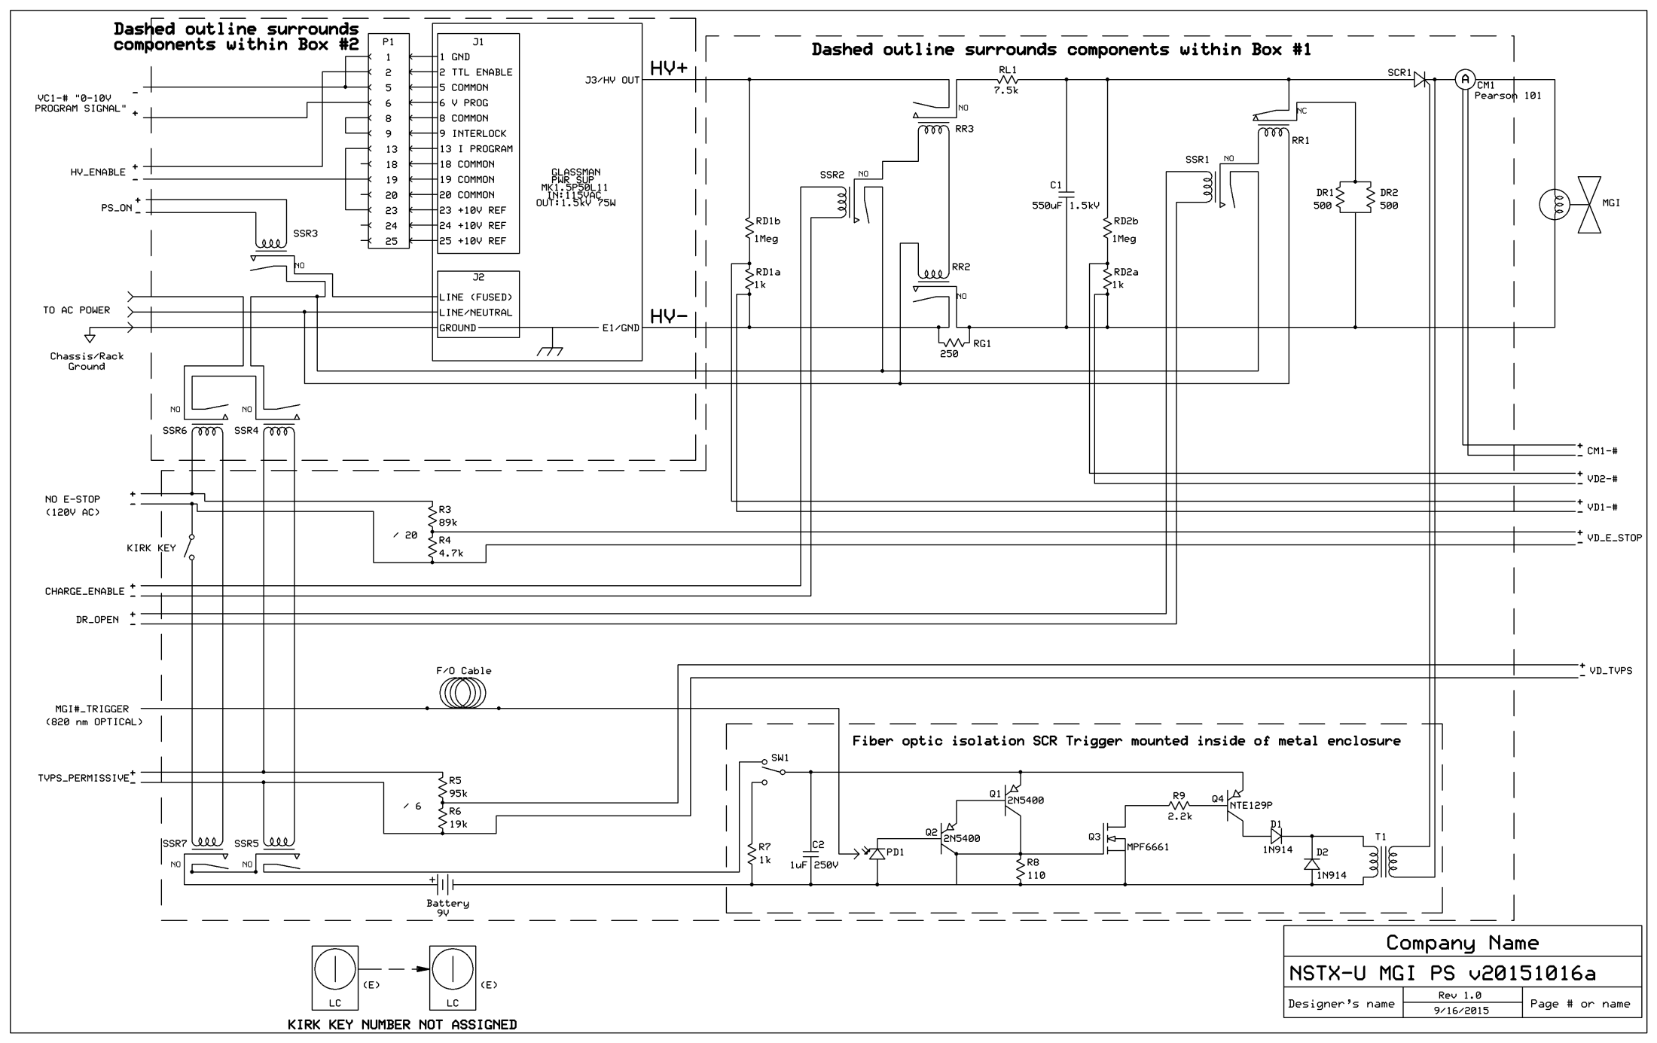

Slide 5
Supply Schematic I
High Voltage Ross Relays control the connections to the dump resistor (RR1) and Glassman charging supply (RR2, RR3)
Solid State Relays
SSR1 controls operation of RR1; SSR2 controls RR2 and RR3
SSR3 controls power to Glassman supply
SSR4 and SSR5 allows TVPS (24 VDC) to inhibit power to the charging supply, RR1, RR2, and RR3
SSR6 and SSR7 allows NO-E-STOP (120 VAC) to inhibit power to the charging supply, RR1, RR2, and RR3
Kirk key interlock is in series with NO-E-STOP
Kirk keys lock the boxes shut. The supply is inside these boxes
Normal operation
SSR1, SSR2, and SSR3 are controlled by NI cRIO Control System
SSR4, SSR5, SSR6, and SSR7 are controlled by NO-E-STOP, TVPS and Kirk Key
Loop Set/H.I.S. is monitored by NI cRIO Control System (discussed later)

Slide 6
Supply Schematic II
Control signals
Everything is coming from the NI cRIO system
Digital: DR_OPEN, CHARGE_ENABLE, PC_ON, HV_ENABLE
Analog: VC1
Several signals are continuously monitored, typically through voltage dividers
VD_E_STOP, VD_TVPS, LOOP_SET (discussed later) to monitor permissives
VD1, VD2 to monitor supply and capacitor voltage
CM1 to monitor current out to MGI solenoid
High Voltage
Suggested: Capacitor (-) is connected to chassis ground at all times
As built: Capacitor (-) is connected to 250 Ohm which is connected to ground through the Glassman power supply
The device that triggers the SCR is battery-powered, electrically isolated (via fiber optic) from the rest of the system and isolated by a transformer from the SCR
System has been tested for functionality and high-potted to 2.5 kV

Slide 7
Supply Schematic III
Cost Estimate
I don’t have costs for all ‘big ticket’ items
Glassman power supply, Ross Relays, Enclosure
Around $500-$600 total for rest
Prototype is under construction at U-Wash
Photographs are on the next slides

Slide 10
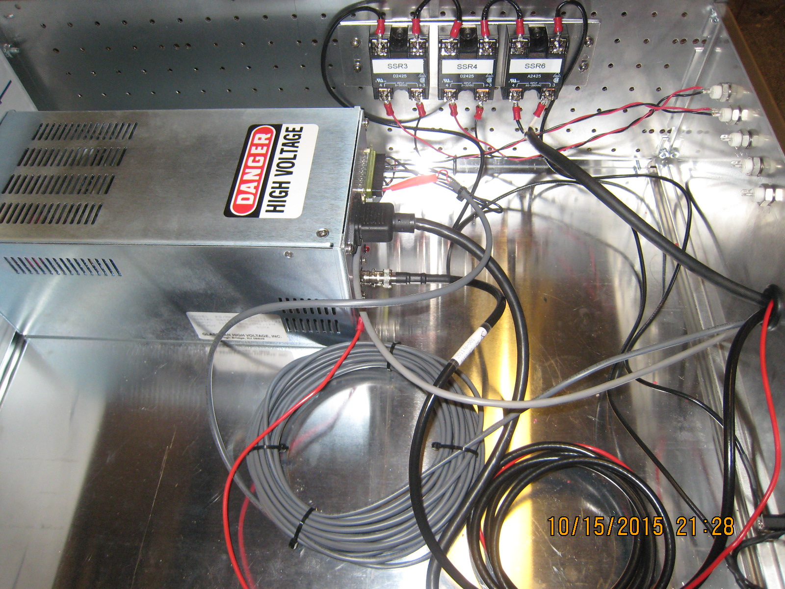

Slide 11
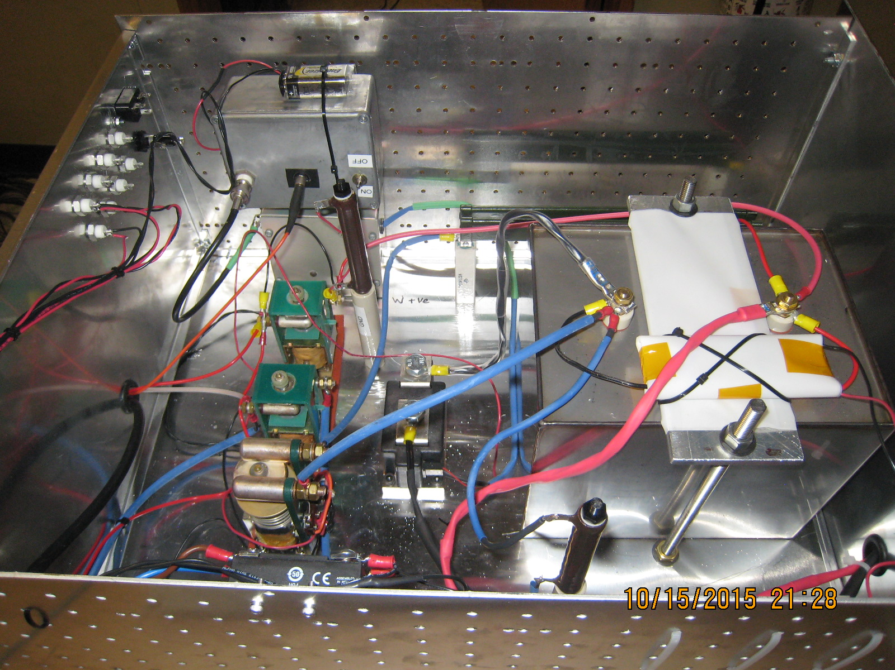

Slide 12
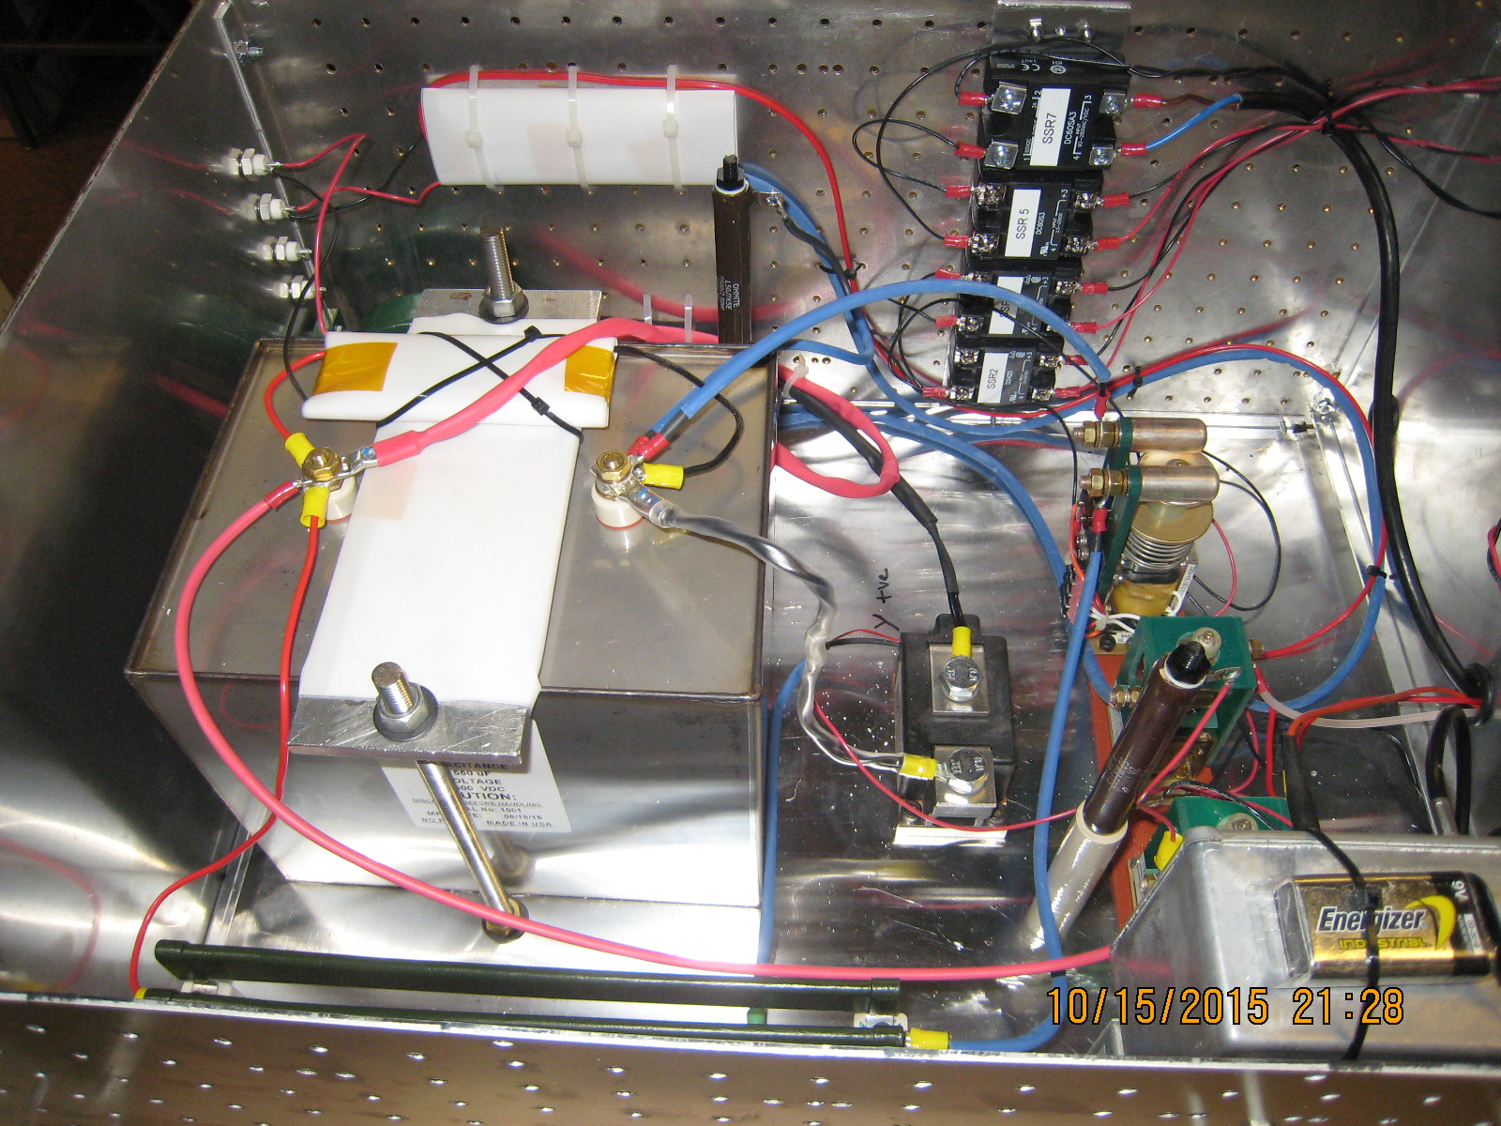

Slide 13
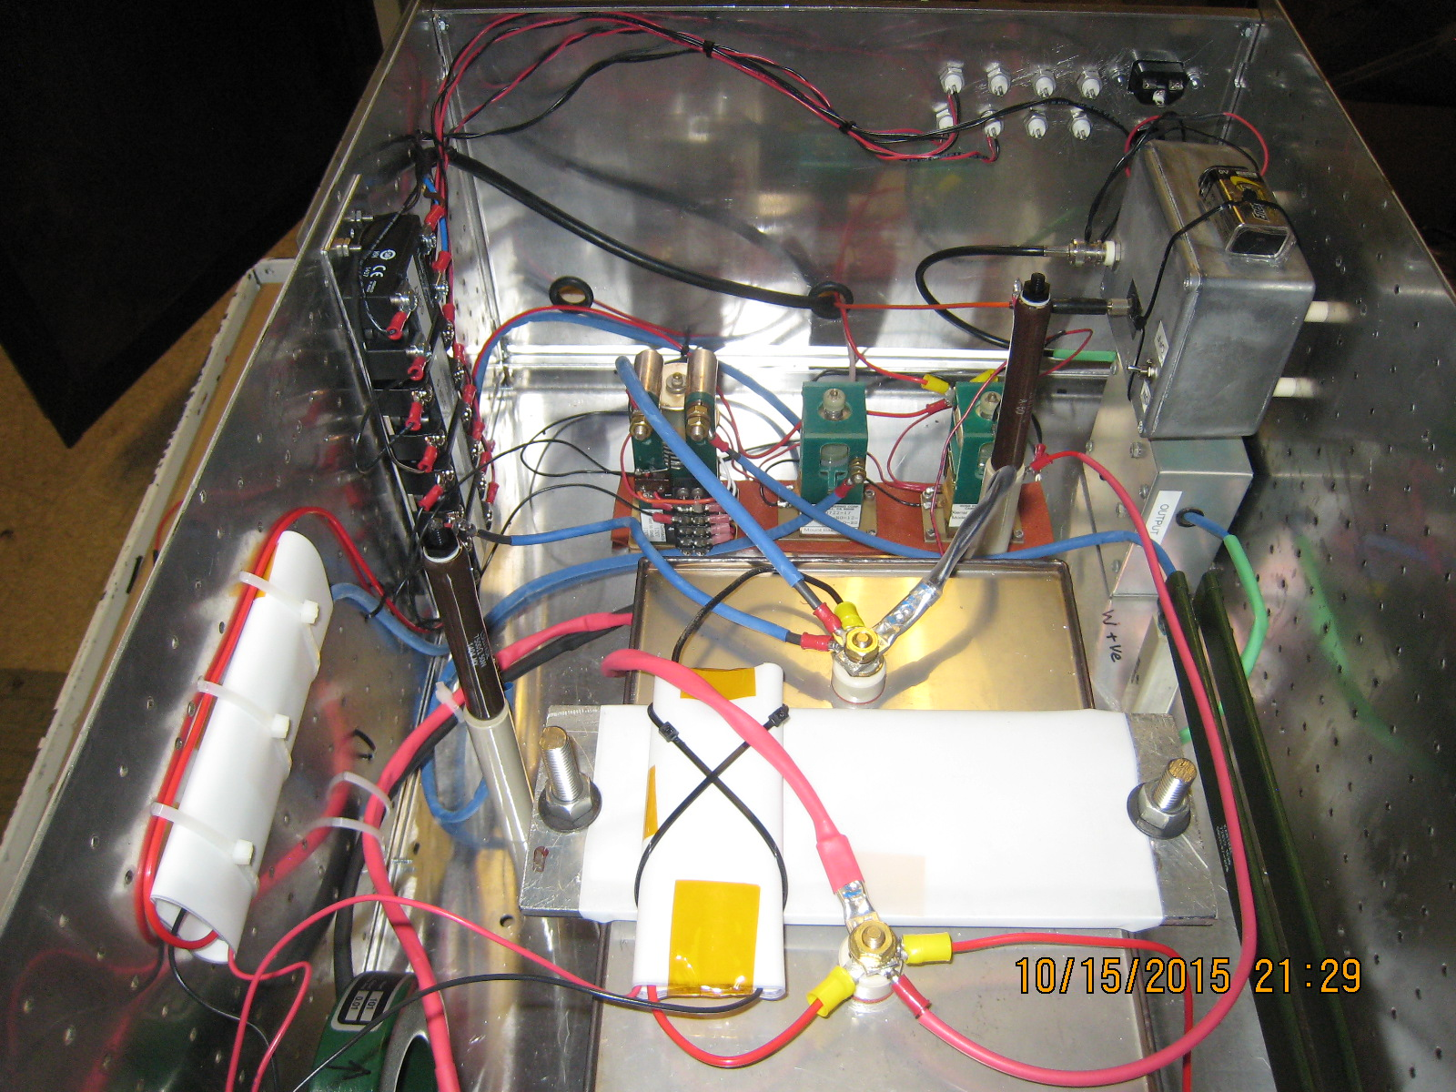

Slide 14
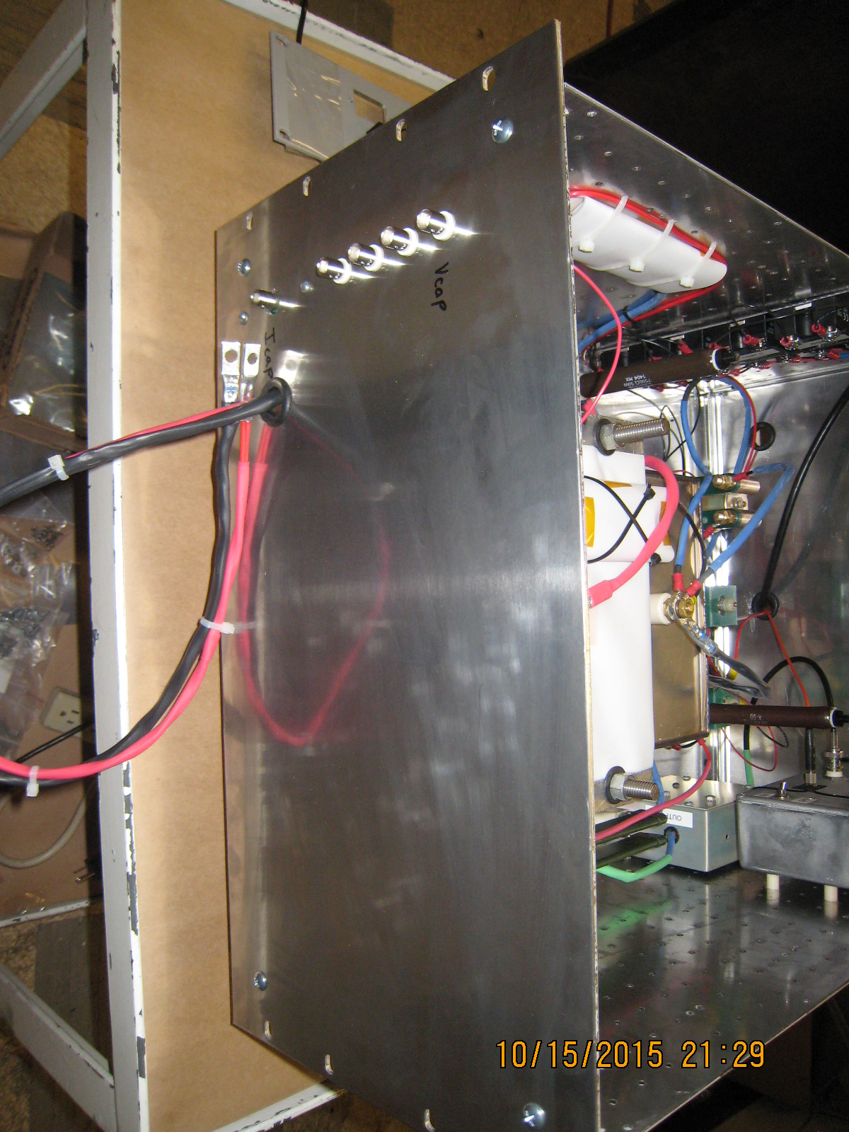

Slide 15
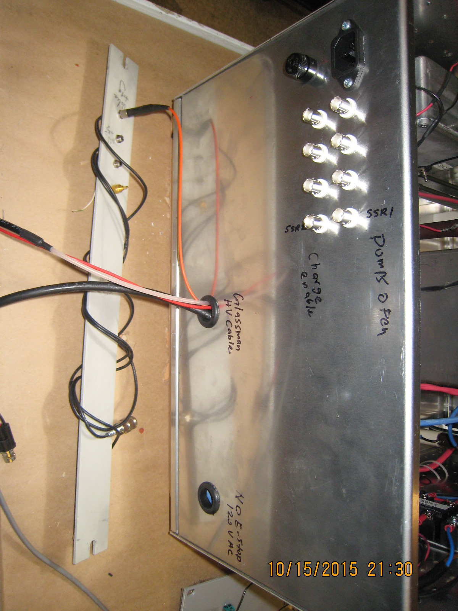

Slide 16
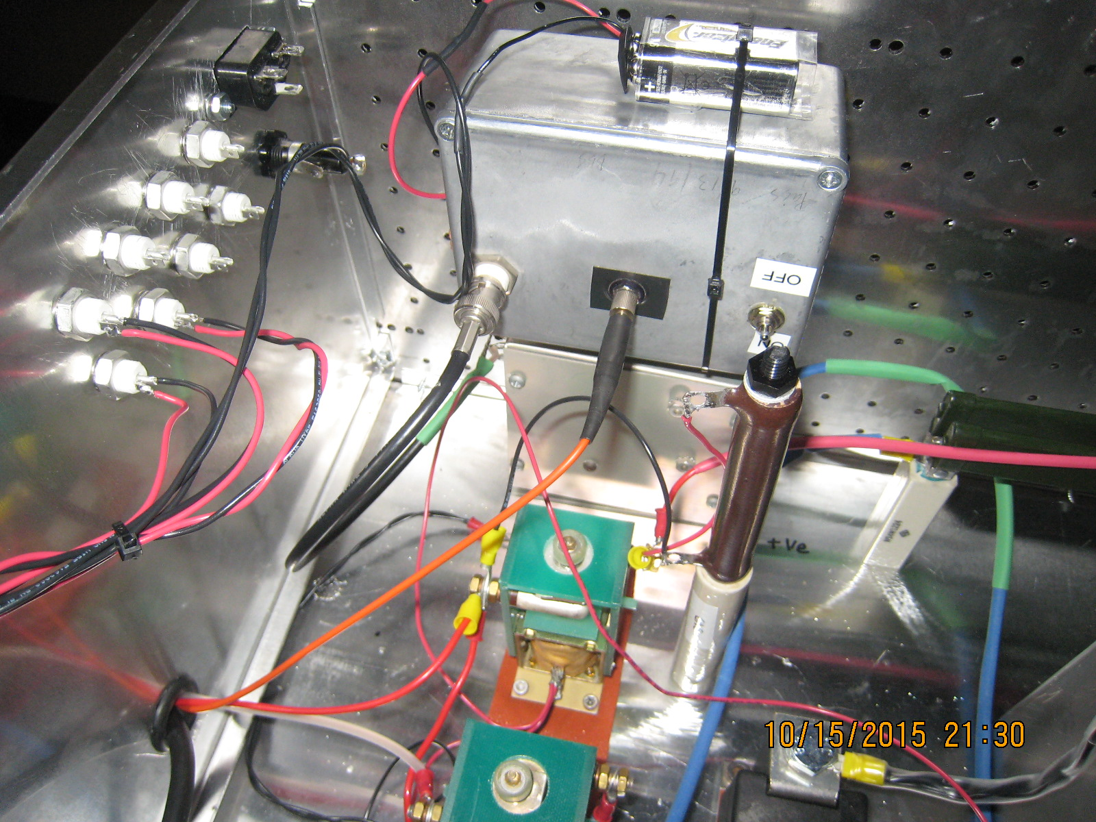

Slide 17
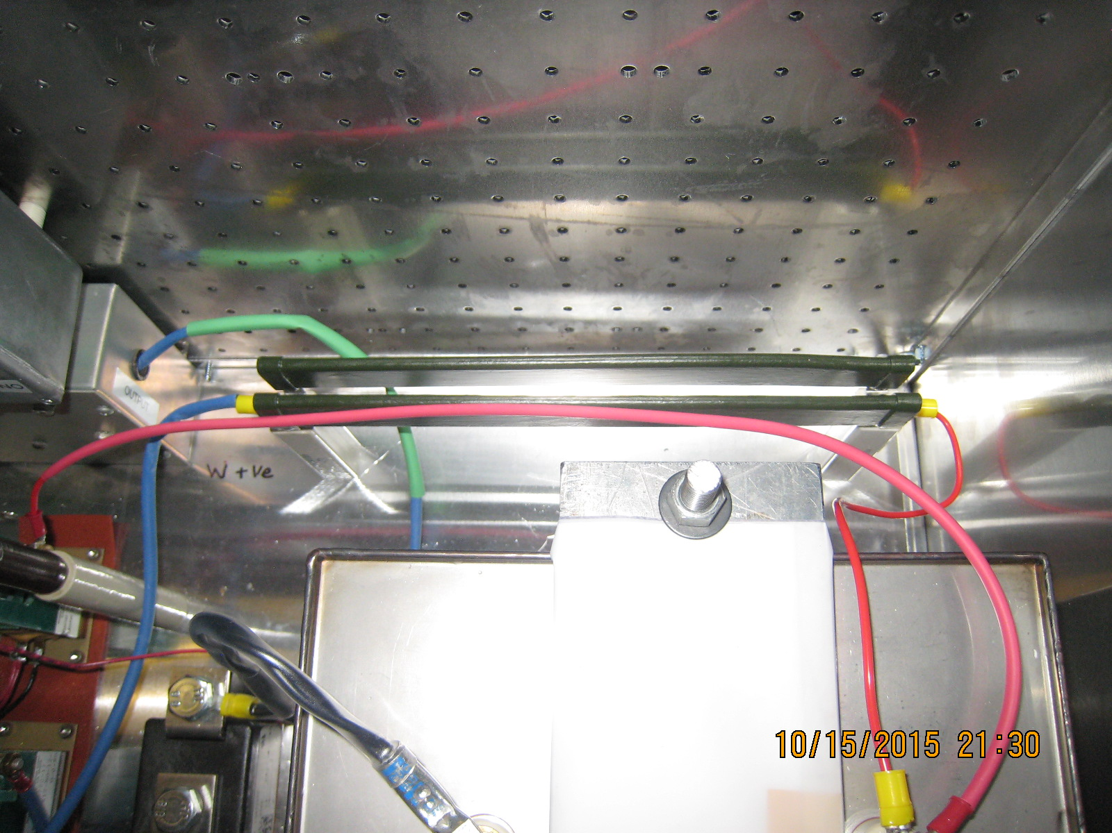

Slide 18
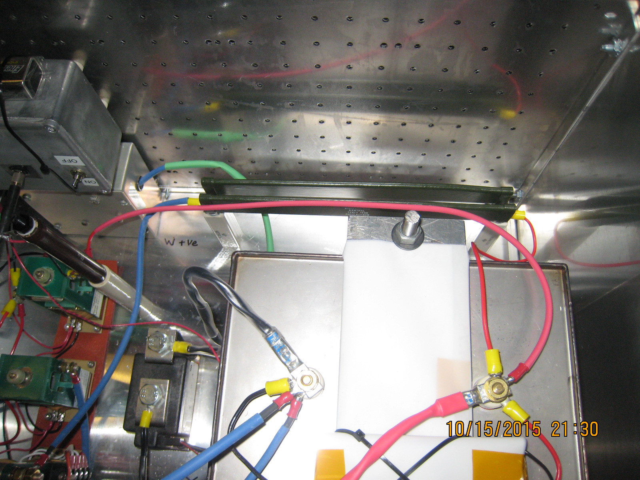

Slide 19
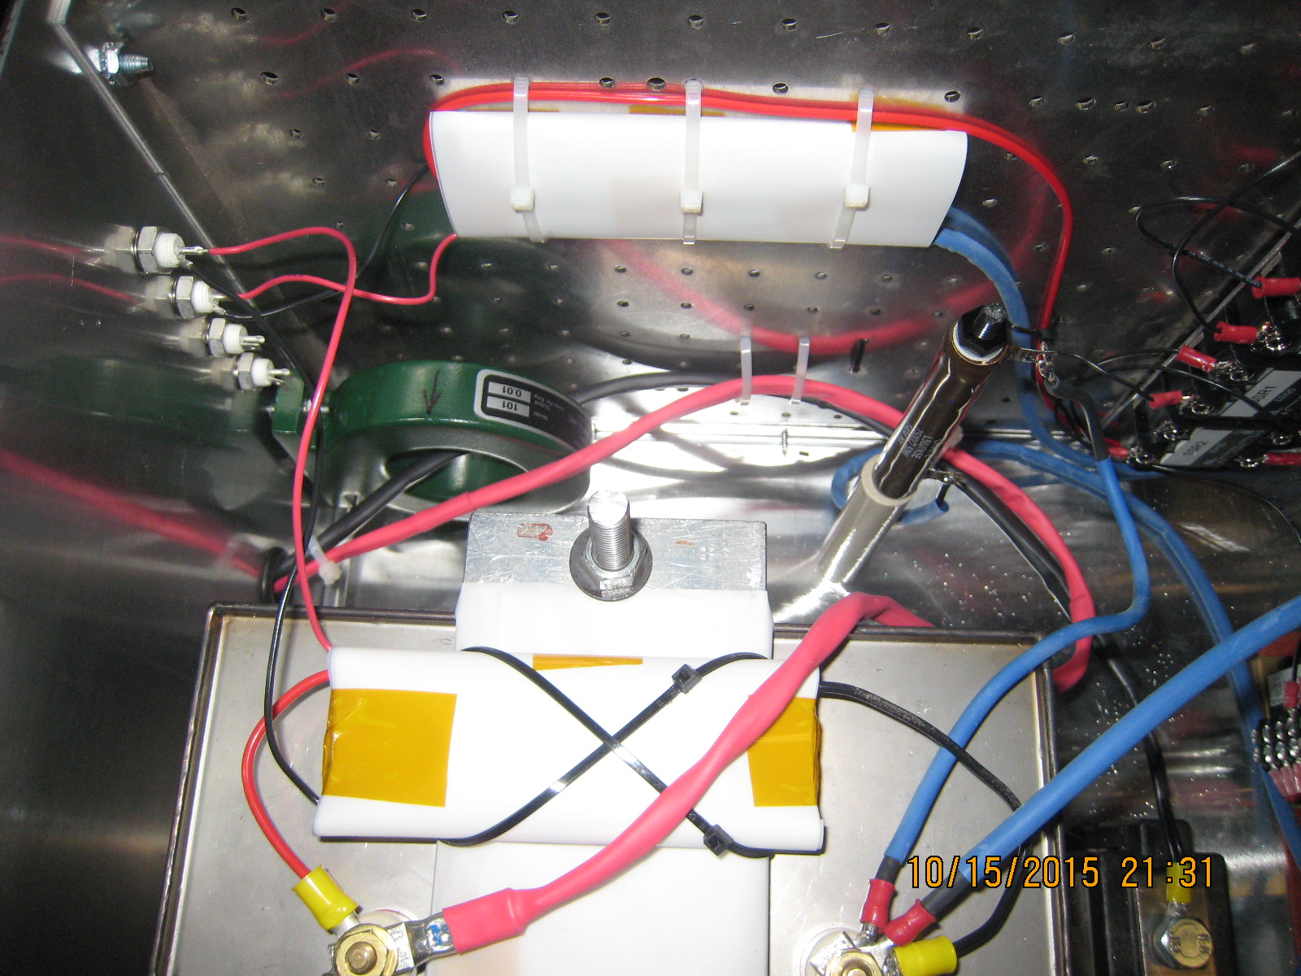

Slide 20
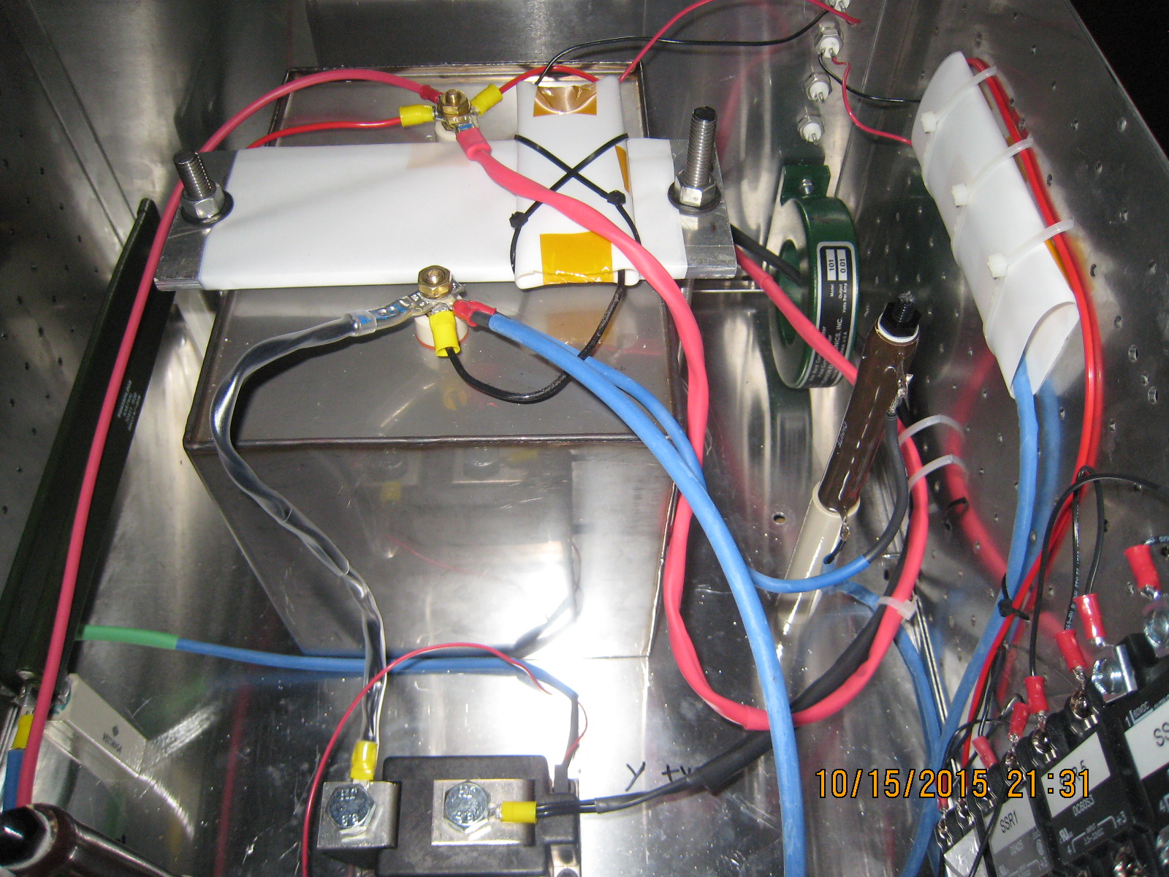

Slide 21
NI cRIO Control System I
Chassis: CompactRIO-9065
4-Slot Artix-7 FPGA
667 MHz dual-core ARM Cortex-A0
1GB NV Storage, 512 MG DDR3 Memory
NI Linux Real-Time OS
Ethernet
Modules
NI 9201: 8-ch Analog Input, ±10V, 12-Bit 500 kS/s
NI 9263: 4-ch Analog Output, ±10V, 16-Bit, 100 kS/s/ch
NI 9401: 8-Ch, 100 ns, 5V/TTL Digital I/O Module
NI 9472: 8-Ch, 100 us, 6-30 V Sourcing DO Module
Power
Chassis and DO Module require external power supply
10V, 2A ‘brick’ style supply, plugged into a power strip located in rack would suffice
NI Quote: $4419

Slide 22
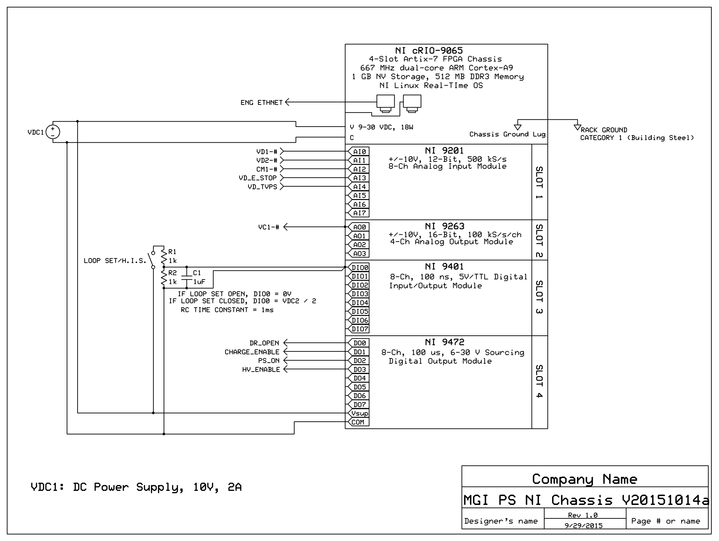

Slide 23
NI cRIO Control System II
State Diagram
See attachment
Software issues
Using existing NI software license (Labview, FPGA and Realtime): FREE, but with risks
I have never had ‘official’ NI LV training; Software may not be optimal
Paul S and I would be ‘sharing’ the license
Upgrading to the newest ‘embedded’ suite software: $5700
Still time sharing the license, no training
New embedded suite with online training: $9900
Two complete software setups
Access to online training – go at my own pace
Software would more likely be optimal
Just training (1-year, unlimited classroom and virtual, not online): $6210
Still time sharing license, no online training, may have to travel to classroom
Just the bare minimum courses, classroom training (off-campus)
Core 1 and Core 2 - $4000
Embedded Control and Monitoring - $3210

Slide 24
System Tests
Power inhibit tests
No_E_stop, TVPS_Permissive, Kirk Key
High-pot/isolation tests
Software E stop
Power on/No SCR trigger
V_{cap} > 1.05 x V_{request}
Basic Timing/Functional
This list needs to be formalized

Slide 25
Other necessities
NEPA form - done
Vacuum PLC – Will need TVPS permissive to racks
PCS – Will need trigger signal to racks
NO-E-STOP, Loop set / H.I.S. signals to racks
Kirk Keys
Others?

Slide 26
Timeline
MGI Power supply: Mid-December
Control system: Early December
Install Electrical system HW: Mid-December
Test supply into dummy load: Early January
Test supply into MGI valve: Early January

