Slide 1




NSTX-U
Supported by
FDR for Upper and Lower MGI Valve Supports for NSTX-U
W. Blanchard, R. Raman, L. Morris, G. Labik
9/4/14
Coll of Wm & Mary
Columbia U
CompX
General Atomics
FIU
INL
Johns Hopkins U
LANL
LLNL
Lodestar
MIT
Lehigh U
Nova Photonics
ORNL
PPPL
Princeton U
Purdue U
SNL
Think Tank, Inc.
UC Davis
UC Irvine
UCLA
UCSD
U Colorado
U Illinois
U Maryland
U Rochester
U Tennessee
U Tulsa
U Washington
U Wisconsin
X Science LLC
Culham Sci Ctr
York U
Chubu U
Fukui U
Hiroshima U
Hyogo U
Kyoto U
Kyushu U
Kyushu Tokai U
NIFS
Niigata U
U Tokyo
JAEA
Inst for Nucl Res, Kiev
Ioffe Inst
TRINITI
Chonbuk Natl U
NFRI
KAIST
POSTECH
Seoul Natl U
ASIPP
CIEMAT
FOM Inst DIFFER
ENEA, Frascati
CEA, Cadarache
IPP, Jülich
IPP, Garching
ASCR, Czech Rep

Slide 2
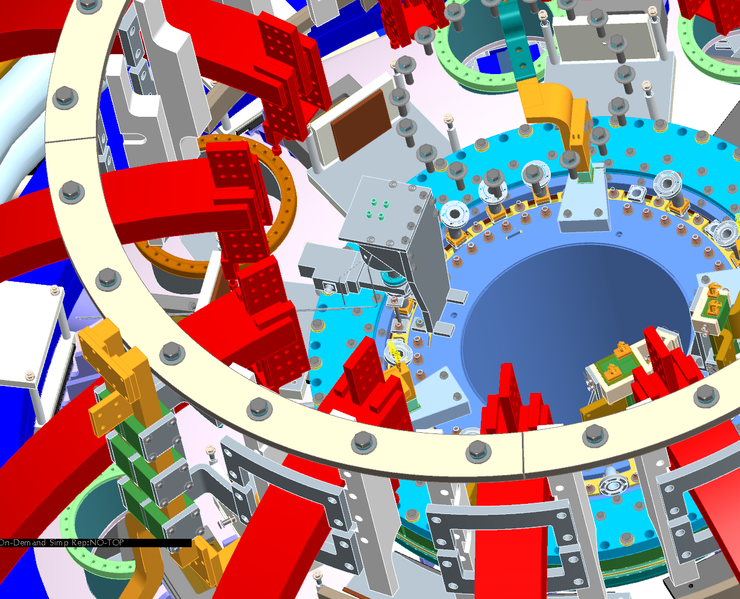
Upper MGI Valve
* Located on organ pipe at Bay L
* Electrically isolated from center stack and outer vessel
* Axis of valve (solenoid) is vertical
* Toroidal Field = 1T (worst case)
* Radial Field = 0.03T
* Vertical field = 0.04T

Slide 3
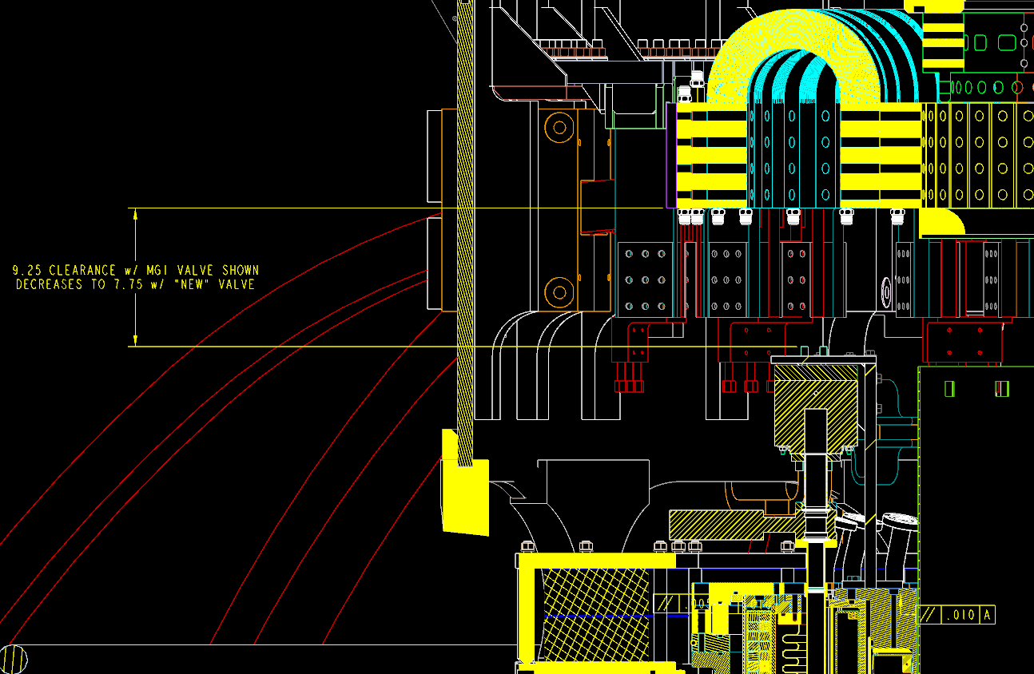
Upper MGI Valve

Slide 4
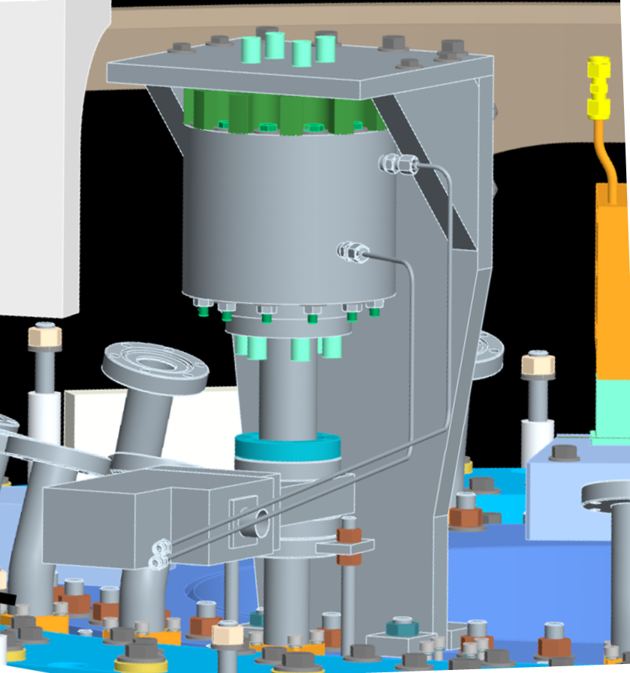
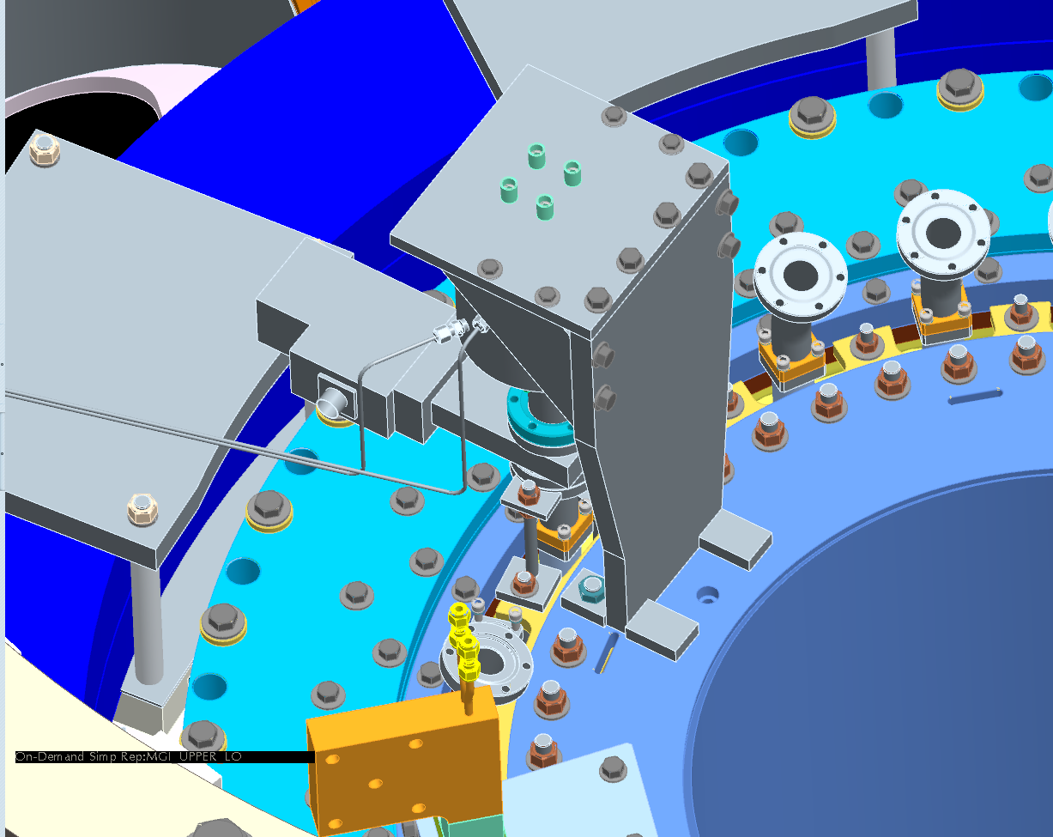
Upper MGI Valve
insulators
¼-28 bolts
3/8-16
bolts
insulators
1/2“ bolt
15” ht
7.5” along toroidal axis (top)
5.13” along toroidal axis (base)
7” wide (radial)
½” top plate
¾” backplate and gussets

Slide 5
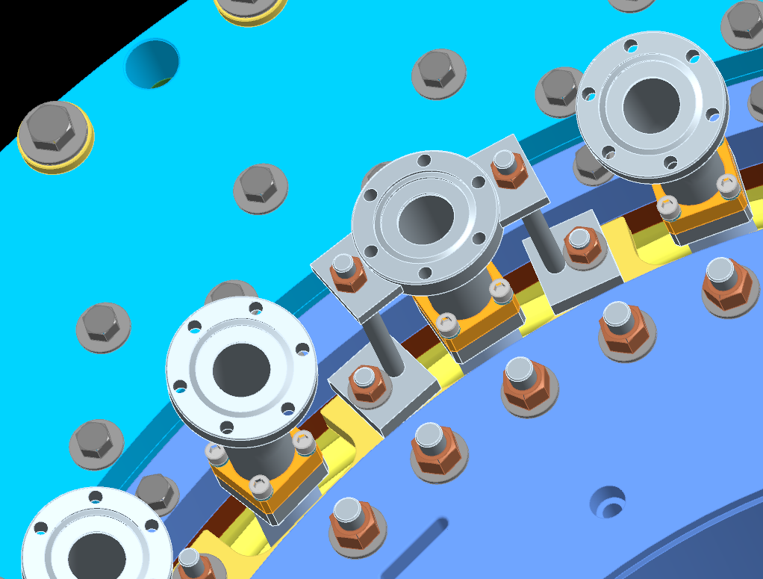
Upper MGI Valve
3/8-16 rod
welded tabs

Slide 6
Upper MGI Valve
Solenoid has ID/OD = 1.8 / 4 inches & 21 turns
Maximum current = 2.5 kA
Maximum external B_{T} = 1T
Torque=I*AxB (in-lbs) for each of the 21 turns
The sum of the 21 overturning torques = 2080 in-lbf in toroidal direction
Radial Field = 0.03T Torque = 62.4 in-lbf
1/4-28 bolt (2000 lbs in tension and 630 lbs in shear - conservatively)
3/8-16 bolt (4200 lbs in tension and 1400 lbs in shear)
1/2-13 (7500 lbs in tension and 2500 lbs in shear)

Slide 7
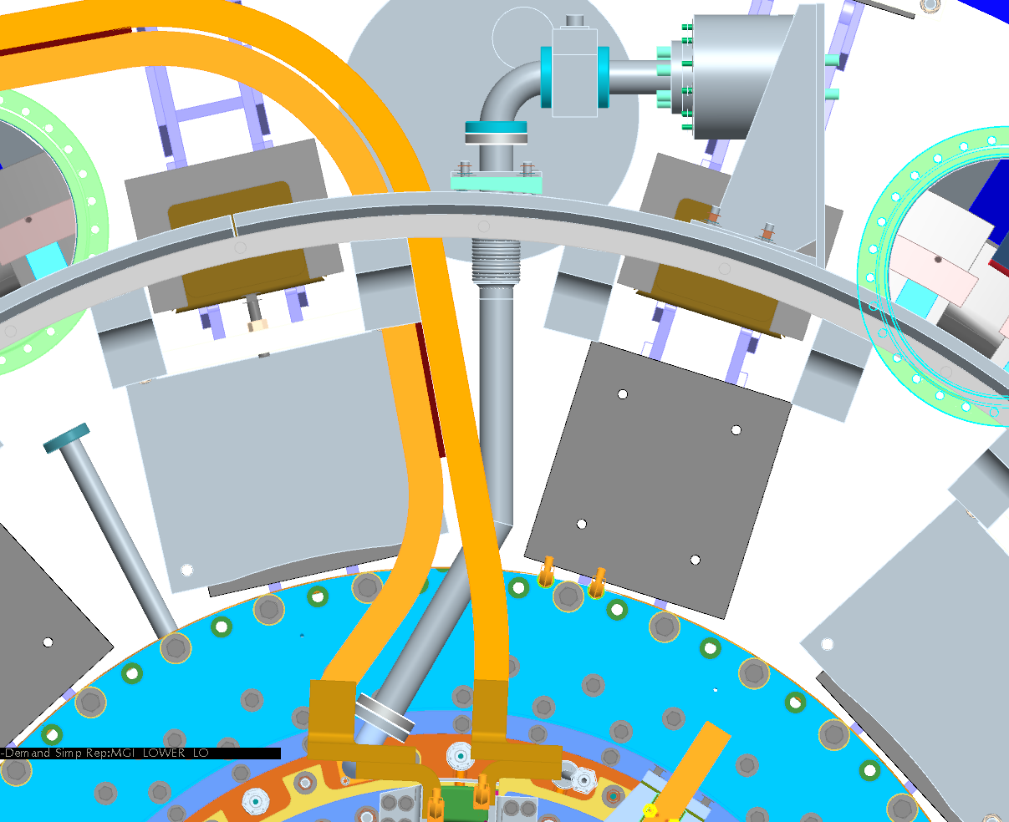
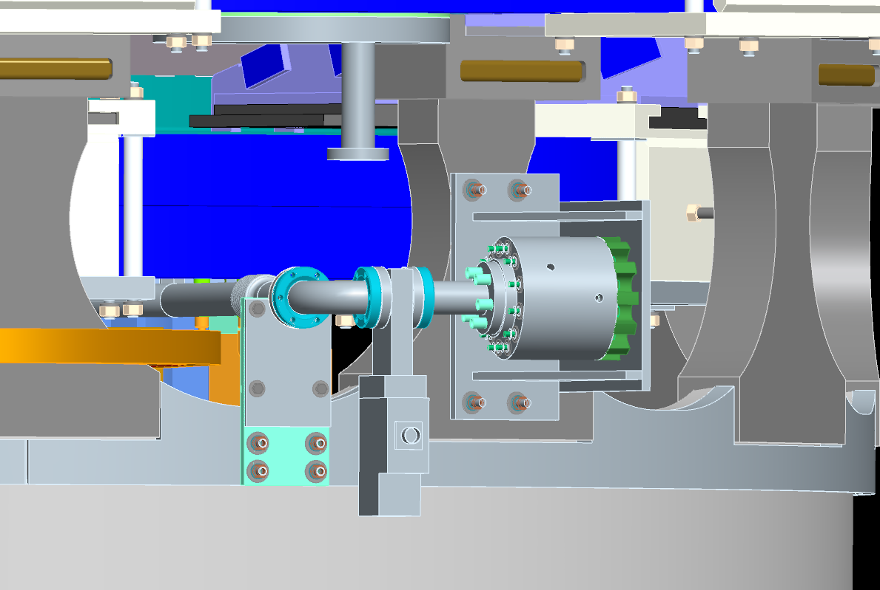
Lower MGI Valve
* Located on organ pipe at 180 deg and comes out at BAY F
* 1 ½” tube mitered and welded to eliminate interference with PF bus and PF support brackets
* Welded bellows
* Electrically isolated from center stack and outer vessel (same as upper)

Slide 8
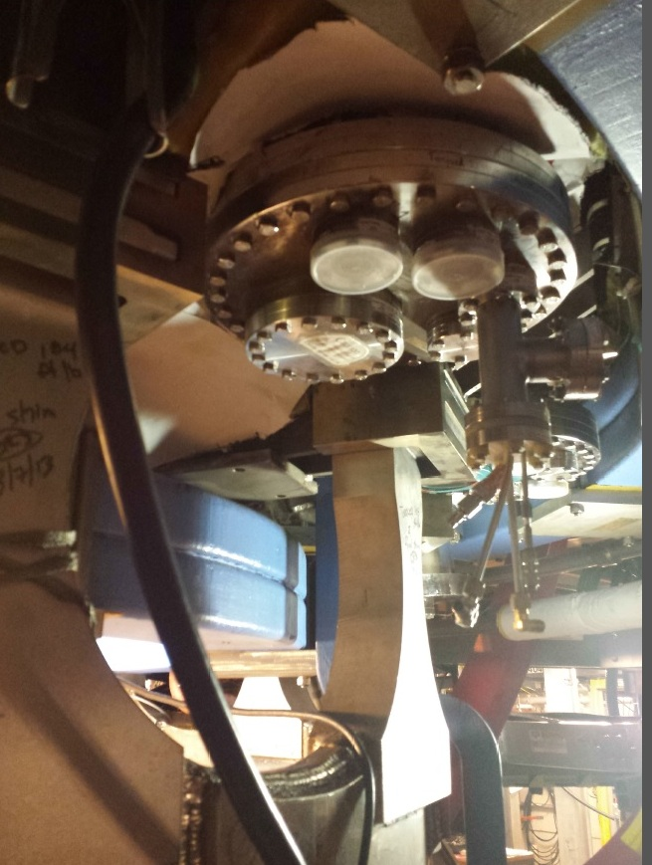
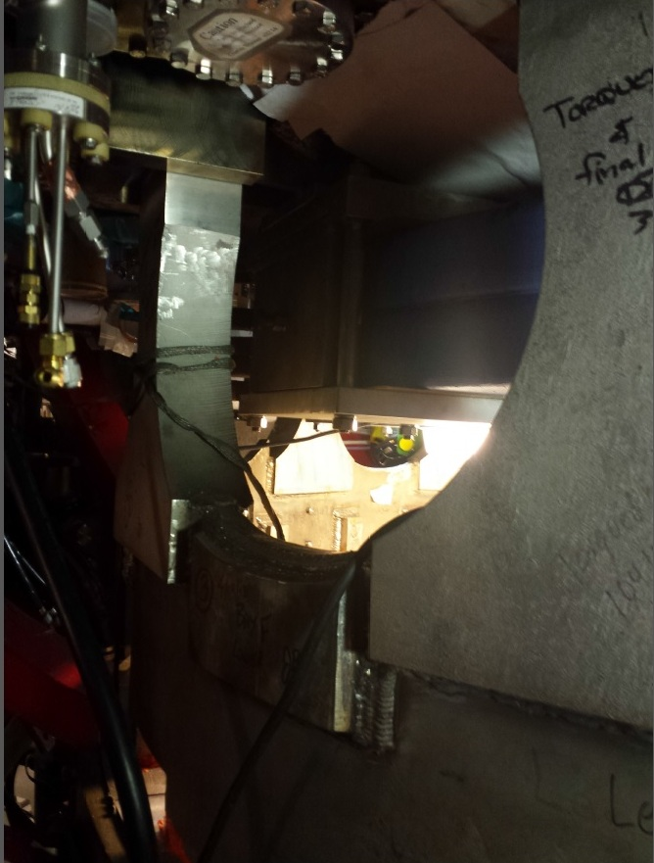
* Approx. 1” clearance from micro- balance diagnostic in Bay F
* Procedure will state that C. Skinner be contacted prior to any modifications to leads for micro- balance
Lower MGI Valve

Slide 9
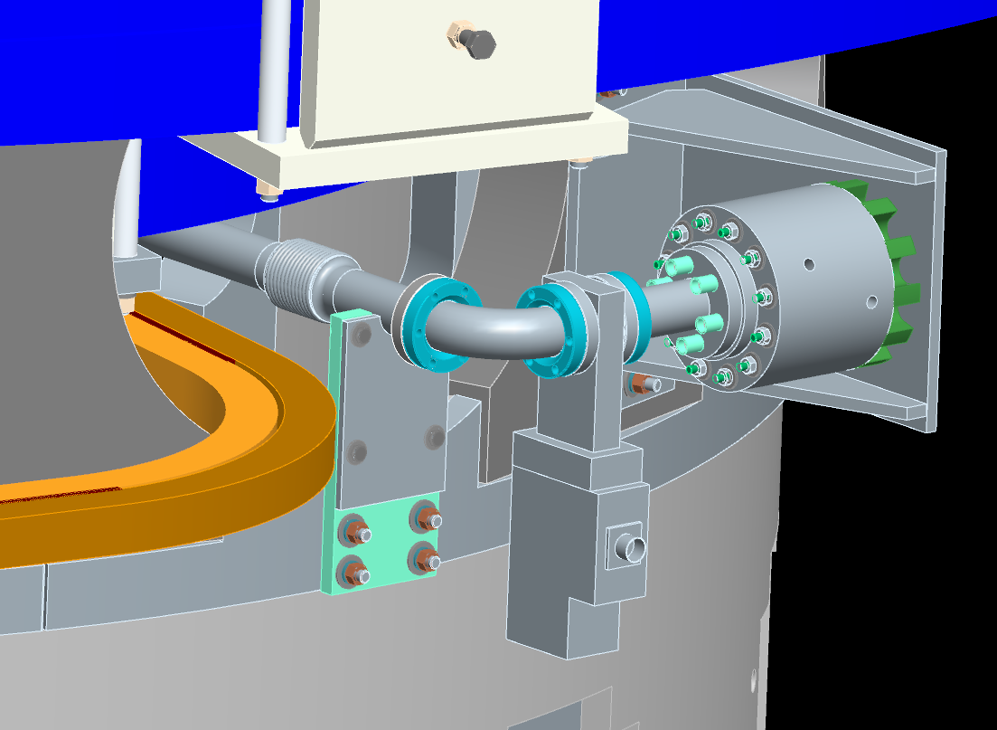
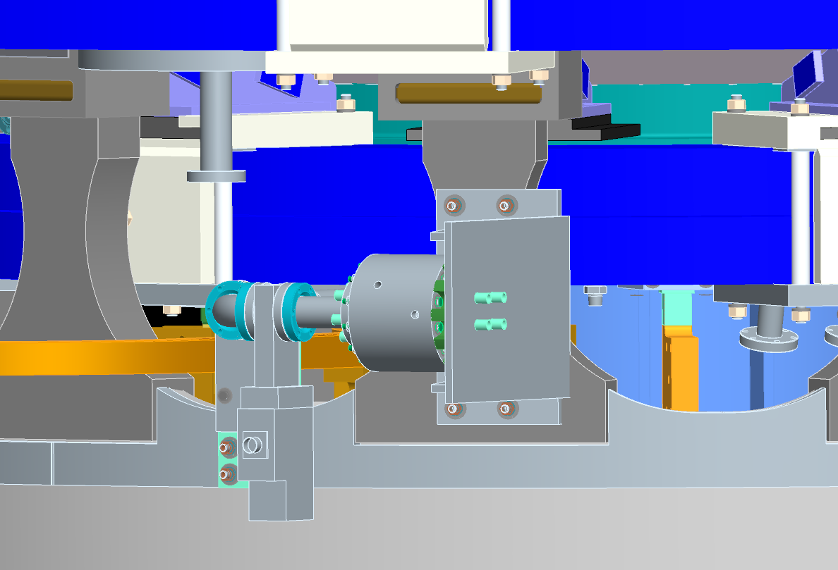
Lower MGI Valve
Maximum current = 2.5 kA
Maximum external B_{T} = 1T
Torque=I*AxB (in-lbs) for each of the 21 turns
For 20 degrees off axis in (sin 20 = .34) there is a 711 in-lbf torque in the radial direction from the max toroidal field
Radial Field = 0.06T Torque = 124.8 in-lbf
Vertical field = .12T Torque= 249.6 in-lbf
Welded 3/8-16 bolt (900 lbs in shear - conservatively)

Slide 10
SUMMARY
* No interferences with other systems for both MIGs
* Support systems adequate for all overturning moments
* MGI valves electrically isolated from the inner and outer vessels

