Slide 1
Massive Gas Injector
Power supply and control system
PDR
12/15/2015

Slide 2
Outline
Massive Gas Injector (MGI) Overview
  Hardware Status
  CDR CHIT summary
Supply schematic UPDATE
  Relays and interlocks UPDATE
  Control signals UPDATE
  High voltage considerations UPDATE
  ‘Grounding’ diagram
Control system – NI cRIO chassis and modules UPDATE
  Power UPDATE
  Modules: DO, DI, AO, AI
  Sequence and state diagrams UPDATE
Installation, Access and System tests UPDATE
Other necessities UPDATE
  NEPA, Vacuum PLC, PCS, etc.
Timeline UPDATE

Slide 3
MGI Overview
Unmitigated disruptions in a tokamak discharge
  Cause excessive diverter heat loads
  Large halo currents
Injecting massive amounts of gas prior to the disruption can thermally quench the plasma and reduce the impact of disruptions
  NSTX-U is studying the effects of MGI at various poloidal locations around the plasma
  The injectors are installed; Power supplies and control systems are presented here

Slide 4
MGI Hardware Status
Lower and Midplane MGI – All components installed by end of January
  Two valves, piping and supports
  Digitize signal from pressure transducer on valve
  Install the gas piping to the valves
Upper MGI – Later, during the run
  Power supply can be installed later

Slide 5
CDR Chit Summary 1/2
Item | Concern/Recommendation | Current Status
1 | For during-shot digitized signals, the A/D trigger time and the data sampling time must be correlated. Or, also digitize a 3rd "timing mark" channel. | High speed digitizing of cap voltage and current triggered at t=0
2 | Define EPICS interface: Stored settings, Waveforms, Shot #, etc. | Plan to record charging request, charge timings, and digitized shot data
3 | Battery status needs monitoring. Replace with power supply | Administratively changed every run campaign.
4 | At end of charging, ensure that disabling high voltage does not short the Glassman Supply output. | Delay added between relay connection break and HV turn off.
5 | The Ip Calculator has an "ITF < allowable" signal. Assess of this should be incororated into the MGI Controls | Is it feasible to bring 3 signals out of Ip and distribute it to the Racks? Is this (overly) redundant?
6 | On the "NI Chassis V20151014a"inputs; Check the interface for "Loop Set/HIS". Contact closure or 120VAC? | 120 VAC – SSR added to circuit
7 | 24 V supply to control logic rather than 10V (as shown) | 24 V will be used
8 | Do not co-mingle the High Voltage and A/C Control power in Box #2 | To be verified on delivery & installation.
9 | On the Power Supply drawing, show I/O Voltages. Also correct the drawing to remove the wire in parallel with R8 (110 ohm) | Done (see below)

Slide 6
CDR Chit Summary 2/2
Item | Concern/Recommendation | Current Status
10 | Make a "grounding" diagram for the next review. Should show ground classes and locations of electrical breaks | Done (see below)
11 | Confirm that the gas delivery system P&ID's have been updated to show the MGI configuration. | Plumbing is done. Instrumentation may not be done.
12 | Develop the plan/requirements for electrical insulation tests (Hi-Pots) when the system is installed. This will help determinewhere to ensure that sufficient insulation exists. | Will follow CHI template
13 | Work packages for system interfaces in the NTC should be prepared/released as soon as possible | CAD request in system. Tech work (lexan doors) in system. Requests for TVPS, NO-E-STOP, MGI trigger, and ethernet not in system. IP/AP not complete.
14 | The MGI capacitor discharge system meets the criteria of a Cap Bank as described in the PPPL Health and Safety Manual. Needs to meet specific safety requirements. (Access procedure, etc.) | Safing and access procedures to follow CHI as a template.
15 | Recommend development of an access procedure outlining a safe and practical process for safing all parts of the system. Needs to include interlocks, required PPE, visibility of conditions, discharge and grounding sticks, rtc.

Slide 7
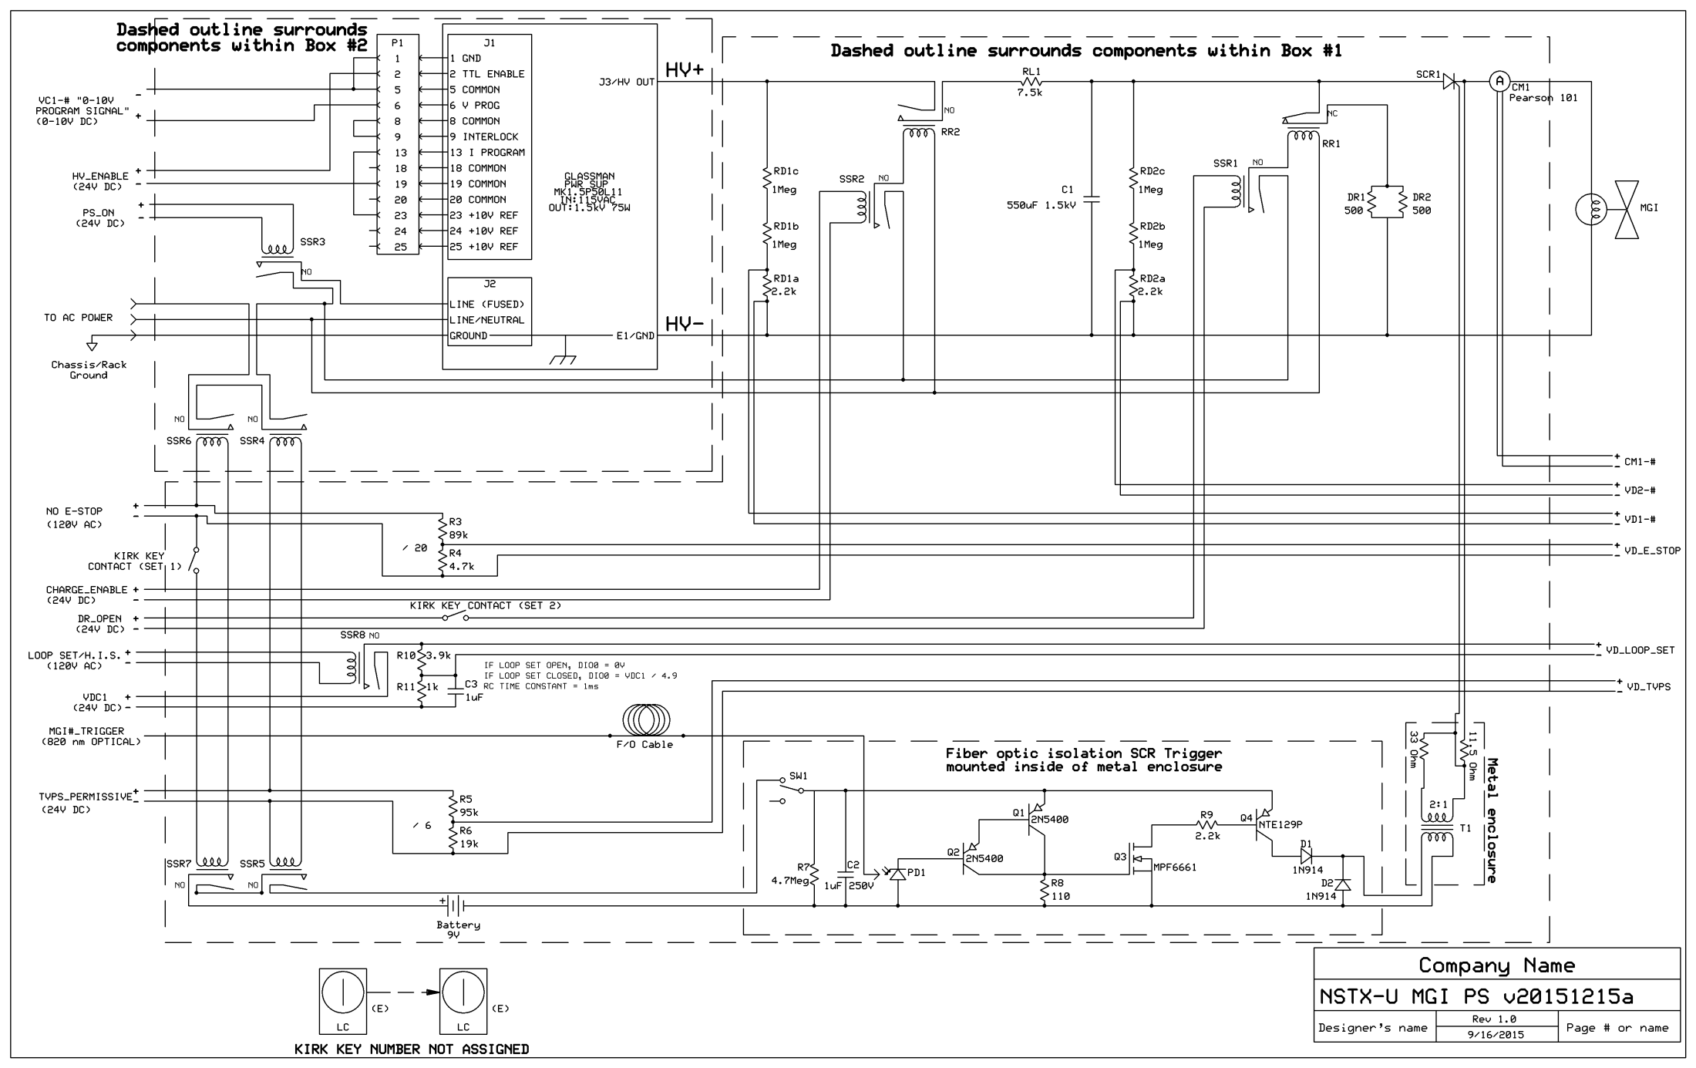

Slide 8
Schematic changes
Removed Ross Relay between HV- and C1-
  Negative terminal of C1 is always connected to Category 1 ground (through the Glassman power supply)
Added discharge resistor to trigger circuit
Updated isolation transformer schematic
Cutouts (with acrylic covers) added to the boxes to allow accessor a ‘view’ to the Ross Relays’ (for safety)

Slide 9
Supply Schematic I
High Voltage Ross Relays control the connections to the dump resistor (RR1) and Glassman charging supply (RR2)
Solid State Relays
  SSR1 controls operation of RR1; SSR2 controls RR2
  SSR3 controls power to Glassman supply
  SSR4 and SSR5 allows TVPS (24 VDC) to inhibit power to the charging supply, RR1, RR2, and RR3
  SSR6 and SSR7 allows NO-E-STOP (120 VAC) to inhibit power to the charging supply, RR1 and RR2
  Kirk key interlock is in series with NO-E-STOP
    Kirk keys lock the front door on the rack. The supply is inside the boxes mounted in this rack.
Normal operation
  SSR1, SSR2, and SSR3 are controlled by NI cRIO Control System
  SSR4, SSR5, SSR6, and SSR7 are controlled by NO-E-STOP, TVPS and Kirk Key
  Loop Set and NO-E-STOP are monitored by NI cRIO Control System (discussed later)

Slide 10
Supply Schematic II
Control signals
  Everything is coming from the NI cRIO system
  Digital: DR_OPEN, CHARGE_ENABLE, PS_ON, HV_ENABLE
  Analog: VC1
Several signals are continuously monitored, typically through voltage dividers
  VD_E_STOP, VD_TVPS, VD_LOOP_SET (discussed later) to monitor permissives
  VD1, VD2 to monitor supply and capacitor voltage
  CM1 to monitor current out to MGI solenoid
High Voltage
  Capacitor (-) is connected to chassis ground at all times
  The device that triggers the SCR is battery-powered, electrically isolated (via fiber optic) from the rest of the system and isolated by a transformer from the SCR
  System has been tested for functionality and high-potted to 4 kV

Slide 11
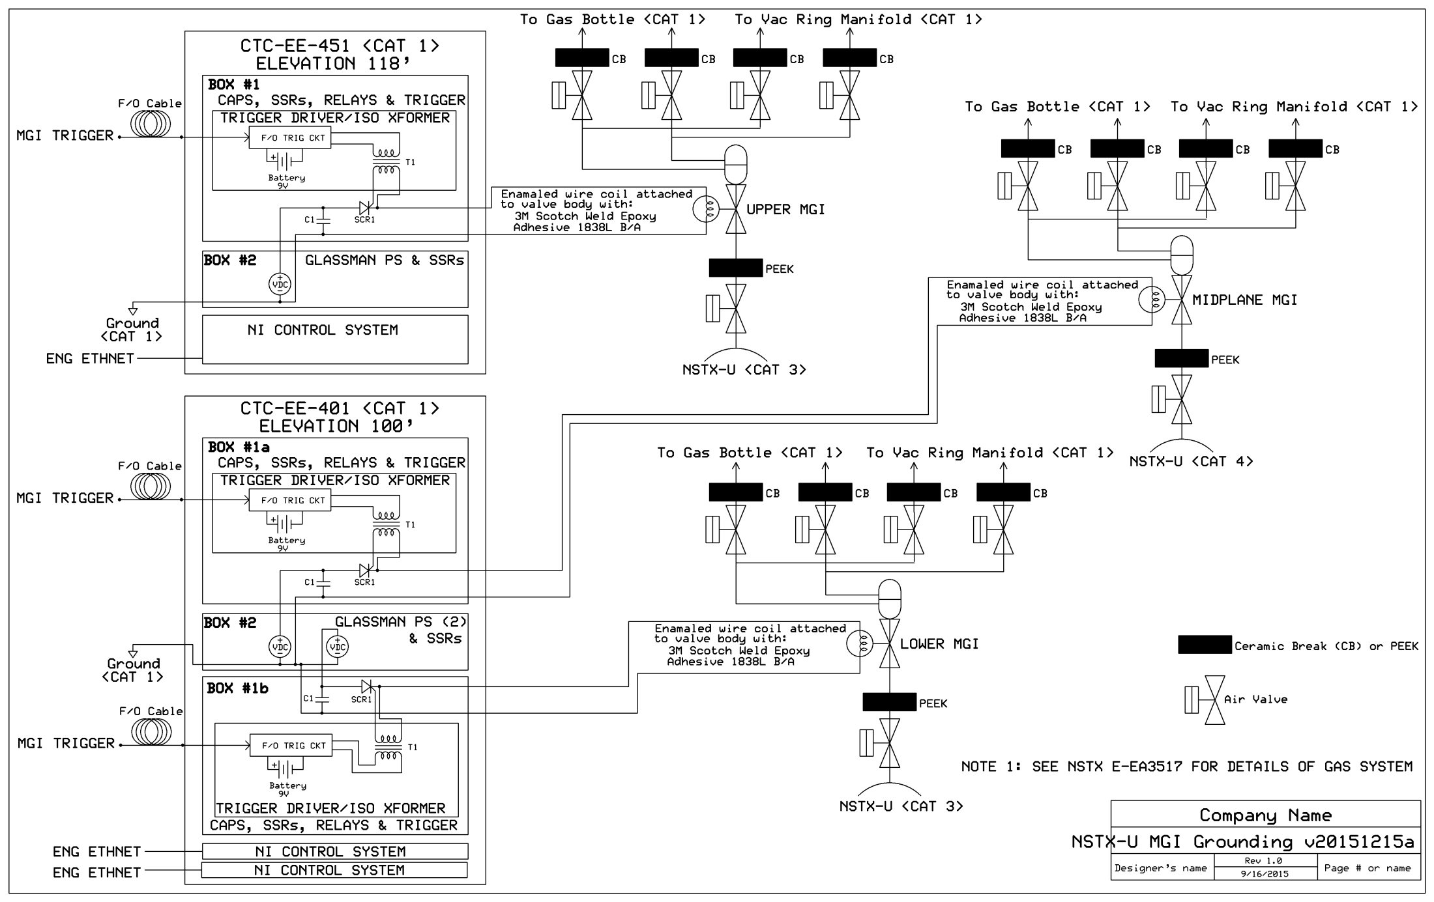

Slide 12
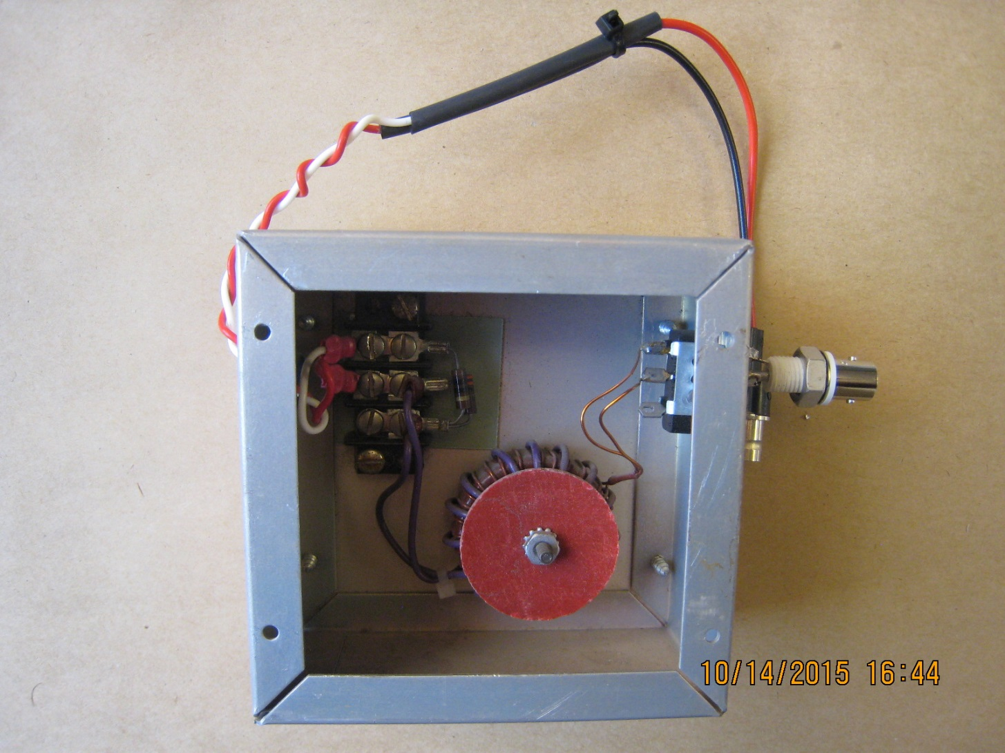

Slide 13
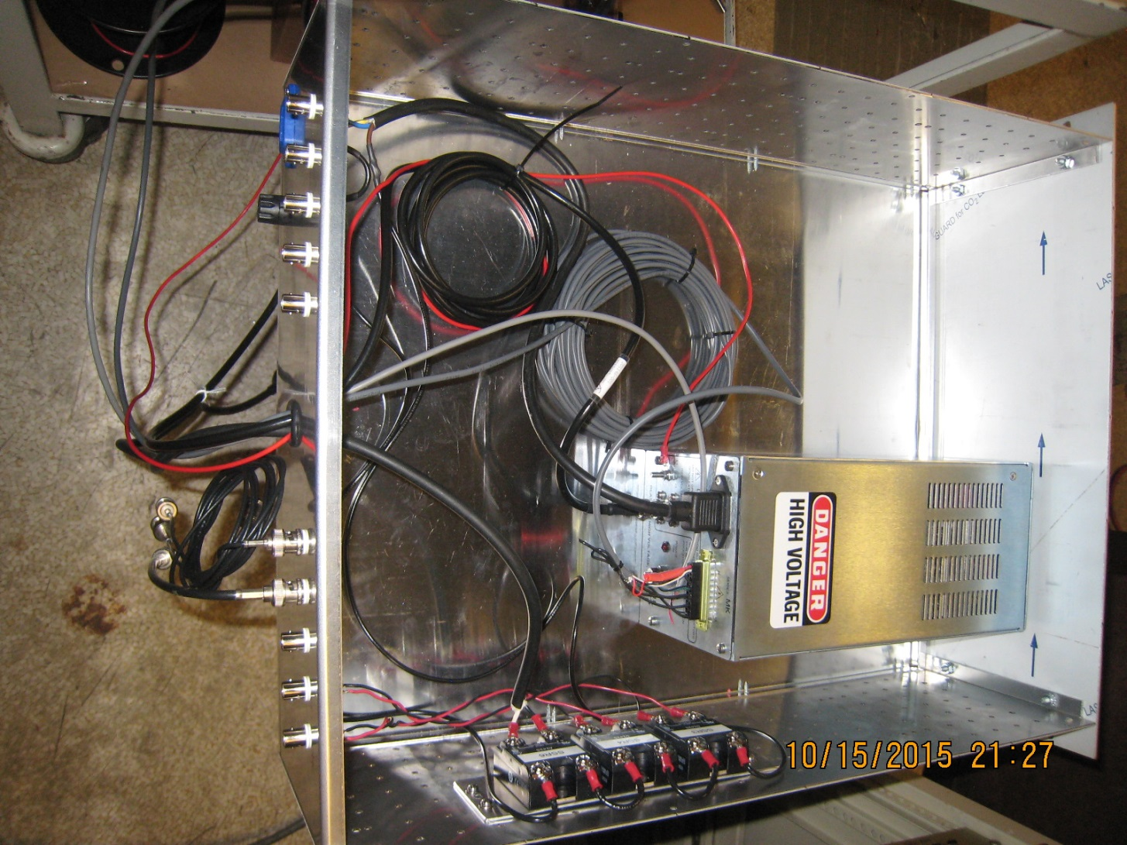

Slide 14
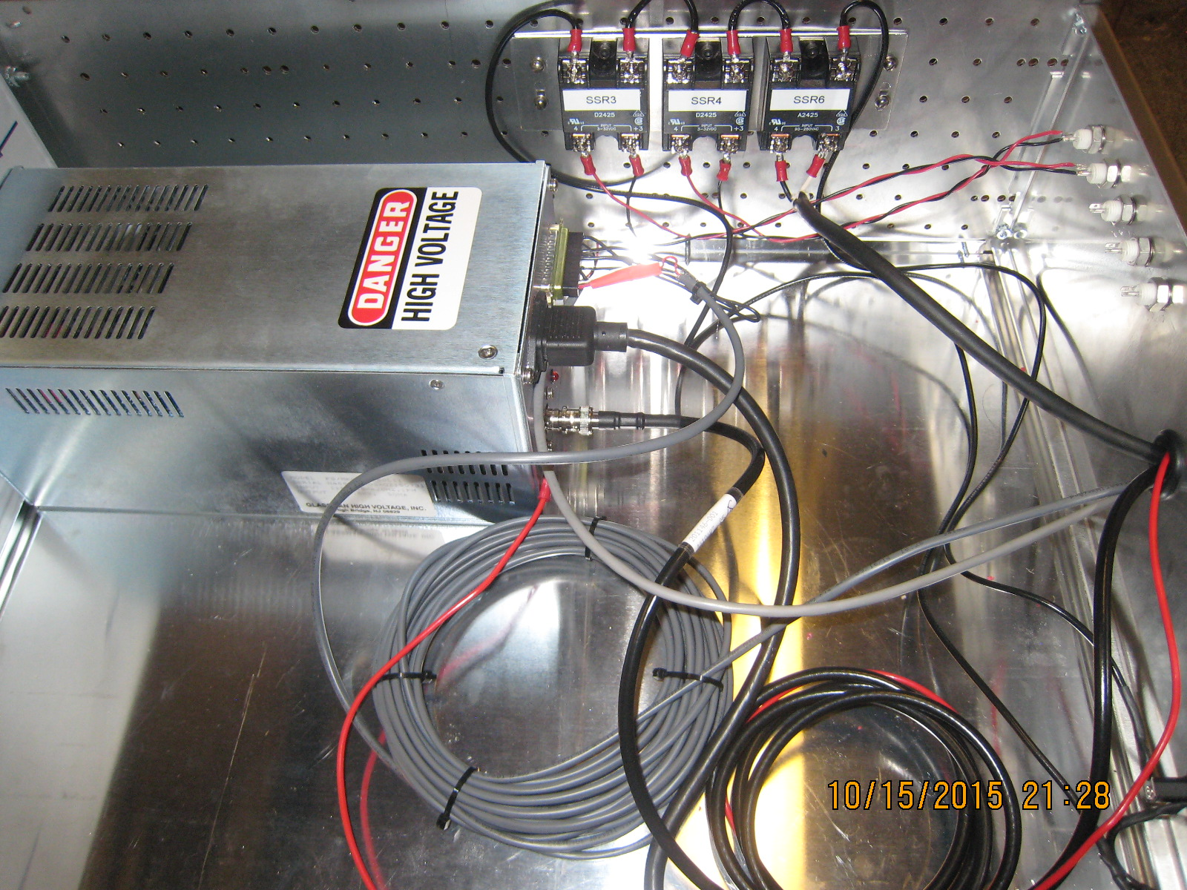

Slide 15
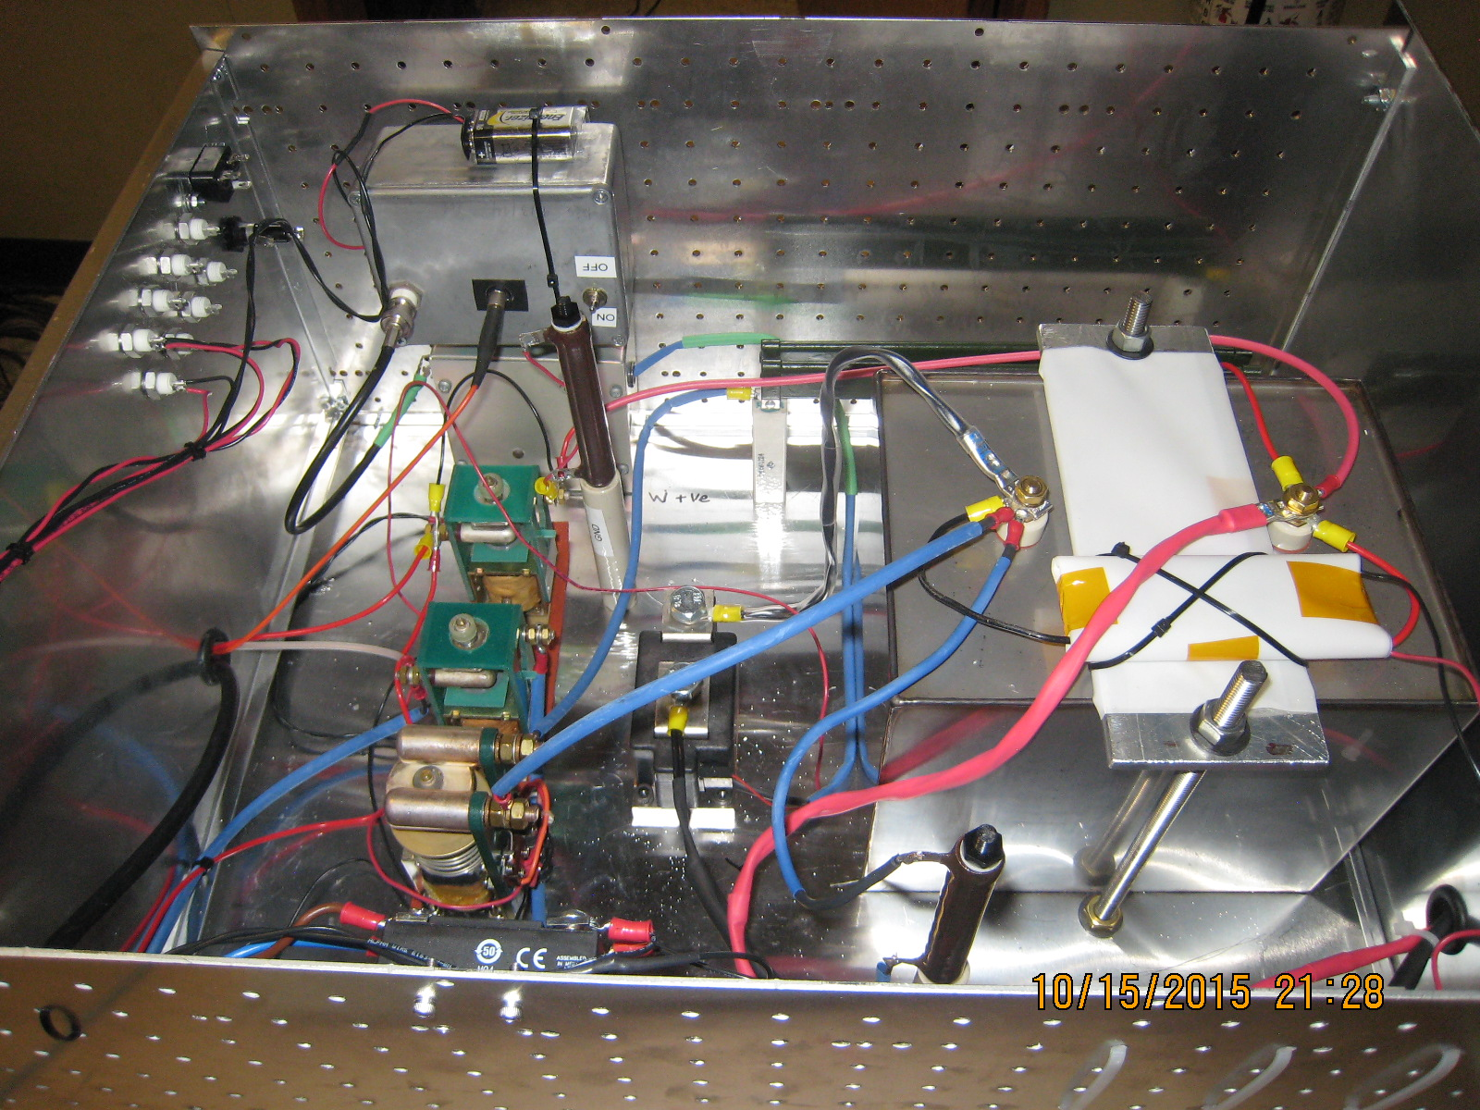

Slide 16
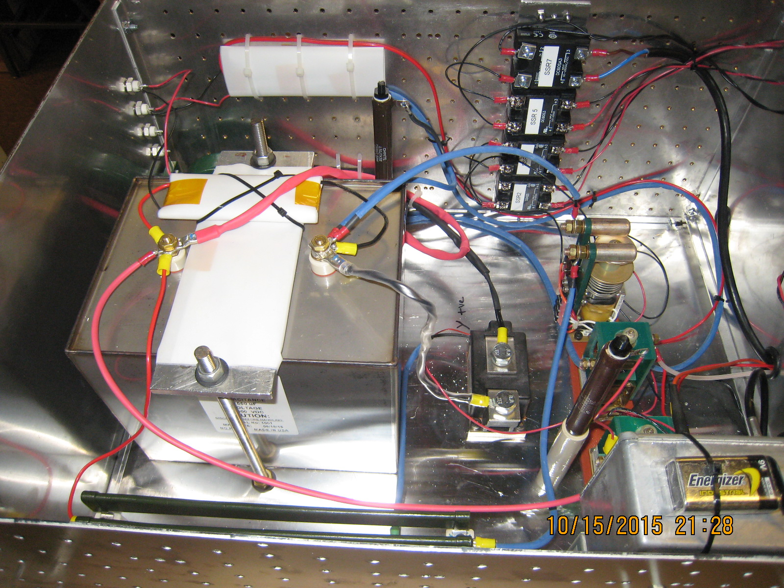

Slide 17
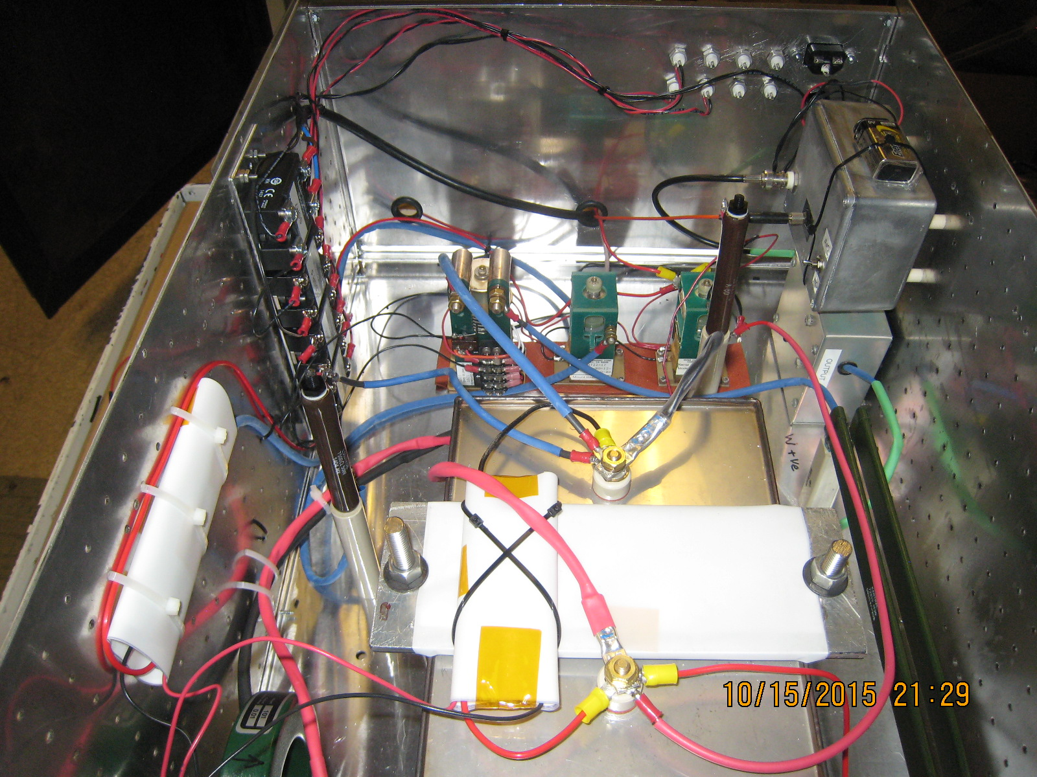

Slide 18
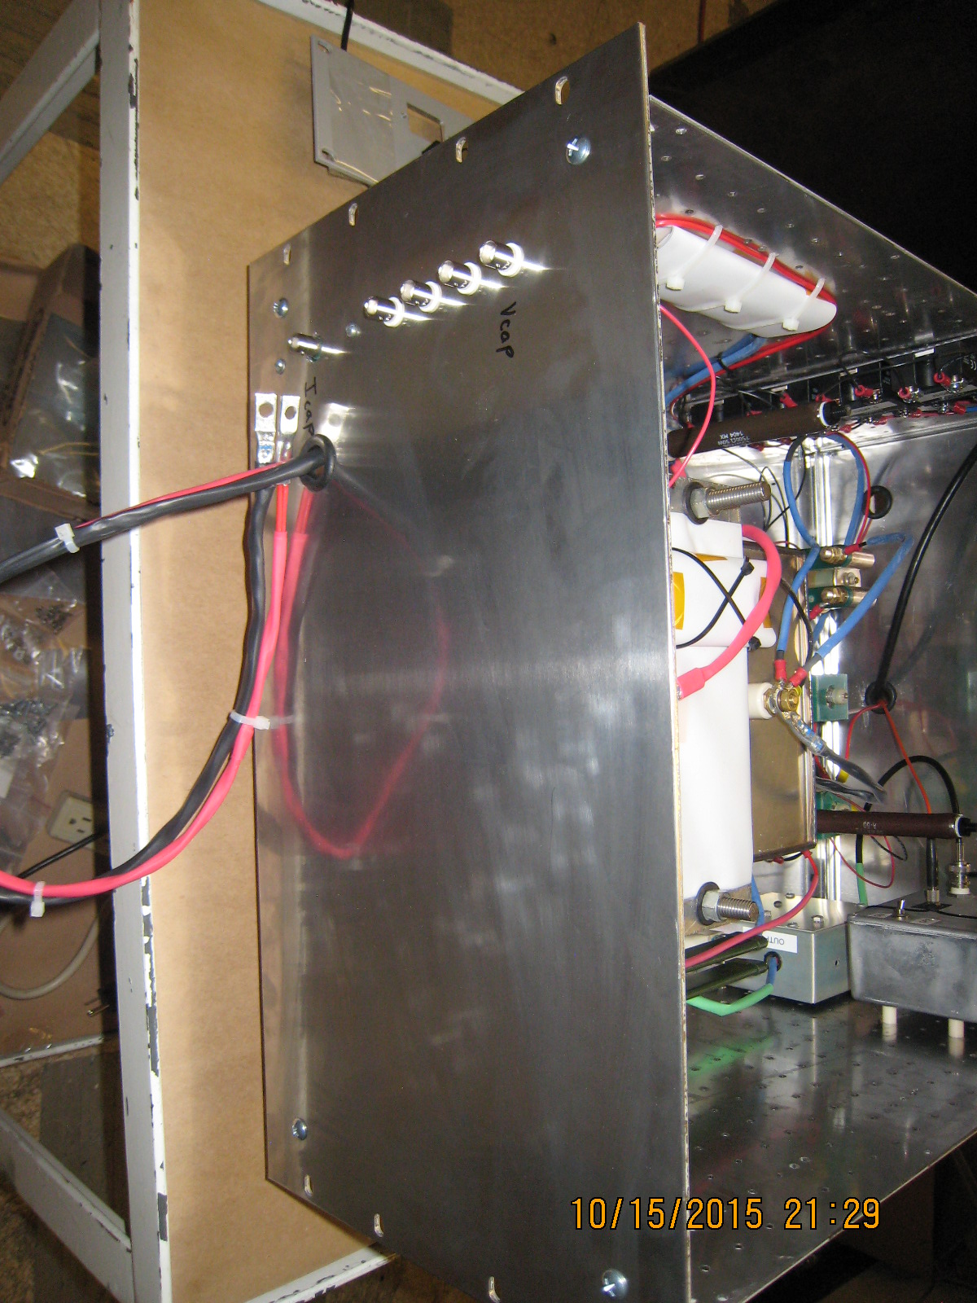

Slide 19
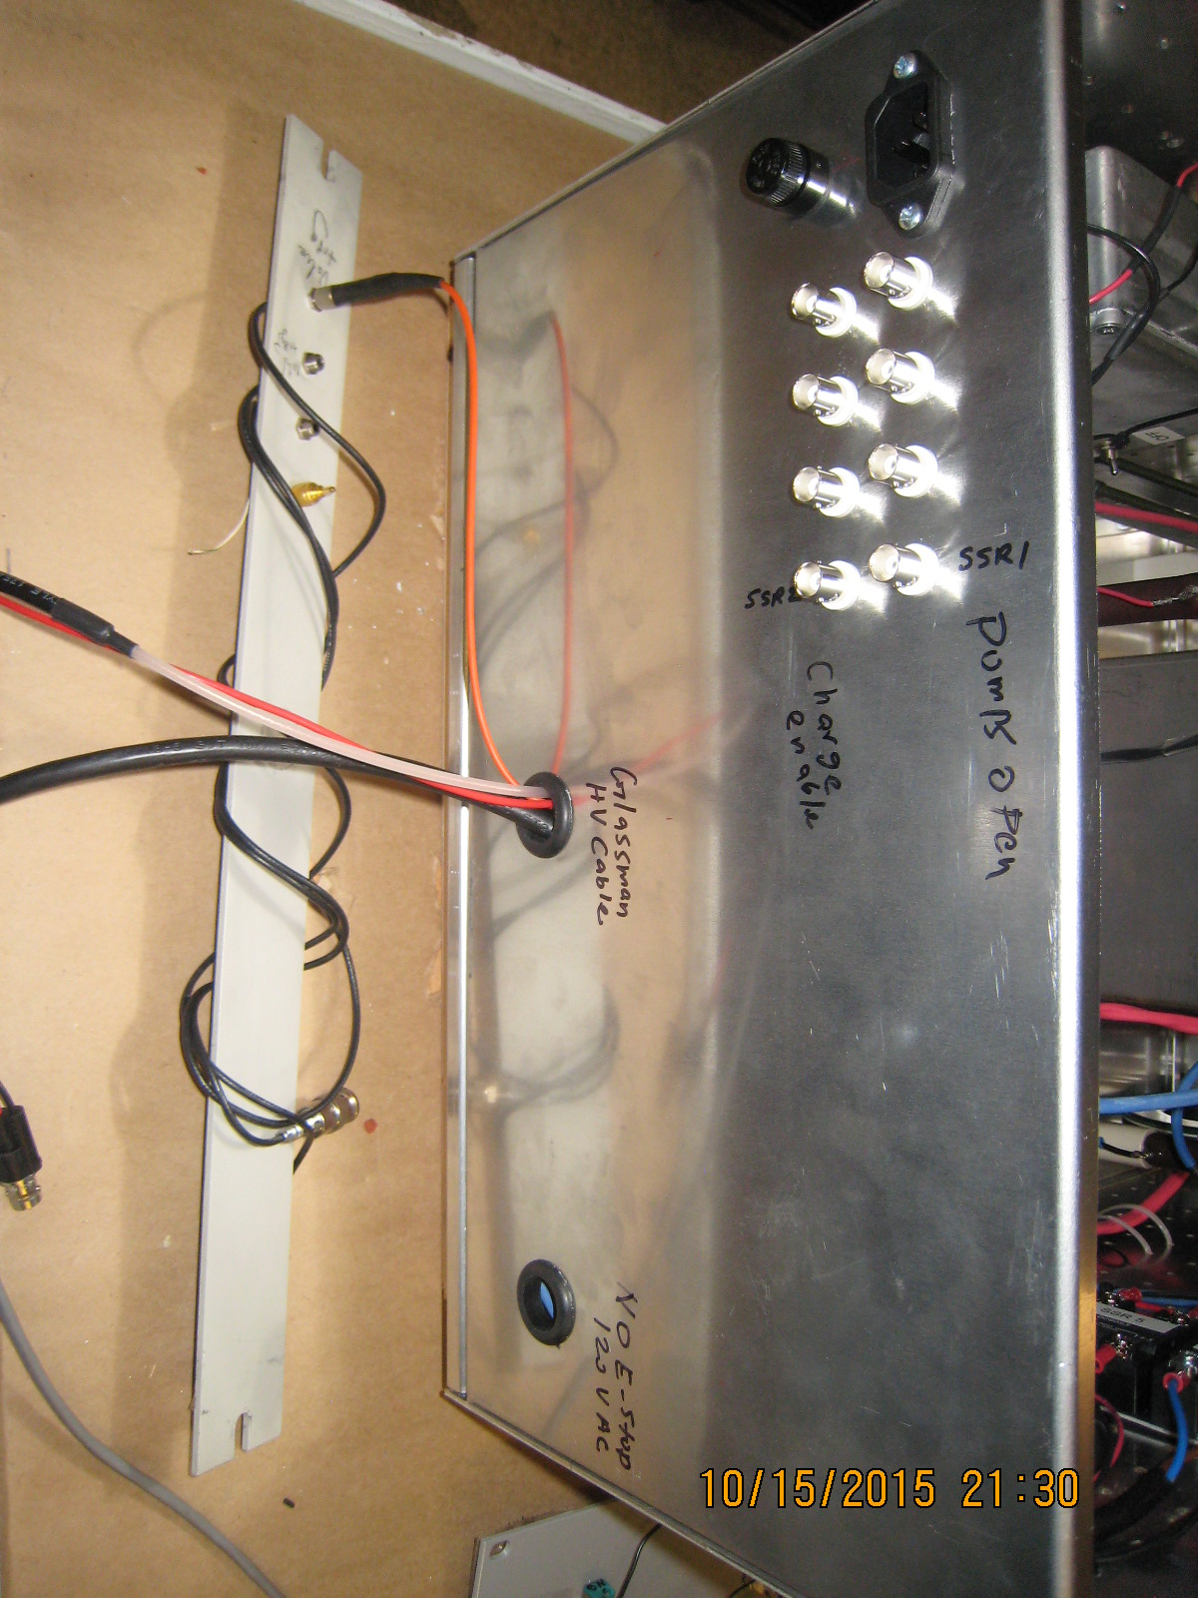

Slide 20
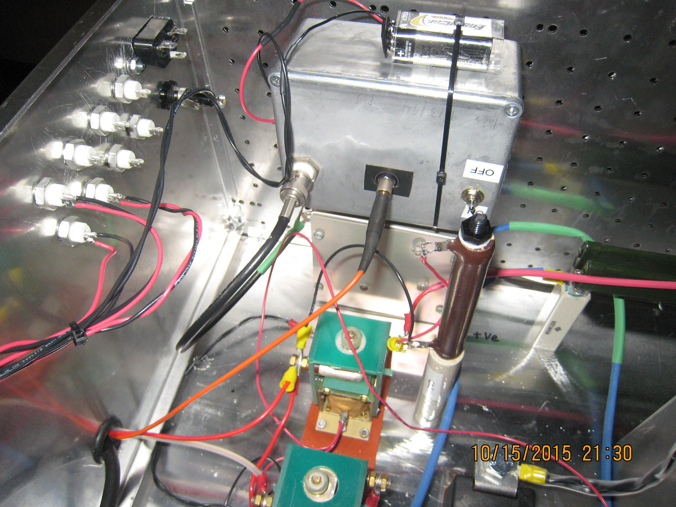

Slide 21
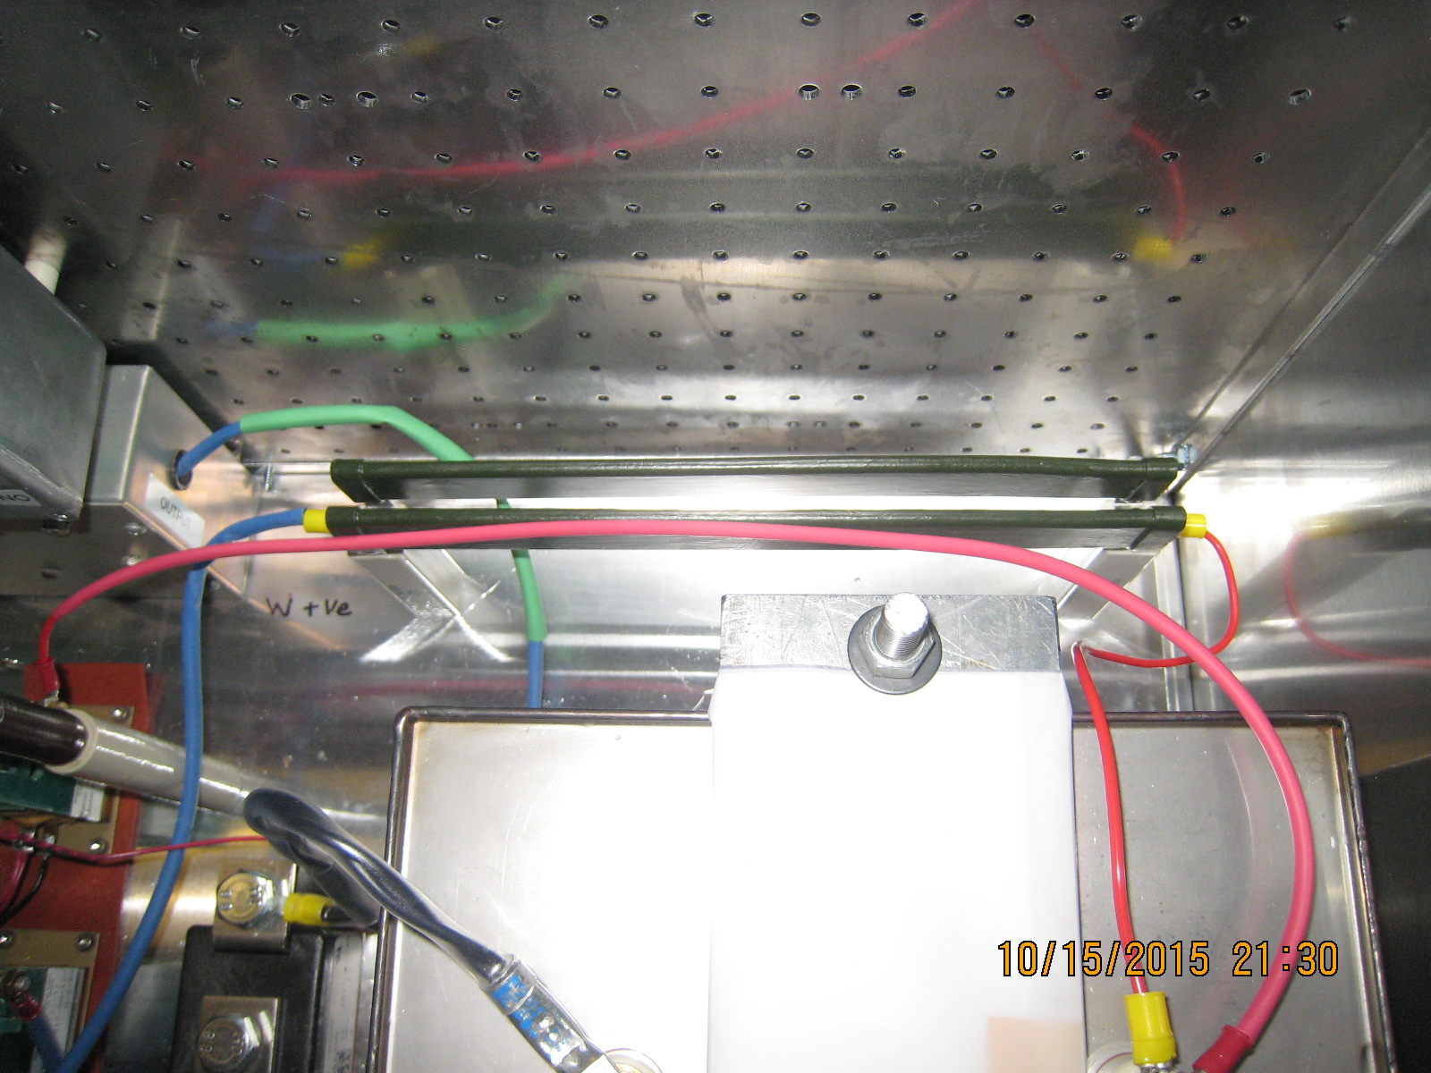

Slide 22
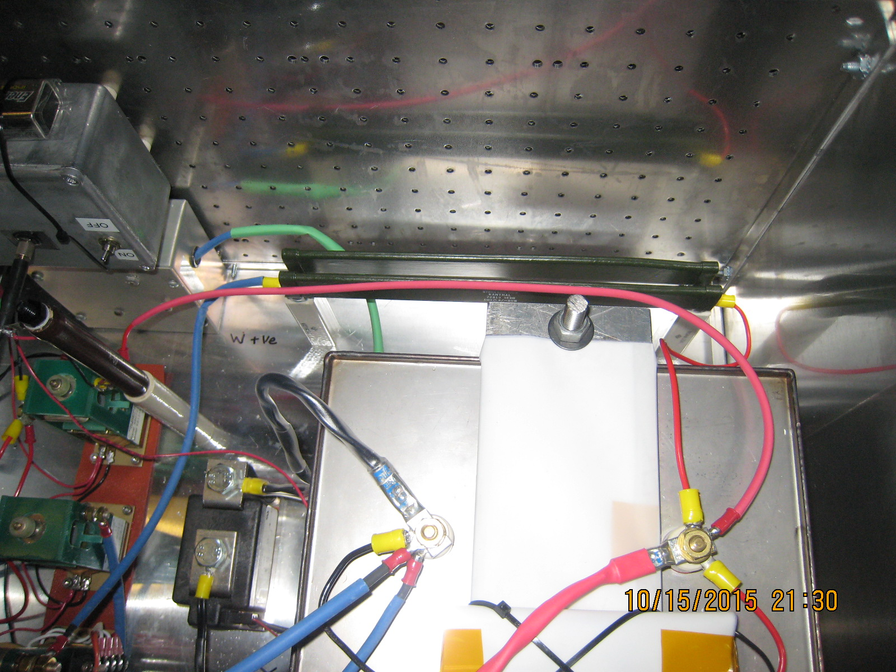

Slide 23
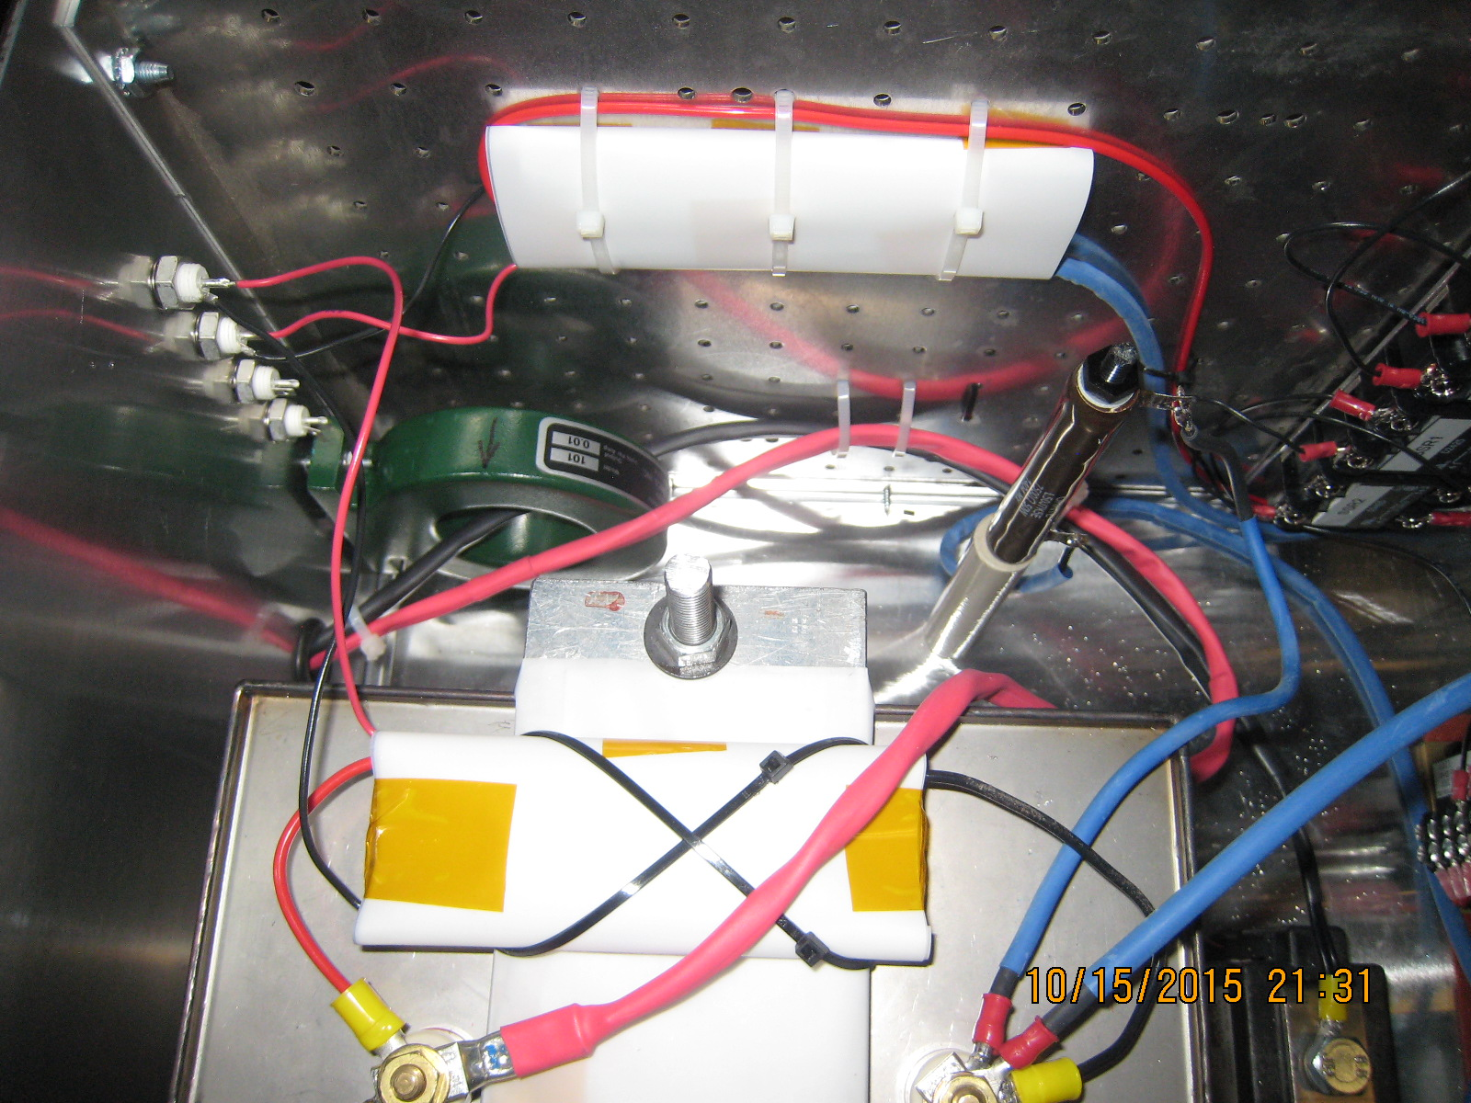

Slide 24
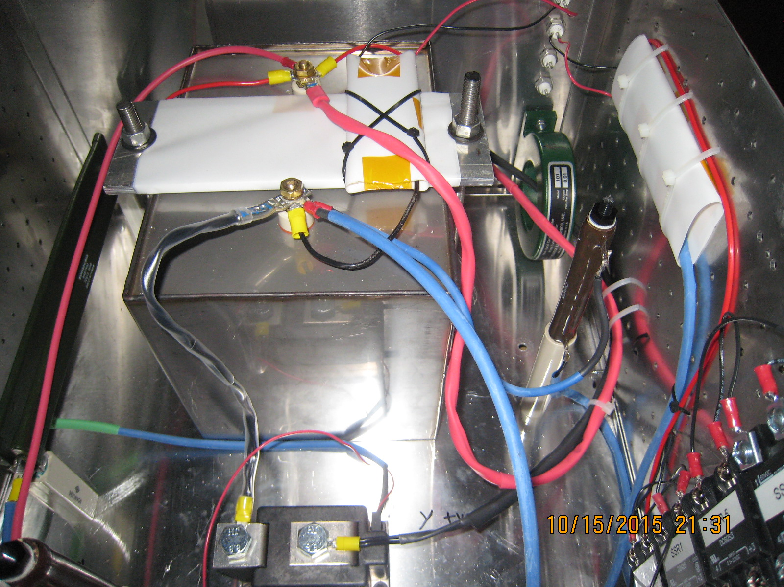

Slide 25
NI cRIO Control System I
Chassis: CompactRIO-9065
  4-Slot Artix-7 FPGA
  667 MHz dual-core ARM Cortex-A0
  1GB NV Storage, 512 MG DDR3 Memory
  NI Linux Real-Time OS
  Ethernet
Modules
  NI 9201: 8-ch Analog Input, ±10V, 12-Bit 500 kS/s
  NI 9263: 4-ch Analog Output, ±10V, 16-Bit, 100 kS/s/ch
  NI 9401: 8-Ch, 100 ns, 5V/TTL Digital I/O Module
  NI 9472: 8-Ch, 100 us, 6-30 V Sourcing DO Module
Power
  Chassis and DO Module require external power supply
    24V – “Standard” at NSTX-U
NI Quote: $4419

Slide 26
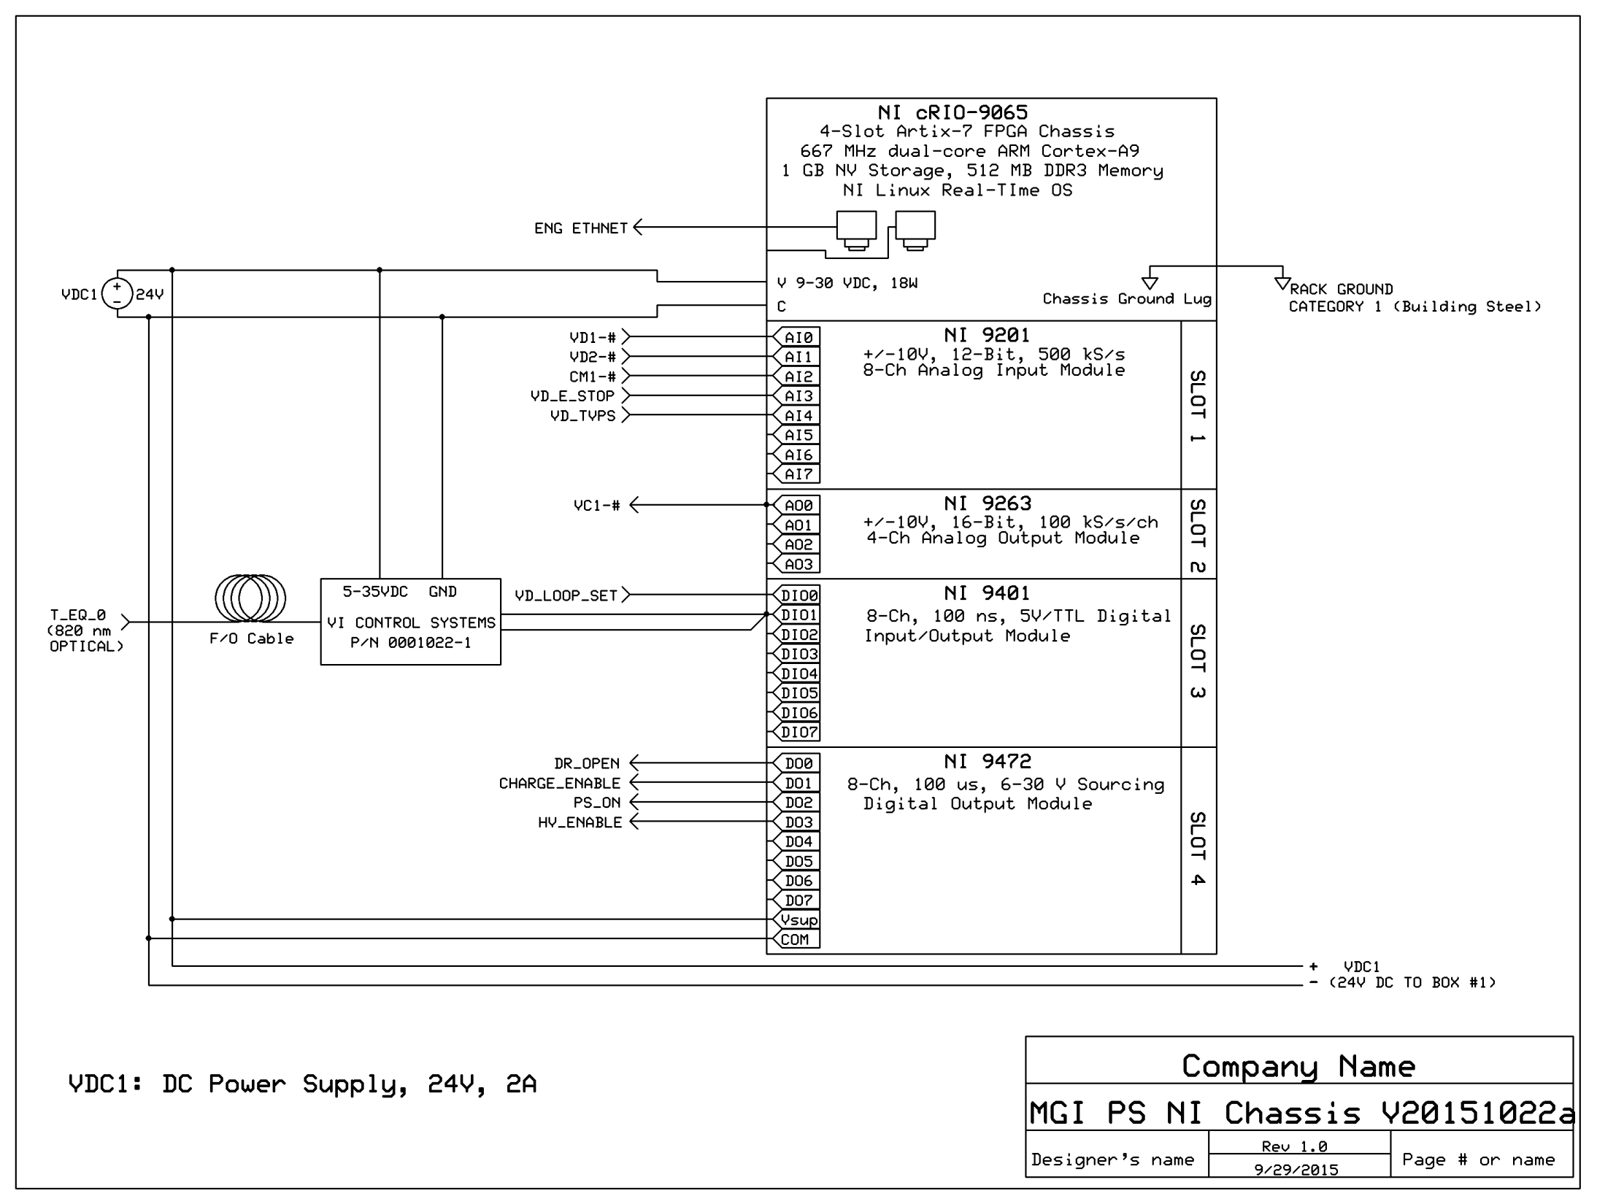

Slide 27
NI cRIO Control System II
State Diagram
  See attachment (No significant changes since last time)
Software
  Using existing NI software license (Labview, FPGA and Realtime): FREE, but with risks
    I have never had ‘official’ NI LV training; Software may not be optimal
    Paul S and I are ‘sharing’ the license
  With G. Zimmer’s EPICS and MDSplus example VI’s and P. Sichta’s SBRIO example, I have a pretty good set of working examples
  Implementation uses minimal FPGA resources; Mostly using RT side of system
We should purchase the NI cRIO system ASAP (w/o software) so that we can begin testing with real hardware

Slide 28
Installation and Access Procedures
Installation procedure
  To be developed with R. van Kirk’s group
  Needs to include testing procedure
Access procedure will follow CHI AP-NSTX-01 as a template
  Cap bank ‘safing’, access restrictions, grounding sticks, safety equipment, etc.

Slide 29
System Tests
Power inhibit tests
  No_E_stop, TVPS_Permissive, Kirk Key
High-pot/isolation tests
Software E stop
Power on/No SCR trigger
V_{cap} > 1.05 x V_{request}
Basic Timing/Functional
This list needs to be formalized

Slide 30
Other necessities
NEPA form - done
Vacuum PLC, PCS – Will need MGI trigger signal to racks
Need t=0 signal to racks
TVPS (24VDC), NO-E-STOP (120VAC), Loop set / H.I.S. (120VAC) to racks
Kirk Keys – schedule time for block expansion
Others?

Slide 31
Timeline
MGI power supply boxes begin to arrive
  Mid-December
Control system
  Mid December thru Mid-January
Install Electrical system HW
  Mid-January
Test supply into dummy load
  Mid January
Test supply into MGI valve
  Mid January
Kirk key system
  ???
Am I missing anything else?

