Slide 1
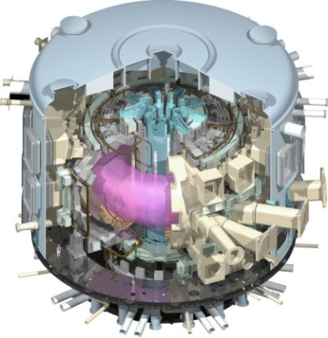
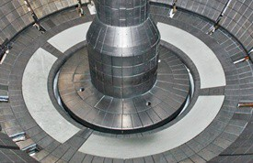
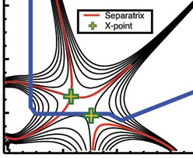
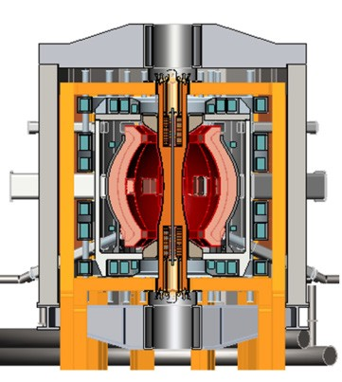
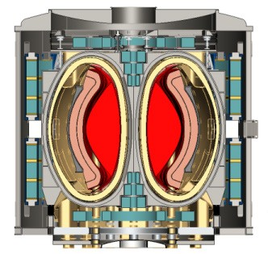
NSTX-U Mission Elements:
Explore unique ST parameter regimes to advance predictive capability - for ITER and beyond
ITER
Develop solutions for plasma- material interface (PMI)
Liquid metals / Lithium
Snowflake/X
ST-FNSF /
Pilot-Plant
Advance ST as Fusion Nuclear Science Facility and Pilot Plant

Slide 2
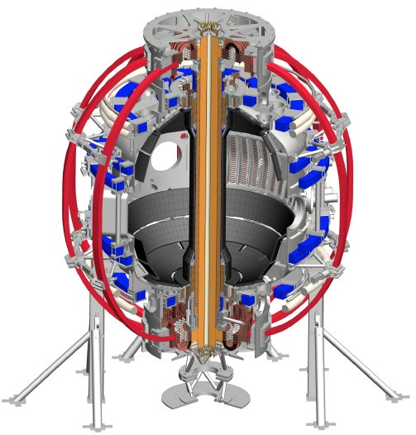
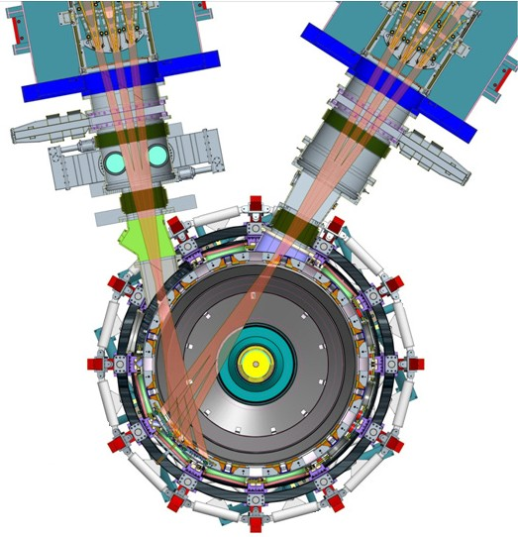
NSTX-U will access new physics with 2 major new tools:
1. New Central Magnet
2. Tangential 2nd Neutral Beam
Higher T, low collisionality at high β
→ Unique regime, study new transport and stability physics
Full non-inductive current drive
→ Not demonstrated in ST at high-β_{T}
Essential for any future steady-state ST

Slide 3
NSTX-U will have major boost in performance
1. New Central Magnet
2. Tangential 2nd Neutral Beam
➢2× heating power (5 → 10MW)
Tangential NBI → 2× current drive efficiency
➢4× divertor heat flux (→ ITER levels)
➢Up to 10× higher nTτ_{E} (~MJ plasmas)
➢2× toroidal field (0.5 → 1T)
➢2× plasma current (1 → 2MA)
➢5× longer pulse (1 → 5s)

Slide 4
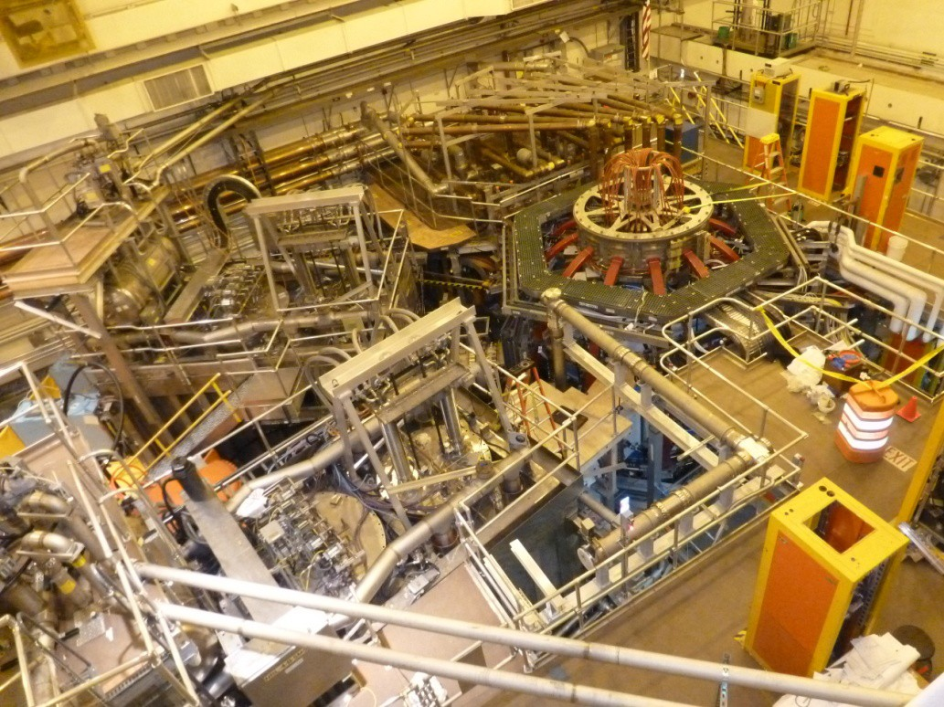



Completed NSTX Upgrade Project
New Central Magnet
Original Neutral Beam
New 2nd Neutral Beam

Slide 5
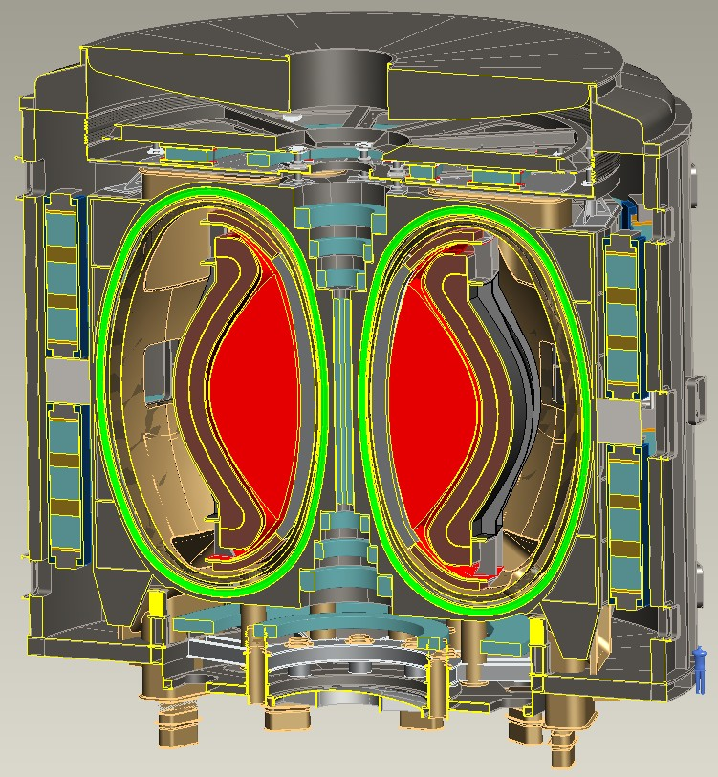
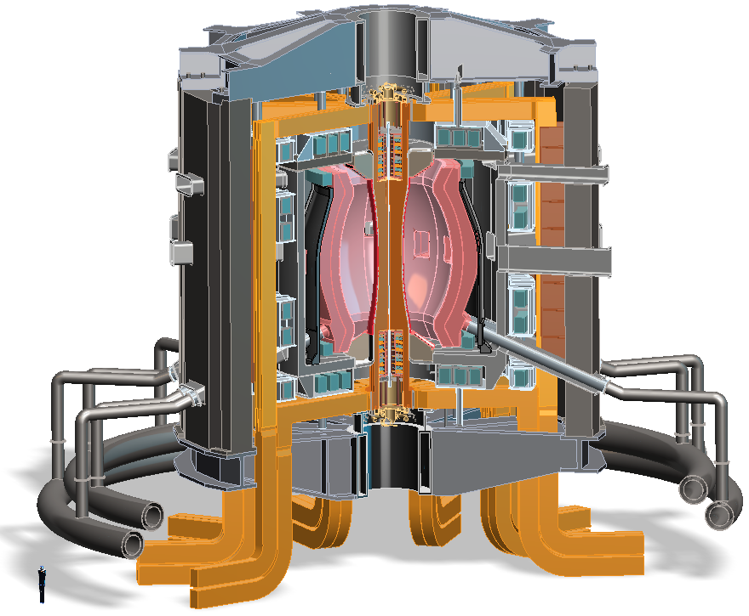
Design studies show ST potentially attractive as
Fusion Nuclear Science Facility (FNSF) or Pilot Plant
FNSF: Provide neutron fluence for material/component R&D + T self-sufficiency
Pilot Plant: Electrical self-sufficiency: Q_{eng} = P_{elec} / P_{consumed} ≥ 1 + FNSF mission
FNSF with copper TF coils
A=1.7, R₀ = 1.7m, κ_{x} = 2.7
Fluence = 6MWy/m², TBR ~ 1
FNSF / Pilot Plant with HTS TF coils
A=2, R₀ = 3m, κ_{x} = 2.5
6MWy/m², TBR ~ 1, Q_{eng} ~ 1

Slide 6
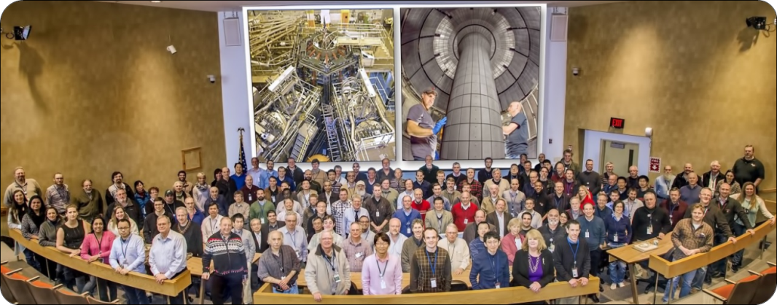
NSTX-U = National Spherical Torus eXperiment - Upgrade
Highly collaborative research program
Domestic (33)
International (22)
~400 team members
~350 data users
55 institutions
22 US Universities
April 2016

Slide 7
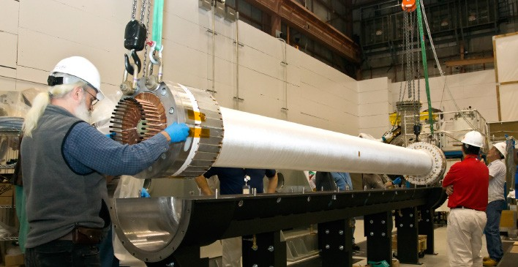
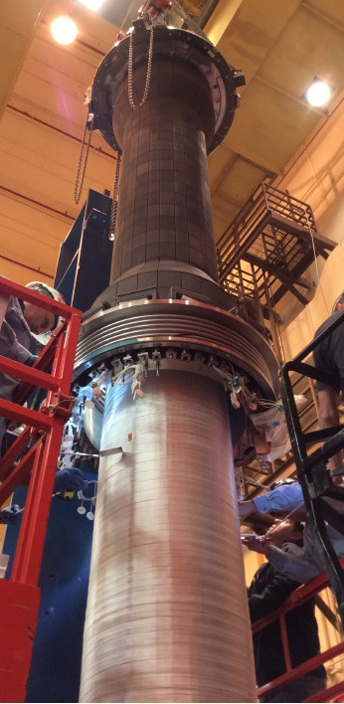
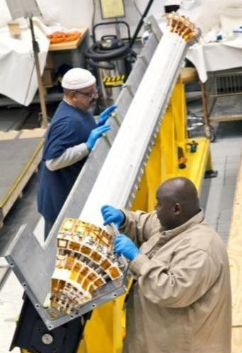
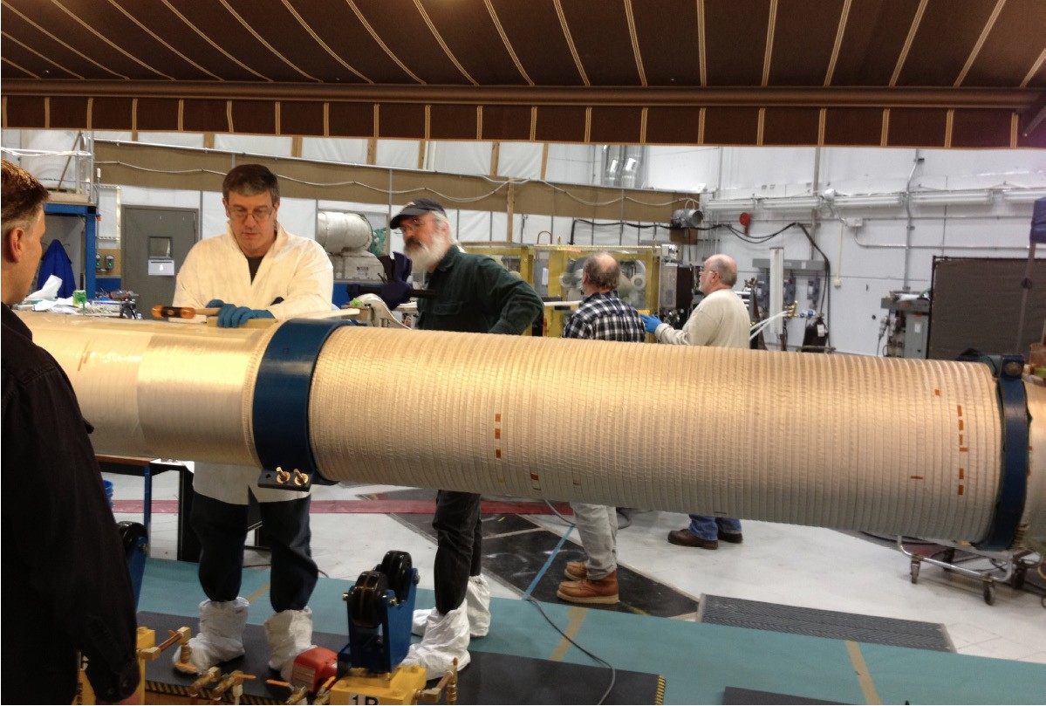
Central magnet construction was complex, multi-stage, multi-year effort
Built 4 toroidal field (TF) quadrants
Install vacuum- tight casing over TF + OH bundle
Combine quadrants (5th VPI)
Wind ohmic heating (OH) coil over TF, then final 6th VPI
4 vacuum pressure impregnations (VPI)

Slide 8

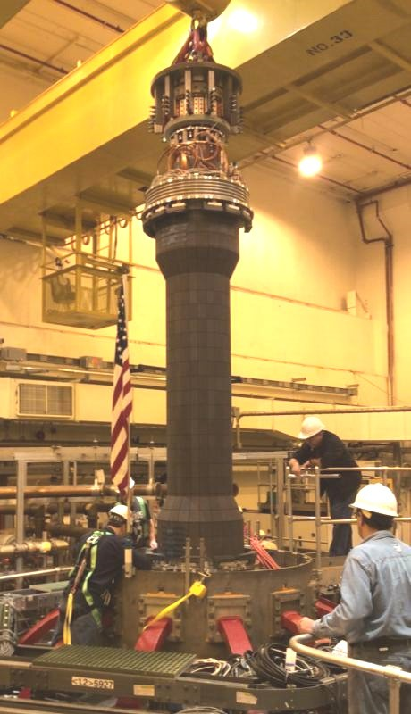


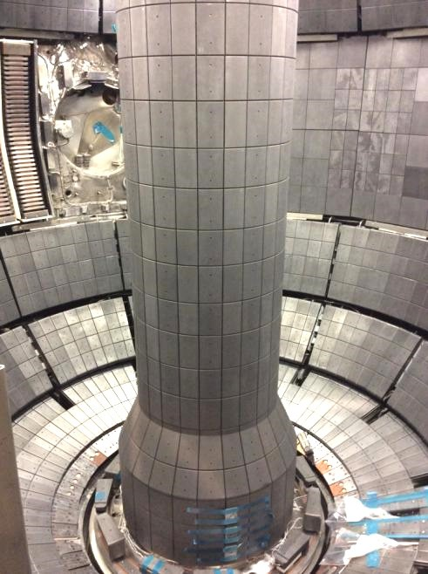
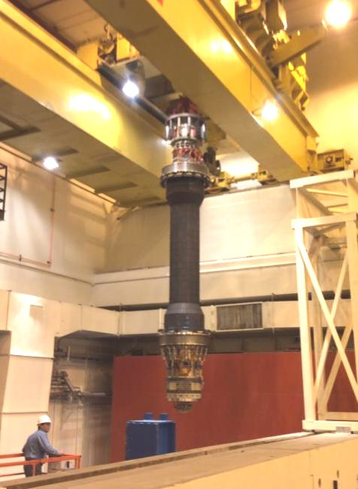
Fabrication and installation of central magnet ultimately successful
Over the machine
Over shield wall
Inside NSTX-U!

Slide 9
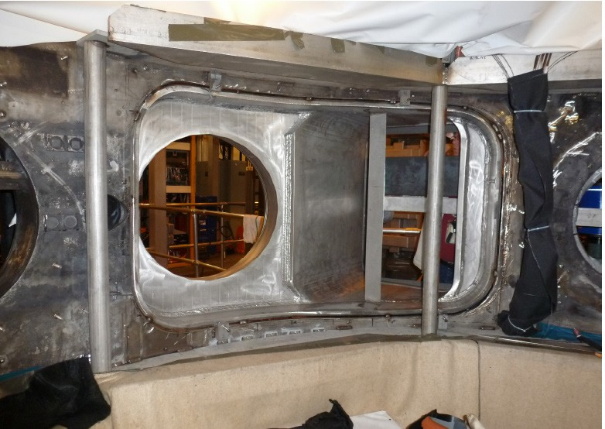
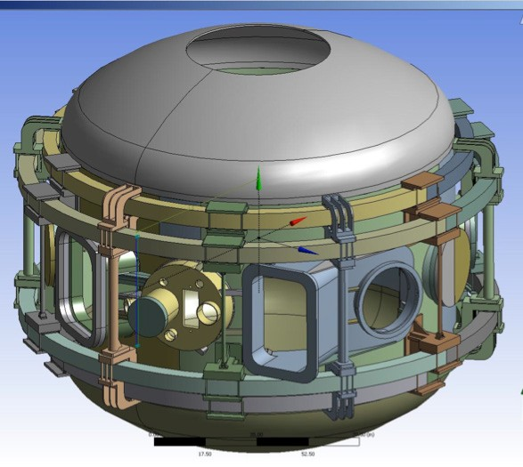

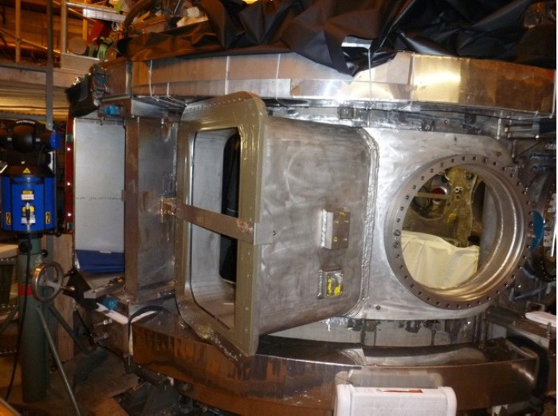

Tangential neutral beam required major vacuum vessel modifications
Interior View of Bay J-K
Exterior View of Bay J-K
JK cap

Slide 10
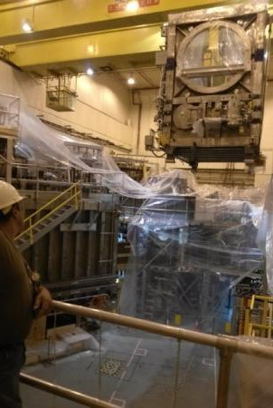
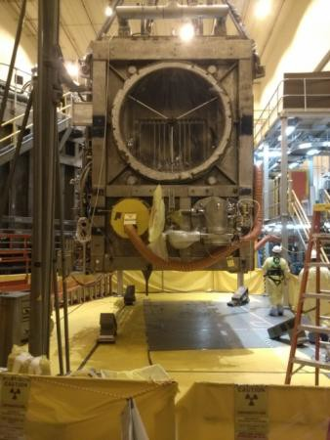
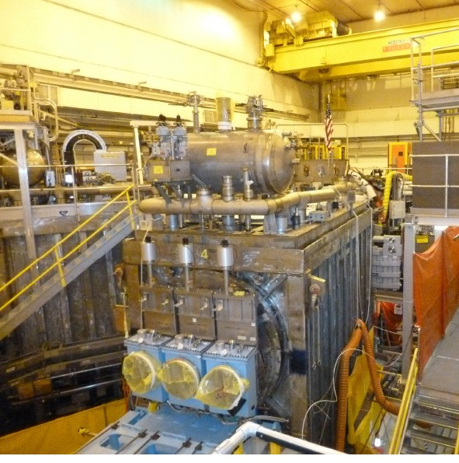
2nd beam (from TFTR DT campaign) required T decontamination, NSTX test-cell re-arrangement
Beam Box being lifted over NSTX
Beam Box placed in its final location and aligned
Beam Box being populated with components

