Slide 1
NSTX-U
Supported by
Fast Time Response Electromagnetic Particle Injection System for Disruption Mitigation
Roger Raman¹
R. Lunsford², T.R. Jarboe¹, R. Nazikian²
¹University of Washington, Seattle, WA, USA
²Princeton Plasma Physics Laboratory
Acknowledgments
¹W-S. Lay, ²J.E. Menard, ²M. Ono
KSTAR Conference 2018
Deogyusan Resort, Muju, KOREA
February 21 to 23, 2018
College W&M
Colorado Sch Mines
Columbia U
Comp-X
General Atomics
INL
Johns Hopkins U
LANL
LLNL
Lodestar
MIT
Nova Photonics
New York U
Old Dominion U
ORNL
PPPL
PSI
Princeton U
Purdue U
SNL
Think Tank, Inc.
UC Davis
UC Irvine
UCLA
UCSD
U Colorado
U Maryland
U Rochester
U Washington
U Wisconsin
Culham Sci Ctr
U St. Andrews
York U
Chubu U
Fukui U
Hiroshima U
Hyogo U
Kyoto U
Kyushu U
Kyushu Tokai U
NIFS
Niigata U
U Tokyo
JAEA
Hebrew U
Ioffe Inst
RRC Kurchatov Inst
TRINITI
KBSI
KAIST
POSTECH
ASIPP
ENEA, Frascati
CEA, Cadarache
IPP, Jülich
IPP, Garching
ASCR, Czech Rep
U Quebec
This work is supported by US DOE contract numbers
DE-SC0006757 and DE-AC02-09CH11466

Slide 2
Limitations of Present DM Systems
Most of the DM databases is from MGI experiments, but MGI has been dropped by ITER due to its slow response time.
    But, the MGI valve is still used to propel the SPI pellet
The speed of the un-fragmented high-mass / high-Z SPI pellets is about 200-300 m/s due to the use of gas propellant
    Shattering process further reduces fragment velocity
Because of the slow speed and size of the fragmented particles, the penetration depth will be severely restricted in high power ITER discharges
Will the SPI fragments penetrate sufficiently deep into the much more energetic ITER H-mode pedestal?

Slide 3
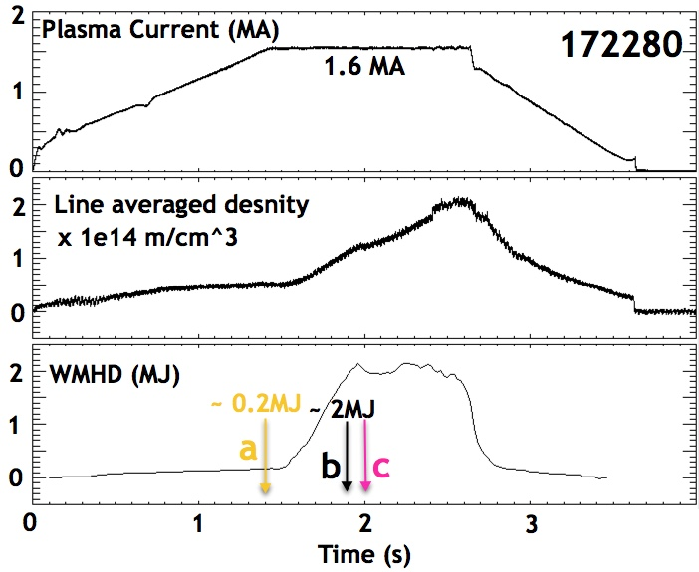
There is Dramatic Difference in SPI Penetration in Low and High-Power DIII-D Plasmas
From: R. Raman, et al., APS DPP 2017 Conference
Presentation PO4.00003

Slide 4
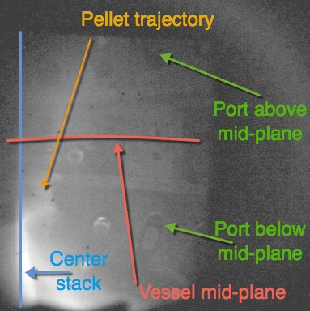
Internal Vessel View of DIII-D Vessel as Viewed from the SPI-2 Imaging Camera
SPI is injected from a port above the vessel mid-plane and directed towards the lower center stack of DIII-D

Slide 5

DIII-D SPI Injection Movies (R. Moyer – UCSD / DIII-D)
From: R. Raman, et al., APS DPP 2017 Conference
Presentation PO4.00003

Slide 6
How does the EPI concept address present limitations?
The EPI concept injects grains of material (of the required size) and at the required velocity – & it does this on a fast time scale (2-3ms)
Because of this - one can precisely calculate the needed size / velocity combination of a spherical particle for penetrating to the center of any given plasma, including the ITER plasma
The present understanding (based on the theoretical work of Konavalov, et al., proceedings of the IAEA-FEC 2012 conference, ITR/P1-38) is that as little as 5g of Be may be adequate for both thermal quench and runaway electron mitigation in ITER. This radiative payload must be deposited sufficiently deep inside the plasma.

Slide 7
How Does the EPI System Achieve These Essential Parameters for a Reactor DMS?
The EPI system accelerates a sabot
The sabot is a metallic capsule that can be accelerated to high-velocity using an electromagnetic impeller
At the end of the acceleration, within 2-3ms, the sabot will release granules of known velocity and distribution – or a Shell Pellet
The primary advantage of the EPI concept over SPI and other gas propelled systems is its potential to meet short warning time scales, while accurately delivering the required particle size and materials at the velocities needed for achieving the required core penetration in high power ITER discharges.
  Delivers radiative payload to the the core where the RE channel is generated

Slide 8
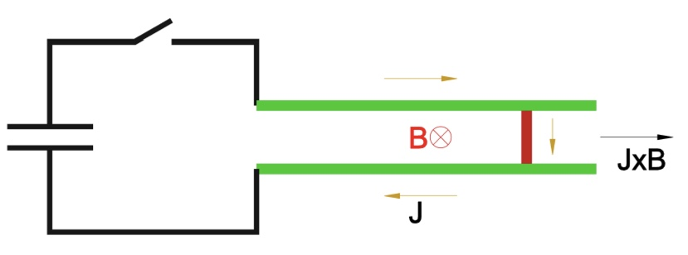
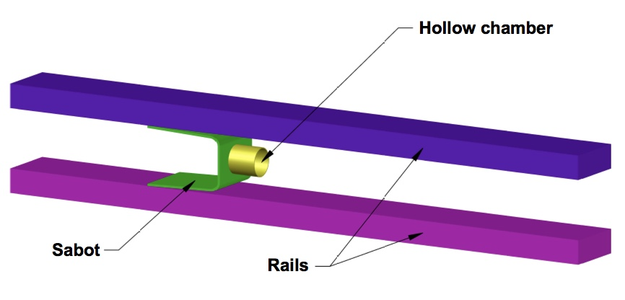
The Ambient B-Field of a High-Field Tokamak such as ITER Can be Used to Improve Device Efficiency
Injector can be positioned very close to the vessel, which further improves the system response time
Use high-field SC boost coils (>8T) if located outside port plug
From: R. Raman, et al., Fusion Science & Technology, Vol.68 (Nov 2015) 797

Slide 9
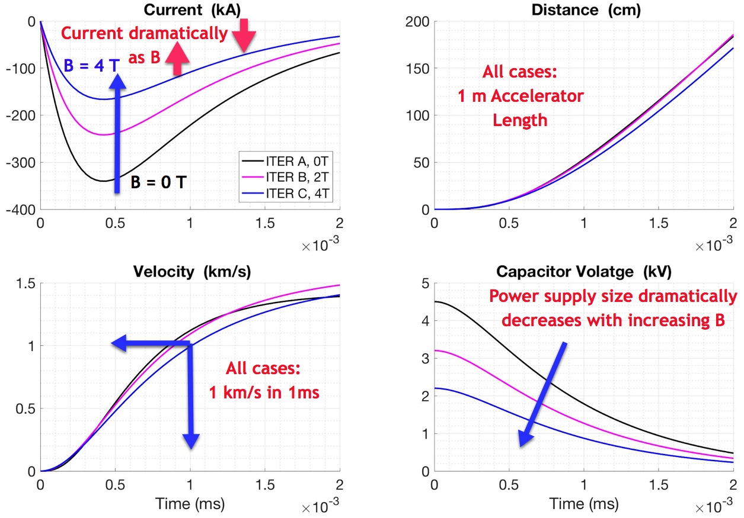
ITER Scale Injector Should Attain 1 km/s in ~1 ms
@ 8T cap bank only 2x
DIII-D-scale system

Slide 10
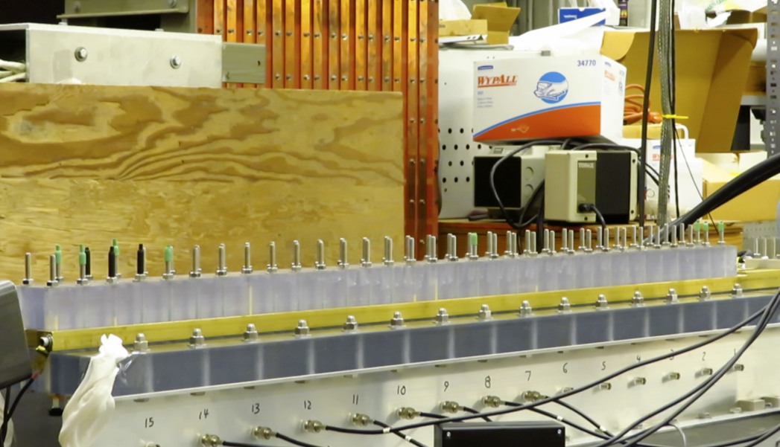
Small Scale System Built To Test Critical Parameters (Sabot motion tracked using magnetic Probes)

Slide 11
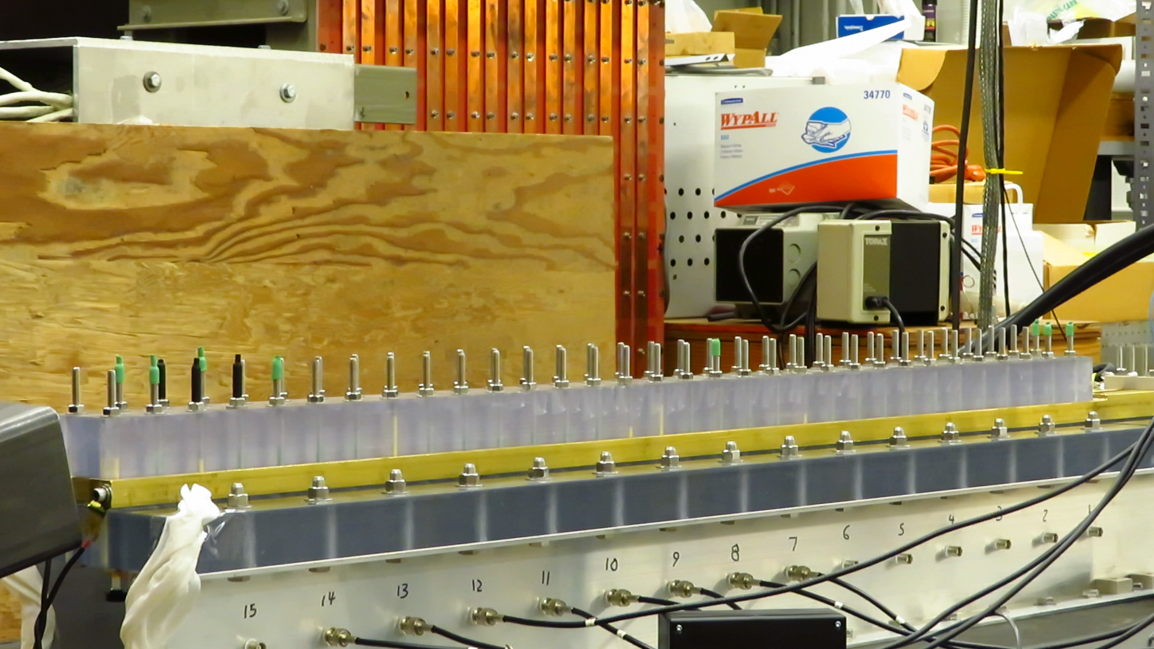
Small Scale System Built To Test Critical Parameters (Sabot motion tracked using magnetic Probes)

Slide 12
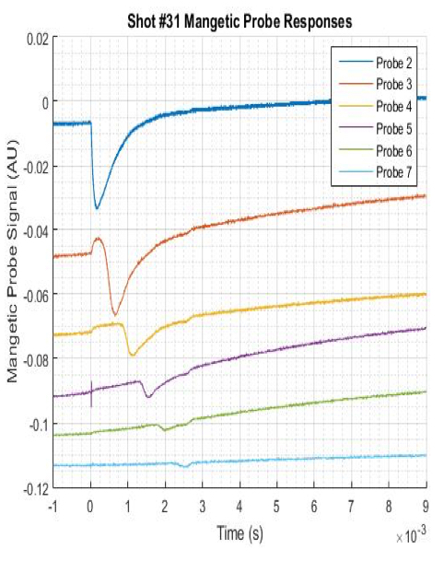
Magnetic Probes Located Below Rail Electrodes Track Sabot Motion & Used to Measure Velocity
Sabot motion

Slide 13

Sabot Motion also Tracked Using Fast Video Camera

Slide 14
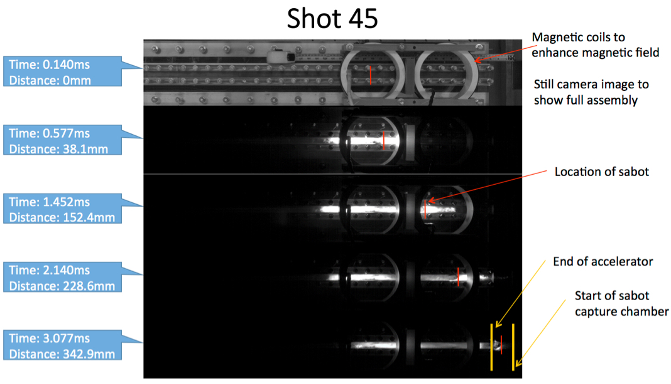
Fast Camera Images Also Used to Measure Sabot Velocity

Slide 15
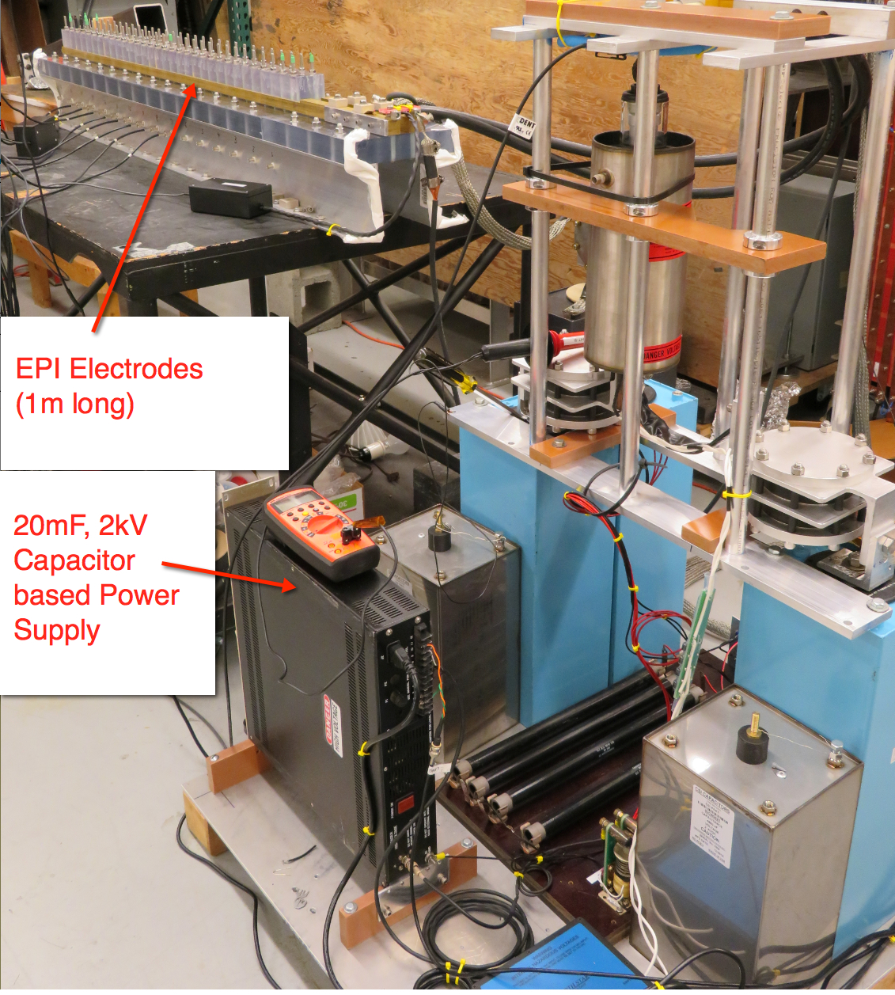
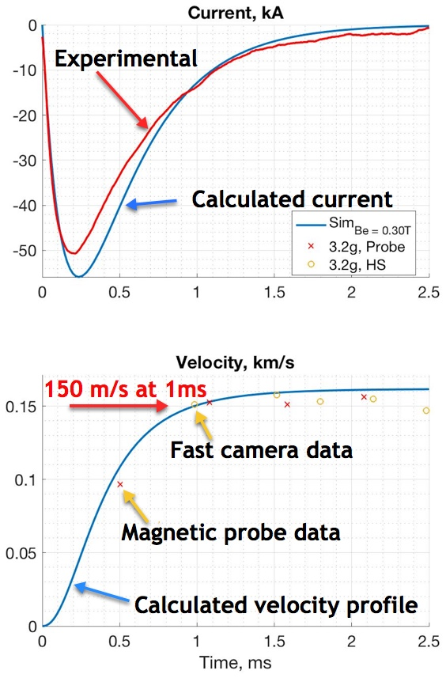
Measured EPI system parameters with 0.3T B-field augmentation in agreement with simulation predictions
University of Washington

Slide 16
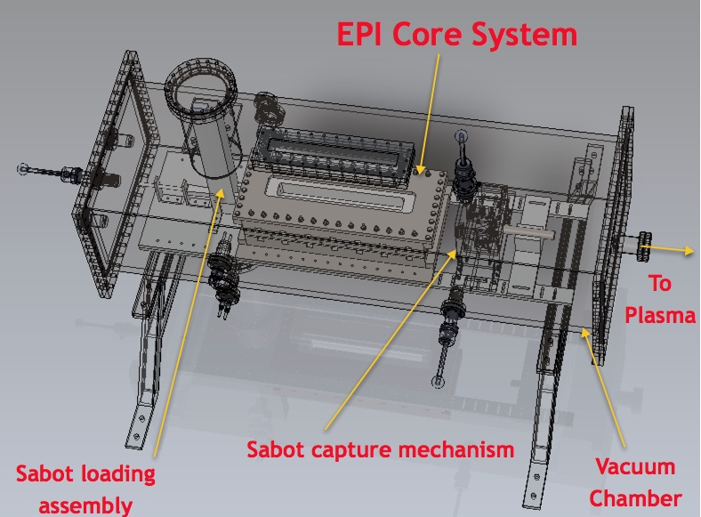
Next Step is to Conduct an EPI Test on a Tokamak
Vacuum Chamber Dimensions (1.5m x 0.6m x 0.5m)

Slide 17
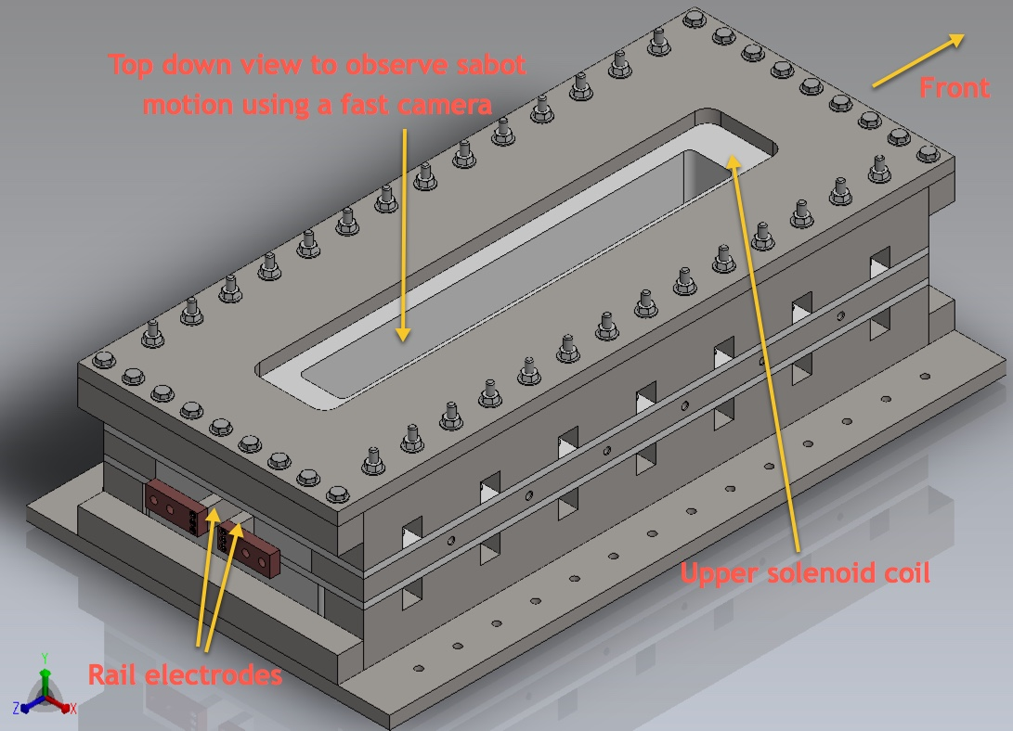
Now Starting to Assemble EPI Core Region For Higher Velocity Tests in Ambient Atmosphere

Slide 18
EPI can Deliver Radiative Payload Deep into the Tokamak Plasma on a Fast 2-3 ms Time-scale
EPI concept accelerates a metallic sabot to high velocity, which releases grains of particles of the required size and velocity
The EPI system has features needed for a reactor DMS
  Can deposit payload in the RE channel – triggering an inside out thermal quench
  It uses a single reliable actuator, and payload that is solid at room temperature – so it should be very reliable
  It can be located close to vacuum vessel further improving response time
Off-line setup at U-Washington has demonstrated key aspects of concept, including 150-200 m/s velocities with 1.5ms response time consistent with calculations
Tokamak tests are the next logical next step for concept development
  Develop experimental data base on solid particle injection for theory simulations

Slide 19
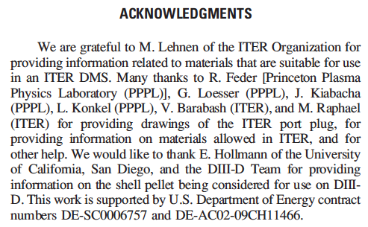
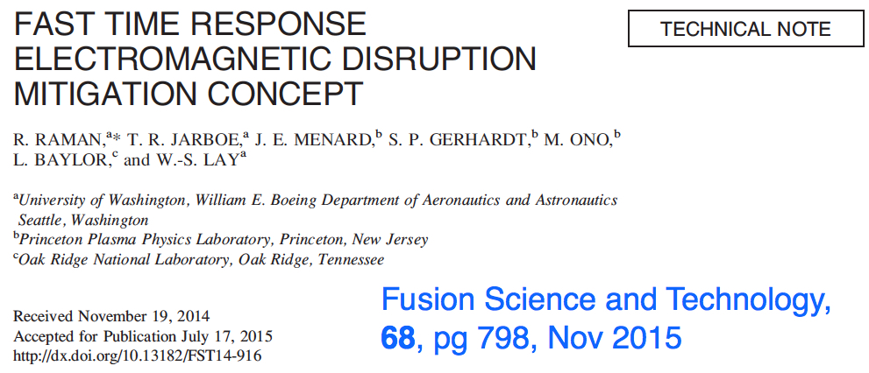
Concept Discussed With ITER Groups During Concept Inception Phase
Motivation and concept details are provided in this paper:
As part of the concept development we consulted with ORNL ITER Disruption Mitigation Group and with ITER Personnel
Held three remote presentation meetings to inform ORNL ITER Group

