Slide 1
Post FY16 initial in vessel inspections
F. Scotti, C. Skinner, S. Gifford
PPPL B318
2:00 PM Thursday Sept 29th 2016

Slide 2
Purpose:
Comparison of before/after in-vessel photos
Initial assessment of any corrective actions.
Any additional metrology request
Unedited photo-survey available at:
smb://filesrv1.pppl.gov/photo-drop$/Drop Photos Here/Elle’s Folder/NSTXU ENTRY 09_16_2016
P:\Photo Drop\Drop Photos Here\Elle's Folder\NSTXU ENTRY 09_16_2016
Presentation and pictures from this presentation at http://nstx.pppl.gov/DragNDrop/Operations/In_vessel_inspections/Post_run_2016/

Slide 3
Initial in-vessel inspections revealed vessel in good conditions, few minor issues
Opportunity for post-plasma inspection without lithiumization
Overall, no evident major issues
A few things to be noted:
One chipped tile: outboard divertor Row 2, I – top
A few leading edges in upper divertor outboard tiles
Flaking aerodag on new port covers (Bay I, J)
Flaking coatings on several midplane components
Four “black tiles”
Others misc.: arcs, lithium dust, …

Slide 4
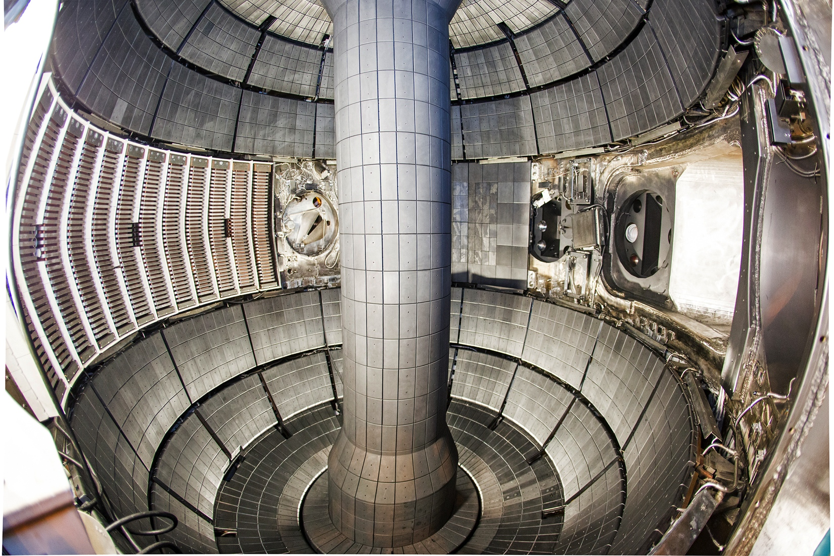
In-vessel fisheye view before campaign 12/05/2014

Slide 5
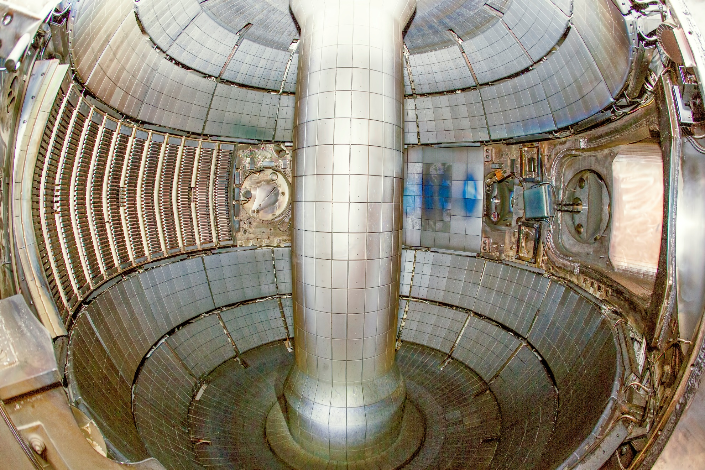
In-vessel fisheye view after campaign 09/19/2016

Slide 6
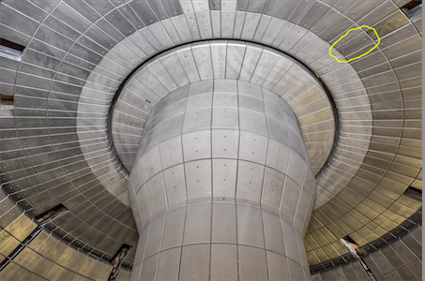
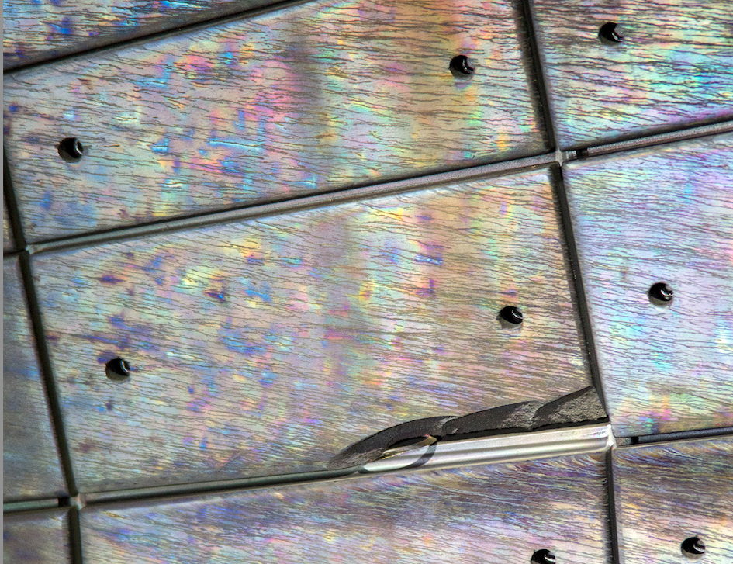
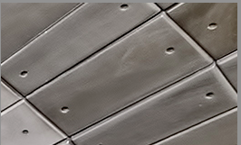
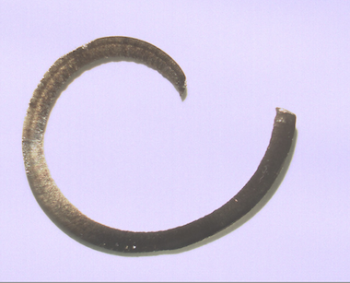
Over-style row 2 tile cracked on non-leading edge in upper outboard divertor in Bay I
Note leading edges
Stainless steel shard
Hypothesis: Heating / thermal expansion of protruding tile edge closed overlay/underlay gap and caused breakage

Slide 7
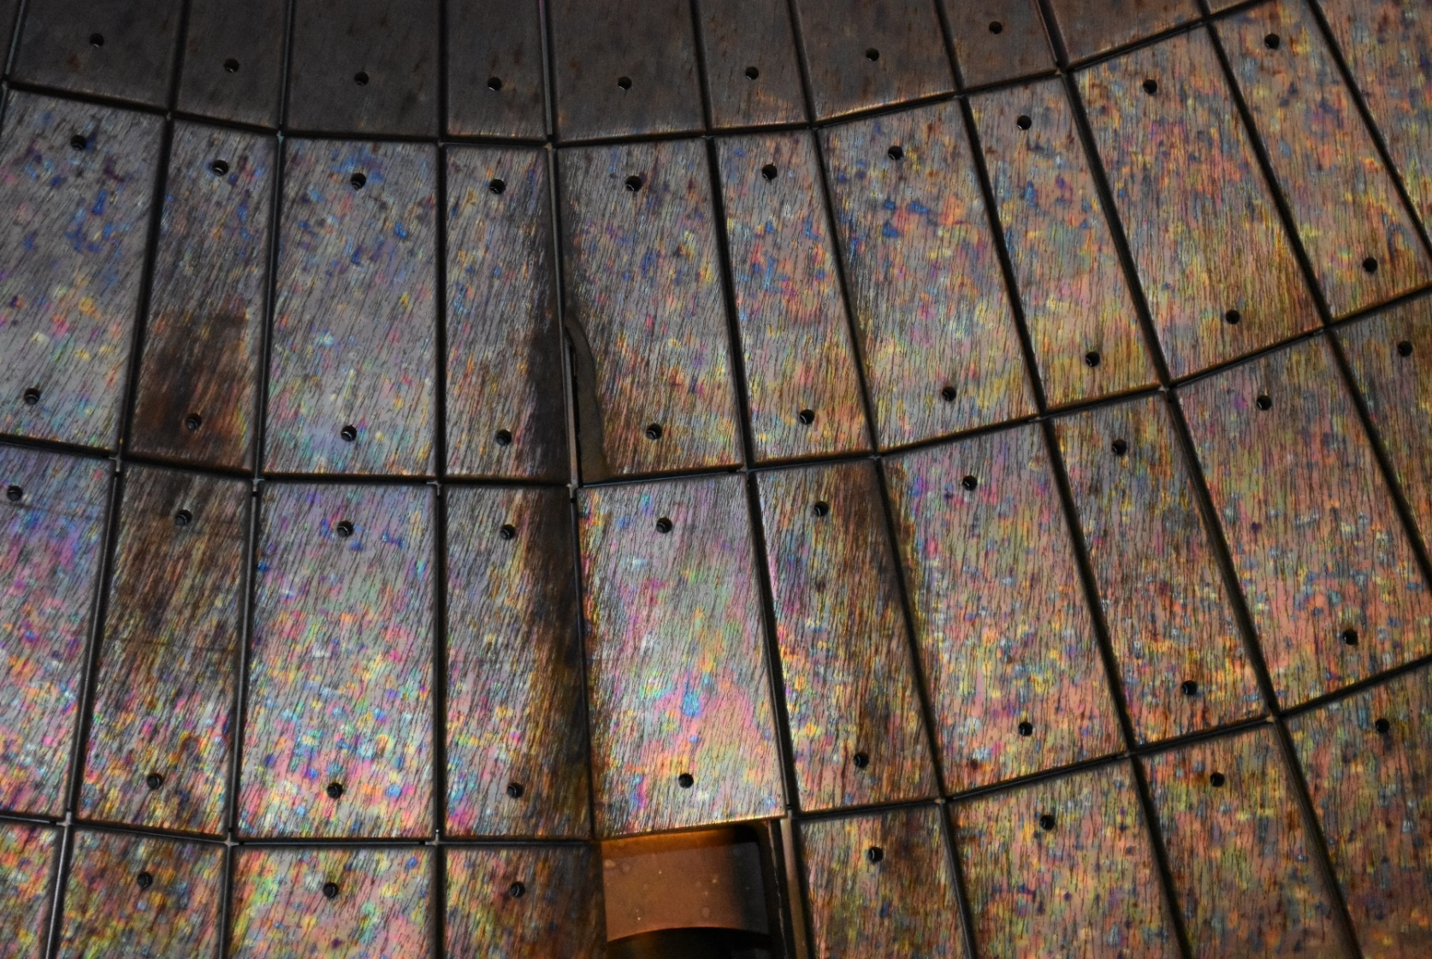
Over-style row 2 tile cracked on non-leading edge in upper outboard divertor in Bay I

Slide 8
Metallic chip peaking from behind cracked tile also exposed to plasma

Slide 9
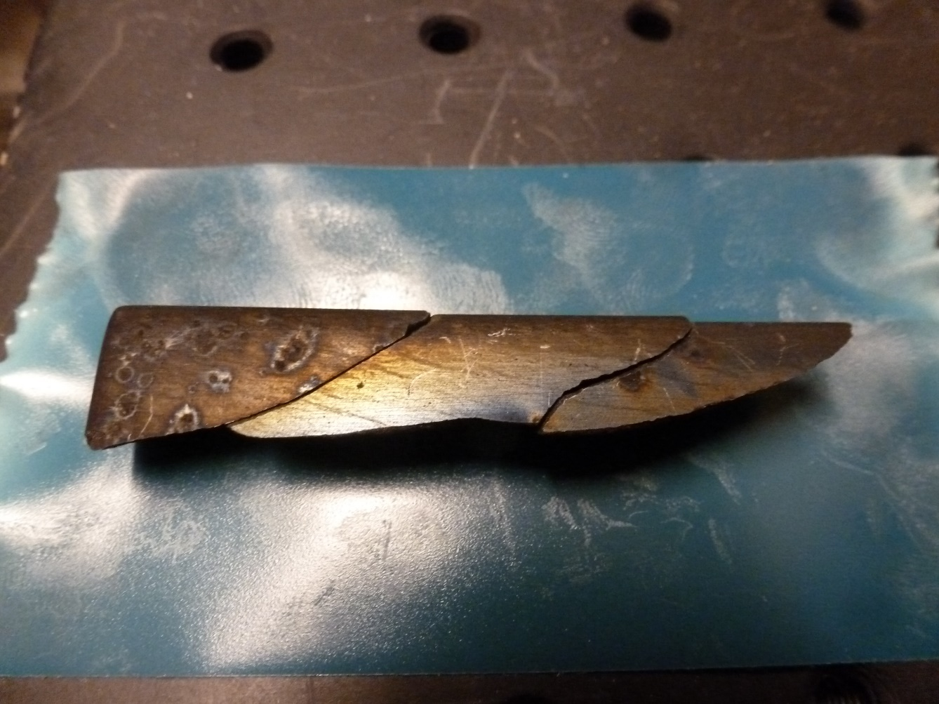
Tile edge shattered in three pieces, found in the CHI gap (between Bay G and Bay K)
Continuity of arcs/deposition on tile suggest tile did not crack during initial bakeout

Slide 10
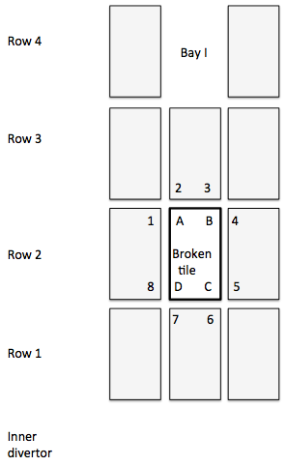
Metrology of broken tile planned
Romer arm measurements
Work Permit 2016277
Recommend engineering task to:
Establishment of maximum permissible tile protrusion (related to design value of overlay/underlay gap).
Fabrication of specialized tool with feeler gauges for rapid detection of tile protrusion over limit.
In-vessel survey of all tiles and adjustment of any tiles over limit.
Potential tool:
Flat plate with 4 feeler gauges
tile
tile
Contact ?

Slide 11
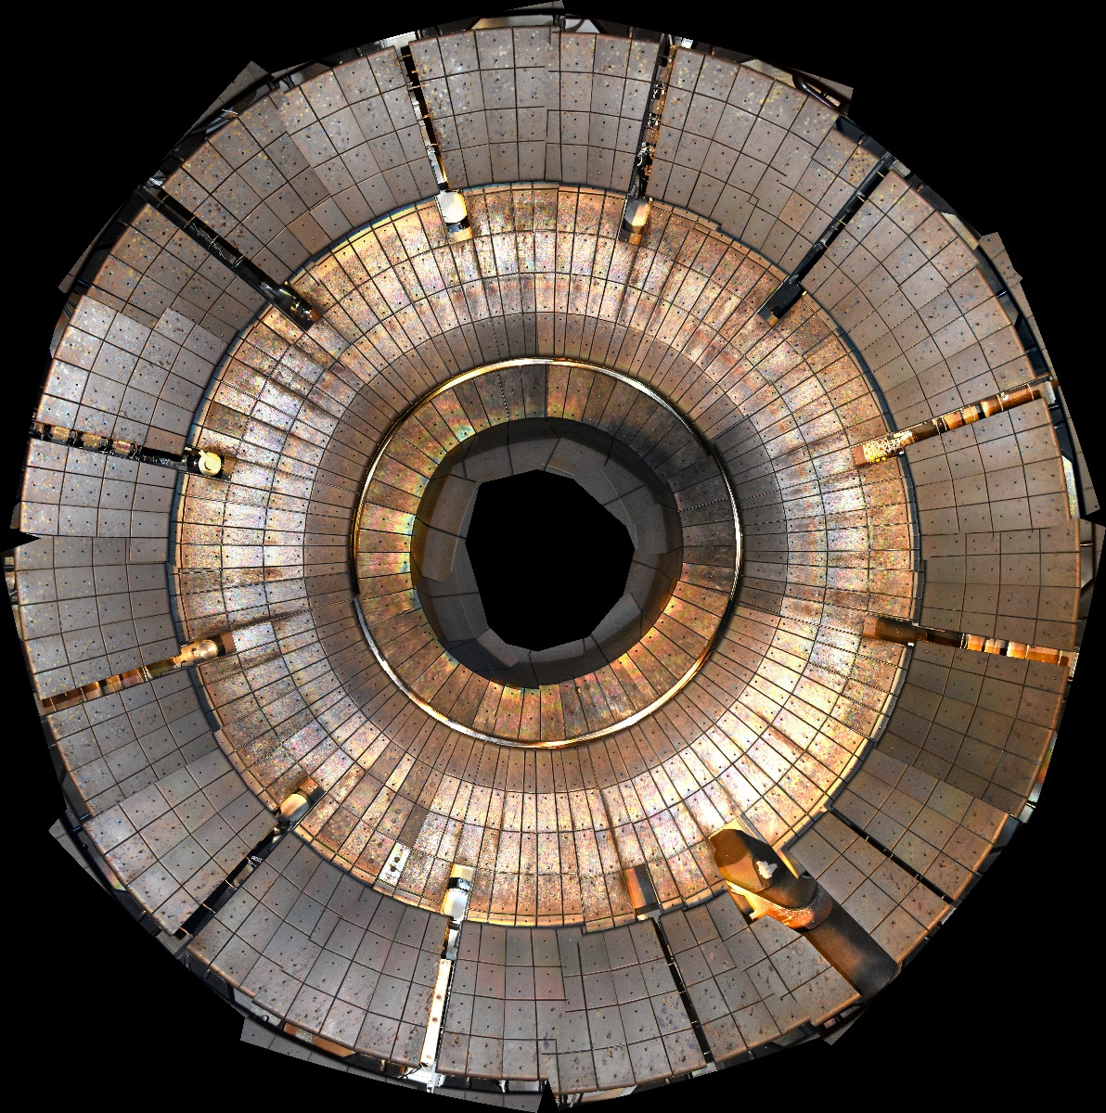
Asymmetric erosion also observed at other toroidal locations in the upper divertor
Full image available in Drag&Drop

Slide 12
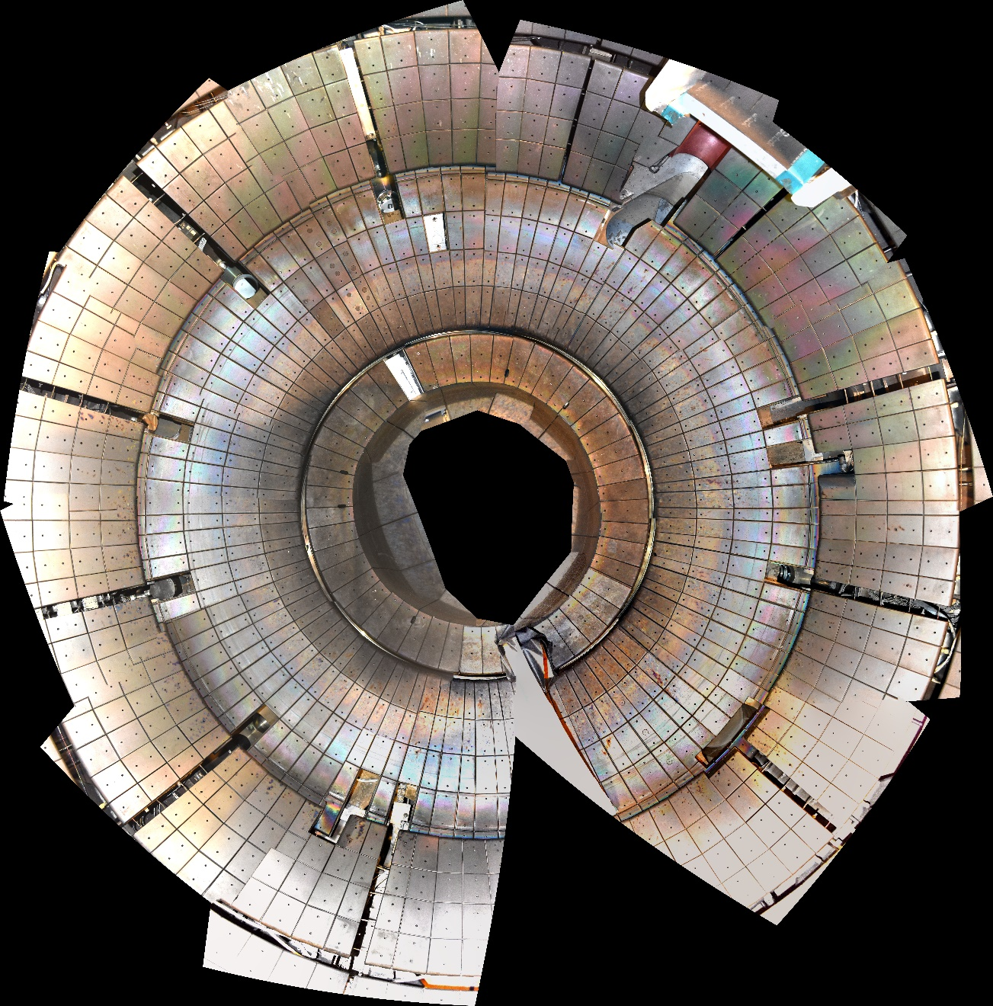
No signs of misalignments in lower divertor tiles (both inner and outer)

Slide 13
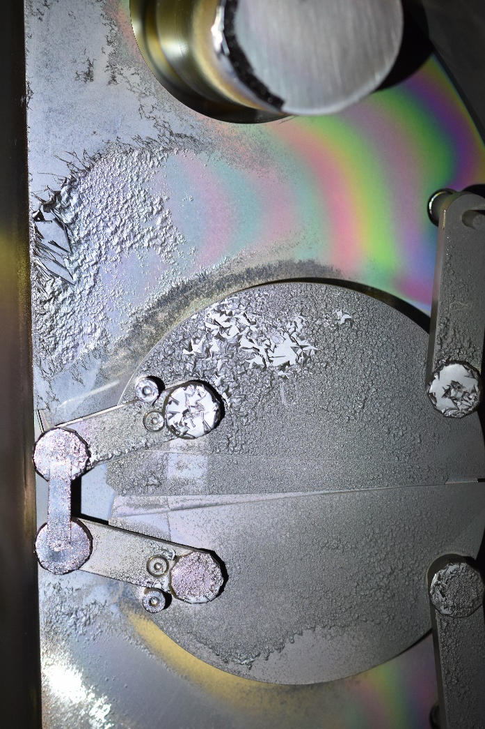
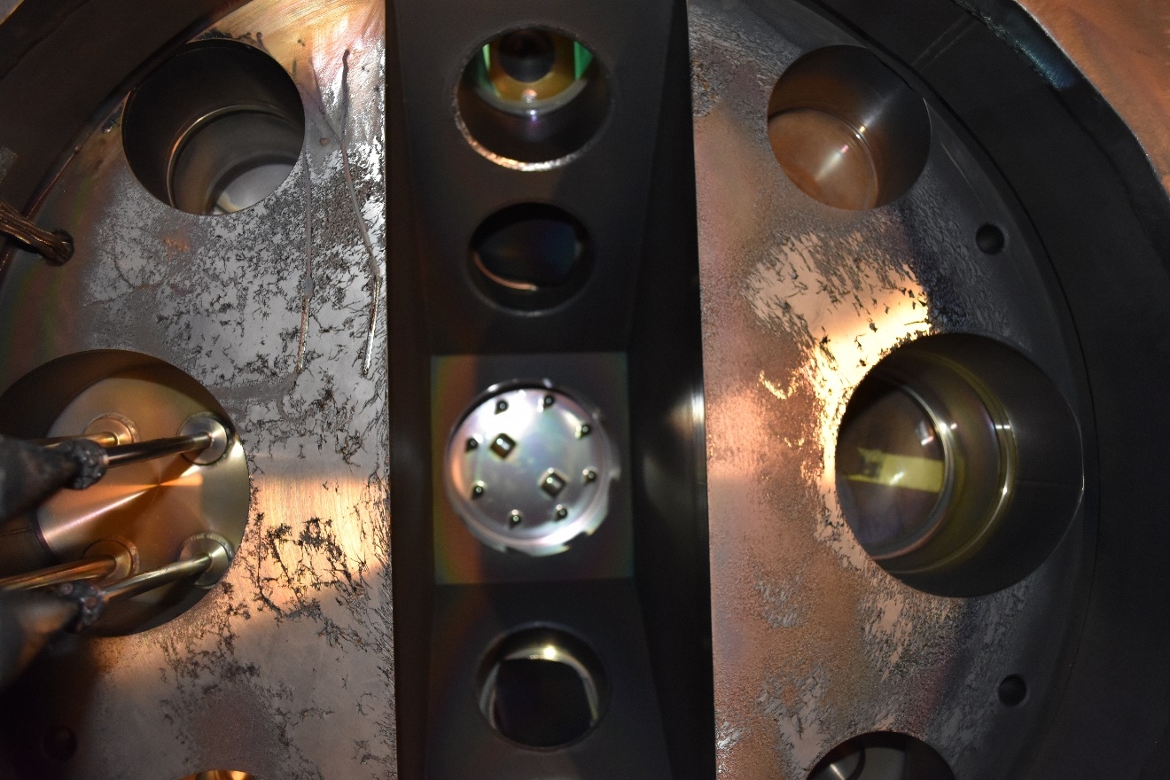
Aerodag coating on new I, J mid port covers flaked off, accumulated at bottom of port
Bay I
Bay J

Slide 14
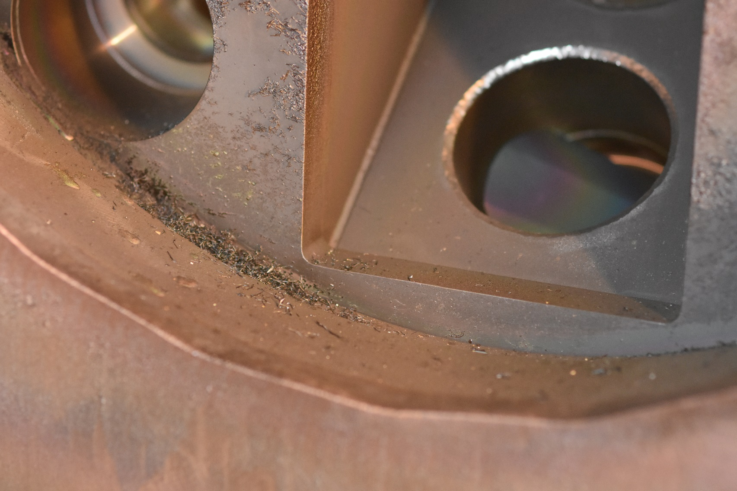
Aerodag coating on new I, J mid port covers flaked off, accumulated at bottom of port
Although it’s carbon, dust/particulate can be an issue
Bay J

Slide 15
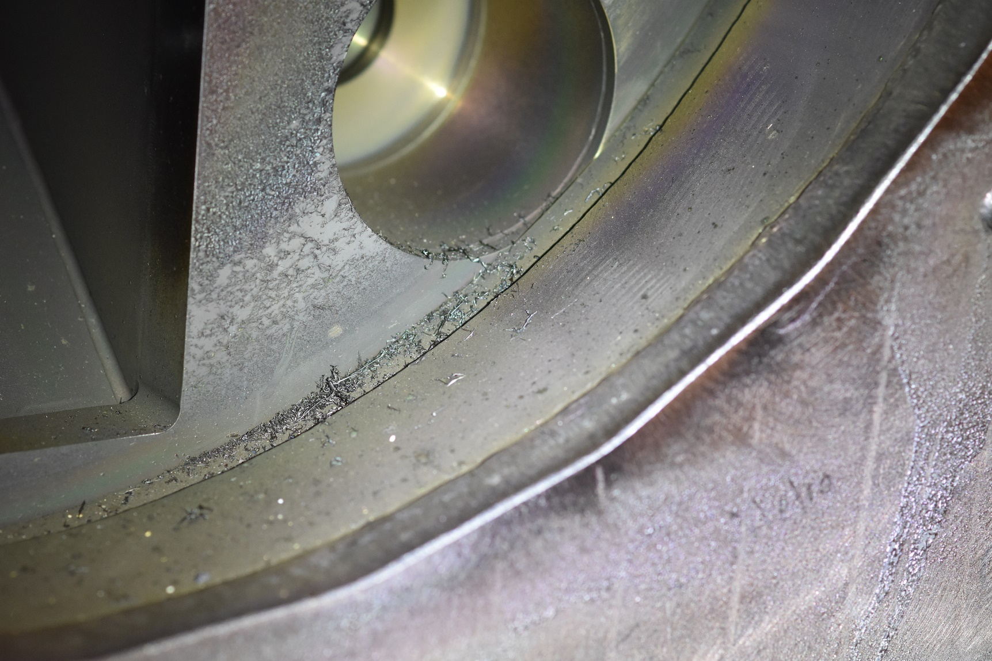
Aerodag coating on new I, J mid port covers flaked off, accumulated at bottom of port
Bay J

Slide 16
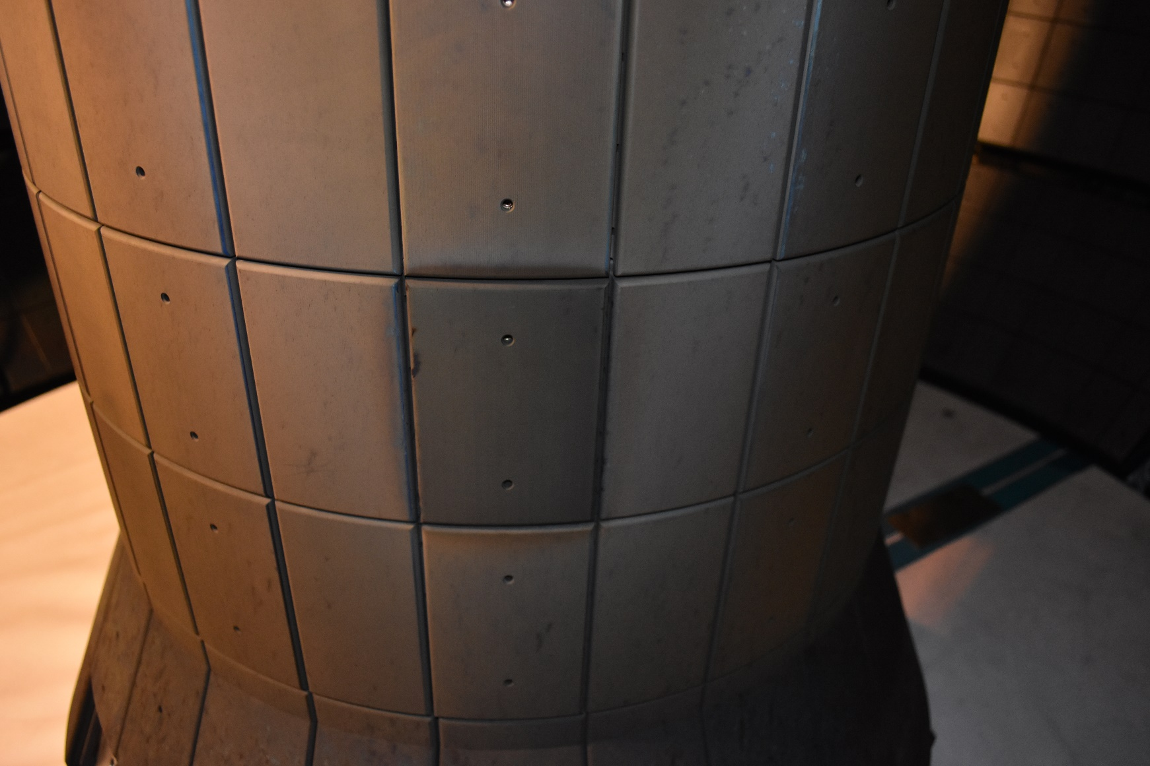
Four darker tiles observed on CS, baked differently before the run?
Already observed during the run

Slide 17
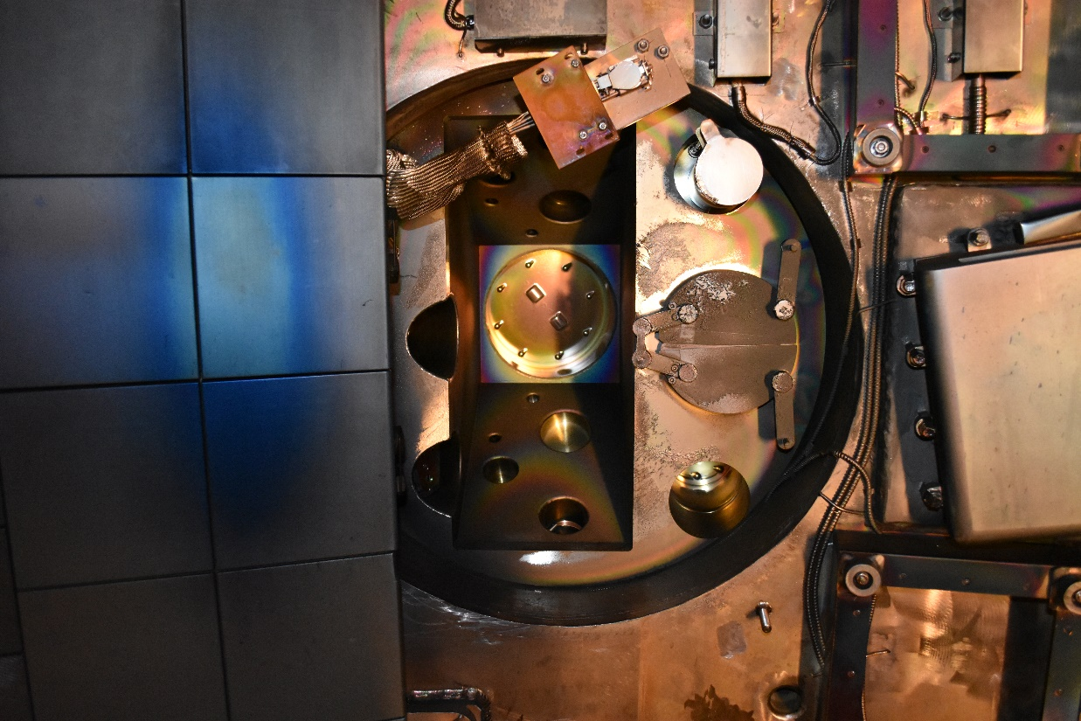
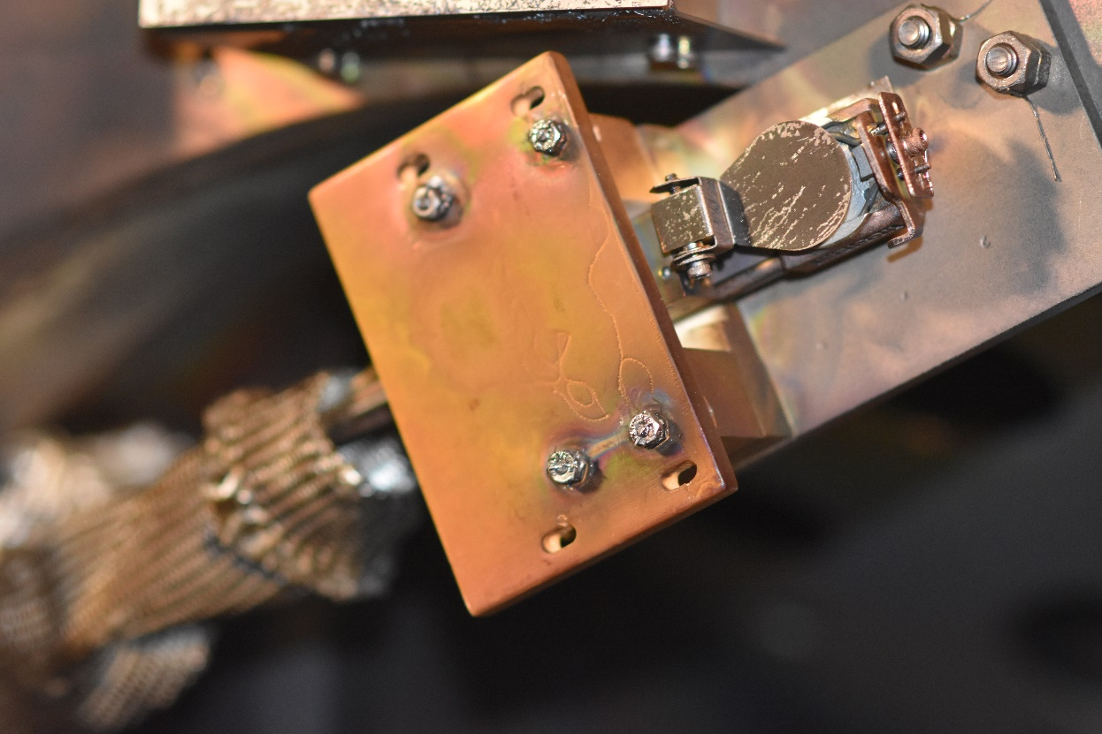
Arc apparent on Bay I mid deposition monitor
Needed to be disconnected during plasma ops to avoid ground fault (to be investigated)

Slide 18
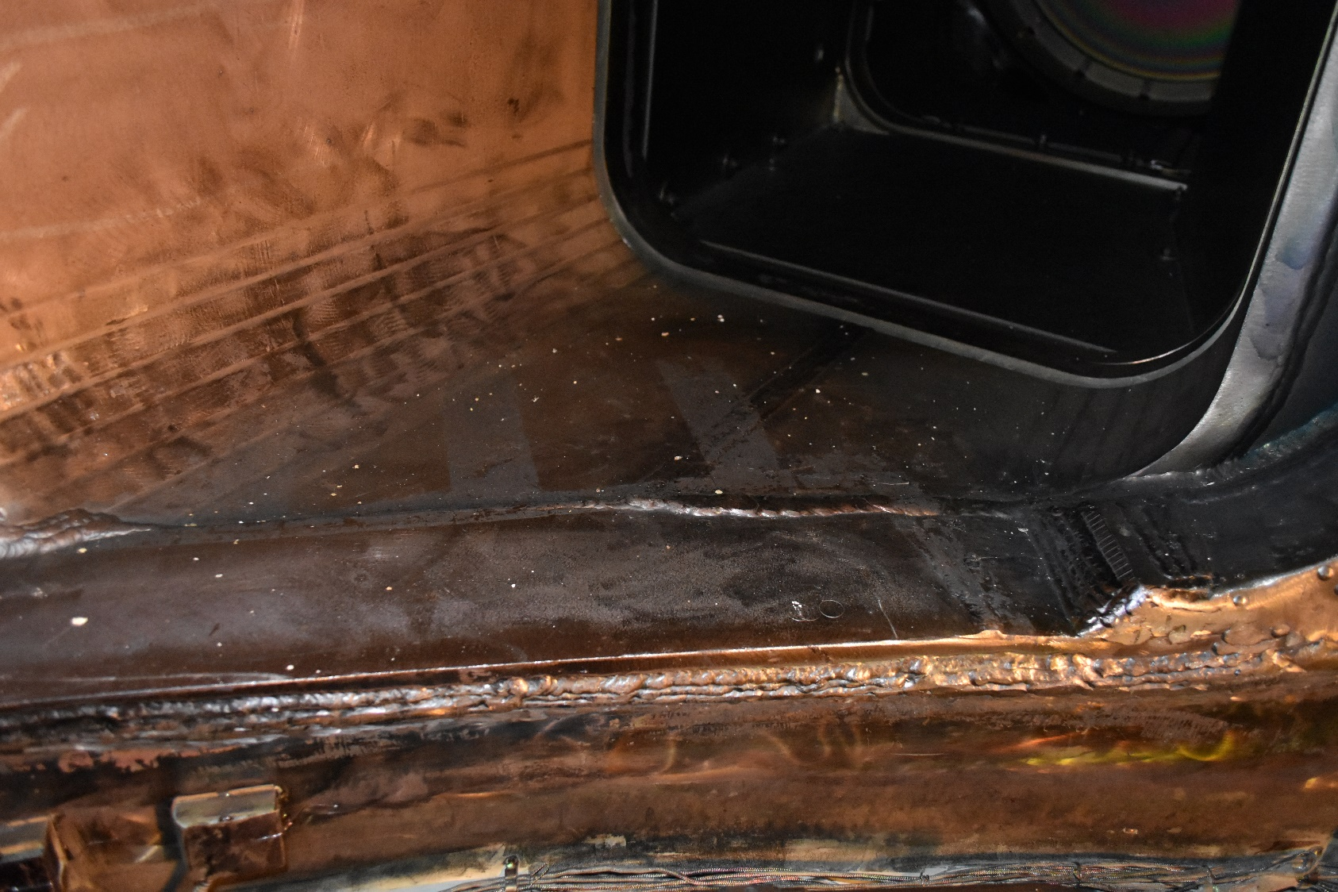
Lithium carbonate dust still around in the vessel, as observed during plasma ops

Slide 19
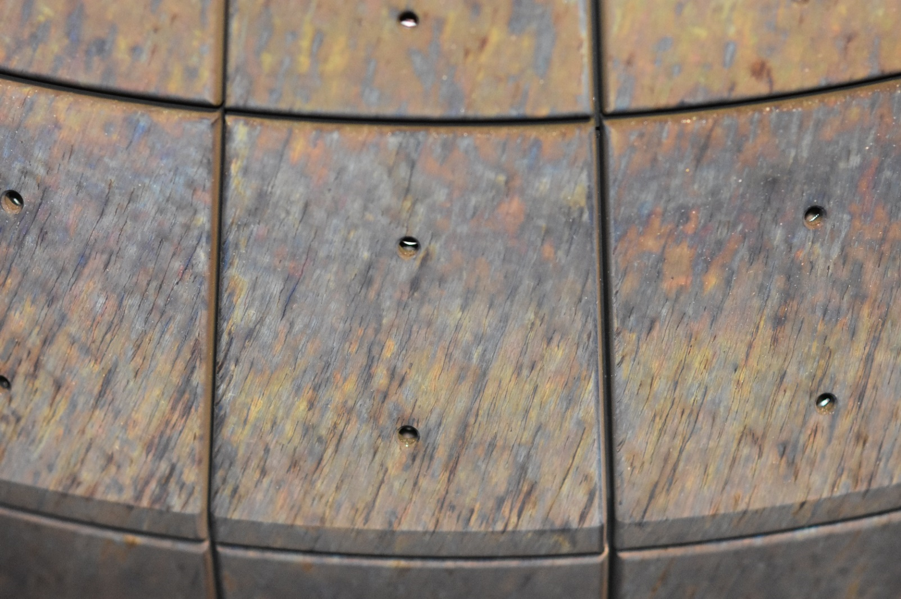
Arc tracks on CS shoulder and divertor tiles
Consistent arcs usually observed during disruptions on fast cameras

Slide 20
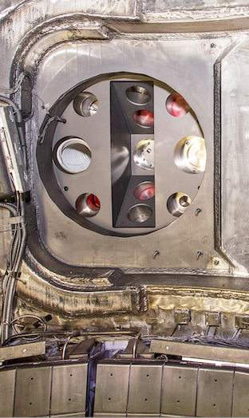
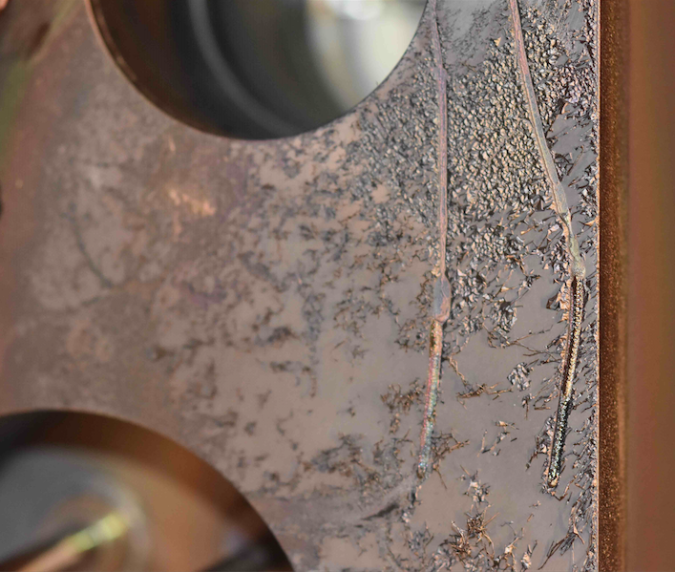
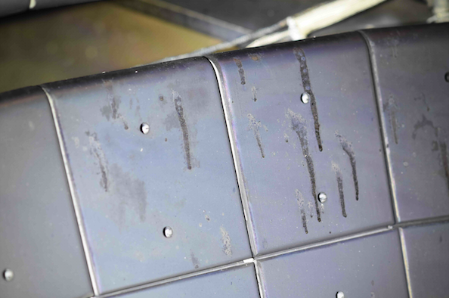
Drips evident on Bay J midplane
Before:
After:
Source ? Leak sealant ?
Remedy ?

Slide 21
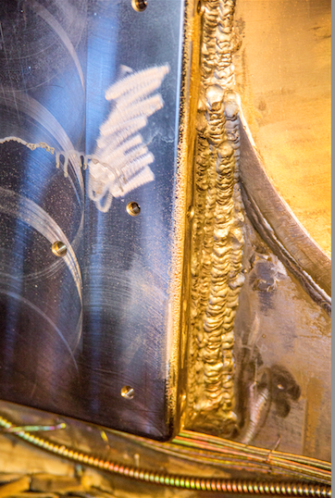
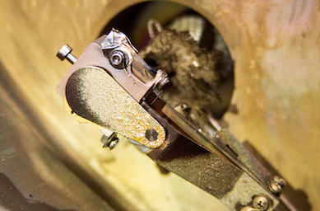
Flaky coating evident on several structures at miplane
Bay L
Bay B QMB shutter
Recommend:
Trials of Aerodag to see if it matches
Restrictions and review of in-vessel surfaces after Aerodag use
Note Bay B QMB developed ground fault and needed to be disconnected during plasma ops
Flaky, greasy like surface found on vessel entry
Related to use of Aerodag?

Slide 22
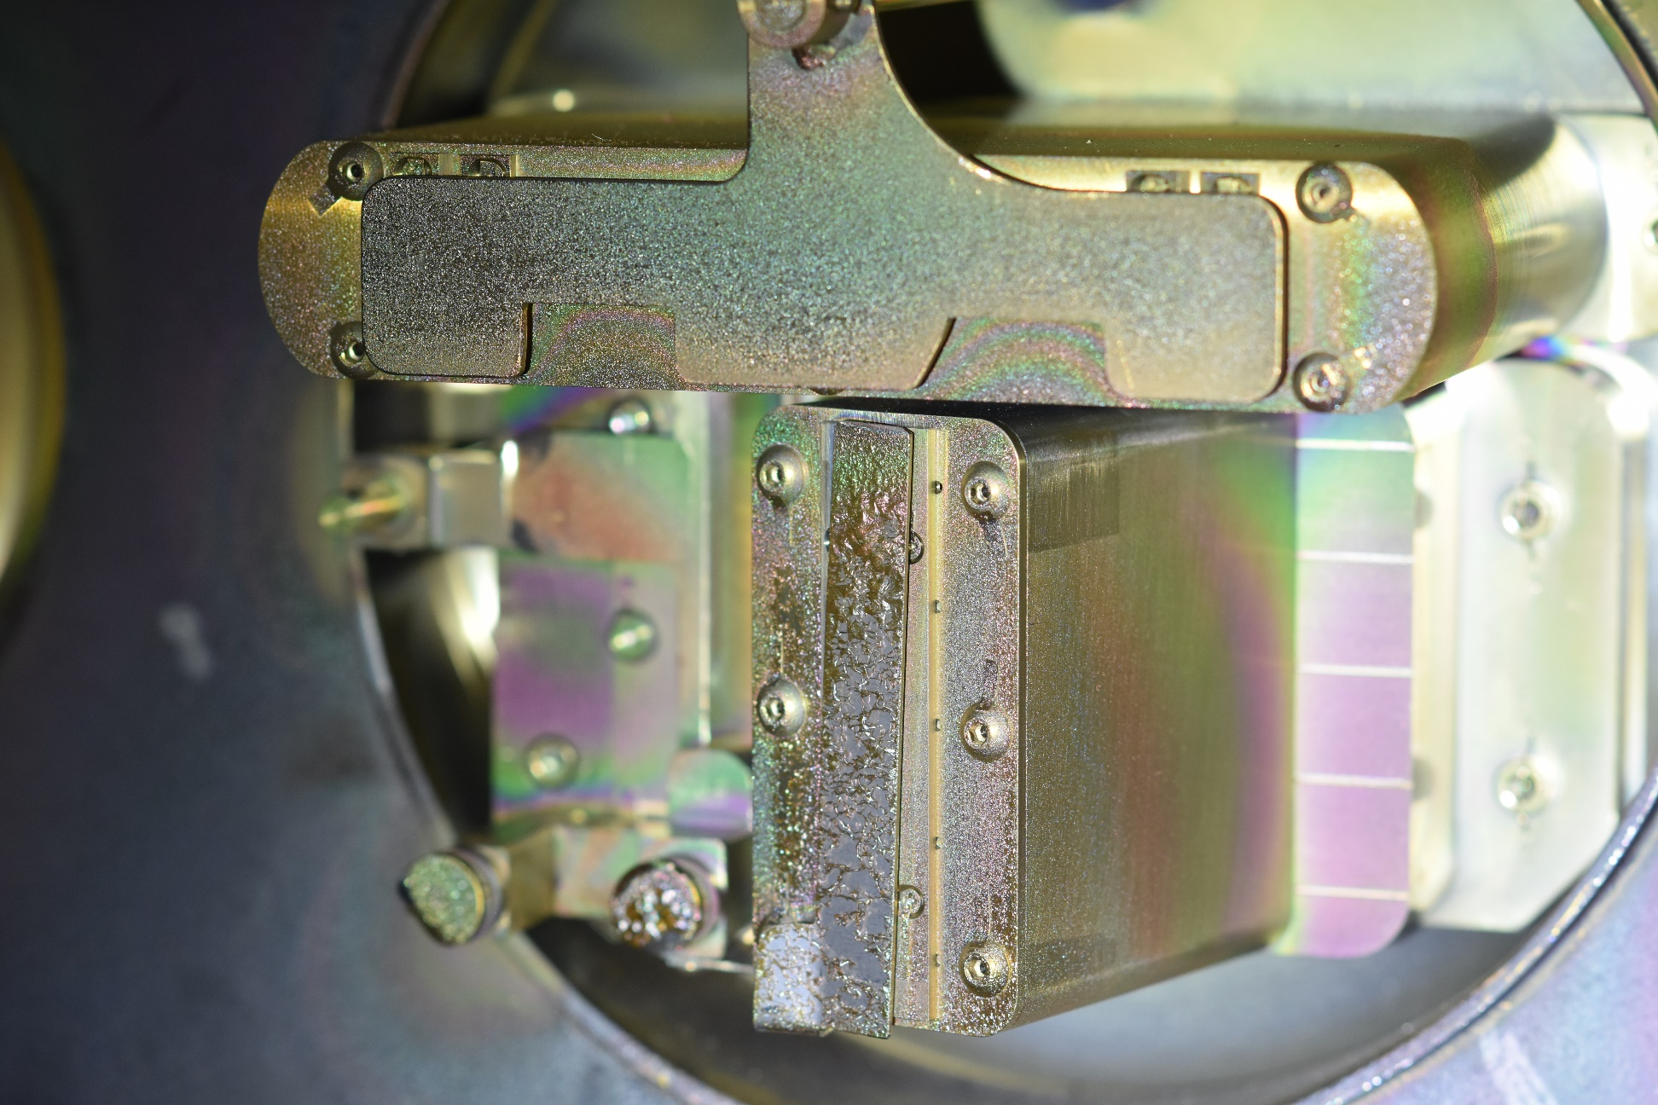
Flaky, ‘greasy’ coating evident on several structures at miplane
ME-SXR shutter
No aerodag used

Slide 23
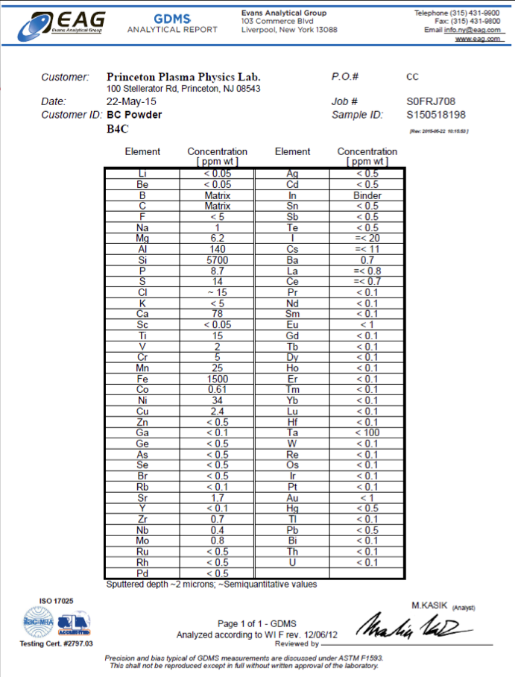
Flaky, ‘greasy’ coating evident on several structures at miplane
Consider Evans East analysis like it was done for IGI granules?

Slide 24
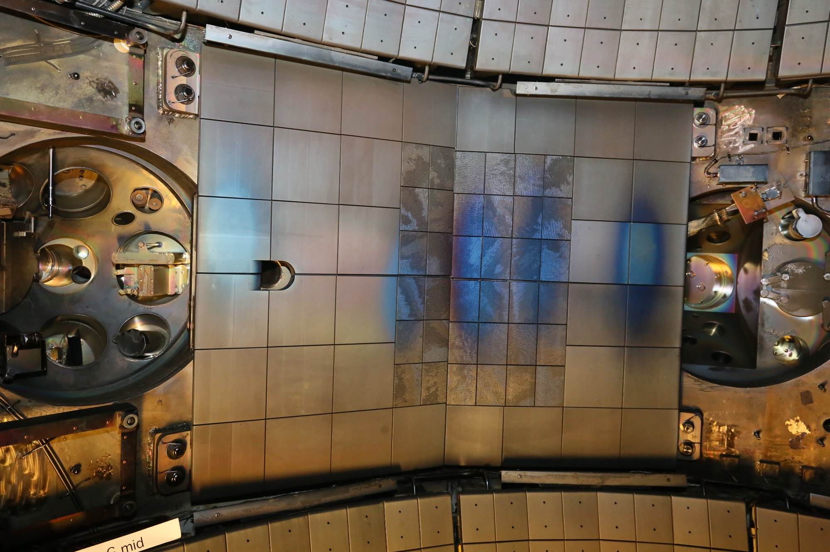
NBI armor

