Slide 1

Navigating the PCS Interface
Devon Battaglia,
Keith Erickson, Dennis Mueller
NSTX-U Physics Operators Training
September 15, 2015

Slide 2
Starting the PCS Interface
Become a member of PCS Unix group
  Submit a ticket to helpdesk
Log in to the real deal when sitting at the P.O. station
  ssh -Y user@pcs-rt-3
  ssh -Y user@pcs-srv-3 (preferred once it is ready)
  Navigate to folder /opt/pcs/INTEL_DIR/
    ./run_wave
Or run stand-alone PCS anywhere
  Set up PCS for future shots or run simulations
  Keith or Roman can help you get this code in your area
  ssh -Y user@pcspool
  Navigate to folder /trunk/INTEL_DIR/
    ./runsa

Slide 3
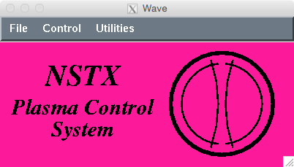
You get the purple box
File
  Version
  Quit
Control
  Next shot
  Future shot
  Shared shot
Utilities
  View PCS log

Slide 4
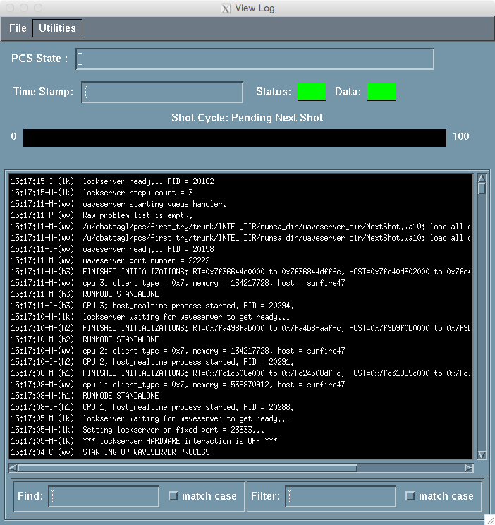
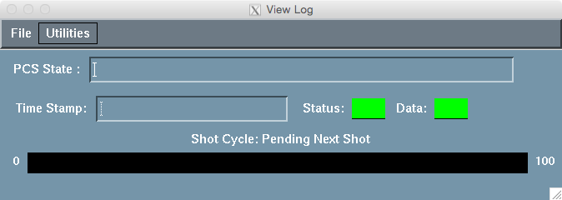
PCS log provides useful feedback on status and communication with realtime system
File
  Quit
Utilities
  Show pcs log messages
  Hide pcs log messages
    This is the default
  PCS process table
    Shows what computers are up
  Show realtime errors only
I like to keep this window open on the desktop

Slide 5
Choose the type of control
Control
  Next shot
    Changes made in GUI are written to the realtime computer
      On pcspool … change parameters for next simulation
      On pcs-rt-3 … change parameters for next shot
  Future shot
    Set up a shot for restoring later
  Shared shot
    Change a future shot made by someone else

Slide 6
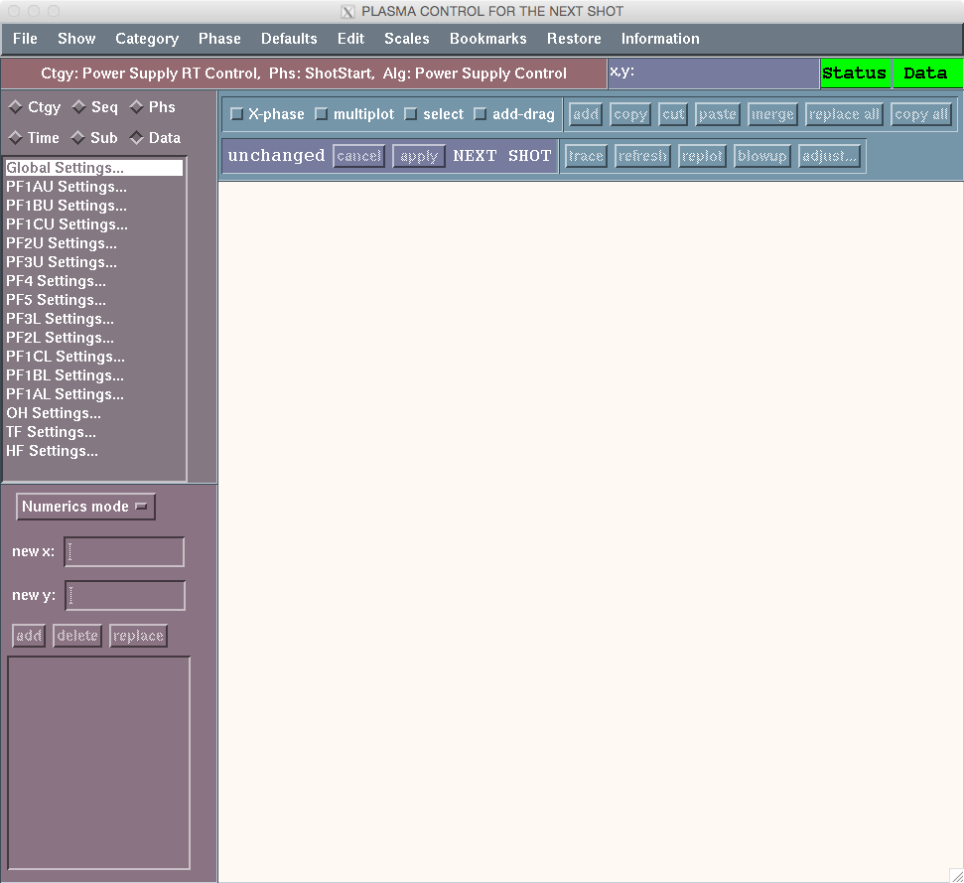
Choosing “Next shot” opens the PCS GUI
Talk will now focus on navigating this window
  But first, let’s take a step back

Slide 7
PCS baseline categories align with control actuators
“Baseline Categories” provide control and/or control switches for a single actuator
Shape
TF Control
Ip/OH Control
RWM Control
Gas Injection
Neutral beam injection
System
Power Supply RT Control (PSRTC)
PLC
138’ level
Protection against out-of-bounds requests from PCS
PF Power supplies
TF Power supplies
OH Power supplies
SPA Power supplies
Gas valves
Neutral beam blocks
Actuators

Slide 8
Upper level categories send requests to baseline categories
Discharge Shape
This is illustrative, not complete and still changing
ISOFLUX
Equilibrium
Snowflake
Profile (DBC)
Vertical Position Control
Density control
Mode ID
TF Control
Ip/OH Control
RWM Control
Gas Injection
Neutral beam injection
System
Power Supply RT Control (PSRTC)
EPICS
138’ level
PF Power supplies
TF Power supplies
OH Power supplies
SPA Power supplies
Gas valves
Neutral beam blocks

Slide 9
Every category has “Algorithms”
TF control has two Algorithms
  TF current control: request TF coil current versus time
  TF rampdown control: ramp TF current from initial value to zero over a specified time interval
Discharge Shape has three Algorithms
  Do Nothing: category is disabled
  Day0: Current control of PF coils
  PCC: Day0 capability plus I_{PF} vs I_{OH}, I_{PF} vs I_{P}, outer gap
    Categories accrue algorithms as new versions come along

Slide 10
Every category has “Phases”
Each phase runs one algorithm with unique parameters
  P.O. can add/delete phases, cannot add/delete algorithms
You could have multiple phases calling the same algorithm but with different control parameters
  Divide pulse into separate experiments where a number of algorithm parameters change
  Or save different settings for an algorithm
    For example “rampdown” and “fast rampdown” in the IP/OH category
Most categories have just one phase for each algorithm
  For example, TF Control category has two Algorithms and Phases
    [Phase] ShotStart = TF current control [Algorithm]
    [Phase] Rampdown = TF rampdown control [Algorithm]

Slide 11
Every category has a “Primary” phase sequence
“Primary” phase sequence sets timing of the phases
  For example, TF Control Primary Phase Sequence:
    T = -5s [Phase] ShotStart = TF current control [Algorithm]
    T = +3s [Phase] Rampdown = TF rampdown control [Algorithm]
Category may also have “Alternate” phase sequences
  P.O. cannot add/delete alternate phase sequences
    P.O. can change the phases in each alternative sequence
  Algorithms switch to these alternate phase sequences
    For example, IP/OH category has two alternate phases that are activated by the IP0 algorithm
      Insufficient Ip: Switch to this sequence if I_{p} is below a threshold
        [Phase] Rampdown = IP1 [Algorithm]
      Ip LOC: Switch to this sequence if OH coil current exceeds bounds
        [Phase] Fast rampdown = IP1 [Algorithm]

Slide 12
Let’s review
PCS control is divided into categories
Every category has a library of algorithms
You create a library of phases
  Each phase uses a single algorithm
You define the timing of phases in the Primary phase sequence
  You also define the timing of phases in any Alternative (dynamic) phase sequences

Slide 13
The main task of a P.O. is to change the input parameters for control algorithms
Inputs to algorithms are organized into subsets
  [Cat] TF Control, [Phase] ShotStart, [Alg] TF current control
    Coil Current
      TF Coil Current
    TF gains
      TF Gain, P
      TF Gain, I
    Rampdown Info
      Automatic Rampdown
      Ip Rampdown Threshold
Subset
Waveform, table or GUI
We aim to have specs for each algorithm

Slide 14
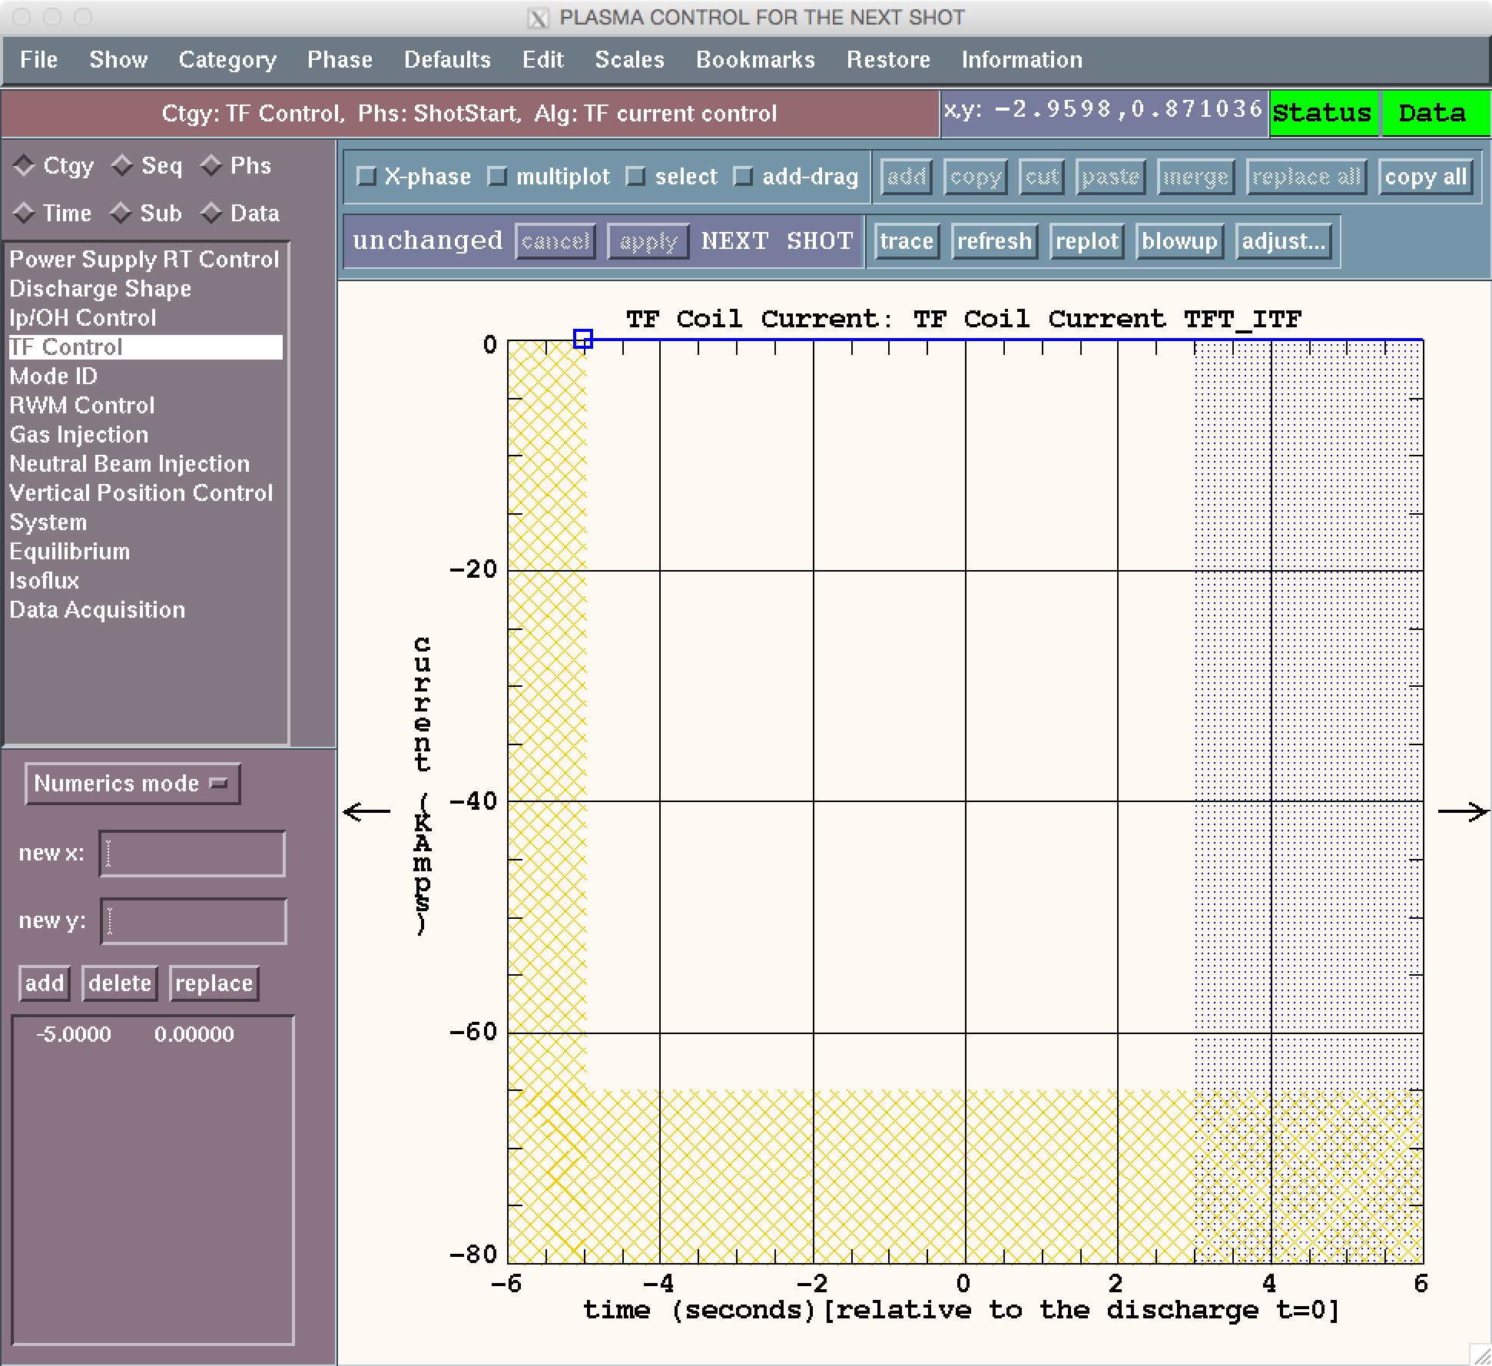
Let’s begin the tour
Open a category:
Select from Category menu
--- or ---
Click Ctgy radio button and select from menu

Slide 15
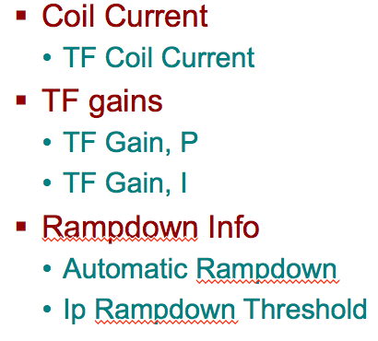
Selecting a category
I have selected “TF Control”
Category
Now we see the first waveform in the first subset of the algorithm in the first phase of the primary sequence

Slide 16
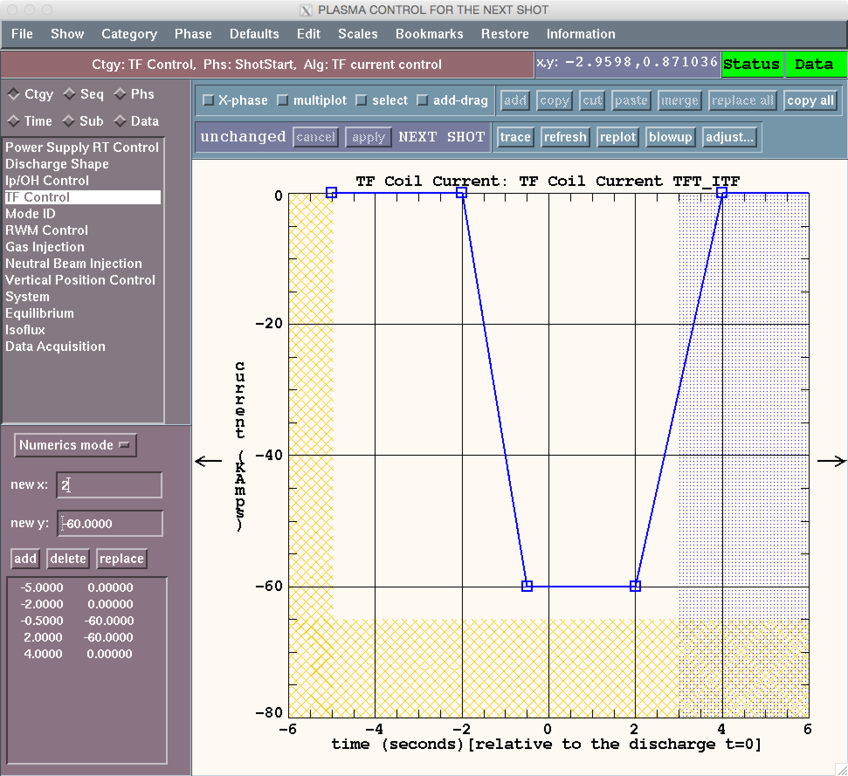
Enter a waveform
You can…
Draw in points
Type in points
Restore points
… more on this later
Yellow: bounds
Blue: switch to new phase

Slide 17
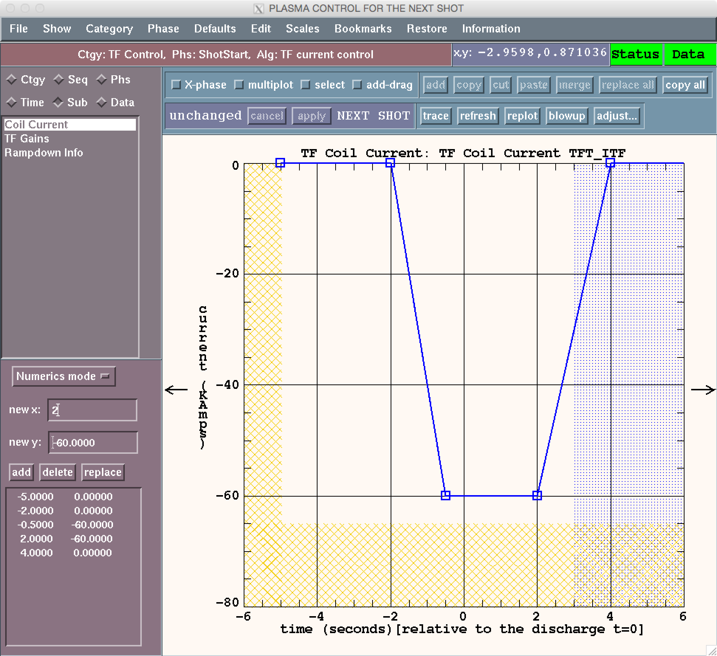
Navigate to a new waveform
Select Sub radio button
Subsets appear in menu window

Slide 18
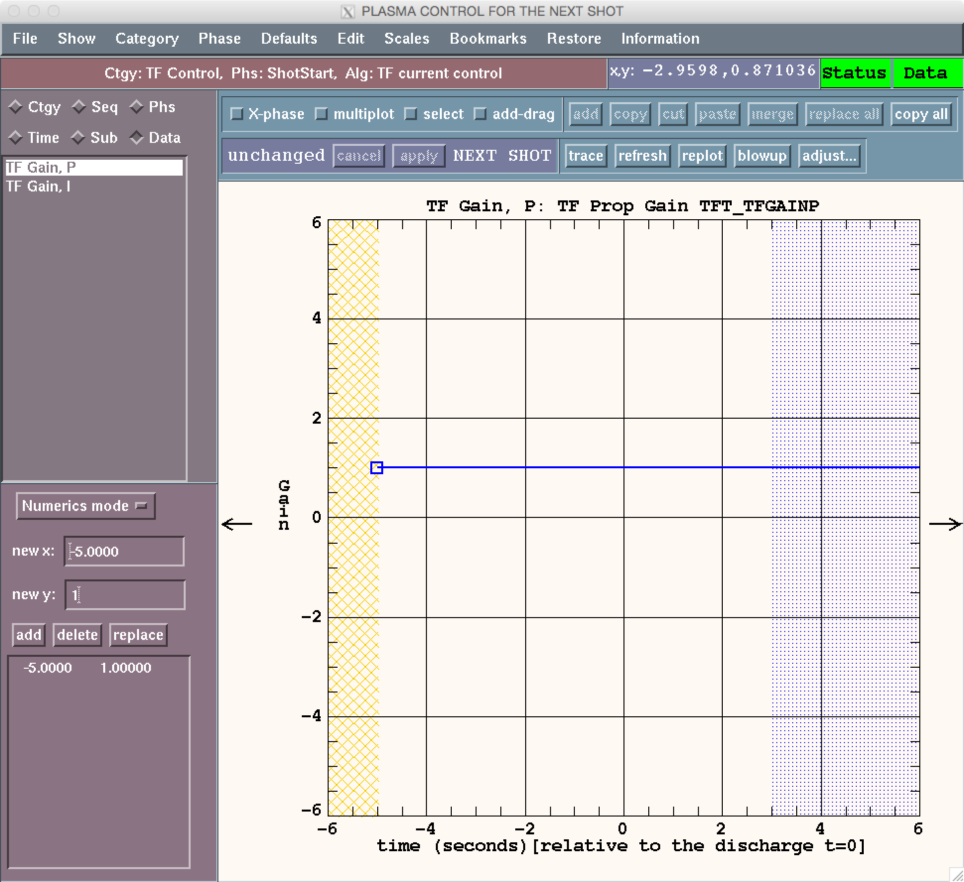
Enter values for a new waveform
I selected TF Gains subset
Now editing TF proportional gain

Slide 19
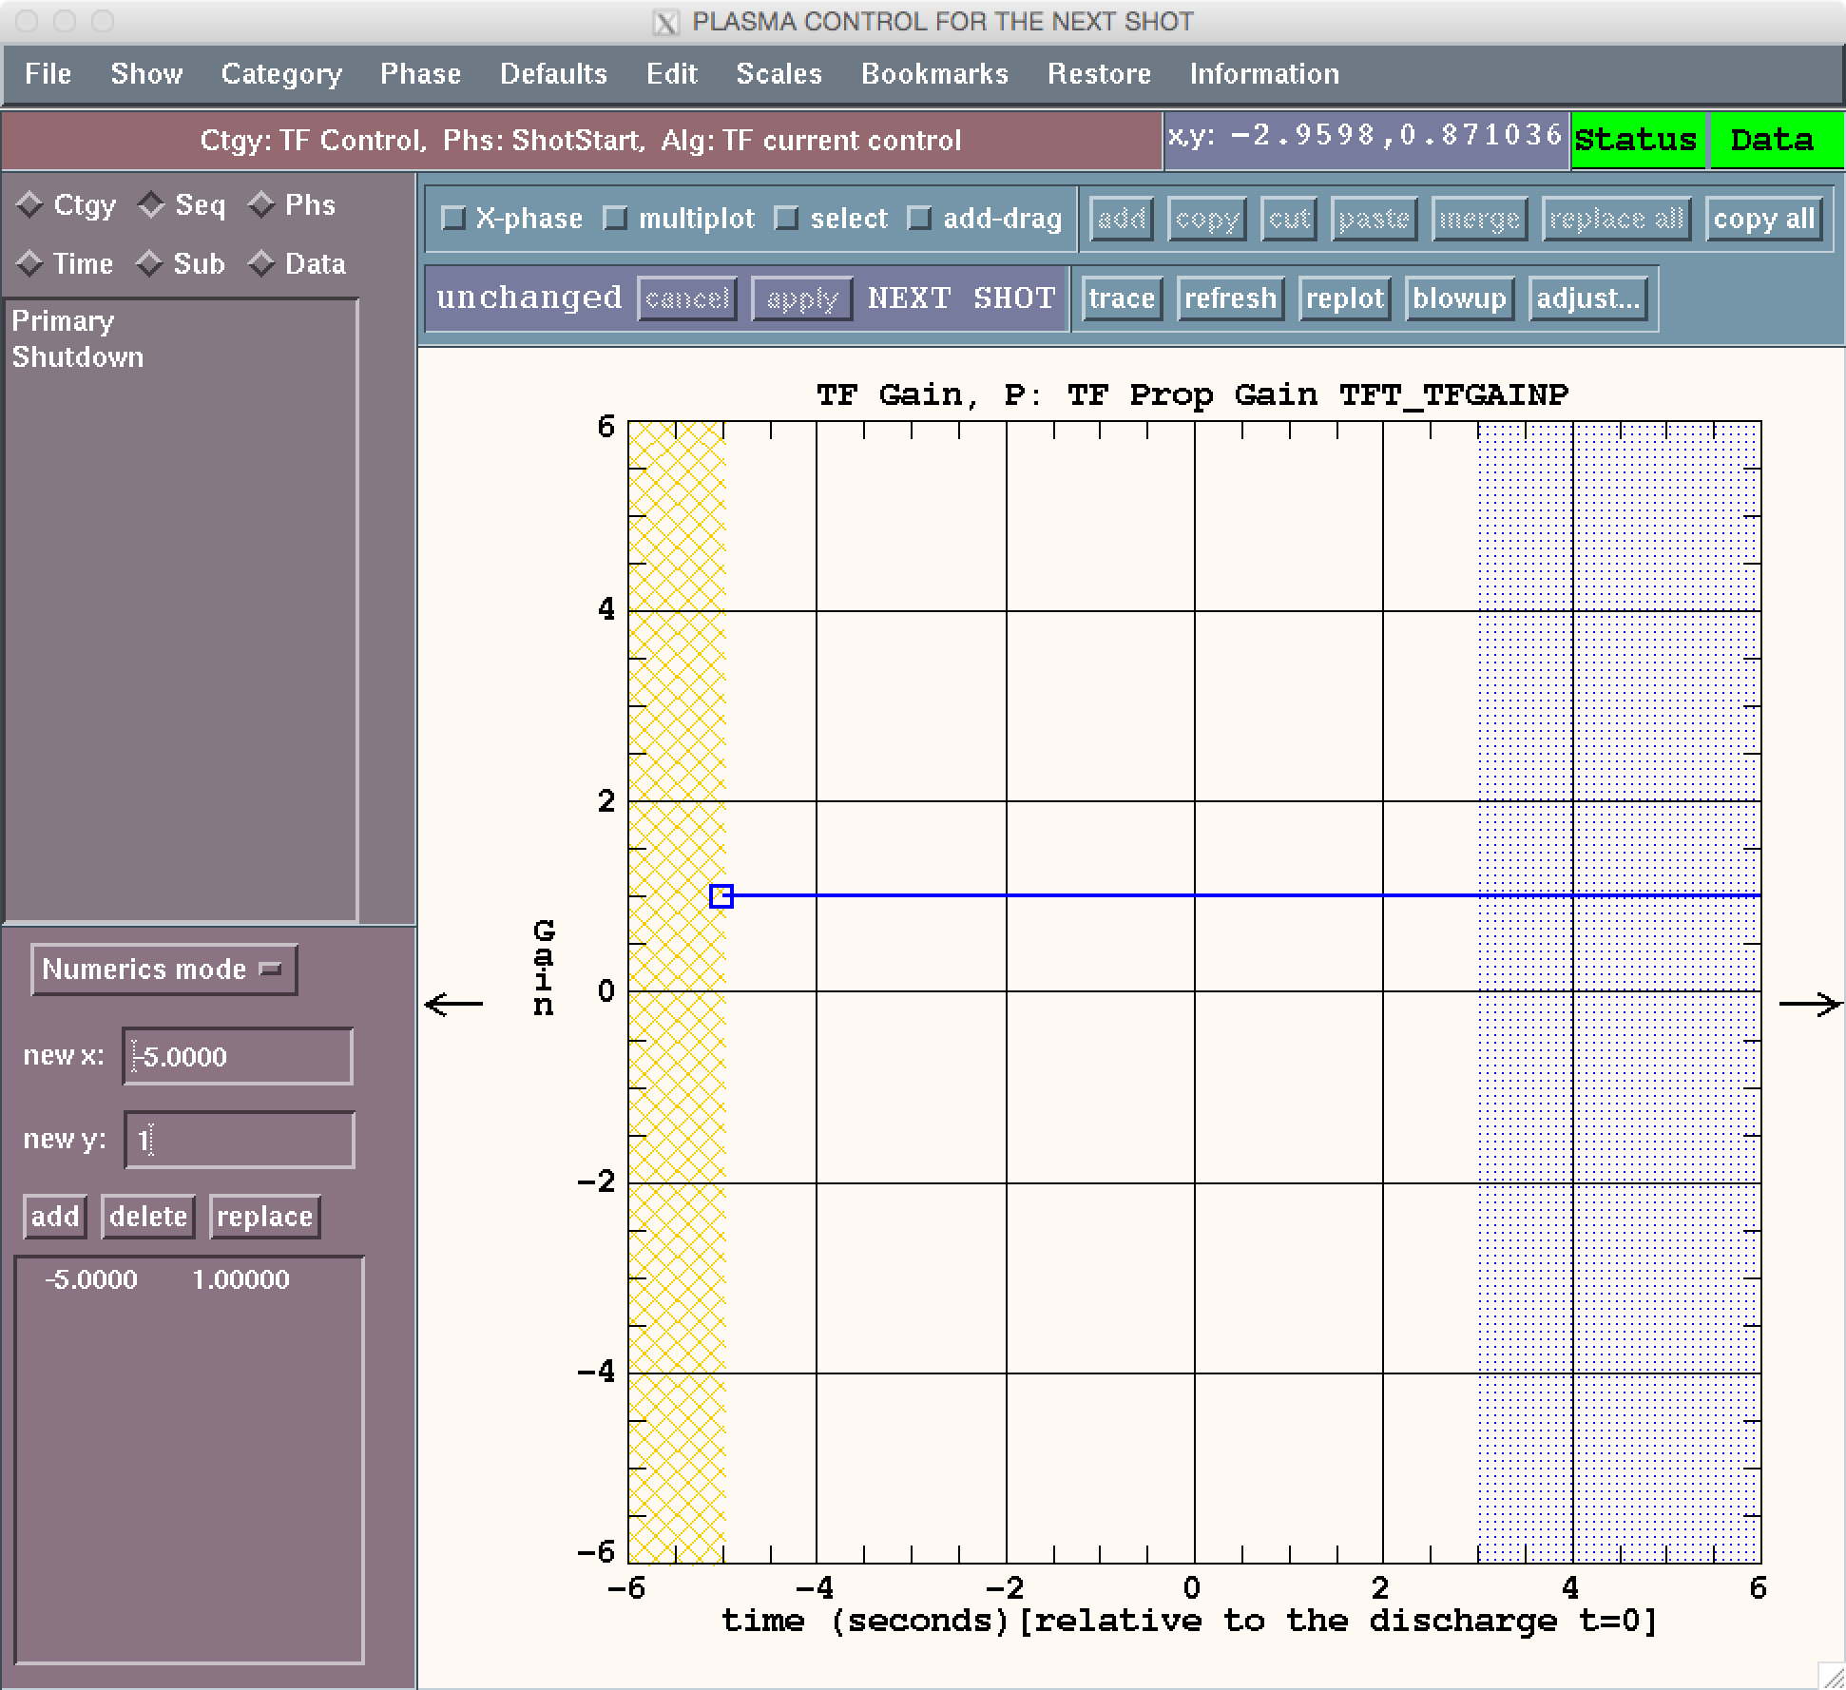
Navigate to Phase sequence
Select the “Seq” radio button

Slide 20
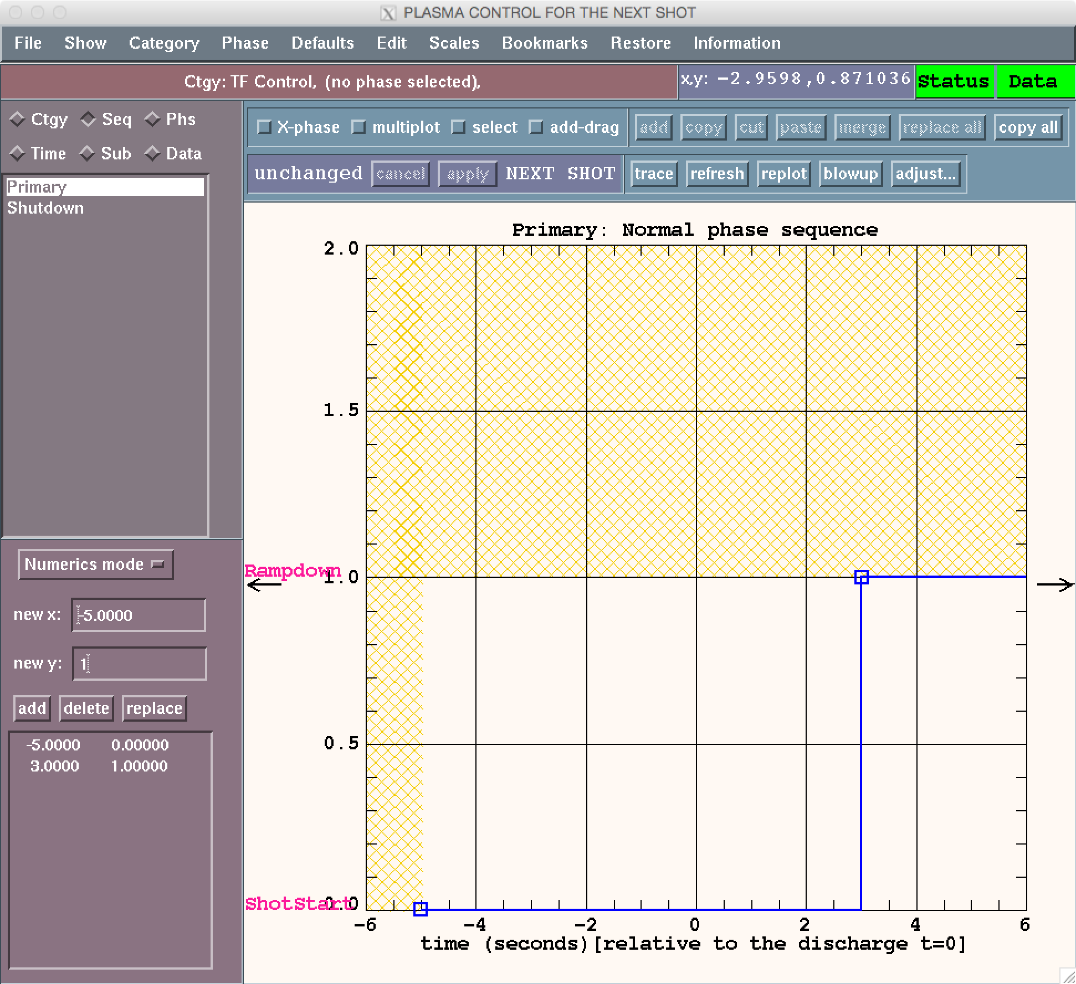
Primary sequence describes order and timing of phases within category
You can add/delete phases in the category using the phase menu
The waveform describes timing of phase switching
TF category has one alternative sequence called Shutdown.
It is called if
Ip < threshold

Slide 21
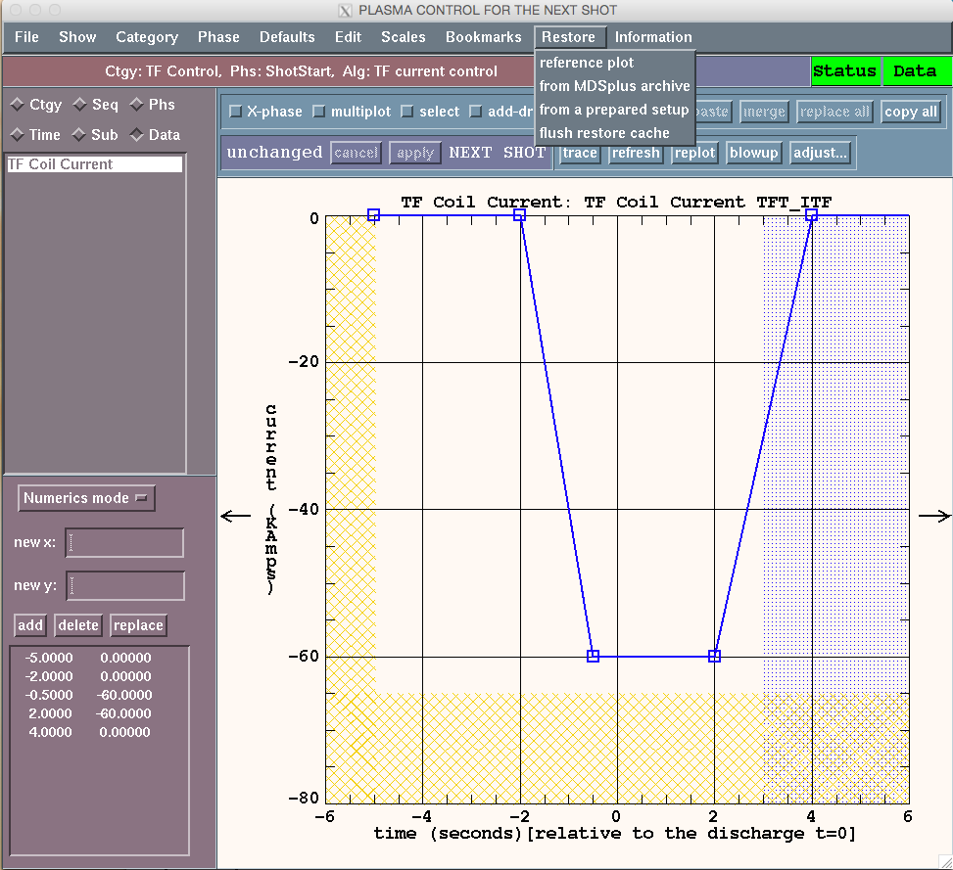
Restoring data from older shots or prepared shots is a common activity
Restore menu
  Reference plot
    Plot data from a shot to compare
  MDS archive
    Restore data from an old shot
  Prepared setup
    Restore data from a future shot
  Flush cache

Slide 22
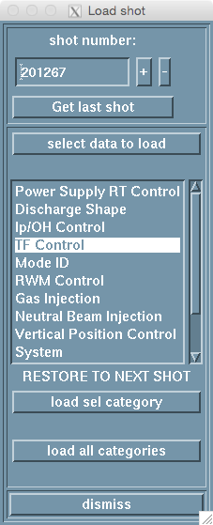
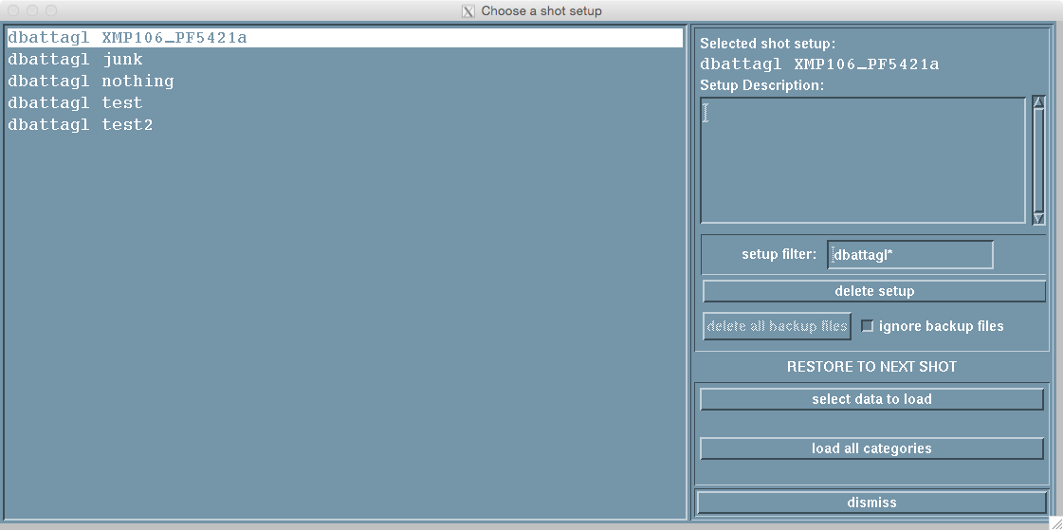
Loading data from an old shot or prepared setup
Load data from shot
Load data from a prepared setup
Load all categories: Reload everything it can
Load sel category: Just reload selected category
Select data to load: Opens a new window

Slide 23
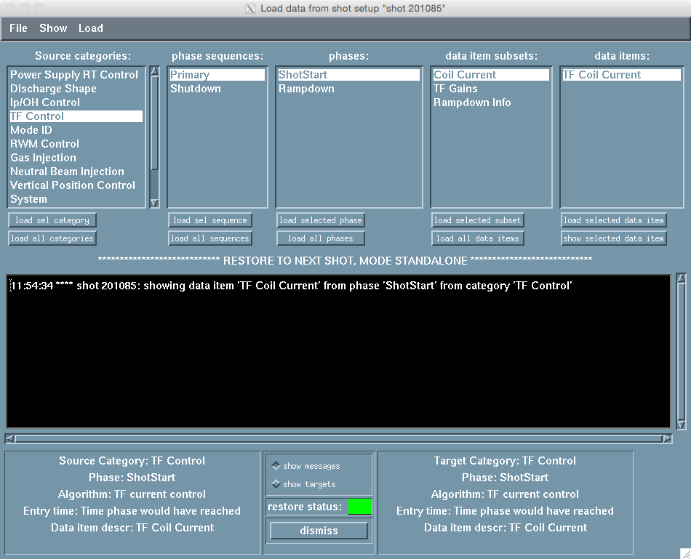
“Select data to load” gives full control over what to load and where
Load selected data item
  Loads that data item from the source
Show selected data item
  Plots that data item for comparison

Slide 24
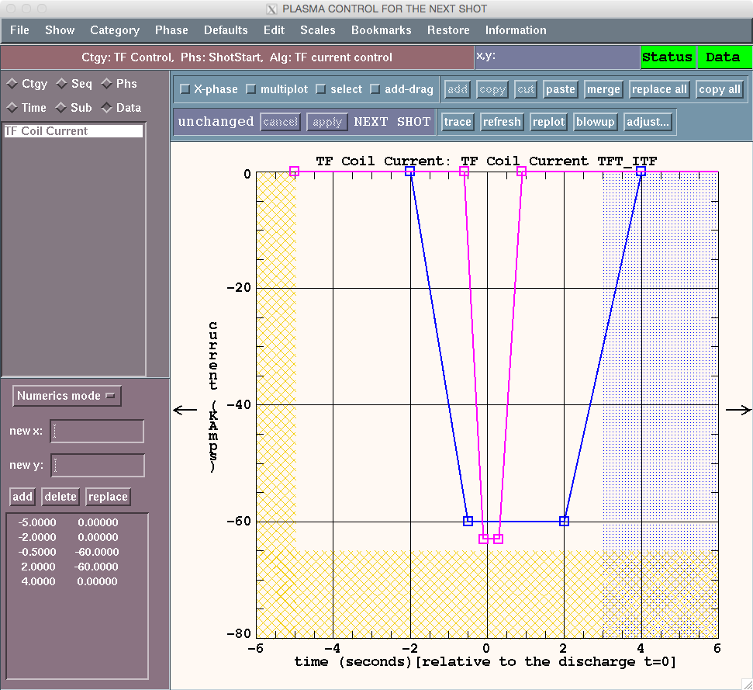
Using “Show selected data item” before restore is good practice
Comparing the TF current request waveform (blue) to the TF request for shot 201085 (pink)

Slide 25
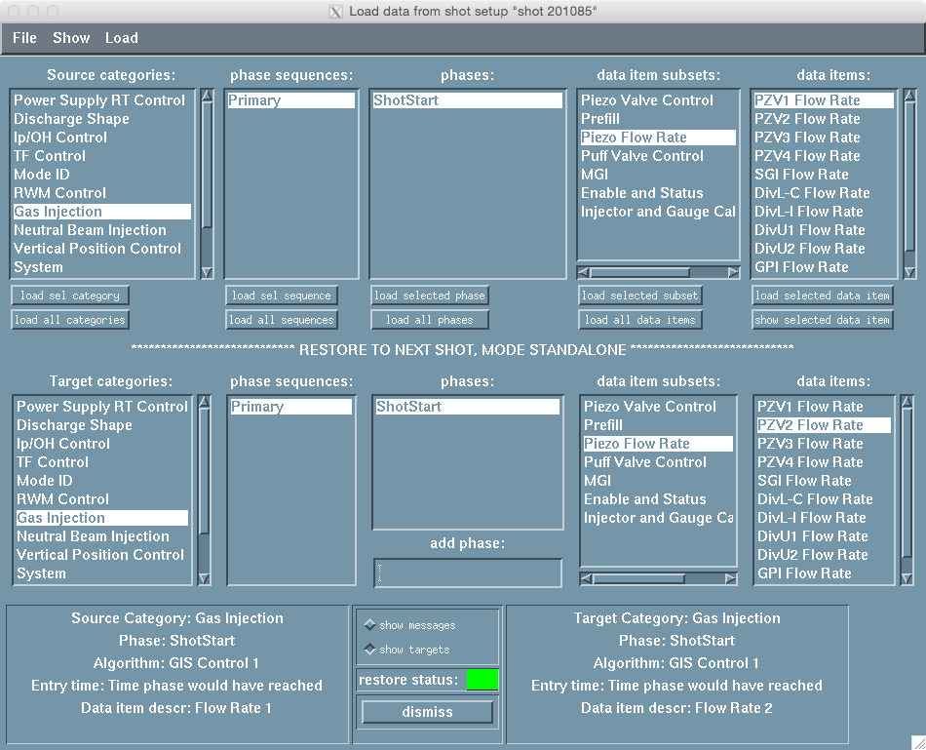
Load a data item into a target with a different name
The radio button “show targets” is selected
Loading the PZV1 Flow Rate from shot 201085 into PZV2 Flow rate for the next shot

Slide 26
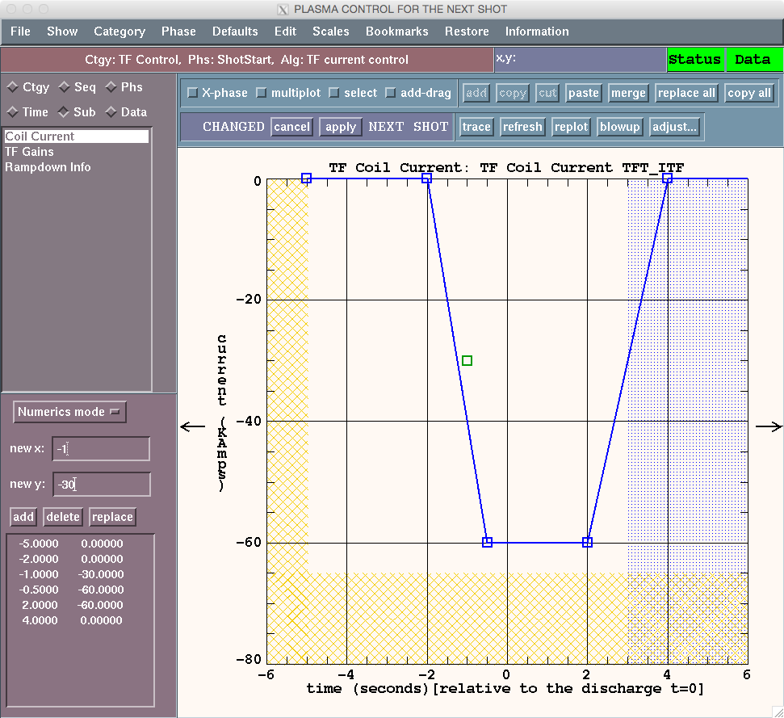
Changing a waveform
A point is added by entering the new x and new y coordinates and pressing “add”
THE CHANGE IS NOT MADE UNTIL YOU PRESS APPLY

Slide 27

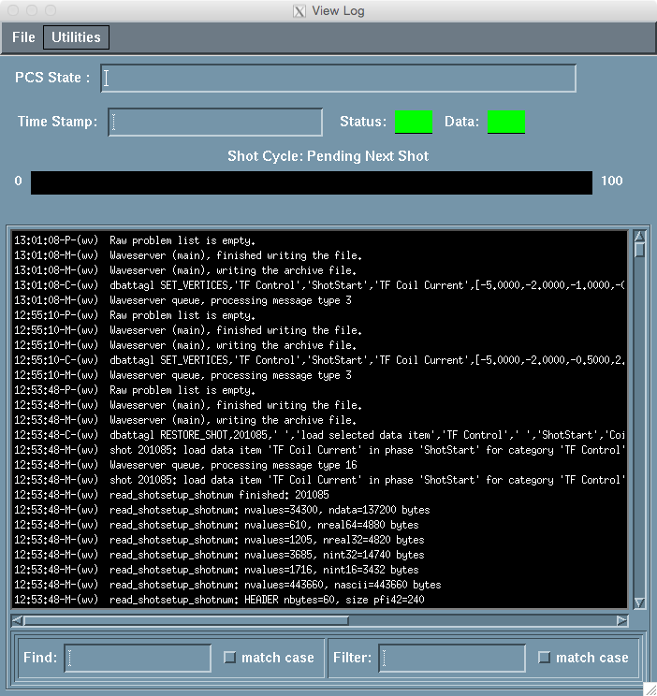
Press apply and the change is made
You have until first lockout (t = -60s in countdown)
to APPLY changes

Slide 28
Entering and manipulating waveforms is best learned on the job
Mouse control lets you select points, add points, delete points, pan and zoom
There is a clipboard for cutting, copying and pasting
Scale or shift selected points
Overplot references, proposed changes
Load points from a text file or use a function generator

Slide 29
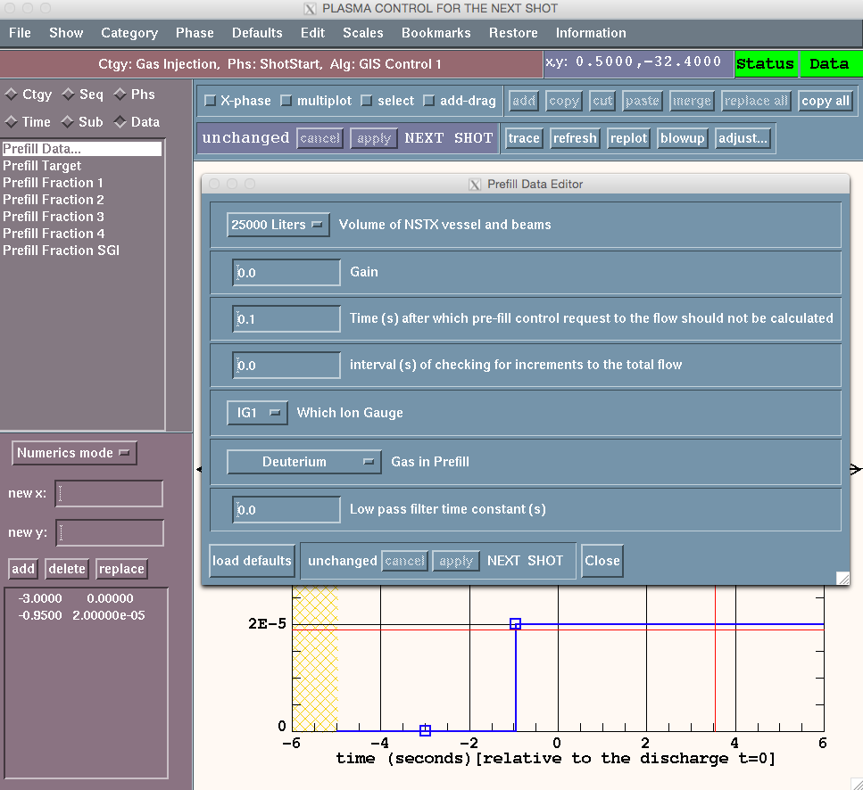
Some data items are GUIs instead of waveforms
GUIs are indicated with “…” in the list of data items within a algorithm subset
GUI could have a mix of menus, radio buttons, sliders and single number parameters
Don’t forget to hit APPLY!

Slide 30
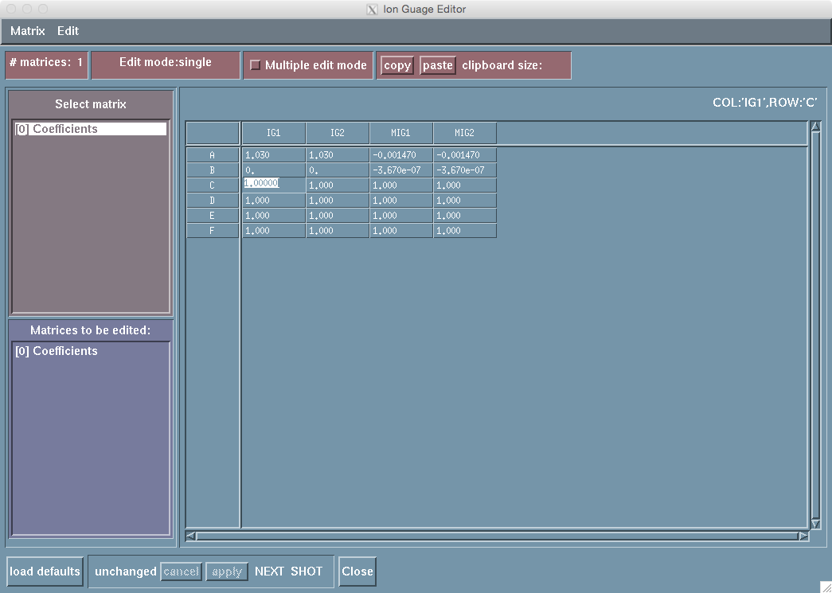
GUIs can also be tables
Multiple versions of the table can exist (a waveform is used to select which table to use)
You can edit the same cell in multiple tables
Don’t forget to hit APPLY!

Slide 31
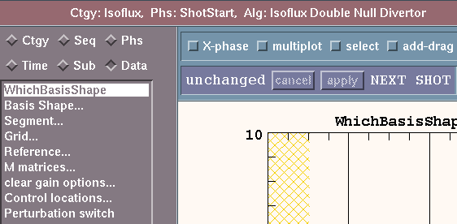
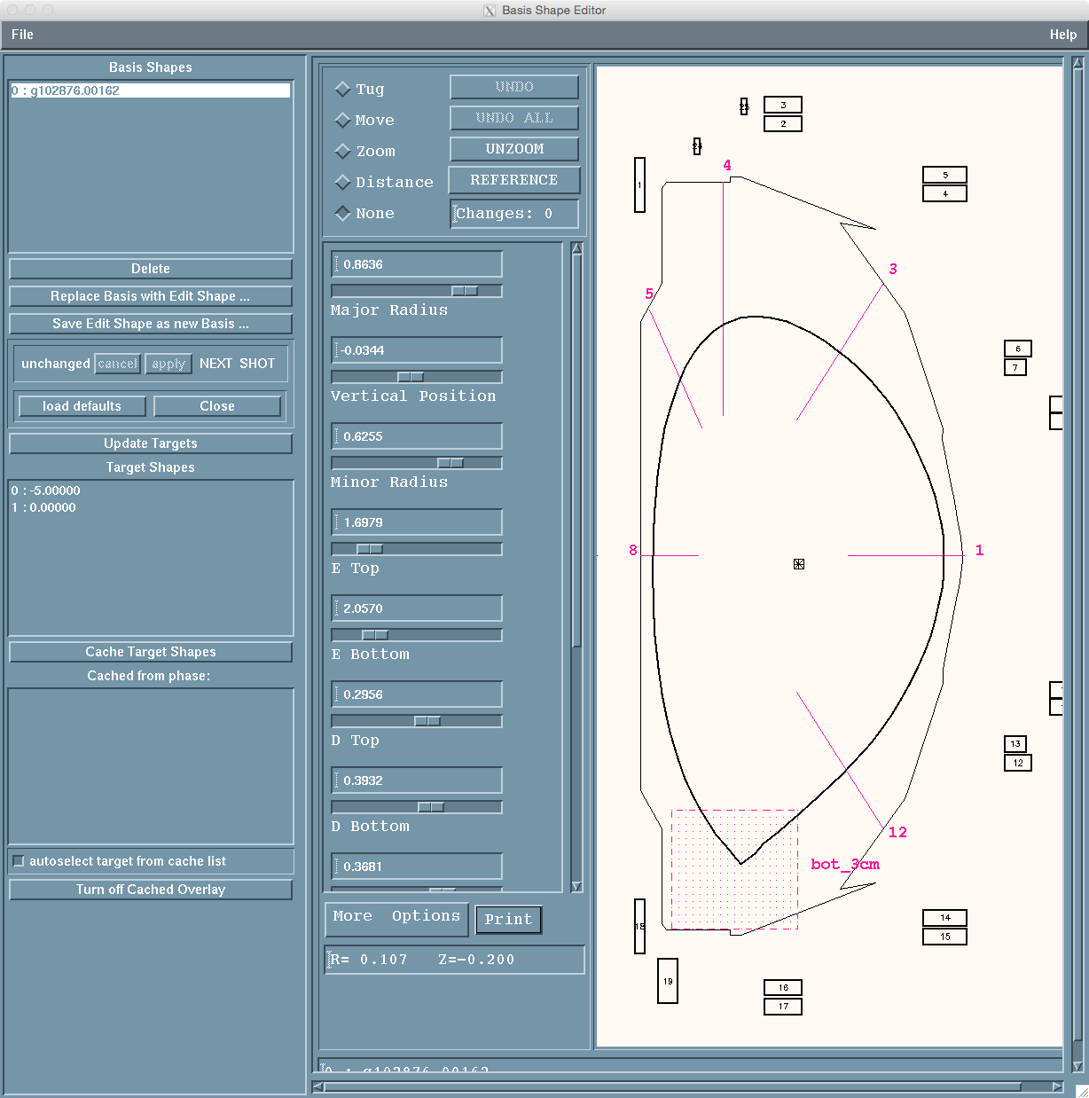
The ISOFLUX GUIs deserve a separate talk

Slide 32
Indicators on the PCS GUI
Note the title of the window. You could have multiple “Next shot” and “Future shot” GUIs open
Data light:
Green means all GUI parameters are in a valid configuration
Status light:
Green means computer systems are running
Shot will not run if either light is red

Slide 33
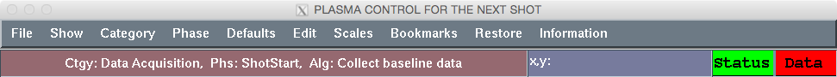
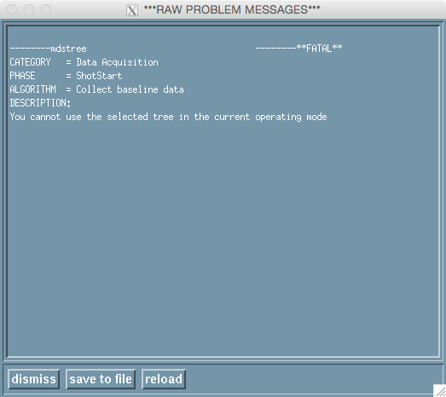
If you get a red or yellow Data light …
Go to “Information” > “Raw data problems”
  Window shows the issue(s)
  Most likely to occur when restoring a shot

Slide 34
Start exploring the PCS GUI
Get in the PCS Unix group
Get the stand-alone PCS software
Refer to:
  PCS programmers manual:
  http://nstx.pppl.gov/nstx/controls/pcs/PCS_doc/master.pdf
  NSTX-U PCS specs in the NSTX PCS shared google folder
Read the specs and navigate through the categories
  Practice changing things
  Ask questions

Slide 35
Summary
PCS software is divided into Categories
  Each category has a library of control algorithms
The PCS interface is used to set the sequence of phases where each phase runs a single algorithm
Each algorithm has waveforms and GUIs that can be edited using the PCS interface
Dennis: “With power and flexibility comes complexity”
  With time and practice, it all makes sense

