Slide 1

3D Fields: Detection and Application
Stefan Gerhardt, Eric Fredrickson, Clayton Myers, Steve Sabbagh, Weiguo Que
Phys. Ops. Course 2015

Slide 2
Topics
Motivation for low-frequency 3-D field sensors and coils.
Application of low-frequency 3D fields
Detection of low-frequency 3D fields
Determination of the currents in the RWM coils
High-frequency rotating MHD detection.

Slide 3
Topics
Motivation for low-frequency 3-D field sensors and coils.
Application of low-frequency 3D fields
Detection of low-frequency 3D fields
Determination of the currents in the RWM coils
High-frequency rotating MHD detection.

Slide 4
Why Do We Have 3-D Field Detection and Application?
(I)
Deliberately apply fields as perturbations:
  Locked mode thresholds vs. density, field,…
  Magnetic braking to study “stuff” as a function of rotation.
  (N)RMP for modifications to pedestal transport & ELM suppression.
    or ELM triggering.
  Strike-point splitting, 3-D effects on divertor loading, “homoclinic tangles”

Slide 5
Why Do We Have 3-D Field Detection and Application?
(II)
Control of Error Fields
  Small non-axisymmetries in machine construction lead to error fields.
  Plasma can amplify the error field (RFA), causing their effect to become stronger….effect is stronger at higher β.
  Detect the amplified error field and suppress it with feedback
    Called “dynamic error field correction” (DEFC).

Slide 6
Why Do We Have 3-D Field Detection and Application?
(III)
Suppression of Resistive Wall Modes.
  RWM=external kink instability modified by the resistive wall.
    Both pressure and current driven kinks can become RWMs.
  Grows on the scale of the wall time=L/R time for dominant eddy current patterns. (~2-5 msec).
  Detect and suppress it.
    Call this “fast” n=1 feedback.

Slide 7
Why Do We Have 3-D Field Detection and Application?
(IV)
Kink, Tearing, *AE
  These show up as rapidly rotating/varying 3D perturbations.
    5 kHz -> 1s of MHz
  Can only be detected with sensors inside the vessel
  Tearing modes and kinks can degrade thermal confinement, stop the plasma rotation, modify the fast ion confinement and current drive.
  Bursting TAE modes can eject (or steal energy from) fast ions, changing beam current drive.
  GAE/CAE modes lead to PRLs.

Slide 8
Topics
Motivation for low-frequency 3-D field sensors and coils.
Application of low-frequency 3D fields
Detection of low-frequency 3D fields
Determination of the currents in the RWM coils
High-frequency rotating MHD detection.

Slide 9
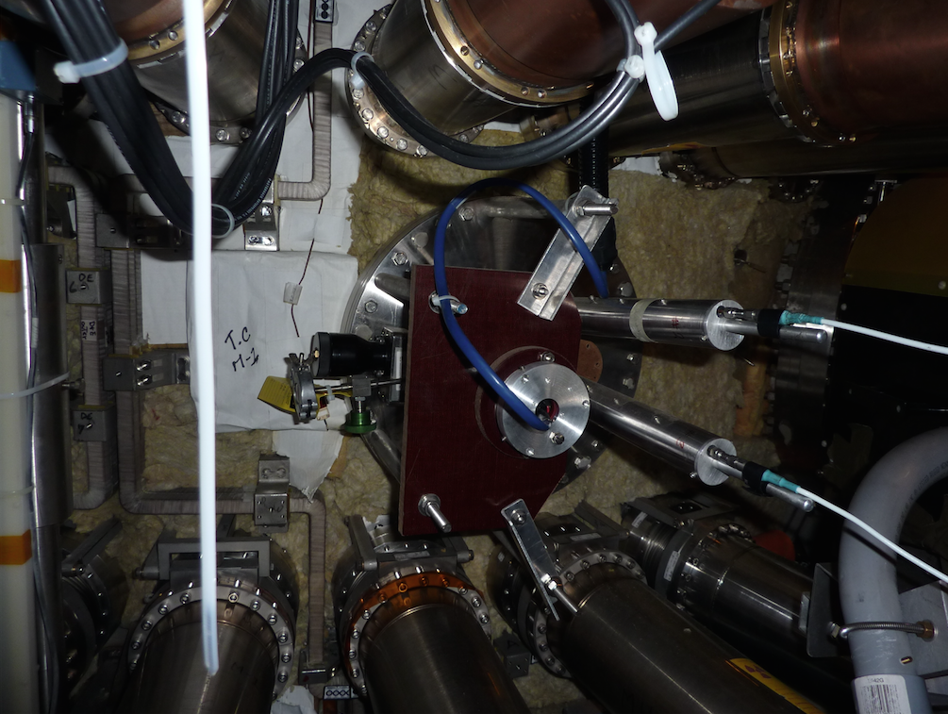
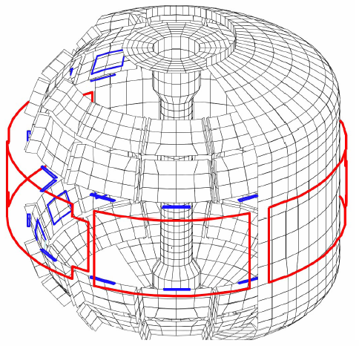
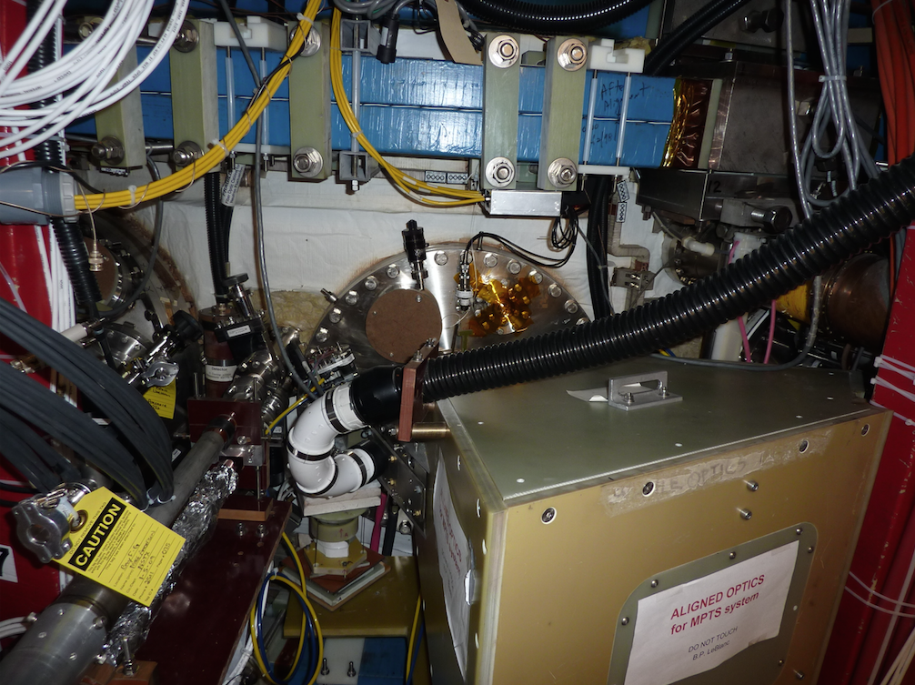
3D Fields Are Applied by the RWM Coils
6 ex-vessel midplane control coils
VALEN Model of NSTX (Columbia Univ.)

Slide 10
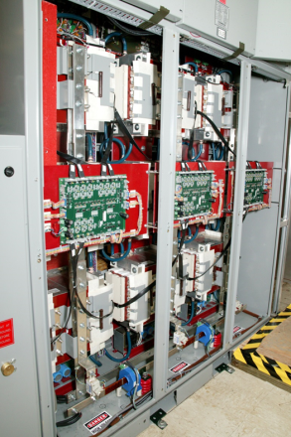
RWM Coil Current is Provided by the SPAs
SPAs are H-bridge power Supplies
  Capacitor bank is a constant voltage
  If G1 and G4 conduct, then load voltage is one polarity
  If G2 and G3 conduct, load voltage has the other polarity.
  Rapidly switch which IGBT conduct. This leads to regulation of the current.
We rely on the on-board controller, and only issue a current request to the SPA.
SPA cap bank is charged by “HF Supply”
  If HF supply doesn’t work, then neither will the SPAs

Slide 11
Previously:
Each SPA in Connected To Two RWM Coils
Bay L
Bay A
1
I_{P}
RWM/EF coil #
6
SPA 1
2
5
SPA 3
3
SPA 2
4

Slide 12
Now:
Each SPA in Connected To a Single RWM Coil
Bay L
Bay A
1
RWM/EF coil #
SPA 1
I_{P}
Positive SPA current makes:
Field flowing CW in the RWM coil as you face the coil.
This makes field pointing into the vessel
6
SPA 2
2
SPA 6
SPA 5
SPA 3
5
B_{T}
3
SPA 4
4

Slide 13
More on Signal Polarities
Positive SPA supply current makes current flowing clockwise when viewed from outside NSTX-U.
  This makes field that points into the vessel.
  Hence, positive supply current makes field pointing into the vessel.
The PCS requests are always supply current.
  So a positive PCS request will make field pointing into the vessel for the associated coil.
  This is a bit different than for the PF/TF coils, where the requests are the coil current.
The SPA currents are recorded multiple ways.
  \pc_spa_SUX_IY, X={1:6} & Y={1:2}, are the 2 DCCTs on the SPAs themselves. They have the polarity of the supply current.
  The \IRWMX, X={1:6} are the subunit currents mapped to the coils and corrected for signs so that positive current corresponds to positive radial field.
  The \RWMX_I, X={1:6}, are current measurements on the coil leads, but with the engineering convention.
    Positive values correspond to clockwise currents and inward pointing field

Slide 14
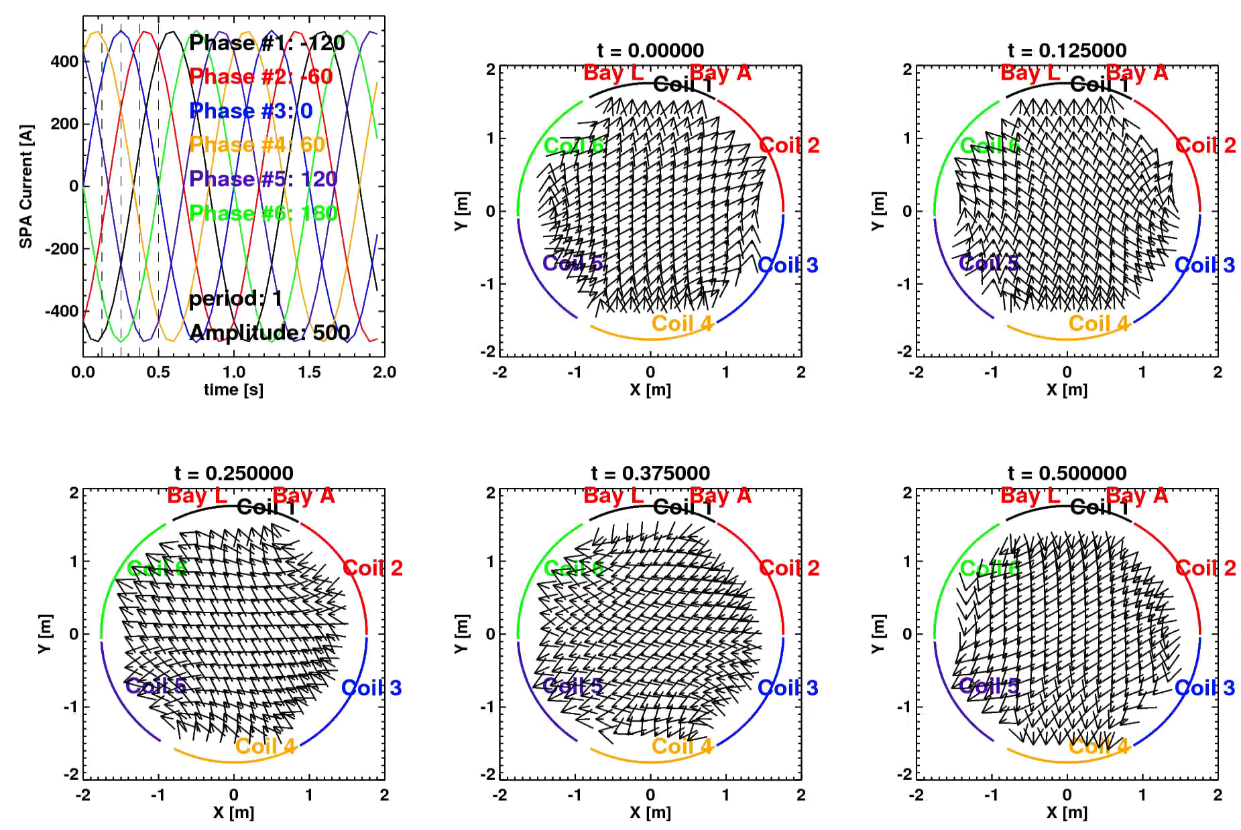
Typical Application is to Make n=1 Traveling Waves

Slide 15
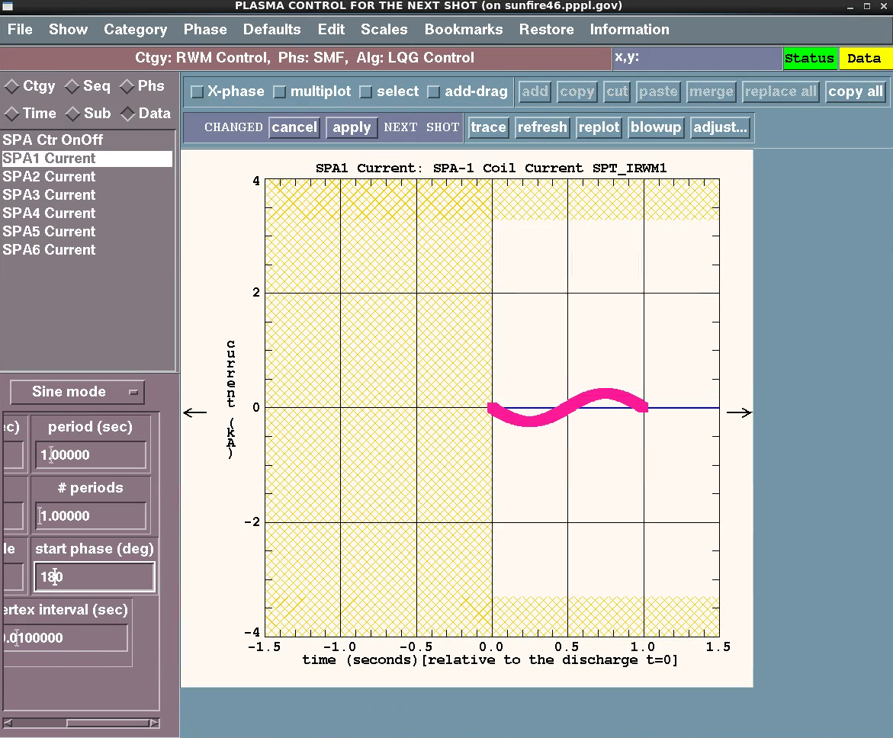
You Will Use the PCS Waveform Generator Function to Produce Traveling Waves
PCS Sine Wave Generator
Determined by Parameters
1: offset,
2: amp,
3: period [seconds],
4: # of periods,
5: start phase [degrees]}
Or
[Y_{DC},Y_{amp},T_{cycle}, # of periods, φ_{start}]
I_{SPA}=Y_{DC}+Y_{AMP}sin(2πt/T_{cycle} + πφ_{start}/180))
XP authors/forms should know exactly the parameters to get the correct traveling wave

Slide 16
Topics
Motivation for low-frequency 3-D field sensors and coils.
Application of low-frequency 3D fields
Detection of low-frequency 3D fields
Determination of the currents in the RWM coils
High-frequency rotating MHD detection.

Slide 17
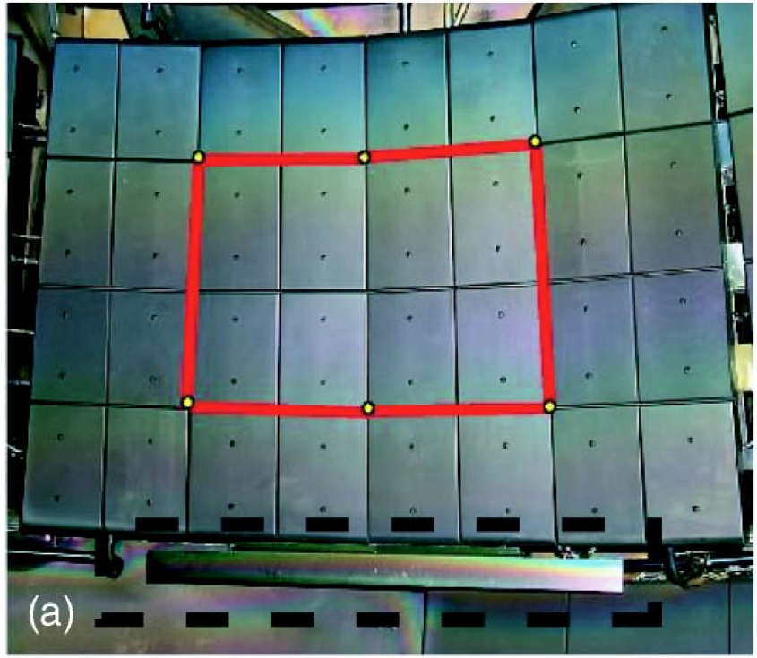
NSTX-U has Off-Midplane Internal 3D Field Sensors
Copper passive
conductor plates
SS Vacuum
Vessel
Sontag et al., Physics of Plasmas 12 056112 (2005)
B_{R}
B_{P} sensor
B_{P} Sensor in a Stainless Box
6 ex-vessel midplane control coils
B_{R} sensor is a loop behind the tiles, but in front of the plate.
VALEN Model of NSTX (Columbia Univ.)

Slide 18
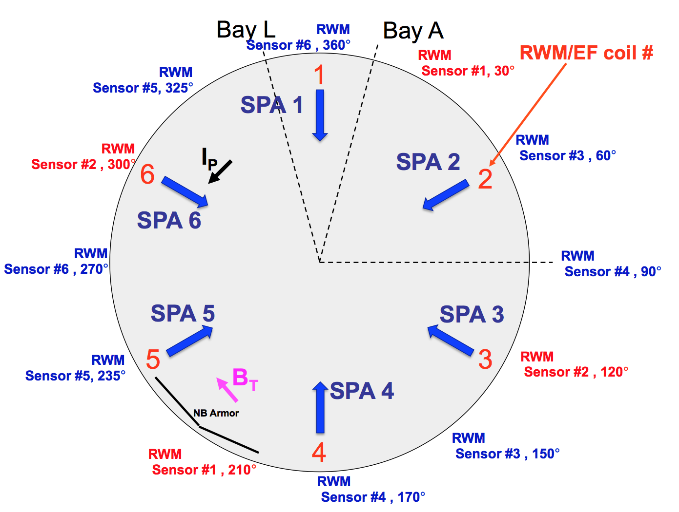
We Actually Integrate Sensor Sums and Differences

Slide 19
PCS Signal Compensation For RWM Coils
Any given sensor detects the field from the plasma perturbation, plus other sources.
  “Other sources” include direct coil pickup, eddy currents.
Subtract non-plasma pickup from each signal.
Many coefficients involved, all in model tree.
AC Compensation For Fluctuating RWM Coil Currents
Eddy currents driven by RWM coils make fields…subtract these out.
Static
Direct pickup between coil and sensor. P_{i,j} are mutual inductances
816 Coefficients
504 Coefficients
Final Field For Plasma Mode Identification
In ACQ
In the modeID category

Slide 20
Topics
Motivation for low-frequency 3-D field sensors and coils.
Application of low-frequency 3D fields
Detection of low-frequency 3D fields
Determination of the currents in the RWM coils
High-frequency rotating MHD detection.

Slide 21
Overall Scheme for Control
Data from 48 RWM Sensors
Comes in on FPDP Stream
Combine signals to form an amplitude and phase of the plasma 3-D perturbation
Done in ModeID Algorithms
Raw Data
Signal Processing To Remove Pickup From All Non-Plasma Field Sources (“Compensation”)
Done in ACQ and ModeID
Compensated Data
Mode amplitude
and phase
Compensated
Data
Vertical Control Category
Other Category Making SPA Request
6 SPA Current Requests
Form Request For SPA Current From RWM Category
1: Preprogrammed Part
2: RWM Feedback Part
Done in RWM Category
6 SPA Current Requests
SPA Request Summer
Done in System Category
PCS Waveforms
Pre-Programmed Requests for Current in Individual SPA Subunits
Done in RWM Category Algorithms
6 SPA Current Requests
PSRTC (clamping)
To SPA On-Board Controller Via FPDP

Slide 22
Process for Mode Identification
The actual magnetic perturbation has an amplitude (A_{RWM}) and phase (φ_{RWM})
  How to determine A_{RWM} & φ_{RWM}?
We measure the plasma field:
  Above and below the midplane
  With B_{R} and B_{P} sensors
Convert the sensor fields at each time point to amplitude and phase.
  Assemble all the measured fields in a column vector [24x1].
  Construct the mode-ID matrix [2 x 24]
  Multiply these together…resulting [2 x 1] array contains (essentially) A_{RWM} & φ_{RWM}
Matrix elements are a/the primary input to the algorithm.
  Stored as “parameter data”
  Restored with the shot.
  GUI matrix editor for changing the values.
Contents of matrix generally come from SPG, SAS, CEM, or JEM.

Slide 23
What is the mode-ID matrix?
The mode has an amplitude (A_{RWM}) and phase (φ_{RWM})
At the i^{th} sensor, the measured amplitude is:
Many sensors…build a matrix and invert it!
  Matrix elements are a/the primary input to the algorithm.
Many more details in reality, but this is the idea.
Big gotcha: Sometimes sensors fail. The mode-ID matrix must use only the good sensors.
  Beware reloading! Consult CEM and SPG if in doubt.

Slide 24
Algorithms for Mode Identification: mid
mid=“Mode Identification” (modeid Category)
Uses static compensation only.
Inputs:
  Rezeroing time (time at end of I_{p} flat top where sensor values are reset to zero).
  The mode-ID matrix (2x24): see previous slide.
Outputs passed within PCS to RWM feedback algorithms.
  Amplitude and phase of mode as detected by B_{P} sensors.
  Amplitude and phase of mode as detected by B_{R} sensors.
  Amplitude and phase of mode as detected by B_{R} + B_{P} sensors.

Slide 25
Algorithms for Mode Identification: miu
miu=“Mode Identification Upgrade” (modeid Category)
Applies AC compensation (with an on/off switches).
Inputs:
  Rezeroing time (time at end of I_{p} flat top where sensor values are reset to zero).
  Switches to turn off various compensations
  The Matrix (2x24): see previous slides.
Outputs passed within PCS to RWM feedback algorithms.
  Amplitude and phase of mode as detected by B_{P} sensors.
  Amplitude and phase of mode as detected by B_{R} sensors.
  Amplitude and phase of mode as detected by B_{R} + B_{P} sensors.
  Compensated sensor data for the “advanced controller”.

Slide 26
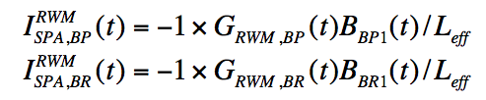
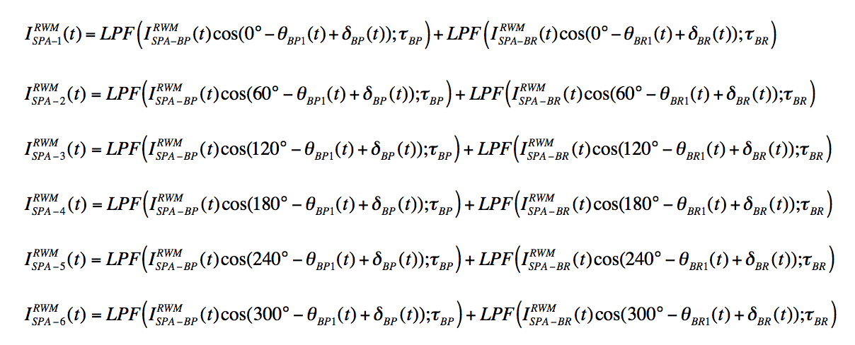
RWM/DEFC Feedback Methodology in the “tmf” Algorithm
We know the amplitude B₁(t) and phase θ₁(t) of the detected 3D field, from both B_{R} and B_{P} sensors.
Apply an n=1 field with:
  Amplitude proportional to the detected 3-D field
  Fixed phase shift from the detected 3-D field.

Slide 27
RWM/DEFC Feedback Methodology in the “tmf” Algorithm
We know the amplitude B₁(t) and phase θ₁(t) of the detected 3D field, from both B_{R} and B_{P} sensors.
Apply an n=1 field with:
  Amplitude proportional to the detected 3-D field
  Fixed phase shift from the detected 3-D field.
Feedback Gain (PCS Waveform)
Detected Mode Amplitude
(From Mode ID)

Slide 28
RWM/DEFC Feedback Methodology in the “tmf” Algorithm
We know the amplitude B₁(t) and phase θ₁(t) of the detected 3D field, from both B_{R} and B_{P} sensors.
Apply an n=1 field with:
  Amplitude proportional to the detected 3-D field
  Fixed phase shift from the detected 3-D field.
Feedback Gain (PCS Waveform)
Detected Mode Amplitude
(From Mode ID)
Coil Toroidal Angle
(Hard Coded)
Feedback Phase Shift
(PCS Waveform)
Detected Mode Phase
(From Mode-ID)

Slide 29
RWM/DEFC Feedback Methodology in the “tmf” Algorithm
We know the amplitude B₁(t) and phase θ₁(t) of the detected 3D field, from both B_{R} and B_{P} sensors.
Apply an n=1 field with:
  Amplitude proportional to the detected 3-D field
  Fixed phase shift from the detected 3-D field.

Slide 30
RWM/DEFC Feedback Methodology in the “tmf” Algorithm
We know the amplitude B₁(t) and phase θ₁(t) of the detected 3D field, from both B_{R} and B_{P} sensors.
Apply an n=1 field with:
  Amplitude proportional to the detected 3-D field
  Fixed phase shift from the detected 3-D field.

Slide 31
RWM/DEFC Feedback Methodology in the “tmf” Algorithm
We know the amplitude B₁(t) and phase θ₁(t) of the detected 3D field, from both B_{R} and B_{P} sensors.
Apply an n=1 field with:
  Amplitude proportional to the detected 3-D field
  Fixed phase shift from the detected 3-D field.

Slide 32
There Are Other Algorithms in the RWM Category
“ssp”=“six subunit control”
  Pre-programmed EFC coil currents only.
  No real reason for you to use this.
“LQG” = “Linear Quadratic Gaussian”
  State-Space feedback
  Next slide.
Old defunct algorithms that have vanished
  “spa”: pre-programmed control of 3 sub-units
  “fec”: Field Error Correction
  “imf”=Initial Mode Feedback
  “smf”=Second Mode Feedback

Slide 33
Advanced RWM Controller
Effort lead by Columbia University collaborators
State-Space implementation of RWM feedback.
  “State” is a mathematic representation of the system status
    Plasma surface currents to represent the RWM.
    Vessel and plate currents (VALEN EM model).
    Coil currents.
  Solve a linearized version of the dynamical system equations to determine optimal correction currents.
    A simple model of the RWM is built into the controller.
    No PID…”Gains” are numbers in a bunch of matrices.
  Will generate requests for currents:
Add the optimal controller request to other requests.
  Preprogrammed, Proportional feedback,…
Tested in 2010 run, will be used again in 2016 run.

Slide 34
About Reloading
All plasma shots ever taken were in the 3 subunit configuration.
  A few engineering test shots taken with 6 subunits.
Therefore, you should never reload the entire RWM category from ShotNumber<200000.
  OK to reload specific waveforms after consideration.
Due to changes in the RWM sensor availability, you should never reload the ModeID category from ShotNumber<200000
  Again, OK to reload specific waveforms after consideration.
No use of these categories until they have been qualified by XMPs (Gerhardt, et al)

Slide 35
Topics
Motivation for low-frequency 3-D field sensors and coils.
Application of low-frequency 3D fields
Detection of low-frequency 3D fields
Determination of the currents in the RWM coils
High-frequency rotating MHD detection.

Slide 36
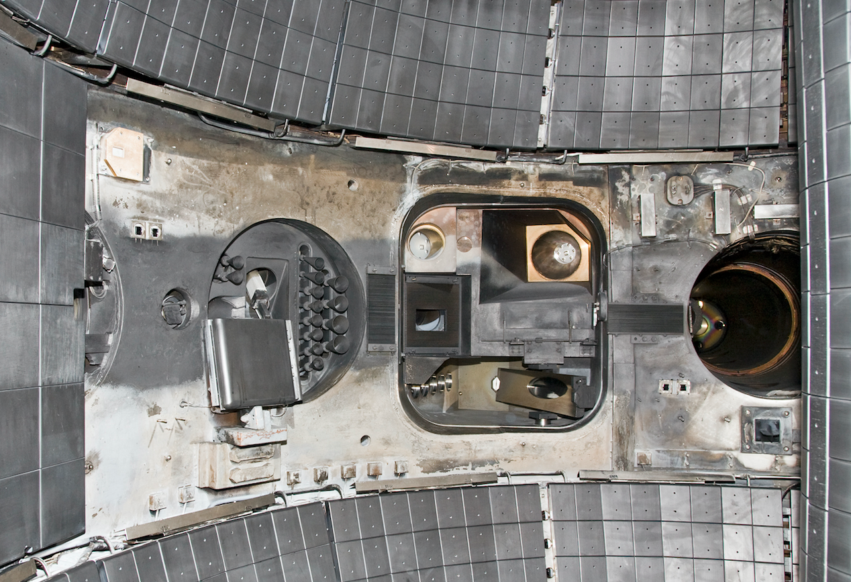
High-Frequency 3D Fields Detected by In-Vessel Sensors
(NSTX, not NSTX-U, but Conceptually Identical)
RWM B_{P} Sensors
High-f B_{T} Sensor
High-f B_{P} Sensors
High-n B_{P} Sensors
RWM B_{P} Sensor

Slide 37
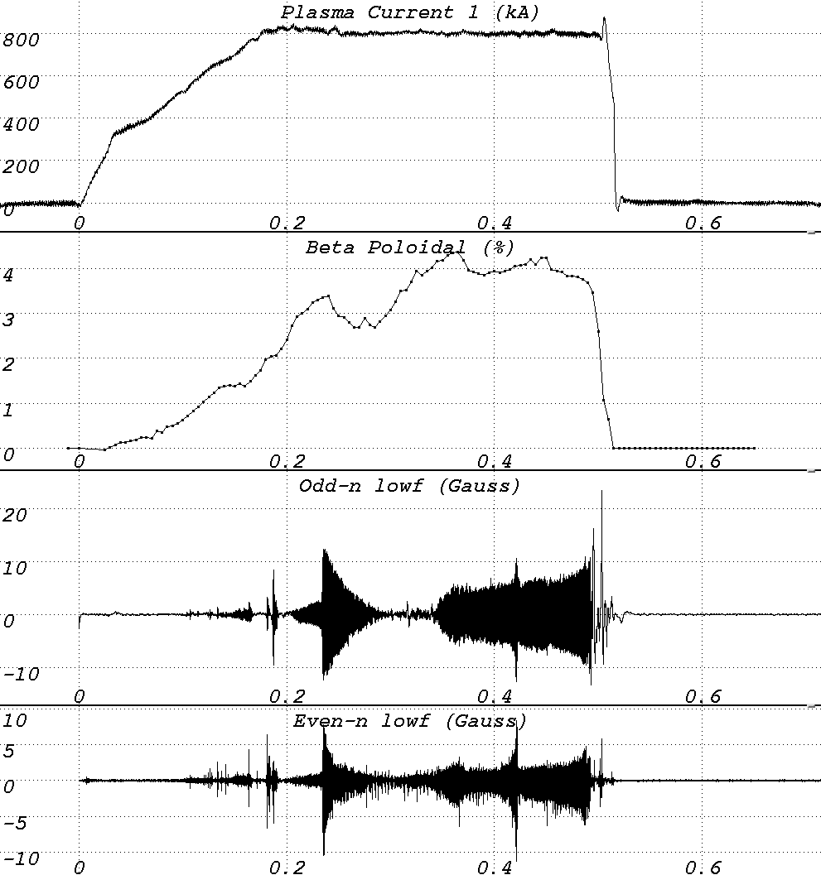
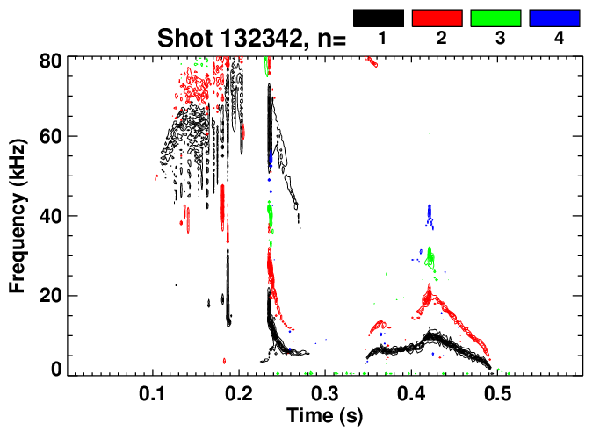
Analysis Methods For High-Frequency Perturbations
Pick 2 sensors 180º apart
  Add the signals: Even-n magnetic signature.
  Subtract the signals: Odd-n magnetic signature.
  These signals written to the tree on every shot.
Or, do a full decomposition in n-number….type in idl:
  @/u/sgerhard/NSTX/idl/startup
  Mirnovgui
Or Eric Fredrickson has lots of routines.

Slide 38
Who’s Who For 3D Fields
SPAs: Weiguo Que, Bob Mozulay, Raki Ramakrishnan
RWM Coils: George Labik, Steve Raftopoulos
RWM Sensors: Stefan, Clayton
Mode-ID Software: Stefan, Clayton
RWM Control Codes: Stefan, Steve Sabbagh, Clayton
High-n array: Eric Fredrickson and Stefan Gerhardt
High-f array: Eric Fredrickson
Magnetic Braking: S. Sabbagh, J.-K. Park

