Slide 1

DCPS & Running with Aquapour/CTD-425 Composite between the OH and TF
Stefan Gerhardt, Keith Erickson, Ed Lawson, Hans Schneider, Tim Stevenson, Weiguo Que
2015 Physics Operator Training

Slide 2
Disclaimer
This is not a complete or uniform overview of DCPS.
I’ll skip many details about the hardware, software design, test procedures,…
It is weighted towards things the PiC needs to know.

Slide 3
Outline
Overview of DCPS
Algorithms
Aquapour Consequences and Protection
dI/dt Protection
PiC as a Protection System
Demonstration of DCPS Fault Determination

Slide 4
Outline
Overview of DCPS
Algorithms
Aquapour Consequences and Protection
dI/dt Protection
PiC as a Protection System
Demonstration of DCPS Fault Determination

Slide 5
What is DCPS?
DCPS is the “Digitial Coil Protection System”
It is a suite of computers, data acquisitions systems, custom software, custom hardware, automated testing systems, procedures, and parameter data.
The DCPS is primarily designed to protect the NSTX-U coils and their mounting hardware against excessive thermal & mechanical loads.
It is NOT a global machine protection system.
It is NOT a rectifier protection system.
It does NOT know about the RWM coils, and cannot protect them.

Slide 6
Two DCPSs, and for Each, Two Ways of
Stopping the Shot
There are two instances of DCPS:
  One at D-Site, in the “Junction Area”
  One a C-site, in the FCC
  Same executable runs on both system
Each can terminate the shot by a pair of actions:
  Can declare a “software fault”, because of an algorithm trip.
    This becomes a L1 fault via hardware for the JA DCPS.
  Can stop the “Watch Dog Timer” because of a software or input problem.
    WDT is a [JA,FCC]=[5 kHz, 2.5 kHz] pulse train generated by the program.
    Obviously, if the software is not running, the timer will not toggle.
    Hardware detects this loss of toggling and declares a L1 fault.
The shutdown is a suppress and bypass applied to all rectifiers.
  Suppress = Stop the rectifier from rectifying
  Bypass = Short out the coil through a diode

Slide 7
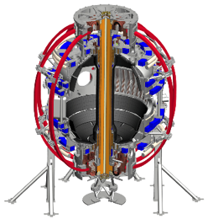
Simplest Block Diagram
FCC and JA DCPS have identical code, and are the same executable file, but i) get their input from different source providers, and ii) send their output to the rectifiers different ways
Coil and Plasma Current Measurements
Power Supply Suppress and Bypass
2 measurements per coil
Hardware User Interface
FPDP Data Acquisition
Fault
Detectors
Red for Junction Area
Green for FCC
Blue for FCPC
FPDP Data Link
Local Acquisition
FCC DCPS & Plasma Control Computer(s)
Junction Area DCPS
Computer(s)
WDT
FPDP Data Link
SW Fault
FCC DCPS WDT Monitor
WDT
Firing Generators
Hardware User Interface
This block diagram is missing A LOT of details!
FOMs
Suppress, Bypass

Slide 8
Input Data to DCPS
Parameter data controls all of the DCPS functions
  Stored in MDS+ trees
  One tree for FCC DCPS, and one for JA DCPS
  Pairs of trees are controlled so that the FCC has more restrictive parameters (by a few %)
    FCC should always trip first!
Realtime data is limited to some digital status and timing information, and 2 measures of the coil current for each coil system.
  No line-switch positions, no coil voltages, no water temperatures, no strain gauges, no displacement monitors

Slide 9
Sign Convention
Same sign convention is used in PCS, DCPS
Right handed with {R,φ,Z} cyclic order.
  R (major radius) increases moving out of the vessel.
  Φ (toroidal angle) increases in the CCW direction as viewed from above.
  Z (vertical direction) increases moving towards the NTC ceiling.
This leads to the following “rules”
  I_{P} is a positive number in standard co-injected operation.
  I_{TF} is a negative number in normal operation with the lower X-point in the favorable drift direction.
    TF is CW from above, the rod current is down.
  PF-5 is negative for positive I_{P}.
  OH coil pre-charges positive, and swings negative.
These enforced by careful sign-corrections on current measurements, magnetic measurements.

Slide 10
Who’s who in DCPS
Cognizant Engineer: Tim Stevenson
  He acquired this role when Ron Hatcher passed away.
DCPS software: Keith Erickson (who wrote it) and Roman Rozenblat
DCPS hardware: Hans Schneider (and Ed Lawson, and Paul Sichta)
DCPS MDS+: Greg Tchilinguirian
DCPS morning startup: Ed Lawson
  Done using DCPS-779
Moral support: Stefan Gerhardt

Slide 11
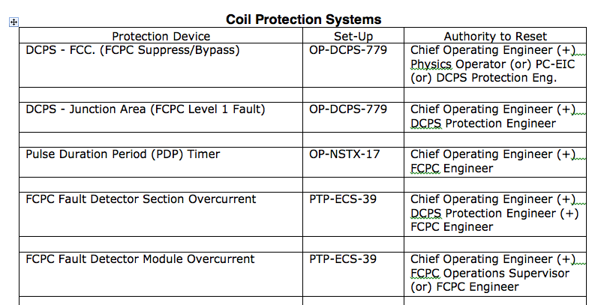
Procedural Response to a Fault
We gotta figure out why.
  You can use the GUI to assess if it was plasma control dynamics.
Need authorization from correct people before faults can be reset.
  Governed by D-NSTX-OP-G-176

Slide 12
Outline
Overview of DCPS
Algorithms
Aquapour Consequences and Protection
dI/dt Protection
PiC as a Protection System
Demonstration of DCPS Fault Determination

Slide 13
NSTX-U Coils
1a,b,c (Upper)
PF-5,4 Coils:
Provide the vertical field,
Upper and lower coils in series.
PF-3 Coils:
Control the plasma vertical position by applying a radial field (up-down asymmetric currents).
Also help in controlling the elongation, squareness, and dr-sep
Upper and lower coils independently controlled
PF-1a,1b,1c,2 Coils:
Control the divertor geometry, X-point and strike point locations.
Upper and lower coils are independently controlled.
OH Coil:
Single coil provides loop voltage to the plasma.
TF Coil (not shown)
Makes toroidal field.
2U
3U
4U
5U
OH
5L
4L
3L
2L
1a,b,c (Lower)
C2, R2

Slide 14
List of DCPS Algorithms
Overcurrent
I²t integrals
T_{TF}-T_{OH}
  Must limit this due to aquapour.
Vertical and radial forces on coils
Combinations of vertical forces
Local stresses in OH, PF-4, PF-5
TF Torsional Shear Stress
TF outer leg moments
Including the heating after a suppress and bypass
Including calculations of the forces following a disruption with a simple model for the post-disruption currents.

Slide 15
DCPS Has a Post-Disruption Current Algorithm And Two Plasma Shapes
Algorithm is based on a very simple inductive coupling model.
  The plasma current is assumed to vanish “instantaneously”.
  The flux from the plasma is transferred to the coils, ignoring the vessel entirely
Mathematically, it is very simple:
  I_{coil} is a size N_{coils} vector of coil currents.
  I_{coil,PD} = I_{coil}+C_{D}I_{P}, where C_{D} is a N_{coils} vector of coupling coefficients derived from the full mutual inductance matrix.
At each time point, every algorithm is evaluated on both I_{coil} and I_{coil,PD}.
Furthermore, many algorithms are evaluated for both a “shaped” and “circular” plasma cross-section.
  These are generally small effects.

Slide 16
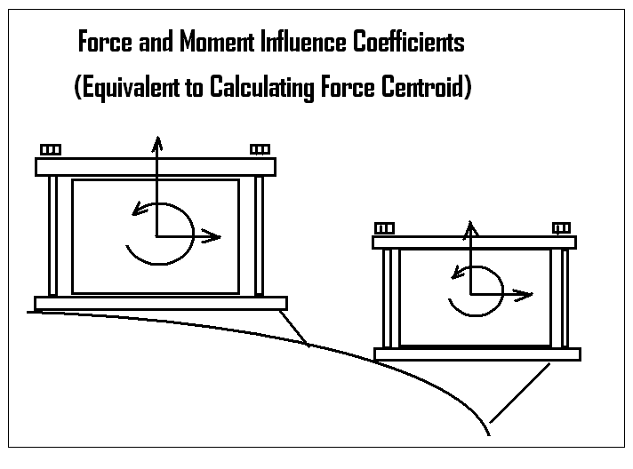
DCPS Calculates Radial & Vertical Forces on Coils, Moments
Simple calculations of the form Force/Moment on i^{th} coil is given by F_{i}=I_{i}Σα_{i,j}I_{j}.
  Index j is a sum over all coils, and the α_{i,j} come from calculations.
  Forces computed for all coils.
  Asymmetric limits in many cases.
Radial force is basically the coil hoop force (self force) + radial force due to nearby coils.
Vertical force is that due to nearby coils…no vertical self-force.
Moments are related to twist of the winding pack due to nearby coils

Slide 17
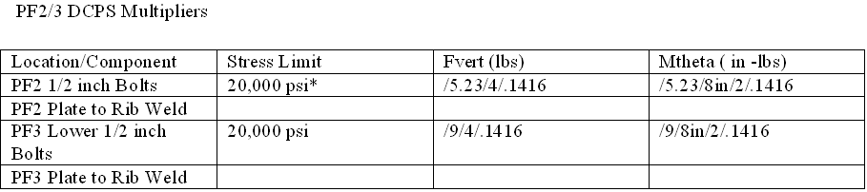
DCPS Calculates Stress on Bolts
PF-2 through PF-5 are clamped with bolts.
The force on these bolts is due to both:
  Vertical force on the coil
  “moment” about the coil centroid.
Stress: S_{i}= C_{1,i}M_{i}+C_{2,i}F_{1,I}
  i➔{PF-2U, PF-3U,…,PF-5U,…PF-3L, PF-2L}

Slide 18
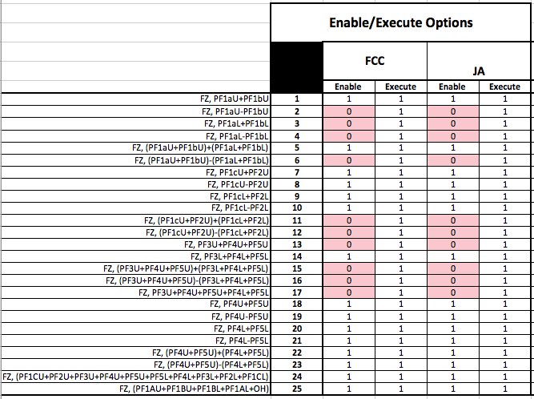
DCPS Computes Combined Vertical Forces
Some forces on brackets and welds go like the sum of coil vertical forces.
Example is the PF-4 and PF-5 mounting brackets, who’s load scales like F_{Z} on PF-4U+PF-4L+PF-5U+PF-5L

Slide 19
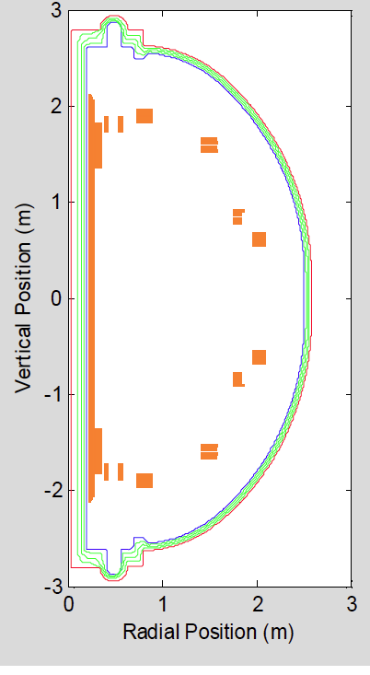
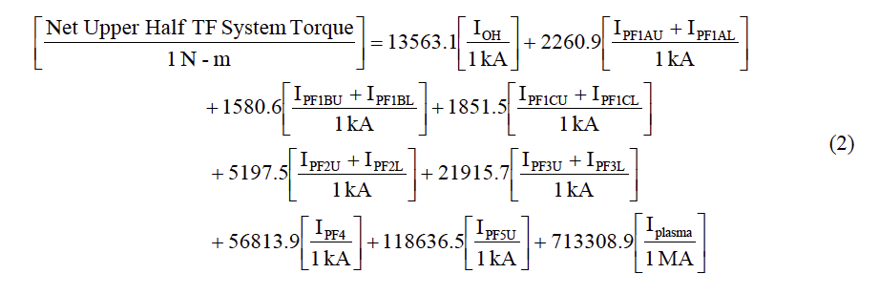
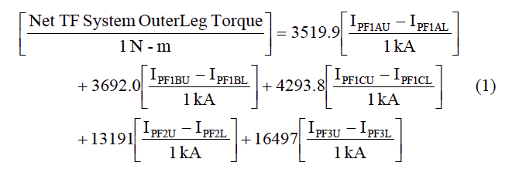
DCPS Calculates the Torque on the TF
Torques on the TF due to the radial part of the TF current crossing the vertical field, or the vertical part of the TF current crossing the radial field.
NSTXU-CALC-132-03-00

Slide 20
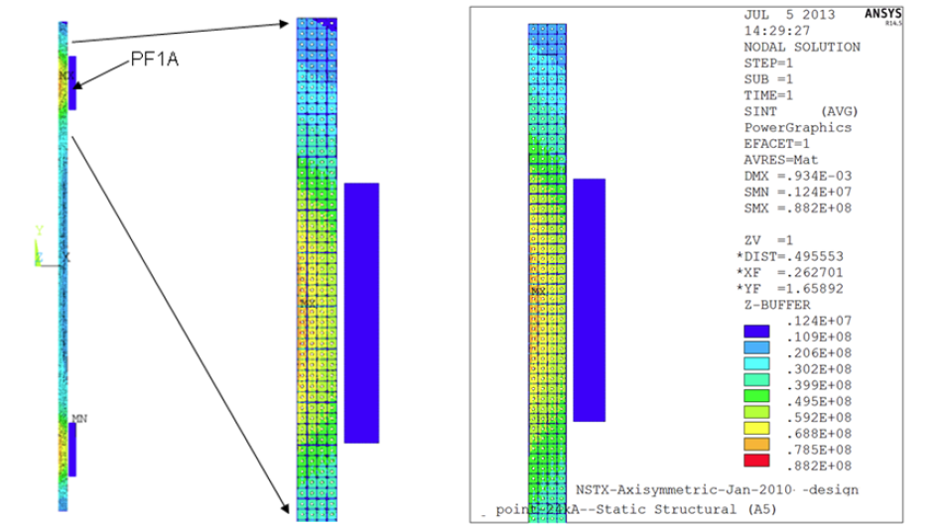
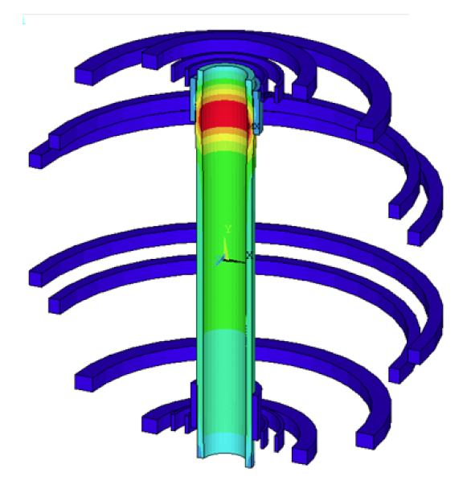
DCPS Calculates Local OH Stresses
Basically, hoop-force is not a constant along the length of the coil.
  Can be increased or decreased in the vicinity of a coil.
S_{OH}=I_{OH}Σα_{j}I_{j}, with the shear stress computed at the top, middle, and bottom using this formula.

Slide 21
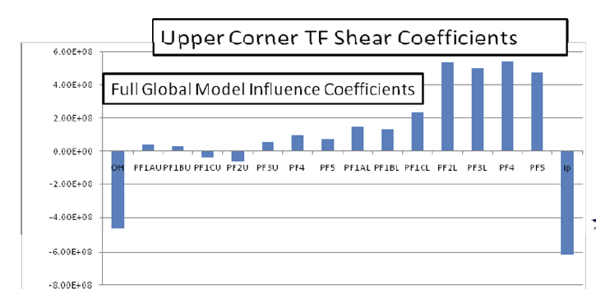
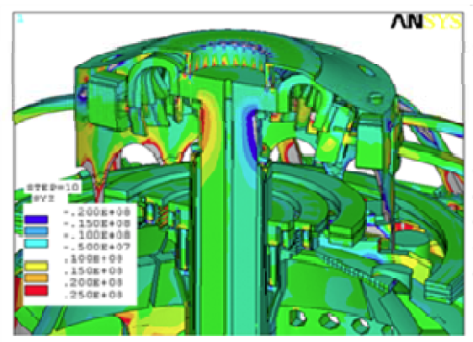
DCPS Calculates Shear Stresses on the TF Inner Bundle
S_{TF}=I_{TF}Σα_{j}I_{j}, with the shear stress computed at the top, middle, and bottom using this formula.
Basically, the torque on the TF flags (due to radial current and vertical field) leads to shear stress between the conductors.
  Also the vertical radial current on the TF inner legs and the radial field from coils and plasma
That shear stress must be taken by the CTD-425 resin system.
NSTX-CALC-132-07

Slide 22
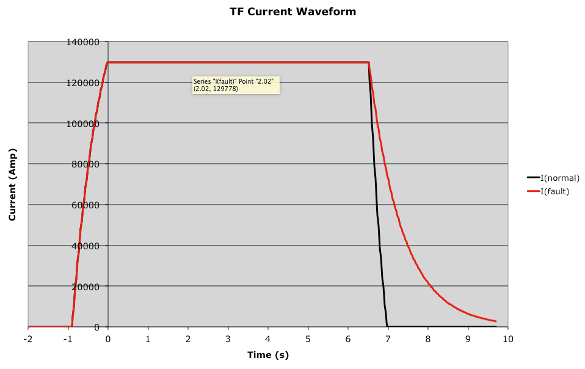
DCPS Calculates I²t Integrals
Computes the simple integral(I²t)
  This is called “action”
Computes the action that would occur if a suppress and bypass were to happen: τI_{i}²/2
  τ is the L/R time when bypassing
Quantity compared to limit: integral(I²t)+τI_{i}²/2

Slide 23
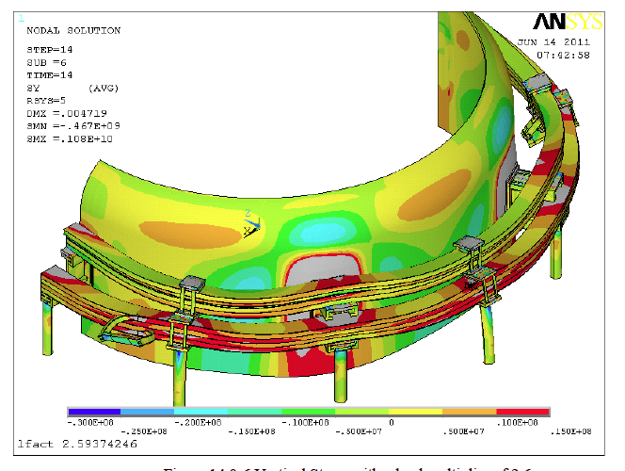
DCPS Calculates Bending Stresses on PF-4 and PF-5
S_{PF5}=I_{PF5}Σα_{j}I_{j} & S_{PF4}=I_{PF4}Σα_{j}I_{j} .
Basically, the brackets on the PF-4 and PF-5 coils cause local stresses where they support the coils against vertical loads

Slide 24
A Note on Limit Values
All the previous mechanical things are checked against limit values to determine if there are faults.
Different calculations have different sources of limit values.
  Known mechanical properties and mechanical limits
    OH vertical force, radial forces, OH stresses, TF shear stresses.
  Qualification against 96 scenarios
    Many vertical forces, TF torques
Again, DCPS parameter trees created so that the FCC tree is less permissive than the JA tree.

Slide 25
Outline
Overview of DCPS
Algorithms
Aquapour Consequences and Protection
dI/dt Protection
PiC as a Protection System
Demonstration of DCPS Fault Determination

Slide 26
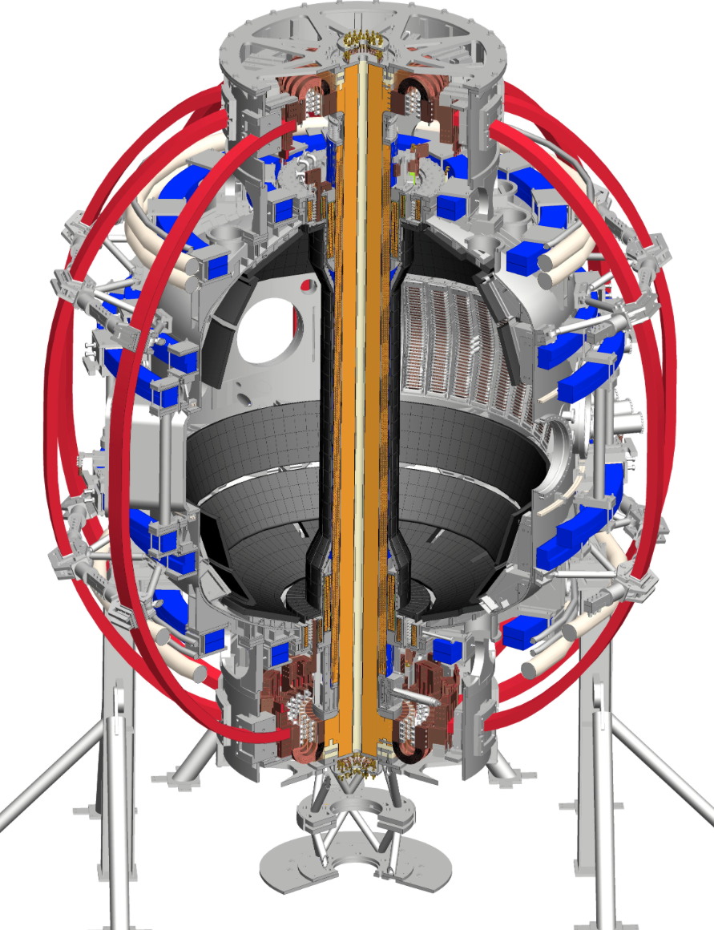
Background on Aquapoxy
OH coil is wound on the TF coil.
  Intent was to have a small air gap between the OH ID and the TF OD.
  Aquapour that was in that gap during winding was supposed to wash out.
  It didn’t wash out because it was it got inundated with CDT-425 resin (epoxy).
  Aquapour + CTD-425+cure cycle is like concrete.
TF coil grows axially when it gets hot.
  With an air gap, no big deal.
  Without air gap, it can pull on the OH coil

Slide 27
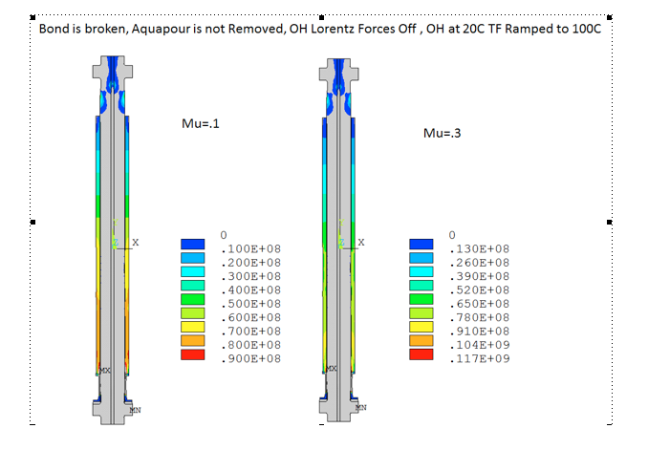
The TF Can Tear the Bottom of the OH Coil Apart
With the TF hotter than the OH, the TF will “tug” on the OH as it grows.
OH can slide on the TF, but there is some friction.
Stress accumulates at the bottom of the coil.

Slide 28
Analysis Suggests We Can Eliminate OH Stresses by Keeping OH Hotter than TF
Bounding Line is Essentially 1MPa/C !
(Note, it does depend weakly on the friction coefficient, talk by Titus)
Stress [MPa]
T_{TF}-T_{OH} [C]
Basically, OH expands enough to eliminate the frictional interaction

Slide 29
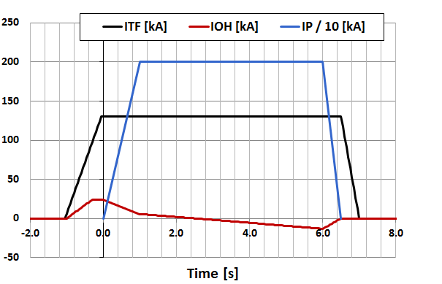
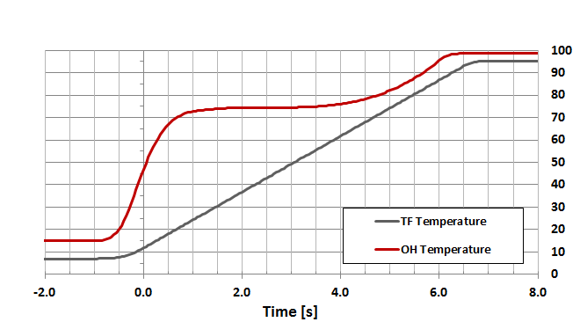
Adjust the OH Waveform to Keep OH Hotter than TF
Illustrative Example: 2 MA, 1T, 5 second.
TF Coil:
  Current is constant
  Temperature is linearly increasing
OH Coil:
  Current has a zero-crossing
  Temperature has an “S-Shaped” curve.
Options for maintaining T_{TF}<T_{OH}.
  Pre-heat the OH coil using currents before the TF turns on.
  Control the shape of the OH S-curve by adjusting the amount of pre-charge.
In this example,
  Full 24 kA pre-charge
  Pre-charge duration is extended to provide heating.
H₉₈ = 1.2, f_{Greenwald} = 0.75, P_{NBI} = 8MW, β_{N} = 4.6

Slide 30
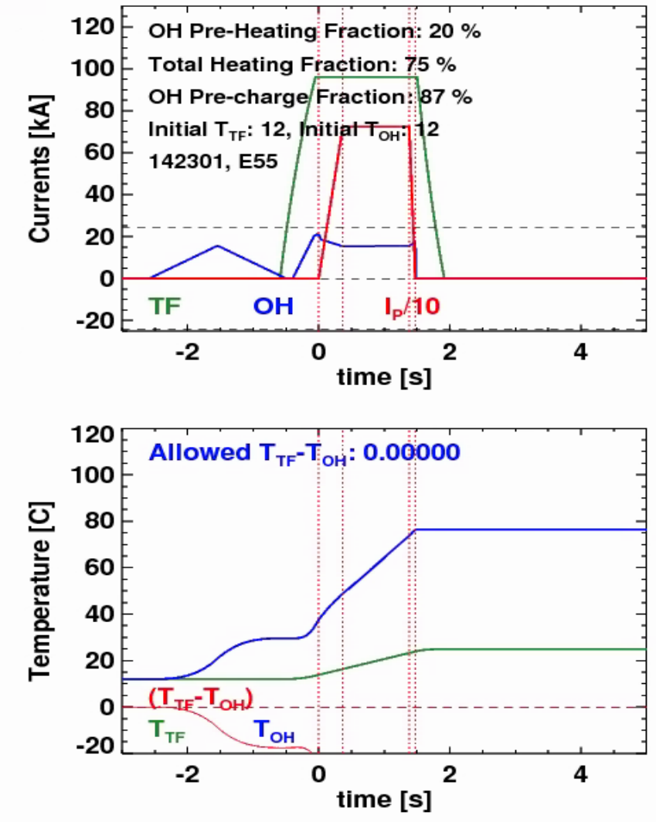
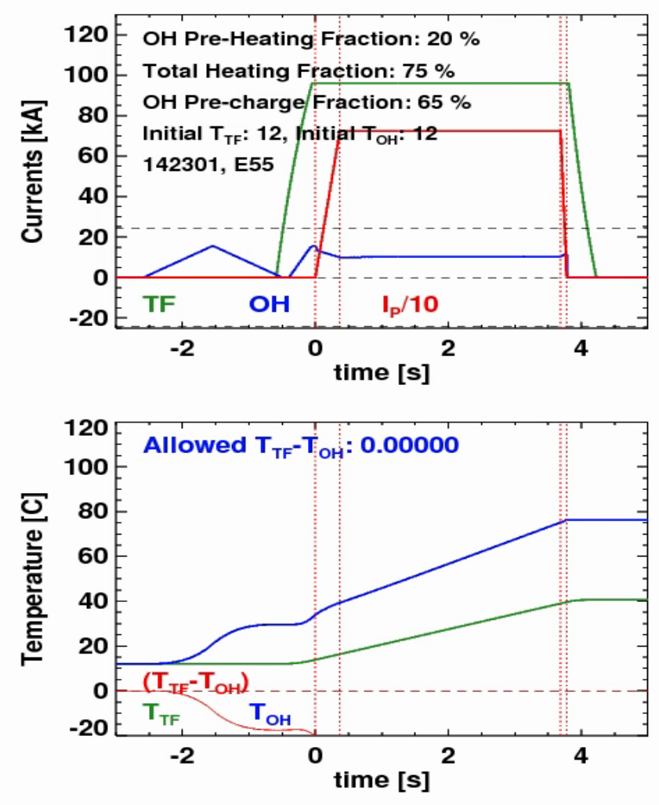
Pre-Heating/Pre-Charge Scenarios…Examples From 100% Non-Inductive Scenarios

Slide 31
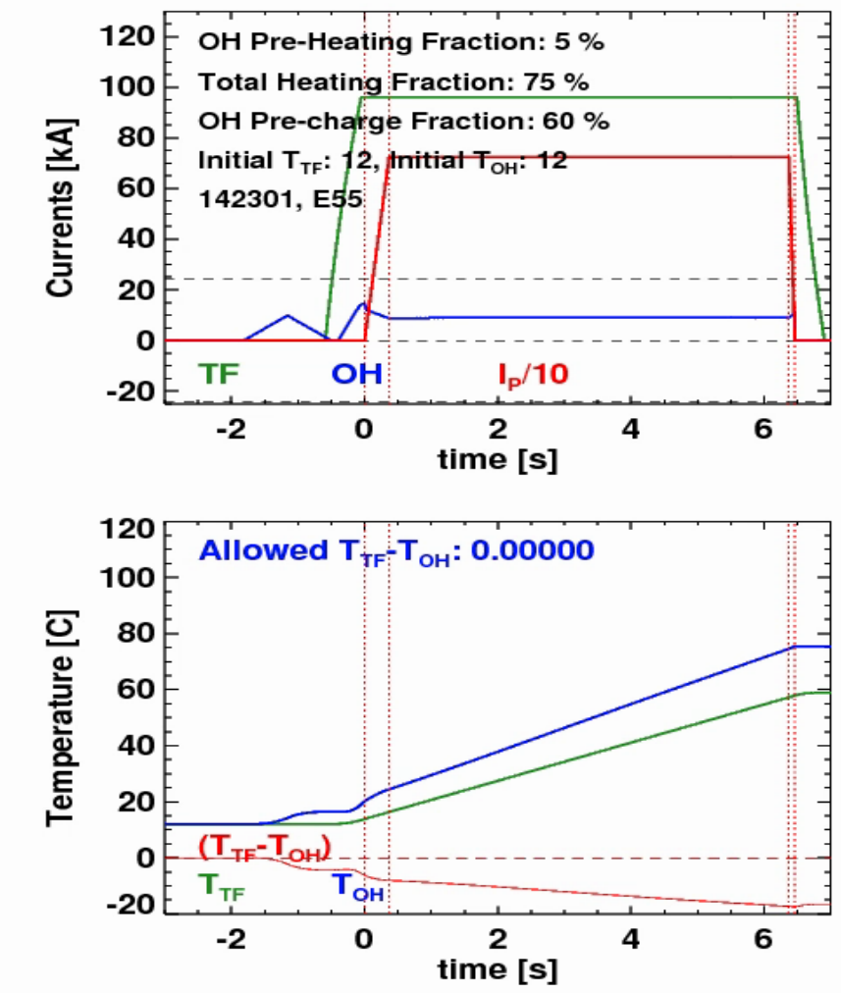
Pre-Heating/Pre-Charge Scenarios…Examples From 100% Non-Inductive Scenarios
So for these 100% non-inductive plasmas, a low pre-heat and moderate pre-charge gets the longest shot.
But note that this result depends on:
TF Current
Plasma current (flux required for ramp-up)
Non-Inductive fraction (heating, confinement)

Slide 32
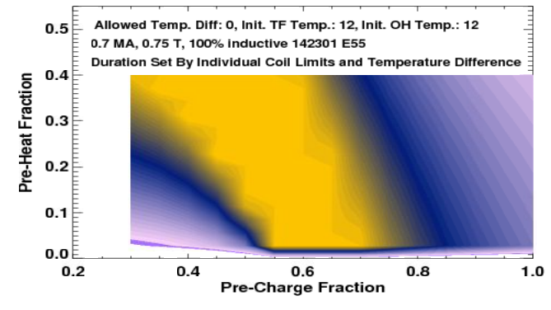
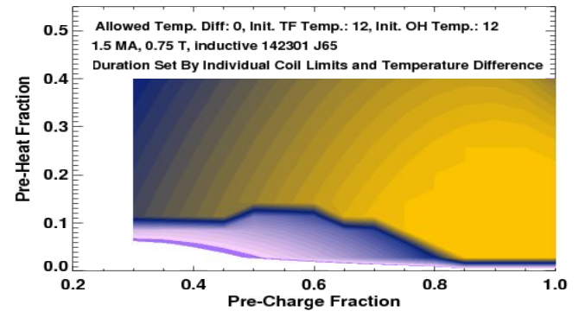
For the First Year, a 15-20% Pre-Charge Appears to be a Good Compromise
Scan two variables in these studies:
  Pre-heat level, quantified as the fraction of the full OH coil I²t limit used before the shot starts.
  Pre-Charge fraction, quantified as the fraction of 24 kA used.
Resistive pre-heat of ~15% provides operating room for 0.75 T scenarios typical of the first year.
  Same as starting the coil at ~23 C
0.7 MA, 0.75 T, 100% Non-Inductive
1.5 MA, 0.75 T, Partial Inductive
5 sec
5 sec

Slide 33
DCPS Will Be Used to Enforce This Temperature Difference
Operating engineer & water-systems PLC enforce that the coils be cooled to a pre-defined set-point at the start of the discharge.
Coil temperature evolution computed in DCPS based on I²t integrals.
  T_{TF,i}=T_{TF,0} + S_{TF}•dt•ΣI_{TF}² T_{OH,i}=T_{OH,0} + S_{OH}•dt•ΣI_{OH}²
  δT_{i} = (T_{TF,i}) - (T_{OH,i})
Consider the heating that would occur in the event of a fault:
  δT_{TF,fault,i} = I_{TF,i}²C_{TF}, δT_{OH,fault,i} = I_{OH,i}²C_{OH} (OH may or may not heat up more than the TF)
  δT_{i,fault} = (T_{TF,i}+δT_{TF,fault,i}) - (T_{OH,i}+δT_{OH,fault,i})
At each cycle, compare both δT_{i} and δT_{i,fault} to the defined limit (0 in the first year).
Algorithm accounts for both instantaneous heating, and fault heating, while only relying on coil current measurements.

Slide 34
Outline
Overview of DCPS
Algorithms
Aquapour Consequences and Protection
dI/dt protection
PiC as a Protection System
Demonstration of DCPS Fault Determination

Slide 35



Basic Idea is To Confirm The Grossly Proper Electrical Behavior of the Coil Systems
When a coil has a turn-to-turn short, there is a step change in the inductance and resistance.
Coil current evolution is generally solved by a large set of coupled 1st order ODEs
Throw out many of the terms
Algorithm:
  Compute the expected dI/dt
  Compute the measured dI/dt
  Take their difference
  Compute the maximum dI/dt
  Declare fault if abs((dI_{coil}/dt)_{error}) >(dI_{coil}/dt)_{max}

Slide 36
Implementation Details
This protection is in PSRTC, within PCS.
  Needs to be there because PSRTC knows the coil voltage requests, while DCPS knows nothing about voltages.
All the mutual couplings are neglected.
  This is OK because the vessel tends to shield out most of the fast transients.
  The term f_{dI/dt} is set to 0.7 right now, which gives a big margin for error.
When will this trip?
  In the event of a major coil fault.
  Possibly after fast disruptions? This is TBD.
  If you request too much current in the wrong direction for a unipolar supply.
    And how much is too much depends on the coil system inductance.
How will you know it tripped?
  You will get an un-announced suppress and bypass.
  Look at the dedicated scope (in a few slides)
  Does the fault indicator go high before the suppress and bypass starts?

Slide 37
Outline
Overview of DCPS
Algorithms
Aquapour Consequences and Protection
dI/dt protection
PiC as a Protection System
Demonstration of DCPS Fault Determination

Slide 38
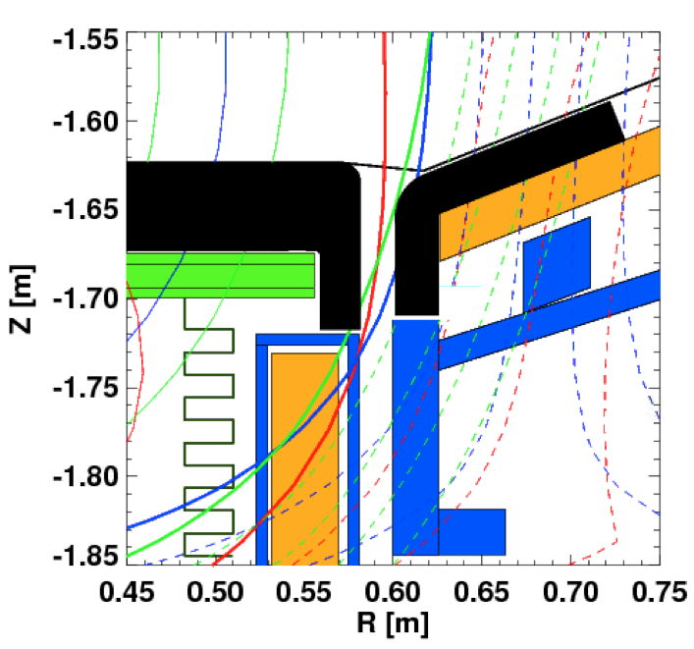
PiC Will Need to Be Cognizant of Vessel/PFC Internal Thermal Loading
Primary concern is the PF-1c coil can.
  TCs in the PF-1c can should be kept below 200 V to limit fatigue.
  TCs in the tiles within the gap can also be monitored.
Rules
  If diverting with any of PF-1a, PF-1c, or PF-2 alone, essentially impossible to land field lines on the PF-1c coil.
    Same conclusion when diverting with PF-1a and PF-2.
  A negative PF-1c coil current can push the field lines away.
  Positive PF-1c current mixed with positive PF-1a can land field lines on the PF-1C coil casing!
Note: Gap between PF-1C and IBDH tile is larger at the top.
Other concerns:
Thermal loading the RF antenna…use the cameras, does it glow after the shot.
Casing temperature…is it ratcheting?

Slide 39
The PiC is Often the First to Know When Something is Off
Listen to the shots on the speakers, watch the plasma TV images.
Be suspicious
Don’t take the next shot if you are unsure…ask Dennis/Devon/Stefan or the CoE for help.

Slide 40
Outline
Overview of DCPS
Algorithms
Aquapour Consequences and Protection
dI/dt protection
PiC as a Protection System
Demonstration of DCPS Fault Determination

Slide 41
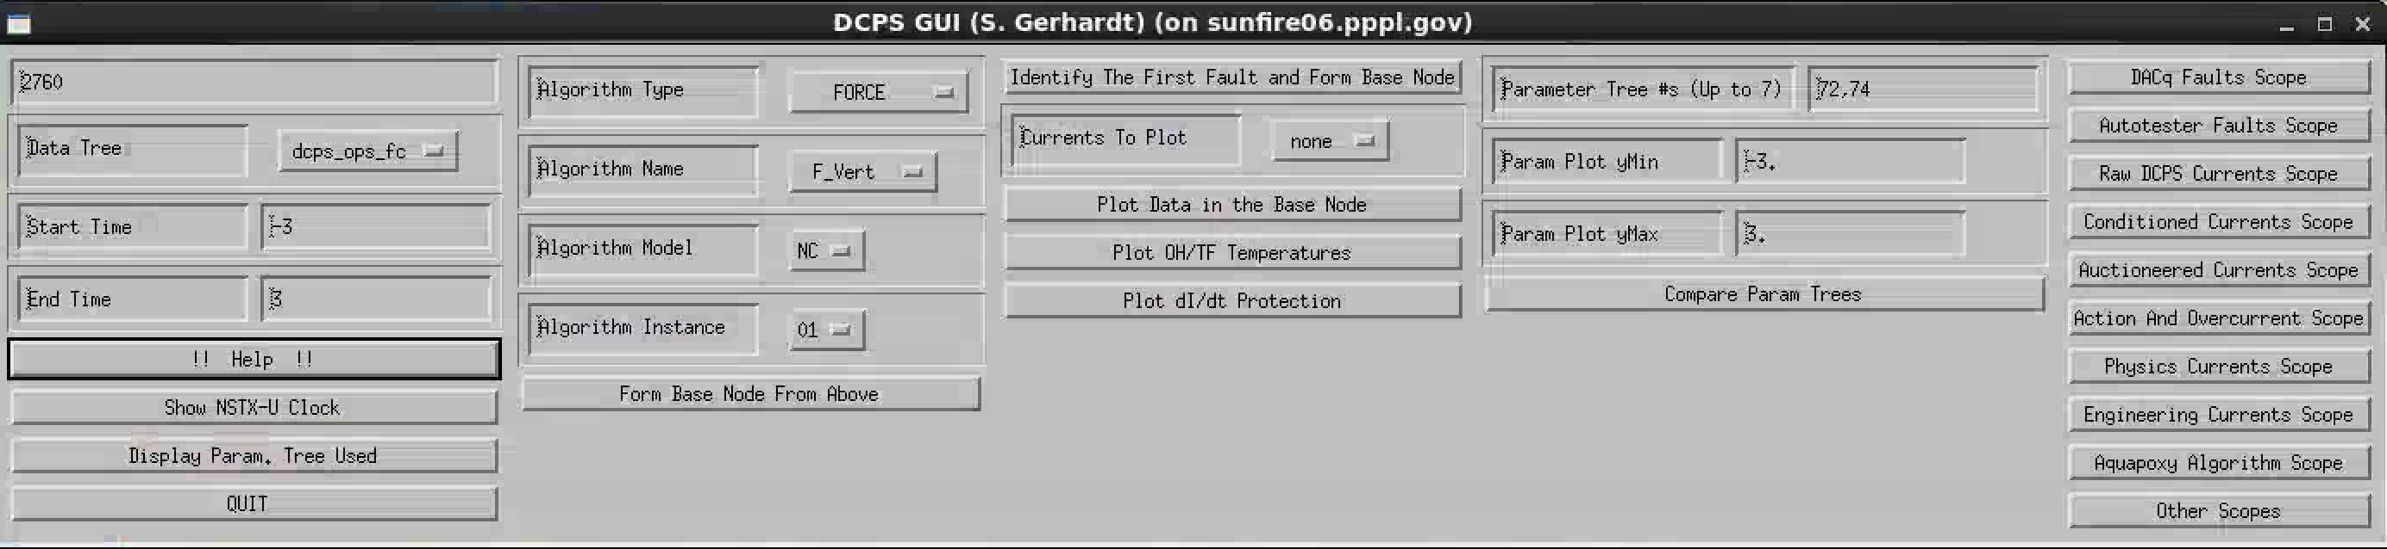
An idl GUI Exists to Help You Understand Why DCPS is Tripping
Put the following in your .cshrc file:
  alias DCPSGui 'idl /p/nstxusr/nstx-users/sgerhard/DCPS/GUI/GUIScript’
  alias ScopeGui 'idl /p/nstxusr/nstx-users/sgerhard/DCPS/GUI/ScopeGUIScript’
  module load nstx/mdsplus
  module load nstx/dcps
At the command prompt:
  [sunfire06:/u/sgerhard.356]DCPSGui
You should get this:

Slide 42
Hands on Training
Hope you brought you laptop
Shot number…enter a number here and hit enter
Tree: use ‘dcps_ops_fc’ or ‘dcps_ops_ja’
“Identify The First Fault and Form Base Node”
  Use this to identify the first fault that occurs on a shot, and then put the type, name, model, and instance in the “base node”
“Plot Data in Base Node”…does what it says.
Use shot 200148, find the fault that occurred (hint: dcps_ops_ja)
Adjust limits to zoom in.
Add a current to the plot; add two currents to the plot
Use shot 200157 (test shot)…then “Plot OH/TF Temperatures”
Pull up the “action and overcurrent” scope see 200148 (dcps_ops_ja) & 200049 (dcps_ops_fc).
Use the “Aquapoxy Algorithm Scope”, look at 200157, dcps_ops_fc
  Then 146539, tree=dcps_auto_fc
Use the “dI/dt” protection scope from “Other Scopes”…see 201286

Slide 43
The end…

Slide 44
Stefan’s Email on 3/9/13 on Magnetically Protecting the PF-1C Coils
Hypothesis:
That Kelsey's work on the gap tiles has made it much harder to put the OSP on the PF-1C casing, and that only a limited # of configurations can now cause this problem.
That maybe NSTX-U can live without those configurations.
Analysis Method
Use isolver to solve for plasma boundaries with fixed PF-1C current. These PF-1C currents are specified as a fraction of the total plasma current.
Provide input requests for aspect ratio, elongation, and triangularity, and allow the code to find values of currents in PF-1A, PF-1B, PF-2, PF-3, and PF-5.
Adjust triangularity, elongation, and R0 requests to find if, for any given value of the fixed PF-1C current, it was possible to put the OSP on the PF-1C can.
Result
For PF-1A alone, essentially impossible to land the OSP on the PF-1C.
Under this condition, no need for anything beyond Kelsey's tiles
For PF-1A+PF-2 only, very difficult to land the OSP on the PF-1C.
Kelsey's tile modifications appear to shield the coil for the most dangerous configurations.
For PF-1A+PF-1B+PF-2, can once again land the OSP on the PF-1C coil
Kelsey's tiles don't protect against this configuration...the PF-1B can push the field lines into the gap.
For PF1A+PF-2 (+PF-1B if you want), and positive PF-1C current (and positive Ip)
Tried PF-1C ratios from 0.001 to 0.007 A/A (or 7 kA at 1 MA), still could find cases with the OSP hitting the PF-1C coil with other coils currents having reasonable values
So, adding PF-1C in the positive direction is a bad idea
This is essentially saying that if PF-1C is used as a divertor coil (parallel to Ip) then the PF-1C must be the dominant divertor coil to be absolutely sure that the OSP cannot land on the PF-1C can.
  May want to forbid use of PF-1A and/or PF-2 when PF-1C has current in the diverting direction.
For a PF1A+PF1B+PF-2, and negative PF-1C current
A negative PC-1C current at the level of 0.001 A/A (or 1kA at 1MA) appears to be enough "buffer" field to eliminate the tendency of the field lines to hit the 1C can when 1B is on.
(recall), w/o PF-1B, no real problem after Kelsey's tile modifications.
Potential Solution
Never allow PF-1C to be run as a divertor coil, except when the other divertor coils are off or have very small values.
Still need to define "very small" in this context.
Still allows the SFD research with PF-1C "pushing"
If PF-1B is in the circuit & control loop, and thus may turn on, then maintain a buffer field using PF-1C in the "pushing" direction of at least 0.001 A/A
Could enforce this trivially through DCPS or PCS.

