Slide 1


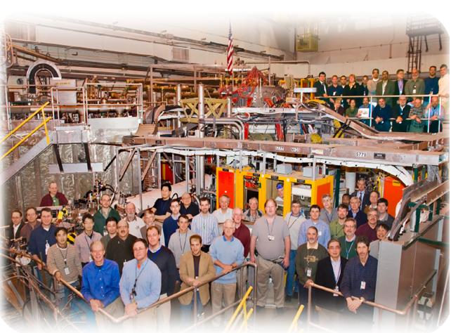
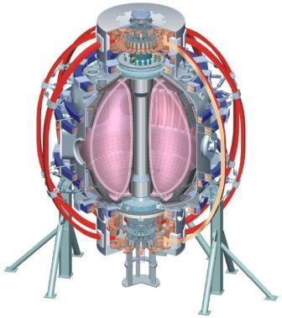
NSTX
Supported by
System Identification and Control at NSTX-U
College W&M
Colorado Sch Mines
Columbia U
CompX
General Atomics
INL
Johns Hopkins U
LANL
LLNL
Lodestar
MIT
Nova Photonics
New York U
Old Dominion U
ORNL
PPPL
PSI
Princeton U
Purdue U
SNL
Think Tank, Inc.
UC Davis
UC Irvine
UCLA
UCSD
U Colorado
U Illinois
U Maryland
U Rochester
U Washington
U Wisconsin
Egemen Kolemen
Culham Sci Ctr
U St. Andrews
York U
Chubu U
Fukui U
Hiroshima U
Hyogo U
Kyoto U
Kyushu U
Kyushu Tokai U
NIFS
Niigata U
U Tokyo
JAEA
Hebrew U
Ioffe Inst
RRC Kurchatov Inst
TRINITI
KBSI
KAIST
POSTECH
ASIPP
ENEA, Frascati
CEA, Cadarache
IPP, Jülich
IPP, Garching
ASCR, Czech Rep
U Quebec
DIII-D Science Meeting
Oct/6/2015

Slide 2
Two Parts
  System Identification
  Control Design

Slide 3
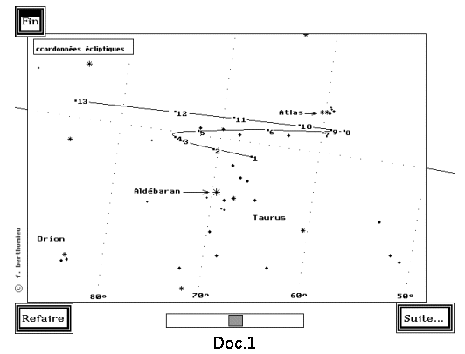
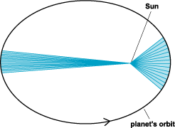
System Identification
System Id: Identify the internal dynamics and effect of the actuator on the state of a system.
Example:
Retrograde motion of Mars

Slide 4
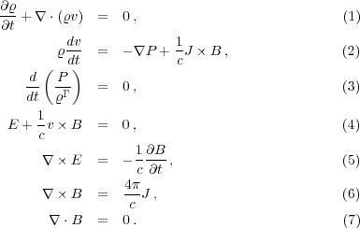
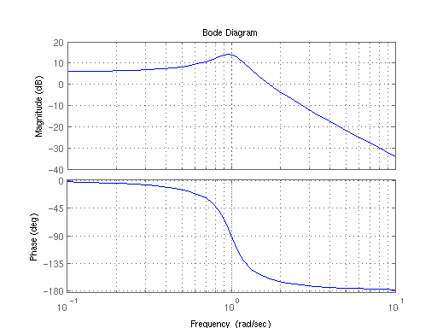
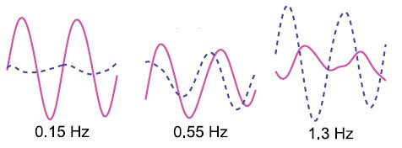
System Identification: Aim and Methods
Understand the physics system
  Use reduction of the complicated physics (ex. Ideal MHD equations)
  Experimental: Spectral Analysis
  Data Mining

Slide 5
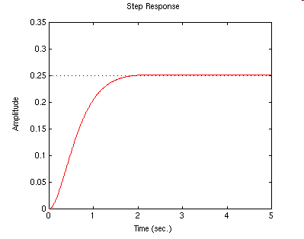
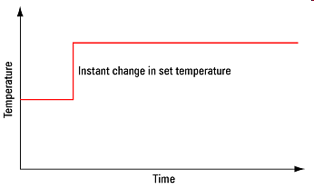
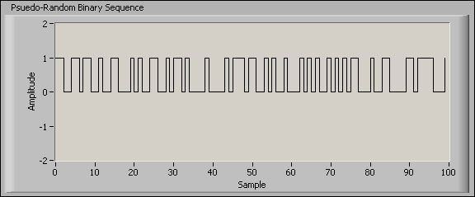
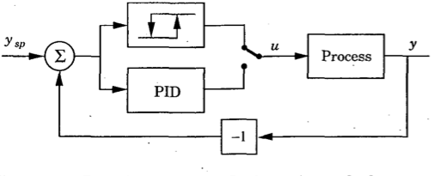
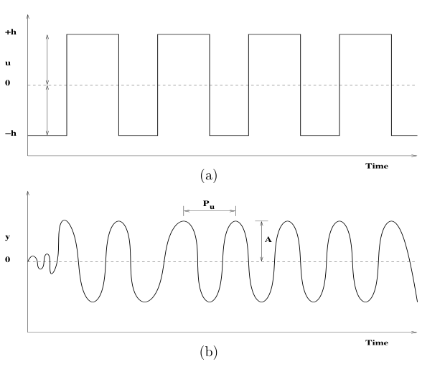
System Identification: Aim and Methods
Control the system to a desired state
  Experimental: Open Loop (Step, Pseudo Binary Excitation)
  Experimental: Closed Loop (Use special control function for SID)
  Data Mining from XPs not aimed at System ID
u

Slide 6

System Identification: Aim and Methods
  2. Control the system to a desired state
  d) Use reduction of the complicated physics (ex. Linearized MHD)
  e) Real-time System Identification:
  Based on the diagnostic information, obtain the real-time system dynamics

Slide 7
a. Experimental: Open Loop

Slide 8
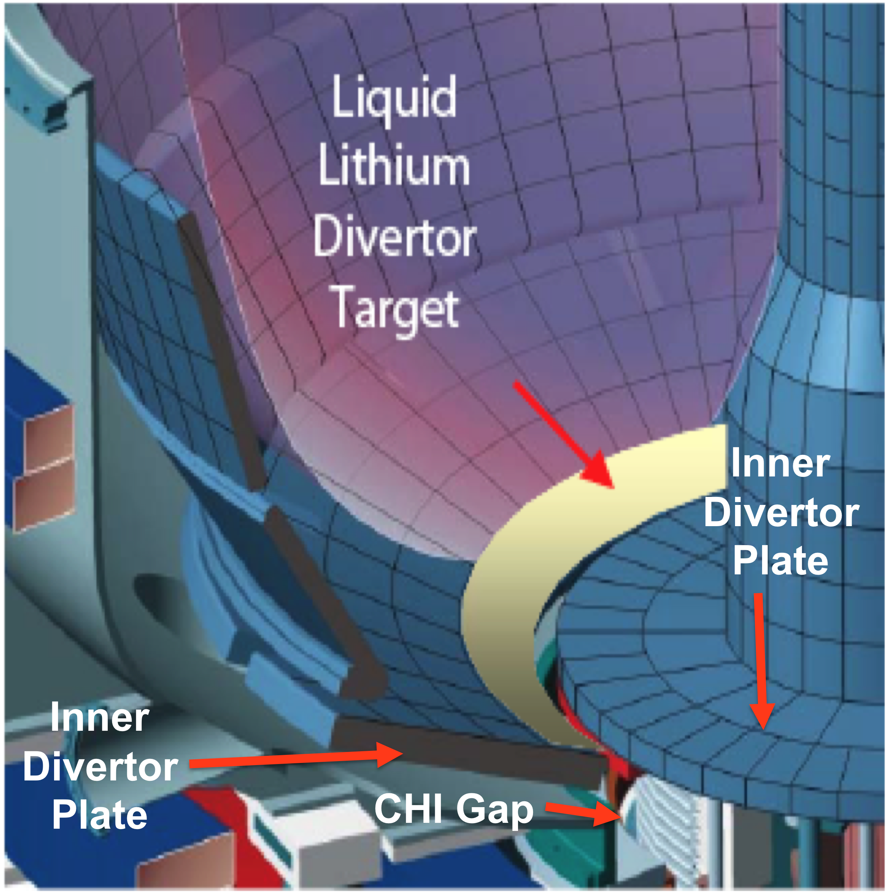
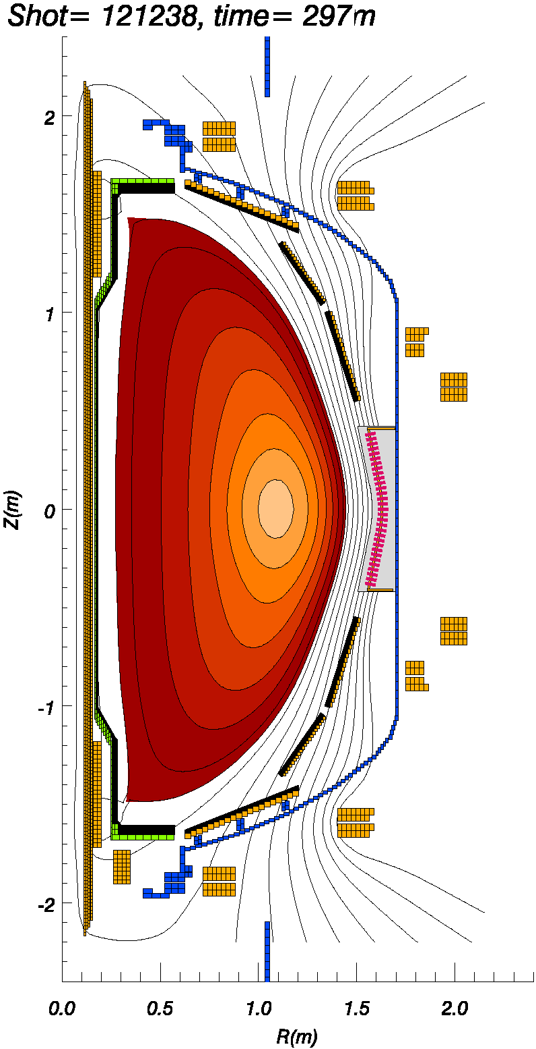
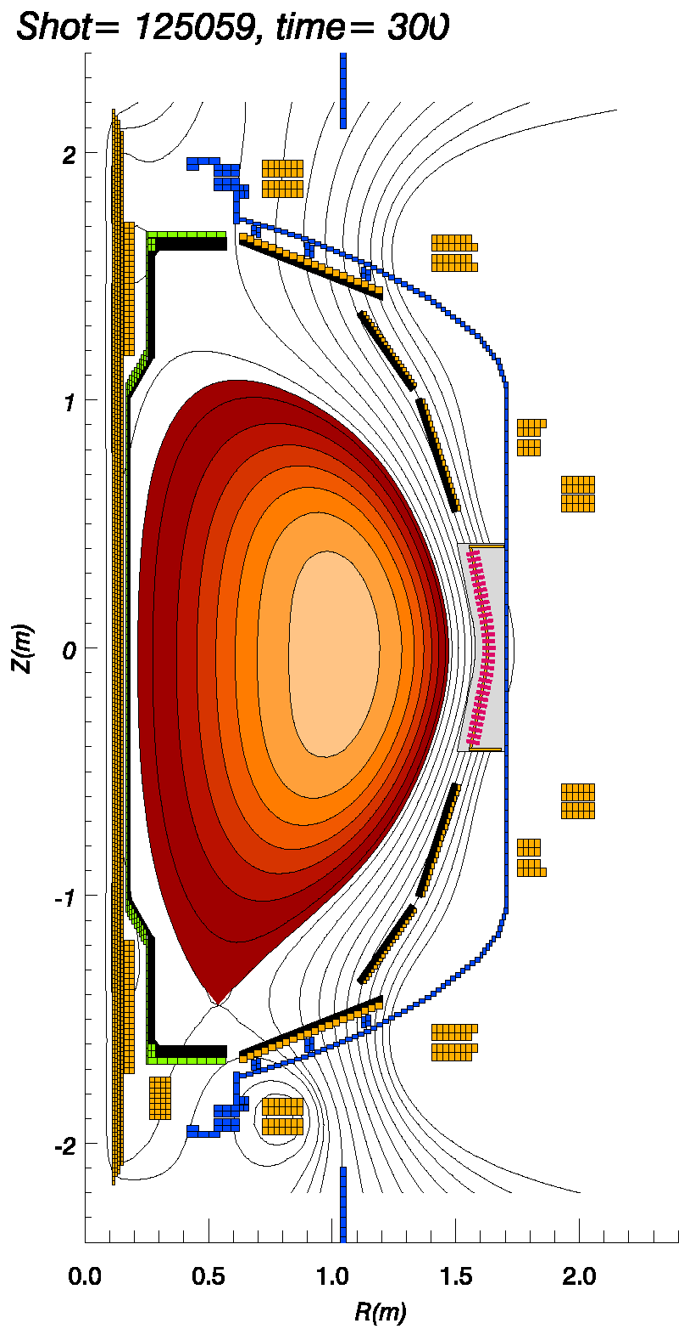
a.1. LLD and Need for Strike Point Control
Liquid lithium divertor (LLD), is installed on NSTX,
Expected reduced recycling with LLD depends on proximity of the outer strike point (SP) to LLD.
To get better and consistent density reduction and to avoid contact with the LLD and the CHI gap, the most important parameter is SP position and it needs to be closely controlled.
Illustration of LLD inside NSTX
LLD
LLD
R=0.65
R=0.84
R=0.65
R=0.84
Transport Simulations a) High δ: %25 n_{e} reduction b) Low δ: %50 n_{e} reduction

Slide 9
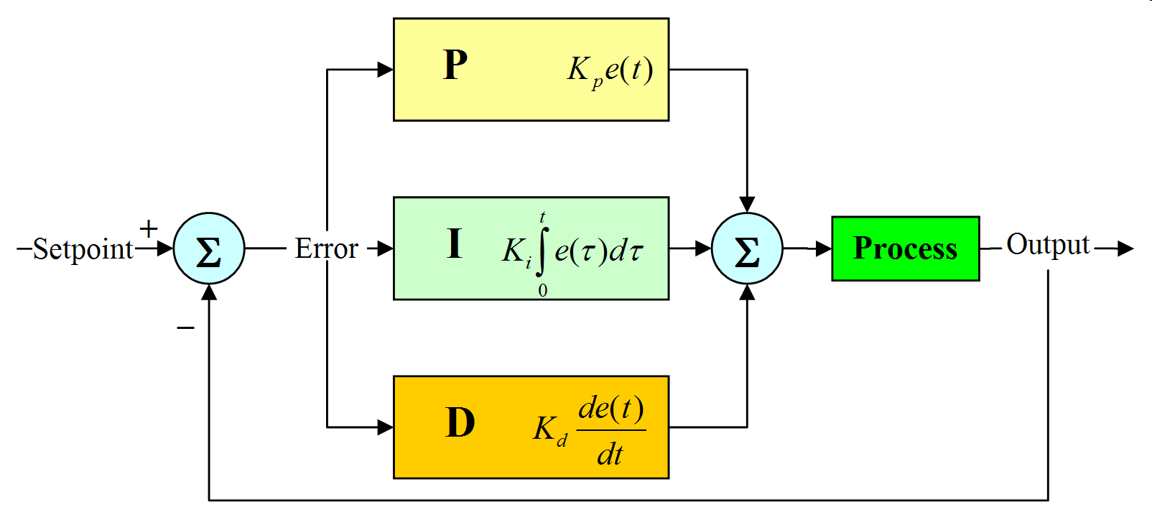
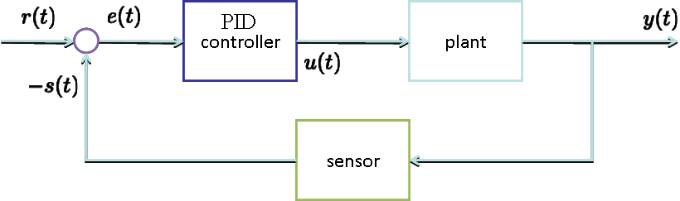
Design a Real Time Controller for Strike Point
Use the insight from the non-dynamic model to design a PID controller to keep the strike point at the center of LLD, with ~1 cm variation from the reference value.
Why PID?
  Simple but effective (used in >90% of controlers)
  First try PID before going to more detailed controls
Study the compromise with respect to the loss in control for shape control and other control aims.
In this case, s=position and r=reference position of the strike point.
Notes:
{\mathcal J} = \kappa_1 \int_t \int_\psi \left[ v_t(\psi,t) - v_t^*(\psi,t)\right]^2 d\psi\,dt + \kappa_2 \int_t \int_\psi f_\text{NBI}^2(\psi,t) d\psi\,dt
9

Slide 10
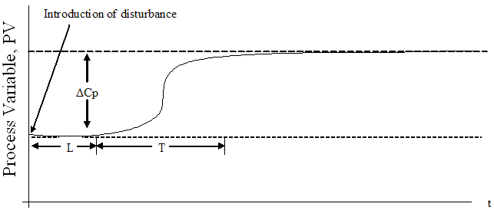


Experiment Analysis: Step Response and PID controller
L = lag in time response
ΔCp (%) = the percentage change in output signal in response to the initial step disturbance
T = the time taken for this change to occur
N = ; where N is the reaction rate
Given these we define
PF2
P
Notes:
{\mathcal J} = \kappa_1 \int_t \int_\psi \left[ v_t(\psi,t) - v_t^*(\psi,t)\right]^2 d\psi\,dt + \kappa_2 \int_t \int_\psi f_\text{NBI}^2(\psi,t) d\psi\,dt
10

Slide 11
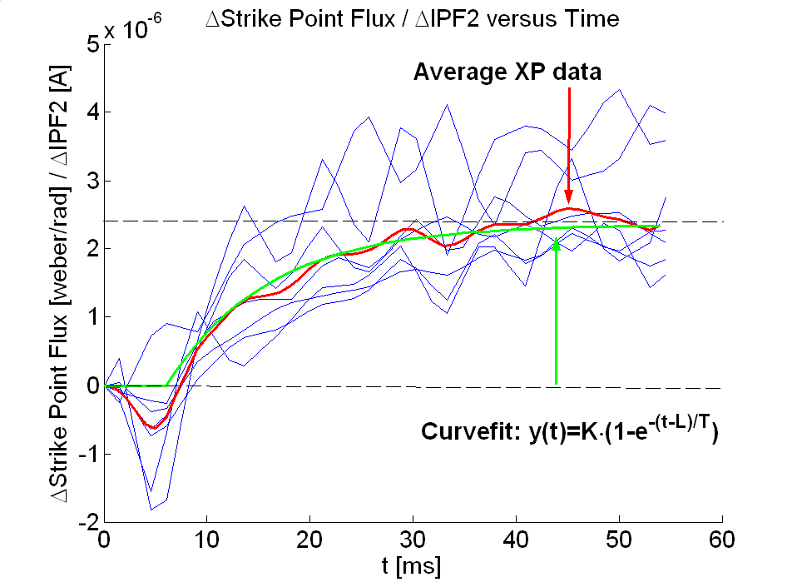
a.1. Experimental System ID (Open Loop) for Strike Point Dynamics Modeling
System Id: Identify the effect of the actuator on the boundary shape.
Reaction Curve Method
Problem:
  Many shots needed
  Need the actuator in open loop.
  Not precise
ΔP
System Id results

Slide 12
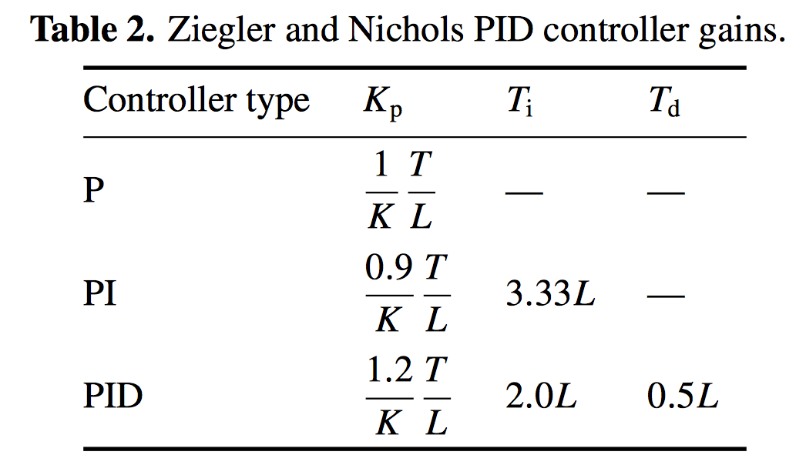
Experiment Analysis: Step Response and PID controller
The point of “tuning” a PID loop is to adjust how aggressively the controller reacts to errors between the measured process variable and desired setpoint.
  If the controlled process happens to be relatively sluggish, the PID algorithm can be configured to take immediate and dramatic actions whenever a random disturbance changes the process variable or an operator changes the setpoint.
  Conversely, if the process sensitive: more conservative, longer period.
The essence of loop tuning is identifying the aggressiveness PID
Ziegler and Nichols developed a heuristic sub-optimal but robust first guess for PID controller gains based on their expertise in the controls:
Notes:
{\mathcal J} = \kappa_1 \int_t \int_\psi \left[ v_t(\psi,t) - v_t^*(\psi,t)\right]^2 d\psi\,dt + \kappa_2 \int_t \int_\psi f_\text{NBI}^2(\psi,t) d\psi\,dt
12

Slide 13
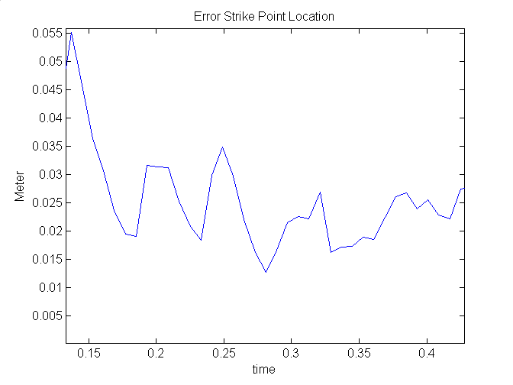
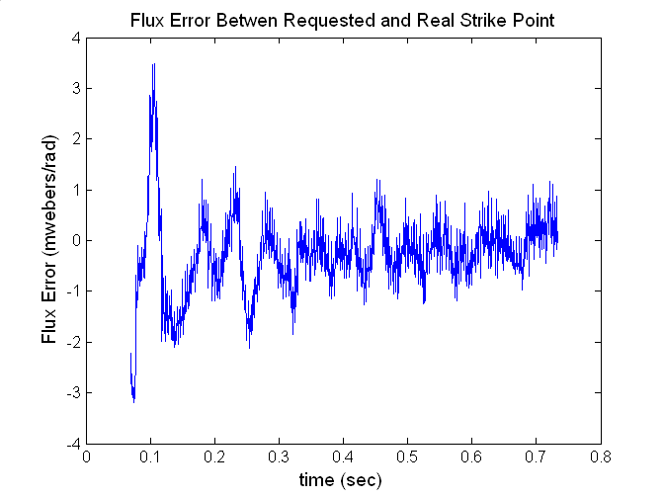
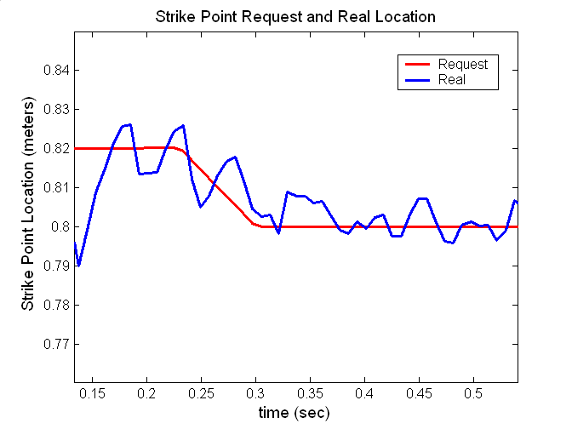
Results: Step Response and PID controller
Shot 133886:
Calculated PID controller P: 170 – 550 (mean 360)
P-I has 1-2 ratio I: 340 – 1100 (mean 720)
Experimental tuned these values in experiment to P: 400 and I: 800.
Notes:
{\mathcal J} = \kappa_1 \int_t \int_\psi \left[ v_t(\psi,t) - v_t^*(\psi,t)\right]^2 d\psi\,dt + \kappa_2 \int_t \int_\psi f_\text{NBI}^2(\psi,t) d\psi\,dt
13

Slide 14
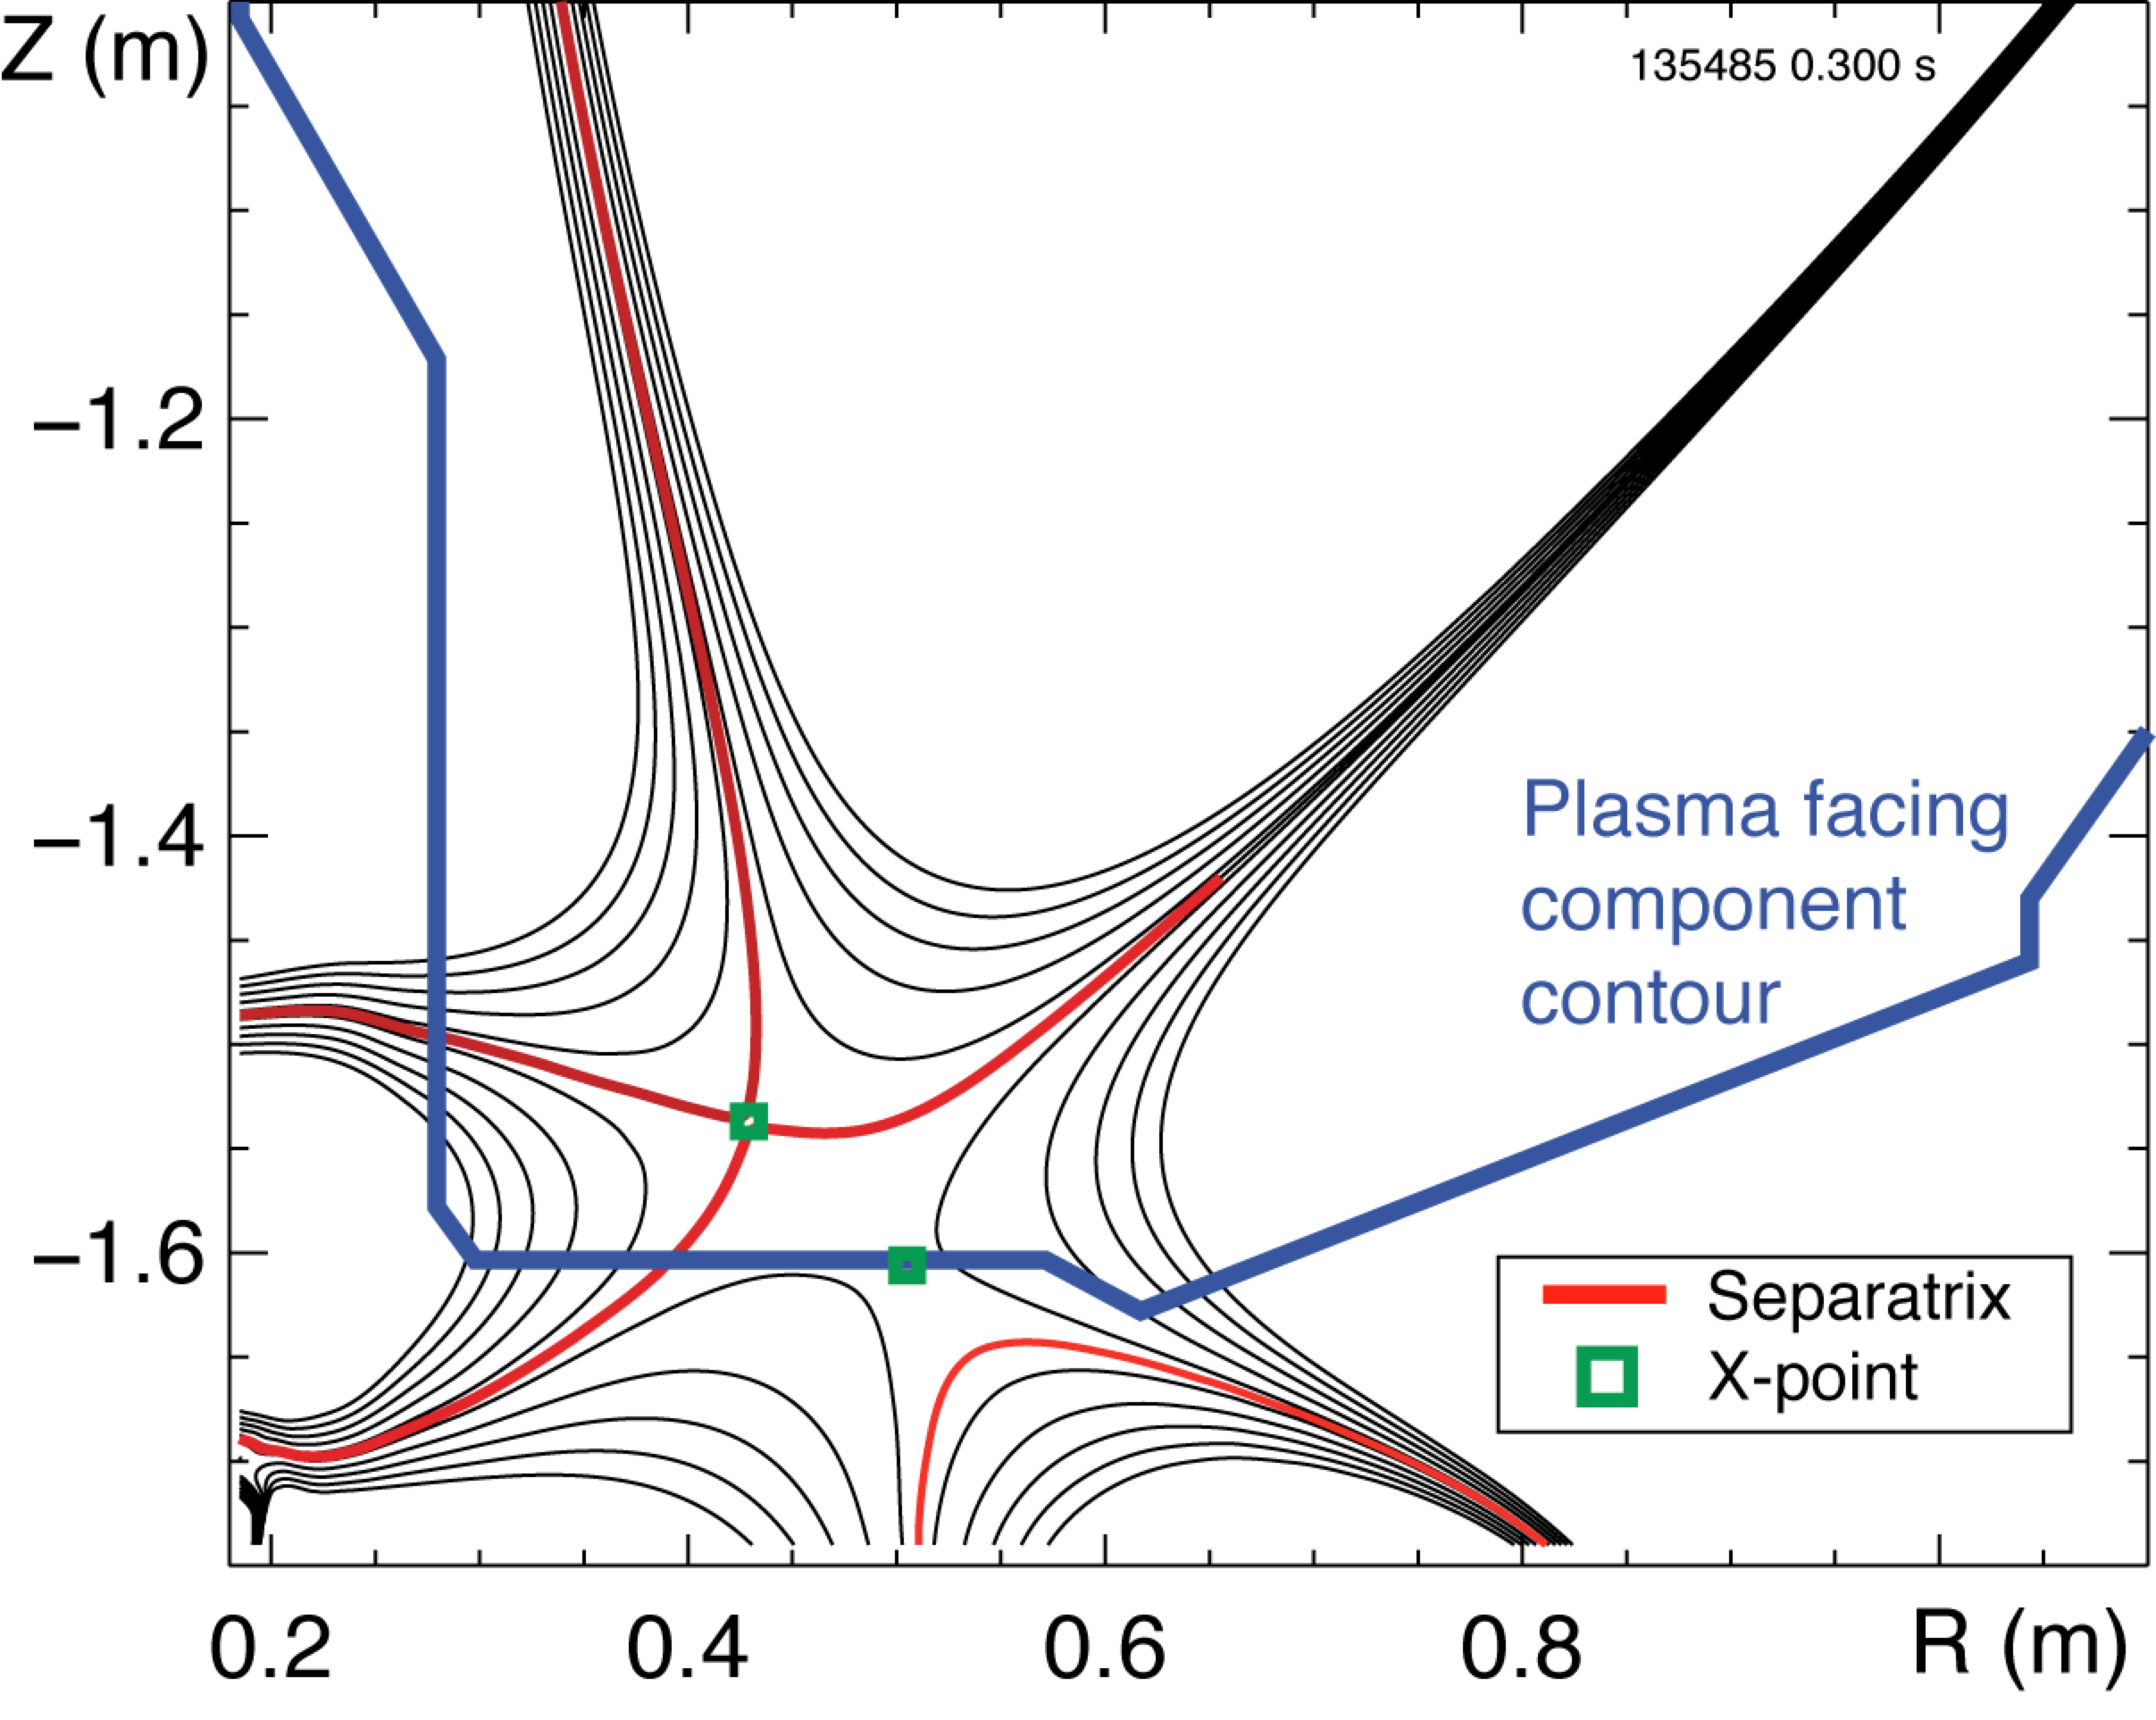
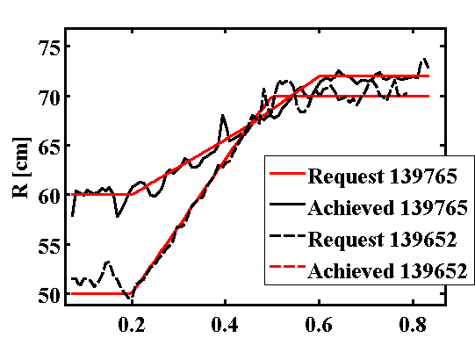
a.1. Combined Upper/Lower-Inner/Outer
Strike Point (SP) Control
PID control for U/L-I/O SP to enable “snowflake”, LLD operation
8 PF coils in Single-input-single-output control (Outer gap, vertical position and 4 SP are controlled).
Snowflake high-flux expansion divertor obtained via SP control at NSTX
Example SP control
Notes:
{\mathcal J} = \kappa_1 \int_t \int_\psi \left[ v_t(\psi,t) - v_t^*(\psi,t)\right]^2 d\psi\,dt + \kappa_2 \int_t \int_\psi f_\text{NBI}^2(\psi,t) d\psi\,dt
14

Slide 15
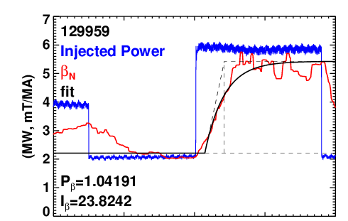
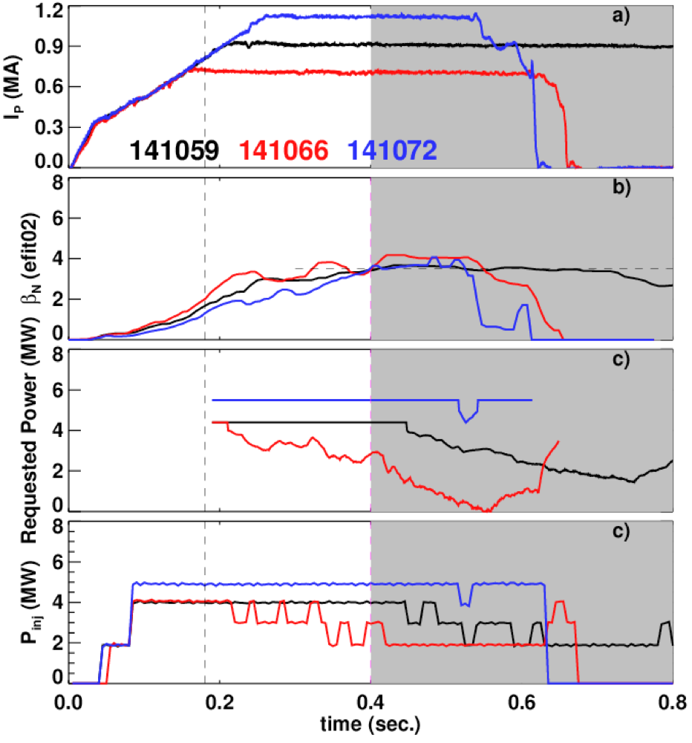
a.2. Experimental System ID (Open Loop) for β_{N}
Controller implemented in the General Atomics plasma control system (PCS), implemented at NSTX.
Measure β_{N} in realtime with rtEFIT.
Use PID scheme to determine requested power:
Determination of Gains Using Ziegler-Nichols Method
I_{p}=700 kA, τ_{β}=27, τ_{dead}=14
B_{T}=0.485 T, δβ_{N}=3.2
Constant-β_{N} During I_{P} and B_{T} Scans
n=1 ramps
Use Ziegler-Nichols method to determine P & I.
  Based on magnitude, delay, and time-scale of the β_{N} response to beam steps.
Convert “analog” requested power to NB modulations.
  Minimum modulation time of 15 msec.

Slide 16
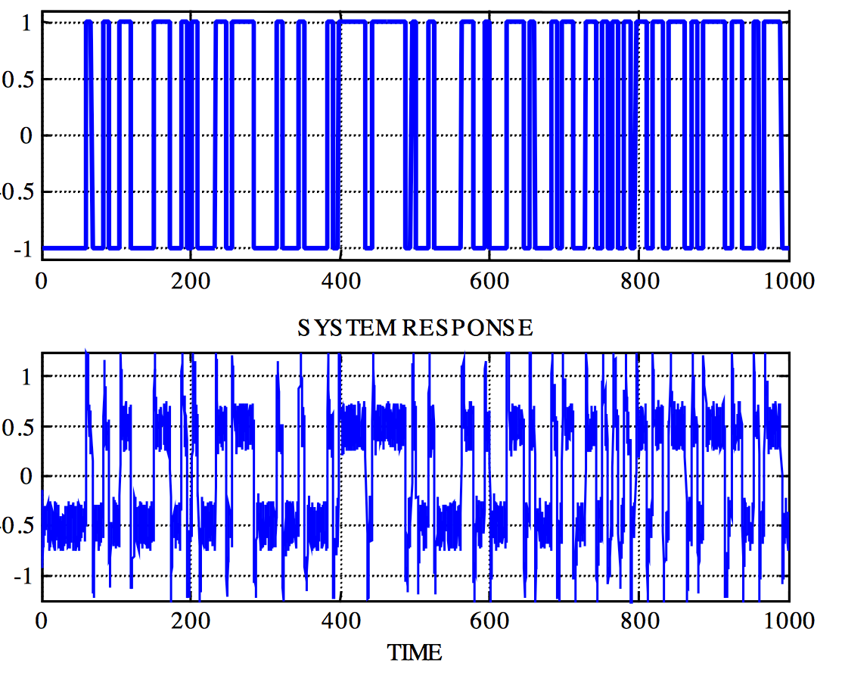
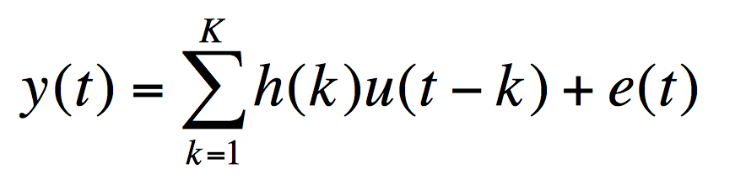
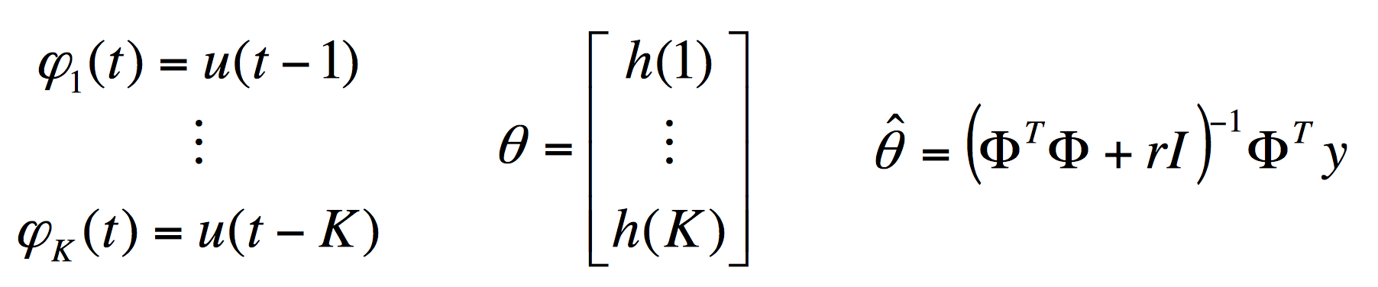
a.3. Pseudo-random Binary sequence System Identification
(reaction curve on steroids)
Impulse response model
Linear regression representation

Slide 17
b. Experimental: Closed Loop

Slide 18
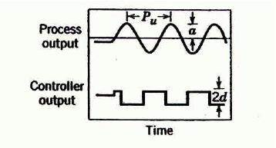
b. Improved Experimental System ID:
Closed Loop Auto-tune with Relay Feedback
Control
Output
→
Choose a special control function, the relay feedback.
This control induces a critical response from the system which gives the most important mode for control.
The closed-loop plant response period (P_{u}) & amplitude (A) are used for controller tuning.
Process
Output

Slide 19
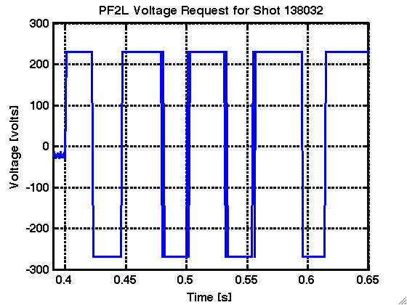
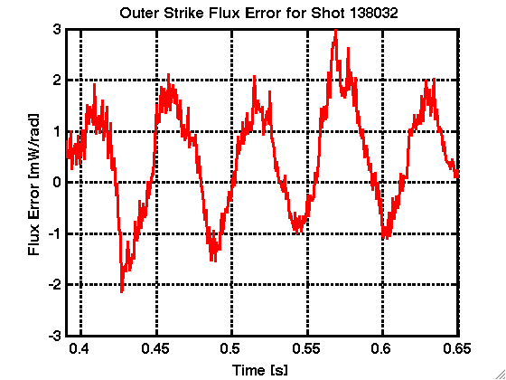
b. Improved Experimental System ID:
Closed Loop Auto-tune with Relay Feedback
h
h
Control
Output
→
Choose a special control function, the relay feedback.
This control induces a critical response from the system which gives the most important mode for control.
The closed-loop plant response period (P_{u}) & amplitude (A) are used for controller tuning.
Example: P_gain: 2h/(A)
Process
Output
A
P_{u}

Slide 20
b. Advantages of Closed Loop Tuning
It identifies process information around the important frequency, the ultimate frequency (the frequency where the phase angle is). Instead of full spectral analysis.
It is a closed-loop test; therefore, the process will not drift away from the nominal operating point.
For processes with along time constant, it is a more time-efficient method than conventional step or pulse testing. The experimental time is roughly equal to two to four times the ultimate period.
SID for actuators that can’t be open loop (ex: vertical control)
Methods for minimally invasive auto-tuning the control during the shot as it evolves (u =u[Normal Control] + u[Relay]). Useful for RWM/NTMs and minutes long ITER shots.
Example:

Slide 21
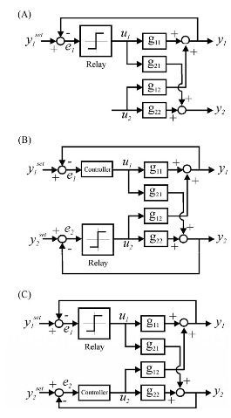
Sequential SISO Relay Feedback System ID for X-point/SP.
Sequential SISO Tuning
Perform relay-feedback for SP and X-point using Sequential Single Input Single Output Method.
Tune SP control, then X-point control while SP control is on, finally tune SP control while X-point control is on.
Relay feedback worked as expected.

Slide 22
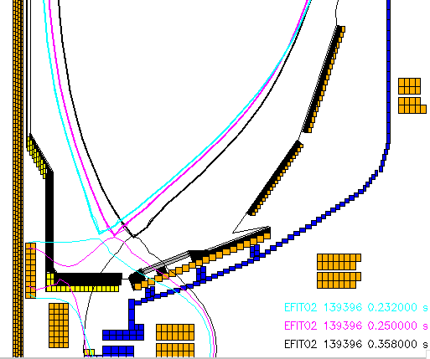
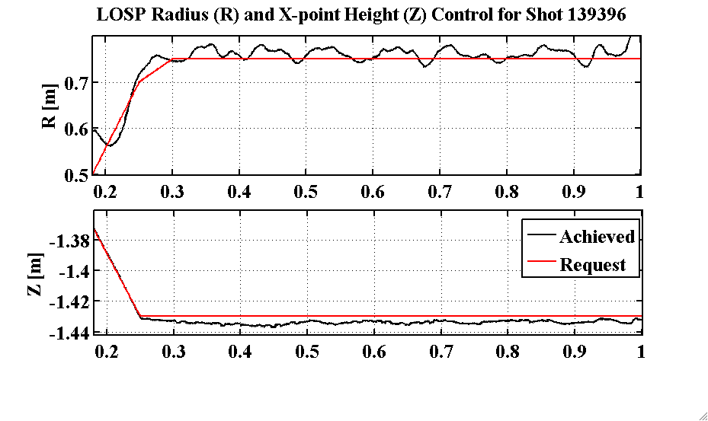

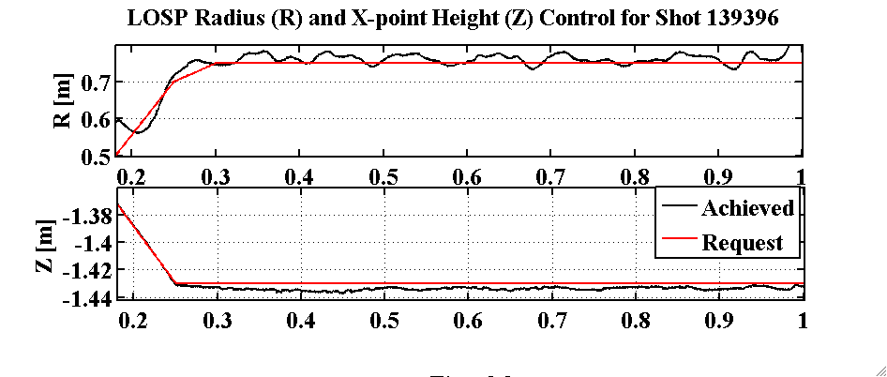
c. Successful Development of Combined X-point Height / SP Control
Tuned via Relay-Feedback.
Achieved RMS <1 cm X-point height error and <2 cm SP.
Scenario used for LLD experiments.
Evolution of Plasma Boundary: X-point height roughly constant as OSP ramps

Slide 23
b. Data Mining

Slide 24
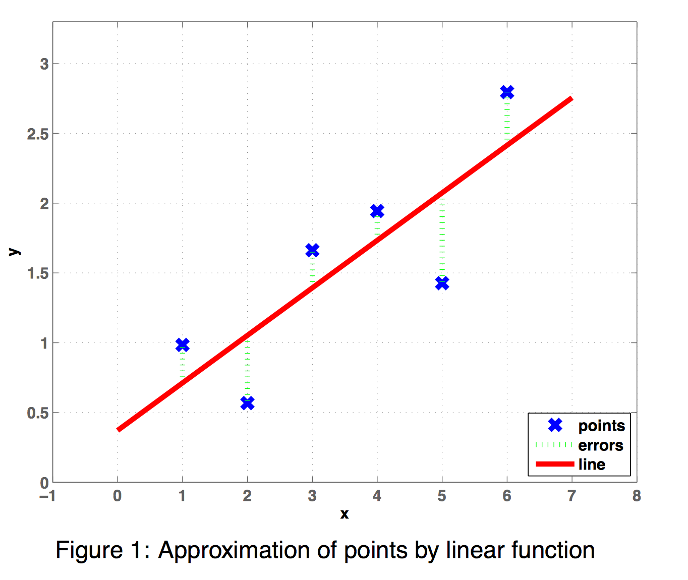
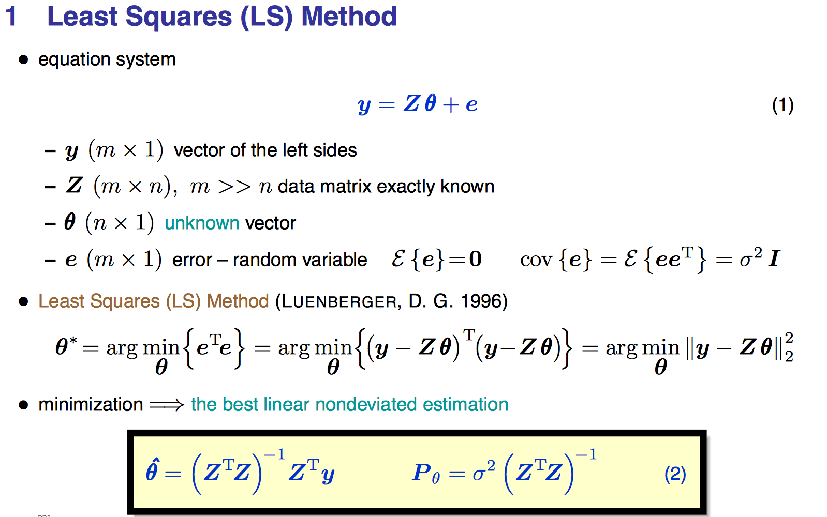
Simple Data Fitting
Ideas expand to More Complicated Methods of experimental data fitting (ARMA-X etc.)

Slide 25
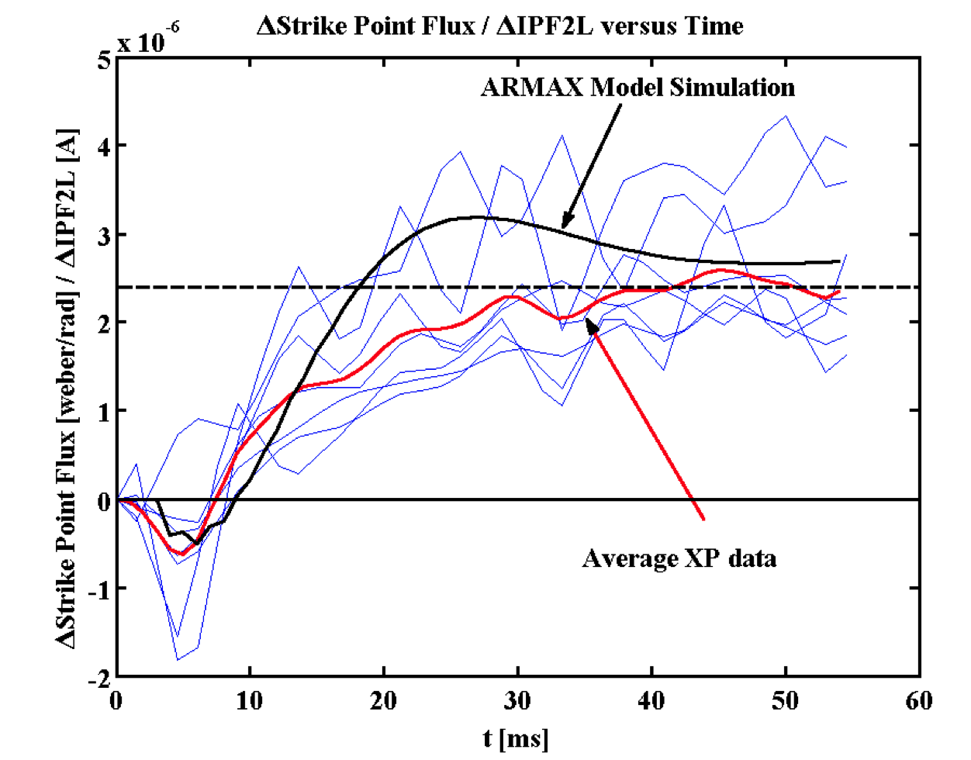
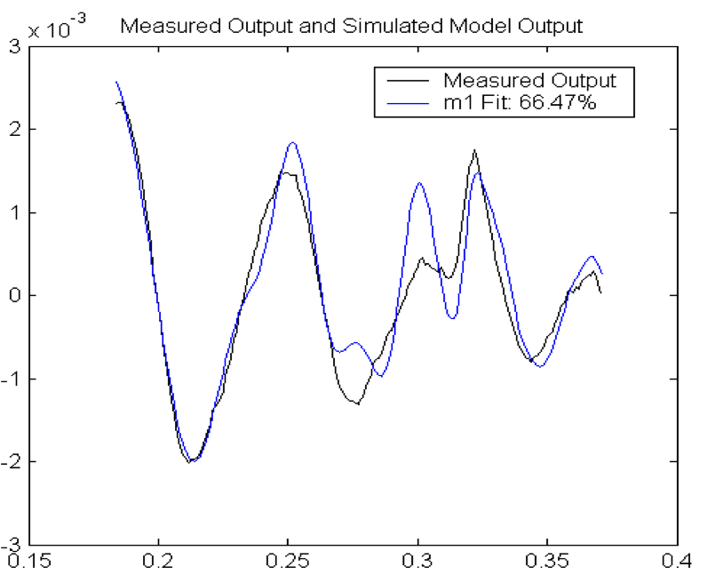
d) Strike Point Dynamics via Data Mining
Use the experimental data which was not intended for SID to obtain a linear system:
Find the coefficients via subspace algorithms (ARMA-X)
Black: EFIT data for shot 133888
Blue: Simulation of the ARMAX model

Slide 26
c. Use reduction of the complicated physics

Slide 27
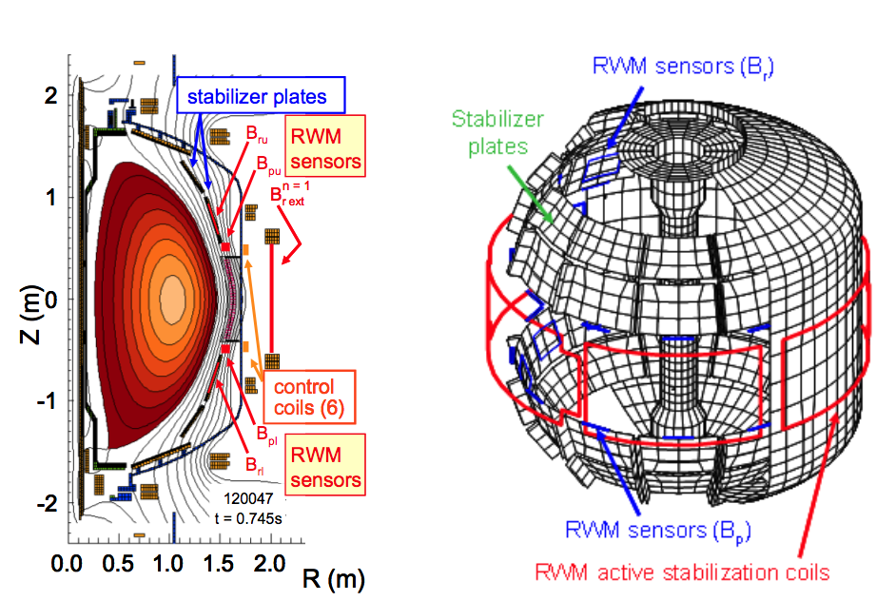
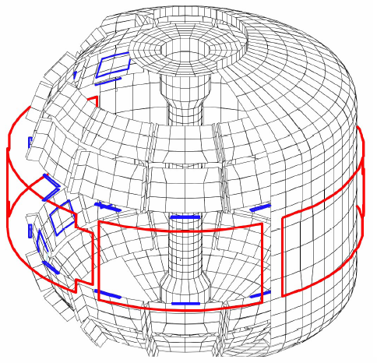
c.1. RWM Control: 3-D Field Coils Important For Scenario Development
Pre-programmed n=3 correction
Main VF coil is not a
perfect circle
n=1 feedback system
Internal B_{R} and B_{P} sensors
Slow response: error field correction
Fast response: RWM control
Newly implemented state-space RWM controller.
Copper passive
conductor plates
SS Vacuum
Vessel
B_{R}
Sensor
B_{P} Sensor
6 ex-vessel midplane control coils

Slide 28
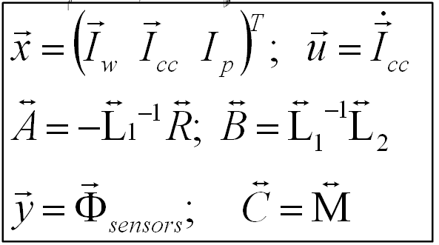
c.1. New RWM State Space Controller Implemented to
Sustain High β_{N}
Full 3-D model
~3000+ states
State reduction (< 20 states)
RWM
eigenfunction(2 phases, 2 states)
Balancing
transformation
…
truncate
Theoretical feedback performance (ω_{φ} = 0, 12 states)
Controller can compensate for wall currents
  Including mode-induced current
Potential to allow more flexible control coil positioning
  May allow control coils to be moved further from plasma, shielded
  Examined for ITER
Katsuro-Hopkins, et al., NF 47 (2007) 1157

Slide 29
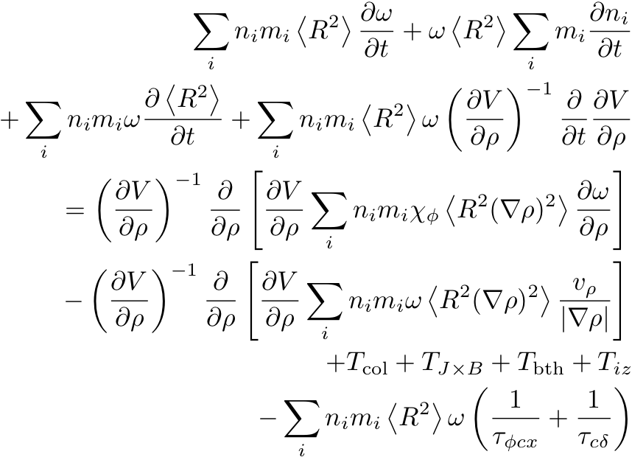
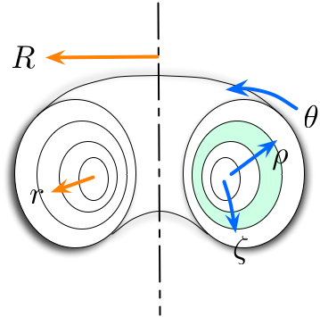
c.2. Rotation Control:
Governing Equation
Toroidal momentum balance (Goldston, 1986)
Temporal change
Diffusion
Pinch
0
Torque input
Loss
(charge ex, ripple)
0
Notes:
\sum_i n_i m_i \left<R^2\right> \frac{\partial \omega}{\partial t} + \omega \left<R^2\right> \sum_i m_i \frac{\partial n_i}{\partial t} \\ + \sum_i n_i m_i \omega \frac{\partial \left<R^2\right>}{\partial t} + \sum_i n_i m_i \left<R^2\right> \omega \left( \frac{\partial V}{\partial\rho}\right)^{-1} \frac{\partial}{\partial t} \frac{\partial V}{\partial \rho}\\ = \left( \frac{\partial V}{\partial\rho}\right)^{-1}\frac{\partial}{\partial \rho} \left[\frac{\partial V}{\partial \rho}\sum_i n_i m_i \chi_\phi \left< R^2 (\nabla \rho)^2\right> \frac{\partial\omega}{\partial\rho}\right] \\ - \left( \frac{\partial V}{\partial\rho}\right)^{-1}\frac{\partial}{\partial \rho} \left[\frac{\partial V}{\partial \rho}\sum_i n_i m_i \omega \left< R^2 (\nabla \rho)^2\right> \frac{v_\rho}{|\nabla\rho|}\right] \\ + T_\text{col} + T_{J\times B} + T_\text{bth} + T_{iz} \\ - \sum_i n_i m_i \left< R^2\right> \omega \left( \frac{1}{\tau_{\phi cx}} + \frac{1}{\tau_{c\delta}}\right)

Slide 30
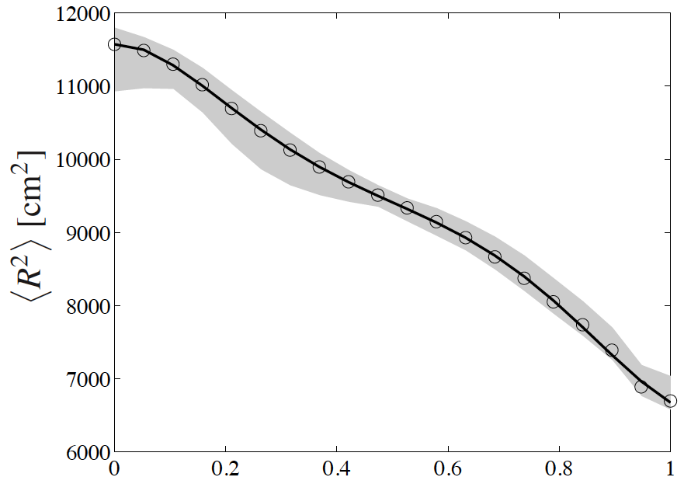
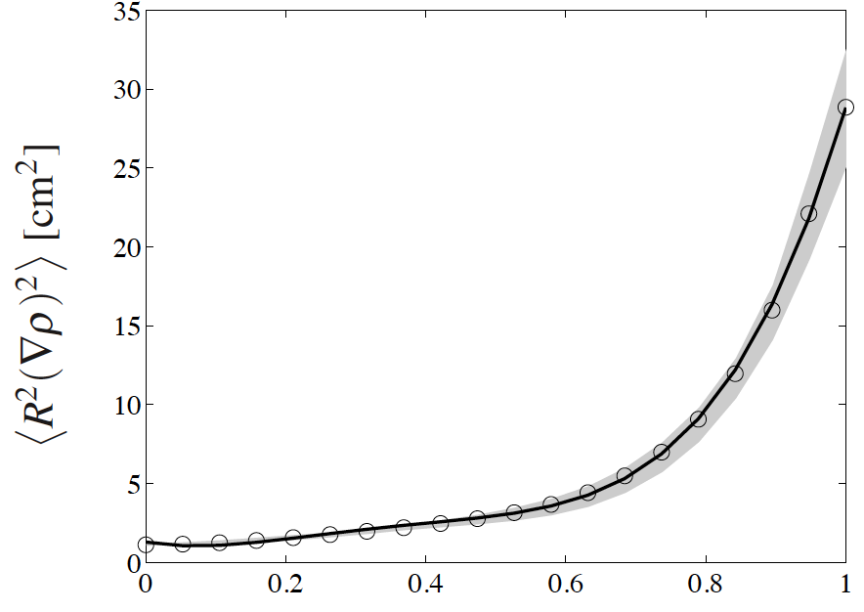

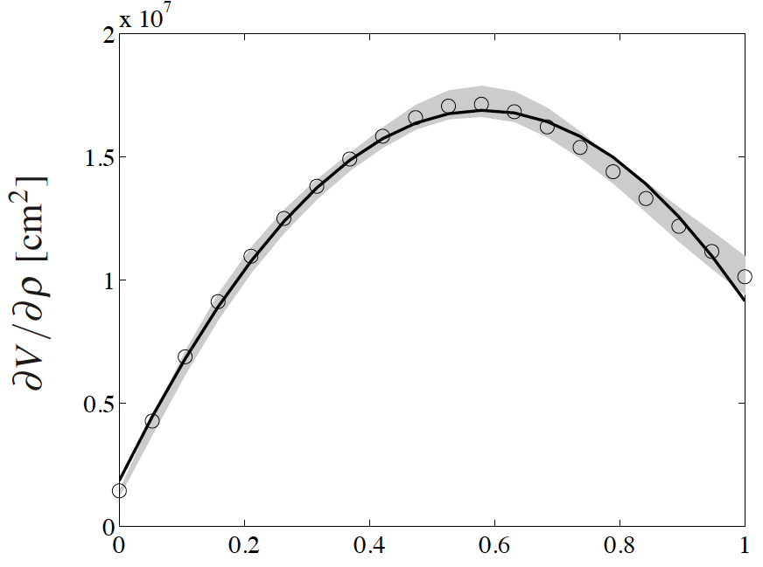
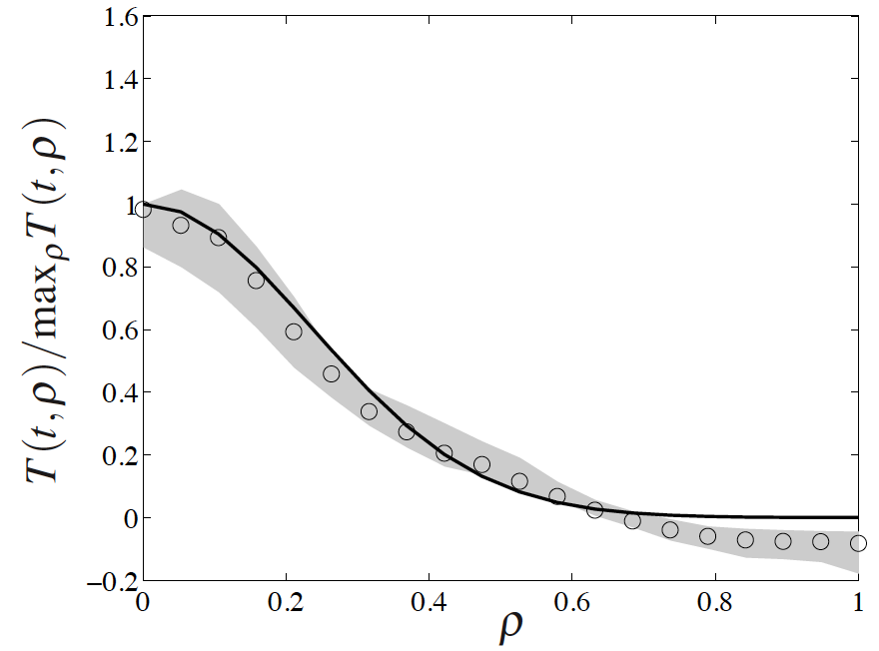

Shape Functions
Circle: time avg
Shade: variation
Line: curve fit
Shot 120001
Model shape functions with curve fit of time averages

Slide 31



Model Equation
Toroidal momentum balance
  1D Linear PDE (parabolic) – diffusion equation with forcing
  Neumann (ρ=0) and Dirichlet (ρ=1) BCs
  Curve fit coefficients (4 shape variables)
  Coefficients to be supplied from data: and

Slide 32




c.2. Rotation Control
Reduced order model for rotation control via NB & 3D coils(NTV)
Adequate models for torque inputs and time evolution
NBI Torque profile prediction:
Model versus data
Rotation time evolution:
Reduced model versus TRANSP data
NTV torque profile: Calculations (Zhu et al.) versus experimental data

Slide 33


Controller Design
Freeze A (linear time invariant)
Steady desired state (Ex: avg of ω = ω_{d} = 100,000 rad/sec)
Cost function for LQR
Response time ~ 100 ms
Actuator shapes
  Torque input, NBI, NTV → Gaussian
Side note: eigenvalues of A < 0 (parabolic equation)
Notes:
J = \int_{t_0}^\infty \left( \tilde x^T Q \tilde x + u^T R u \right)dt

Slide 34



a.2. Optimal Rotation Control
Converted PDE to ODE for control purpose
Solve the optimization problem to minimize the cost function
The feedback control law that minimizes is given by differential Riccati equation.
Example shows where an average of 10% change in Ω is requested to be achieves in 20 ms.
Optimal Ω control with full state control

Slide 35
Recent and In Development Capabilities

Slide 36

Simserver: Simulation Model
Simulate PCS realtime computers on other machines. Now can simulate the updated PCS.
Ability to run PCS tests with mds data (no dynamics)
Ran/Tested plasma simulations with TokSys plasma model.
Simserver: Ability to connect the plasma model with PCS in real-time
Simserver
⬅➔ Real-time Connect Plasma Model with PCS

Slide 37

Simserver
Tokamak Simulation consists of PS, Tokamak and diagnostic model.
PS model is not working properly needs to be modified.
Linear Tokamak Model Works but needs improvement
Needs update

Slide 38
New Capability: TRANS (and P-TRANSP)
TRANSP integration into this structure.
Time TRANSP sim >> PCS+Simserver sim, i.e. time nonissue
Exchange data between TRASNP
Interface developed (R. Andre and D. Boyer)
Simserver
⬅➔ Real-time Connect Plasma Model with PCS
P-TRANSP

Slide 39

TRANSP Integration for Control (Boyer)

Slide 40


q profile and BetaN control
TRANS Model System ID
Designed control
Simulations ➔
To be implemented
this year (D. Boyer)

Slide 41
q profile and BetaN control
TRANS Model System ID
Designed control
Simulations ➔
To be implemented
this year (D. Boyer)

Slide 42
Control based on Real-Time System Identification

Slide 43
Snowflake Divertor (SFD) Has Advantages Compared to the Standard X-point Divertor
Exact Snowflake
Snowflake divertor(SFD): second-order null (2 X-points)
Geometric changes compared to standard divertor can lead to:
  High poloidal flux expansion, large plasma-wetted area ➔reduce peak q_{div}
  Four strike points ➔ share P_{div}

Slide 44

Snowflake Control System
SFD (-)
Desired SFD
+
SFD
controller
I_{PF}
-
DIII-D
SFD
locator
SFD (+)

Slide 45
Snowflake Locator: Finding the Two X-points
Locally expand the Grad-Shafranov equation in toroidal coordinates:
Keep the 3rd order terms
Find coefficients, c_{exp}, from sample points
Find the null points (X-points) <250us
Real-time calculation with reasonable accuracy (<250 us)
SFD (+)
➔

Slide 46




NSTX Snowflake Locator: Finding the Two X-points
Above: Snowflake tracking for NSTX:
Red cross is the tracked snowflake centroid
Black crosses are the calculated X-points locations by the snowflake tracking algorithm
Left: X-point position computed from the radius and angle obtained from the snowflake tracking and position of the 2nd X-point.

Slide 47



Calculation of Expansion Coefficients
Six Unknown Coefficients
Magnetic Field at 3 Points
Six Equations

Slide 48


Snowflake Controller
Control coils
Snowflake parameters
Need to find control matrix M

Slide 49

Snowflake Control: Controlling the PF Coil Currents
Snowflake parameters:θ, ρ, r_{c}, z_{c}
Calculate A matrix which shows how PF coils affect X-points (2 ms)
3 closest PF coils are used for controlling the formation
θ
F4B
x
x
ρ
x
F5B
F8B
Location of the X-points and Centroid

Slide 50

Snowflake Control: Obtaining Exact Snowflake (ρ Scan)
Simulation

Slide 51
Snowflake Control: Obtaining Exact Snowflake (ρ Scan)
Simulation

Slide 52

Snowflake Control: Obtaining Snowflake (Exact, + and -)
Near Exact
Snowflake
Snowflake Control (Control Starts at 3 s)
Obtained long stable S-F close to exact S-F
  No adverse confinement degradation
  Pedestal profile for S-F has little change compared to regular divertor
  Observed broadening of heat flux profiles with snowflake

Slide 53

Snowflake Control: Scanning the Angle
Simulation

Slide 54
Snowflake Control: Scanning the Angle
Simulation

Slide 55



Snowflake Control: Angle Control (+80° to -45°)
Angle requested
Angle achieved
Time [ms]
x
80°
x
x
-45°
x

Slide 56
Snowflake with 2.5x Reduced Heat Flux Compatible with High Performance Plasmas
β_{N} = 3.0 and H98(y,2) ≅ 1.35 conditions preserved with SF with no adverse effects
Outer:
  SF bifurcating targets
  Peak heat flux outer reduced by 2.5x for the SF AT
Inner:
  Similar heat flux profiles at the inner target
  SF: q^{P}_{⊥,Iin} > q^{P}_{⊥,out}

Slide 57

Snowflake with 2.5x Reduced Heat Flux Compatible with High Performance Plasmas
β_{N} = 3.0 and H98(y,2) ≅ 1.35 conditions preserved with SF with no adverse effects
  Peak heat flux outer reduced by 2.5x for the SF AT
  SF: q^{P}_{⊥,Iin} > q^{P}_{⊥,out}

Slide 58
Calculation of Expansion Coefficients
Six Unknown Coefficients
Magnetic Field at 3 Points
Six Equations

Slide 59
Snowflake Controller
Control coils
Snowflake parameters
Need to find control matrix M

Slide 60

Shot Plan

