Slide 1



NSTX-U
Supported by
NSTX UPGRADE POWER SUPPLY SYSTEM
Coll of Wm & Mary
Columbia U
CompX
General Atomics
FIU
INL
Johns Hopkins U
LANL
LLNL
Lodestar
MIT
Lehigh U
Nova Photonics
Old Dominion
ORNL
PPPL
Princeton U
Purdue U
SNL
Think Tank, Inc.
UC Davis
UC Irvine
UCLA
UCSD
U Colorado
U Illinois
U Maryland
U Rochester
U Tennessee
U Tulsa
U Washington
U Wisconsin
X Science LLC
Weiguo Que
Culham Sci Ctr
York U
Chubu U
Fukui U
Hiroshima U
Hyogo U
Kyoto U
Kyushu U
Kyushu Tokai U
NIFS
Niigata U
U Tokyo
JAEA
Inst for Nucl Res, Kiev
Ioffe Inst
TRINITI
Chonbuk Natl U
NFRI
KAIST
POSTECH
Seoul Natl U
ASIPP
CIEMAT
FOM Inst DIFFER
ENEA, Frascati
CEA, Cadarache
IPP, Jülich
IPP, Garching
ASCR, Czech Rep
Physics Operators’ Course
PPPL
July 28, 2015

Slide 2
Introduction
The NSTX-U power supply system includes three major parts.
  The first part is the DC power supplies which supply the current for the toroidal field (TF) coils, the poloidal field (PF) coils, the ohmic heating (OH) coil and the resistive wall mode (RWM) coils.
  The second part is the power supply real time control (PSRTC) system. The scope of the upgrade includes a new stand-alone digitizer version 2 (SAD2) , a new digital signal processor (DSP) based firing generator (FG), a new power supply communication link and a new real time control computer which runs the new PSRTC software.
  The third part is the power supply protection system which is used to prevent the coils and the power supplies from the damage under fault conditions. It includes a new digital coil protection system (DCPS) and a new PLC based hardwire control system (HCS).

Slide 3
Overview
Part I: AC Power, Magnet Coil and DC Power System
  NSTX-U AC Power System
  NSTX-U Magnet Coil System
  NSTX-U DC Power System
  Transrex Power Supply and Operation Basics
  Coil Circuit Types and TF, OH, PF, RWM Coil Power Supplies
Part II: PSRTC Hardware and Software System
  Difference Between Legacy and New PSRTC
  PSRTC Control Block Diagram
  PSRTC Control Operation Mode
  PSRTC Control Hardware Upgrade
Part III: Coil and Power Supply Protection System
  DCPS Hardware System
  DCPS Interconnection Subsystem
  DCPS Software Algorithms
  PLC based Hardwired Control System and other Protection Systems

Slide 4
NSTX-U AC Power System
PSE&G delivers the power to the PPPL using a 138 kV transmission line. Two transformers XST-1, XST-2 step down the voltage from 138 kV to 13.8 kV.
AC power system is divided into two systems, the experimental system and the auxiliary system. The experimental system includes the magnet coil loads, heating and current drive system. The auxiliary system consists of the vacuum pumping system, the gas delivery system, the cooling water system, etc.
XST-1 feeds the power to the S1 bus. It delivers the power to the two motors and generator exciters. Each generator is rated 475 MVA, 13.8 kV and 60-90 Hz. The generator output is connected to the coil system through the buses SV1 and SV2.

Slide 5
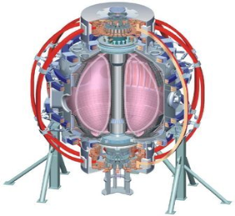
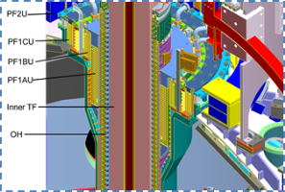
NSTX-U Magnet Coil System
The magnet coils are the current loads which are used on the NSTX-U machine. There are the toroidal field (TF) coils, the poloidal field (PF) coils, the ohmic heating (OH) coil and the resistive wall mode (RWM) coils.
  The function of the TF coil system is to provide the toroidal magnet field for the NSTX-U plasma confinement.
  The function of the OH coil is for the plasma initiation and heating the plasma.
  The function of the PF coil system is to control the plasma position and shape, including vertical and radial position stability control.
  The RWM coils are used to generate non-axisymmetric magnet fields for a variety of purposes that enhance plasma stability.
PF2U
Outer TF
PF3U
PF4U
PF5U
PF5L
PF4L
PF3L
PF2L

Slide 6
NSTX-U DC Power System
Input power is supplied to each converter by three- winding transformer with a rating of l3.8kV/750V. The transformer has a polygon primary and Δ/Y secondary windings. The polygon is arranged to produce +7.5º or -7.5º phase shifts .
Each power supply consists of two independent sections which are electrically isolated from each other.
Each power supply section has a rating of 1kV, 24kA - 6 seconds every 300 seconds which are comprised of six Power Modules and two Bypass Modules.
SV BUS 13.8 kV
AC Feeder Reactor
500 MVA AC Breaker
Rectifier Transformer
13.8 kV/750V
Power
Module
Power
Module
Bypass
Module
Bypass
Module

Slide 7
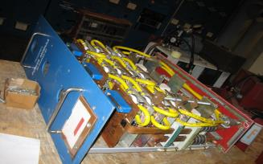
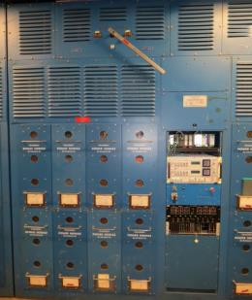
Transrex Power Supply
Each Power Module is a 6-pulse thyristor rectifier rated at 1 kV and 4 kA DC. Six power modules are paralleled which provides 24kA rating.
There are two Bypass Modules in parallel in each section.
Pringle Switch: on or off line
FG: generate firing pulses
MGD: thyristor trigger pulse
FD: local protection system
PLC Hardwired Control System (HCS): system level protection
HCS Defeater: for power supply test.
Pringle Switch
Master Gate Drivers
(MGD)
PLC HCS
Firing Generator (FG)
HCS Defeater
Fault Detector (FD)
Bypass Module
Power Module

Slide 8
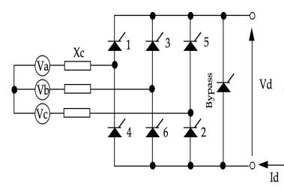
Transrex Power Supply
Standard 3-phase bridge rectifier with full-rated bypass module.
Variable AC frequency operation
50 ≤ f_{AC} ≤ 90 Hz
No load “Vd” is 1012.85 VDC with primary voltage of 13.8 kV on 13.8 kV / 750 V transformer.
One firing generator per each blue box (controls firing angle, α).
Single fault detector for each blue box (used to protect rectifier and respond to external faults).

Slide 9
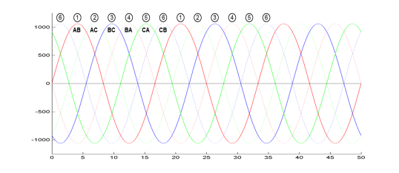
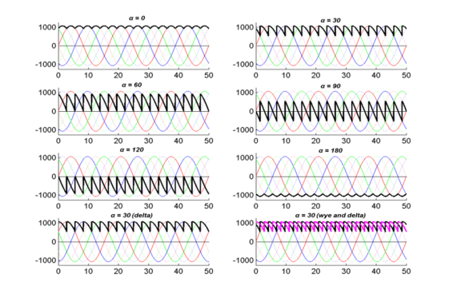
Operation Basics for the Transrex Power Supply
In normal operation, two devices from different phases are always conducting, each device conducts for 120 “electrical” degrees
Vd = 1.35V_{LL} * Cos(α). α is called “delay angle”.
In practice α is controlled such that ~0° ≤ α ≤ 165°.
0° ≤ α ≤ 90° (+Vd) is called conversion, 90° ≤ α ≤ 180°is called inversion (-Vd).

Slide 10
Coil Circuit Types
Type I
Type III
Type I – Unipolar, 2-wire circuit (current flows through a single series or parallel connected load group) –PF4, PF5
Type II
Type III – Bipolar, 4-quadrant*, 2-wire circuit (bi-directional current through a single series or parallel connected load coil group) – OH
Type II – Unipolar, 3-wire circuit (current flows through two series or parallel connected load coil groups with currents not necessarily equal) – PF1AU/L, PF1BU/L, PF2U/L
* Four Quadrant = +/- V, +/-I
Type V
Type IV
Type IV – Bipolar, 4-quadrant*, 3-wire circuit (bi-directional current through two series or parallel connected load coil groups with currents not necessarily equal) – PF1CU/L, PF3U/L
Type V – Unipolar, two layer operation, Bypassed layer is used as a diode–TF

Slide 11
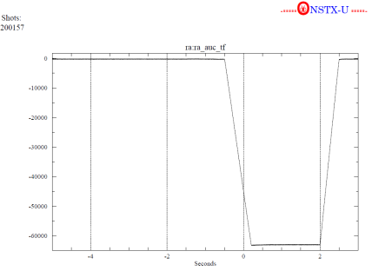
TF Coil Power Supply System
TF current (amps)
The NSTXU increases the TF current from 71 kA for 1.1 seconds to 130 kA for 7.04 seconds. The TF power supply system has eight parallel branches.
Each parallel branch has two 1 kV Transrex power supply sections in series. One section is kept on an electrical bypass condition acting as a diode. The other section is set up as a normal 1 kV power supply.
The typical current waveform for the TF coil during the Integrated System Test Procedure (ISTP).

Slide 12
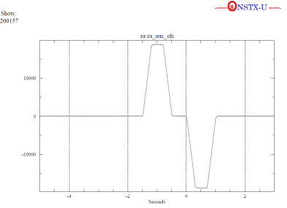
OH Coil Power Supply System
OH current (amps)
The NSTX-U OH coil requires a 6 kV bipolar power supply with an rating of +/- 24 kA for 1.47 seconds.
Two branches of power supplies are connected in anti-parallel.
The typical current waveform for the OH coil during the ISTP.

Slide 13
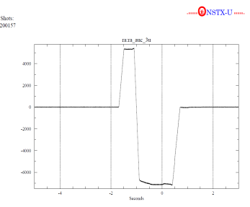
PF Coil Power Supply System
The PF coil system has 12 circuits. The PF1BU, PF1CU and PF1CL are new coils for the NSTX-U. The PF1 and PF3 upper and lower coils circuit are bipolar power supplies.
Circuit (Coil) | Type | Series/Parallel | Voltage (kV) | Currents (kA) | ESW Time (Sec)
PF1AU PF1AL | Unipolar | 2/1 | 2 | 19 | 5.5
PF1BU PF1BL | Unipolar | 2/1 | 2 | 13 | 2.1
PF1CU PF1CL | Bipolar | 2/1 | 2 | -8/+16 | 4.3
PF2U PF2L | Unipolar | 2/1 | 2 | 15 | 5.5
PF3U PF3L | Bipolar | 2/1 | 2 | -16/+12 | 5.5
PF4 | Unipolar | 2/1 | 2 | 16 | 5.5
PF5 | Unipolar | 3/1 | 3 | 34 | 5.5
PF3U current (amps)

Slide 14
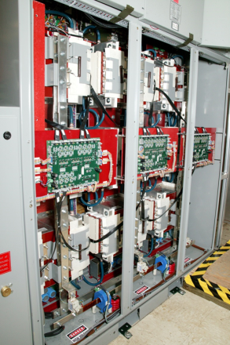
RWM Coil Power Supply System
The six RWM coils require fast and accurate current control to stabilize the plasma. The switching power amplifier (SPA) technology is selected as the power source.
The SPA consists of three independently controlled sub-units. Each SPA sub-unit consists of an H-bridge PWM inverter capable of 4-quadrant operation. The rating for each sub-unit is 1kV/3.333 kA for 6 second every 300 second.
The 1 kV thyristor rectifiers are used to charge the capacitor bank which is the energy source for the SPA.
It has internal fast current feed back loop control.

Slide 15
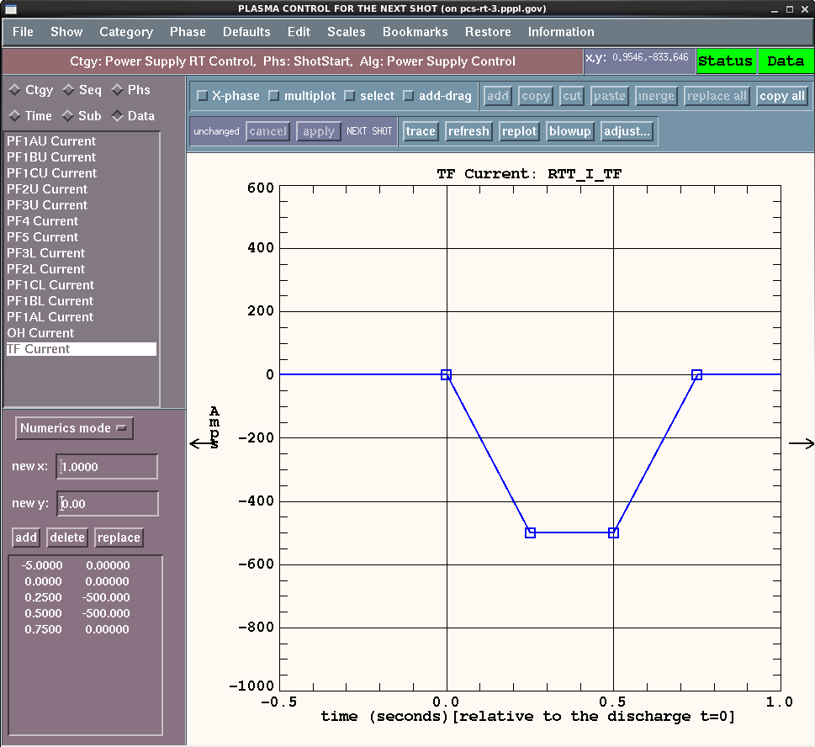
Power Supply Real Time Control System (PSRTC)
The PSRTC runs on a computer with 64-bit real-time Linux operating system. The software was developed using the General Atomics Plasma Control System (GA PCS) code generator.
The computer has 64 2.8 GHz cores with 64 GB memory is used for the NSTX-U plasma control system (PCS), including the PSRTC. It also has the fiber optic serial FPDP (SFPDP) cards used for communication.
The PSRTC requires configuration data from an MDSPlus data tree for each power supplies. For each shot, the PSRTC also archives a set of shot data in the MDSplus trees.
The control reference timing waveforms for each power supply can be defined in the PSRTC GUI using piecewise-linear method.

Slide 16
Difference Between Legacy and New PSRTC
Legacy PSRTC standalone software combined all control functions and various protection functions. The new PSRTC software handles only control functions. The DCPS handles all protection functions.
The new PSRTC software uses different control functions for the thyristor power supplies and the SPA.
A new version of the overcurrent clamp function is included in the voltage and physics control mode.

Slide 17
PSRTC Control Block Diagram
Inputs:
DCCT : Current Measurement.
Halmar Signal Conditioner: buffer and filter the DCCT signal.
SAD2: digitize the analog signal
DITS: generate time stamp
FIMM: buffer and combine the FPDP data.
SFPDP: fiber optic communication
Outputs:
SFPDP: fiber optic communication
FOMS: routing the firing angle , convert and bypass command
Firing Generator: generate the firing pulse.
Thyristor and SPA Power supply: generate DC voltage

Slide 18
PSRTC Control Operation Mode
The PSRTC computer uses the firing angle, the convert and the bypass command to control the thyristor power supplies. There are three typical control operation modes in the PSRTC.
1) Close Loop Current Control Mode
  A proportional-integral (PI) controller is used for the closed loop current control. The control reference timing waveforms can be defined in the PSRTC GUI using piecewise-linear method. To avoid integral windup, the integral gain is only applied when the error falls below 5% of the reference.
2) Voltage Control Mode
  The voltage request is from the preprogrammed reference voltage waveform. This is an open-loop voltage control. This mode is typically used for the open circuit test.
3) Physics Control Mode and Current Clamp
  The voltage request is coming from the PCS. The coil current control is based on the physics requirement for the plasma control. When the load current limit is reached, the voltage request is limited by a current clamping feature.

Slide 19
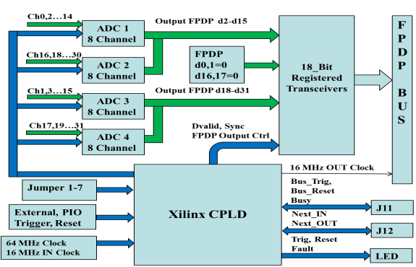
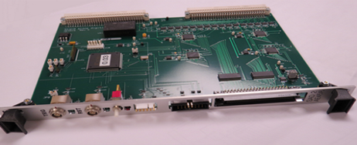
PSRTC Control Hardware Upgrade, SAD2
SAD2 circuit board
Stand Alone Digitizer Version 2 (SAD2)
  The new SAD2 is developed for the real time coil current data acquisition. It uses ADS8548 14bit eight-channel ADC. It has 32 differential analog input channels, up to 50 kHz sample rate.

Slide 20
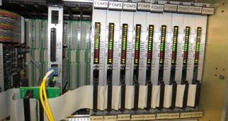
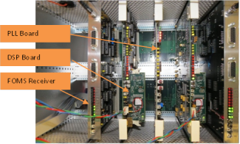
FOMS Transmitter and Receiver
FOMS Transmitter and Receiver
  FOMS transmitter works like a router. It reads the Group, Module and Power address information in the FPDP word from the real time computer and sends the command to its ultimate power supply destination.
  FOMS receiver: Type I: checks the parity error and send the 16 bits digital command word directly to the digital signal processor inside the firing generator. Type II: converts the digital command to an analog signal to control the SPA.
FOMS Transmitter Board
FOMS Receiver Board

Slide 21
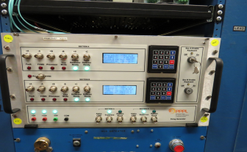
New Firing Generator (FG)
The new FG is designed based on the TI TMS320F28335 DSP. It receives the firing angle command from the PSRTC real time computer and generates the six firing pulses for the thyristors at the appropriate phase angle of the incoming AC voltage (50-90 Hz).
The PLL board receives the phase A, B, C voltage signal and generates the continuous digital pulse train which runs at 3600*f Hz (f is the input AC voltage frequency). The digital pulse train is used as a counter clock and each clock is 0.1 degree. The firing angle can be calculated based on the pulse count.
The DSP uses this clock to control the timing for the six thyristor firing pulse.
Firing Generator Front Panel
Firing Generator Circuit Board

Slide 22
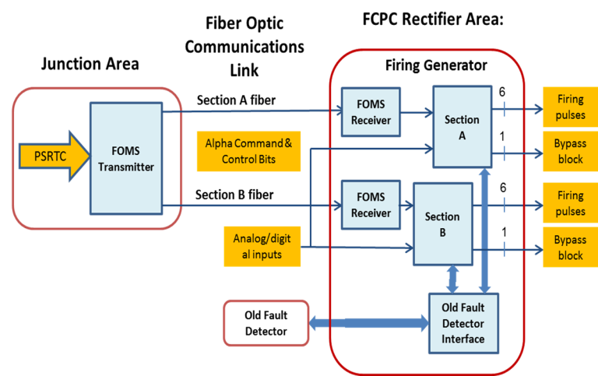
New Firing Generator System Diagram

Slide 23
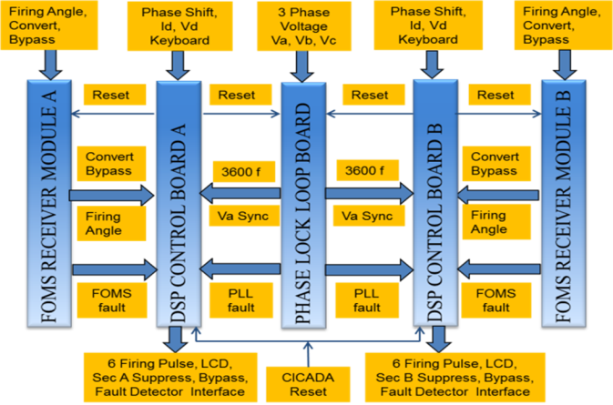
Firing Generator Function Block Diagram

Slide 24
Coil and Power Supply Protection System
There are two separate protection systems in NSTX-U. The first is the coil protection system. NSTX-U replaced the old analog coil protection system with the new digital coil protection system (DCPS).
The second is the power supply protection system. This system prevents the rectifiers from any overcurrent, incorrect voltage, and over temperature fault.
The Hardwired Control System (HCS) is the central protection control system which is used to coordinate the two protection system. It is implemented to invoke the Level 1 (suppress and bypass power supplies) and Level 3 (close mechanical bypass/grounding switches) faults of the rectifier power supply system. The HCS has been redesigned using Siemens PLC S7-300 for the NSTX-U.

Slide 25
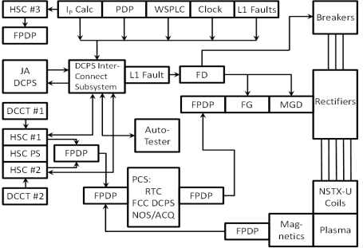
DCPS Hardware System
The new DCPS will protect the coils and their mechanical supports when the magnetic Lorentz forces, the mechanical stresses or the temperature exceed the operating envelope.
The NSTX-U DCPS comprises the Fusion Computation Center (FCC) DCPS and the Junction Area (JA) DCPS. The FCC DCPS share the real time computer with the PCS. The JA DCPS use a stand-alone real time computer.
Combined with the fault detector (FD), it has three levels of coil current protection. The instant trip settings from low to high are the FCC DCPS, the JA DCPS and the FD. Each level acts as the back up to its predecessor.

Slide 26
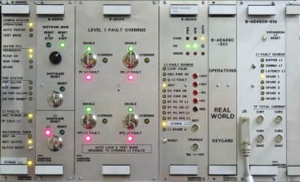
DCPS Interconnection Subsystem
The DCPS interconnection subsystem provides the copper and fiber optic connectivity for several NSTX-U control, data acquisition, protection and testing systems. The features and functionality includes:
  Connect all analog inputs and digital inputs and outputs for the JA DCPS real time computer.
  Centralize fault latching and routing from multiple systems to the FD.
  Quick repeatable and interlocked reconfiguration of interconnections for Auto Tester interfacing to the JA DCPS.
  Bussed chassis configuration enabling ability to modify, upgrade and maintain without total redesign

Slide 27
DCPS Software Algorithms
The new DCPS protection scheme considers the different coil currents combination for the force and stress calculation. The DCPS has five types of software algorithms for the coil protection.
  Over-Current Trip: The current in the coil circuit is over the limit.
  Action Integral Trip: ∫I²(t)dt is used to estimate the coil temperature rise due to Joule heating.
  Forces and Moments (torques): This algorithm will calculate the radial, vertical magnetic Lorentz forces and torque on the coil.
  Derived Limit Variables Type I (stress): This algorithm can be used to calculate the particular mechanical stress at a certain location in the coil support structure.
  Derived Limit Variables Type II (future use): This algorithm is a square root of the sum of squares of all Type I limit variables.

Slide 28
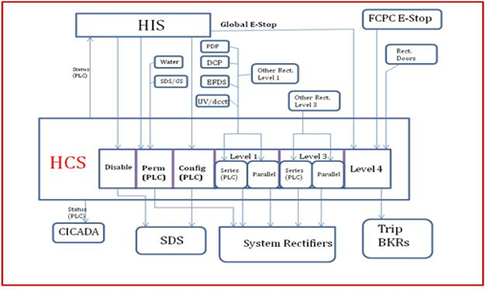
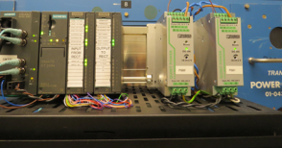
PLC based Hardwired Control System (HCS)
The function of the programmable logic controller (PLC) includes:
  The PLC accepts the interlock commands from the Hardwired Interlocked System (HIS) from the main control room.
  The CONFIGURE is used to permit the line and ground switch to be configured. The ARM is used to give the permissive signal to allow the power supplies to be controlled by the real time computer.
  Process the fault trip signals from DCPS, FD, PDP timer, etc. and invoke Level 1 (series) Fault in all the associated power supplies

Slide 29
Other Protection Systems
Fault Detector (FD)
  The FD is a key component for the rectifier power supplies, which is used for local protection (second line of defense) set “outside” software protection limits. It has several protection function:
    Section overcurrent
    Module overcurrent
    Current imbalance (module)
    Bypass current
    Reverse bypass current
    Max junction current

Slide 30
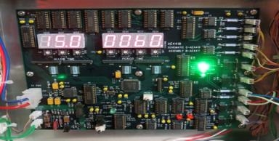
PDP Timer
Pulse Duration Period (PDP) Timer
  The FD overtime protection is not functional when the coil current below 3 kA. To prevent the coil from overheat due to long time small current, the PDP timer is added to the coil protection system.
  PDP timer enforces pulse duration and repetition rate for all systems.
  There are two time settings for the PDP timer. One is the “Allow Time” which is from 1 to 20 seconds. The other is the “Period Time” which is from 1 to 40 minutes.
  The PDP timer is triggered by the Start of Pulse (SOP). During the allow time, the PDP timer send out the permissive signal to the HCS, DCPS, and all the power supply control system until the “allow time” is expired. The PDP will not re-trigger until the “period time is expired.

Slide 31
Ground Fault Protection System
All the coils in the NSTX are kept floating at high voltage It is important to protect and isolate the coils from any unintentional grounding. The current design of the ground fault detection applies to all coils
The resistances R1 & R2 are connected across the load. The junction of R1 & R2 is connected to ground via the ground fault relays and a permanent resistor R3.
Two relays are used to detect the ground current. One relay is the inverse time over-current relay 51 G which is set to trip at 5 mA. The other is the instantaneous over-current relay 50G is used which is typically set at 100 mA.

Slide 32
Summary
The legacy PSRTC was developed in 1998 using an old computer platform that had become obsolete and needed a thorough revision. The new PSRTC runs on a real time computer with 64-bit Linux operating system.
The legacy analog FG was in use for 35 years and needed to be redesigned and modernized for the NSTX-U. The new DSP-based FG is designed and implemented with excellent performance and reliability.
The old analog coil protection system was replaced with the new DCPS. The DCPS introduces protection features that consider combinations of coil currents, rather than individual coil currents, thereby allowing full exploitation of the operating envelope provided by NSTX-U.
The old HCS system used electromechanical relays for the protection. A new PLC based HCS system is designed and implemented to facilitate easy monitoring and trouble shooting for the power supplies.

