Slide 1
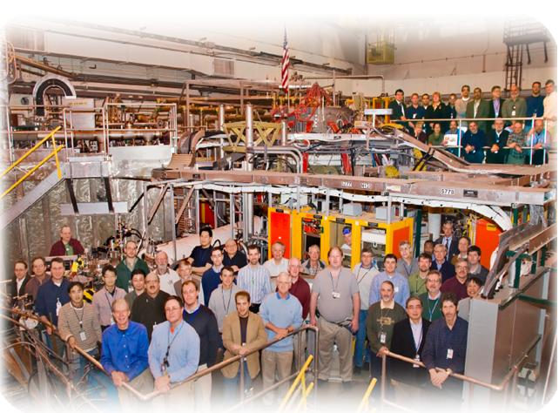
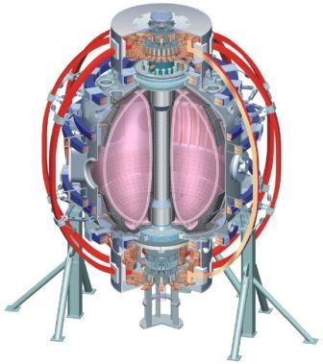
NSTX
Supported by
COE and Machine Operations
Ray Camp
* Responsibilities
* Daily Startup Activities
* Typical Shot Sequence
* Machine/Vacuum Tech Operations
* COE Operations
College W&M
Colorado Sch Mines
Columbia U
CompX
General Atomics
INEL
Johns Hopkins U
LANL
LLNL
Lodestar
MIT
Nova Photonics
New York U
Old Dominion U
ORNL
PPPL
PSI
Princeton U
Purdue U
SNL
Think Tank, Inc.
UC Davis
UC Irvine
UCLA
UCSD
U Colorado
U Illinois
U Maryland
U Rochester
U Washington
U Wisconsin
Culham Sci Ctr
U St. Andrews
York U
Chubu U
Fukui U
Hiroshima U
Hyogo U
Kyoto U
Kyushu U
Kyushu Tokai U
NIFS
Niigata U
U Tokyo
JAEA
Hebrew U
Ioffe Inst
RRC Kurchatov Inst
TRINITI
KBSI
KAIST
POSTECH
ASIPP
ENEA, Frascati
CEA, Cadarache
IPP, Jülich
IPP, Garching
ASCR, Czech Rep
U Quebec
NSTX Physics Operations Course July 2015

Slide 2
COE Responsibilities
Safe operation of NSTX-U
  Personnel Safety
  Equipment Operation within established limits
Coordinating the various groups to achieve the above
  Machine Technicians
  Health Physics
  Physics Operator/Session Leader
  Diagnostics
  ESU
  Engineering (PCEIC, Grounding, OIT)

Slide 3
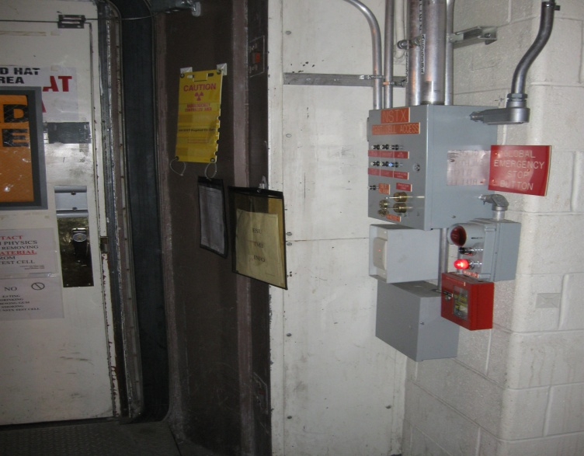
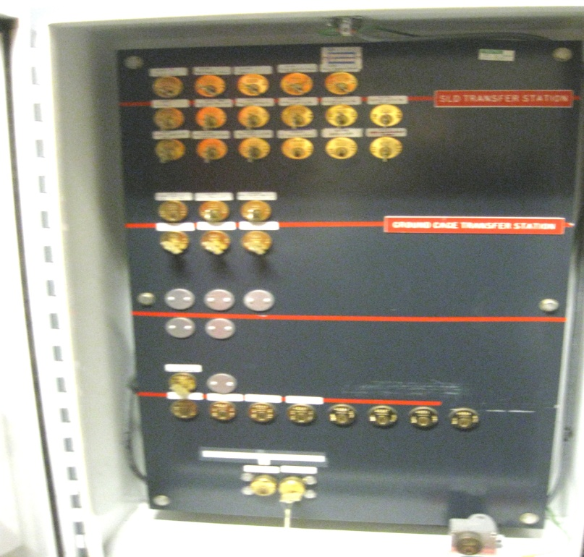
Machine/Vacuum Techs - Daily Startup
* Hi-pot the inner and outer vessel
* Configure the gas injection system and check pumping systems
* Configure diagnostics as required
* Kirk keys at appropriate stations for operations
* Ensures the experimental areas (TC, TCB gaged area and VCR/CSR) clear of personnel (search and secure) and set the loops
* Informs the COE that the machine and test cell are ready for operations
* Runs typically 30 minutes of helium GDC prior to fiducial plasma
NSTX Physics Operations Course Feb. 9-11, 2010

Slide 4
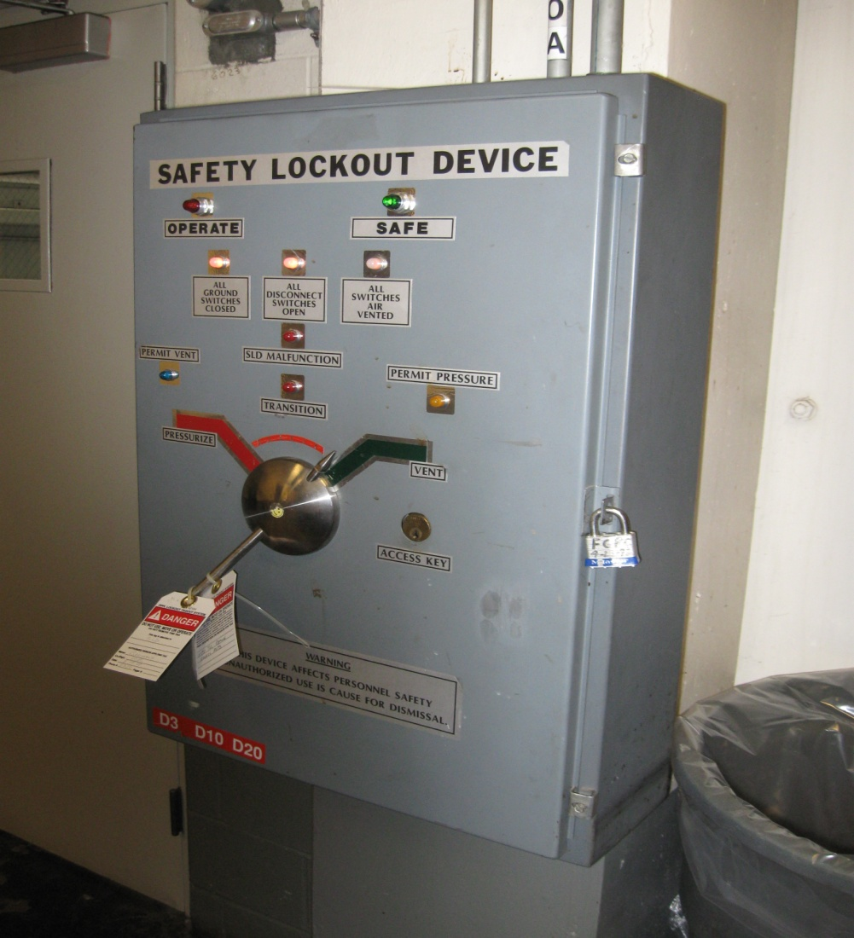
COE Daily Startup
* Instructs water systems and MG to startup at 7 am
* Starts up various programs:
- EPICS
- Energy monitor
- Scope pages
- Database for shot statistics
* Runs clock cycle to test acquisition and EPICS are OK
* At 7:30 test cell is cleared and closed up and COE requests the Safety Lockout Device (SLD) be pressurized by FCPC
- SLD supplies air to the Safety Disconnect Switches (SDSs) in the FCPC area so that the line and ground switches can be configured
NSTX Physics Operations Course July 29, 2015

Slide 5
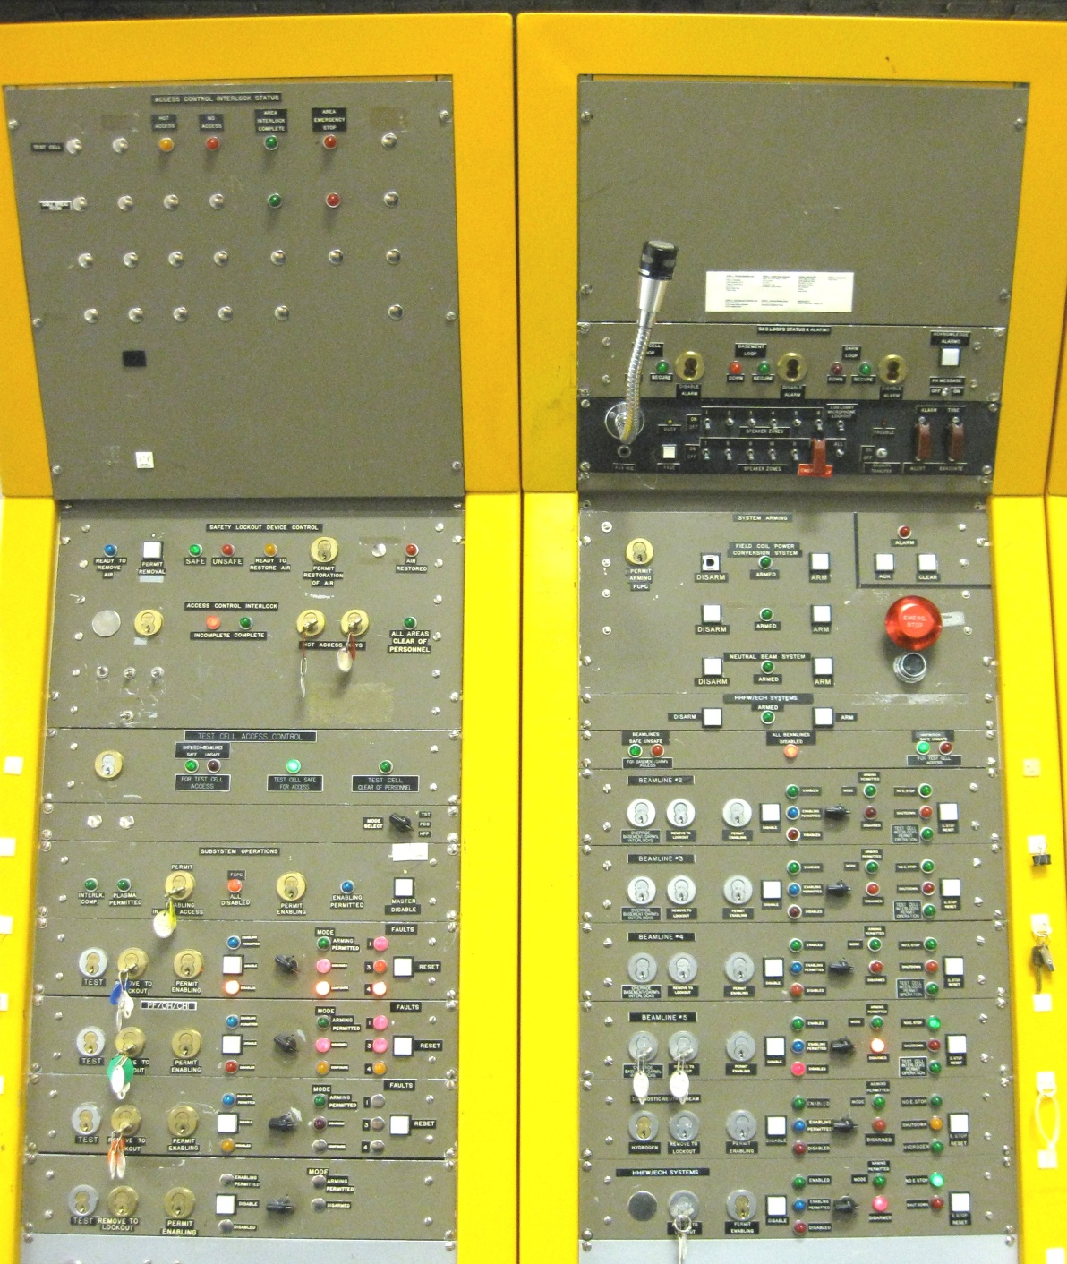
COE Daily Startup (cont)
* Supplies enable and arming permits to NB and RF(ECH)
* FCPC performs a hi-pot of the coils separately and the coils and rectifiers together
* Hi-pot values entered in database and checked for typical values
* PCEIC starts PSRTC/DCPS and Runs two coil only test shots at 50% and 100% current levels
* Runs fiducial plasma discharge and hands over plasma operations to the Physics Operator and Session Leader (usually between 8 and 8:30 am)
NSTX Physics Operations Course July 29, 2015

Slide 6
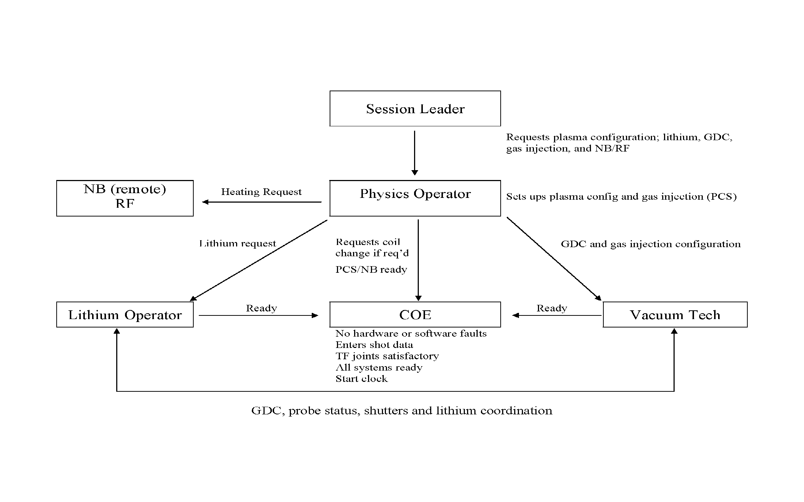
Typical Shot Sequence
NSTX Physics Operations Course July 29, 2010

Slide 7
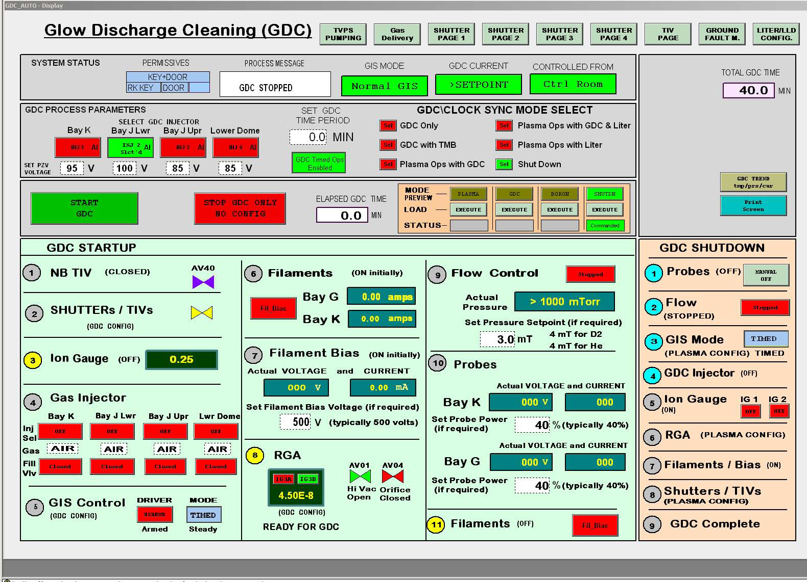
Vacuum Tech / Between Shot GDC
* Enters:
- Operating mode (lithium and operations or operations only)
- Time period per SL or PO
- Pressure (typically 2.5 mT)
- Gas/injector (typically helium from injector #3 at Bay J mid-plane but may use #1 at the top of Bay K this run)
* Ensures shutter configuration is correct
* GDC runs and shuts down automatically
* PLC cog may assist until interlocks and timing between GDC and LITER are developed
* GDC time usually decreases with increased lithium use
NSTX Physics Operations Course July 29, 2015

Slide 8
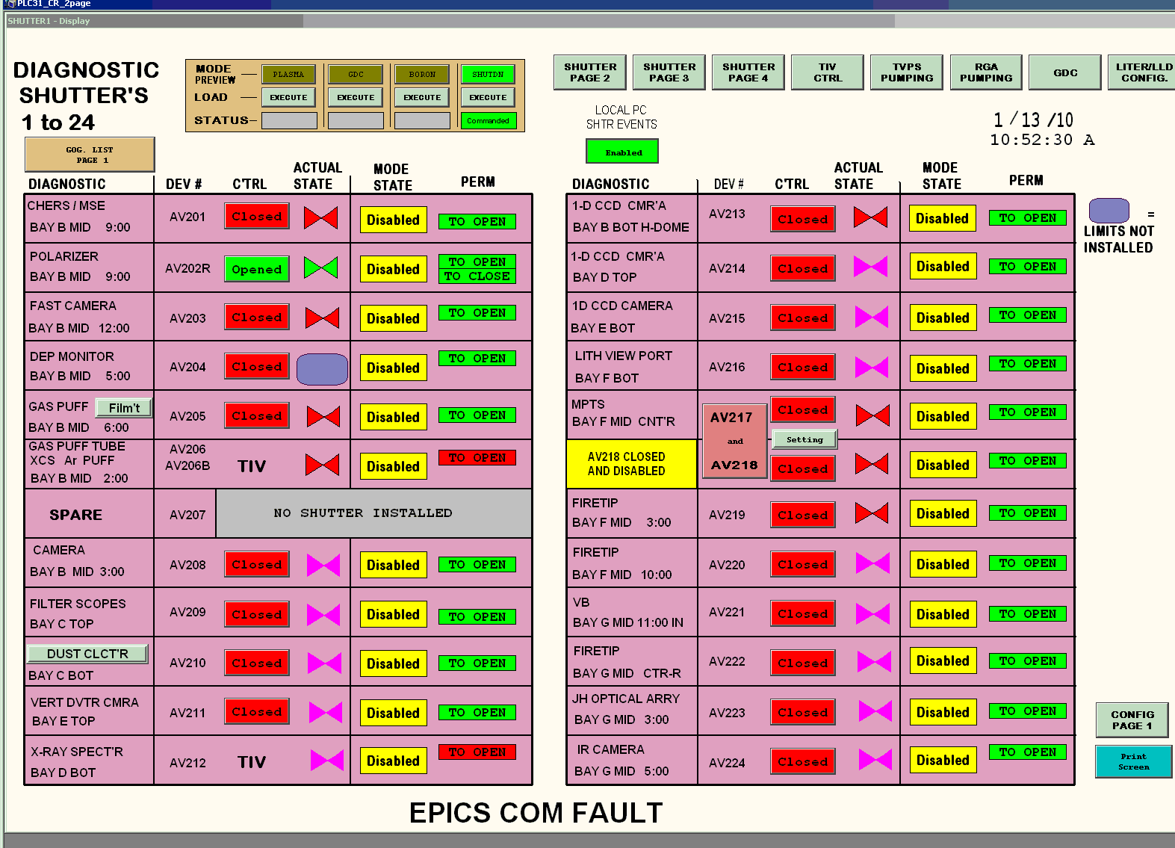
Vacuum Tech Operation
* One of four PLC controlled diagnostic shutter pages
* Can be operated manually or programmed for automatic actions in different modes of operation such as plasma operation, GDC and shutdown
* Diagnostic TIV page which is controlled in a similar manner as the shutters
NSTX Physics Operations Course July 29, 2015

Slide 9
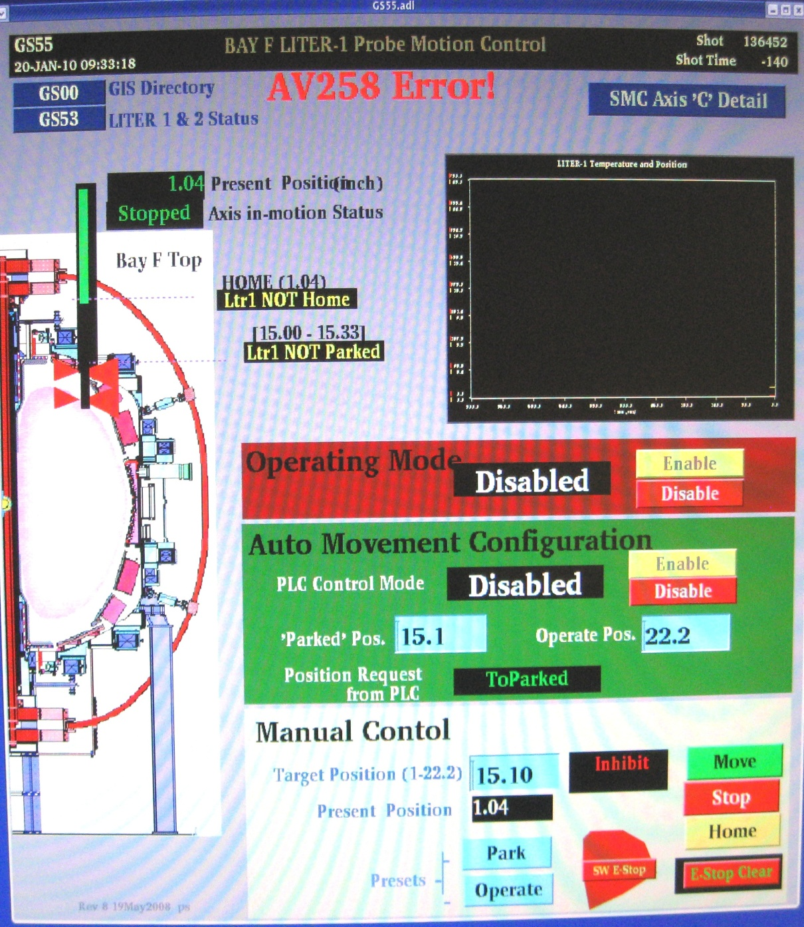
Vacuum Tech Lithium Operations
* Controls and monitors the operation of the two LITER probes from EPICS pages
- Home, parked and operate
* Co-ordinates GDC and LITER probe operation with lithium operator and COE to get requested between shot lithium and GDC
NSTX Physics Operations Course July 29, 2015

Slide 10
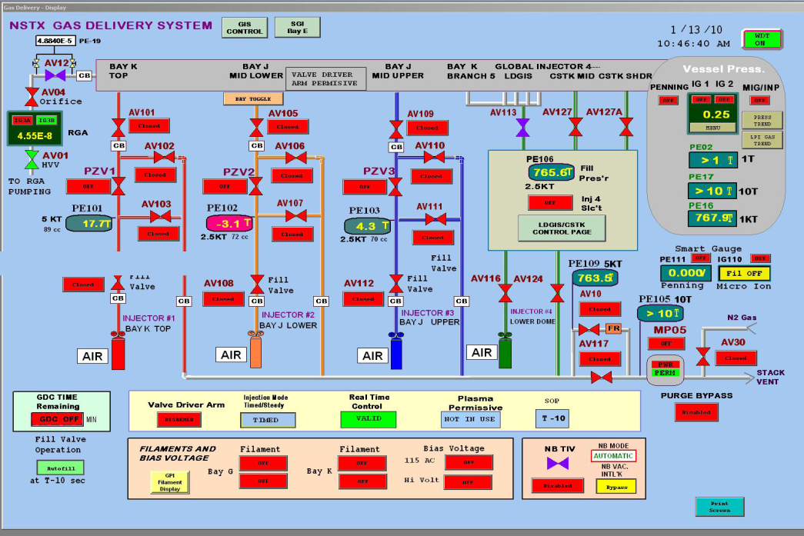
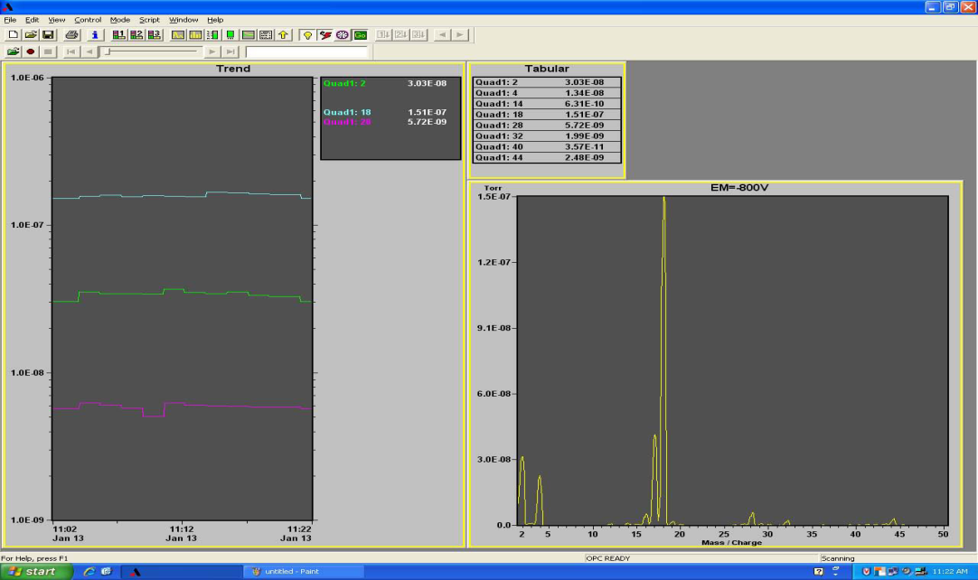
Vacuum Tech – Gas Injection
* Fills high field side center stack injections systems (and lower dome injector if needed) to requested pressure per PO
* Controls SGI (PLC and EPICS based) and other EPICS gas injection systems at request of cogs and with concurrence of SL
* Monitors vacuum conditions
NSTX Physics Operations Course July 29, 2015

Slide 11
COE Panels
LHS panel status:
- Test cell status
- Loop status
- E-Stop status
- Permit to pressurize/vent the SLD
- Enable and arm permits to FCPC
for configuring TF/PF/CHI line and ground SDSs
- Reset hardwired faults
RHS panel status:
- Provides final arm for FCPC/NB/RF(ECH) after systems are ready
- E-Stop alarm and acknowledge
- E-Stop button and resets
- Enable and arming permit for NB and RF to configure
NSTX Physics Operations Course July 29, 2015

Slide 12
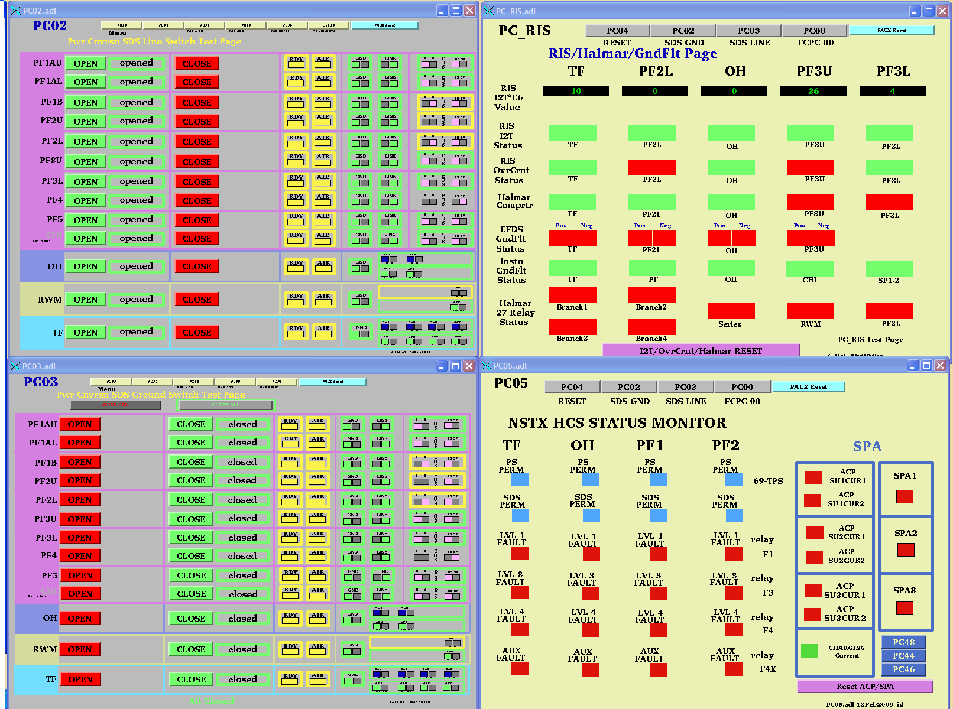
COE Operations
* Monitors configuration of the FCPC SDS and ground switches.
* Gives permissive to FCPC to make configuration changes by placing the switch on the COE panel to configure
* Monitors fault conditions and resets faults when systems are satisfactory
NSTX Physics Operations Course July 29, 2015

Slide 13
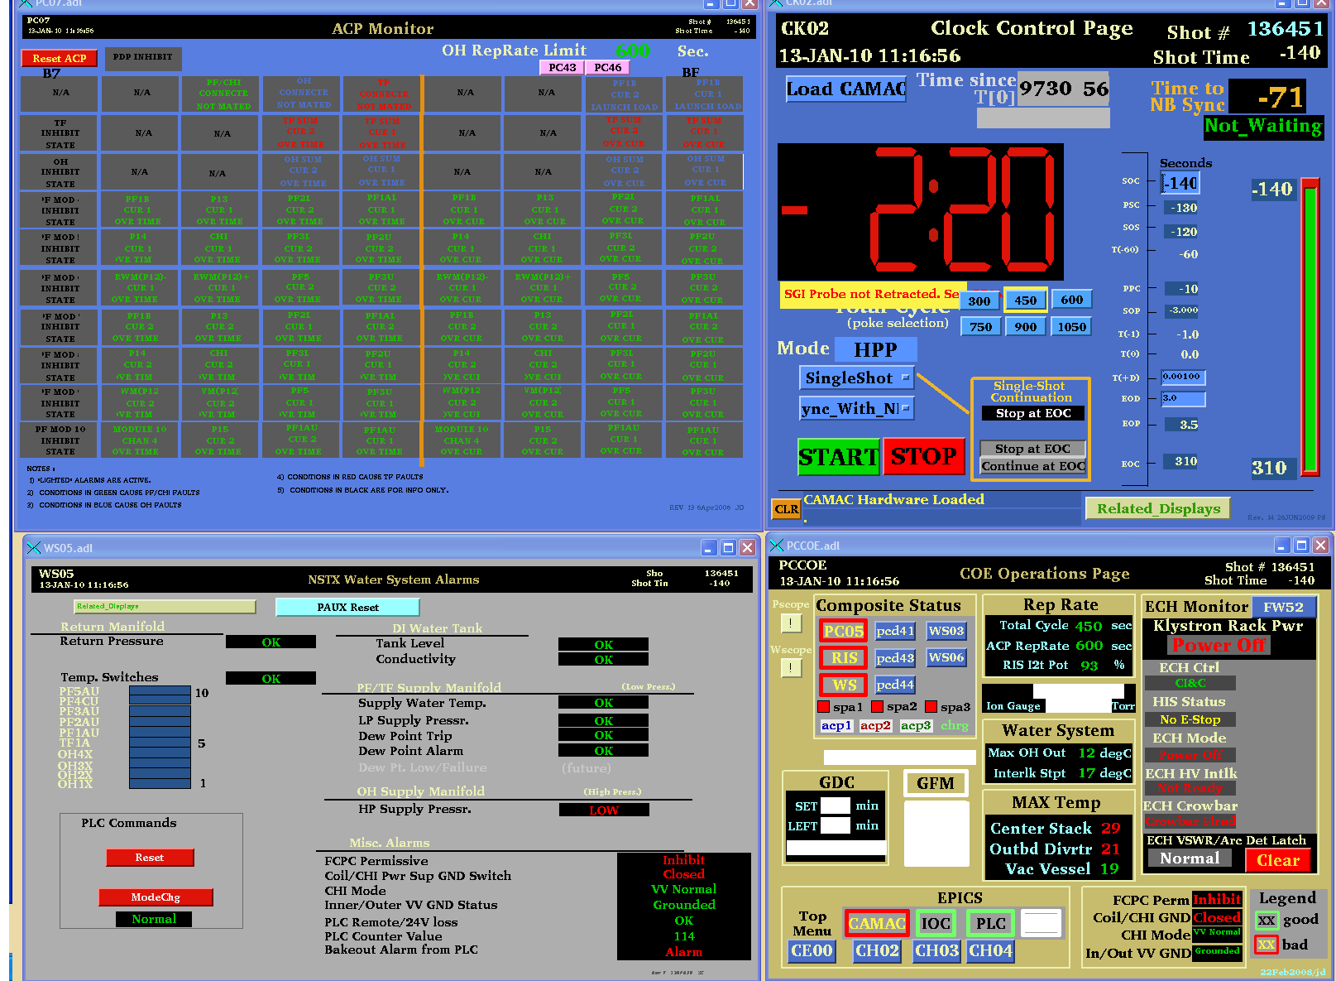
COE Operations
* Monitors ACP for faults and resets when satisfactory
* Lower right corner is a summary page of the status of a various systems
* Sets minimum clock cycle, (NB interlock 2.5 minutes) and starts clock when all systems and personnel are ready
NSTX Physics Operations Course July 29, 2015

Slide 14
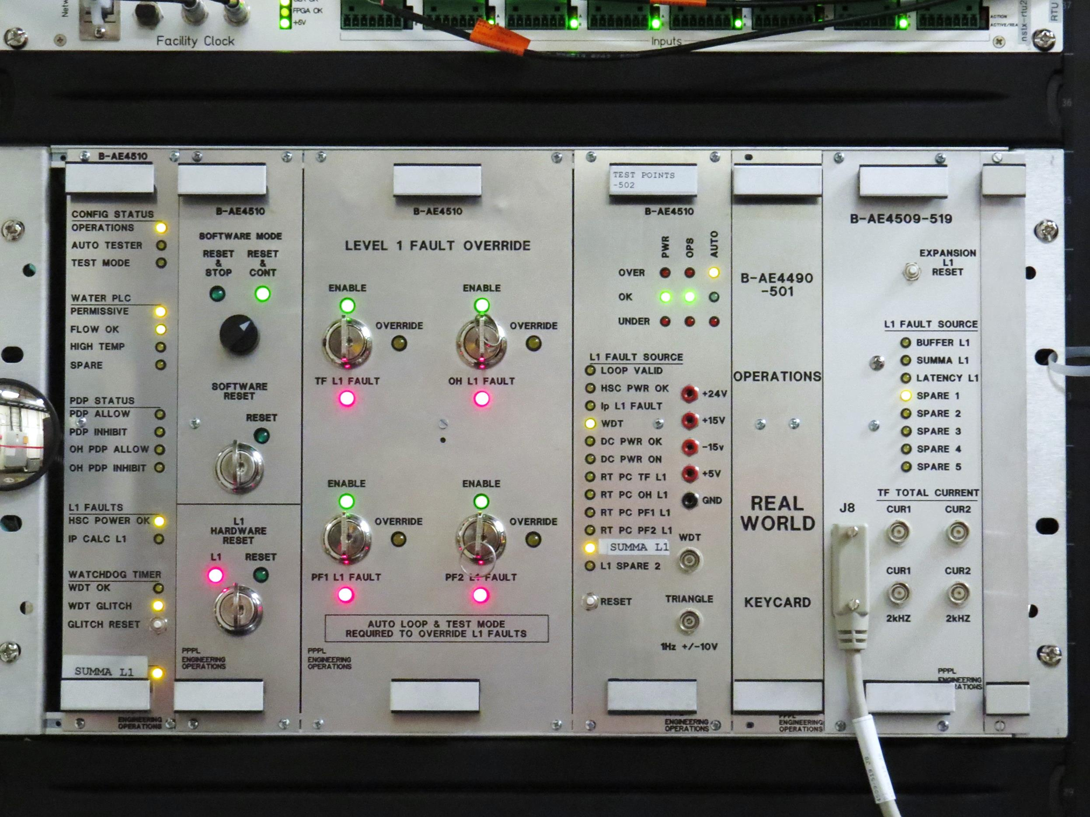
DCPS

Slide 15

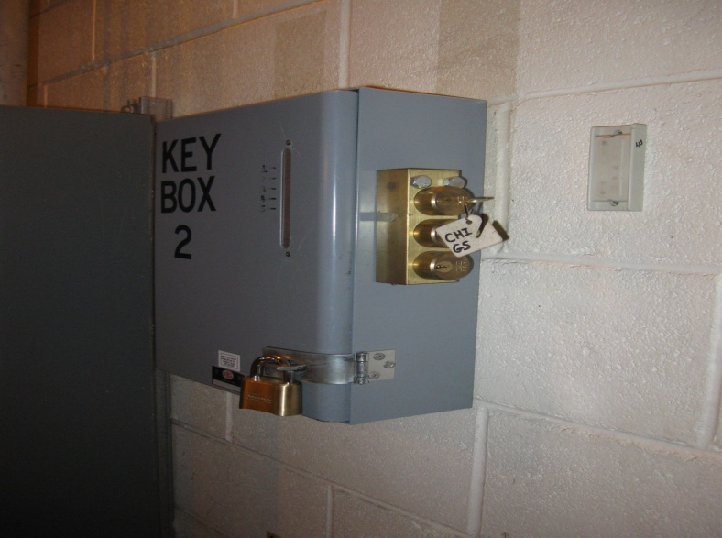
Controlled Access and Shutdown
Controlled Access
- FCPC, NB, RF, CHI shutdown and safed
- FCPC then vents the SLD
- Machine tech obtains the SPA kirk key from the transfer station on 2nd floor of FCPC
- Machine techs let personnel into the test cell once all systems are safed (HP may be first)
- Activity is monitored by machine techs and search and secure is performed before exiting the test cell and loop is set
Shutdown
- All systems safed (FCPC, MG, NB, RF and MPTS) and SLD vented
- Cool down LITER probes (couple of hours)
- Kirk keys back at test cell door
- Place test cell in Free Access (typically 10-15 minutes after last shot)
NSTX Physics Operations Course July 29, 2015

Slide 16
Conduct of Operations
At the Controls Area
Health Physics
Stubborn COE
Communications
Emergencies and Off-normal Events

