Slide 1
Gas Injection System (GIS)
Devon Battaglia,
Keith Erickson, Dennis Mueller, Stefan Gerhardt,
Roger Raman, Vlad Soukhanovskii
NSTX-U Physics Operators Training
September 15, 2015

Slide 2
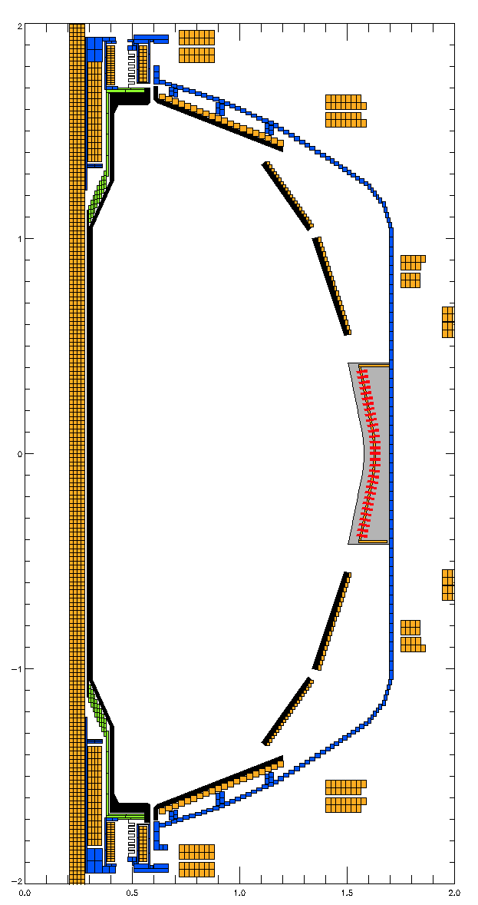
Gas Injection Systems on NSTX-U for FY16
Piezoelectric (P10) valves
Fast on/off using piezoelectric crystal that bends in response to voltage
PZV: Main LFS injection valves
SGI: Supersonic gas injector
Advanced nozzel on moveable probe
GPI and Impurity: Diagnostic gas
DIVL: Two valves (Bay I and Bay C)
Two upper divertor systems (DIVU) in the future
Pneumatic (puff) valves
Empty plenum into vessel when triggered
HFS: 2 at midplane, 2 at shoulder
Each location has 2 varieties of tube diameter
CHI: 2 systems used for CHI
See Rogers talk
Massive gas injector (MGI)
See Roger’s talk
PZV1
Shoulder
GPI
Imp.
SGI
Midplane
PZV2
PZV3
CHI
DIVL

Slide 3
Piezo valves on NSTX-U
Piezoelectric (P10) valves
PZV, SGI used for prefill, plasma fueling, GDC
GPI, DIV, Impurity used for specific experiments
Each valve supplies gas from a plenum
Typical maximum flow rates ~ 150 Torr-liters/second
Flow-rate control using pulse-width modulation
Valves cycle between fully-opened and closed to achieve, on average, the desired flow rate
Algorithm considers min on/off time, evolving plenum pressure to compute open/close times
Why not control flow by partially opening valve?
Drifting voltage response of piezo crystal requires frequent tuning, irreproducible results
PZV1
GPI
Imp.
SGI
PZV2
PZV3
DIVL

Slide 4
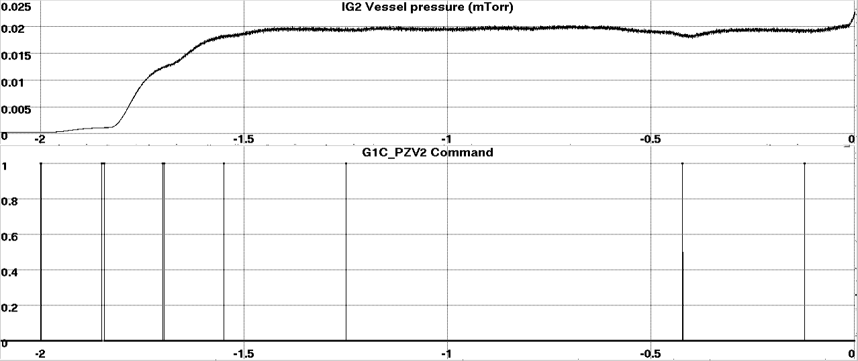
Prefill control for plasma startup
Gas injected prior to breakdown
Pumped away by turbo (vessel) and cyro (beam) pumps
Prefill algorithm does active feedback on vessel pressure
Vessel pressure gauges have a slow response
Target
Field pickup
Open
Closed

Slide 5
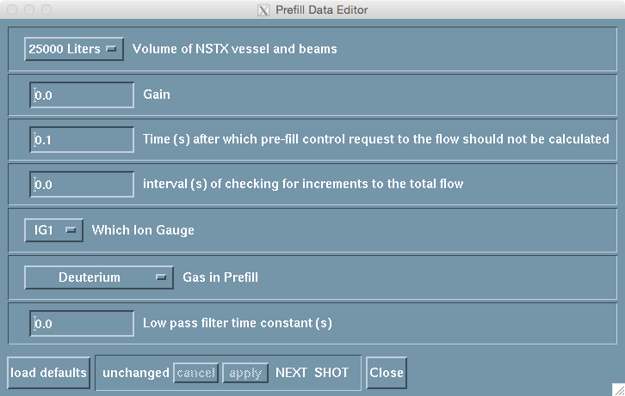
Prefill is mostly left alone, except …
Approximate vessel volume must be chosen
NBI beam line volume similar to NSTX-U volume
Planned: consistency check with beam TIV status in EPICs
Until then, be aware of opening and closing NBI TIVs
Not fatal, but could result in missing prefill target
Gas injection category →
Prefill Subset →
Prefill Data …
25000 liters: No beam TIVs open
50000 liters: One beam TIV open
75000 liters: Both beam TIVs open

Slide 6
Prefill is mostly left alone, except …
Approximate vessel volume must be chosen
NBI beam line volume similar to NSTX-U volume
Planned: consistency check with beam TIV status in EPICs
Until then, be aware of opening and closing NBI TIVs
Not fatal, but could result in missing prefill target
All other changes or problems …
Fail to break down, gas injector or pressure gauge breaks, not getting prefill target, changing prefill gas type …
Call Devon or Dennis

Slide 7
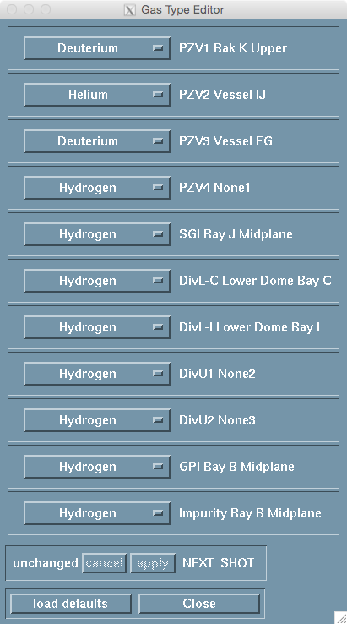
If you want gas, you must …
Enable valve in PCS
Gas Injection → Enable and Status → Injector enable …
Tell the vacuum PLC operator
They also need to know the plenum pressure
Make sure Piezo gas type is correct in PCS at the start of XP
Gas Injection → Enable and Status → Gas type …
Daily checklist would have this in it
Future: check consistency with EPICS

Slide 8
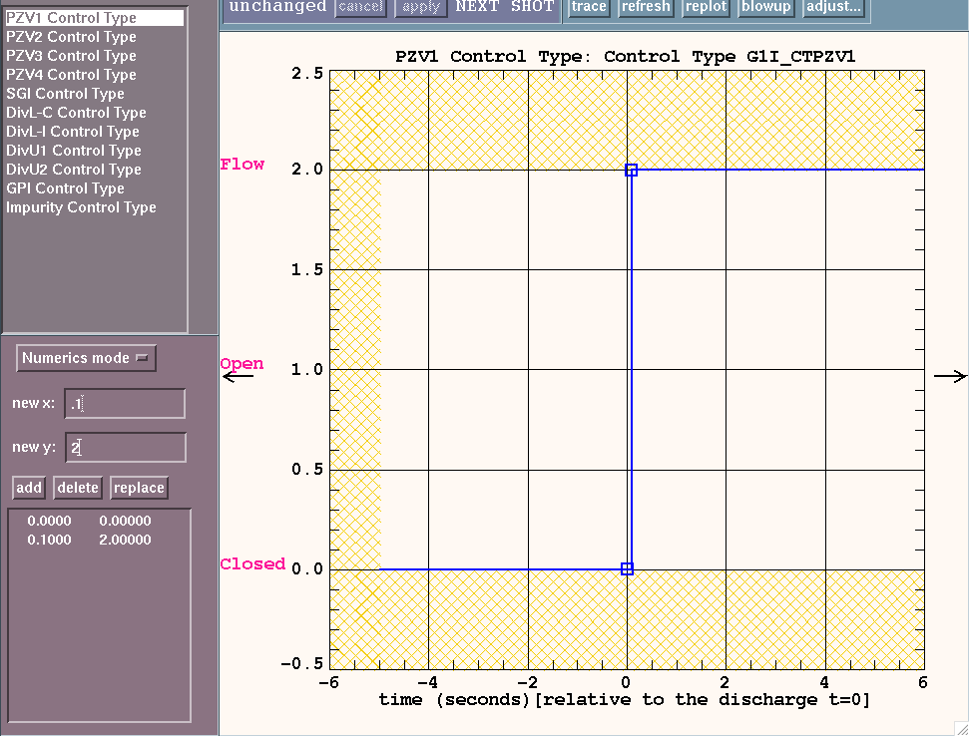
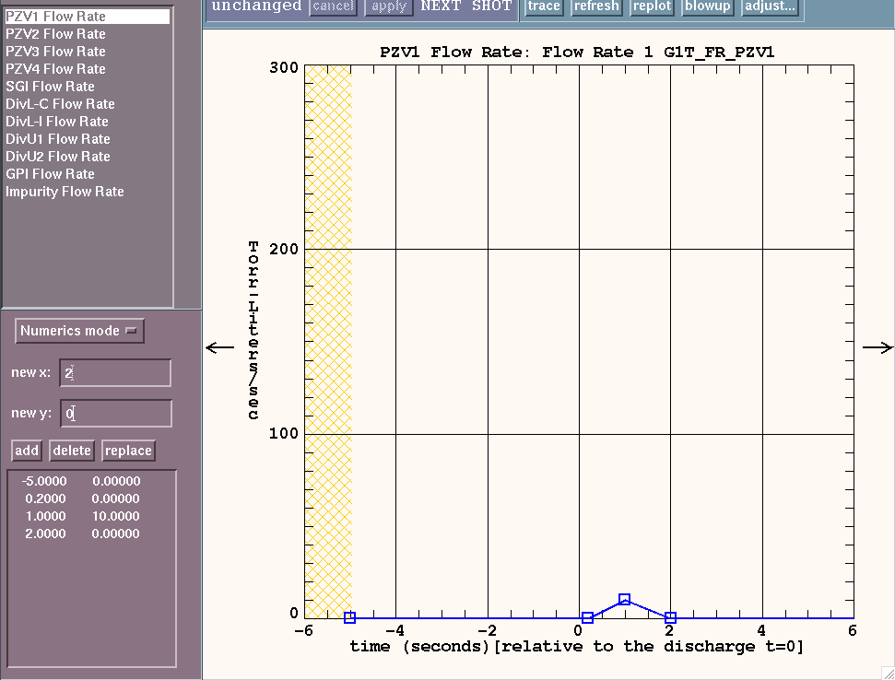
Piezo valve control from the PCS
Piezo valve control waveform
Valve is closed, open or in flow rate (PWM) control
In the future, could have option for density, div radiation …
Piezo flow rate waveform
Set target flow rate for when valve control = flow

Slide 9
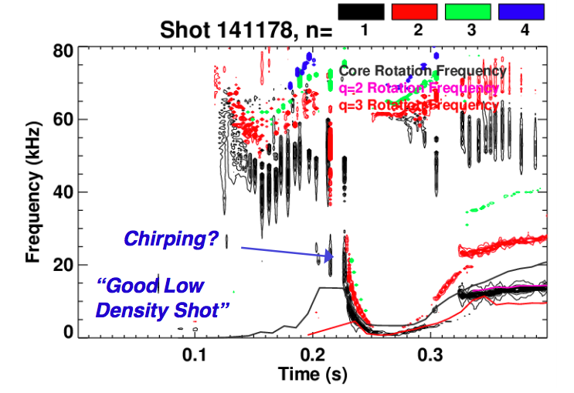
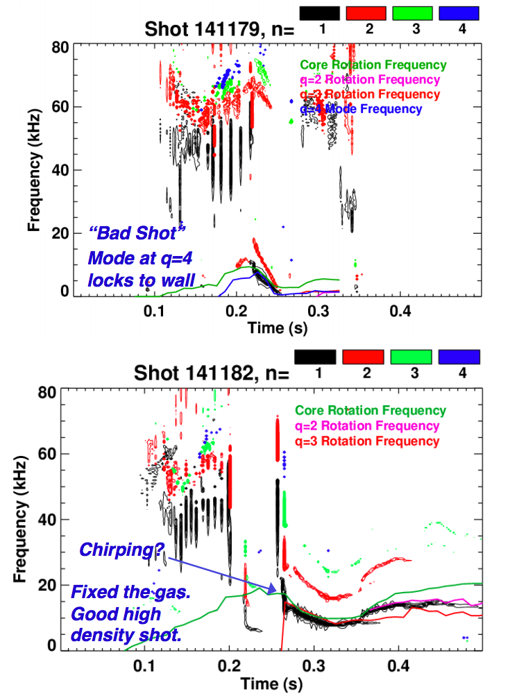
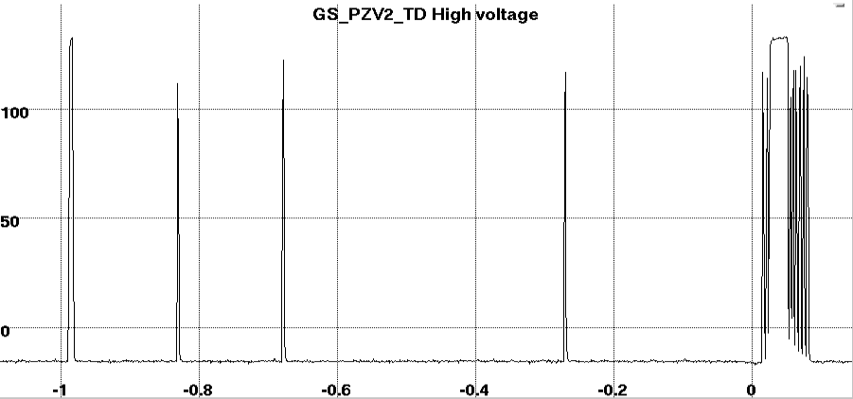
Early fueling (t < 100ms) was important on NSTX for avoiding locked-modes
PZV2 Voltage 141182
Time (s)

Slide 10
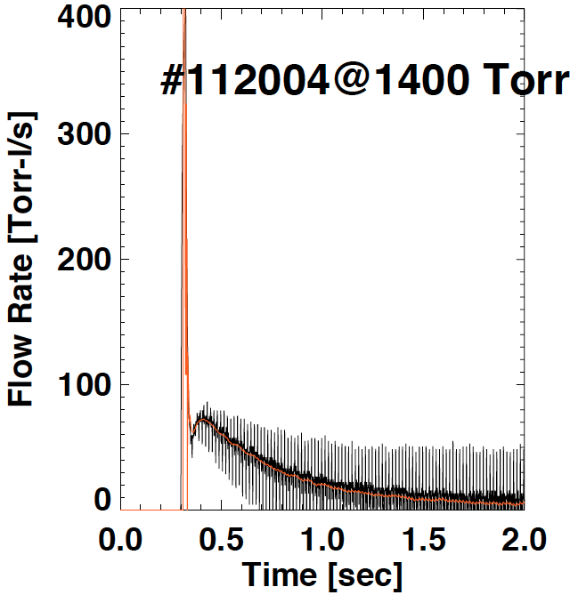
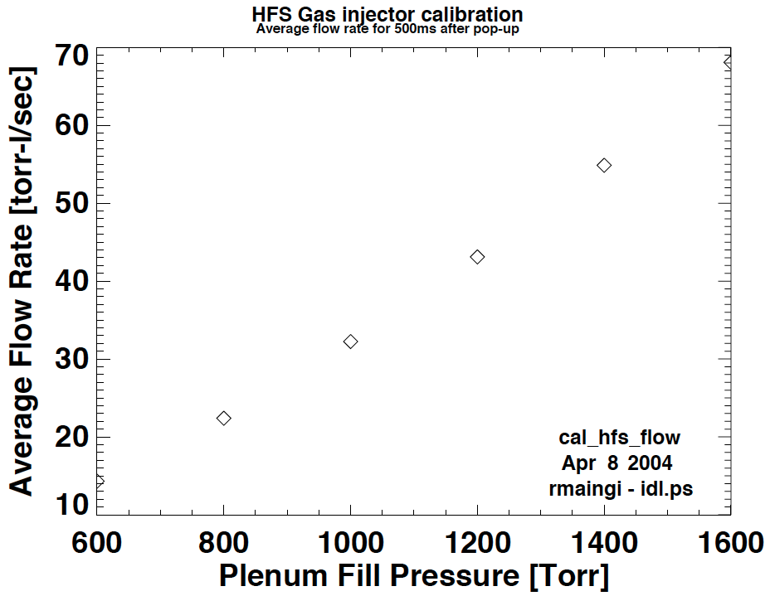
HFS gas important for H-mode access
Reliable and lower power H-mode access observed on STs with HFS fueling
HFS geometry limits injectors to solenoid valves with long tubes
P.O. sets trigger to open in PCS
Gas “leaks” in after some delay
Flow rate and gas load set by plenum pressure and tube diameter
Two poloidal locations: midplane and shoulder
NSTX-U: two tube diameters at each location to choose from

Slide 11
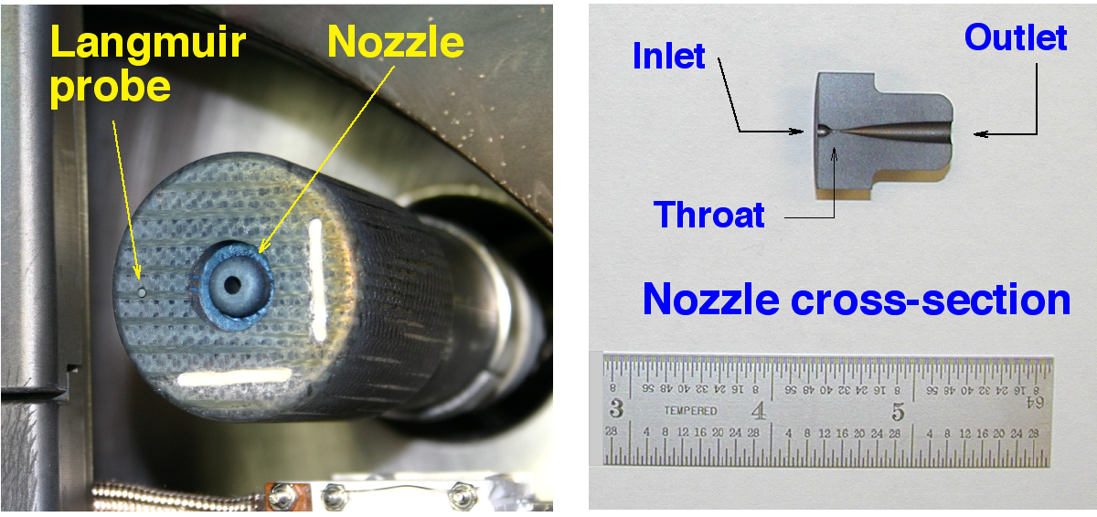
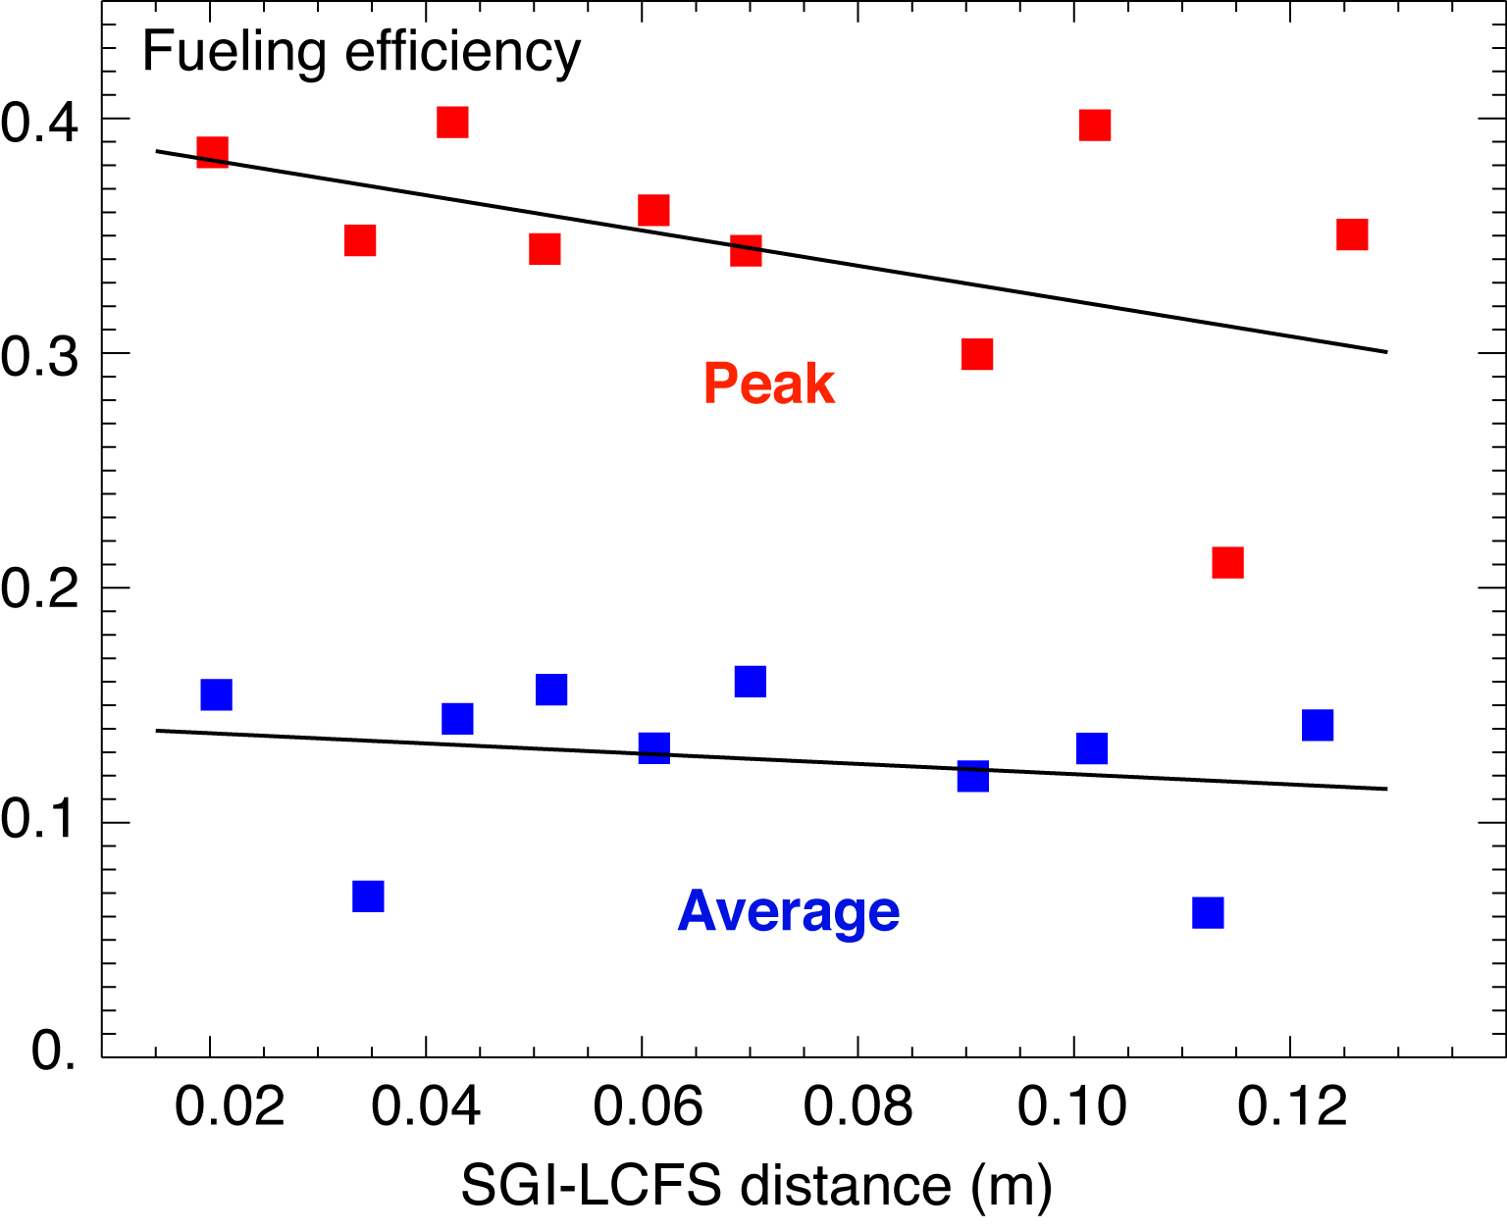
Supersonic gas injector (SGI) provides increased fueling efficiency
SGI is a standard piezo valve fitted with a nozzle
Mounted on a moveable, shielded probe at the midplane
Probe position request made to vacuum PLC operator
Gas injected at Mach 4 speeds
NSTX experiments demonstrated SGI can replace HFS fueling for H-mode access
Also shown to increase fueling efficiency for early LFS gas
Vlad Soukhanovskii SOFE07

Slide 12
Summary of NSTX-U gas injection system
LFS Piezo valves
Prefill with vessel pressure feedback
Early fueling with flow-rate feedback
Glow-discharge cleaning (GDC)
Diagnostics (GPI), trace impurities or divertor fueling
Puff valves
HFS for H-mode access
CHI startup
Supersonic Gas Injector
Tool for improving fueling efficiency

