Slide 1




NSTX-U
Supported by
UCLA Research Plans for NSTX-U
Tony Peebles
Neal Crocker, Shige Kubota, and Jie Zhang
and the NSTX-U & DIII-D Research Teams
Coll of Wm & Mary
Columbia U
CompX
General Atomics
FIU
INL
Johns Hopkins U
LANL
LLNL
Lodestar
MIT
Lehigh U
Nova Photonics
ORNL
PPPL
Princeton U
Purdue U
SNL
Think Tank, Inc.
UC Davis
UC Irvine
UCLA
UCSD
U Colorado
U Illinois
U Maryland
U Rochester
U Tennessee
U Tulsa
U Washington
U Wisconsin
X Science LLC
Culham Sci Ctr
York U
Chubu U
Fukui U
Hiroshima U
Hyogo U
Kyoto U
Kyushu U
Kyushu Tokai U
NIFS
Niigata U
U Tokyo
JAEA
Inst for Nucl Res, Kiev
Ioffe Inst
TRINITI
Chonbuk Natl U
NFRI
KAIST
POSTECH
Seoul Natl U
ASIPP
CIEMAT
FOM Inst DIFFER
ENEA, Frascati
CEA, Cadarache
IPP, Jülich
IPP, Garching
ASCR, Czech Rep
NSTX-U Diagnostic Planning Meeting
PPPL
July 26th, 2012

Slide 2
Summary of UCLA Planned Research
Implications of budget reduction
  Reflectometry density profile system transferred to LTX - a loss to NSTX-U
  NSTX-U effort will focus on mutlichannel reflectometry and installation of new polarimeter system
  Doppler Backscatter system for NSTX-U is important – no current support
Continue contributing to “Waves and Energetic Particles” topical science area
  Utilize existing16 channel reflectometry for structure measurements and code validation - particularly interested in the role of CAEs and GAEs.
  Port J reconfigured to provide access for above – four horns accommodated through central 8 inch flange. Discussions with Bob Kaita and Lane Roquemore
288GHz polarimetry planned for magnetic fluctuation measurements
  System was planned for NSTX but had to be transferred to DIII-D for test.
  Research involves student thesis research – Jie Zhang
  Installation on NSTX-U planned for Port G. Requires “special” tile on center stack. Discussions with Bob Kaita and Lane Roquemore.

Slide 3
UCLA contributions/plans in fast-ion driven mode research area
Recent Work:
TAE structure measured and compared with theory
  radial phase variation also measured; indicates non-ideal effects
  structure measurements compared with M3D-K simulation (G. Y. Fu); reasonable agreement for both reflectometer amplitude and phase
    Rotation affects radial phase variation
CAE and GAE structure have been measured in 6 MW beam-heated H-mode plasma, suggesting CAE role in electron thermal transport.
  comparison with HYM simulation (E. Belova) – promising initial results
Future work:
Investigate non-ideal TAE structure
Use validated TAE mode structures from M3D-K with ORBIT to predict fast-ion transport and loss
Use validated CAE and GAE structures from HYM with ORBIT to predict role in electron thermal transport

Slide 4
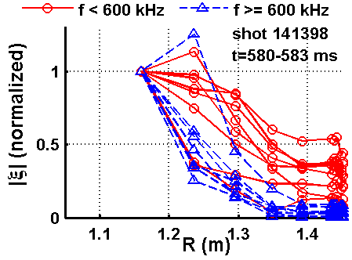
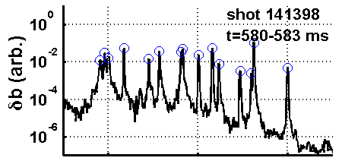
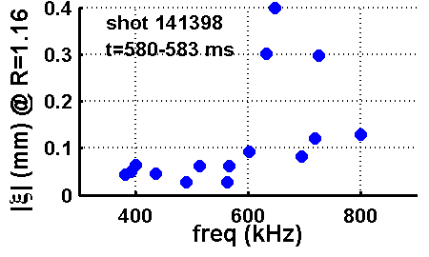
Core-localized CAEs identified in beam-heated H-mode plasma
- motivates investigation as possible cause of enhanced ^{χ}_{e}
High frequency AE structure measured in core of beam heat-heated H-mode plasmas ⇒ identified both CAEs and GAEs
Observed modes fall in two primary categories:
  GAEs: Small amplitude + broad structure,
  f < ~ 600 kHz, n = -6 – -8
  CAEs: Large amplitude + strongly core localized,
  f > ~ 600 kHz, n = -3 – -5
CAEs more strongly core localized ⇒ also could cause anomalous thermal electron transport
  CAEs share key GAE characteristics (D. Stutman) regarding their potential role in electron thermal transport: core localization & frequency
GAEs
CAEs

Slide 5
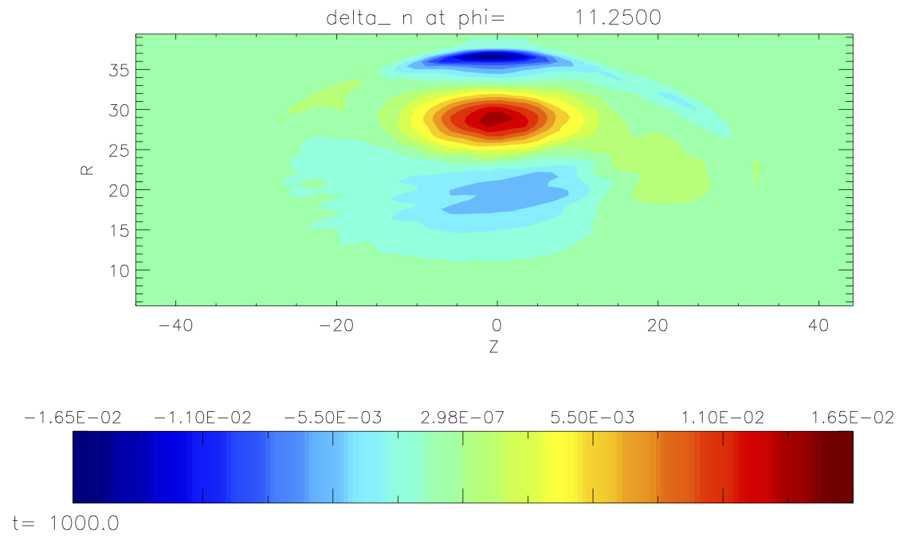
Recent simulations show unstable sub-MHz, low-n CAE (E. Belova)
Comparison (i.e. validation) with measurements underway
HYM CAE n = 4, f = 868 kHz (0.35*f_{ci})
shot 141398, t = 582ms
(E. Belova)
Simulations performed by E. Belova for 6 MW beam-heated equilibrium where CAEs identified
  shot 141398, t = 582 ms
Unstable sub-MHz core-localized CAE observed
  n = 4, f = 868 kHz (f = 0.35*f_{ci})
CAE has strong density peak near magnetic axis - similar to experiment
Detailed structure comparison/validation to reflectometer measurements underway
Future work: use validated HYM mode structure for ORBIT electron transport calculations
120
δn
60
0
Z (cm)
-60
magnetic axis
-120
40
80
120
R (cm)

Slide 6
Magnetic fluctuations can play important role in fusion plasma stability and transport
Macroscopic stability can be perturbed by large scale instabilities driven by current or pressure gradients
  e.g. NTMs (Neoclassical Tearing Modes) degrade confinement, and often lead to disruption
Fast-ions lead to instabilities, e.g. Alfvén Eigenmodes
  Cause/modify fast-ion transport or loss ⇒ modifies heat deposition (distribution of fusion α’s, neutral beams)
  CAEs and GAEs can also potentially cause anomalous electron thermal transport
Magnetic turbulence can also result in particle, energy and momentum transport
  e.g. Microtearing Modes are possible source of anomalous electron transport

Slide 7
Polarimetry: Magnetic field fluctuation measurement
Also constraint on central q; radial view sensitive interferometer for low start-up density
Radial-view, retro-reflects from center-stack carbon tile
At low magnetic field, polarization modifications are dominated by Faraday rotation.
More complicated as field increases – Cotton Mouton effect + interactions (J. Zhang RSI 81, 1 2010)
Radial view is insensitive to density fluctuations as long as measurement close to mid-plane - where the equilibrium B along propagation direction (B_{II}) is small
GYRO simulated magnetic and density fluctuations associated with micro-tearing modes in NSTX (Walter Guttenfelder) used to calculate expected polarimetry signal
Indicates internal direct measurement of microtearing magnetic fluctuations feasible in NSTX-U. Prototype system transferred to DIII-D for testing

Slide 8
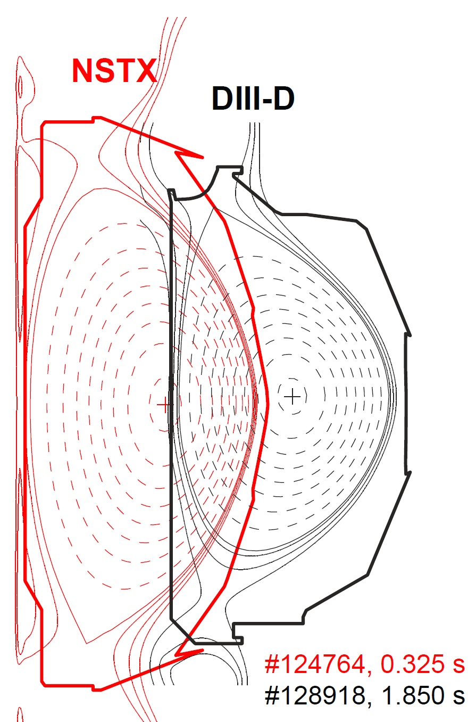


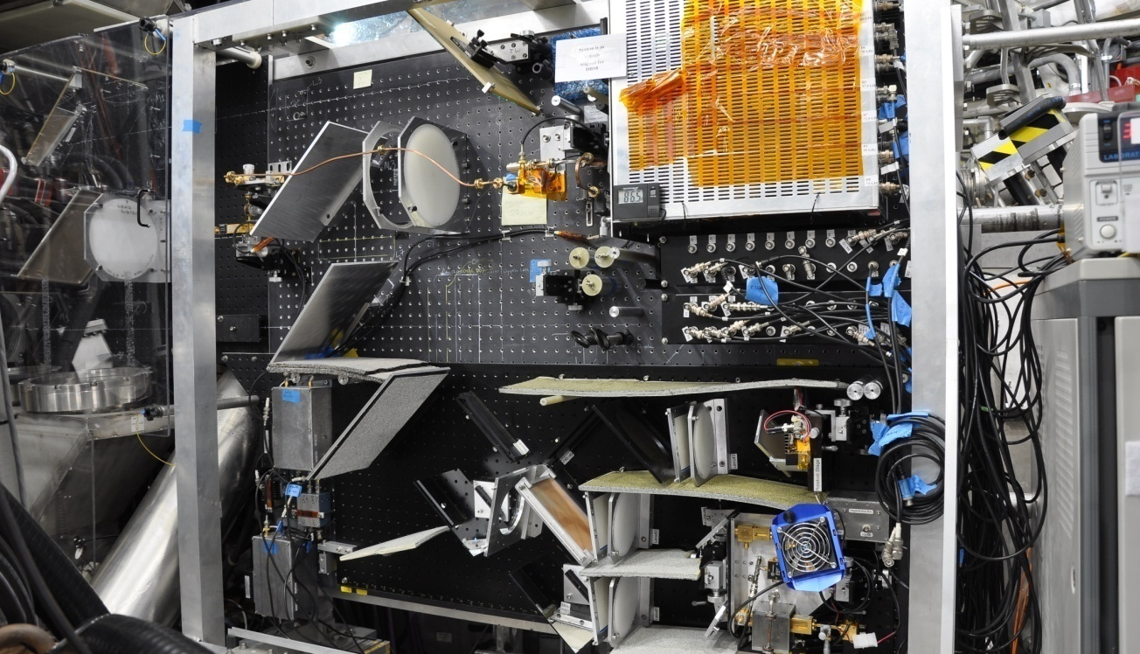

Currently installed on DIII-D for plasma tests prior to future implementation on NSTX-U
Polarimeter was originally planned for NSTX with radial retroreflection geometry
Installation on DIII-D utilizes the same radial retro- reflection geometry as NSTX
Minimal perturbation to existing configuration at 60° R0 port

Slide 9
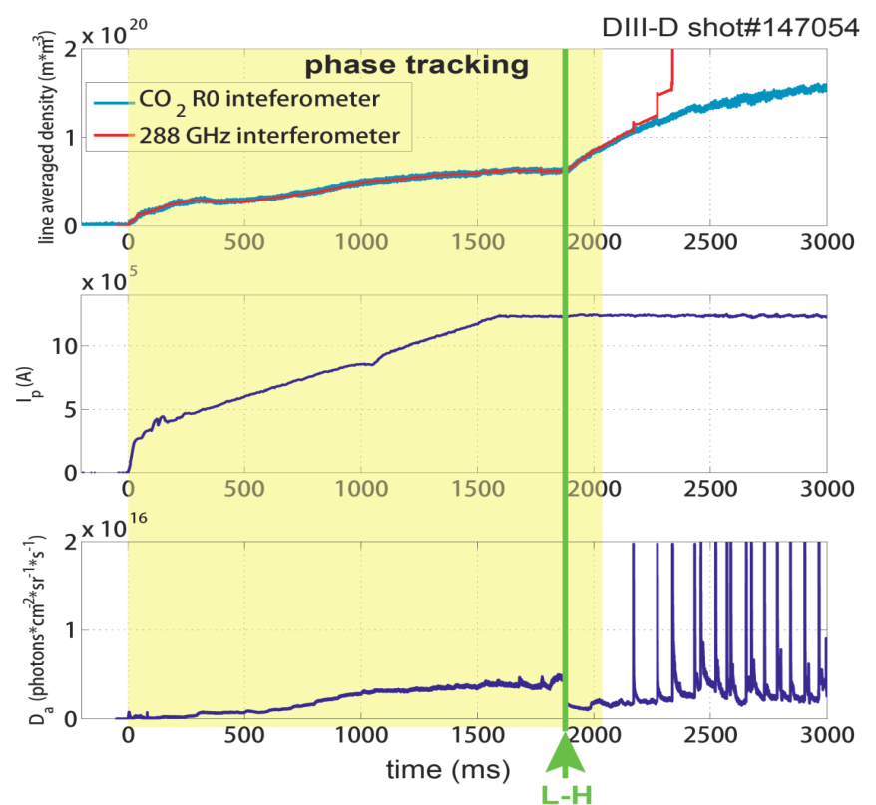
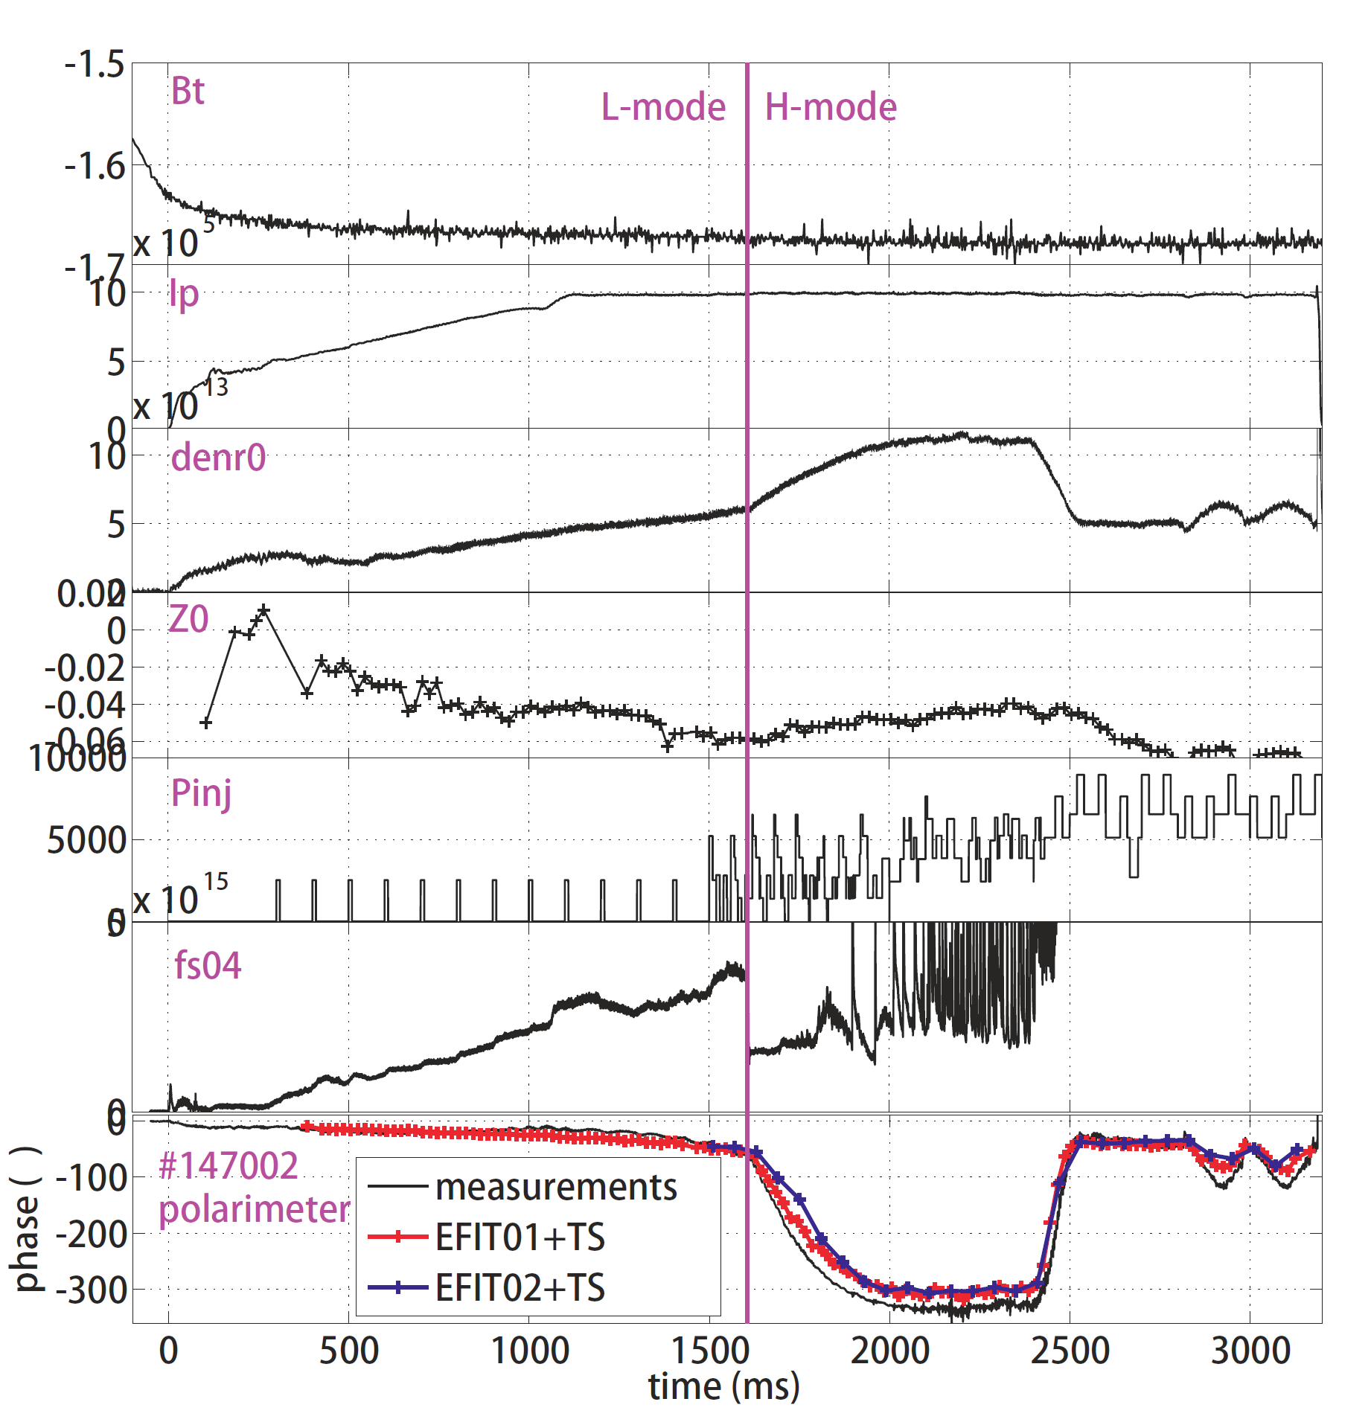


Preliminary DIII-D data indicates good initial operation
- low noise, high resolution interferometer; reasonable equilibrium polarimeter response
Interferometry mode
Polarimetry mode
n_{e}
Ip
Ip
Line density
Dα
Phase
Reasonable agreement
Problem:
Dominant phase noise caused by feedback effects. Eliminated via quasi-optical isolators (J. Zhang RSI 83, 10E321 (2012)
However, residual phase noise still too large (~2 degrees) due to magnetic pick up and some potential alignment/vibration issues. Limits detectable magnetic fluctuation level
Recently improved, but further progress is necessary

Slide 10
Upcoming DIII-D half run day planned for August
GOAL: Investigate equilibrium polarimeter phase variation and phase spectra from fast-ion driven modes, tearing modes, etc.
B_{T} scan, 0.5T, 1.2T, 2.0T - moves from Faraday rotation dominated to Cotton Mouton dominated operating regime
n_{e} ≤ 4 x10¹⁹ m⁻³, oval/circular shape, beam-heated L-mode
Plasma vertically scanned ±15 cm. Varies height of polarimeter chord relative to plasma center – effectively a spatial scan
Also investigate measured phase spectra from fast-ion driven modes, tearing modes, etc.
Measured polarimeter phase response will be compared to calculations using mode predictions as inputs to a synthetic diagnostic code

Slide 11
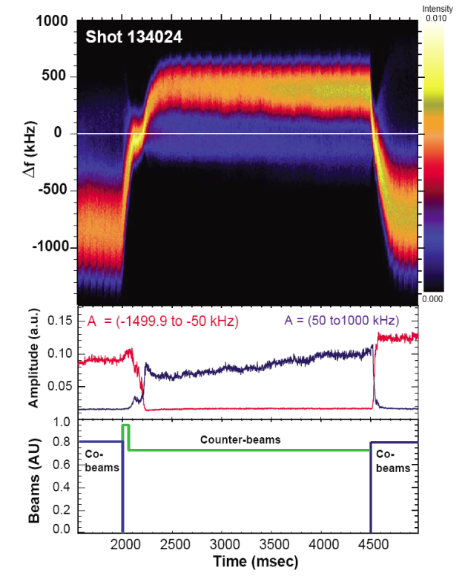
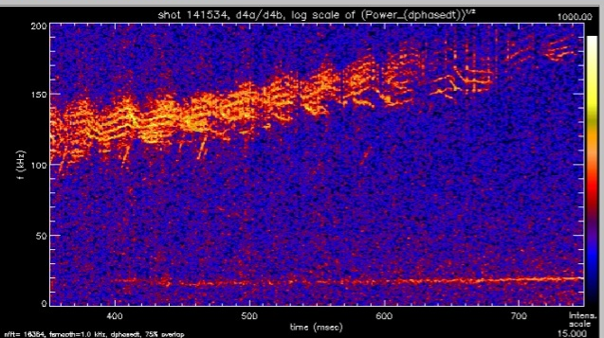
Unfunded Doppler backscattering (DBS): intermediate k turbulence, E_{r}, GAMs, zonal flows and, potentially, wave E-field for fast-ion driven instabilities
DBS locally measures scattering from intermediate scale (~3 – 20cm⁻¹) turbulence
Provides critical link between BES and high k scattering + …
  Doppler shift provides information on turbulent flow (~E_{r}), GAMs, etc.
  Scattered power provides local info on turbulent fluctuation levels at intermediate-scale wavenumbers (~3 to 20cm⁻¹)
X-mode cutoff layer
Quadrature data for co- and counter beams
Phase data illustrating oscillating flows caused by GAMs and TAEs
Counter-beam
k_{incident}
TAEs
k_{scatter}
k_{incident}
k_{scatter}
GAM
Co-beam
Co-beam
GAM
Not currently funded.
UCLA seeking support
Requires a minimum 6 inch port
Possible in Port J – discussed with Bob Kaita and Lane Roquemore
Phase analysis of DBS data reveals the GAM

Slide 12
Back-up Slide

Slide 13
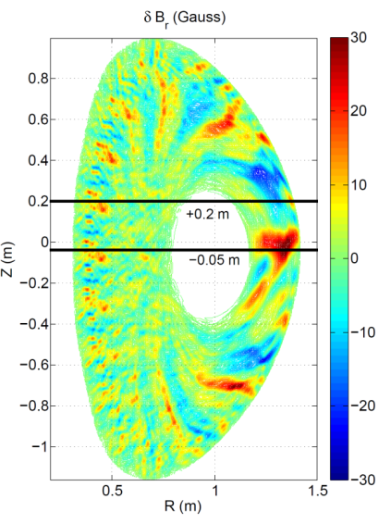
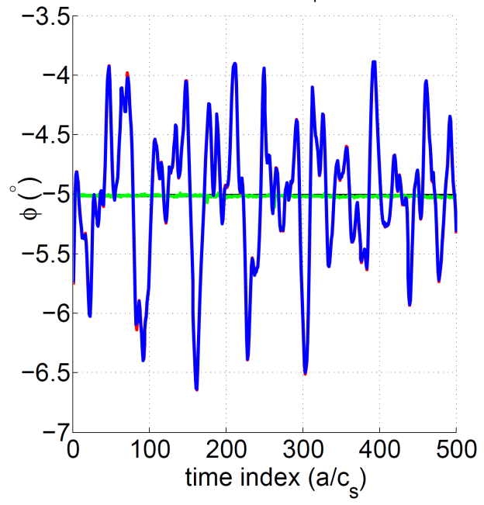
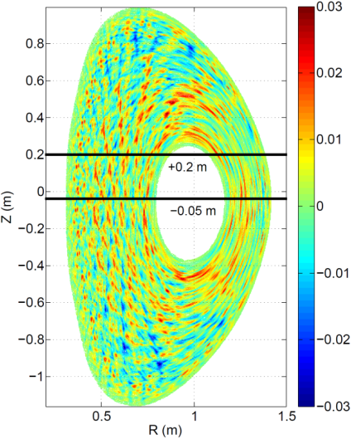
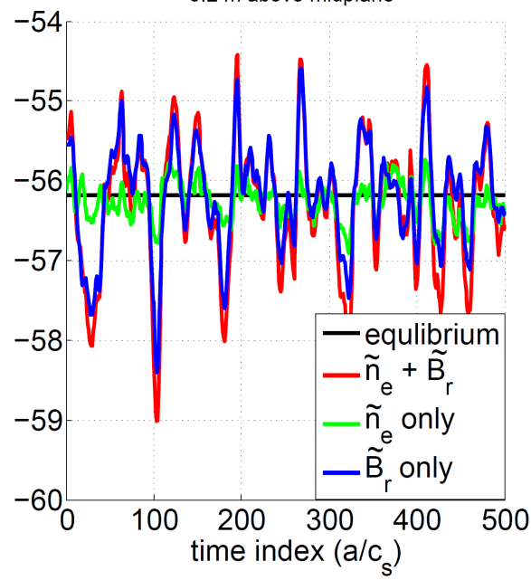
Calculations of microtearing polarimeter response – NSTX
5cm below mid-plane
GYRO calculations (Walter Guttenfelder) illustrate structure of magnetic and density fluctuations associated with micro-tearing in NSTX
These calculations were used as input for polarimetry “synthetic diagnostic” calculations
The calculated polarimetry phase fluctuations were insensitive to density fluctuations as long as the measurement occurred close to plasma mid-plane.
Consistent with expected situation for Faraday rotation dominated case.
20cm above mid-plane

