Slide 1




NSTX-U
Supported by
NSTX-U Collaboration Status and Plans for:
X Science LLC
Coll of Wm & Mary
Columbia U
CompX
General Atomics
FIU
INL
Johns Hopkins U
LANL
LLNL
Lodestar
MIT
Lehigh U
Nova Photonics
ORNL
PPPL
Princeton U
Purdue U
SNL
Think Tank, Inc.
UC Davis
UC Irvine
UCLA
UCSD
U Colorado
U Illinois
U Maryland
U Rochester
U Tennessee
U Tulsa
U Washington
U Wisconsin
X Science LLC
Culham Sci Ctr
York U
Chubu U
Fukui U
Hiroshima U
Hyogo U
Kyoto U
Kyushu U
Kyushu Tokai U
NIFS
Niigata U
U Tokyo
JAEA
Inst for Nucl Res, Kiev
Ioffe Inst
TRINITI
Chonbuk Natl U
NFRI
KAIST
POSTECH
Seoul Natl U
ASIPP
CIEMAT
FOM Inst DIFFER
ENEA, Frascati
CEA, Cadarache
IPP, Jülich
IPP, Garching
ASCR, Czech Rep
Ricky Maqueda
NSTX-U Collaborator Research Plan Meetings
PPPL – LSB B318
April / May 2014

Slide 2
Research plans and needs for this year (FY2014) in preparation for NSTX-U operations in FY2015
Absolutely Calibrated Tangential Imaging of Lower Divertor
  New hardware has mirror/shutter (1), target plate for transmission checks (2), illumination probe (3).
    Lower dome radial port at Bay F.
Needs:
  Finish procurement and fabrication.
  Installation.
  Absolute calibration after new center
  stack is inserted.
Measurements:
  Bright emission lines (Dα, LiI @
  678.0 nm) measured at ≥10 kHz.
  LiII @ 548.5 nm, CII @ 657.8 nm,
  CIII@ 464.7 nm at ~1 kHz.
3
2
1
R. Ellis & H. Feder, PPPL

Slide 3
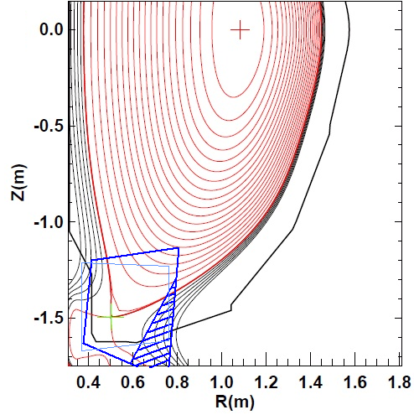
Research plans and needs for this year (FY2014) in preparation for NSTX-U operations in FY2015
Forward problem (ray paths) implemented
  Can convert 2-D emission profiles (R-Z) into artificial images.
Work underway for inversion software
  Possibly use LLNL’s (Bill Meyer’s) software.
S. Gerhardt,
PPPL
View obstructed by nearby tiles
MARFE-like structure, artificial images

Slide 4
Research Plans for FY2015 beyond
FY2015
  Invert images from NSTX-U operation into emission profiles (R, Z plane).
  Initiate comparisons with UEDGE/DEGAS runs.*
  Obtain (first, preliminary) measurements of deuterium and impurity densities.
FY2016
  Continue measurements analysis through FY2016 experimental campaign.
  Perform transient/localized measurements to obtain diffusion coefficients and flow speeds of deuterium and impurities.
  * See next slide.

Slide 5
Ideas to enhance participation in NSTX-U research/program by U.S. Universities, early-career researchers, and students
Main physics results will come from interaction with modeling.
2-D edge modelling runs have been hard to come by.
  Project will benefit from user-friendly and often-run 2-D edge simulation model.
    Few software knobs adjusted until model results match experimental 2-D emissions.
University, post-doc project?
  Perhaps (with LLNL’s permission and participation), make a UEDGE friendly to NSTX-U.

Slide 6
Highest-priority incremental measurement capability
Tangential imaging of upper divertor
  NSTX-U plans include development of double null techniques for power handling (radiative divertors, snowflake, etc.)
  LSN and USN operation also planned to test different plasma facing materials.
Main problem might be port allocation.
    Radial ports on upper dome “presently obstructed”.

