Slide 1




NSTX-U
Supported by
NSTX Upgrade: ST research to
accelerate fusion development
Jon Menard (PPPL)
For the NSTX-U Research Team
Coll of Wm & Mary
Columbia U
CompX
General Atomics
FIU
INL
Johns Hopkins U
LANL
LLNL
Lodestar
MIT
Lehigh U
Nova Photonics
Old Dominion
ORNL
PPPL
Princeton U
Purdue U
SNL
Think Tank, Inc.
UC Davis
UC Irvine
UCLA
UCSD
U Colorado
U Illinois
U Maryland
U Rochester
U Tennessee
U Tulsa
U Washington
U Wisconsin
X Science LLC
Culham Sci Ctr
York U
Chubu U
Fukui U
Hiroshima U
Hyogo U
Kyoto U
Kyushu U
Kyushu Tokai U
NIFS
Niigata U
U Tokyo
JAEA
Inst for Nucl Res, Kiev
Ioffe Inst
TRINITI
Chonbuk Natl U
NFRI
KAIST
POSTECH
Seoul Natl U
ASIPP
CIEMAT
FOM Inst DIFFER
ENEA, Frascati
CEA, Cadarache
IPP, Jülich
IPP, Garching
ASCR, Czech Rep
FESAC Strategic Planning Panel Meeting
Gaithersburg Marriott - Washingtonian Center
July 8-10, 2014

Slide 2
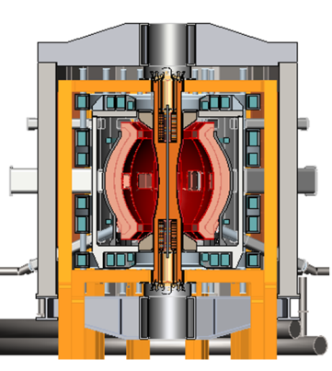
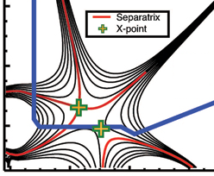
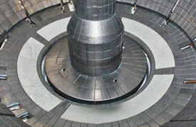
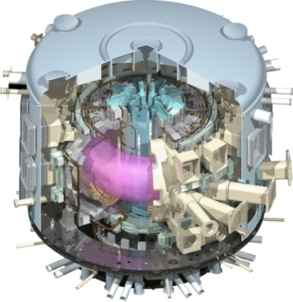
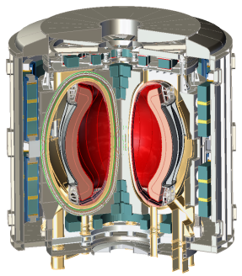
NSTX Upgrade mission elements
Advance ST as candidate for Fusion Nuclear Science Facility (FNSF)
Develop solutions for the plasma-material interface challenge
Explore unique ST parameter regimes to advance predictive capability - for ITER and beyond
Develop ST as fusion energy system
ST-FNSF
Snowflake/X
Liquid metals/Li
ITER

Slide 3
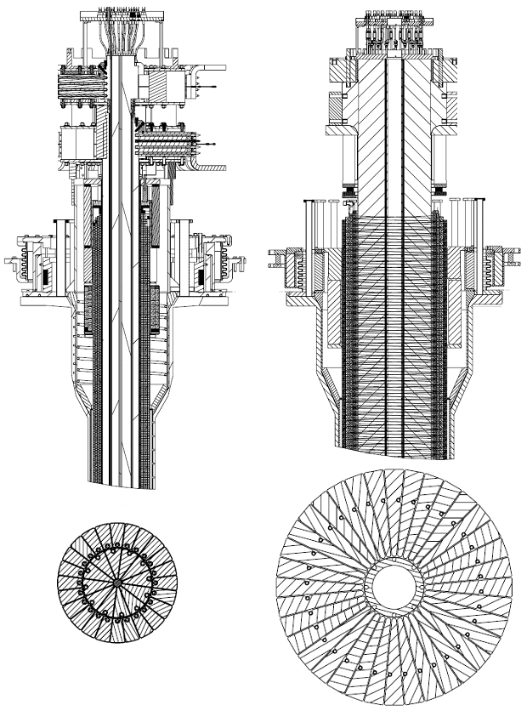
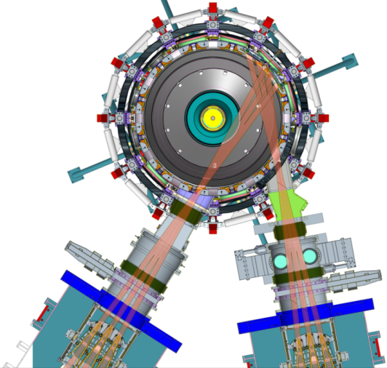
NSTX-U provides world-leading research capabilities across all 5 ReNeW Themes
B_{T} = 0.5 → 1T
I_{P} = 1 → 2MA
Full non-inductive ~1MA
5× longer pulse
5-10× higher nTτ
1st plasma Jan/Feb 2015
+
Previous New
Center-stack
Present New 2nd
Neutral Beam Injector (NBI)
Theme 1: Burning Plasmas in ITER
  Access, understand, control non-linear Alfvénic instabilities
Theme 2: Predictable, High-Performance, Steady-State Plasmas
  Goal: 100% non-inductive operation with high-β_{T} ~15-20%, profile control
Theme 3: Taming the Plasma-Material Interface
  Leader in Li PFCs, integration: core + snowflake + detachment + high-Z + Li
Theme 4: Harnessing Fusion Power
  Leader in physics basis and design of low-A fusion systems
Theme 5: Optimizing the Magnetic Configuration
  NSTX-U most capable ST facility/program in world for assessing ST for FNSF
NSTX-U + DIII-D/U provide world-leading development of ST, AT for FNSF

Slide 4
10 year goal: Integrate high-performance core + metal walls
5 year goal: Establish core physics/scenarios for ST-FNSF
Establish ST physics / scenarios
High-performance + metal walls
2015-2019
2015-2019
2× field, power, current, 5× pulse-length
10-20s pulses for PFC/LM equilibration
Start-up to 0.4MA
Ramp-up 0.4 → ~1MA
Sustain at ~1MA
(Density control needed for all phases)
100% non-inductive:
Inform choice
of FNSF
aspect ratio
and divertor configuration (with divertor data from
MAST-U Super-X + other experiments)
Inform choice
of FNSF/DEMO plasma-facing materials for
divertor and first-wall
Reduce collisionality: ~10× lower vs. NSTX
Sustain high β_{N} ~ 6 with profile/mode control
Mitigate high q_{div}: up/down snowflake/X+radiation
Divertor C → high-Z, Li vapor shielding
All high-Z PFCs, hot walls, static Li-wall
Liquid Li modules → flowing Li/LM modules → flowing Li divertor

Slide 5
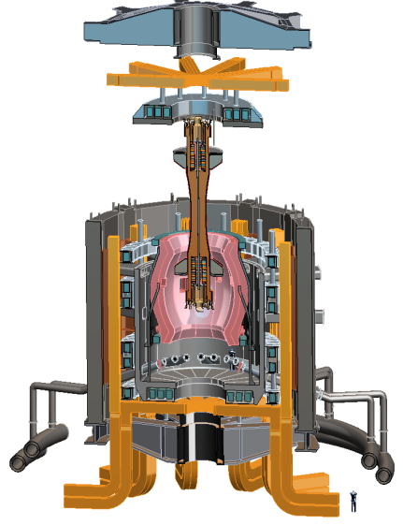
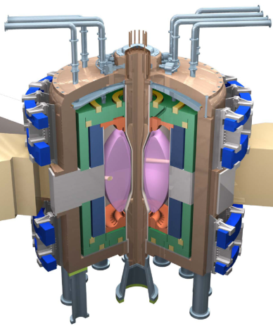
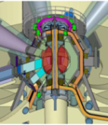
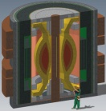
ST is potentially attractive as
Fusion Nuclear Science Facility (FNSF)
Example ST-FNSF concepts
Projected to access high neutron wall loading at moderate R₀, P_{fusion}
  W_{n} ~ 1-2 MW/m² , P_{fus} ~ 50-200MW, R₀ ~ 0.8-1.8m
Modular, simplified maintenance
Tritium breeding ratio (TBR) near 1
  Requires sufficiently large R₀, careful design
Challenges/Gaps: (FESAC-TAP, ReNeW)
  Non-inductive start-up, ramp-up, sustainment
    Low-A → minimal inboard shield → no/small transformer
  Confinement scaling (especially electrons)
  Stability and steady-state control
  Divertor solutions for high heat flux
  Radiation-tolerant magnets
PPPL
ORNL
Culham (UK)
UT Austin

Slide 6

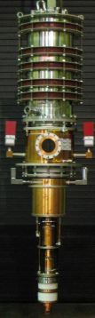
Gap 1: Start-up/ramp-up with small/no transformer
  Achievements since Greenwald Report, NSTX-U base-program research, remaining gaps/enhancements needed
Helicity injection (HI) start-up: 150-200kA → projects to ~0.4MA on NSTX-U
New 2nd NBI projected to enable non-inductive ramp-up from ~0.4 → 1MA
HI start-up T_{e} too low for fast-wave or NBI coupling → use ECH to raise T_{e}
CHI startup
TSC Simulations of CHI
NSTX-U start-up/ramp-up strategy
1.0 ms
1.6 ms
2.7 ms
I_{P} [MA]
P [MW]
2
~0.8-1
1
Z (m)
0
~0.5
CHI, LHI,
EBW,
Fe core
NBI
10-15
-1
~0.3-0.4
Fast wave
4
-2
EC/EBW
1→3
0
1
2
0
1
2
0
1
2
Time
R (m)
R (m)
R (m)
1 → 3MW 28GHz (with 2nd NBI) → world-leading start-up/ramp-up for ST/AT
EBW: efficient off-axis current drive for over-dense ST/RFP/AT plasmas
  See Raman Whitepaper: “Simplifying ST and AT Concepts”

Slide 7
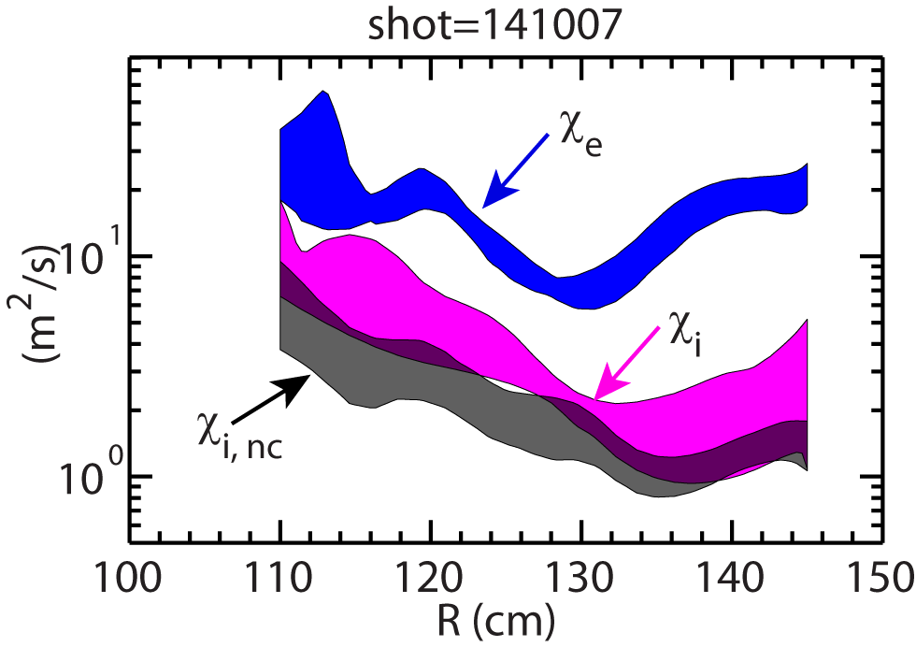
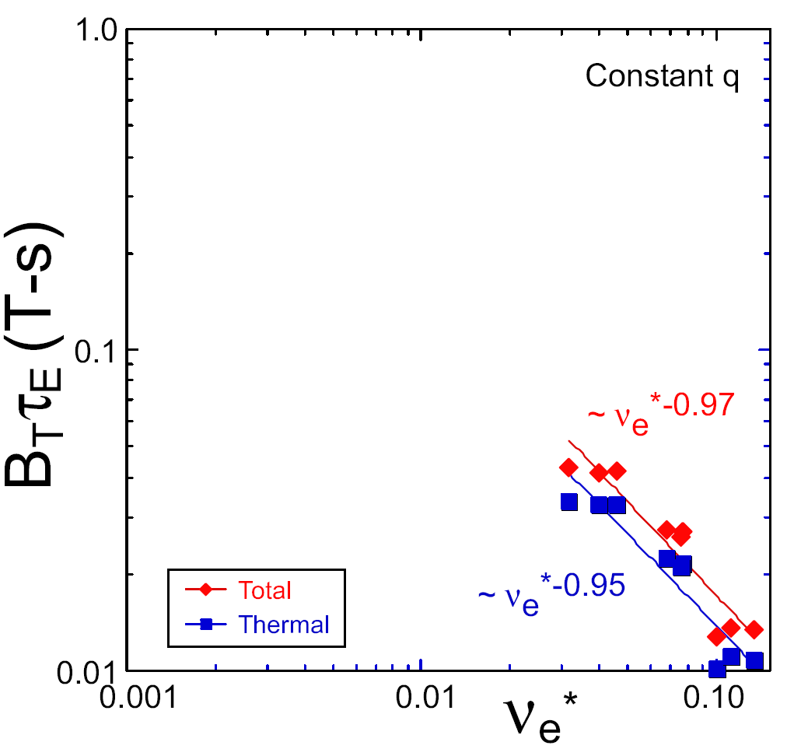
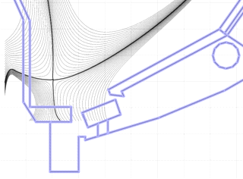
Gap 2: Understand/optimize ST energy confinement
  Achievements since Greenwald Report, NSTX-U base-program research, remaining gaps/enhancements needed
Ion thermal transport ~neoclassical, electron transport anomalous
Confinement scaling: Bτ_{E} ~ ν^{-0.9} β^{-0.2} differs from ITER-98y,2 ~ ν⁰ β^{-0.9}
High-β → electromagnetic turbulence (μ-tearing, Alfvénic, kinetic ballooning)
Doubling I_{P}, B_{T} → 2× T_{e,i}, but need improved pumping to sustain lowest n_{e}, ν*
Typical χ values in NBI H-mode
ST-FNSF
Divertor cryo-pump
constant q, β, ρ∗
NSTX Upgrade
?
ITER-like scaling
NSTX
ν_{e}* ∝ n_{e} / T_{e}²
To reliably project to FNSF-ST/AT → need to understand transport vs. β, ν
Diagnostics: Beam emission spectroscopy, high-k_{r,θ}, polarimetry, Doppler back-/cross-polarization scattering
Leading opportunity to measure, model, understand electron transport
  See Guttenfelder/Crocker whitepaper “Validating EM turbulence/transport effects for burning plasmas”, also A. White whitepaper

Slide 8
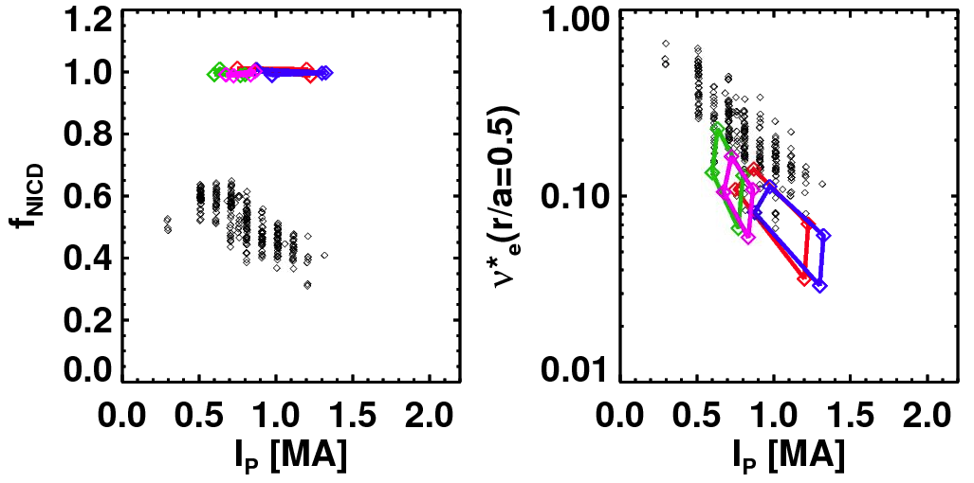
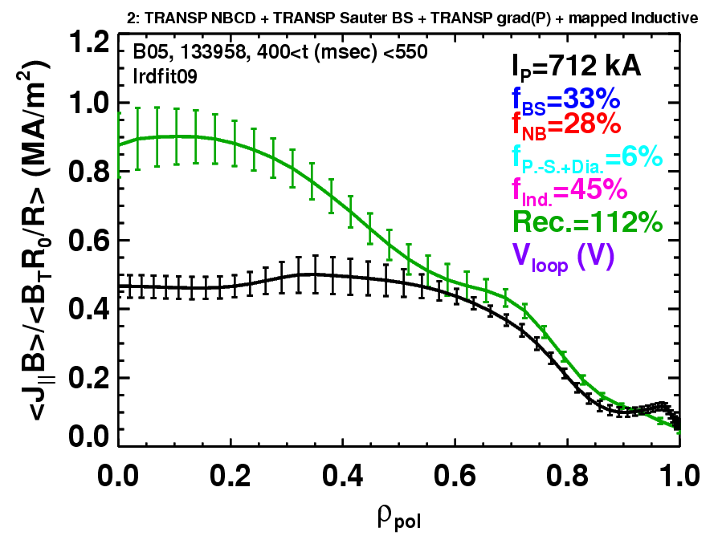
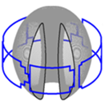
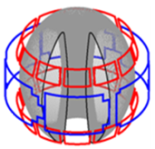
Gap 3: Plasma sustainment, stability, and control
  Achievements since Greenwald Report, NSTX-U base-program research, remaining gaps/enhancements needed
NSTX achieved ~65% non-inductive current drive at FNSF-level β_{T} ~ 15-20%
NSTX-U designed for 100% non-inductive using more tangential 2nd NBI
TAE avalanches can cause redistribution/loss of NBI current drive
High β_{N} ~ 6 sustained w/ active feedback, optimized/broad p, rotation profiles
Non-inductive fraction
Plasma w/ rapid TAE avalanches
Non-axisymmetric Control Coils (NCC)
NSTX-U projections
Total assuming
classical J_{NBI-CD}
Existing
6 midplane
Planned 2x12
off-midplane
NSTX Results
Reconstruction
via high harmonic FW
Simultaneous control of:
rotation, EF, RWM, ELMs, EP/AE
Minor radius
New 3D coils would greatly aid control, disruption avoidance for ITER, FNSF
Will also test novel disruption warning, mitigation (fast MGI, EM mass injector)
  See Sabbagh whitepaper on Disruption PAM, Podestá whitepaper on energetic particle/*AE control, also Strait, Buttery whitepapers

Slide 9
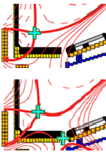
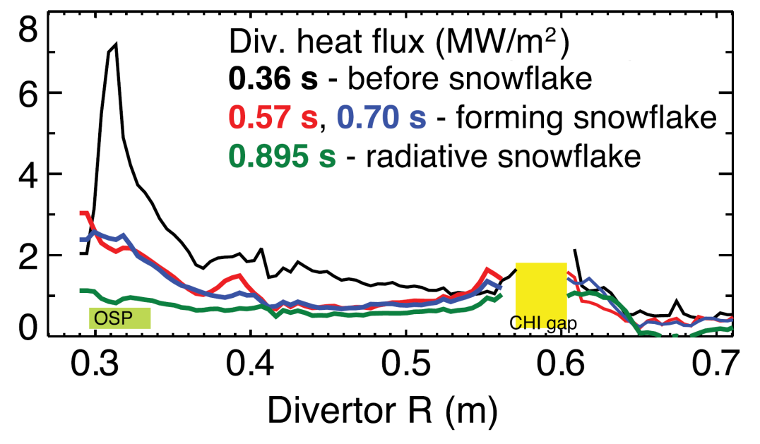
Gap 4: Mitigating high heat (and particle) flux
(+ core/edge integration with high-Z / liquid metal PFCs)
  Achievements since Greenwald Report, NSTX-U base-program research, remaining gaps/enhancements needed
High-flux-expansion snowflake/X-divertor + radiation reduce q_{pk-div} (up to 5×)
NSTX-U: 2× P_{NBI}, I_{P}, 0.5× λ_{q} → q_{pk-div} ~4× higher → 30-40MW/m² unmitigated
Will test mitigation of high q_{pk-div} w/ double snowflake/X + partial detachment
Steady-state FNSF scenario not demonstrated in any device w/ high-Z walls
→ NSTX-U aims to integrate full non-inductive with high-Z + liquid metal PFCs
Standard
NSTX results
2015
by 2020
by 2025
Standard
C
BN
Li
High-Z
High-Z outboard divertor PFCs
All
high-Z PFCs + high-T_{wall}
Static
liquid Li on hot high-Z walls
Snowflake/X
Snowflake/X
Snowflake/X + radiation
Bakeable cryo-baffle
for liquid Li modules
Cryo-pump
Full toroidal flowing Li divertor (closed-loop)
  See Maingi / Jaworski / Allain whitepapers on liquid metals, Hill whitepaper on FNSF PMI, ADX whitepapers

Slide 10
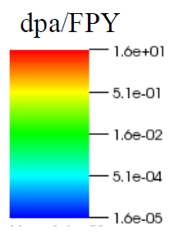
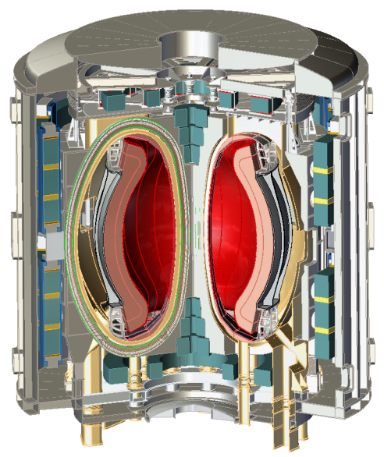
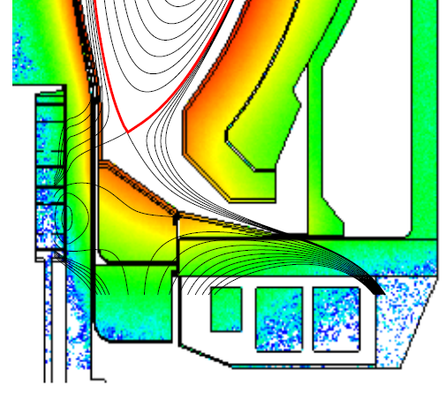
Gap 5: Radiation-tolerant magnets
(+ advanced magnet / configuration design)
High-temp superconductor (HTS) attractive for efficient+compact ST*
Possible missions:
  Steady-state toroidal PMI facility
  ST Pilot Plant (Q_{eng}~ 1), ST DEMO
Key research need: radiation limits
Ex-vessel equilibrium PF coils
  Shielding + MgO insulation → 6 FPY
Long-leg divertor: q_{pk-div} < 5MW/m²
TBR = 0.95-1 for R₀ = 1.6m
*Work supported by Tokamak Energy (UK)
Find τ_{E} > 1.5× ITER H-mode needed for compact FNSF, Pilot (ST or AT)
Recommend enhancing AT/ST FNSF design funding, include QAS, SC/HTS
  Endorse Majeski / LTX whitepaper for high confinement, Minervini / Whyte whitepapers on HTS R&D

Slide 11
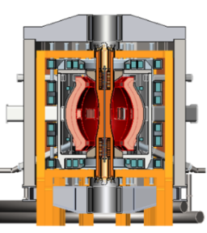
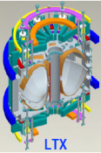
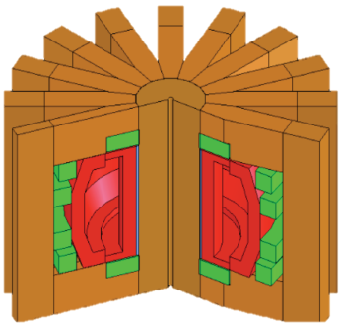
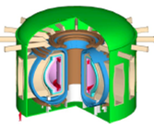
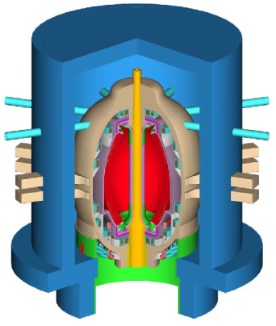
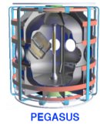
US STs aim to accelerate fusion development (see LTX and Pegasus presentations later this afternoon)
Advance ST as Fusion Nuclear Science Facility
  Pegasus-U, NSTX-U: non-solenoidal start-up: helicity injection, EBW
  NSTX-U: physics + scenario basis for FNSF-ST (also ST DEMO)
Develop solutions for plasma-material interface
  LTX-U, NSTX-U: liquid Li for very high confinement, liquid metal PFCs
  NSTX-U: novel divertors: snowflake/X, detachment, vapor shielding
Explore unique ST parameter regimes to advance predictive capability - for ITER and beyond
  Pegasus-U, NSTX-U: high β, toroidicity, MHD / transport validation
  NSTX-U: non-linear Alfvénic modes, electromagnetic turbulence
LTX
NSTX-U
PEGASUS
DEMO
ITER
FNSF

Slide 12
Backup slides

Slide 13
Cost estimates for facility enhancements to address Gaps
NSTX-U 5YP base / +10% sustained for 10 years → $65M / $95M for enhancements
10 year total:
~$19M
~$8M
$65M
~$23M
$95M
~$45M

Slide 14
NSTX-U plan: ST physics/scenarios→ integrate high-perf core + metal walls (high-Z + Li) → flowing / large area liquid metals
Establish ST physics/scenarios
High-performance + metal walls
Flowing LM divertor/wall
2015-2019 | 2020-2024 | 2025-2029
2× B_{T}, I_{P}, P_{NBI}, 5× pulse-length
10-20s pulses for PFC/LM equilibration
LTX-U results
Start-up to 0.4MA
Ramp-up 0.4 → ~1MA
Sustain at ~1MA
(Density control needed for all phases)
100% non-inductive:
Test large area
liquid Li for very high energy confinement, flowing LM divertors for PFC resilience to off-normal events: ELMs, disruptions
Inform choice
of FNSF
aspect ratio
and divertor configuration
Inform choice
of FNSF/DEMO plasma-facing materials for
divertor and first-wall
Reduce collisionality ν* ~ factor of 10
Sustain high β_{N} ~ 6 w/ advanced control
Mitigate high divertor heat flux
Div. C → high-Z, Li vapor shielding
All high-Z PFCs, hot walls, static Li-wall
Slow-flow Li wall segment
Static liquid Li modules → flowing Li modules → flowing Li divertor
Flowing Li / Sn divertor

Slide 15
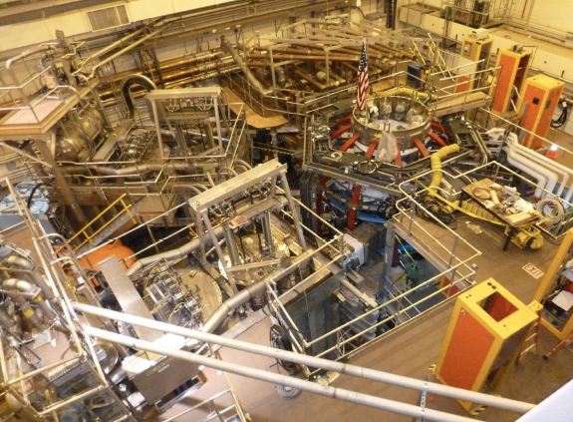
NSTX-U Test Cell Aerial View (May, 2014)
Upgrade project now ~90% complete
HHFW
System
1st NBI
NSTX-U
2nd NBI

Slide 16
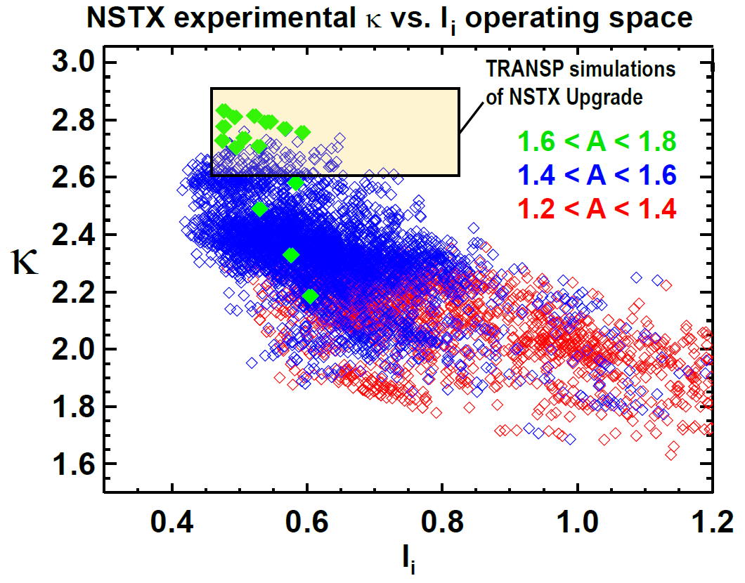
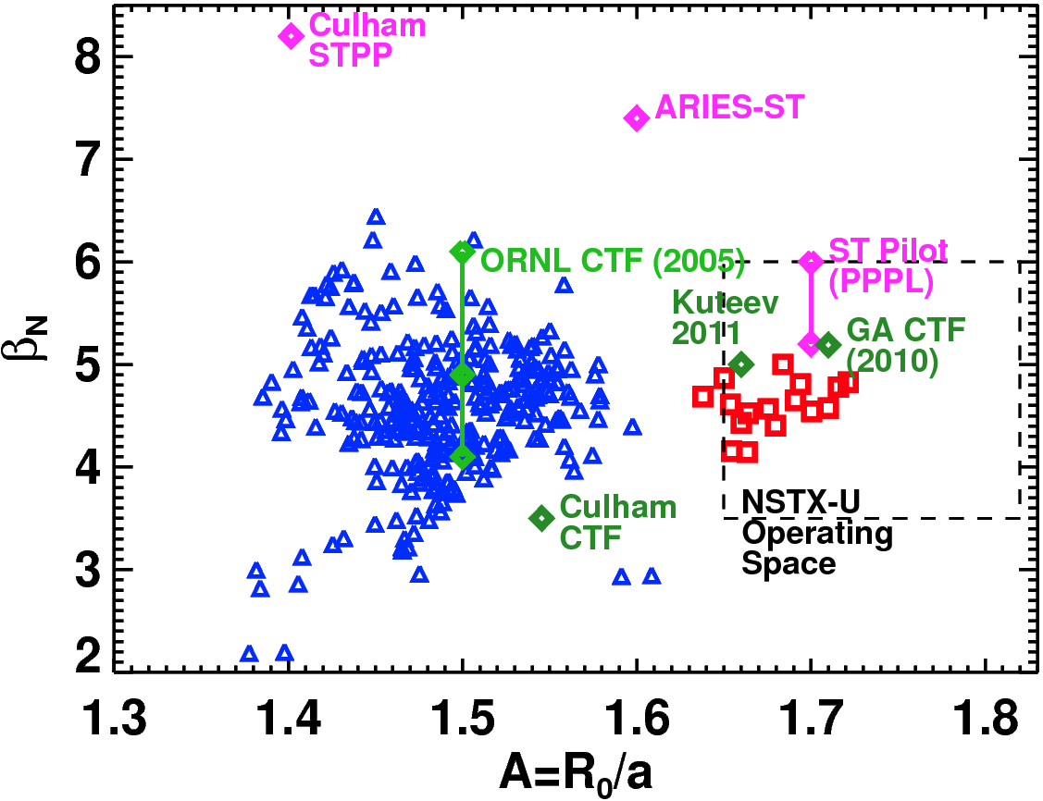
NSTX has already accessed shaping and stability performance needed for an ST-FNSF
NSTX data points

Slide 17
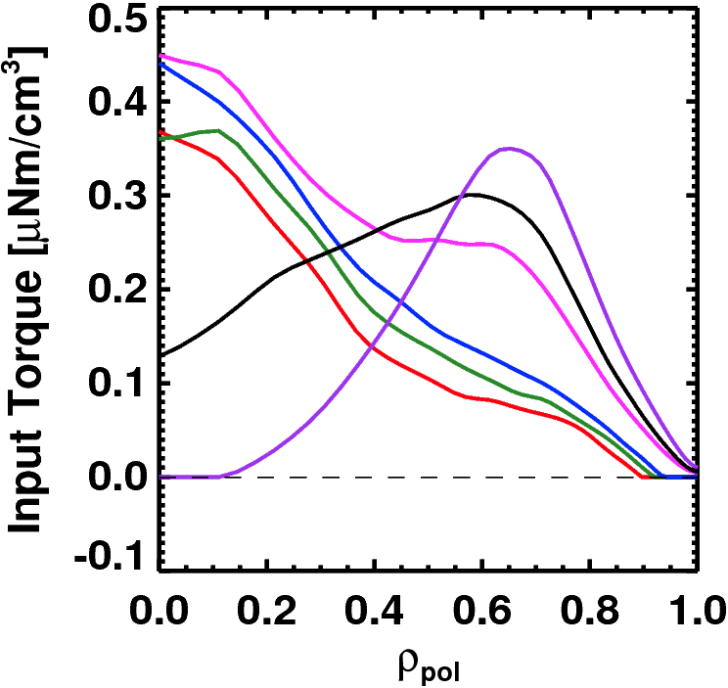
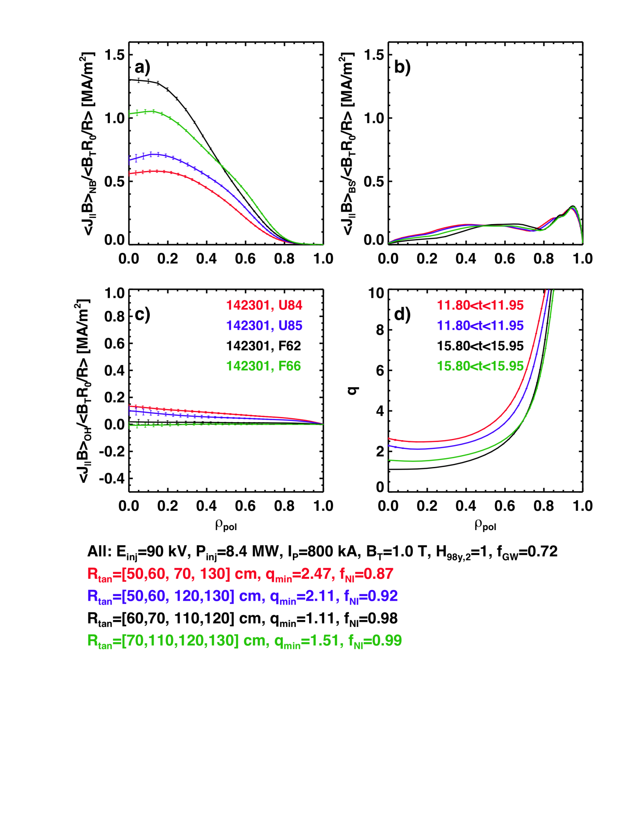
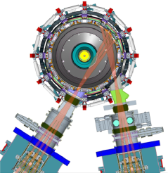
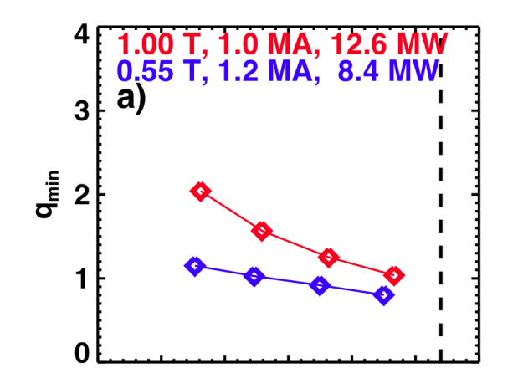
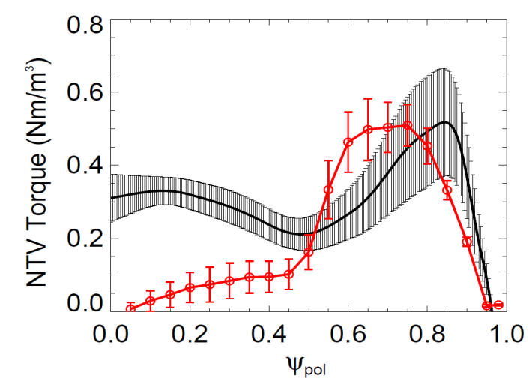

NSTX-U is developing a range of profile control actuators for detailed physics studies, scenario optimization for FNSF
q-Profile Actuators
Rotation Profile Actuators
Variations in Beam Sources
800 kA Partial Inductive, 87% < f_{NI} < 100%
Torque Profiles From 6 Different NB Sources
Largest R_{tan}
800 kA and 1 T
[50,60,70,130] cm
[50,60,120,130] cm
[60,70,110,120] cm
[70,110,120,130] cm
Neutral
Beams
(TRANSP)
Smallest R_{tan}
Variations in Outer Gap
Measured and Calculated Torque Profiles from 3D Fields
n=3 Experiment
n=3 POCA
27 22 17 12 7 2
Outer Gap

Slide 18
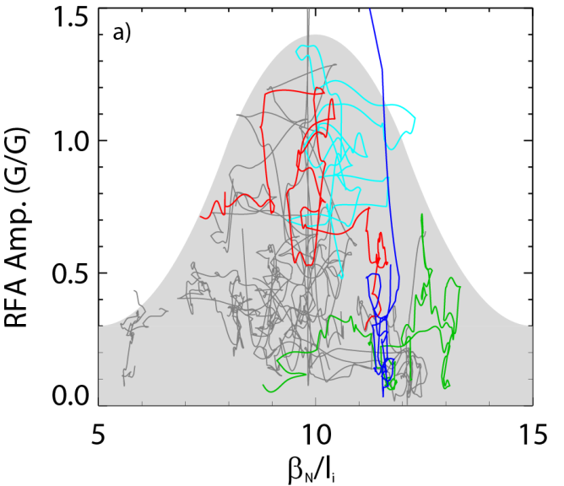

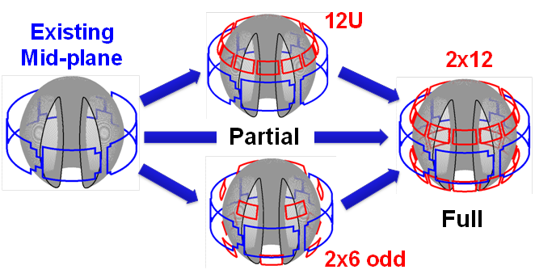
Rotation profile control will be an important tool for accessing and sustaining high β
n=1 MHD spectroscopy: high β_{N} can be more stable → important for advanced scenarios
Resonant Field
Amplification (G/G)
For these plasmas, high β_{N} was correlated with rotation that maximizes RWM damping
  Stabilization from ion precession drift resonance
  Strong motivation for rotation profile control
Berkery - APS Invited 2013
β_{N} / l_{i}
5YP: Off-midplane 3D coils enable control of resonant vs. non-resonant torques, v_{φ} profile
1
Resonant Field
Amplification (G/G)
0
S. Sabbagh, J. Berkery (Columbia)
J-K Park (PPPL), J. Canik (ORNL)
E×B rotation frequency

Slide 19
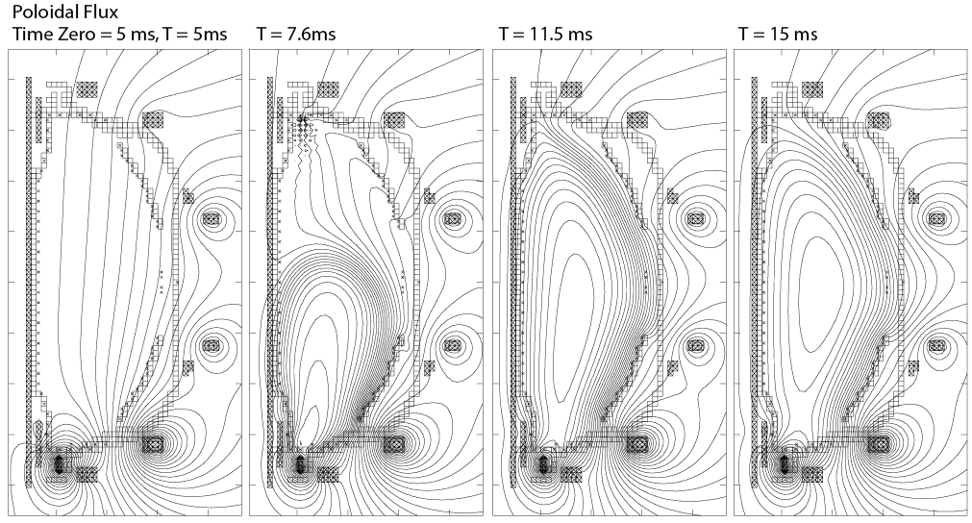
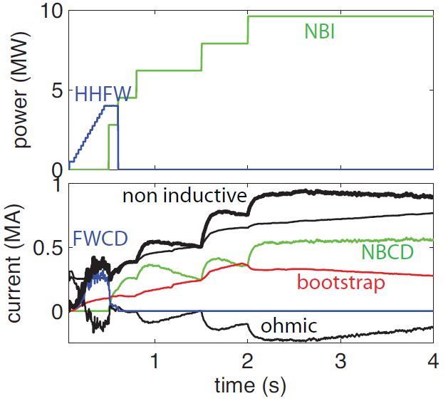
Simulations support non-inductive start-up/ramp-up strategy
TSC code successfully simulates CHI I_{P} ~200kA achieved in NSTX
TRANSP: NSTX-U more tangential NBI → 3-4x higher CD at low I_{P} (0.4MA)
  1.5-2x higher CD efficiency, 3x lower prompt loss
New TRANSP simulations of ramp-up: 0.3MA→0.9MA with FW+BS→NBI+BS
  1st self-consistent NBI-CD calcs during NI ramp-up
FY14: Implemented NSTX-U geometry in TSC
F. Poli
TSC + tools included in 5 year plan support CHI I_{P} → 400kA in NSTX-U
  2.5 x higher injector flux (scales with I_{P})
  Higher B_{T} = 1T (increases current multiplication)
  > 2kV CHI voltage (increases flux injection)
  1MW 28GHz ECH (increases T_{e})
V_{surface} = 0 constraint → need to add induction from PF coil swing (future)
R. Raman (U-Wash)

Slide 20
NSTX-U internal component staging supports goal to assess compatibility of high τ_{E} and β + 100% NICD with metallic PFCs
Base budget case (from 5 Year Plan for FY2014-18)
Nominal 2014-18 5 year plan steps for implementation of cryo-pump + high-Z PFCs + LLD
2015
2016
2017
2018-19
2021
2022-23
All
high-Z FW + divertors
+ flowing LLD module
C
BN
Li
High-Z
Cryo +
full lower
outboard high-Z divertor
Cryo + high-Z FW and OBD
+ liquid Li divertor (LLD)
Lower
OBD
high-Z row of tiles
Cryo + U+L OBD
high-Z rows of tiles
High-Z tile row
Cryo-pump
Bakeable cryo-baffle for liquid Li
Flowing Li module

Slide 21
NSTX-U internal component staging supports goal to assess compatibility of high τ_{E} and β + 100% NICD with metallic PFCs
Incremental budget case (from 5 Year Plan for FY2014-18)
Nominal 2014-18 5 year plan steps for implementation of cryo-pump + high-Z PFCs + LLD
2015
2016
2017
2018
2019-20
Cryo-pump
2021
Upper cryo + all
high-Z & higher-T PFCs
+ full toroidal LLD
Cryo + high-Z FW and OBD
+ liquid Li divertor (LLD)
All
high-Z FW + divertors
+ flowing LLD module
C
BN
Li
High-Z
Lower
OBD
high-Z row of tiles
Cryo + high-Z FW and OBD
PFCs
High-Z tile row
Cryo-pump
Bakeable cryo-baffle for liquid Li
Flowing liquid Li divertor (LLD) module
Full toroidal flowing Li

Slide 22
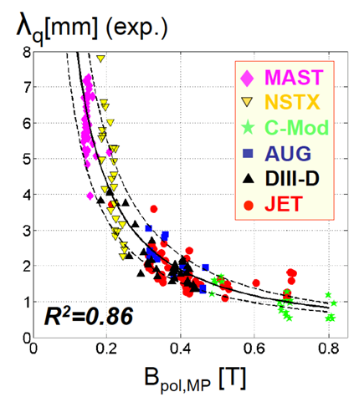
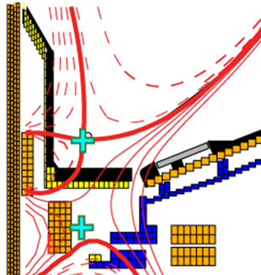
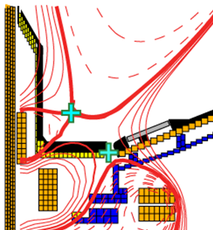
NSTX-U will explore advanced divertor operation, and extend scaling and understanding of power exhaust
Standard Divertor
Snowflake Divertor
Snowflake→ high flux expansion = 40-60 lowers incident q⊥, promotes detachment
NSTX-U: 2× higher I_{P} and P_{NBI} → access q|| 4-5× higher than NSTX
Will ~1/B_{P} scaling still hold?
  See R. Maingi and D. Hill whitepapers

Slide 23
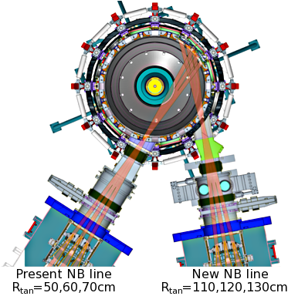
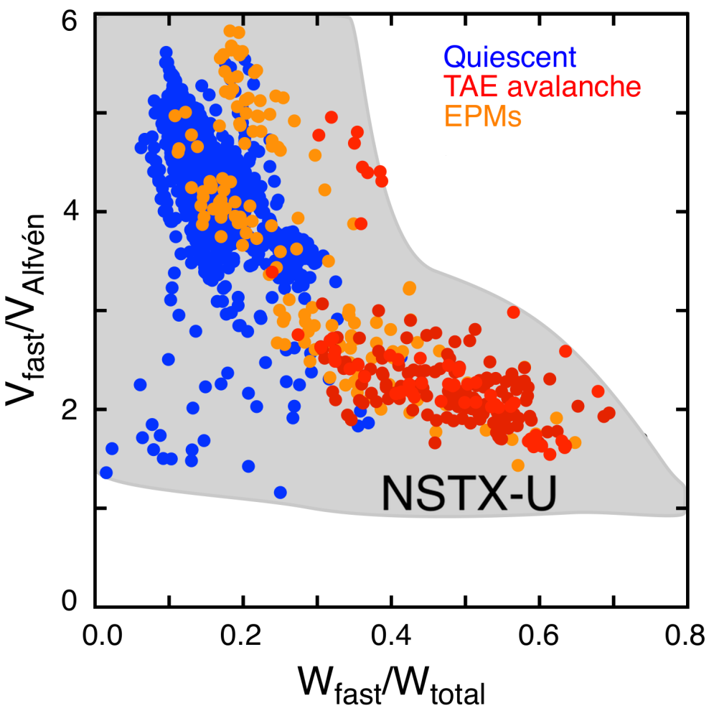
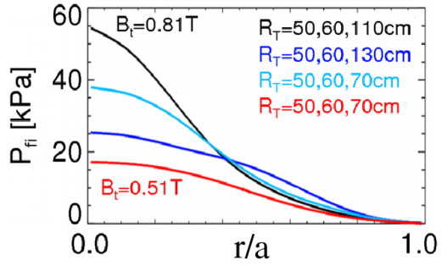
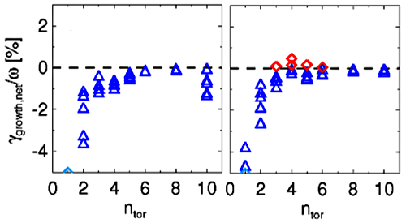
  NSTX-U will explore broad range of fast-ion instability physics and control for ITER and FNSF
ST-FNSF
E. Fredrickson, NF 2014 (submitted)
ITER
Mapping of instabilities based on exp’t DATA and TRANSP analysis
TAE stability from NOVA-K
NSTX
NSTX-U
Fast-wave heating, 3D fields (NSTX), ECH (DIII-D) also influence AE stability
M. Podestà, PoP 2013
blue: stable
red: unstable
  See Podestá whitepaper on fast-ion instability control

Slide 24
NSTX-U will explore a new high β + low ν* transport and turbulence regime
  Will access a variety of drift wave and AE transport mechanisms:
r/a~0.6-0.7
CAE/GAE
KBM
MT
NSTX-U
ITG, TEM, ETG
Will τ_{E}~1/ν* remain valid?
Will microtearing be suppressed?
Will χ_{i}≈χ_{i,NC} & D_{imp}≈D_{imp,NC} hold?
Is core χ_{e} from stochastic fields, or mid-radius KAW excitation → e-heating?
  See Guttenfelder/Crocker whitepaper on electromagnetic effects in transport

Slide 25
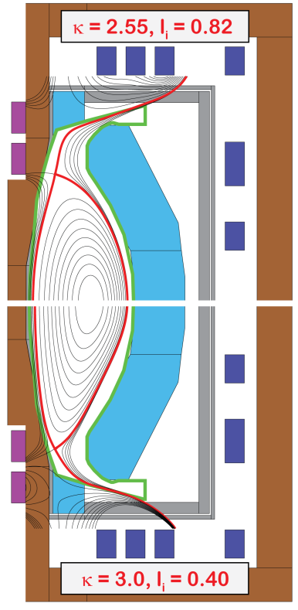

Self-consistent ST configurations identified for
Fusion Nuclear Science Facility (FNSF)
Current drive: bootstrap + NNBI
Neutron wall loading ~1 MW/m²
Tritium breeding ratio (TBR) ~ 1
  Requires breeding blanket near top + bottom of centerstack (CS)
PF coil configuration:
  Strong shaping (κ ~ 2.8-3, δ ~ 0.5-0.6)
  Flexibility in equilibrium β_{N} and l_{i}
  All equilibrium PF coils are ex-vessel
  Long-legged Super-X/snowflake divertor
    q_{peak} ~ 3-5MW/m², partially detached
  Breeding in CS end region + vertical maintenance scheme
Exploring plasma start-up options
  Identified locations for electrodes for coaxial helicity injection (CHI) start-up
  Retractable plasma “guns” may be more compatible with FNSF environment
Vertical maintenance
Blanket regions
R₀ = 1.6m, B_{T} = 3T, I_{P} = 10MA, P_{fus} = 160MW

Slide 26




H_{98y,2} range of 1.4-2.2 favorable for achieving FNSF-relevant neutron wall loading ≥ 1MW/m² , f_{BS} < 85% for external control
ST-FNSF
A = 1.75
R₀ = 1.7m
B_{T} = 2.9T
κ, δ = 2.8, 0.55
f_{Greenwald} = 0.8
f_{NICD} = 100%
E_{NNBI} = 0.5MeV
P_{NNBI} ≤ 80MW
Power limited for H_{98y,2} < 1.5
Stability limited for H_{98y,2} > 1.6

Slide 27

NNBI CD efficiency vs. injection tangency radius and energy for R=1.6m using TRANSP
Fixed target parameters in DD
  I_{P} = 7.5MA, β_{N} = 4.5, l_{i} = 0.5
  n_{e} / n_{Greenwald} = 0.75, H_{98y,2} = 1.5
  A=1.75, R=1.7m, B_{T} = 3T, κ = 2.8
  ⟨T_{e}⟩=5.8keV, ⟨T_{i}⟩=7.4keV
Little current drive benefit from injecting above 0.5MeV
Shine-thru onset for R_{tan} > 2.4m
Achieve full non-inductive for R_{tan} > 2m with P_{NBI} = 60MW
  (Note: P_{fusion} in DT is ~160MW)
0.5MeV NNBI is good choice
(as has been assumed for this configuration)

Slide 28

Free-boundary TRANSP used to compute 100% non-inductive Q_{DT} ~ 2 plasma equilibrium consistent with 0D scalings
TRANSP-ISOLVER (boundary-fit)
Neoclassical χ_{i}
Scaled NSTX T_{e}, n_{e}
  Z_{eff} ~ 2-2.5
n_{e} / n_{Greenwald} = 0.65
I_{P} = 9.8MA, B_{T} = 2.9T
H_{98,y2} = 1.55
β_{N} = 5.9, W_{tot} = 67MJ
  W_{fast} / W_{tot} = 14%
f_{NICD} = 100%, f_{BS} = 65%
E_{NNBI} = 0.5MeV
P_{NNBI} = 80MW
P_{fusion} = 160MW (50-50 DT)
  ~3% alpha bad orbit loss
Need to further tweak NBI-CD to reduce reversed-shear and maintain q_{min} > 2

Slide 29

Ideas to enhance TBR for latest ST-FNSF design
Uniform OB blanket (1 m thick everywhere; no thinning)
Less cooling channels and FCIs within blanket
  Need thermal analysis to confirm
Replace PF coil shield and triangle by blanket (TBD)
Thicker IB VV with internal breeding
Smaller opening to divertor to reduce n leakage
PF Coils
Shield
Triangle

Slide 30


HTS potentially attractive for making electrically efficient ST* (~10× lower magnet cooling power vs. copper)
Possible missions:
  Steady-state toroidal PMI facility
  ST Pilot Plant (Q_{eng}~1 for weeks/months)
Initial configurations favorable:
  A=1.8 w/ strong shaping: κ~2.7, δ~0.5
  All equilibrium PF coils outside TF
    No joints needed for HTS TF coils
  Long-legged divertor for q_{div-pk} < 5MW/m²
  Vertical port-based maintenance
  WC inboard thermal shield for TF
Many remaining issues:
  HTS lifetime in radiation environment
  Blanket/shield thickness, location, TBR
R₀ = 1.4m, B_{T} = 3.2T, I_{P} = 7-8MA, P_{fusion-DT} = 100MW
*This work supported by Tokamak Energy (UK)
  Endorse Minervini / Whyte whitepapers for HTS R&D

